Slide 1

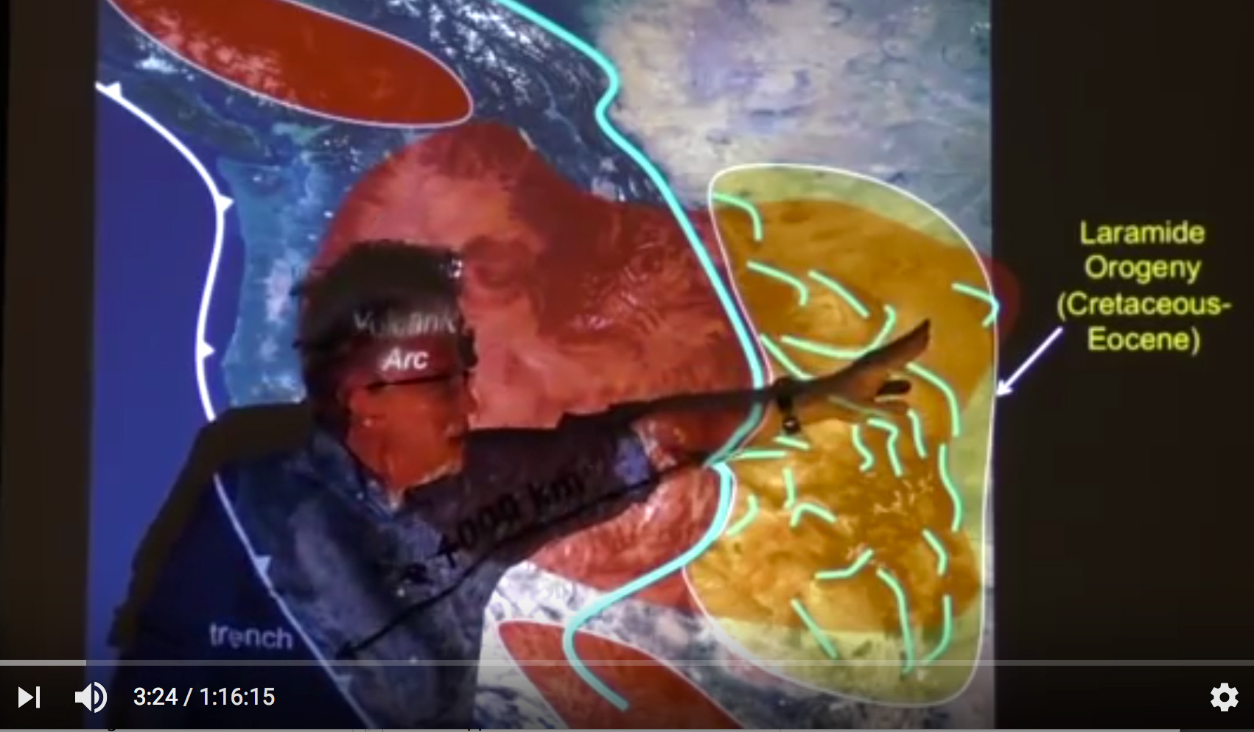
Crustal Deformation, Basin Subsidence, and Paleo-River Response to Eocene Accretion of Siletzia, SW Oregon
Rebecca J. Dorsey ¹, Ray Wells ², Marty Grove ³,
Pamela Brutzkus ¹, Megan Mortimer-Lamb ¹, Gene Humphreys ¹
(1) University of Oregon; (2) U.S. Geological Survey; (3) Stanford University
With thanks to Paul Heller,
a great scientist, friend and mentor
Dynamic Topography and the Laramide Orogeny, U.S. Rocky Mts.
GJH, 05/18/2016
Goal: Understand what happened when Siletz Terrane (large oceanic plateau) collided with North America, Early Eocene (~54 Ma) – SW Oregon.
Integrate: lithospheric dynamics, crustal deformation, surface processes …
Synthesize Data: geology, stratigraphy, geochronology, petrology, paleomag …
Western
Oregon
Siletzia
Heller & Liu (2016) GSA Bulletin
YouTube.com
Notes:
I want to say that learned a lot from Paul Heller, including the value of asking good questions, posing testable hypotheses, and testing them with multiple tools and datasets. In that vein I show here a screen shot from a video of a tlak that Paul gave just last year about dynamic topography of the Laramide Orogeny in the western U.S., this study was published last year in GSAB. Today I want to go back to western Oregon where Paul made his earliest major scientific contributions, and discuss some of our ongoing efforts to understand what happened when the Siletz terrane collided with North America about 54 Ma. To do this we need to integrate concepts from L.D, C.D., and S.P., and synthesize data across a wide range of disciplines, just as Paul did throughout his carreer.

Slide 2
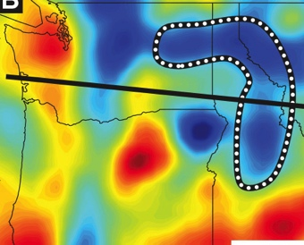
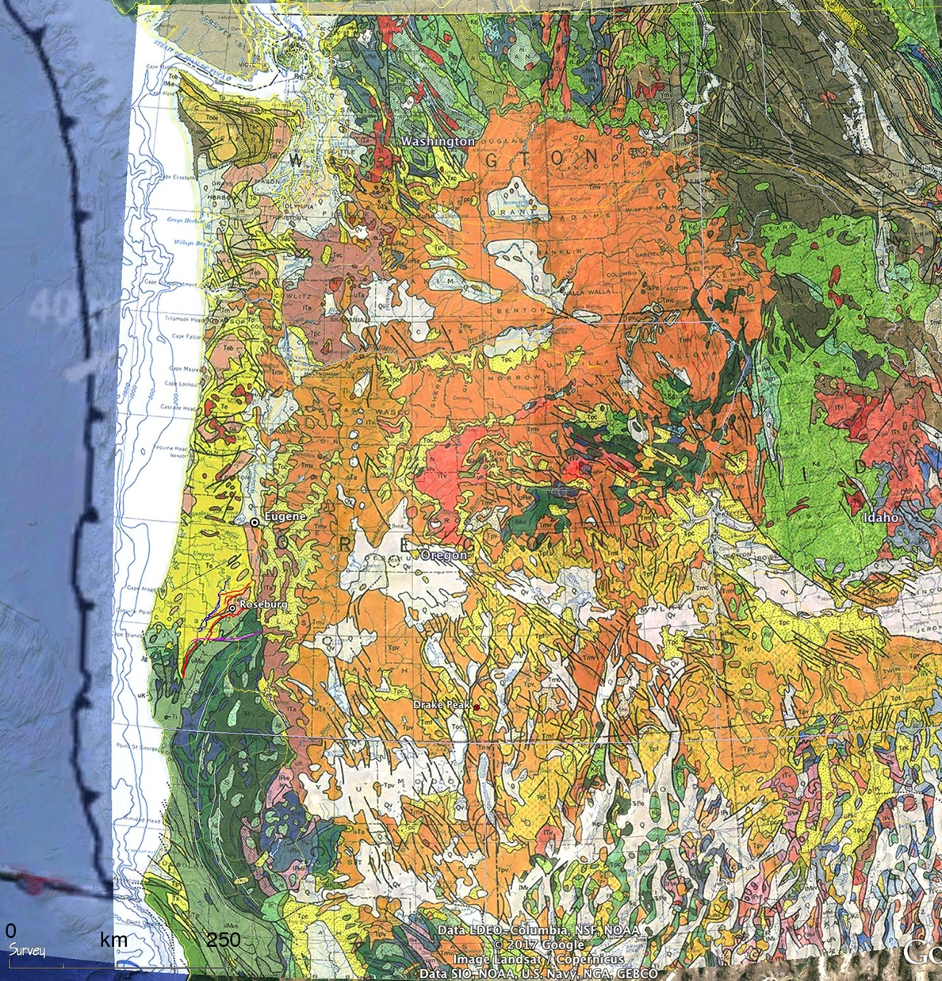
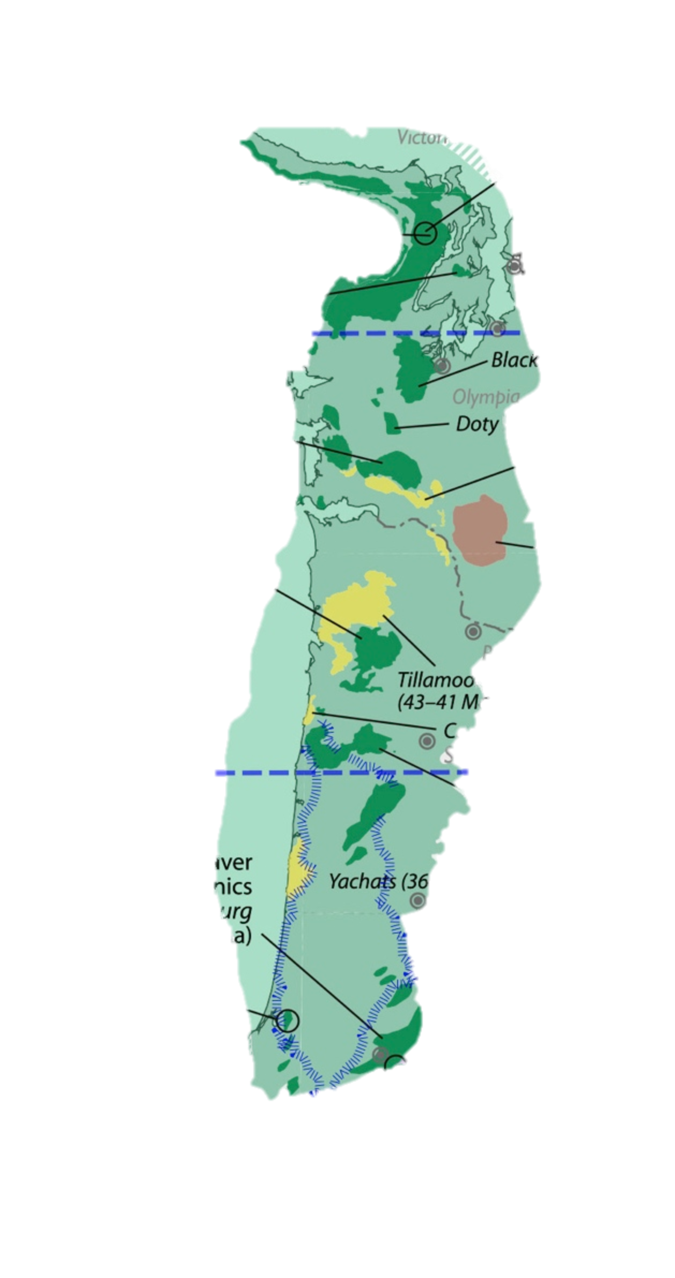
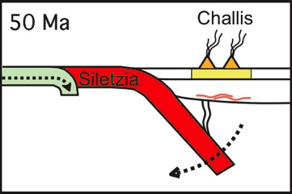
195 km
Tectonics of the PNW Region
North
Cascades
fast anomaly
PC
Some Highlights:
Pz-Mz terranes, Cz volcanic cover; accretion completed by ~ 145 Ma.
Craton boundary and suture WISZ.
Siletz Terrane: tholeiitic basalts, 20-30 km thick oceanic plateau (56-50 Ma), accreted in E. Eocene.
P-wave tomography: vertical slab of stalled oceanic lithoshere.
Two poles of CW oroclinal rotation:
complex history …
SW Oregon: Eocene suture between Siletz terrane and N. Klamath Mts.
cool
OWL
CRB
Cascadia Subduction Zone
Columbia
Embayment:
oceanic crust,
Farallon plate
?
Farallon slab
CRB
KBL
Ch.
Siletz Terrane
Cl.
Blue Mts.
I.B.
WISZ
Interpretation
Upper mantle P-wave tomography
(Schmandt & Humphreys, 2011)
McCrory & Wilson (2013)
Klamath
Mts.
Farallon slab
Basin & Range (Cz)
Schmandt & Humphreys, 2011
King & Beikman (1974)
Notes:
Looking at some highlights of the PNW region, we can see 3 areas -- Klamath Mts, Blue Mts, and N. Cascades (point) -- where Pz and Mz accreted terranes are exposed and surrounded by large areas of Cz volcanic rocks. The Siletz terrane is a thick stack of tholeiitic basalts exposed in western OR and WA that formed in an oceanic plataeu between about 56-50 Ma and were accreted to N.Am. in Early Eocene time. This is a map of upper mantle structure based on P-wave tomography by Schmandt & Humphreys. Their data reveal a fast anomaly beneath western Idaho that they interpreted to be a vertically dipping “curtain” or remnant of the Farallon oceanic slab … and they inferred that accretion of Siltezia caused the Farallon slab to stall and roll back beneath the N.Am, triggering widespred regional extension, crustal exhumation, Challis volcanism, and onset of regional ignimbrite flare-ups.

Slide 3
195 km
Tectonics of the PNW Region
North
Cascades
fast anomaly
PC
SW Oregon – Summary:
Excellent record of Siletz collision,
completed by ~ 49 Ma.
UMPQUA GROUP ~ 54 – 49 Ma Syn-collisional foredeep basin,
Sediment source in Klamath Mts.
TYEE FORMATION 49 – 46 Ma Post-collisional, overlaps thrusts.
Idaho Source for Tyee Paleoriver poses interesting problems …
Multiple Datasets: Suggest
Tyee Fm from Klamath Mts?
cool
OWL
CRB
Cascadia Subduction Zone
Columbia
Embayment:
oceanic crust,
Farallon plate
?
Farallon slab
CRB
WISZ
KBL
Ch.
Siletz Terrane
Cl.
Blue Mts.
I.B.
Tyee Fm
Paleoriver
U.G.
Eocene
Upper mantle P-wave tomography
(Schmandt & Humphreys, 2011)
McCrory & Wilson (2013)
Hypothesized
Klamath
Mts.
Basin & Range (Cz)
King & Beikman (1974)

Slide 4
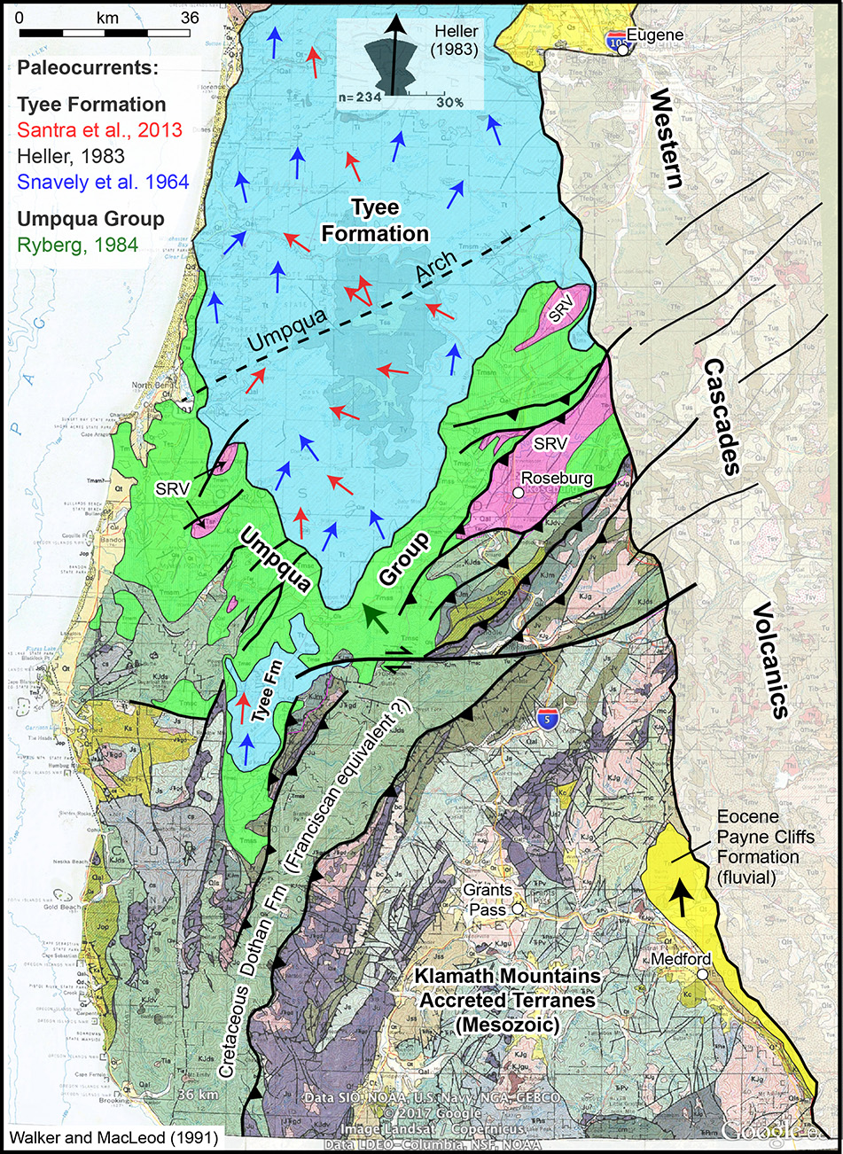
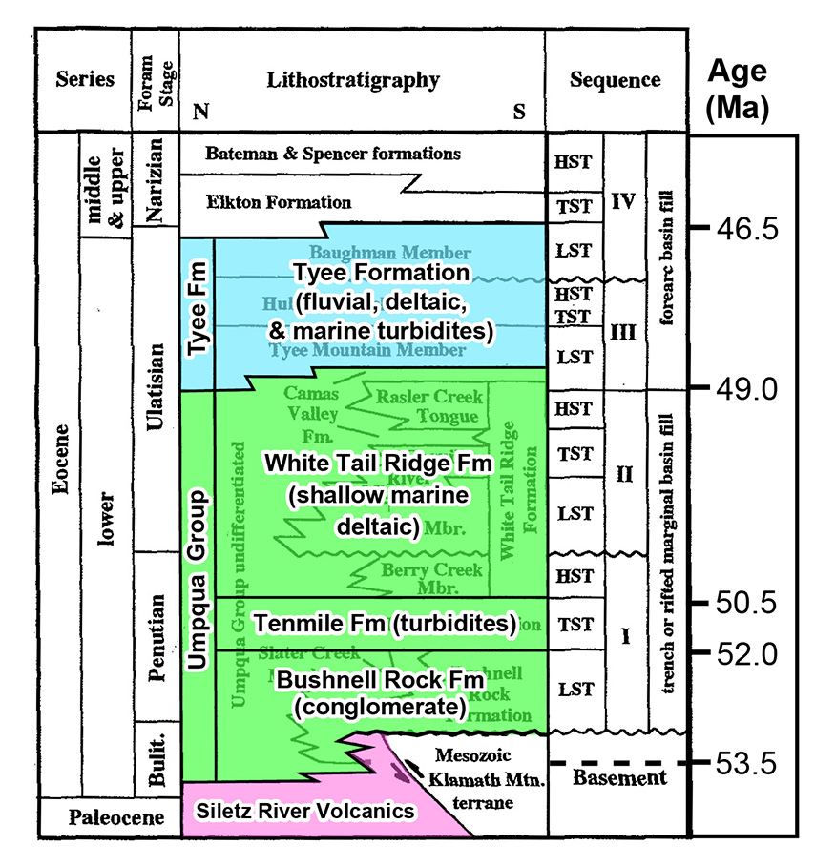
Tectonic Stratigraphy of SW Oregon
Ryu & Niem 1999 (ages from Wells et al., 2014)

Slide 5
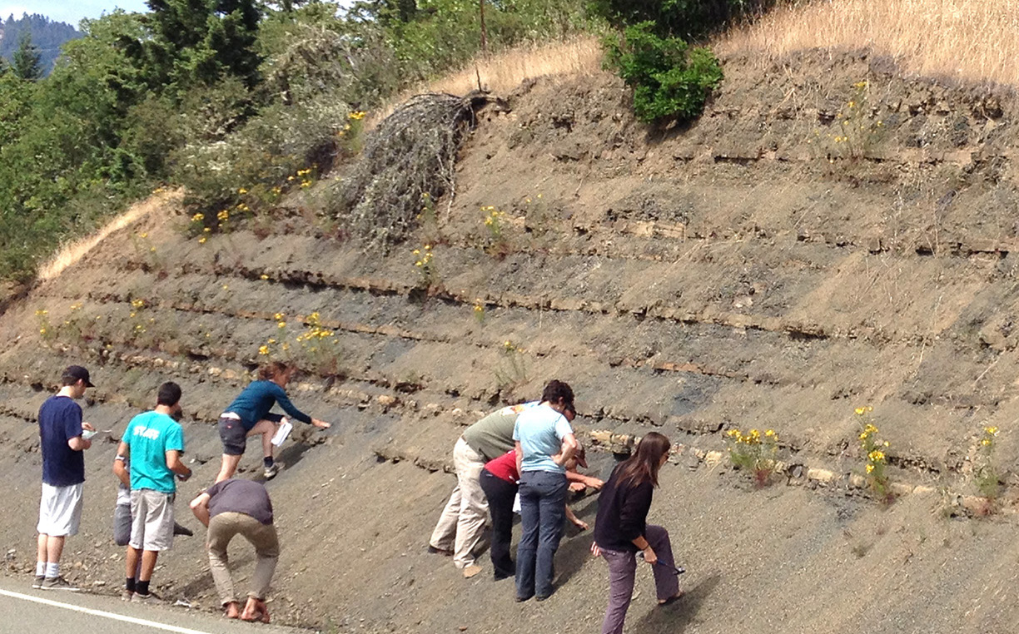
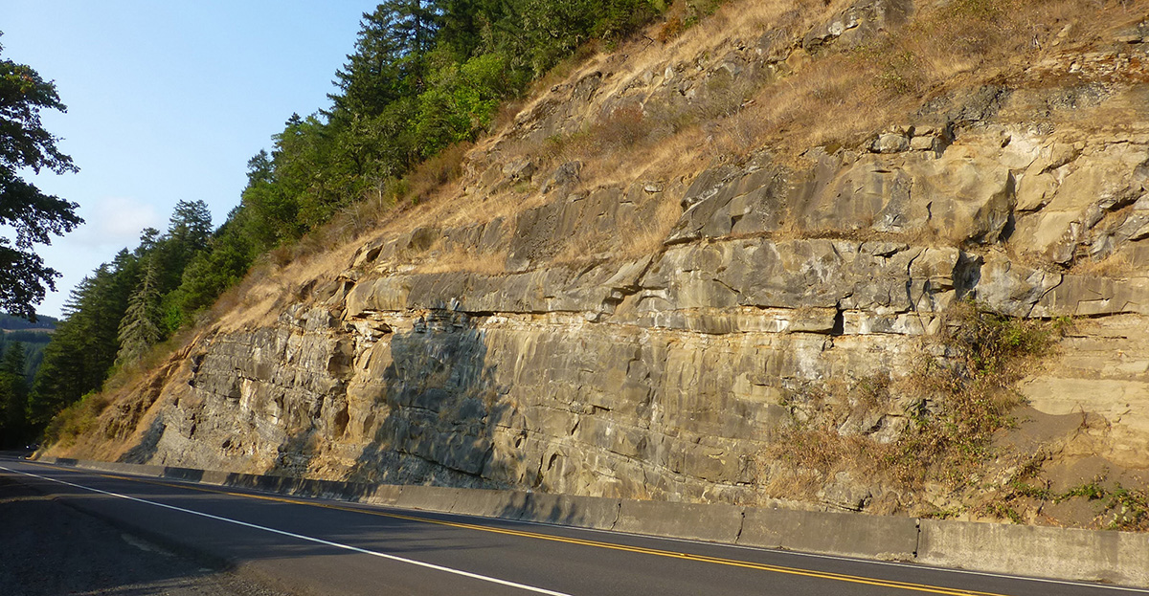
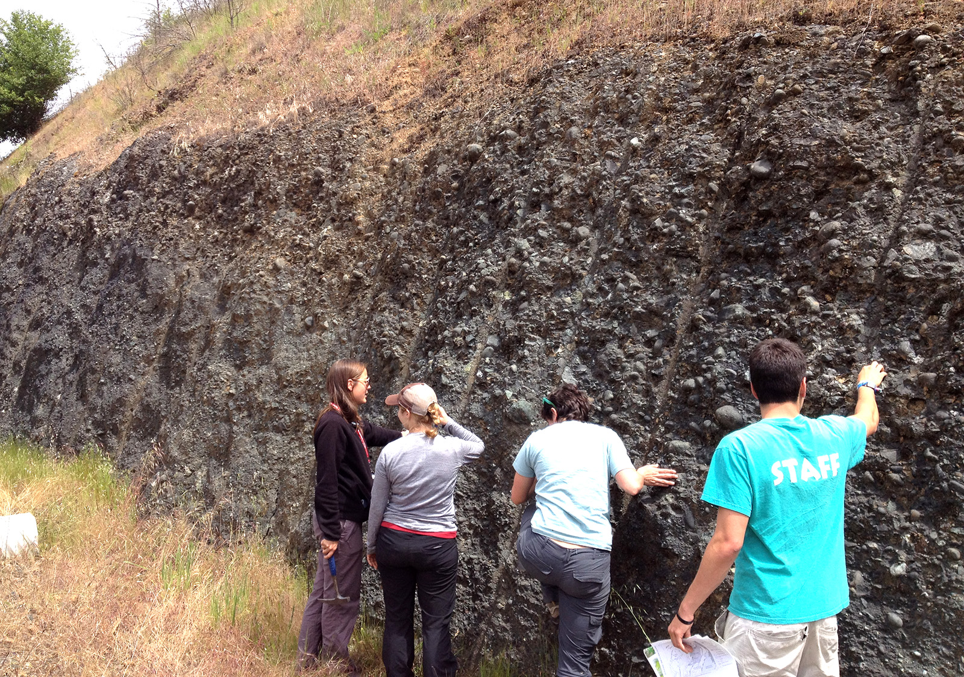
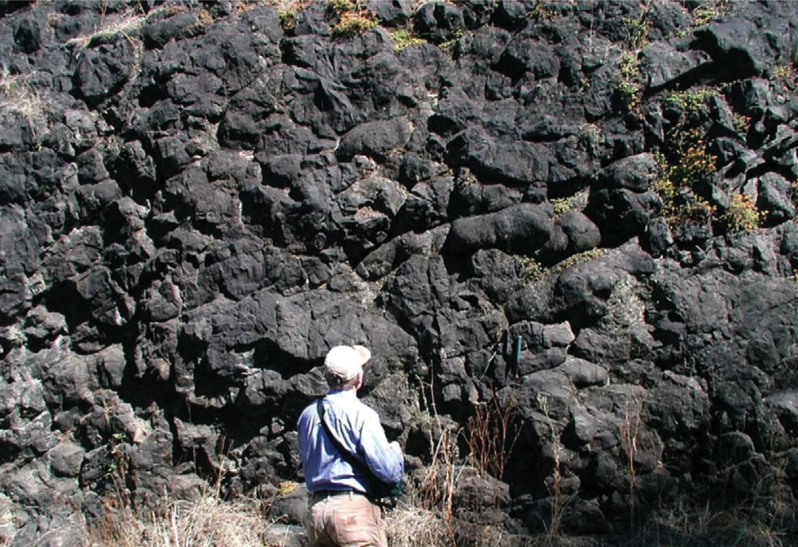
Tenmile Fm: submarine turbidites
(Klamath Mountains source)
Tectonic Stratigraphy of SW Oregon
Bushnell Rock Fm: deltaic to
submarine conglom. & sst
(Klamath Mountains source)
Tyee Formation: turbidites
(Idaho Batholith source ??)
Siletz River Basalts:
56-53 Ma, Roseburg area
Ryu & Niem 1999 (ages from Wells et al., 2014)

Slide 6
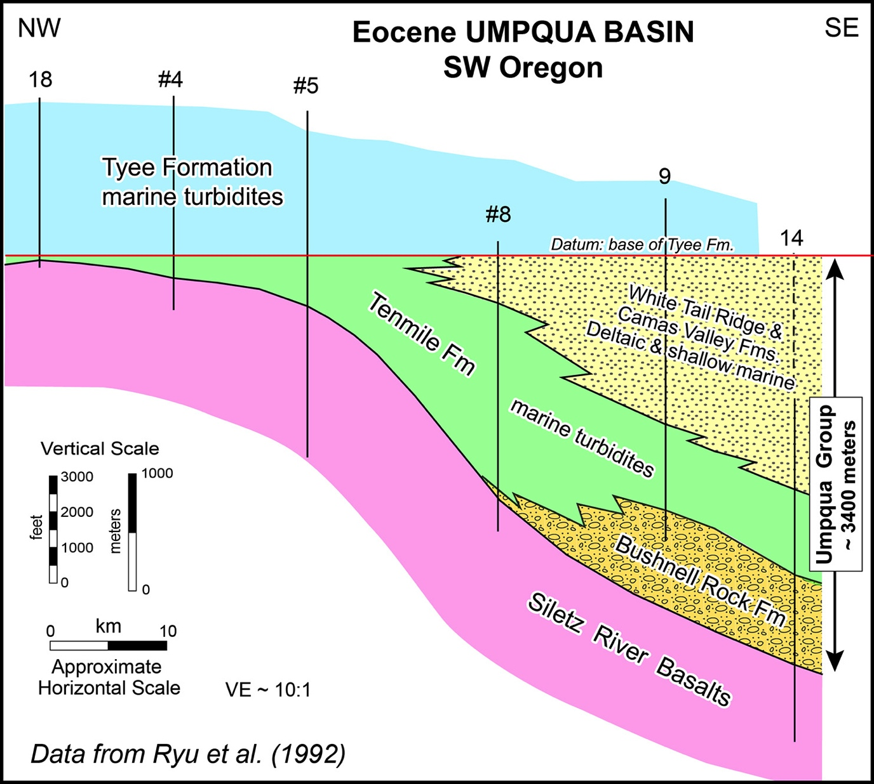
Umpqua Basin – Stratigraphy
Stratigraphic Architecture
Umpqua Arch
~60 km
Umpqua Arch
3,400 m
Umpqua Group

Slide 7
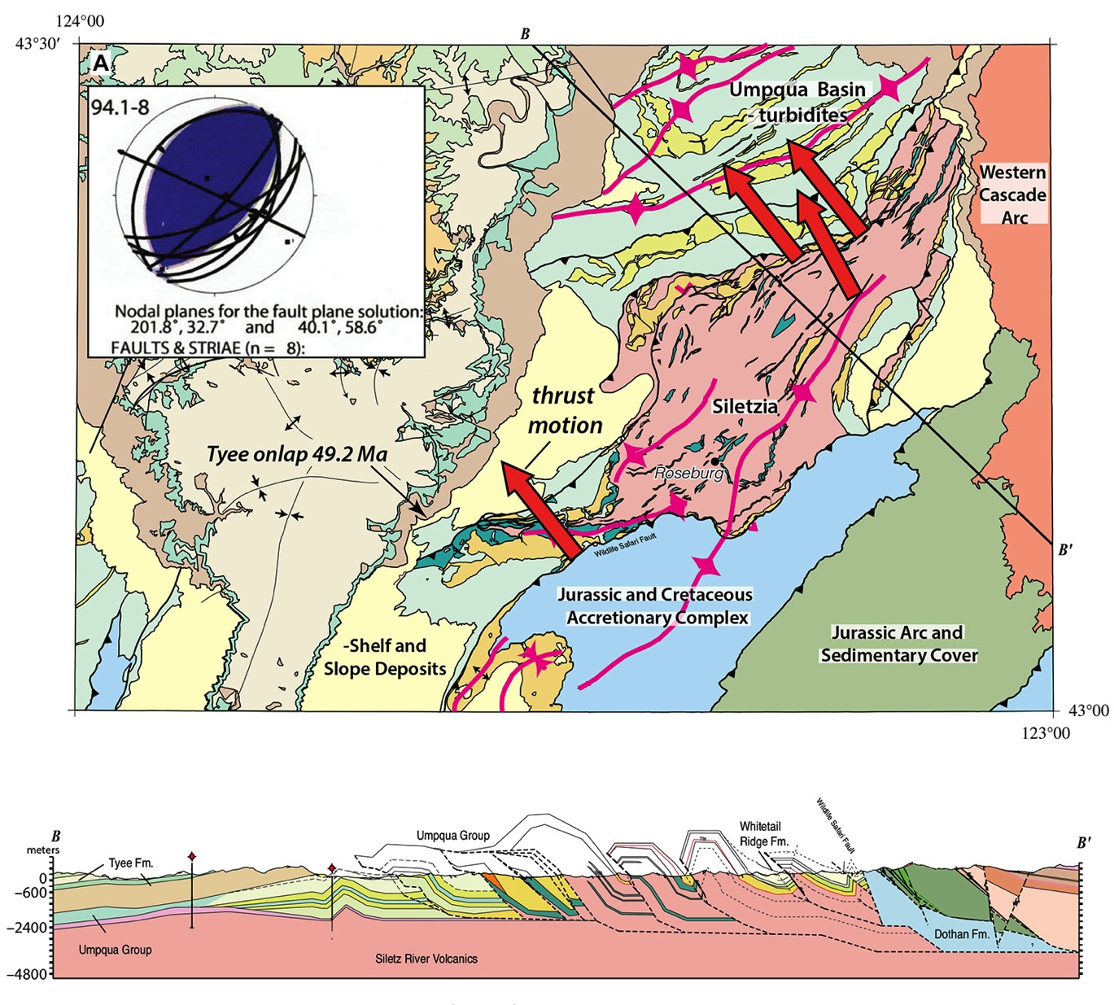
Umpqua Group is a syn-collisional basin fill succession (~ 54 – 49 Ma).
Strongly asymmetric, thickens to SE.
Thrust faults migrated into the basin, deformed progressively younger deposits (growth structures).
Tyee Formation rel. undeformed, overlaps & post-dates thrusts.
Umpqua Basin – Structure
Umpqua Arch
Roseburg Area (Wells et al., 2000, 2014)
NW
SE
Tyee Fm
overlap (base = 49 Ma)
Umpqua Group
Siletz River Volcanics

Slide 8
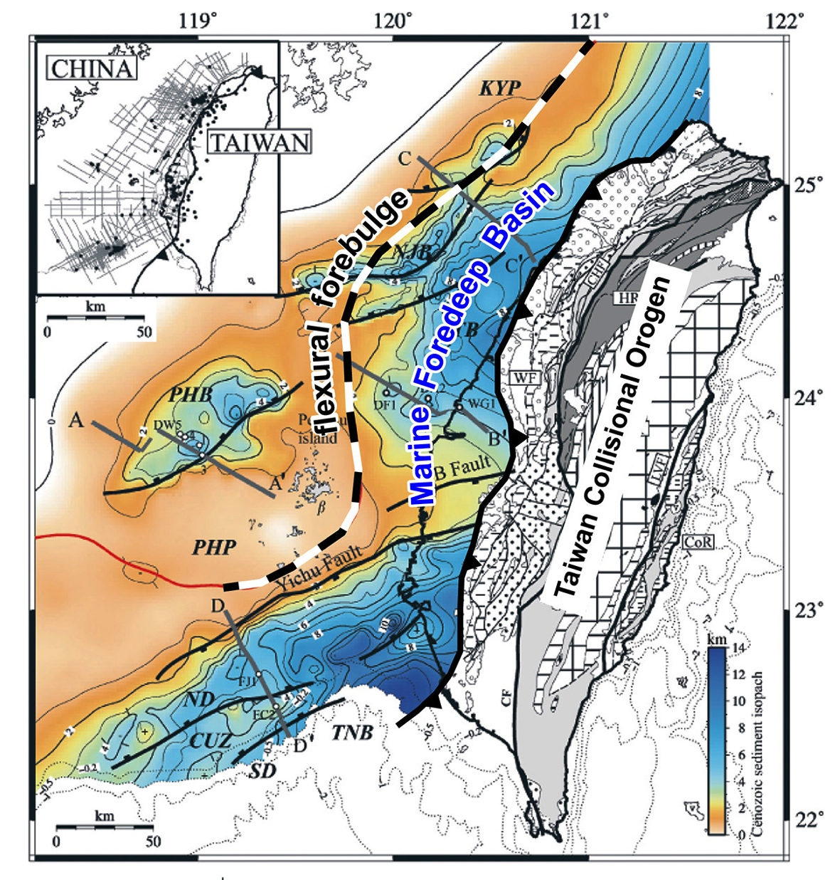
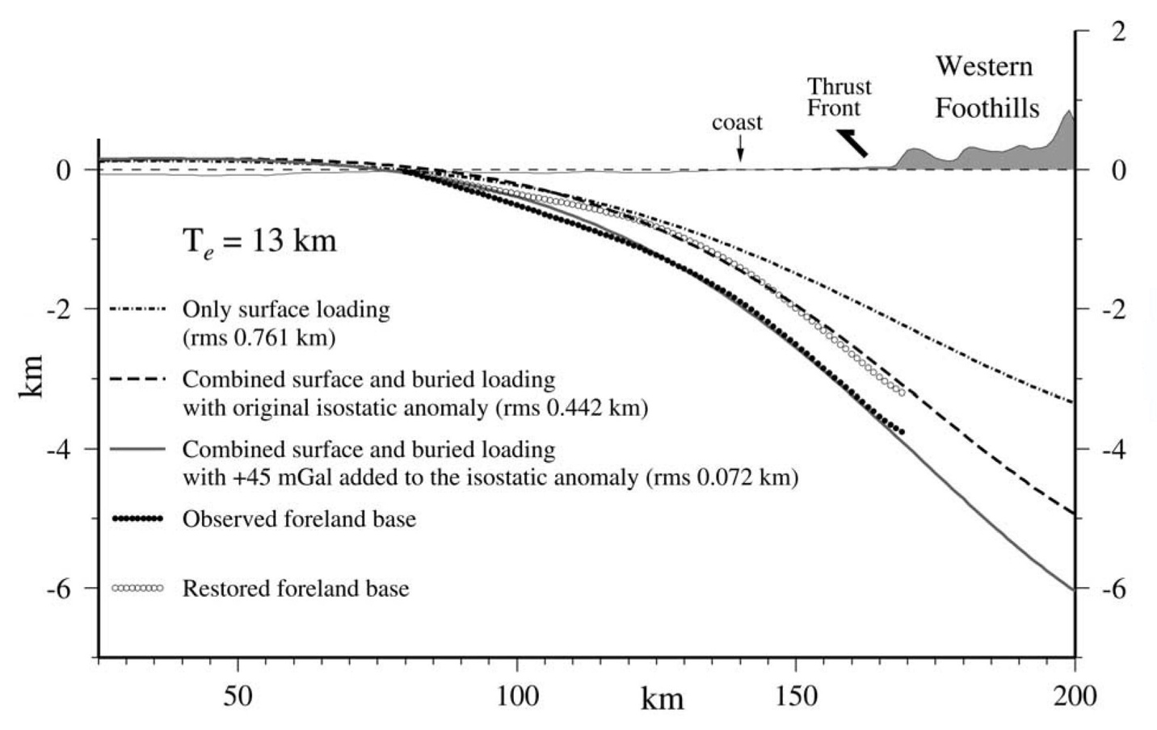
Western Taiwan Foredeep: Modern Analog for Umpqua Basin
Western Taiwan
Flexural Foredeep Basin
50-70 km
Lin & Watts, 2002
Taiwan Foredeep & Umpqua Basin have similar
Scale (width, depth)
Rate and duration (~ 5 Myrs)
Genetic relation to thrust belt (flexural load)
Basin migration, progressive thrusting
Western Taiwan
Foredeep Basin
(Lin et al., 2003)

Slide 9
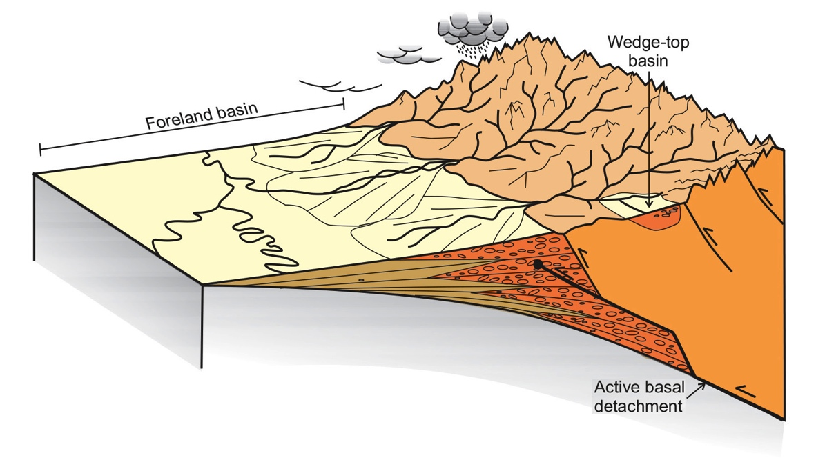
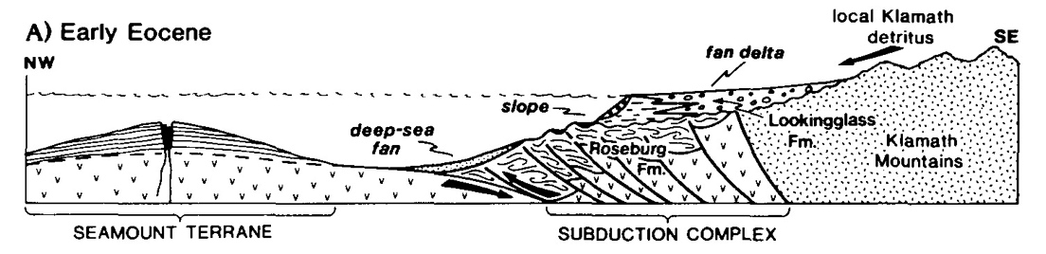
Collisional Orogen & Foredeep Basin
UMPQUA Foredeep Basin:
Flexural Subsidence Response to Thrust Loading
Klamath Mts.
Umpqua Arch
Umpqua Foredeep Basin
(pre-Tyee)
Klamath Mts.
Collisional Orogen
Sinclair (2012)
Heller & Ryberg, 1983 (pre- to syn-collision)

Slide 10
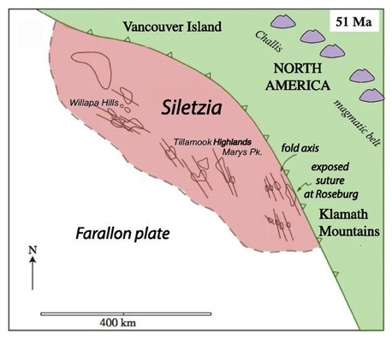
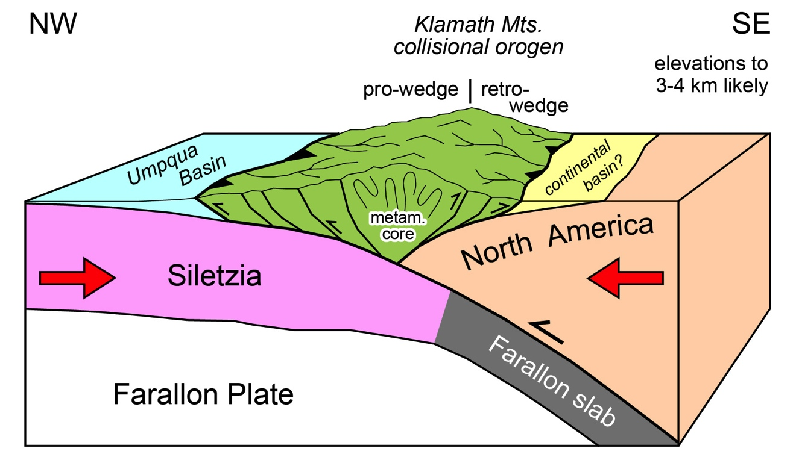
WSW
Regional Context
ENE
54 – 49 Ma
Roseburg area
Wells et al. (2000, 2014)
Pre-Rotation
Unit | Age (Ma) | Clockwise Rotation | Syn-Collision (mid-value) | Syn-Collision (max.)
W. Cascades | post-40 | ~ 30°
Tyee Fm. | 49-46 | 67° ± 14.5°
Umpqua Gp. | 54-49 | (intermed.) | ~ 12° | ~ 39°
Siletz R. Volcanics | 56-53 | 79° ± 12.5°
Northern Klamaths rotated at least 67° ± 14.5°, post-53 Ma.
Up to ~ 50% of total rotation may be syn-collisional.
Restored margin NNW strike (pre-Columbia embayment?)
Paleomagnetic Data
Wells et al. (2000, 2014)

Slide 11
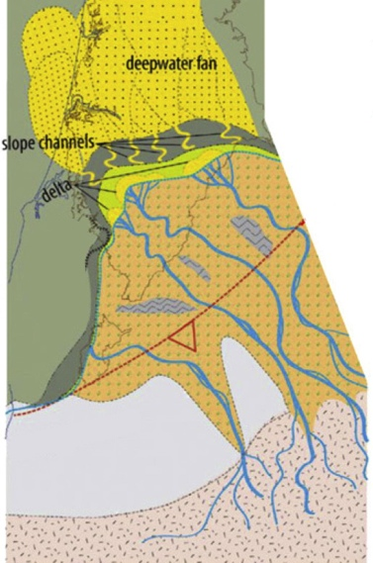
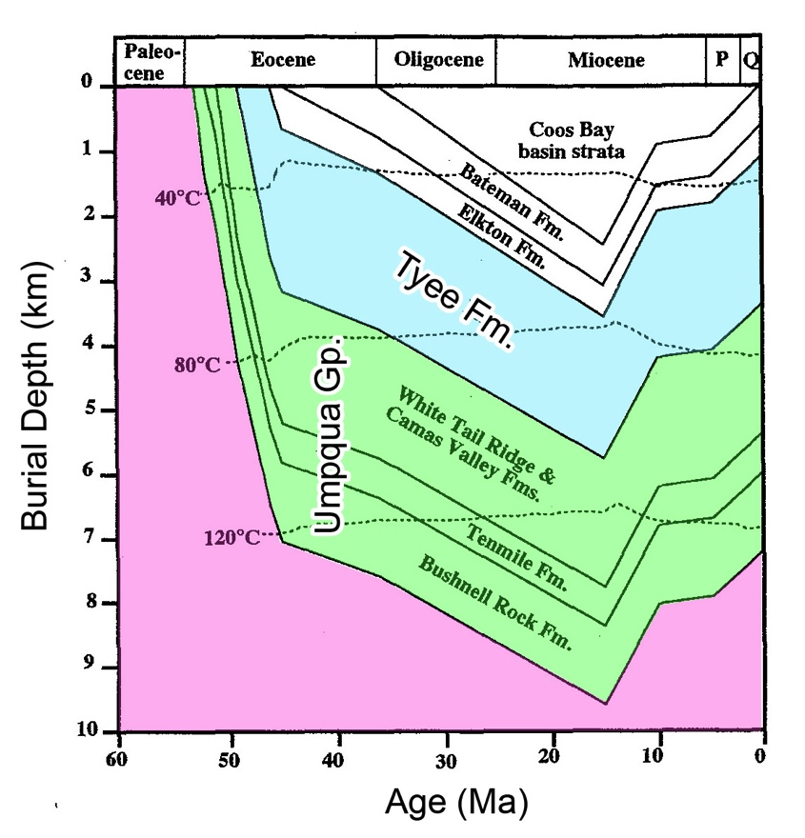
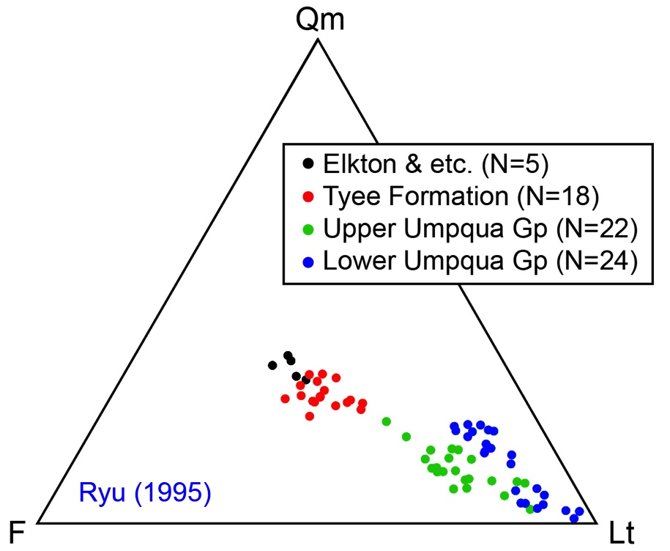
Umpqua Group and Tyee Formation display indistinguishable:
Subsidence rate/history
Implied driver of subsidence
Sediment dispersal pattern
And: Progressive change in sandstone composition (unroofing trend)
49 Ma
Subsidence History
Tyee Formation: Reconstruction
~54 Ma
46.5 Ma
Umpqua Arch
Umpqua Foredeep Basin
(pre-Tyee)
Deltas
Ryu (1995)
Brutzkus (2017)
UO Sr. Thesis
Braid
Streams
~ 0.9 km/Myr (mm/yr)
Single Phase of
Rapid Subsidence
Klamath Mts.
Collisional Orogen
Implies same driving
force (thrust load) for
Umpqua Gp. and TYEE
Ryu & Niem 1999
Tyee Fm.
Santra et al. 2013
Unroofing trend

Slide 12
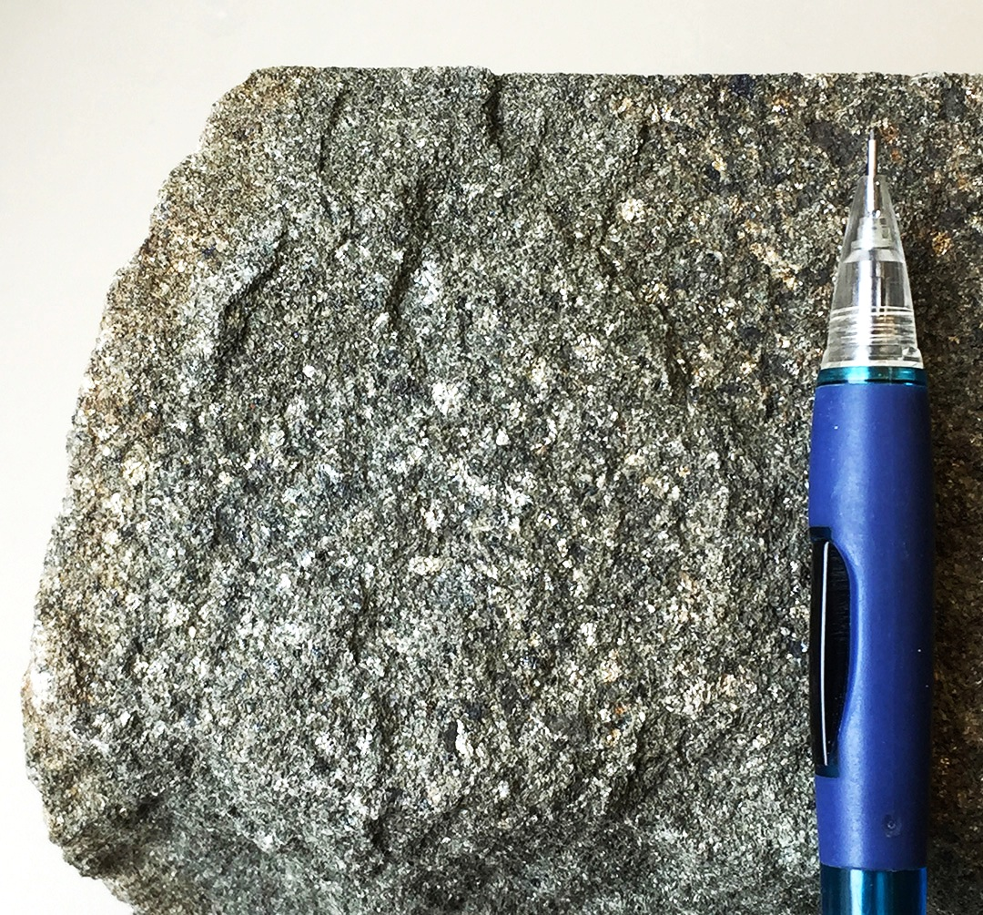
Source of the TYEE FORMATION: Klamath Mts. or Idaho Batholith ?
Provenance Hypothesis | Main Data Types | References
Klamath Mts. (original) | Sst petrography Clast compositions Paleocurrent data | Snavely et al., 1964; Bachman, 1982; McKnight, 1984; Aalto, 1988
Idaho Batholith | Sst petrography Isotope geochemistry Detrital mica ages Detrital zircon ages | Heller & Ryberg, 1983; Heller et al., 1985, 1992; Renne et al. 1990; Dumitru et al., 2013
Klamath Mts. (reconsidered) | Sst petrography Paleocurrents & Facies Subsidence analysis Sedim. mass balance | Ryu et al, 1992; Ryu 1995; Ryu and Niem, 1999; Santra et al. 2013; This Study
North
Cascades
PC
OWL
CRB
Cascadia Subduction Zone
Columbia
Embayment:
oceanic crust,
Farallon plate
?
CRB
WISZ
Tyee Fm
KBL
Ch.
Cl.
Blue Mts.
I.B.
Paleoriver
Snavely et
al. 1964
Eocene
McKnight
1984
Hypothesized
Klamath
Mts.
Montgomery
Creek Fm.
Aalto
1988
Basin & Range (Cz)
detrital
micas
Bachman
1982
Tyee Formation
King & Beikman (1974)

Slide 13
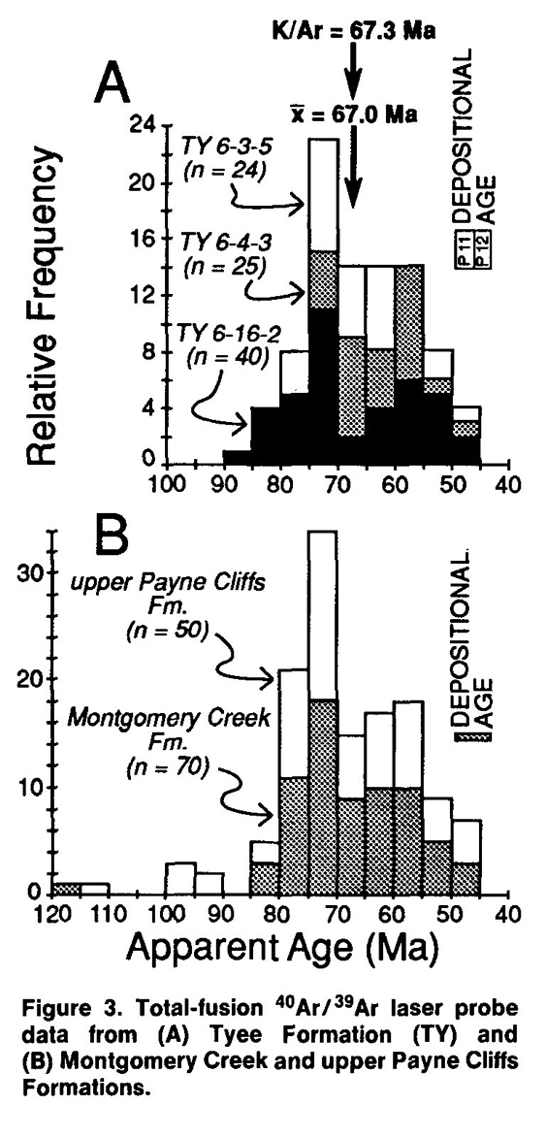
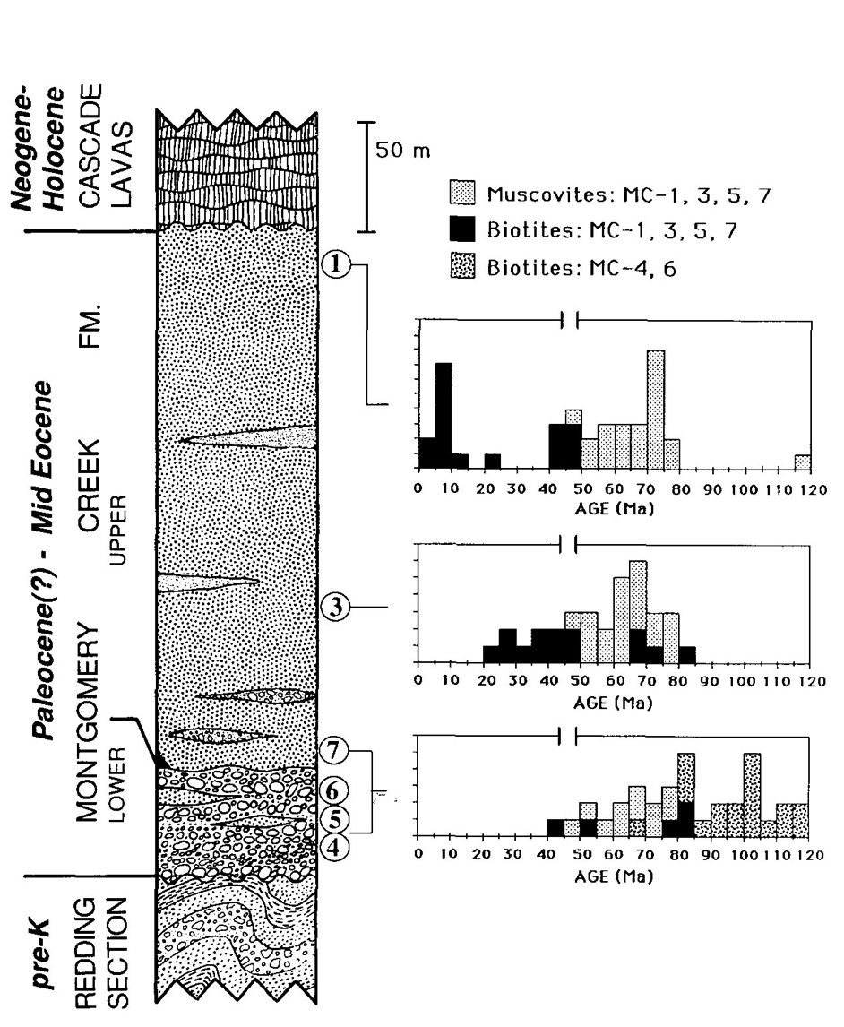
White Micas
Many ages 50–90 Ma
Rocks of this age not known in Klamath Mts., well documented in western Idaho (plutonic and metamorphic rocks).
Support western Idaho source of Tyee Fm and other Eocene deposits …
Detrital Mica Ages
Tyee Fm
Montgomery Creek Fm (northern Calif.)
Muscovite & Biotite
Age
Upper Payne
Cliffs Fm
n = 50
However,
Klamaths source for lower Montgomery Ck. Fm (Aalto, 1988), incl. 50–90 Ma micas.
No published mica ages for Umpqua Group.
Depos.
Montgomery
Creek Fm
n = 70
micas embedded in congl. matrix
Depos.
⁴⁰Ar/³⁹Ar step-heating analyses
Aalto (1988)
Renne et al. (1990)
Heller et al. (1992)

Slide 14
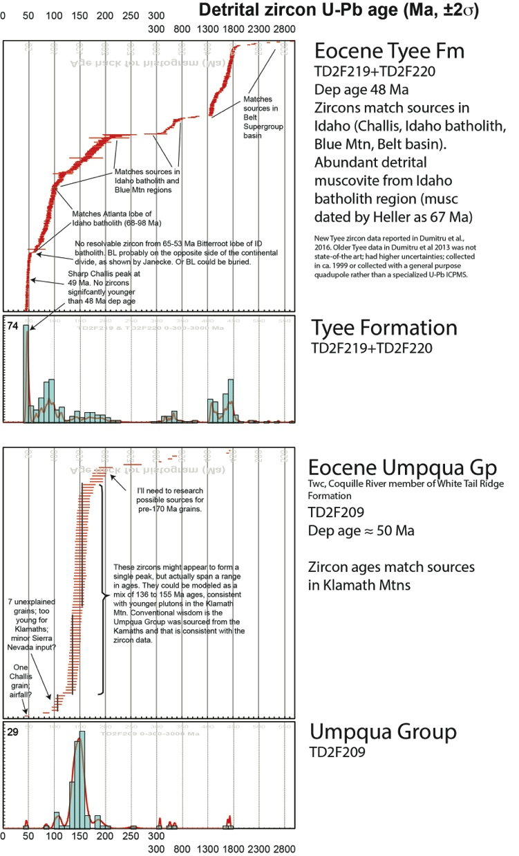
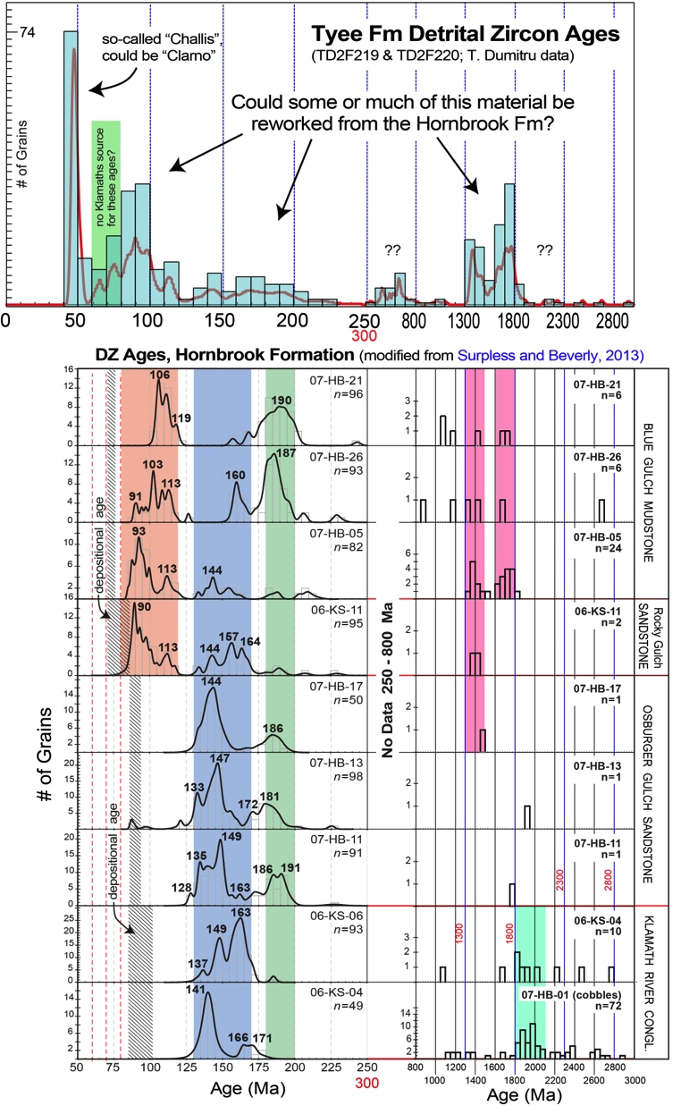
Detrital Zircon Ages
(T. Dumitru, unpubl.)
Clarno input?
REWORKING?
Except .…
Tyee Formation
Multi-modal distribution
Peaks at 49, 70-200, Pz, PC
Consistent with Idaho Batholith, Challis, Belt S.G. sources
Umpqua Group
Cretaceous Hornbrook Fm
Dom. Mesozoic ages
Peak at ~ 150 Ma
Consistent with source in Klamath Mts.
(Surpless & Beverly, 2013)

Slide 15
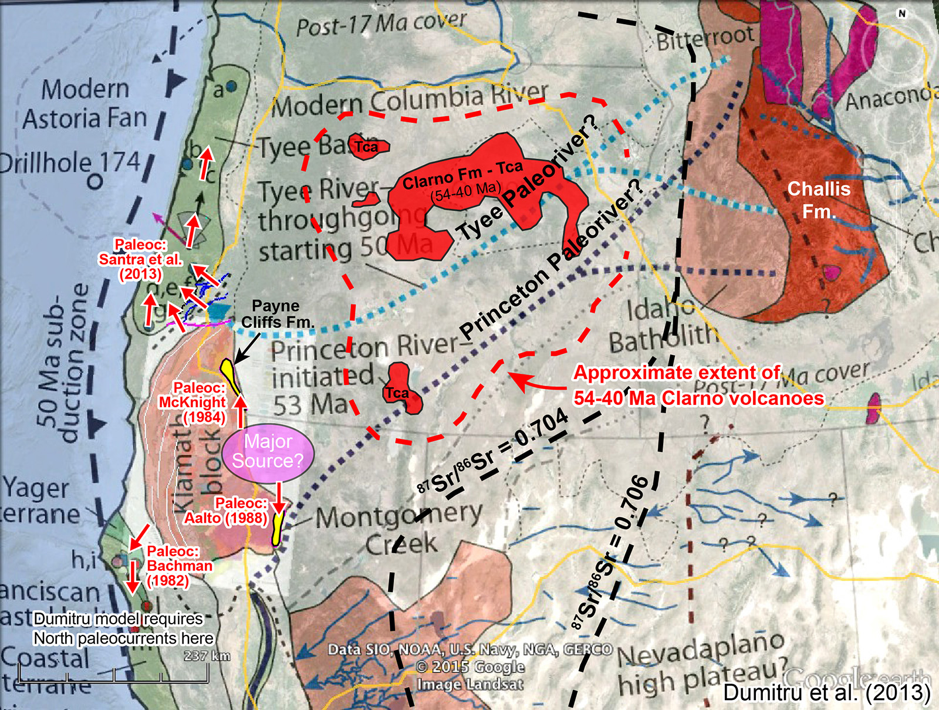
Eocene Paleoriver Problem
Tyee Fm Source – Hypotheses
and supporting datasets
Western Idaho (Id. Batholith, Challis):
- Isotope geochemistry
- Detrital mica ages (with caveats)
- Detrital zircon ages (with caveats)
(2) East-Central Klamath Mountains:
- Sandstone petrography
- Paleocurrent data & facies distribution
- Gravel clast compositions
- Cretaceous deposits (eroded from Klamaths)
- Rb-Sr model ages NOT consistent with Idaho
Batholith source (Heller et al., 1985)
A key difference between proposed sources is location relative to the Sr 0.704/0.706 line: Idaho is on the N.A. craton, Klamaths are in accreted terranes. However, some rocks in the Klamath Mts have high ⁸⁷Sr/⁸⁶Sr ratios (0.706-0.710; Frost et al., 2006).
NO Cretaceous Sediments:
Removed by Eocene erosion
Dumitru et al. (2013

Slide 16
Eocene Paleoriver
Problem
Know: Tyee Paleoriver traversed the Klamath Mountains: required by paleo-current data and facies distribution.
This permits several scenarios:
Paleoriver originated in Idaho, and crossed Klamath Mts across either:
(a) low-lying topography (inactive), or
(b) gorge cut through mountains.
1a is problematic: Klamath Mts formed an active orogen for 5 Myr immediately prior to Tyee deposition – no time to reduce topography by erosion before Tyee Fm.
1b is problematic: orogen-crossing gorge requires antecedant drainage (not), or headward erosion from retro side (not likely in an actively deforming/uplifting orogen).
(2) Paleoriver originated in Klamath Mts.
Tyee Formation could be eroded from Klamath Mts. at average erosion rates < 1.0 mm/yr …
Typical rate for active collisional orogens.
Tyee source in Klamath Mts. is physically plausible, chemistry & petrology debated.
Tyee Fm: Volume ~ 21,600 km³ (~ 2.5 Myr)
Flux rate ~ 8,640 km³/Myr
Est. erosion rate ~ 0.4-0.8 mm/yr
Umpqua Gp: Volume ~ 10,500 km³ (~ 5 Myr)
Flux rate ~ 2,100 km³/Myr
Est. erosion rate ~ 0.2-0.4 mm/yr

Slide 17
North
Cascades
CONCLUSIONS (progress report)
Excellent record of Siletz collision
in SW Oregon – Roseburg area.
UMPQUA GROUP ~ 54 – 49 Ma Syn-collisional foredeep basin,
Sediment source in Klamath Mts.
TYEE FORMATION 49 – 46 Ma Post-collisional, overlaps thrusts.
Idaho-Sourced Tyee Paleoriver poses some problems …
Multiple Datasets: Suggest
Tyee Fm from Klamath Mts.? Unresolved problem.
fast anomaly
PC
cool
OWL
CRB
Cascadia Subduction Zone
Columbia
Embayment:
oceanic crust,
Farallon plate
?
Farallon slab
CRB
WISZ
KBL
Ch.
Siletz Terrane
Cl.
Blue Mts.
I.B.
Tyee Fm
Paleoriver
U.G.
Eocene
Upper mantle P-wave tomography
(Schmandt & Humphreys, 2011)
McCrory & Wilson (2013)
Hypothesized
Klamath
Mts.
Basin & Range (Cz)
King & Beikman (1974)

Slide 20
Unit | Volume (km³) | Duration (Myr) | Flux (km³/Myr) | Likely Catchmt. Area (km²) | Estimated Erosion Rate (mm/yr)
Tyee Fm | ~ 21,600 | ~ 2.5 | 8,640 | 10-20,000 | 0.4 – 0.8
Umpq. Gp | ~ 10,500 | ~ 5.0 | 2,100 | 5-10,000 | 0.2 – 0.4
TOTAL | 32,100 | ~ 7.5 | 4,280 |  | < 1.0
“The source area for Tyee sediments is believed to be a metamorphic, igneous, and sedimentary terrane in the area of the ancestral Klamath Mountains that lay south of the geosyncline. Active andesitic volcanism immediately east of the geosyncline also contributed pyroclastic and epiclastic debris to the streams.”
(Snavely et al., 1964, Kansas Geological Survey Bulletin 169, 461-480).
“The provenance of these sandstones included S-type (two-mica) granites that formed in Late Jurassic time from sources that included an old crustal component. Rocks in the Klamath Mountains and northern Sierra Nevada do not possess these features … The sandstones most likely were derived from the Idaho batholith.” (Heller et al., 1985, GSA Bulletin 96, p. 770-780).

Slide 21
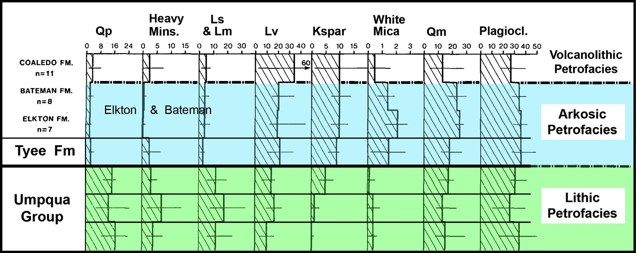
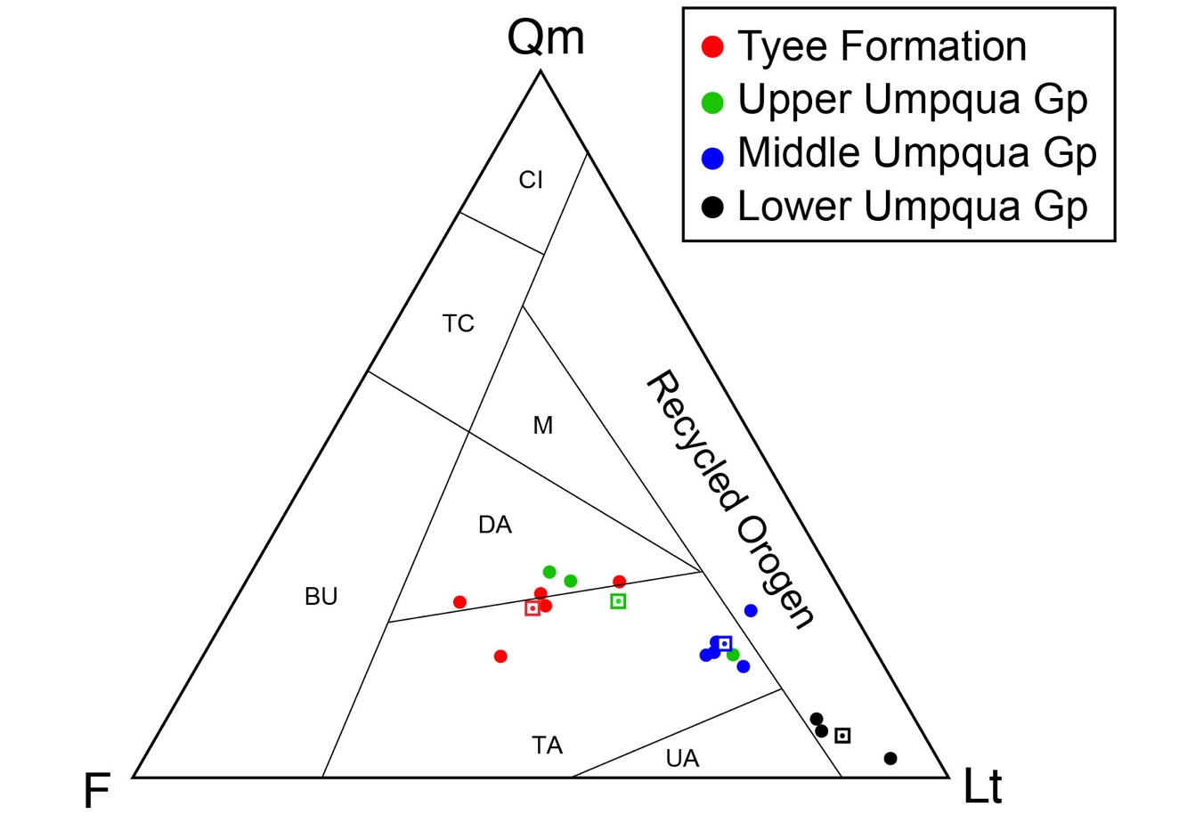
Heller & Ryberg,
1983
Sandstone Petrography
Idaho Batholith Source
Klamath Mts. Source
Mono-xline Quartz
Brutzkus, 2017
UO Sr. Thesis
Tyee Fm.
Tyee Fm.
Total Lithics
(includes Qp)
Feldspar
Unroofing trend
Unroofing trend

