Slide 1
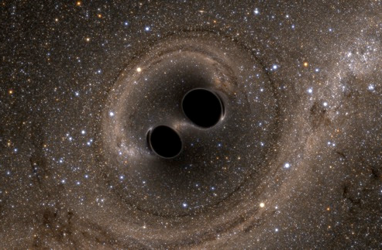
Update on LIGO
and gravitational-wave Astrophysics

Slide 2
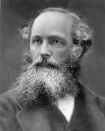
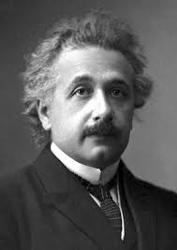
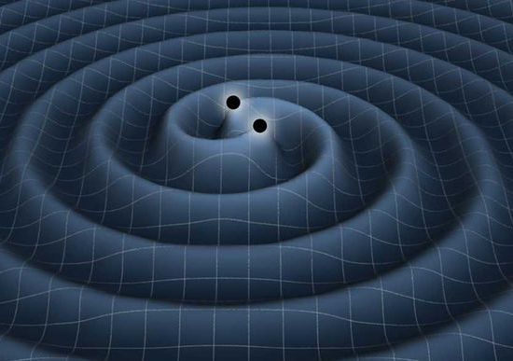
Gravitational Waves (GWs)
The waves of the electromagnetic force are realized as (electric and magnetic) fields which propagate through space and time. [Maxwell, 1865]
General Relativity describes gravity in terms of a spacetime which is deformable. [Einstein, 1915]
GWs are oscillations of that spacetime. [Einstein, 1916]
“ripples in spacetime”

Slide 3
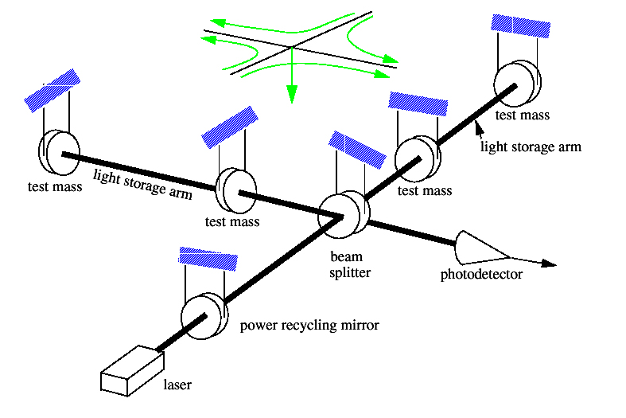
Gravitational waves and LIGO: short version
As detected by LIGO:
Binary black hole system
GW ripples manifest as a space strain h, where h = ΔL / L
Realistic sources: h ~ 10⁻²³ ⇒ ΔL~ 10⁻¹⁹ m (Yikes !)

Slide 4
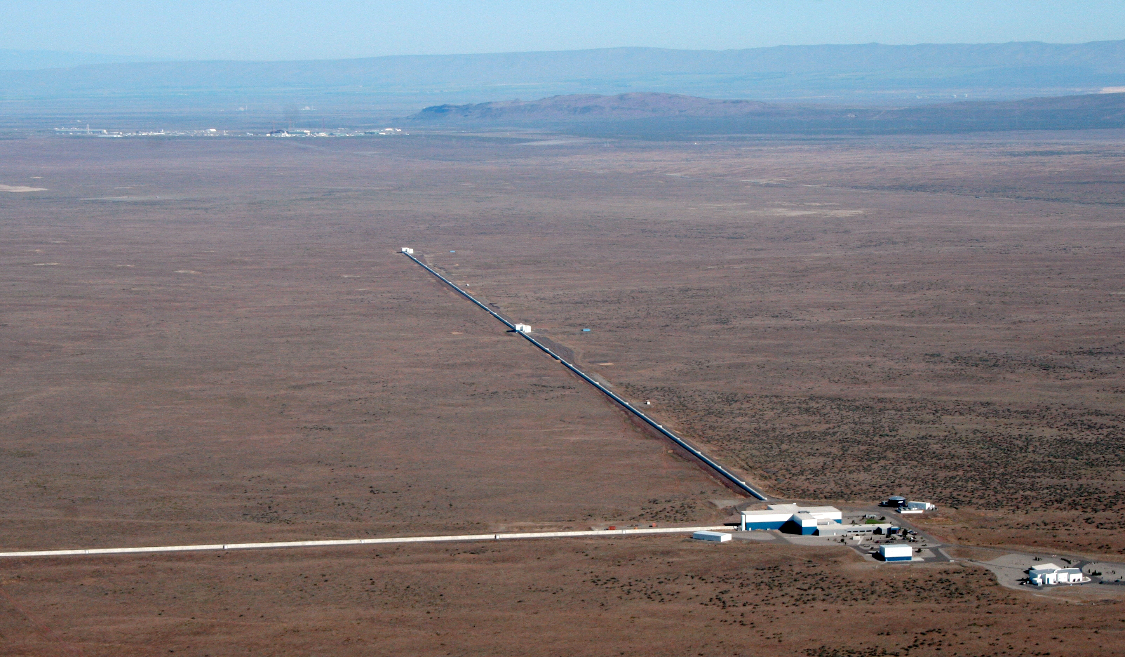
LIGO Hanford Observatory

Slide 5
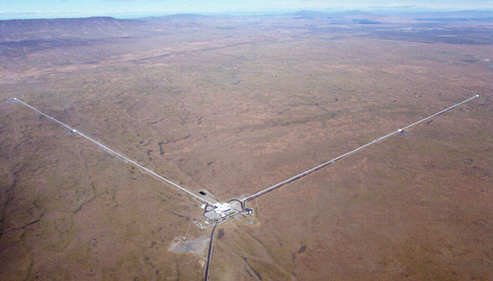
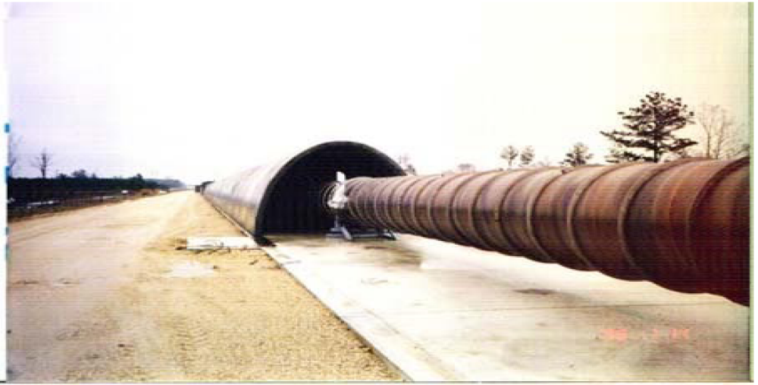
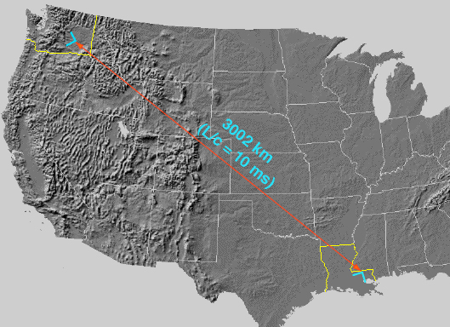
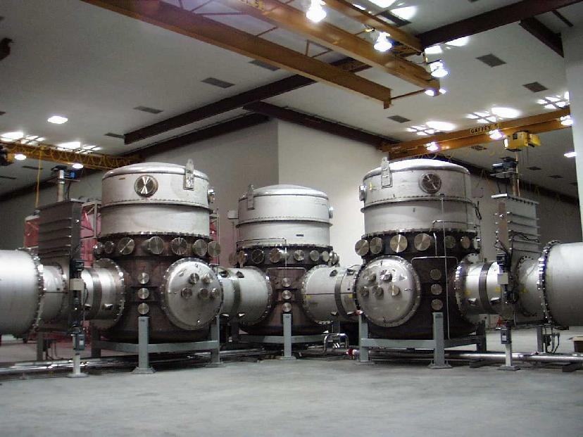
observatories

Slide 6
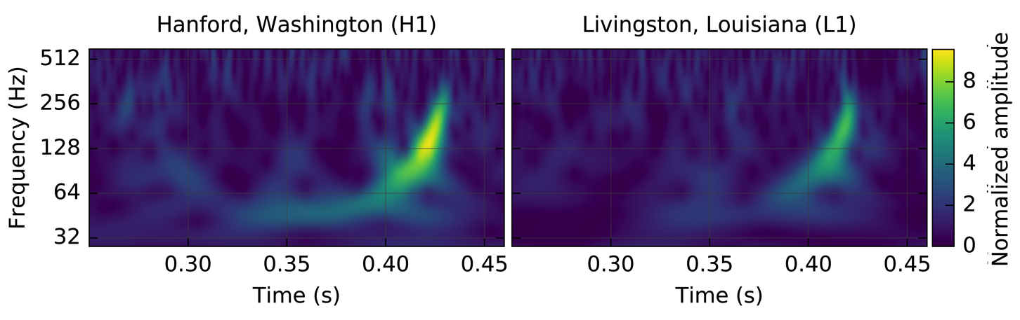
September 14, 2015, 2:51 AM Pacific
Boom !
GW150914
First observation of GWs
First direct observation of black holes

Slide 7
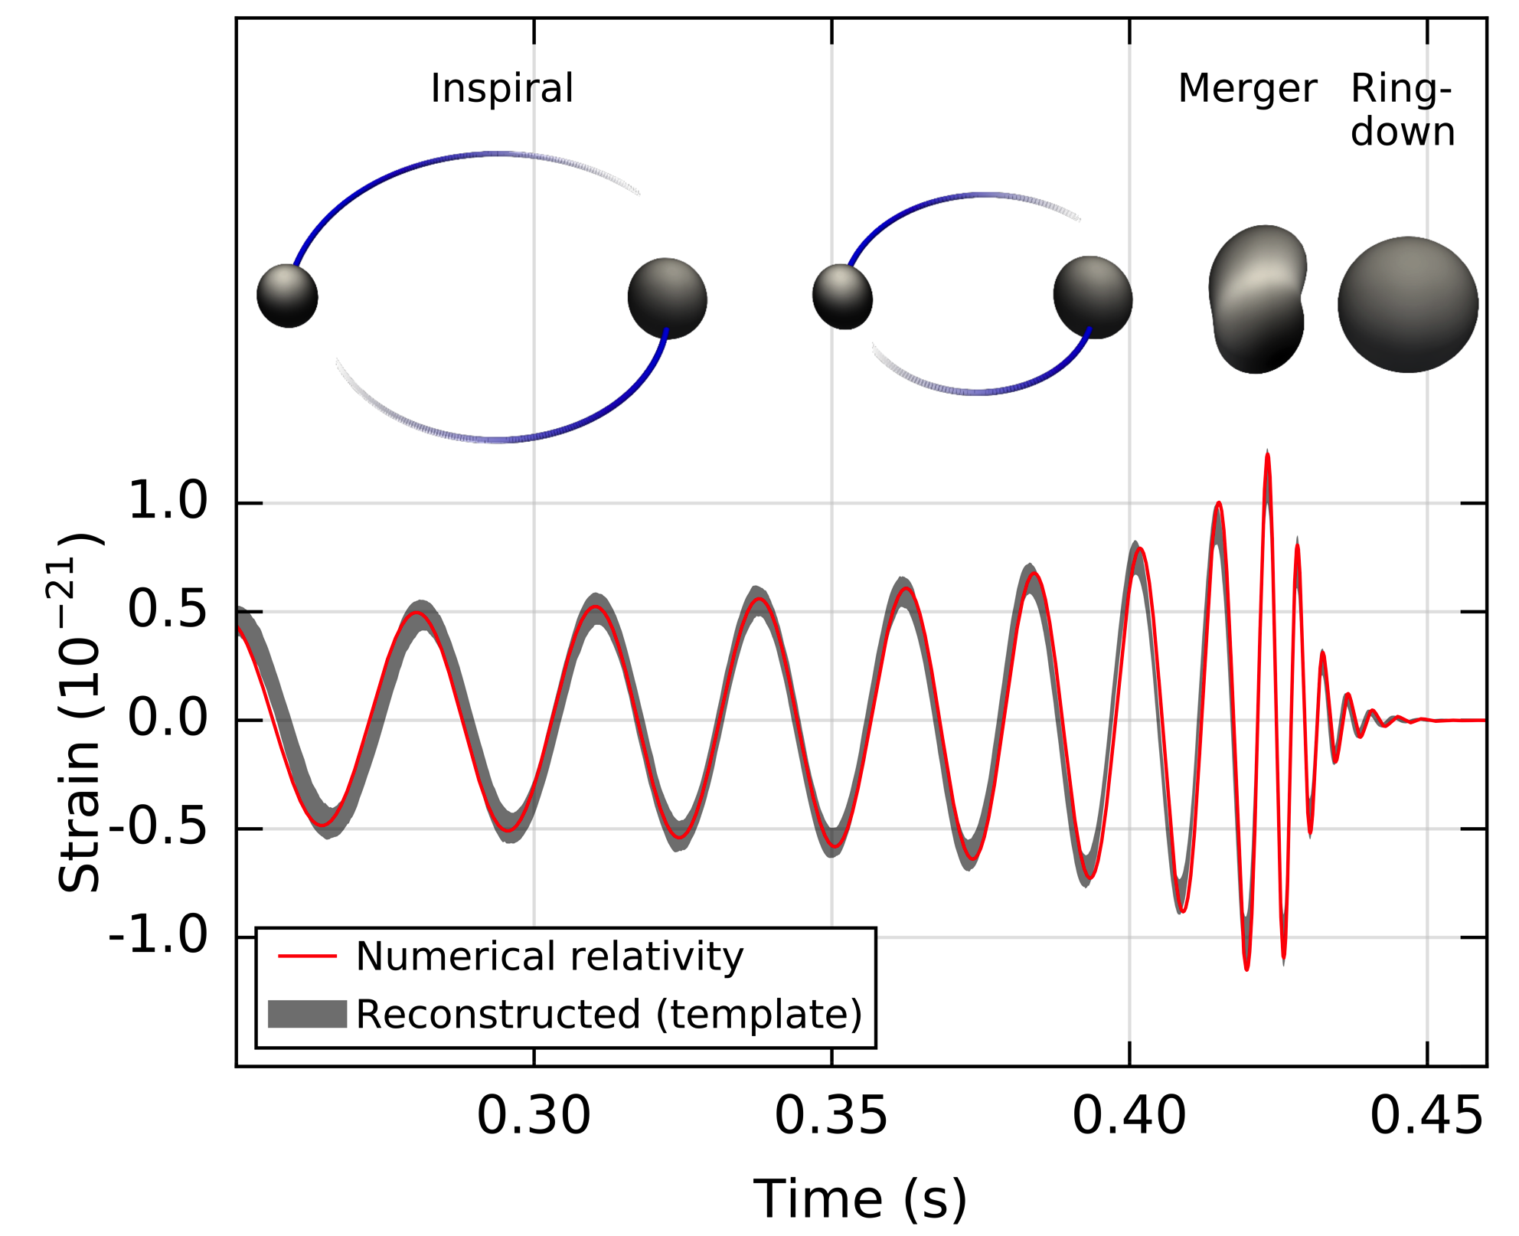
Binary black hole inspiral, merger, ringdown

Slide 8

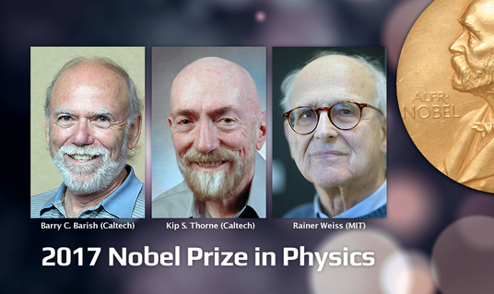
GW Discovery Accolades

Slide 9
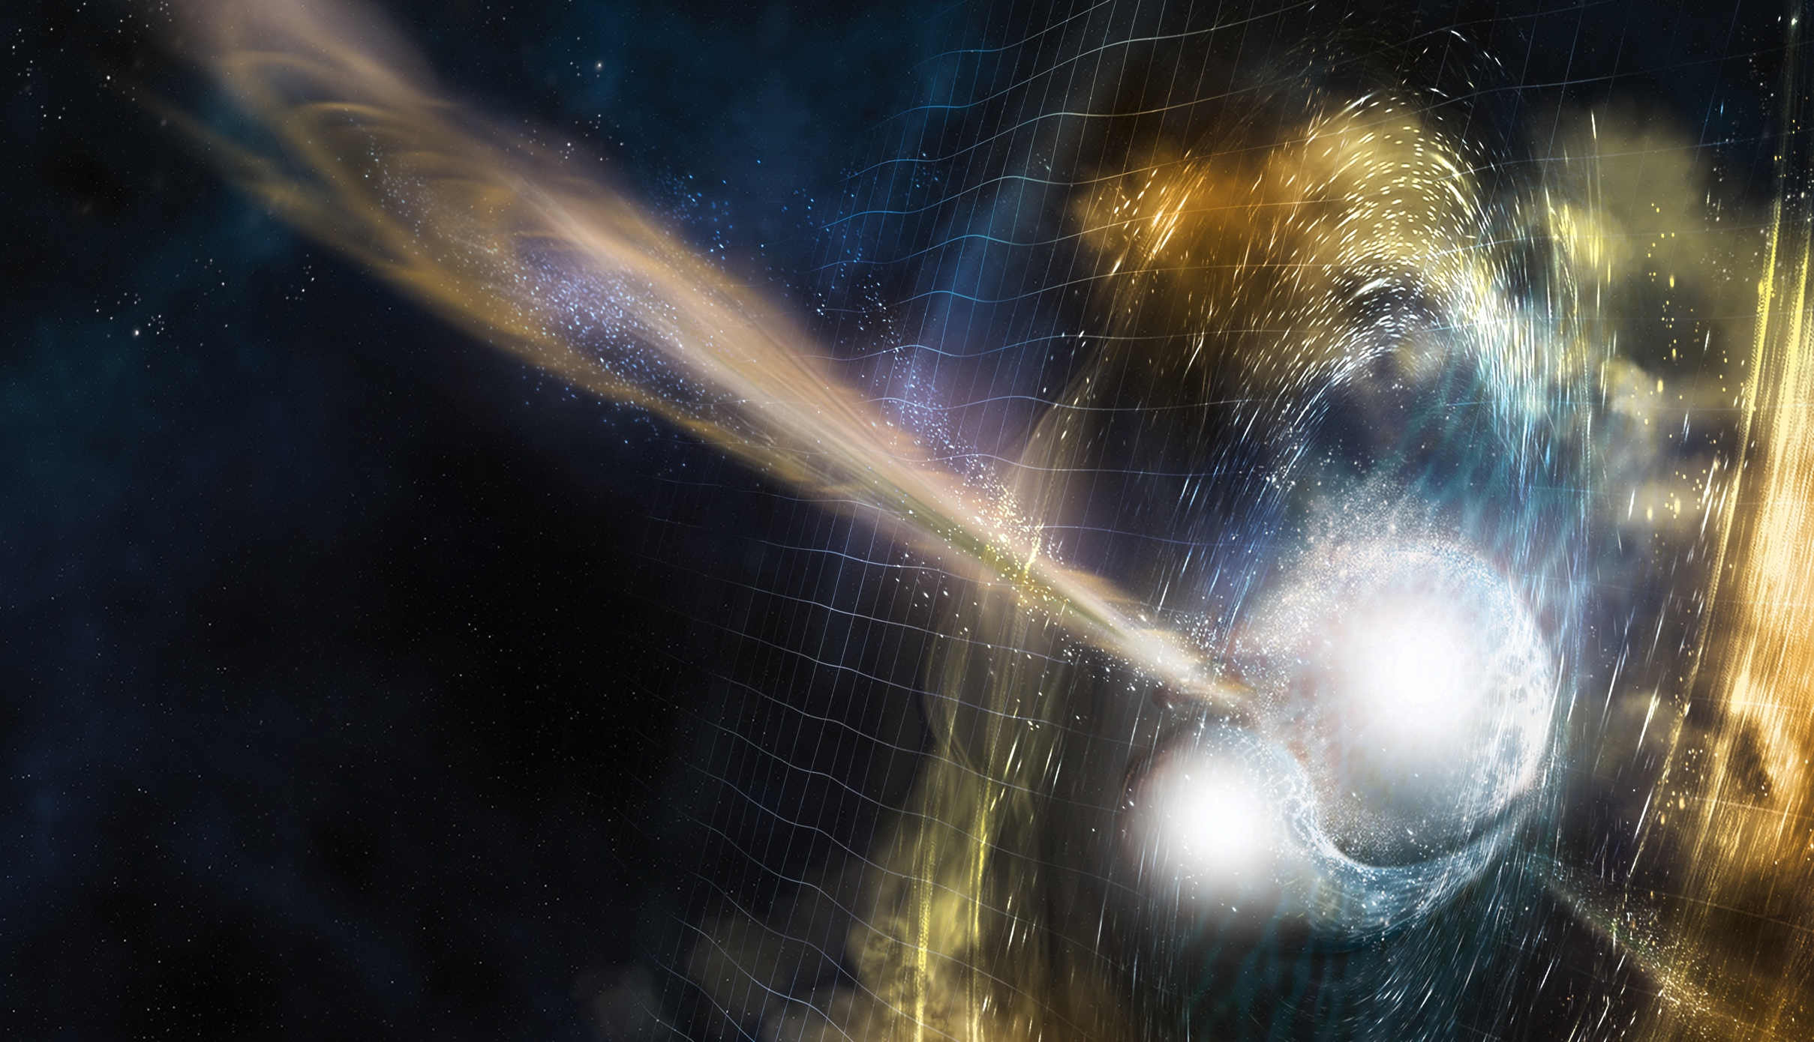
Boom II:
Binary neutron-star merger August 17, 2017

Slide 10
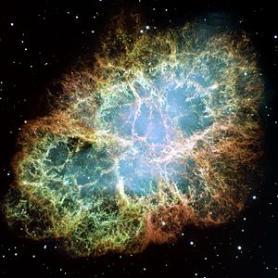
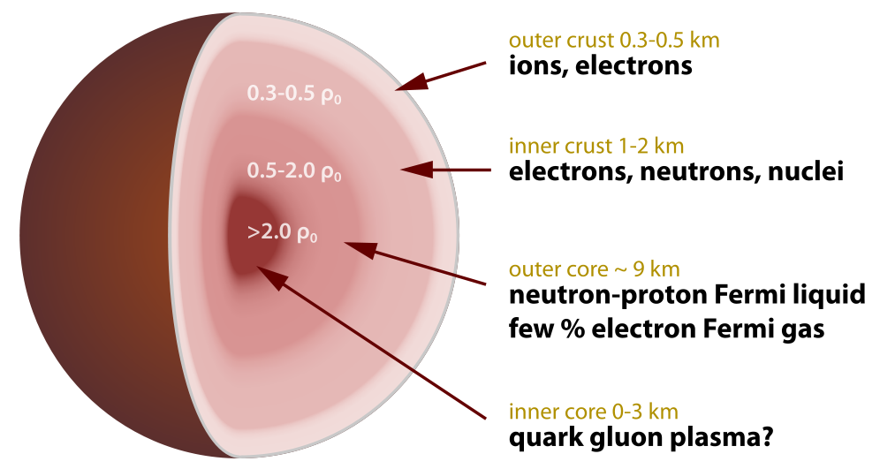
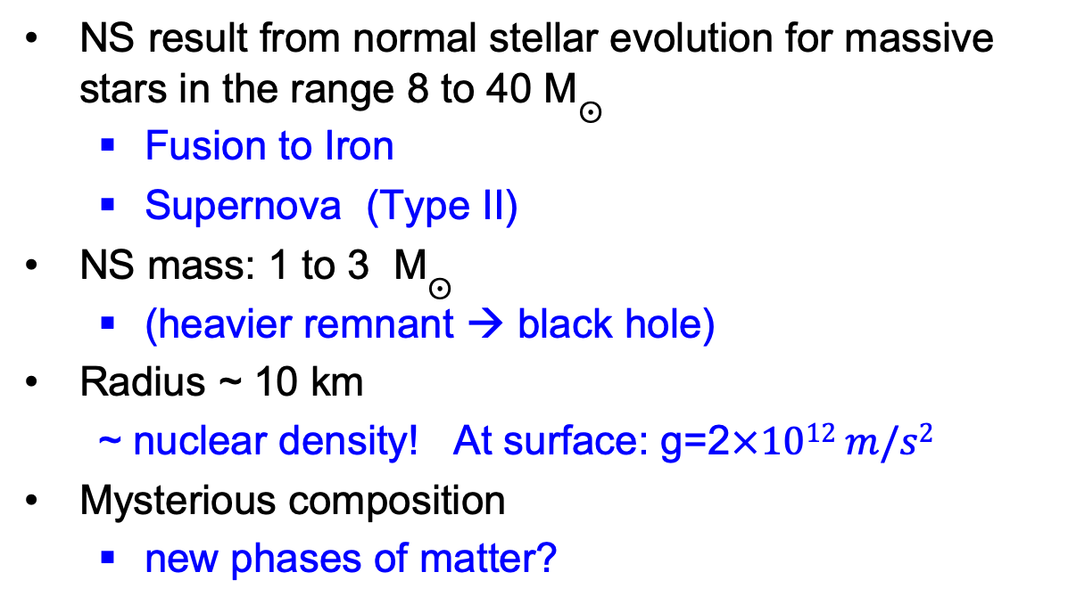
Neutron stars
NS result from normal stellar evolution for massive stars in the range 8 to 40 M$⨀$
  Fusion to Iron
  Supernova (Type II)
NS mass: 1 to 3 M$⨀$
  (heavier remnant → black hole)
Radius ~ 10 km
  ~ nuclear density! At surface: g=2$×1012 m/s2$
Mysterious composition
  new phases of matter?

Slide 11
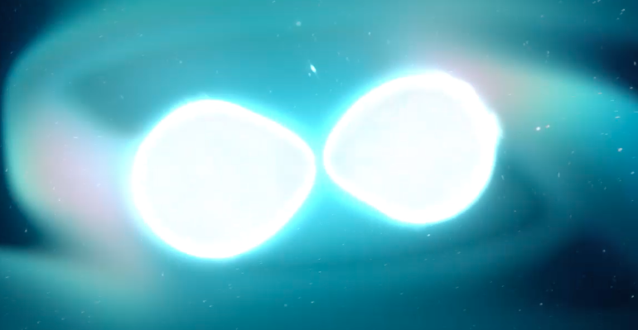
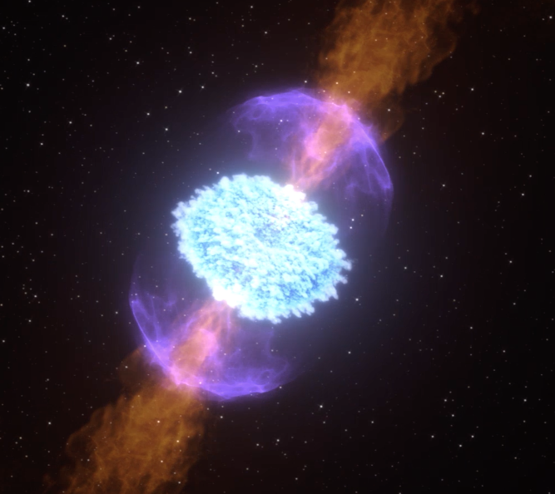
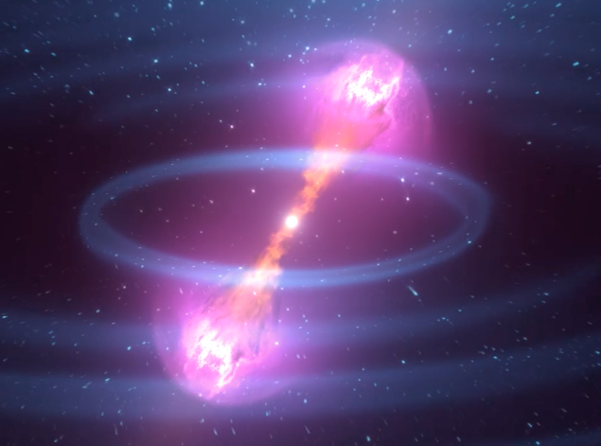
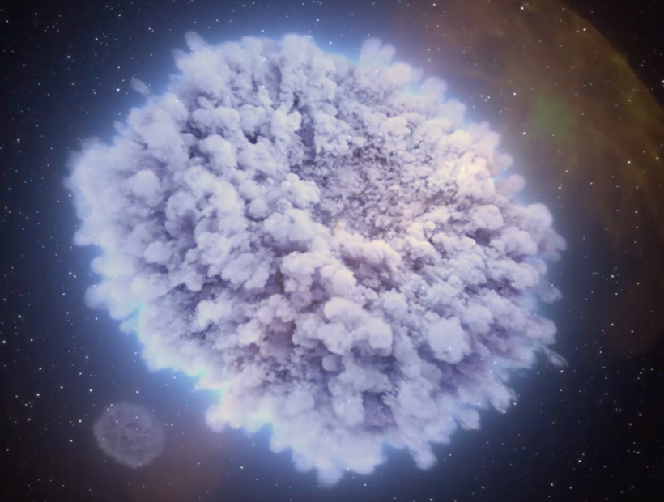
NS Merger, gamma-ray burst, afterglow (“kilonova”)
1
3
2
4

Slide 12
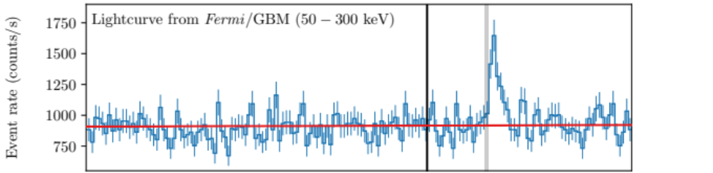
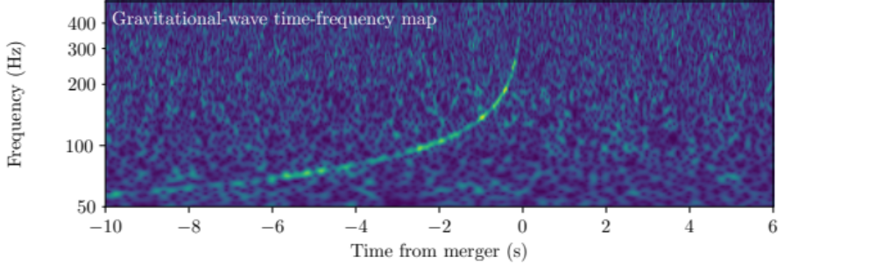
August 17, 2017: LIGO+Fermi
Short GRB
Δt = 1.74 ± 0.05 s

Slide 13
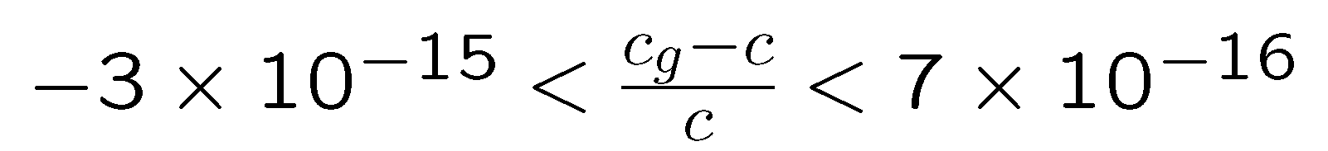
Speed of gravity
Δt_astro ~2 s is very reasonable
  Our prior based on astrophysics of SGRBs was Δt = [0,4] s
  jet with γ ~ 50 is delayed by ~2 s (relative to v=c) at a photospheric radius of ~30 AU
Limits: (1) Let Δt_astro = 0; (2) Let Δt_astro = 10 s:
Future measurements at different distances can improve this
✔

Slide 14
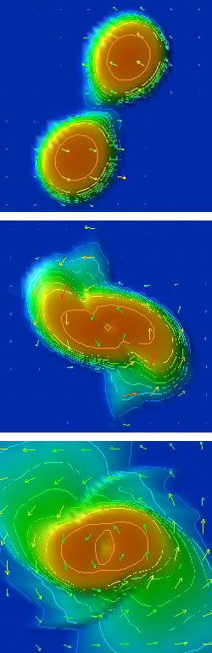
170817: Astrophysics
The “kilonova”
Tidal disruption of the merging neutron stars
  Disruption depends on NS “stiffness” (EOS)
    Subtle effects in GW waveforms
Hypothesis pre-170817:
  Nuclear ejecta bombarded by neutrons
    v ~ 0.1-0.3 c
  Creation of heavy nuclei (r-process)
  Unstable isotopes → decay → glowing object ”kilonova”
  Similar to Supernova afterglow
Shibata
Shibata

Slide 15
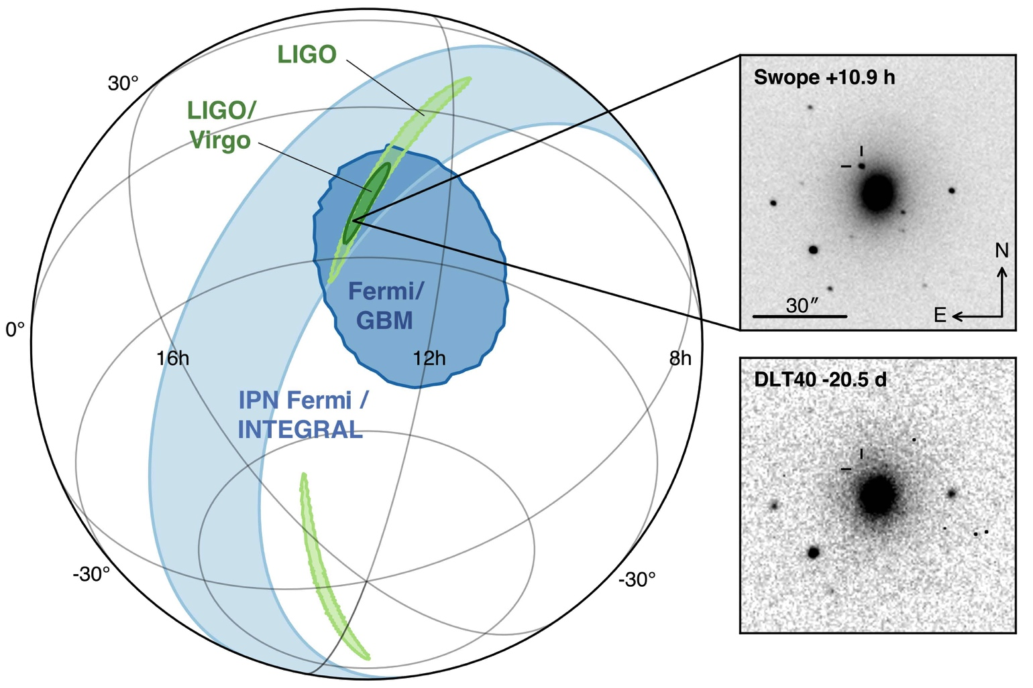
GW localization allows ID of afterglow (kilonova)
ApJL 848 L12
NGC 4993
43 ± 3 Mpc
offset of 2 kpc – typical of kicks
“Multimessenger Astronomy”

Slide 16
and the astronomy world tuned in

Slide 17
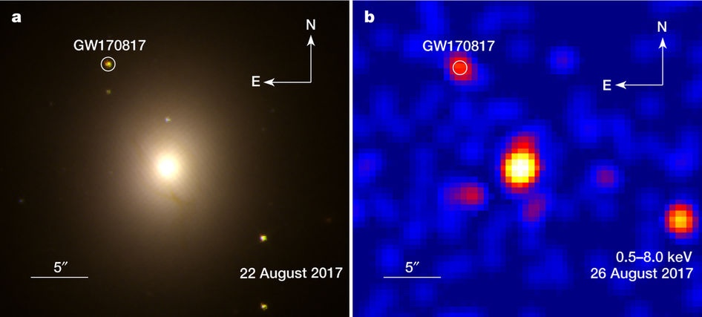
e.g. optical/IR and x-rays
Hubble
Chandra
Troja, et al, Nature 2017

Slide 18
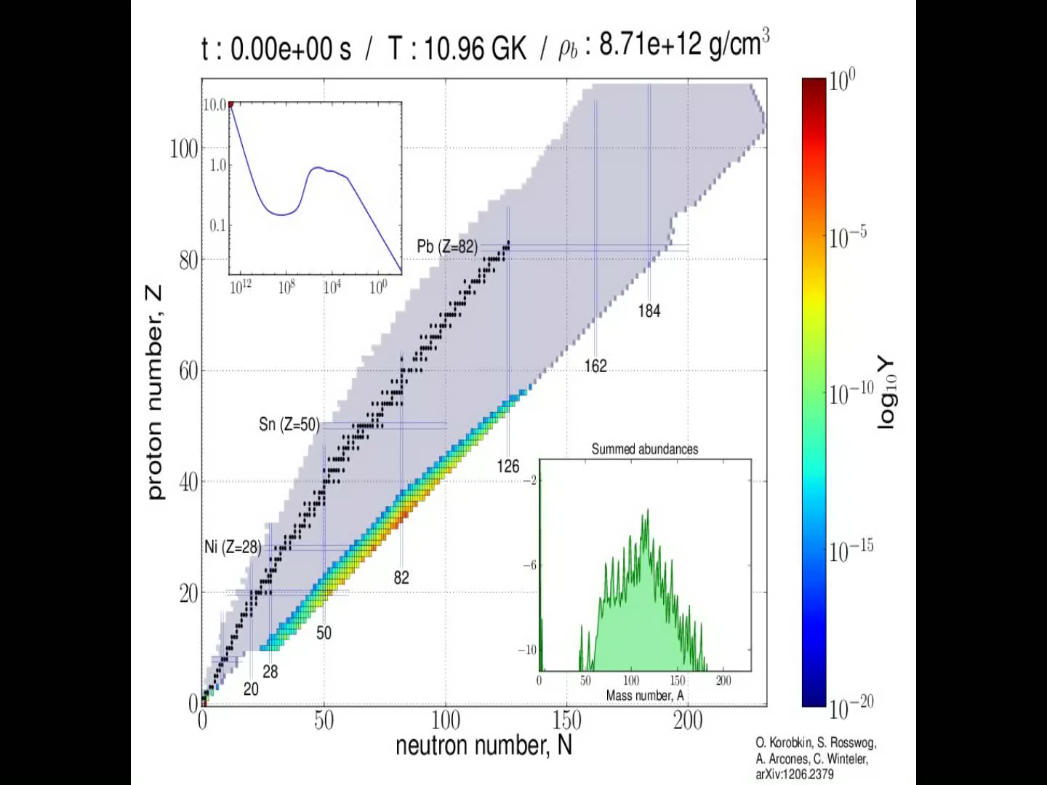
Kilonova simulation

Slide 19
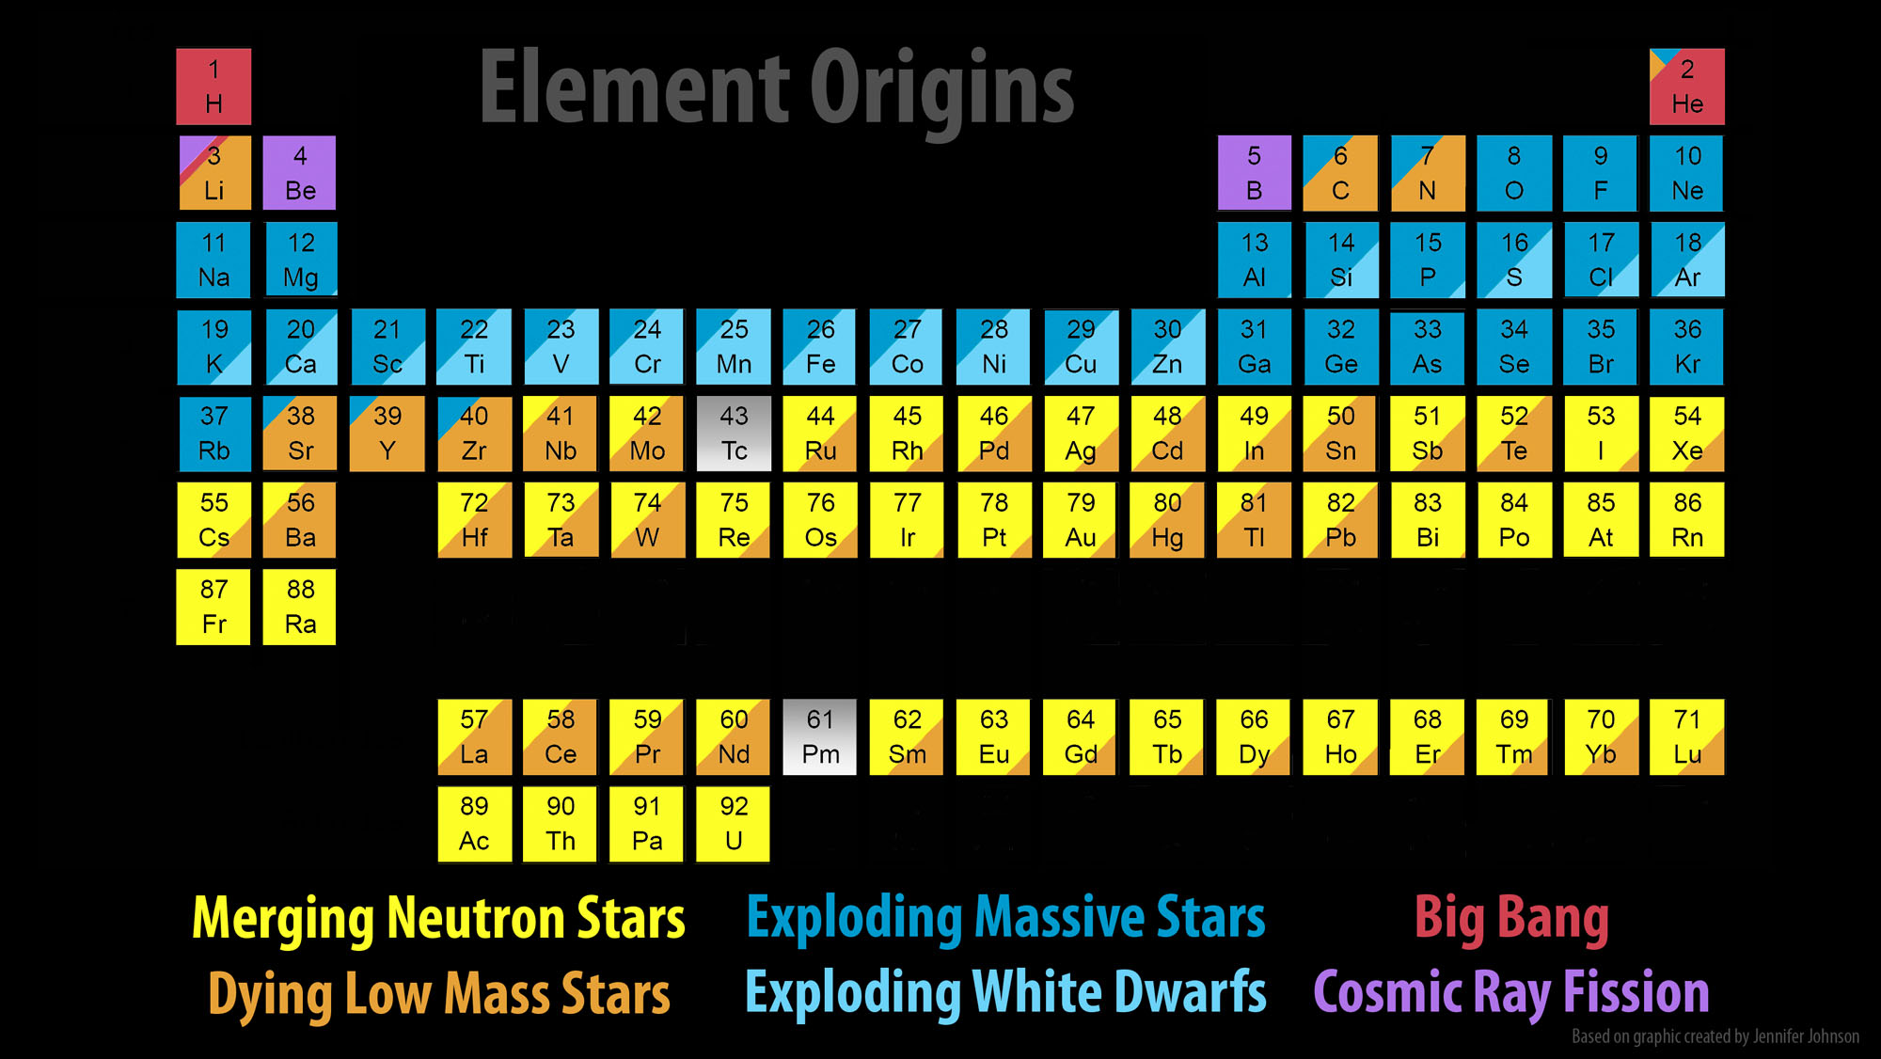
Origins of elements: Major Update

Slide 20
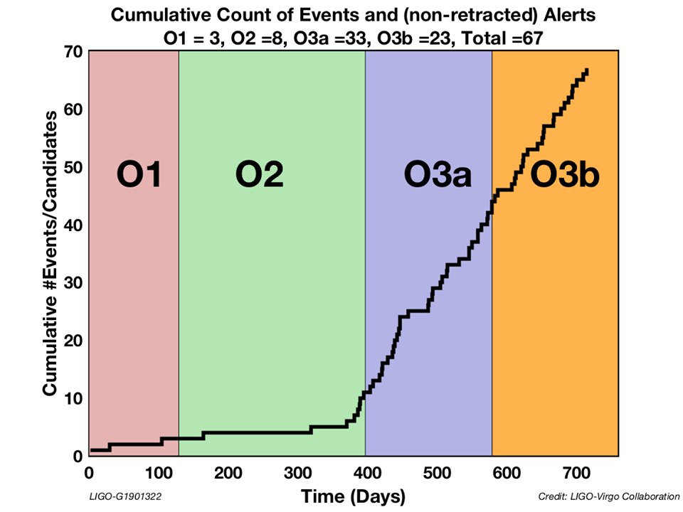
O3 ended March 30, 2020 (a month early)

Slide 21
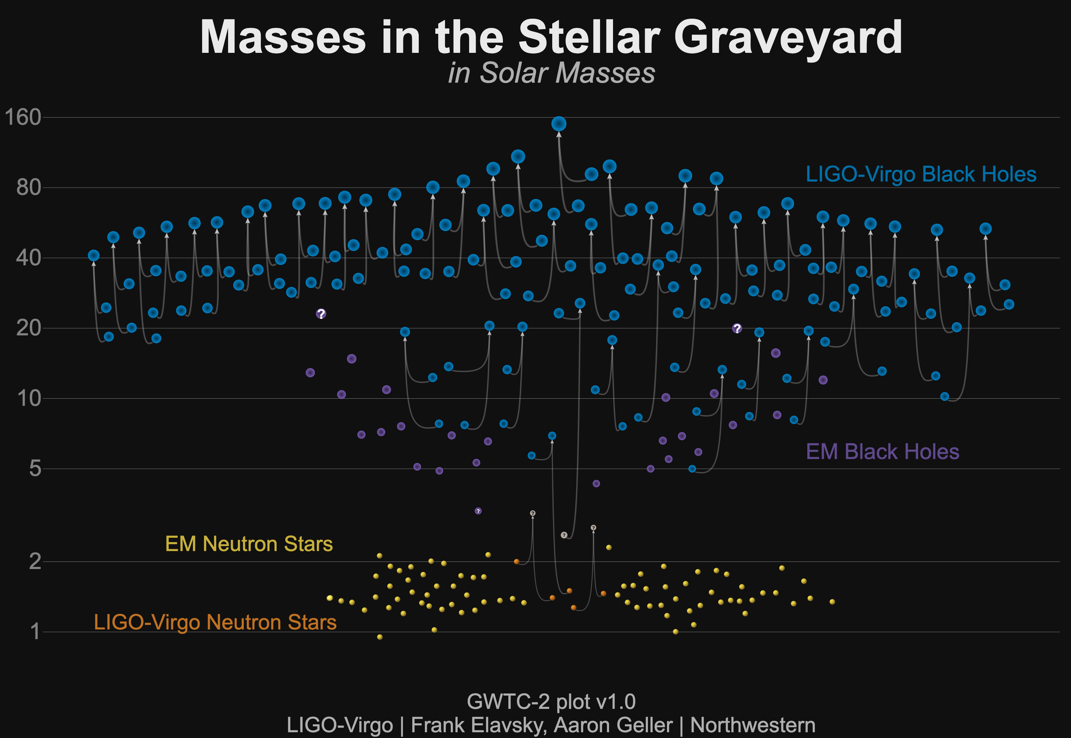
Events published through run O3a

Slide 22
What do we do with these events?
Black Holes
Neutron Stars
What is the origin of these systems?
  Normal stellar evolution of massive stars?
  Pop III ?
  Clusters?
  Primordial??
Spins
Mass gap?
Our sole probe of matter at super-nuclear densities
Understanding the synthesis of heavy elements from merger remnants
Using them as tracers to understand the evolution of the universe (H0)
  Resolving H0 discrepancy: ‘Crisis in Cosmology’
  Is dark energy real?
How about a NS-BH merger!?

Slide 23
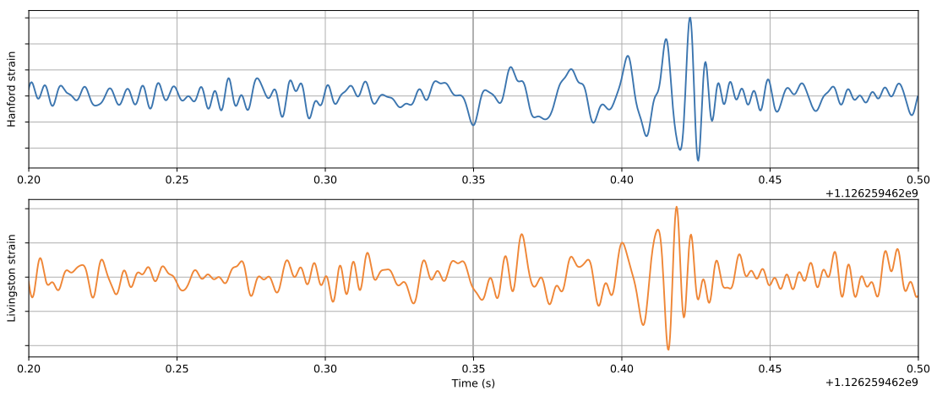
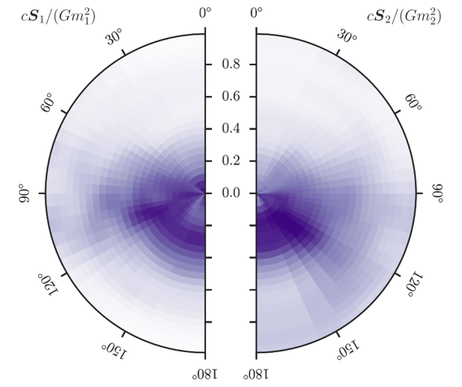
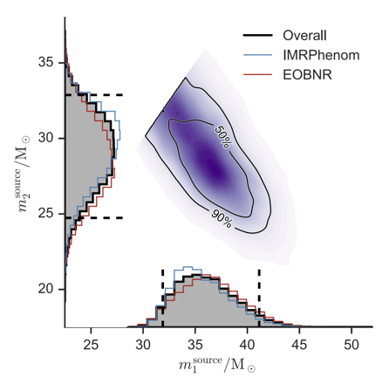
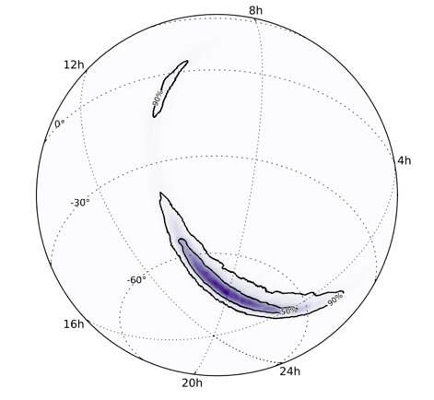
Parameter
Estimation
Masses
Location
Spins
  (e.g., GW150914)

Slide 24
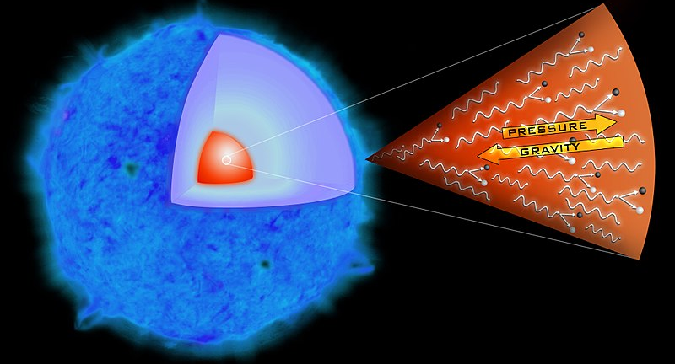
Black hole masses
Supermassive – rapid accretion in early star forming era
  not observable by LIGO
  Galactic centers
  Milky Way: 3×10⁶ M
‘Stellar mass’
  Presumed to be products of stellar evolution
  M > 1.4 M
  If M< M then primordial (!)
  M >30M ‘difficult’ but observed by LIGO (low metallicity)
  50 < M < 130M not supposed to exist (pair instability)
  M > 130M possible; not yet observed

Slide 25
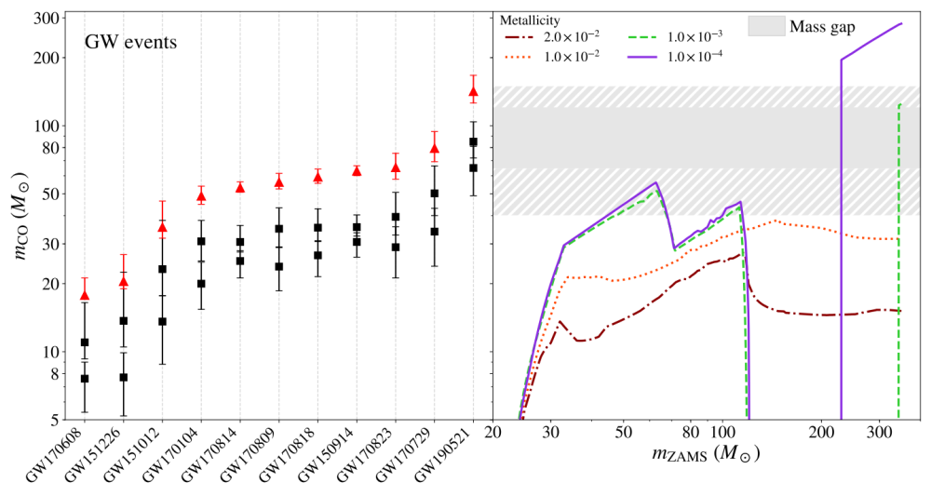
LIGO BHs and the ‘mass gap’

Slide 26

The ‘mass gap’ undone ? Sequential mergers?

Slide 27
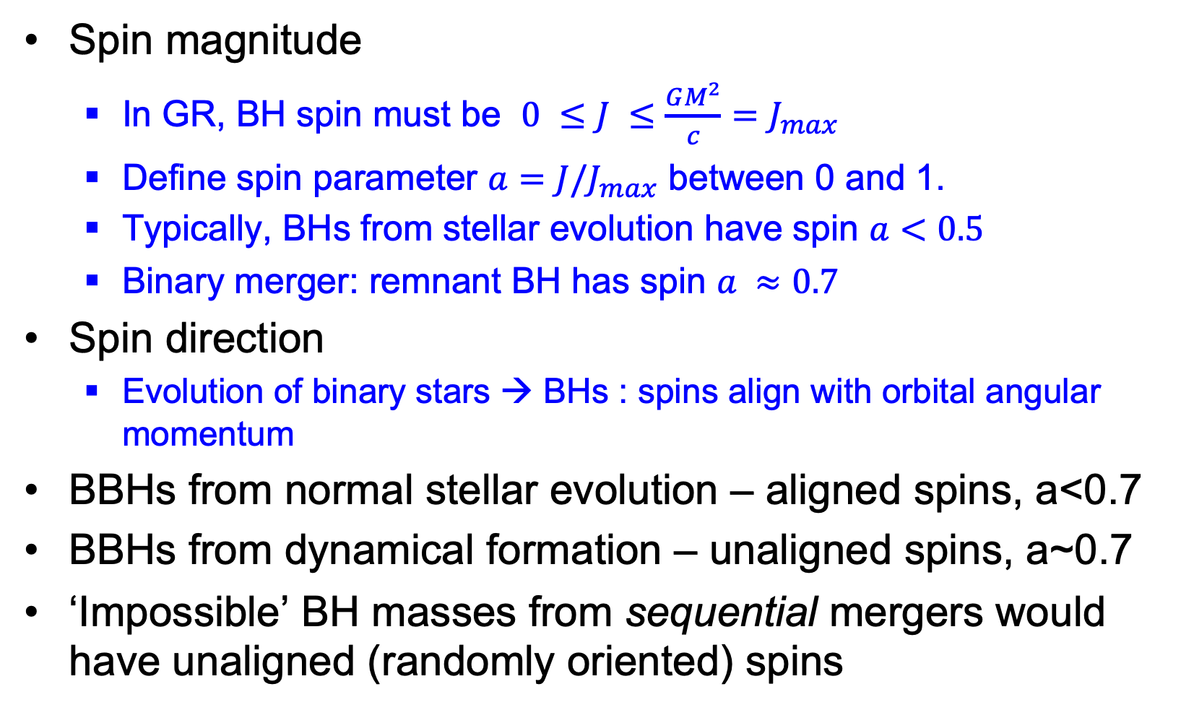
Black hole spins
Spin magnitude
  In GR, BH spin must be $0 ≤J ≤\frac{GM^{2}}{c}=J_{max}$
  Define spin parameter $a=J/J_{max}$ between 0 and 1.
  Typically, BHs from stellar evolution have spin $a<0.5$
  Binary merger: remnant BH has spin $a ≈0.7$
Spin direction
  Evolution of binary stars → BHs : spins align with orbital angular momentum
BBHs from normal stellar evolution – aligned spins, a<0.7
BBHs from dynamical formation – unaligned spins, a~0.7
‘Impossible’ BH masses from sequential mergers would have unaligned (randomly oriented) spins

Slide 28
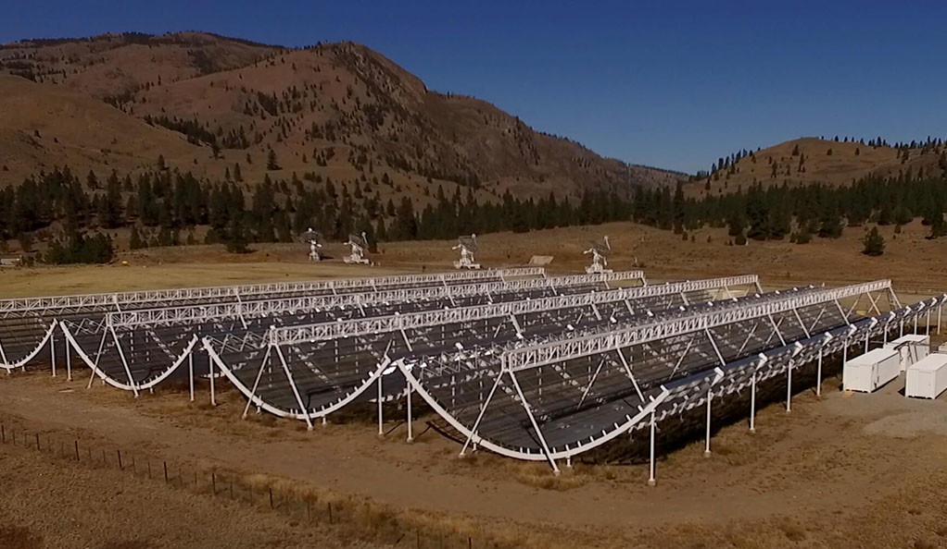
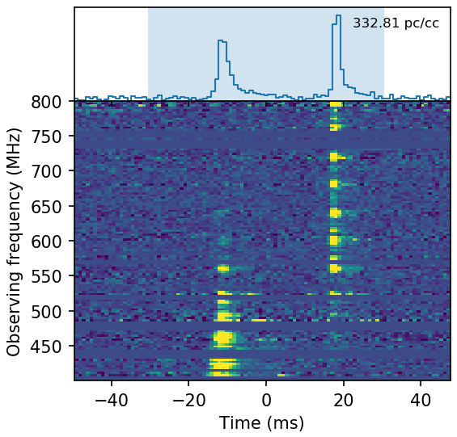
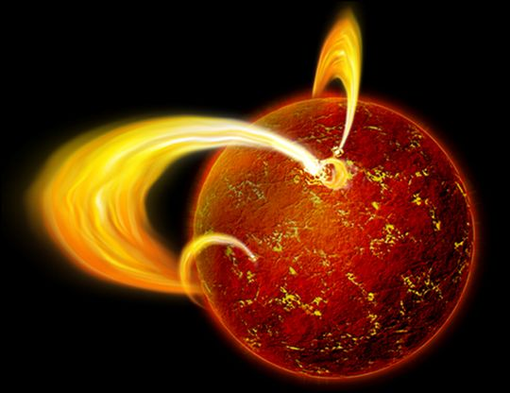
Magnetars and FRBs
Fast Radio Bursts are a cosmic mystery
New FRB detector CHIME has revolutionized the field
April 28, 2020: galactic FRB (first!) associated with known magnetar SGR1935+2154
UO students Kara Merfeld and Matthew Ball on it
CHIME

Slide 29
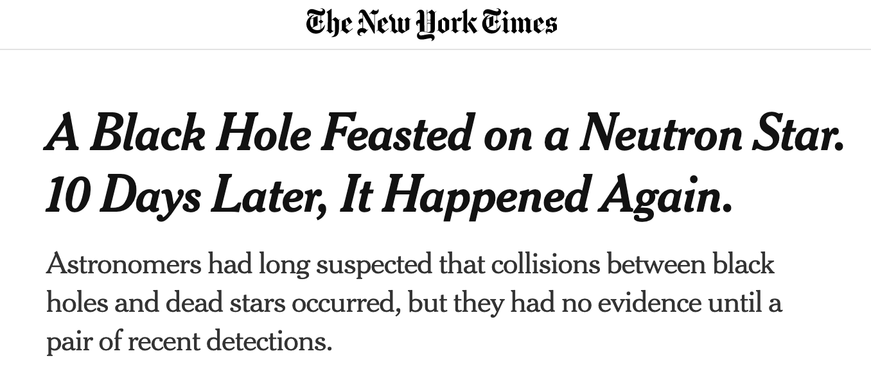
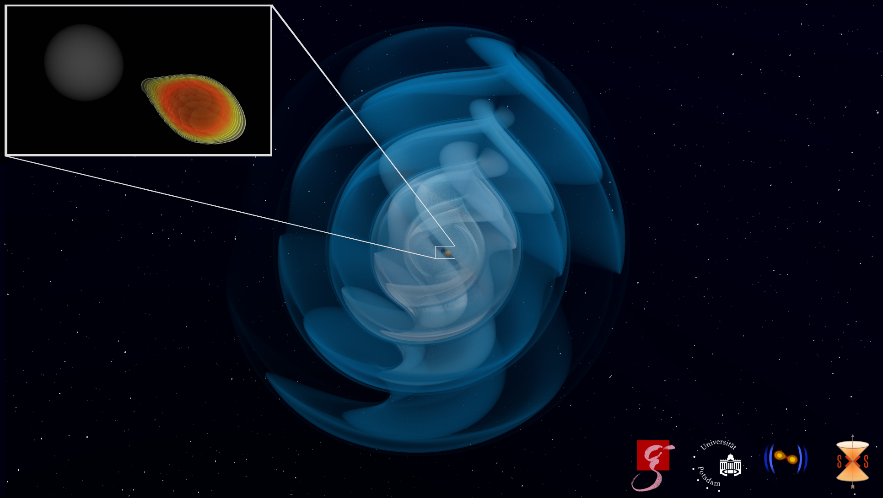
‘What about a BH-NS merger?”
June 29, 2021
How about 2?!
How to distinguish between a BH-BH merger and a NS-BH merger?
The masses, as measured using GWs
A gamma ray burst (GRB), although it is beamed and may be missed
An afterglow or kilonova, although they cannot be observed if too distant

Slide 30
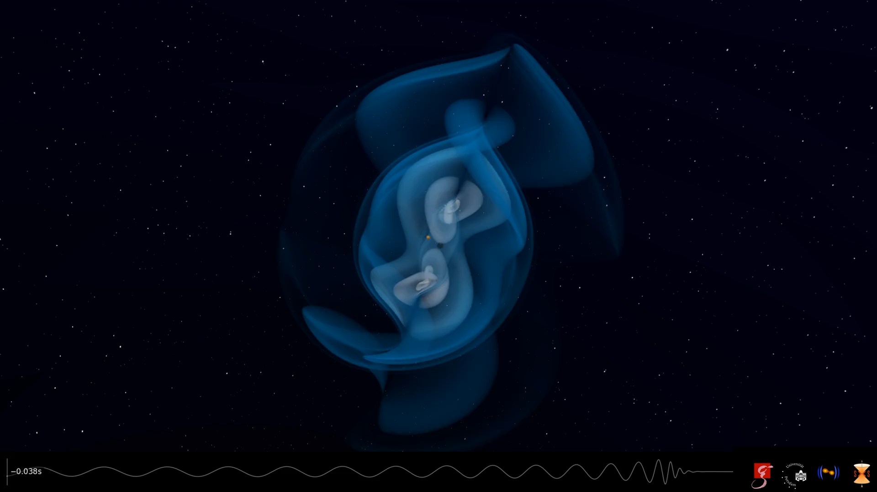
an NS-BH merger simulation

Slide 31
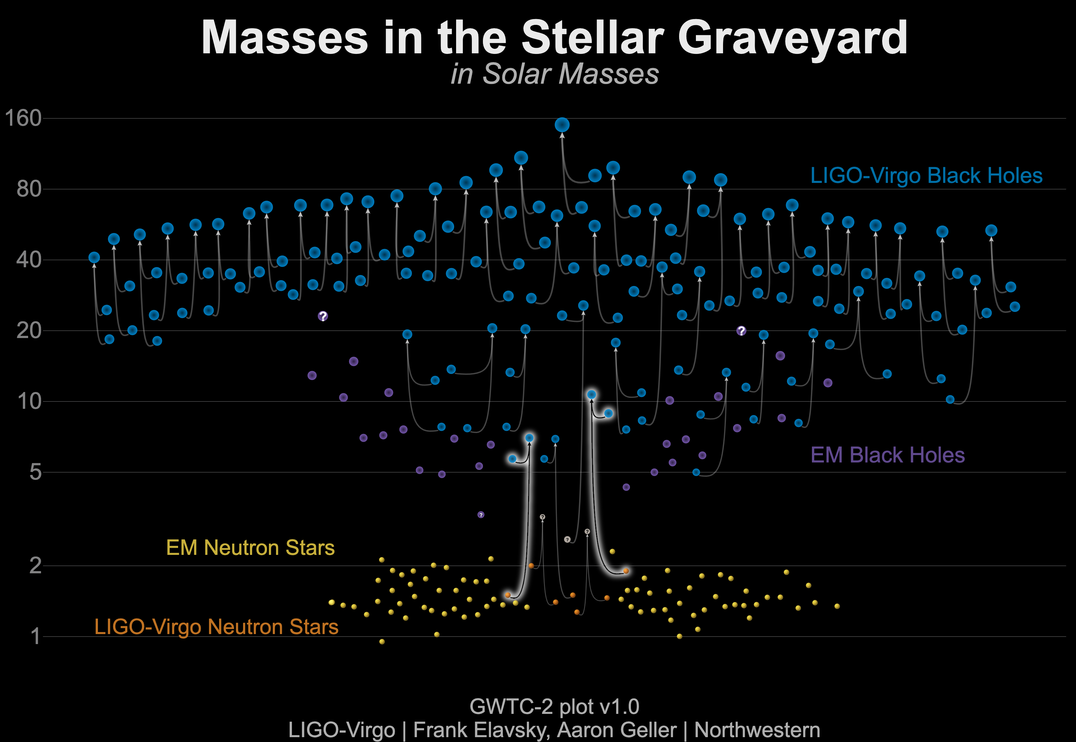
6/29/2021 update!

Slide 32
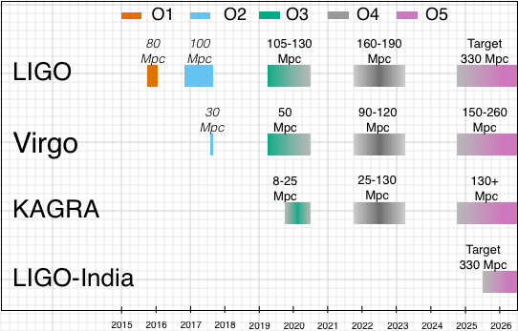
The near future
In O1-O2: about 1 GW event per month
In O3: about 1 GW event per week
  Routine quantum squeezing
O4 (starting ~summer 2022): about 1 event per day
  Frequency-dependent squeezing

Slide 33
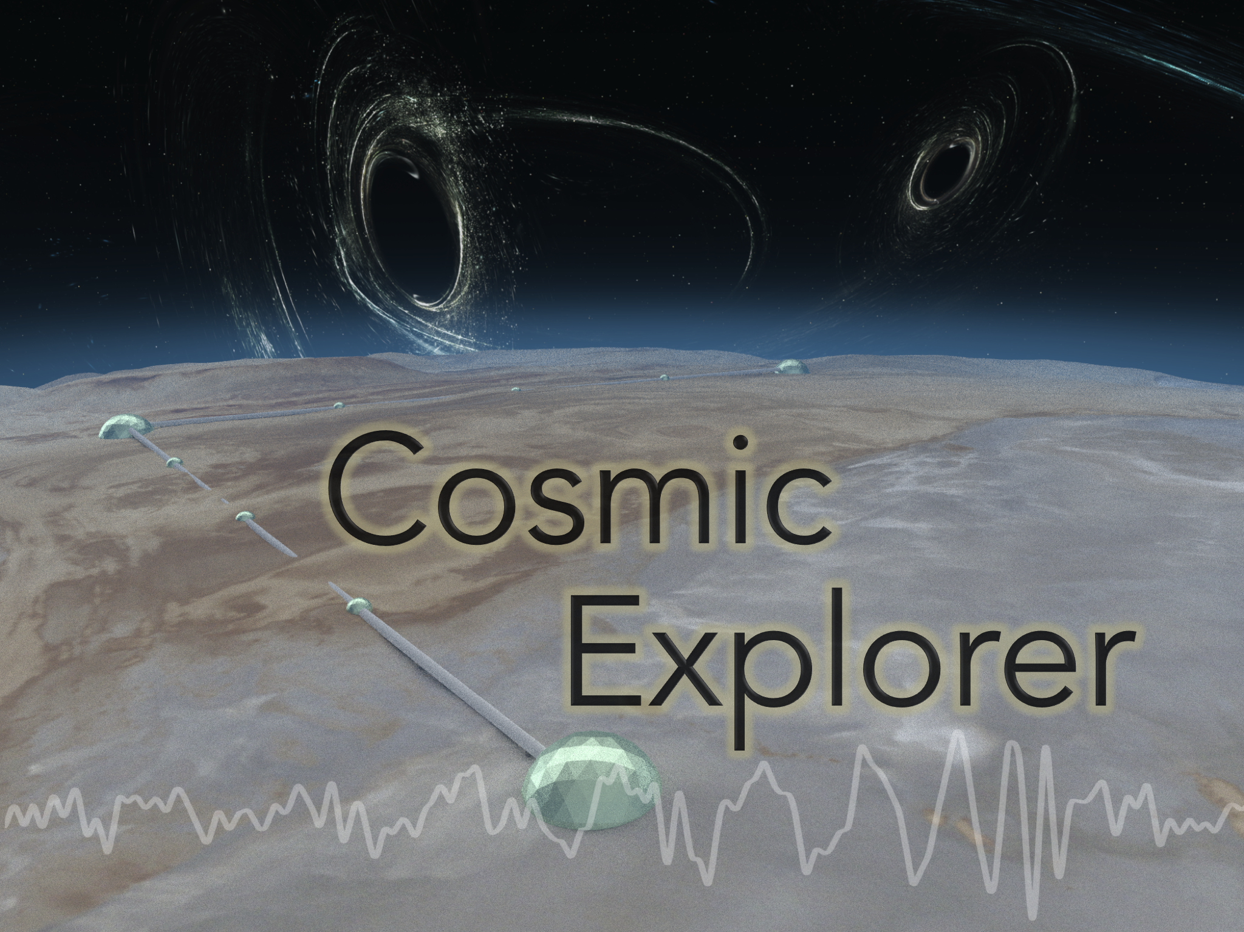
The farther future (2030s)

Slide 34
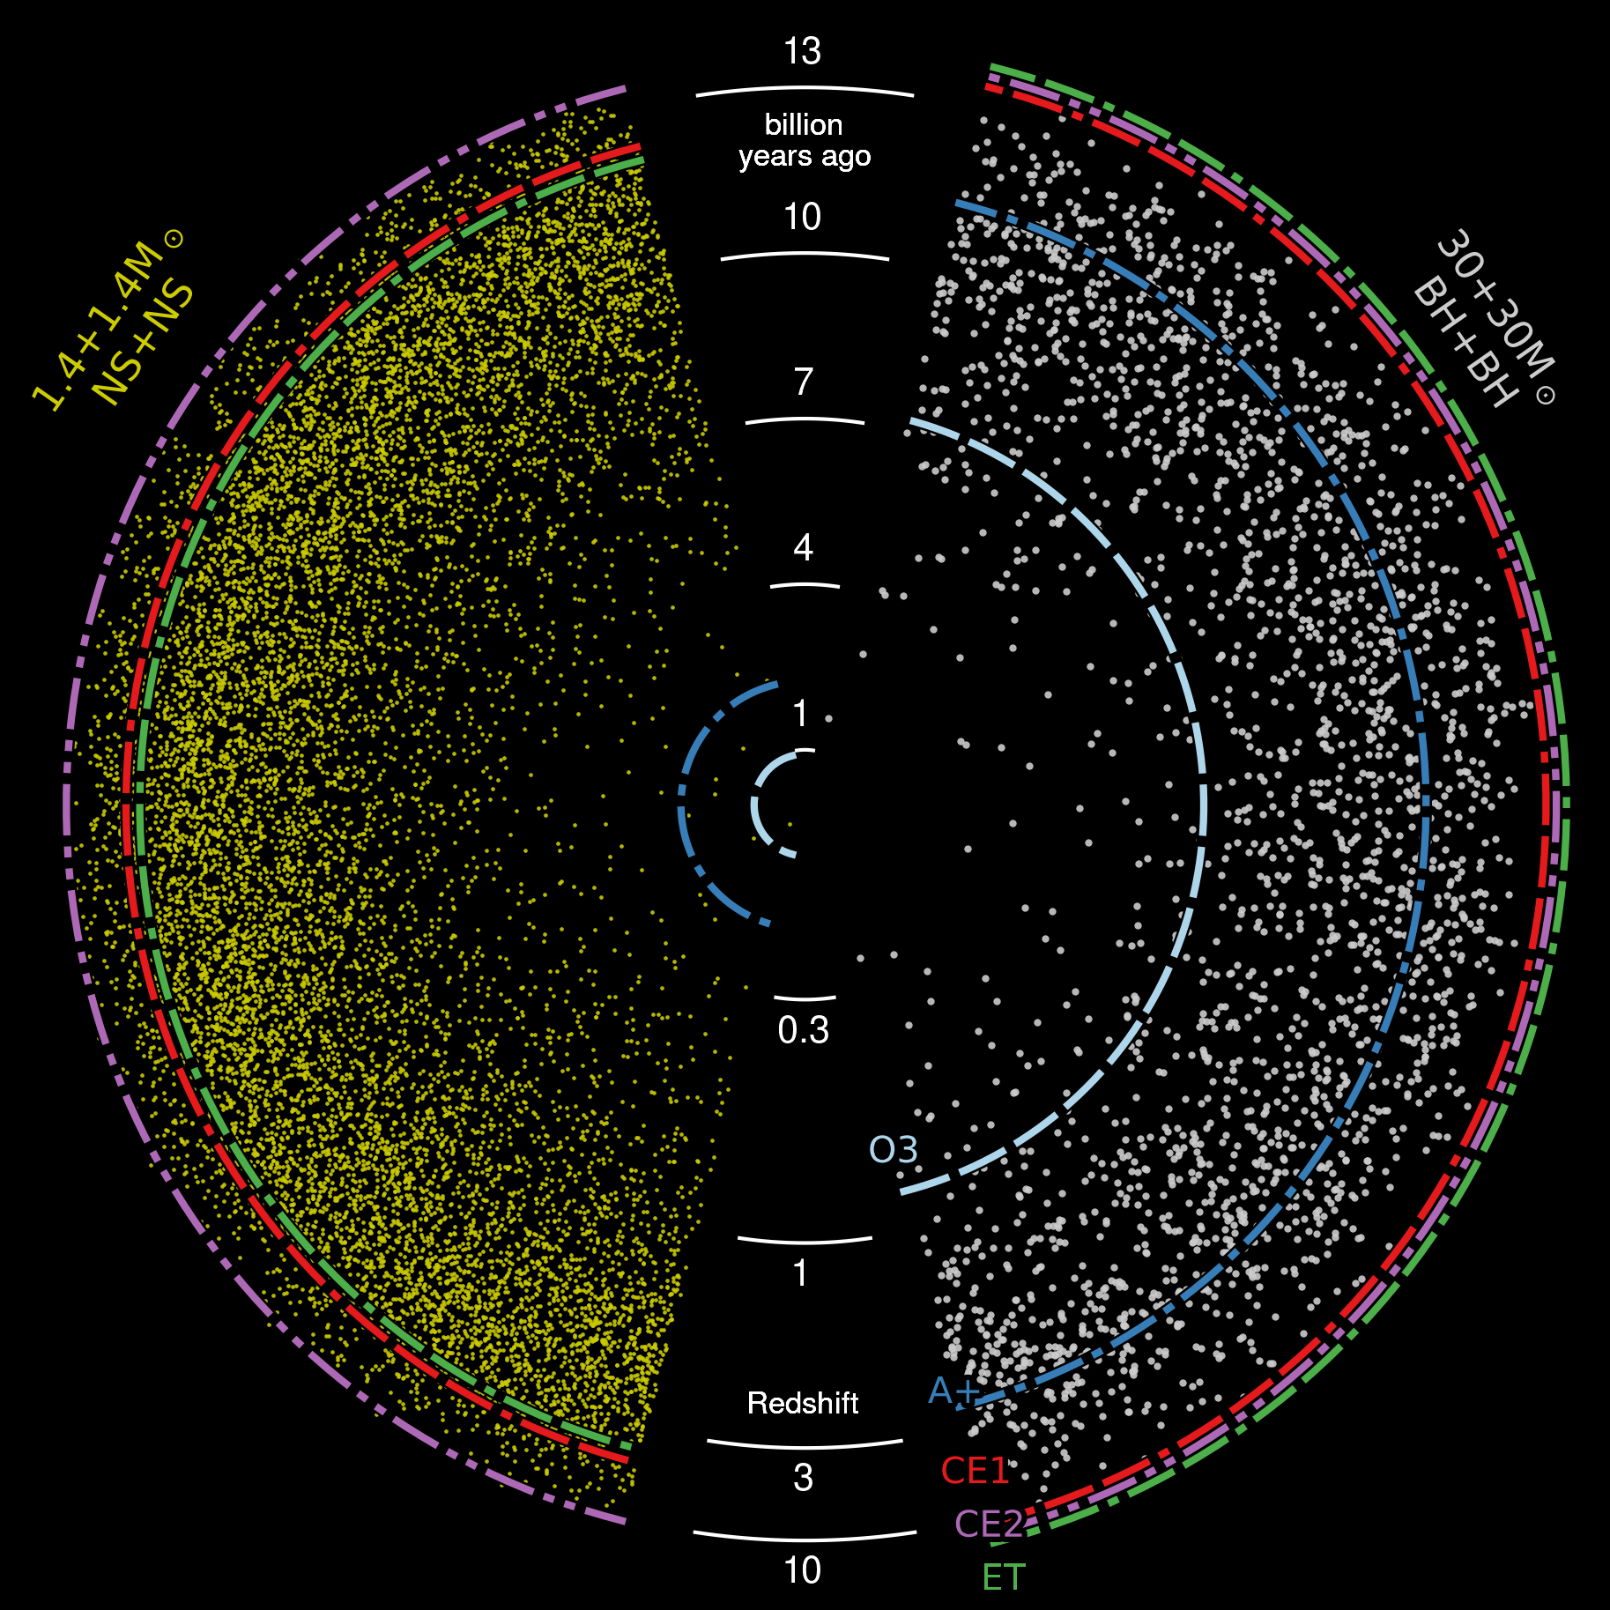
Why CE ?
Also:
10% of BBH will have SNR>1000
1% SNR~10,000

Slide 35
Pre-meeting questions
Surface area of a black hole?
  The Hawking conjecture
  Tested with BBH merger
  Quantum effects
The 40kg mirrors of LIGO as quantum objects?

Slide 36
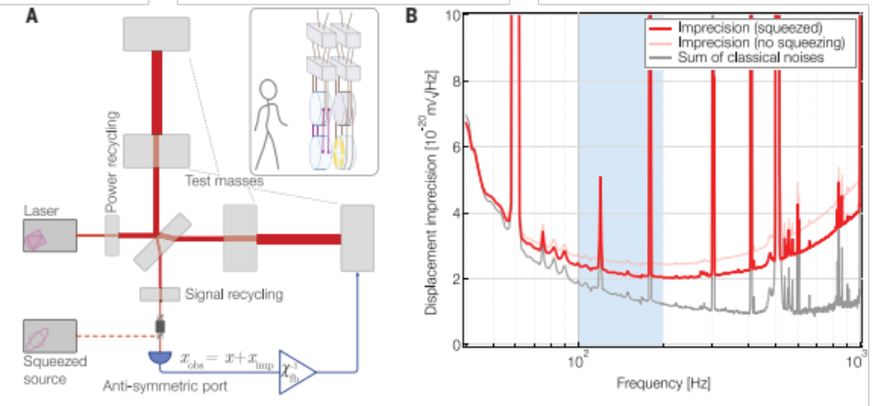
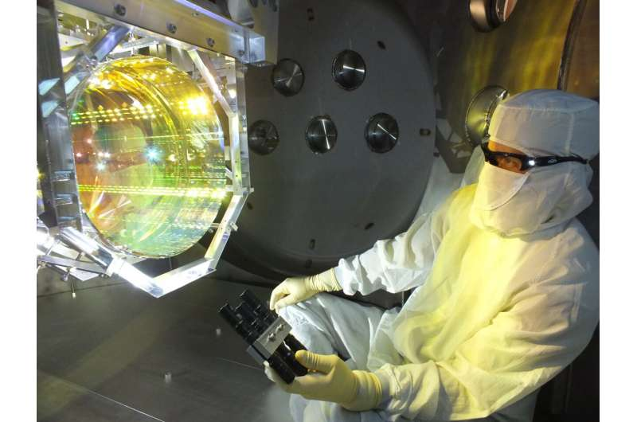


LIGO test masses as quantum objects

Slide 37

UO-LIGO
Ray Frey, Professor
Ben Farr, Assistant Professor
Robert Schofield, Research Professor
Philippe Nguyen, 5th year (DQ, GRB physics, IMBH)
Kara Merfeld, 4th year (DQ, magnetars, FRBs)
Bruce Edelman, 4th year (BBH populations)
JD Merritt, 3rd year (DQ, BBH populations)
Adrian Helmling-Cornell, 3rd year (DQ, cosmic strings)
Matthew Ball, 3rd year (DQ, magnetars)
Gino Carillo, 2nd year (GRB afterglows)
Sangeet Paul – 2nd year (BBH populations)
Ben Mannix – 1st year (?)
Jaxsen Godfrey – 1st year (?)

Slide 38

UO-LIGO June 28, 2021

