Slide 1
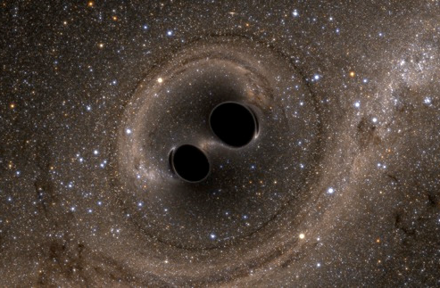
LIGO and gravitational-wave Astrophysics at UO

Slide 2
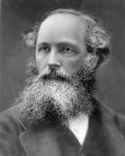
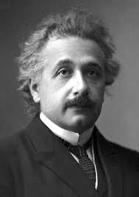
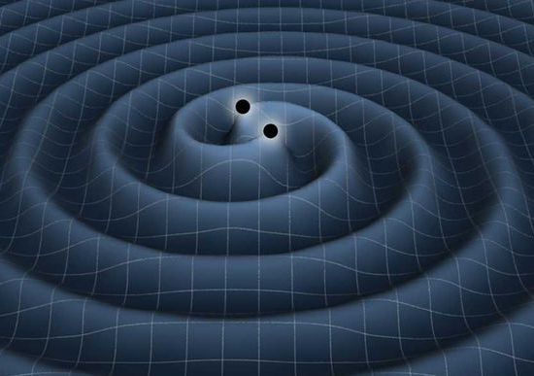
Gravitational Waves (GWs)
The waves of the electromagnetic force are realized as (electric and magnetic) fields which propagate through space and time. [Maxwell, 1865]
General Relativity describes gravity in terms of a spacetime which is deformable. [Einstein, 1915]
GWs are oscillations of that spacetime. [Einstein, 1916]
“ripples in spacetime”

Slide 3
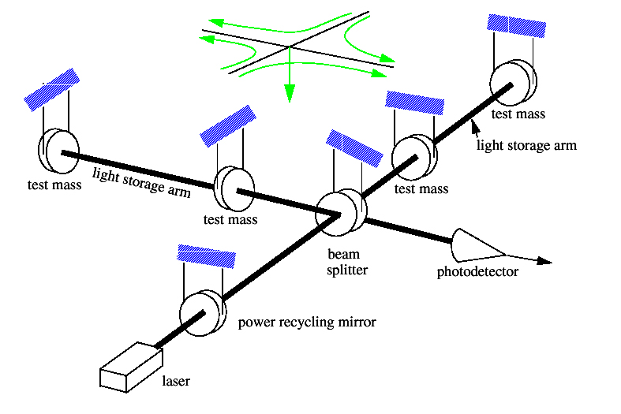
Gravitational waves and LIGO: short version
As detected by LIGO:
Binary black hole system
GW ripples manifest as a space strain h, where h = ΔL / L
Realistic sources: h ~ 10⁻²³ ⇒ ΔL~ 10⁻¹⁹ m (Yikes !)

Slide 4
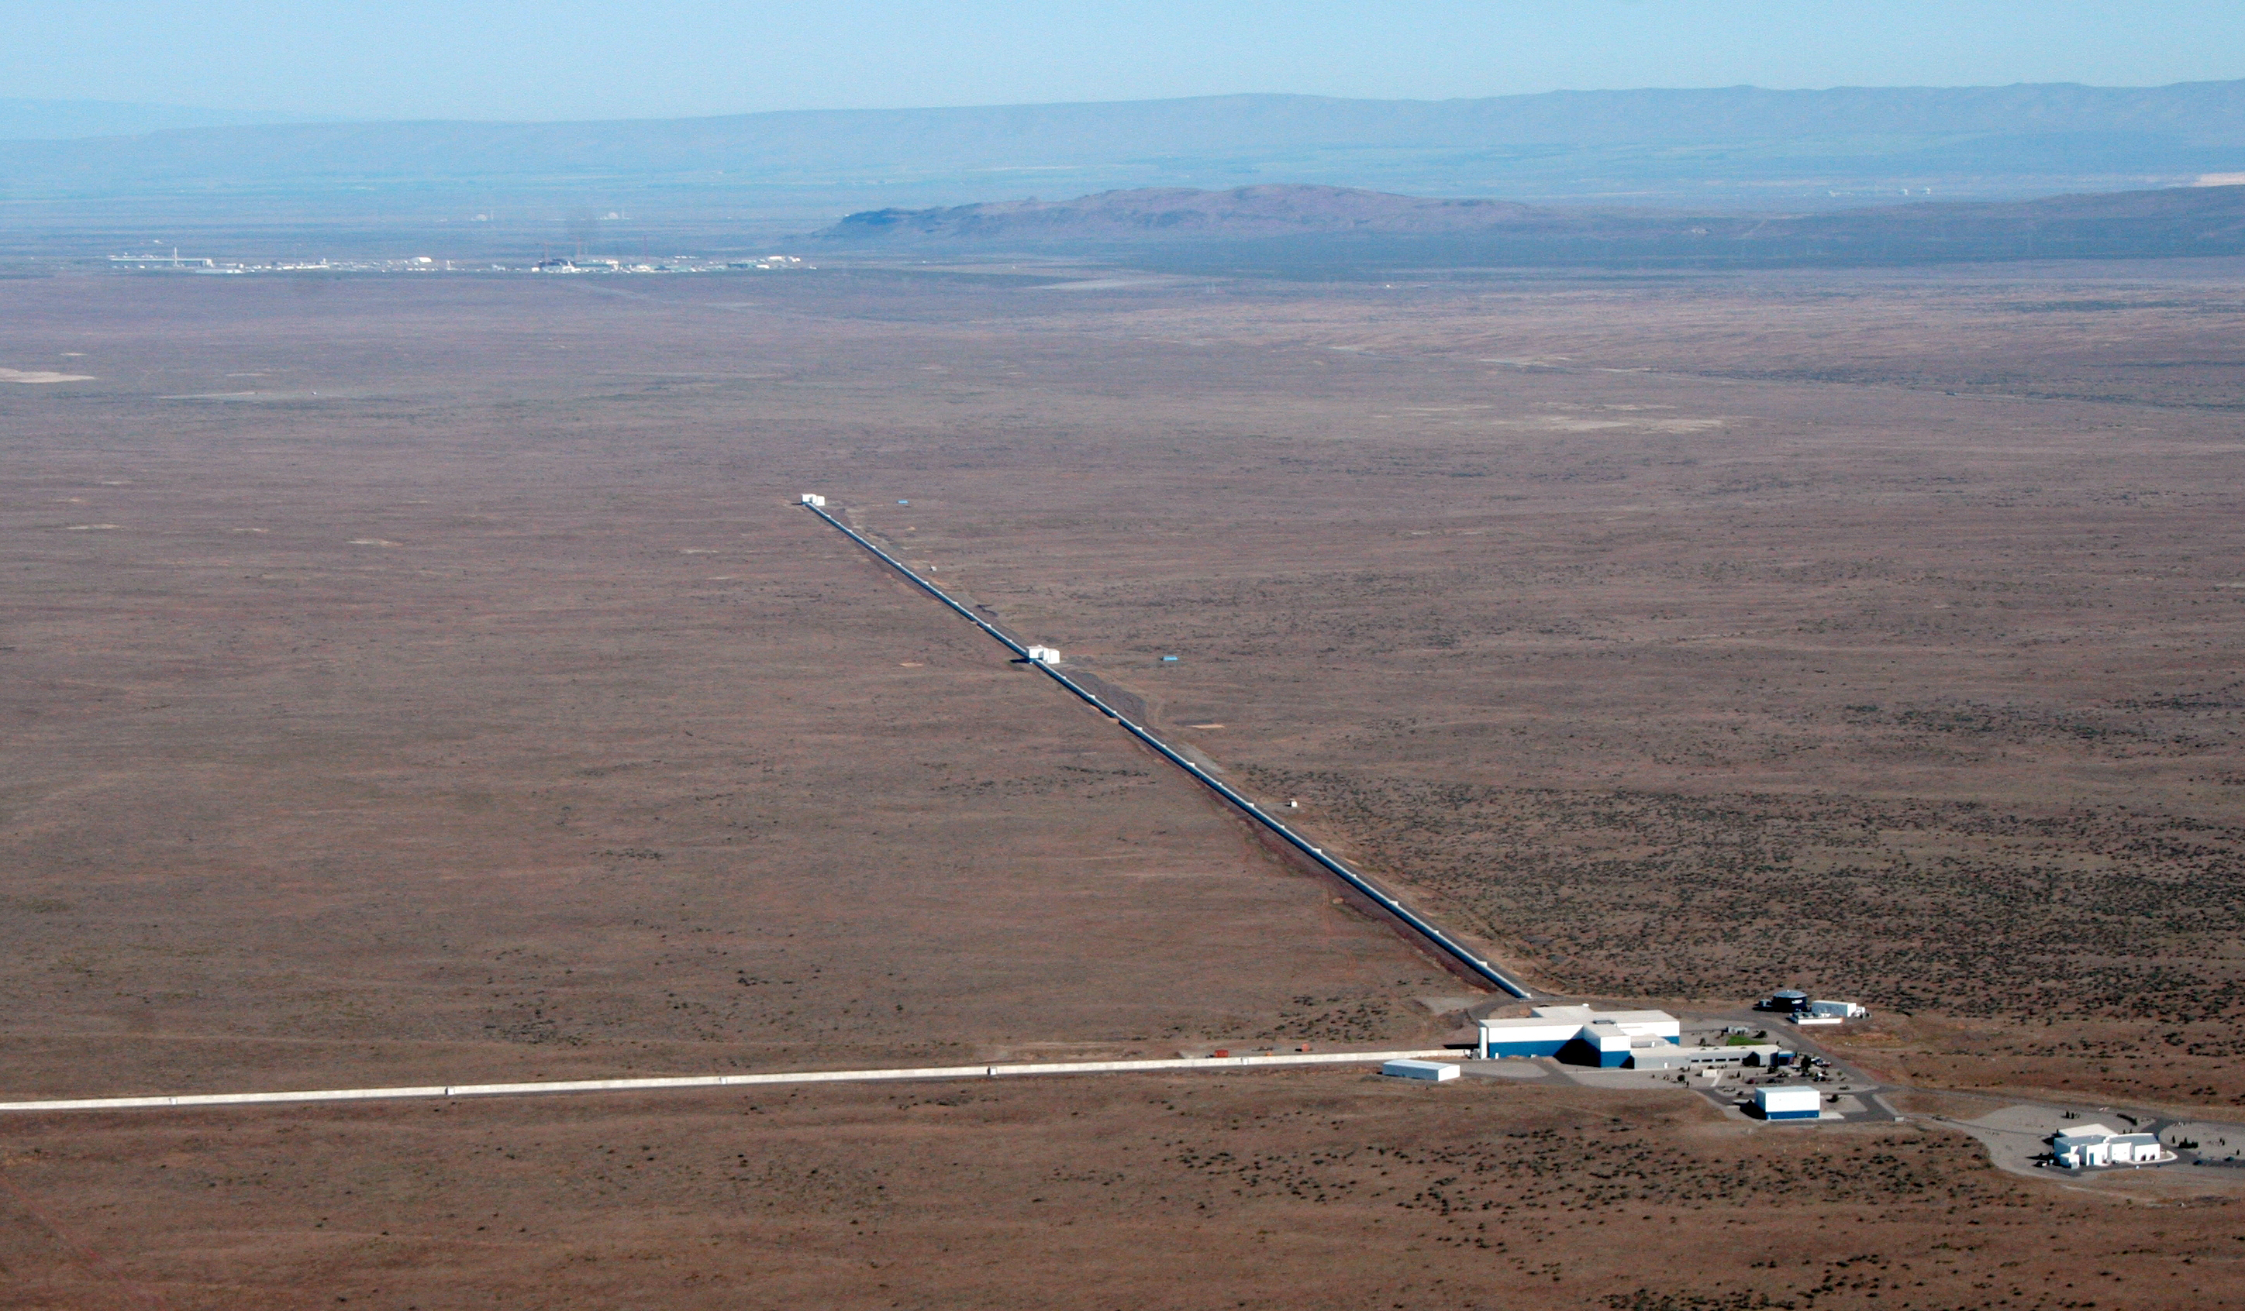
LIGO Hanford Observatory

Slide 5
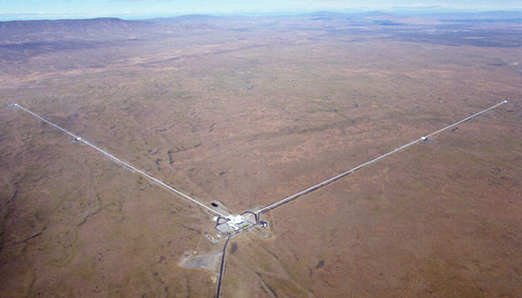
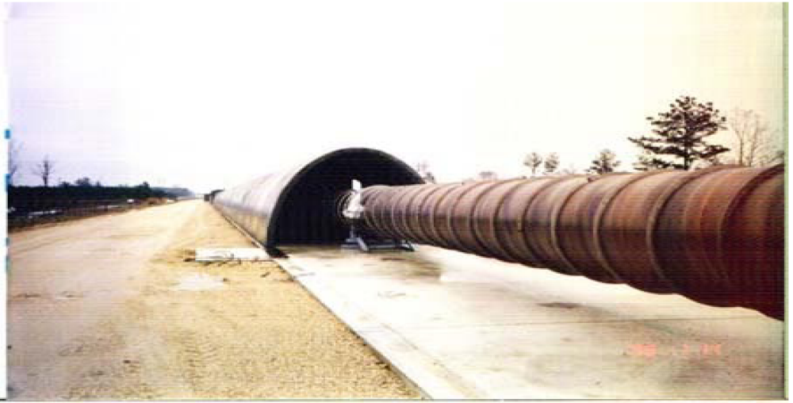
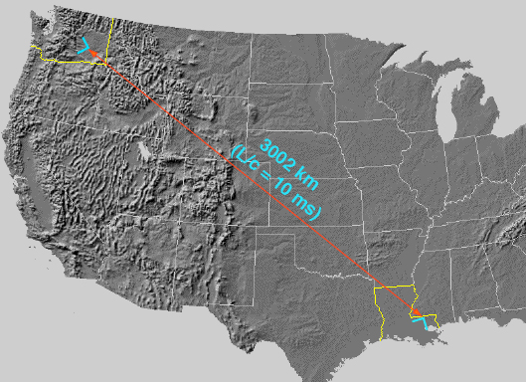
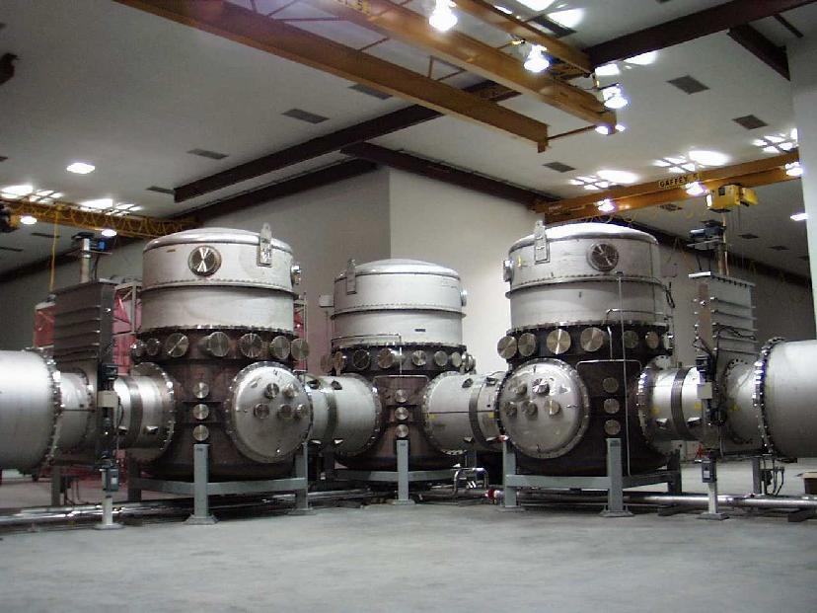
observatories

Slide 6
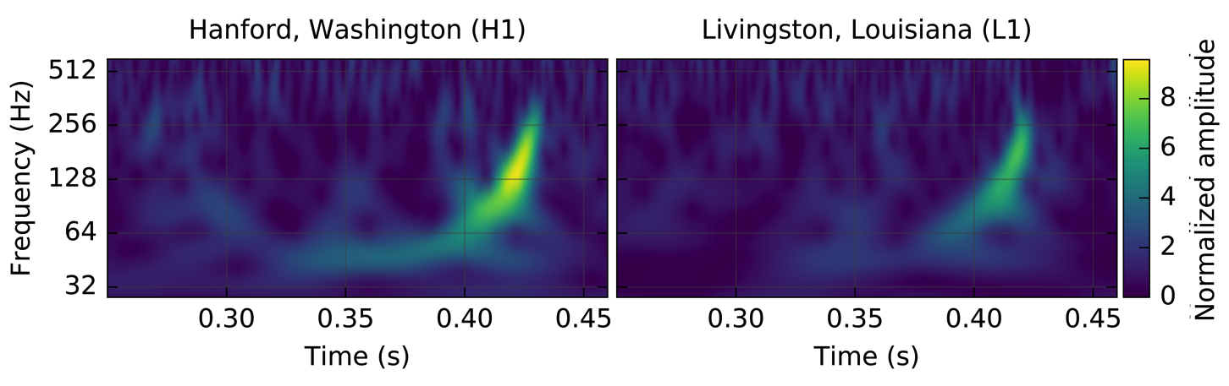
September 14, 2015, 2:51 AM Pacific
Boom !
GW150914
First observation of GWs
First direct observation of black holes

Slide 7
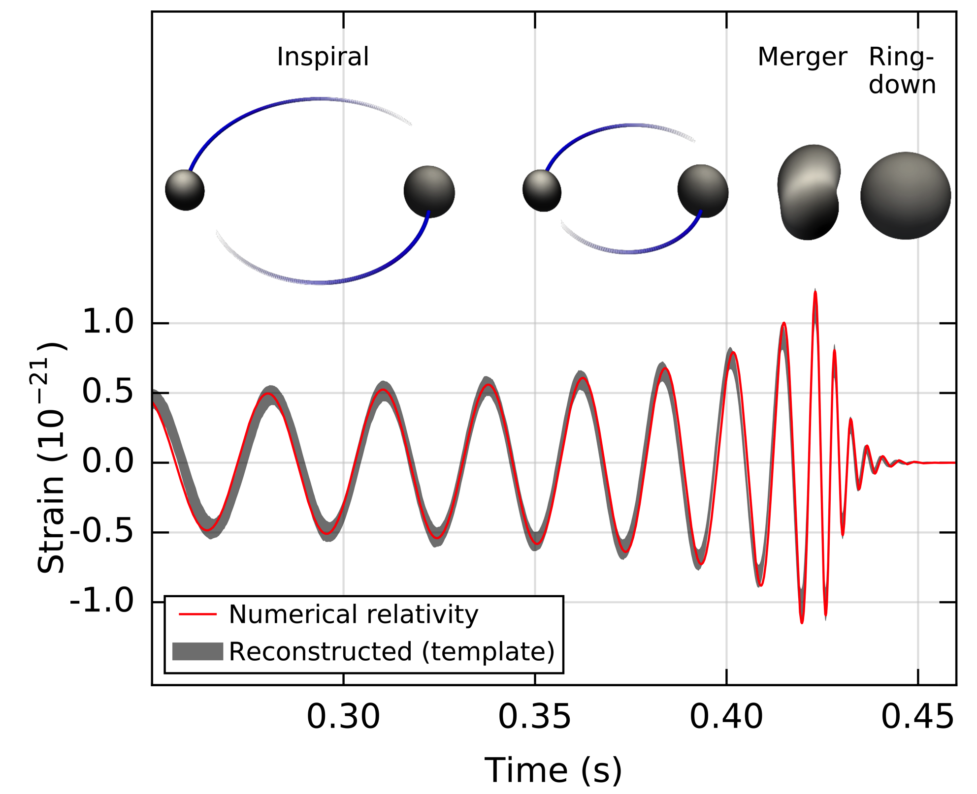
Binary black hole inspiral, merger, ringdown

Slide 8


GW Discovery Accolades

Slide 9
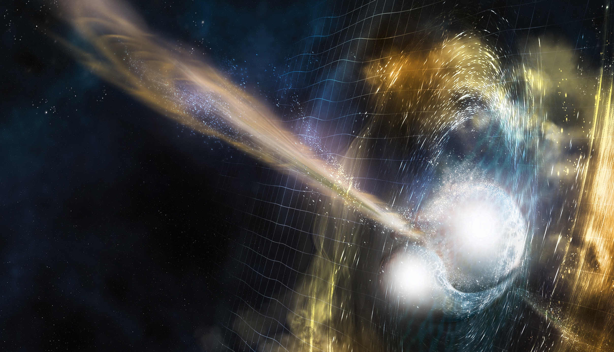
Boom II:
Binary neutron-star merger August 17, 2017

Slide 10
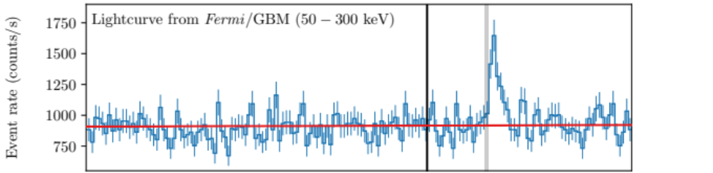
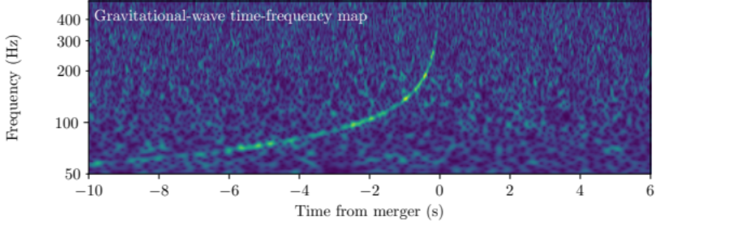
August 17, 2017: LIGO+Fermi
Short GRB
Δt = 1.74 ± 0.05 s

Slide 11
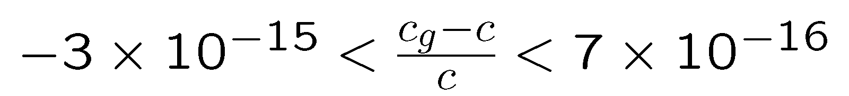
Speed of gravity
Δt_astro ~2 s is very reasonable
  Our prior based on astrophysics of SGRBs was Δt = [0,4] s
  jet with γ ~ 50 is delayed by ~2 s (relative to v=c) at a photospheric radius of ~30 AU
Limits: (1) Let Δt_astro = 0; (2) Let Δt_astro = 10 s:
Future measurements at different distances can improve this
✔

Slide 12
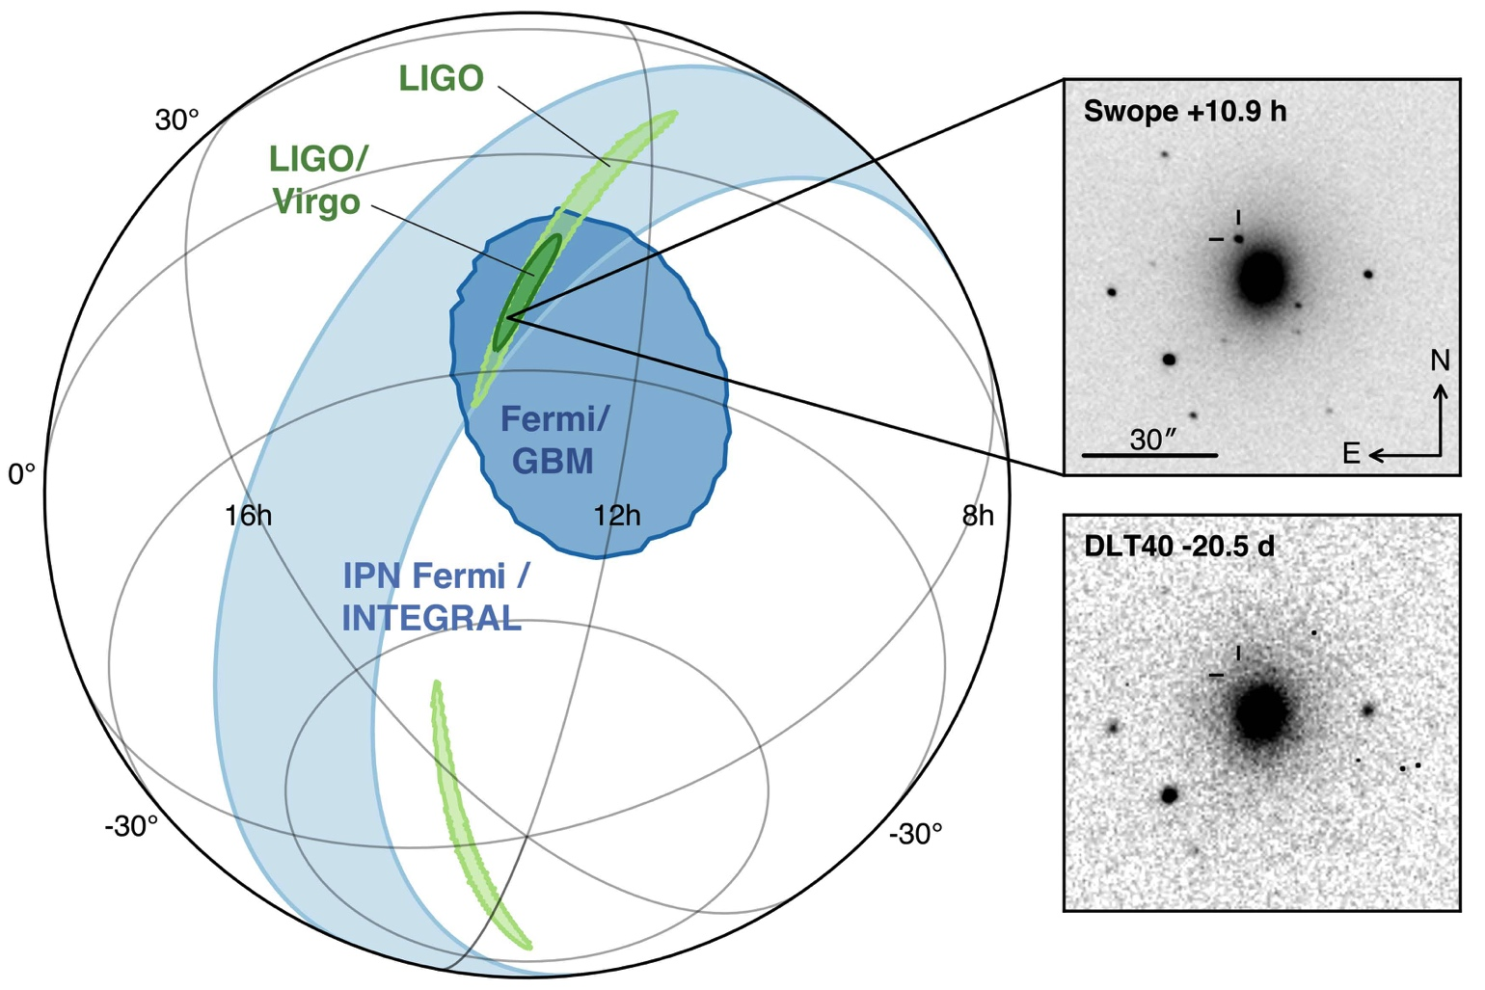
GW localization allows ID of afterglow (kilonova)
ApJL 848 L12
NGC 4993
43 ± 3 Mpc
offset of 2 kpc – typical of kicks
“Multimessenger Astronomy”

Slide 13

Merger, gamma-ray burst, afterglow (“kilonova”)

Slide 14
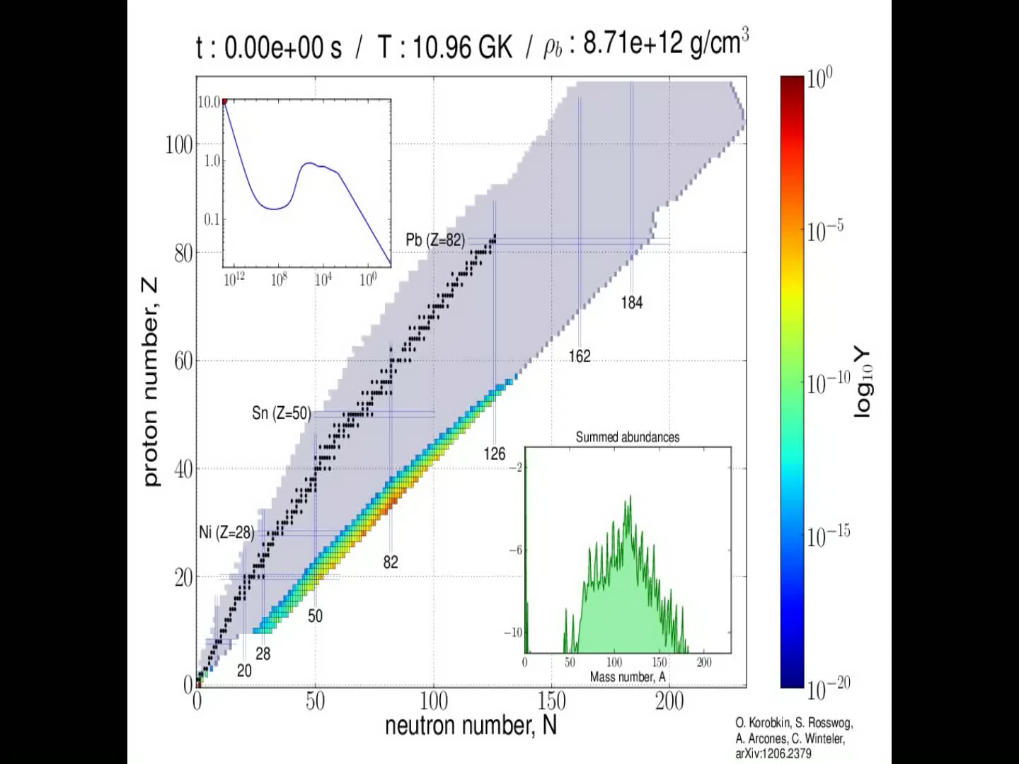
Kilonova simulation

Slide 15
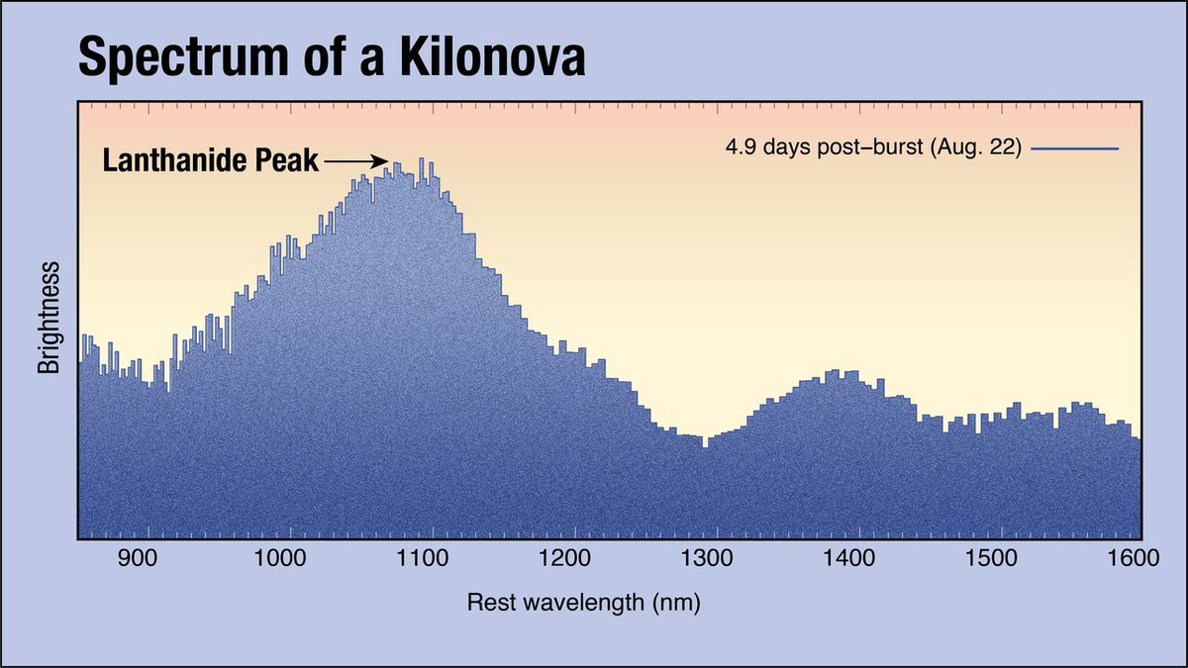
Observed afterglow (“kilonova”) spectrum

Slide 16
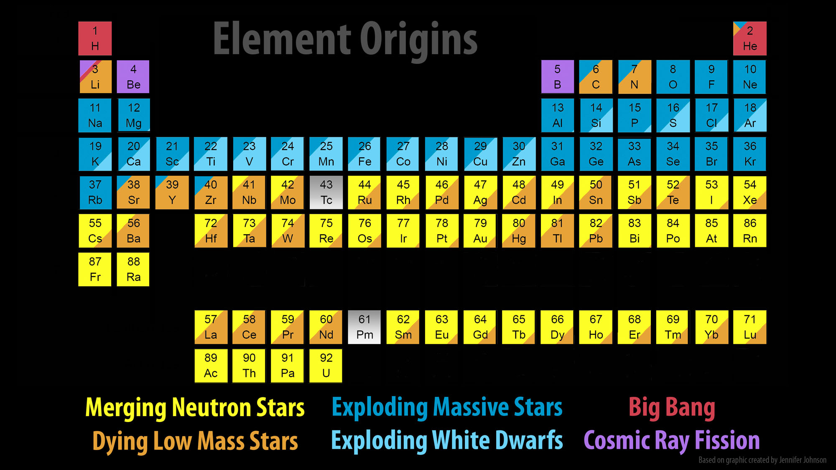
Origins of elements: Major Update

Slide 17
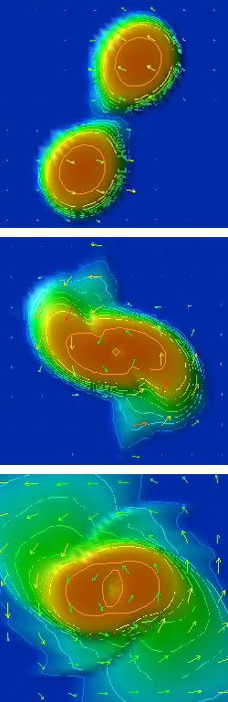
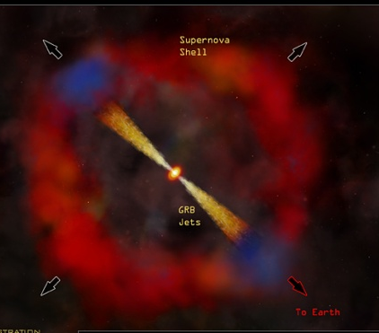
NS-NS or NS-BH mergers, NS equation of state,
EM afterglows (kilonova), Gamma-ray Bursts
Shibata
GW waveform ➔ stiffness of NS (EOS)
GRB astrophysics
Measure distance (GW) and redshift (EM)
independent Hubble plot
➔ accelerating universe
Shibata

Slide 18
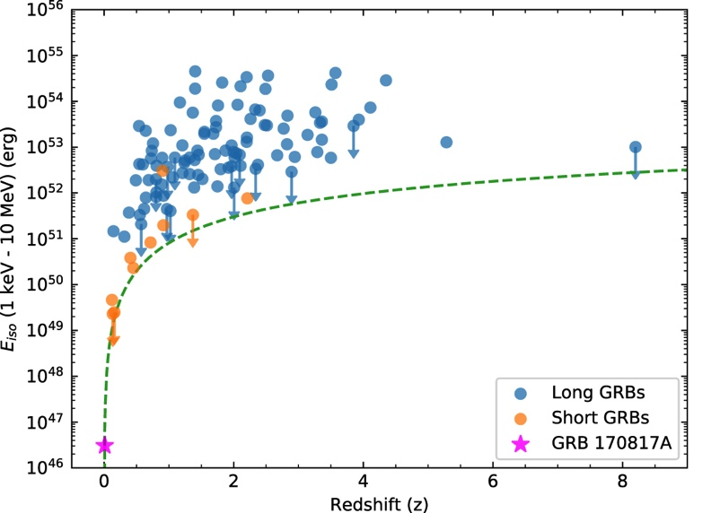
GRB 170817A: a dim outlier

Slide 19
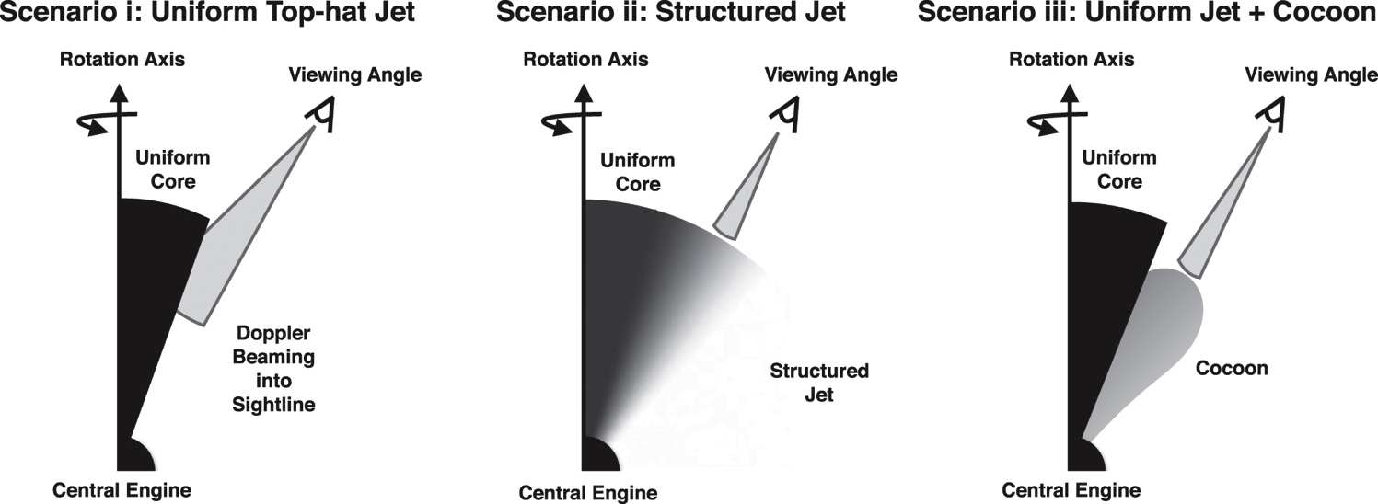
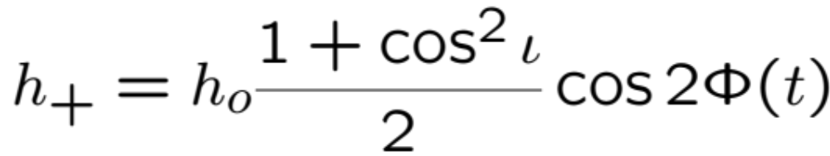
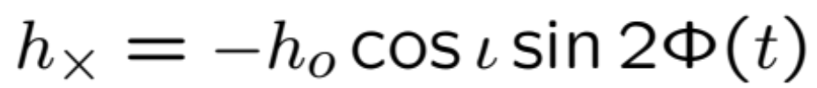
Evidence implies the GRB is viewed off axis - I
GW: ι < 56 degrees
Consistent with GRB viewed 20-30 degrees off axis

Slide 20
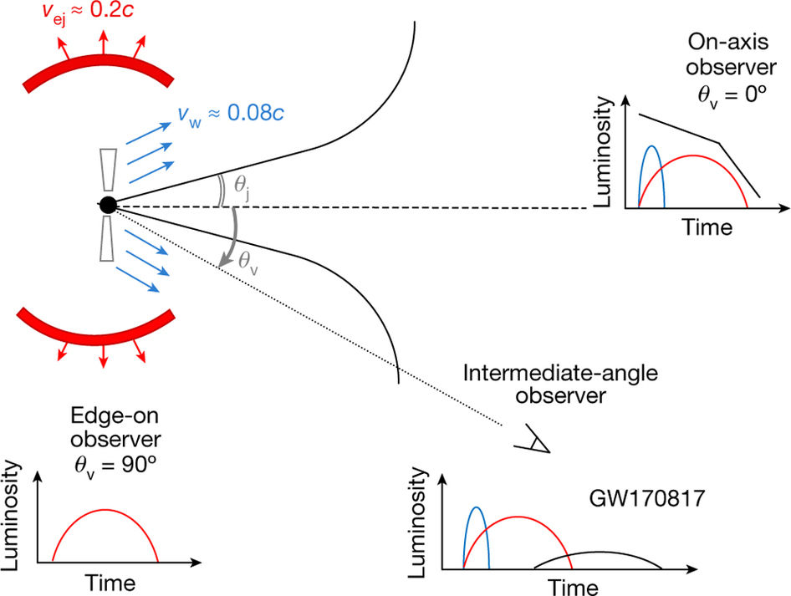
Expected behavior of EM emissions
E. Troja, et al, Nature
n-rich ejecta → IR kilonova
n-poor ejecta → optical kilonova
Rel. jet on axis → x-ray, optical, radio

Slide 21
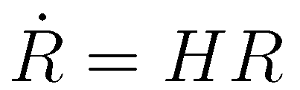
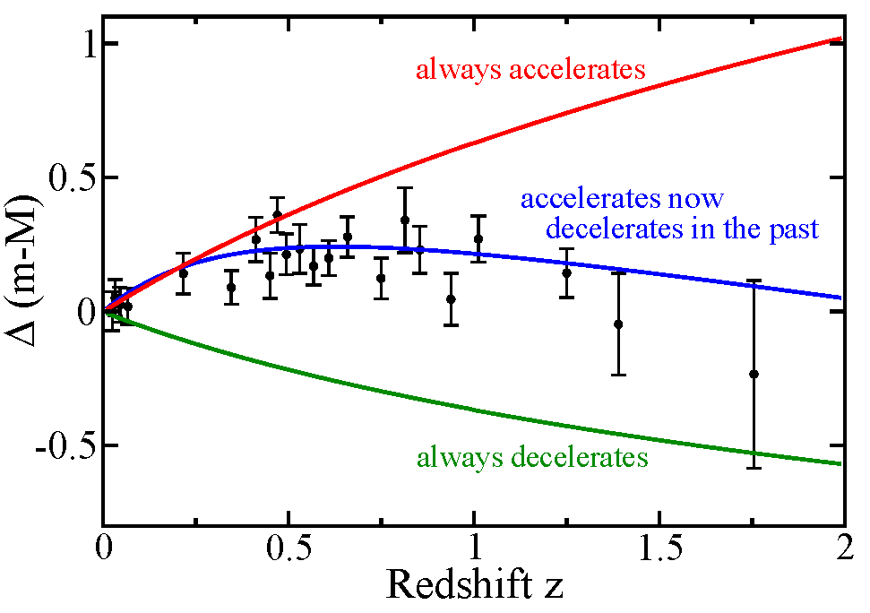
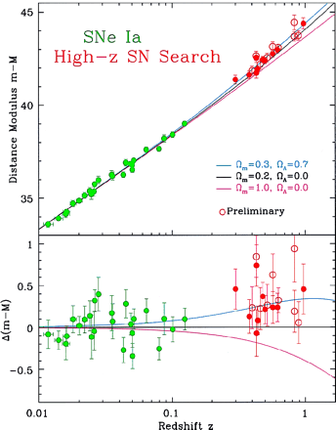
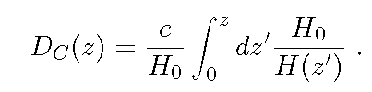
GW Measurement of Hubble Flow
D
Need to measure D and z
EM: does not measure D directly, but GW does
SGRBs (z) + BNS (D from GW)

Slide 22
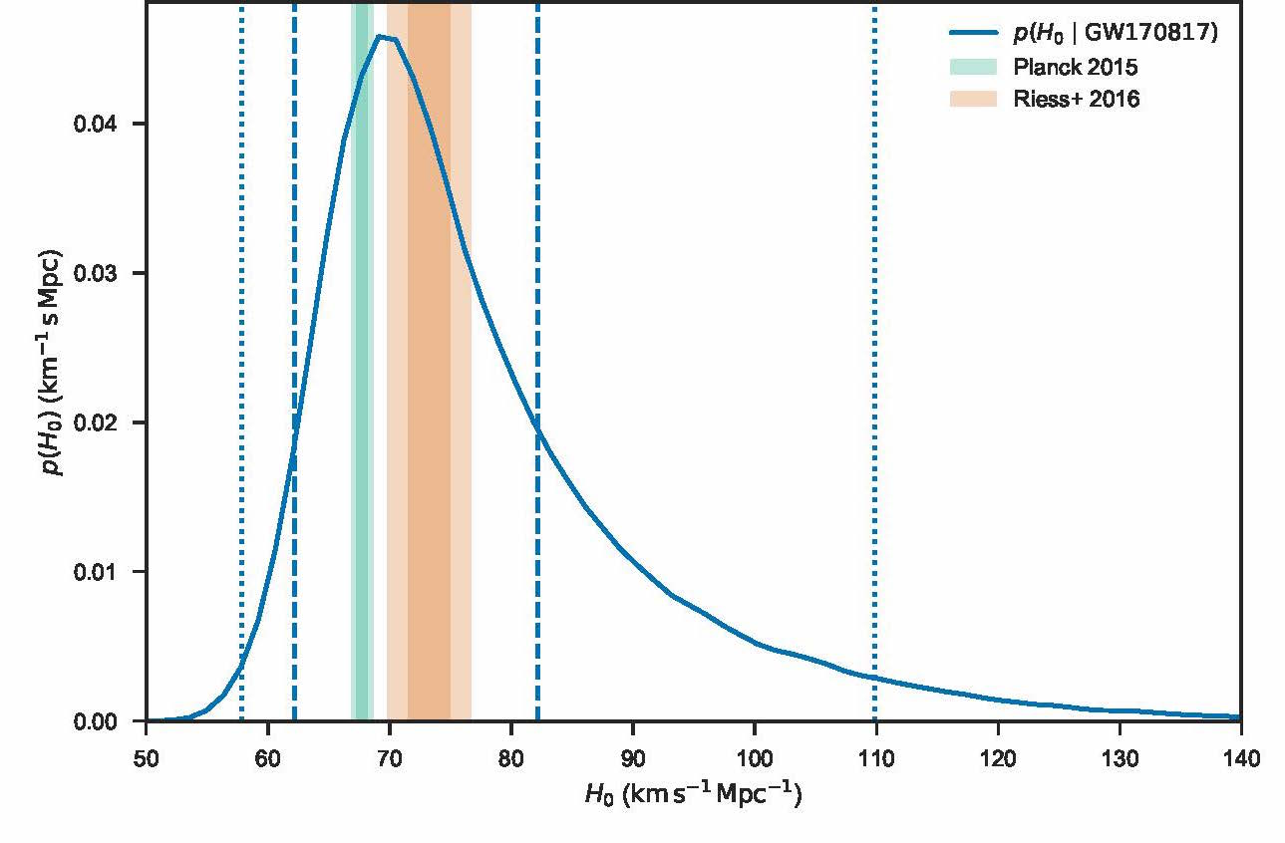
H0 with 1 event (!)
LIGO-Virgo: Nature 551, 85–88

Slide 23
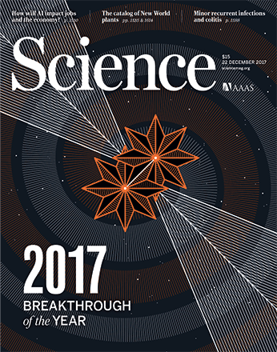
Can the string continue??

Slide 24
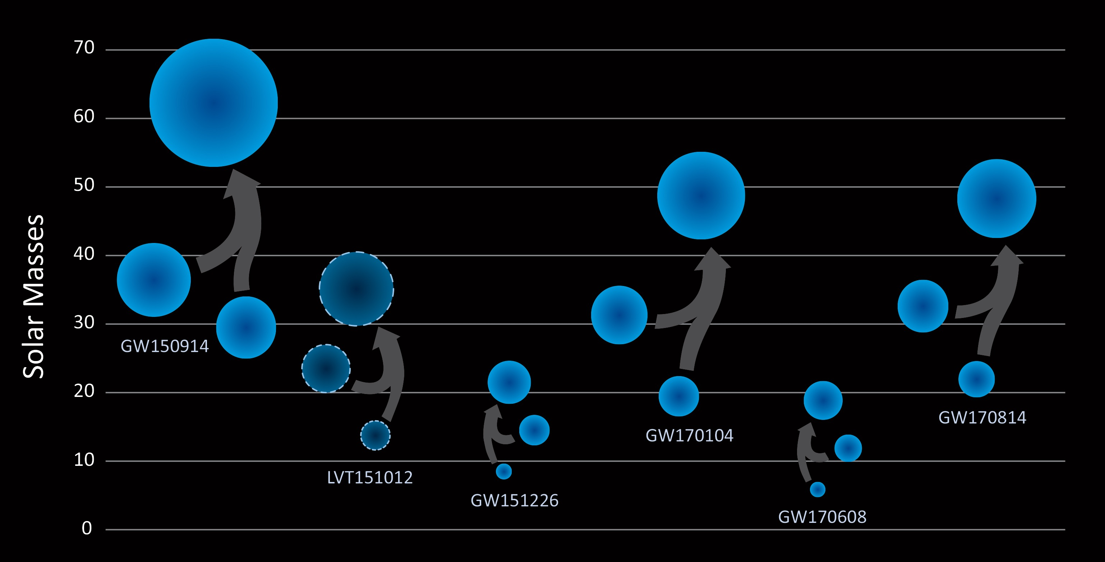
Binary black hole astrophysics
What is the origin of these systems? Pop III ? Clusters? Primordial?

Slide 25

UO-LIGO
Ray Frey, Professor
Ben Farr, Assistant Professor
Robert Schofield, Research Professor
Jim Brau, Professor
Vinny Roma, 6th-year grad student
Sudarshan Karki, 6th-year grad student
Jordan Palamos, 5th-year grad student
Paul Schale, 5th-year grad student
Philippe Nguyen, 2nd-year grad student
Kara Merfeld, 1st-year grad student

Slide 26
What UO Does?
The non-GW environment – are the GW signals astrophysical?
  Sensors and data analysis; time at Hanford Observatory
  Traditional starting point for new graduate students
GWs associated with gamma-ray bursts (GRBs)
  First GW + EM detection; many new astrophysics questions!
  New way to measure Hubble expansion/acceleration
GWs from stellar collapse (supernovae), magnetar flares, …
Farr: Astrophysics of compact binaries (BH-BH, NS-BH, NS-NS)
  LIGO can use BBHs to trace the star formation history of the universe
  Using the measured waveforms to determine the parameters of these systems: masses, distances, spins
  How and where are these systems formed?

Slide 27
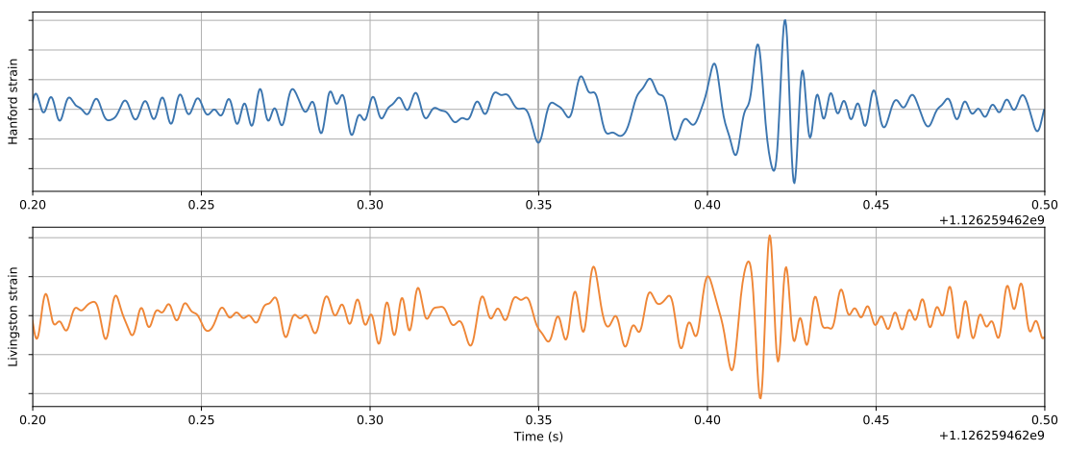
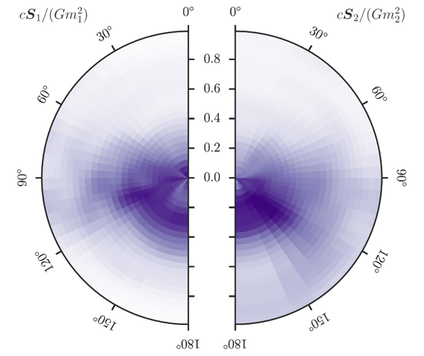
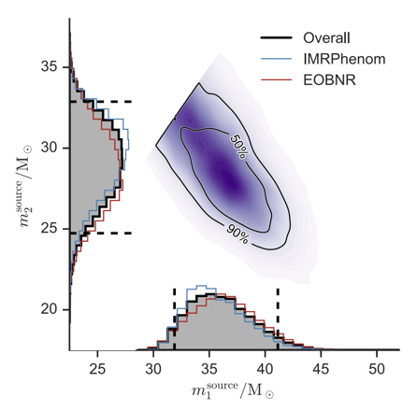
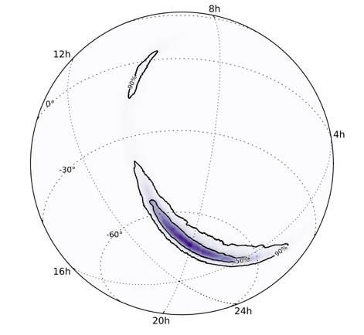
Parameter
Estimation
Masses
Location
Spins
  (e.g., GW150914)

