Slide 1
Introduction to Bridges
Different Types of Bridges And Examples of Structural Loading

Slide 2
Schedule for Bridge Building
Monday | Tuesday | Wednesday | Thursday | Friday
 | 26) Intro; Sketch | No school | No school | No school
 | 03) Design; Full scale |  | 05) Continue | 06) C-day Continue
 | 10) Build |  | 12) Build | 13) ER Build
 | 17) Build; Certify |  | 19) Break | 20) Clean up

Slide 3
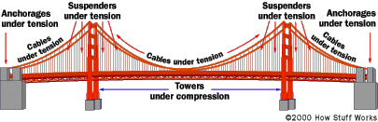
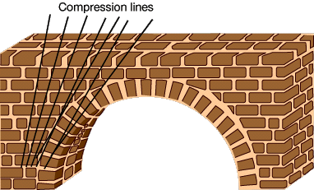
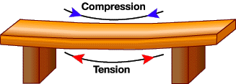
Forces on Bridges:

Slide 4
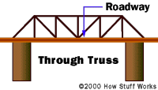

Example Truss Bridges:

Slide 5


Example Truss Bridges:

Slide 6

Example Truss Bridges:

Slide 7


Example Bridges:

Slide 8
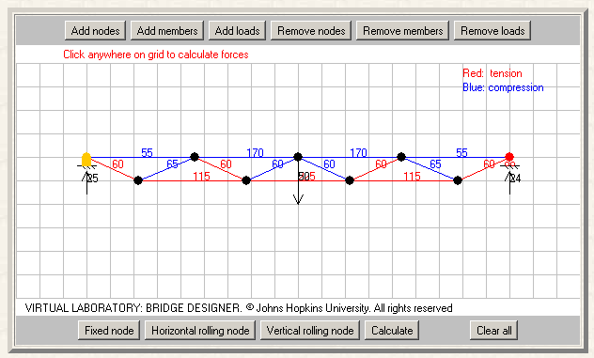
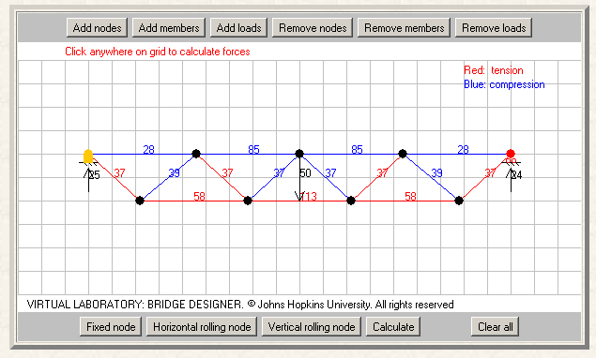
Examples: Structural Loads (truss depth)
15mm deep
30mm deep

Slide 9
Examples: Structural Loads (load placement)
Center Load
Off-center Load

Slide 10
Virtual Bridge Designer:
http://www.jhu.edu/~virtlab/bridge/truss.htm
West Point Bridge Design Contest:
http://bridgecontest.usma.edu/

Slide 11
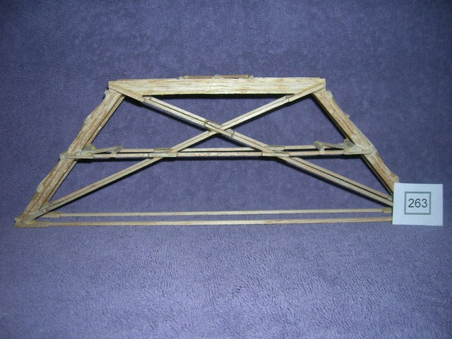
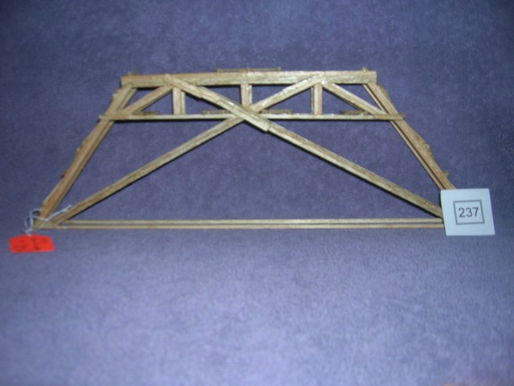
Winning Bridges from 2006-07 State:

Slide 12
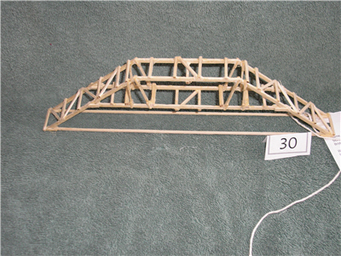
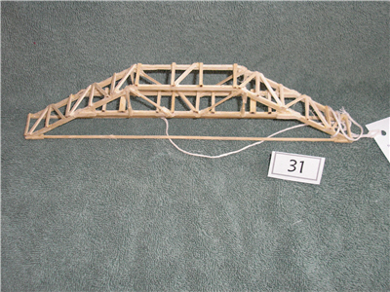
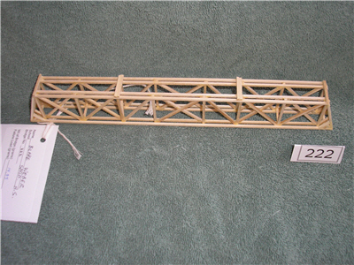
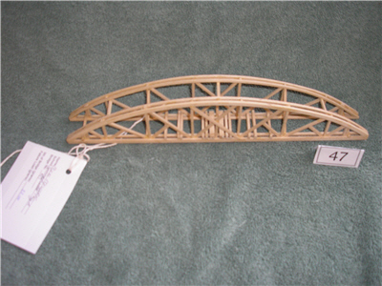
Bridges from 2007-08 State:

Slide 13
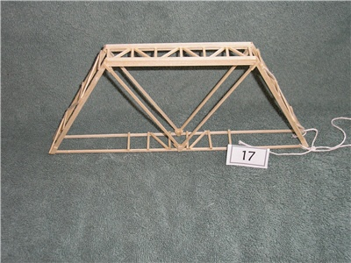
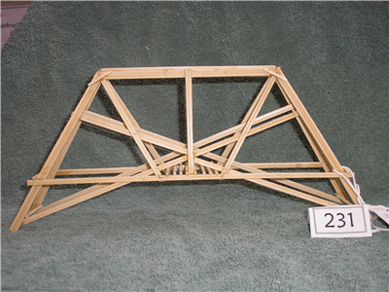
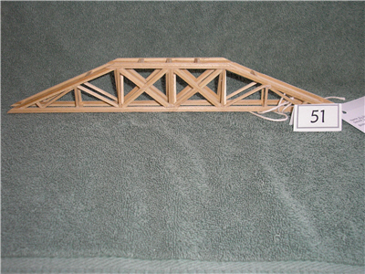
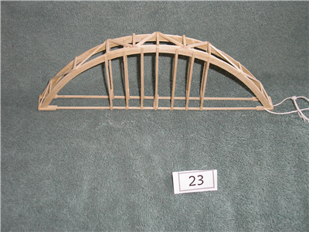
Bridges from 2008-09 State:

Slide 14
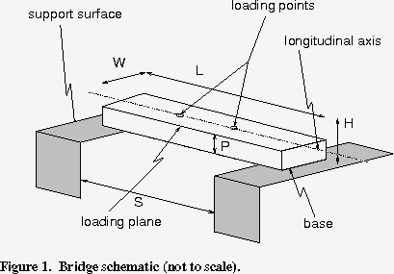
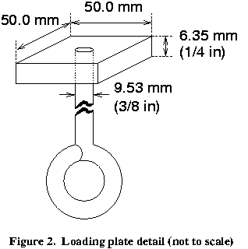
Specifications for 2013-14:

Slide 15
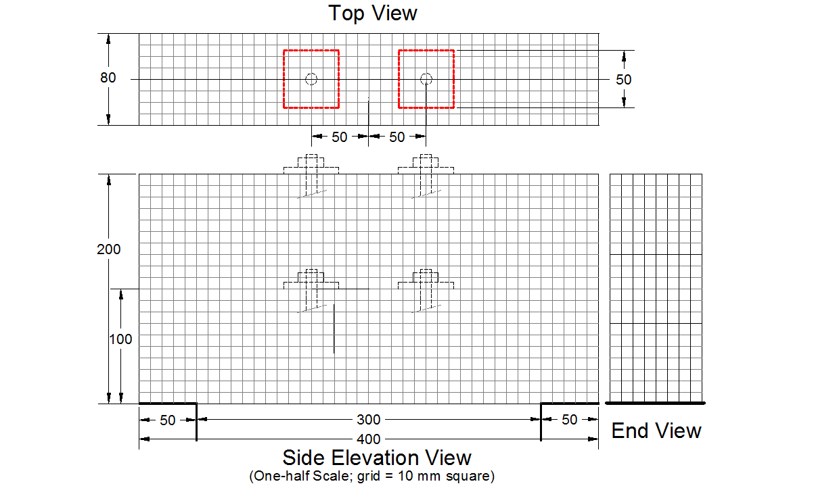
Half-size Sketch for 2013-14:

Slide 16
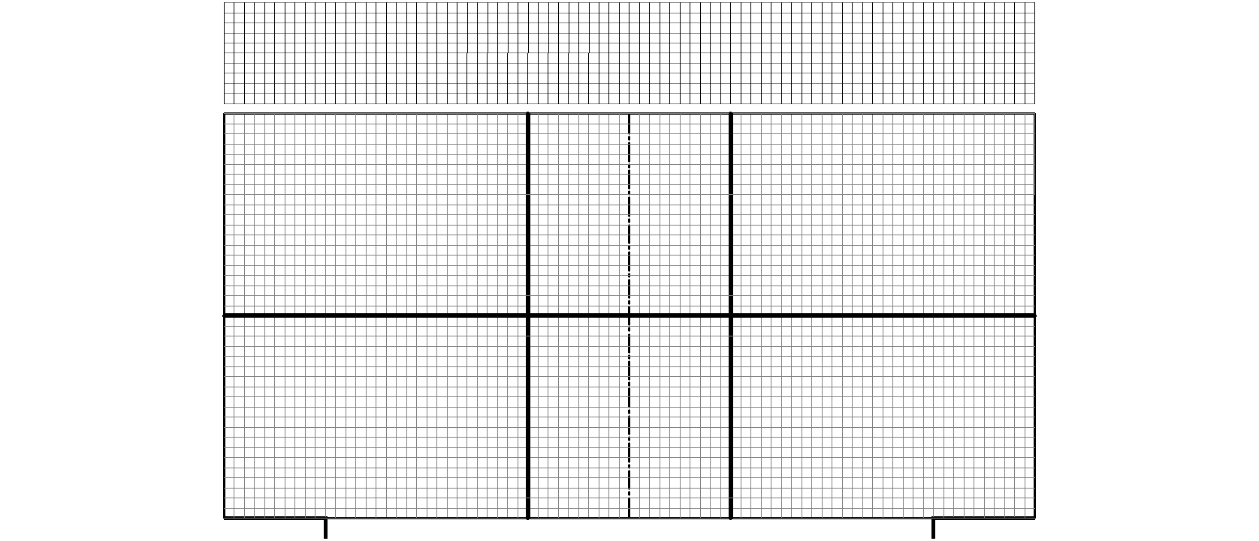
Full-size Drawing for 2013-14:

Slide 17
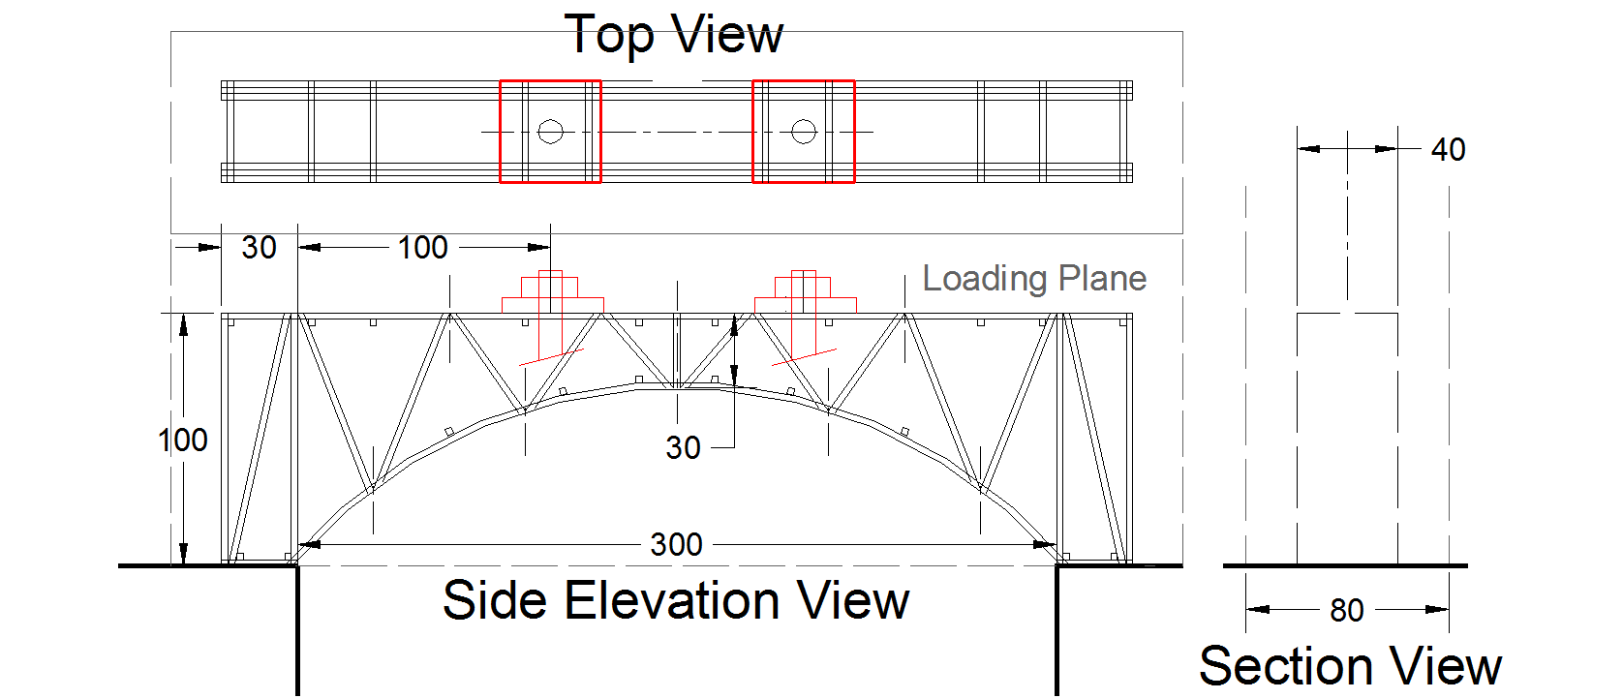
Design Example: Truss-Arch; 100mm tall

Slide 18
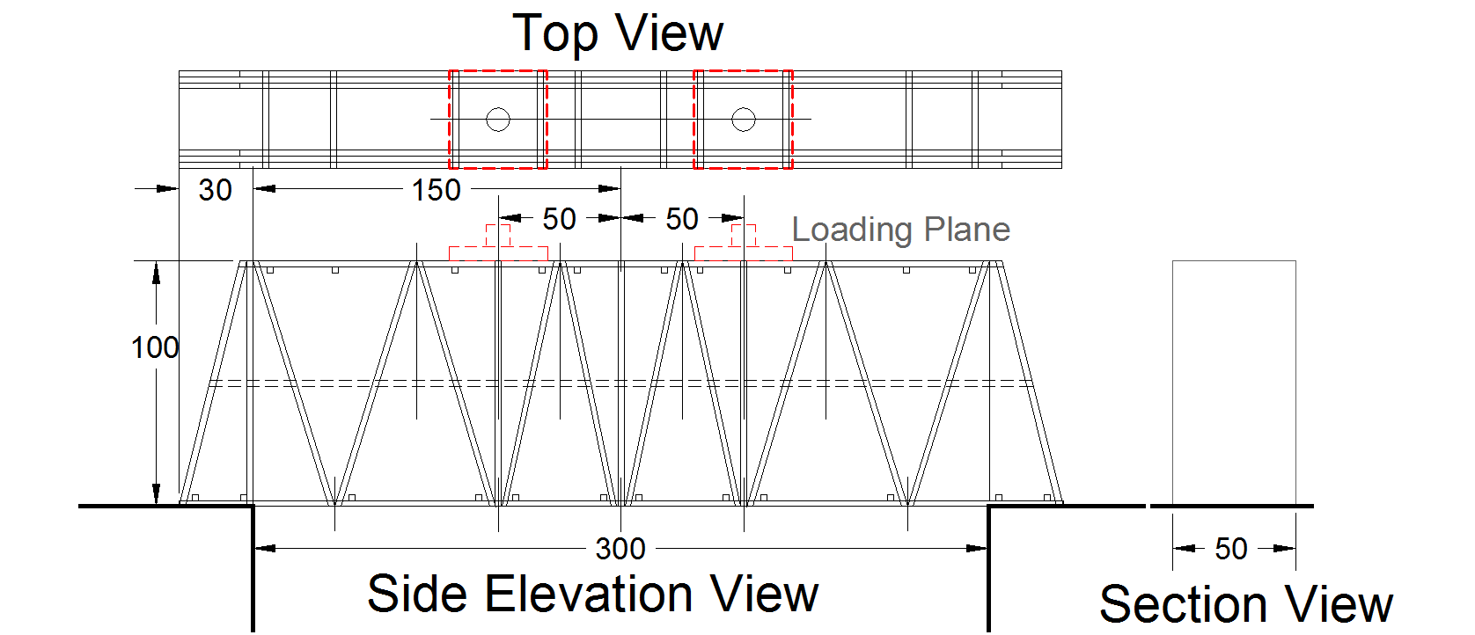
Design Example: Simple Truss—100mm tall

Slide 19
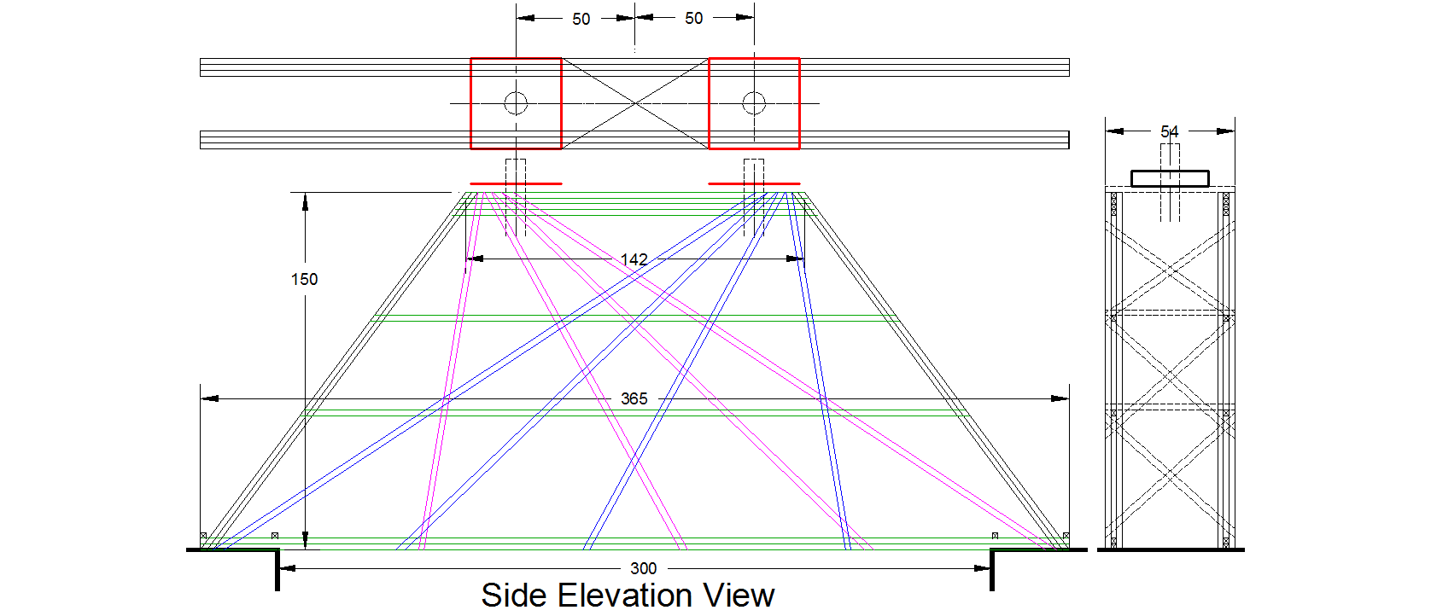
Design Example: 150mm tall Hybrid

Slide 20
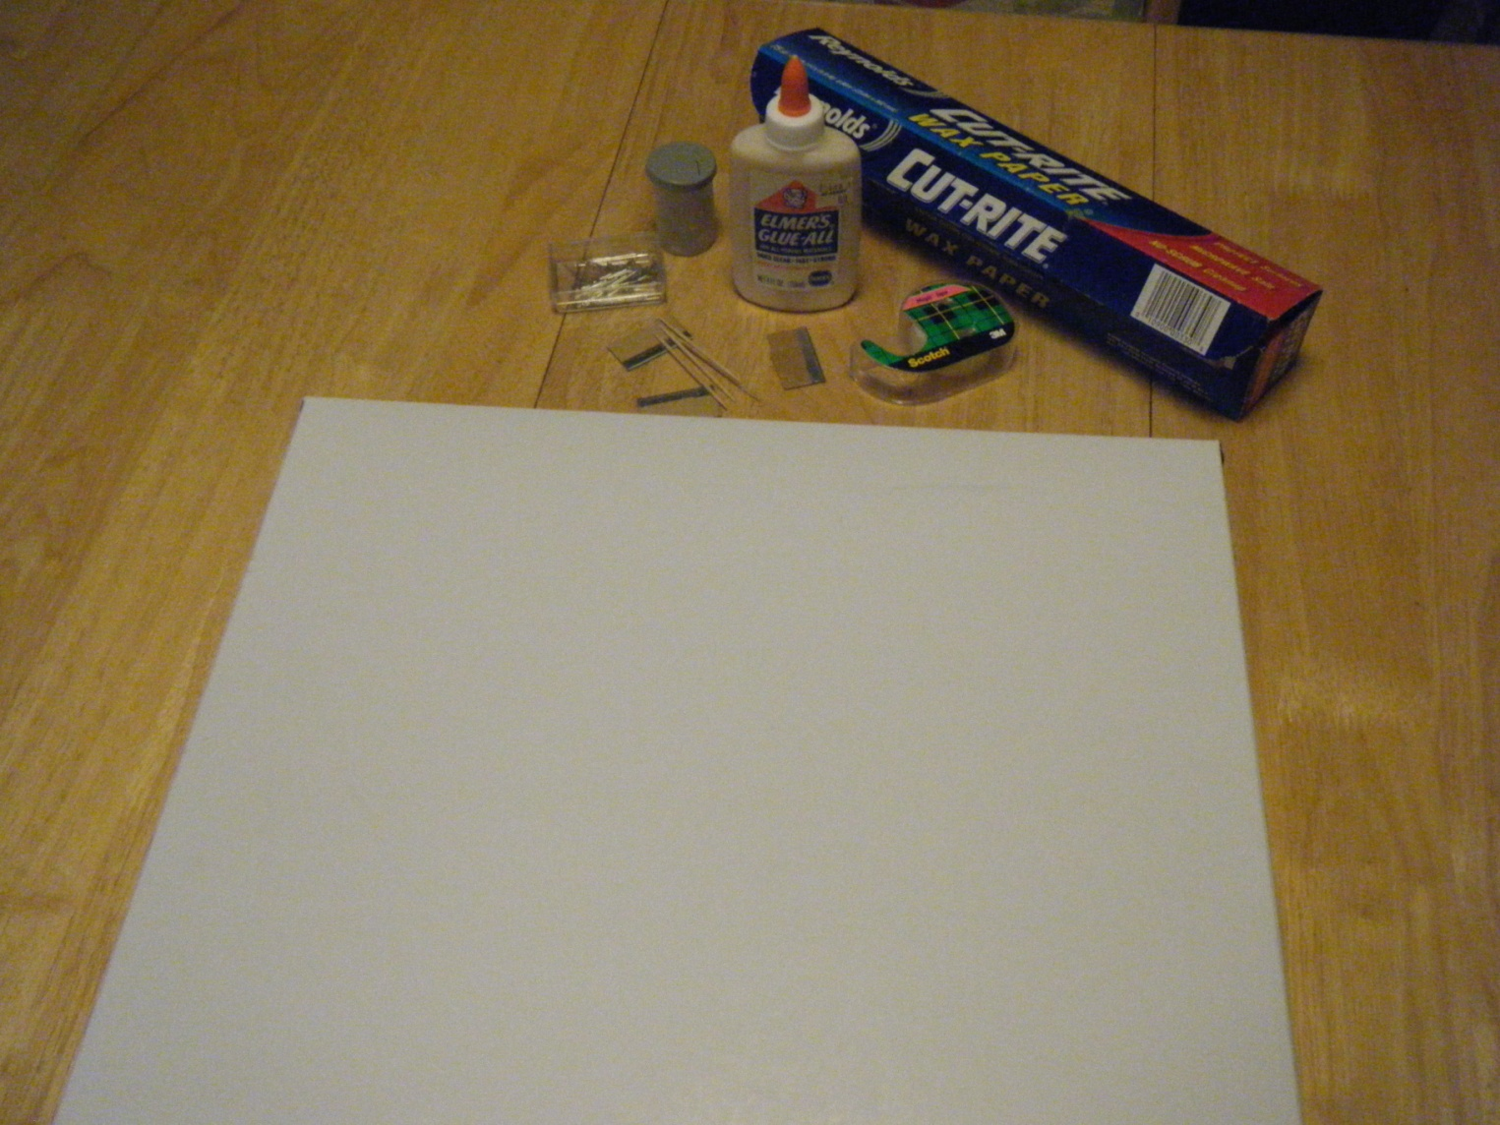
Gather Materials
Building a Bridge:

Slide 21
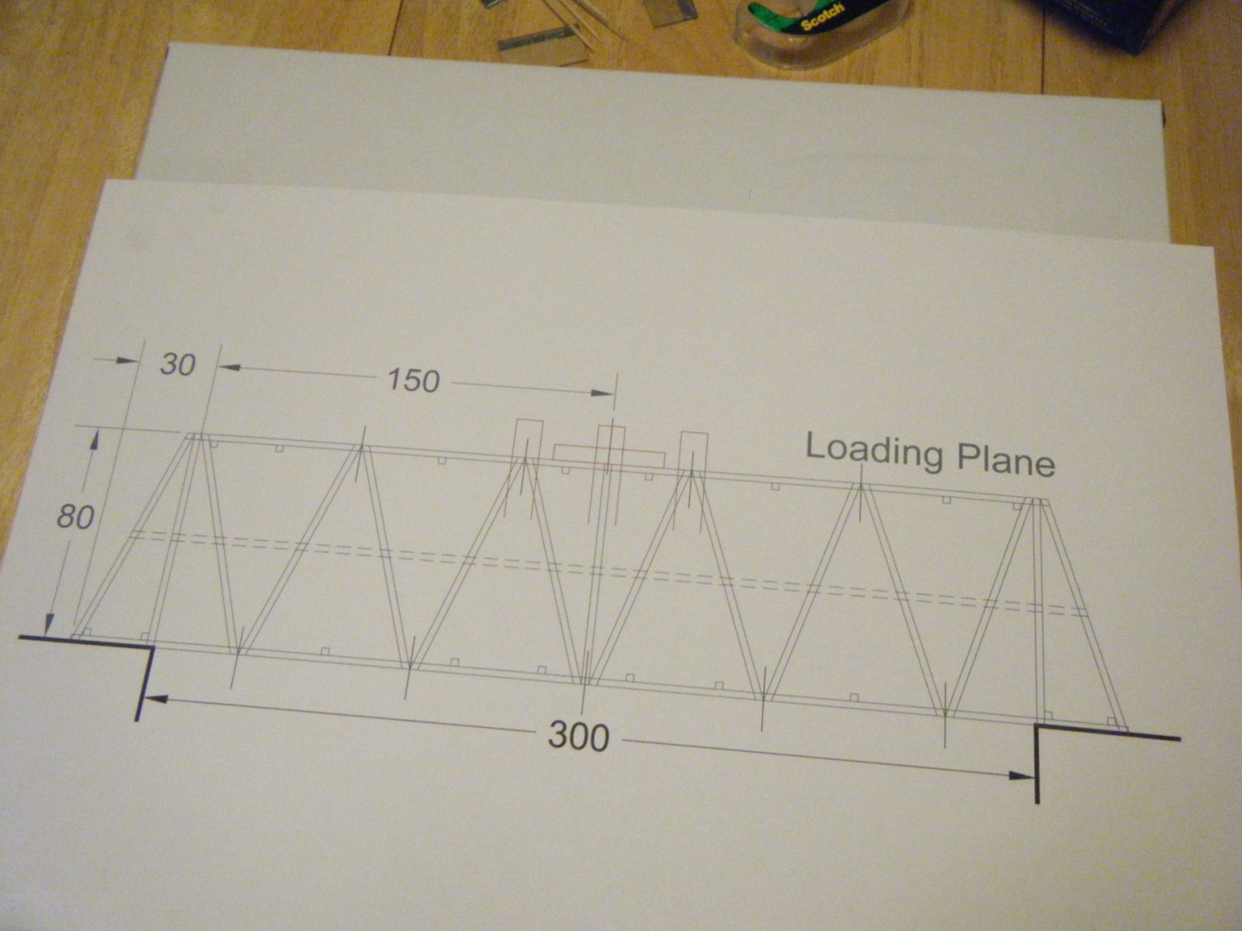
Tape Drawing to Box

Slide 22
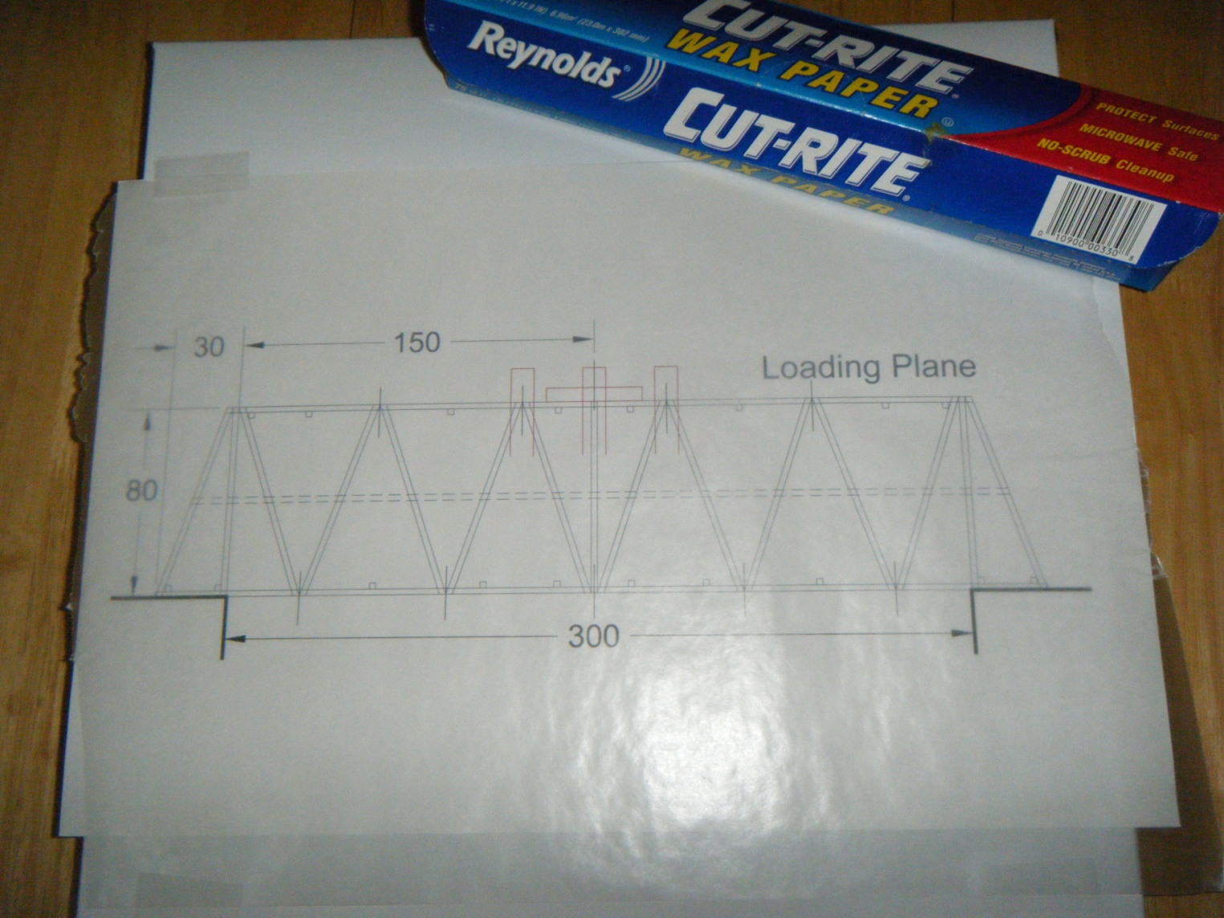
Cover with Wax Paper

Slide 23
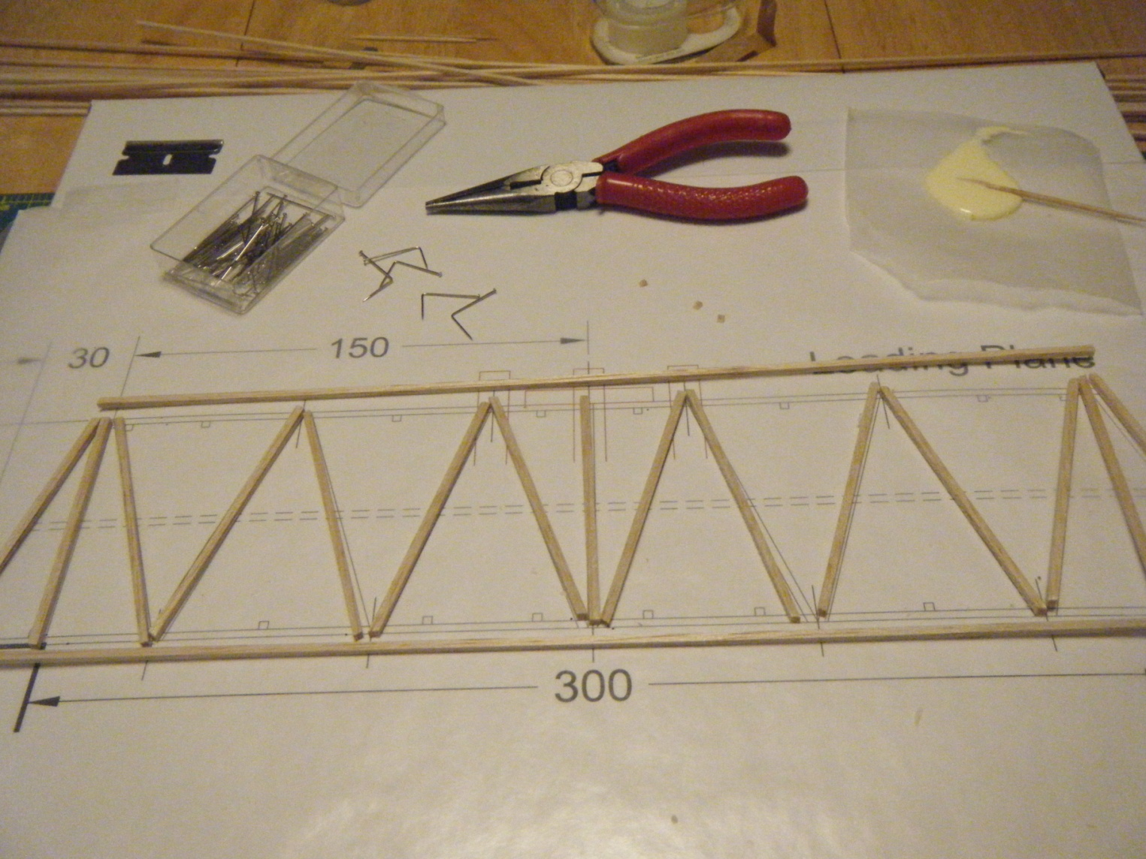
Cut sticks per drawing

Slide 24
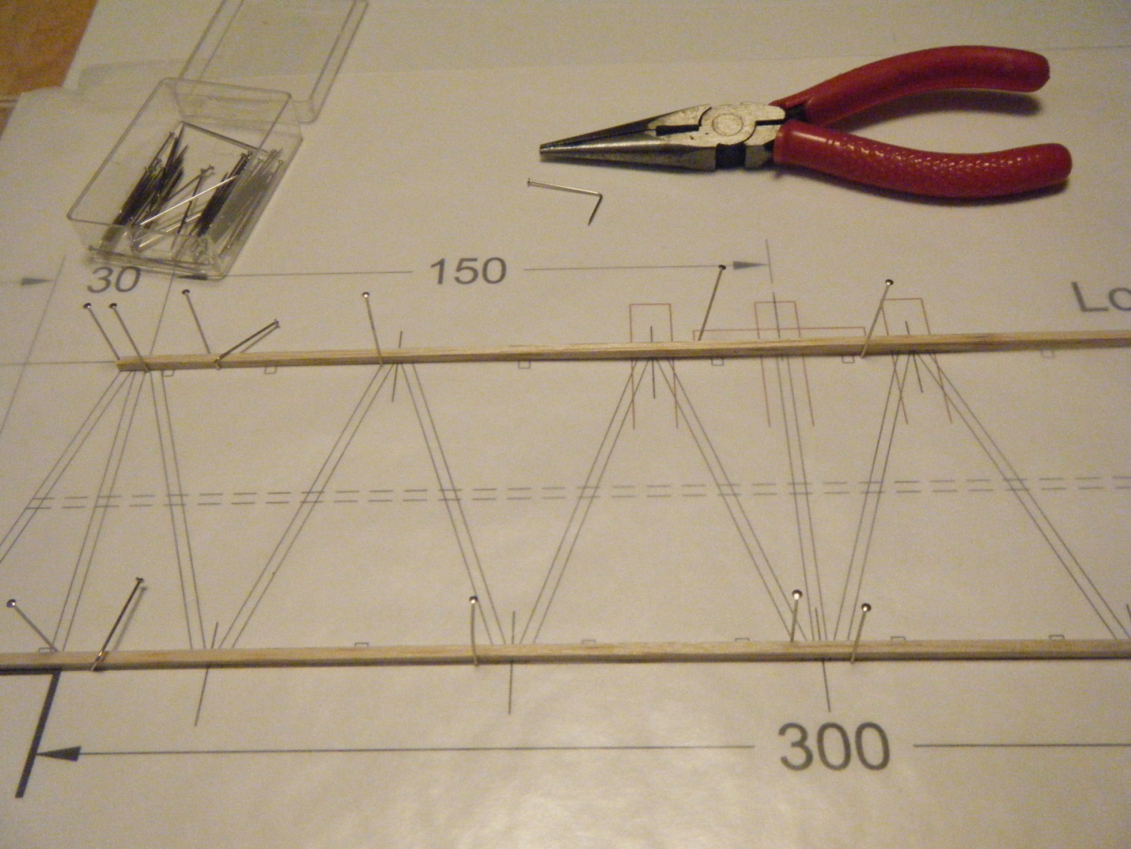
Pin 1st layer of sticks

Slide 25
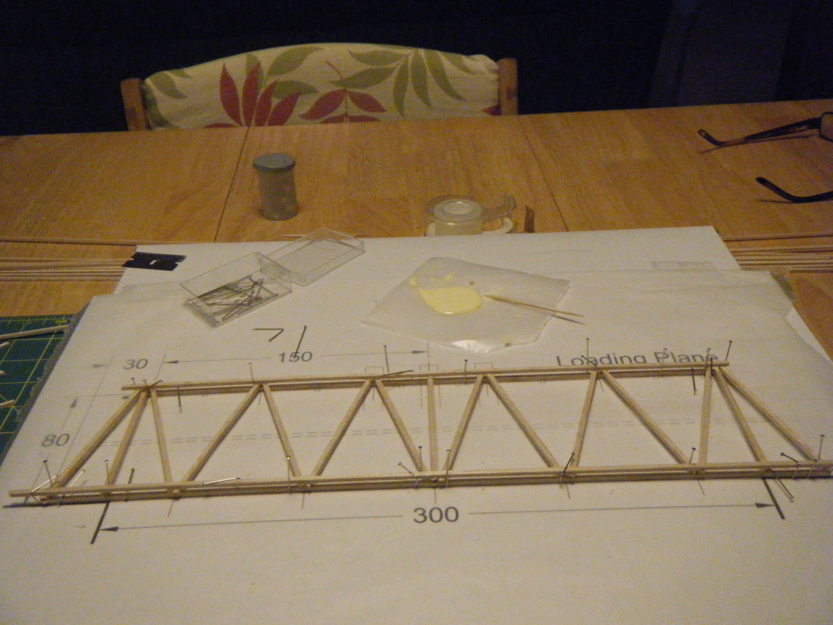
Glue next layer of sticks

Slide 26
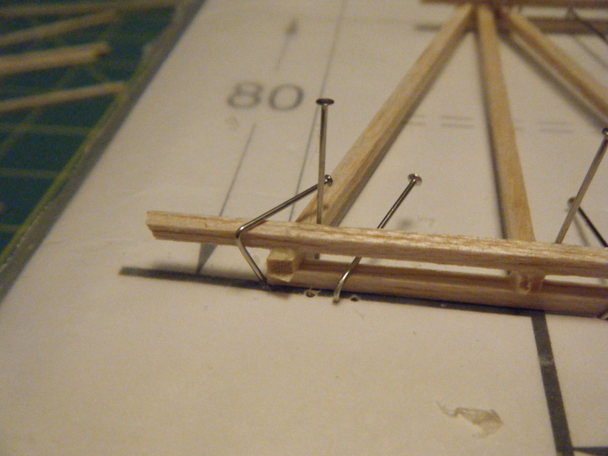
Use pins to clamp sticks…
Lap Joints much stronger

Slide 27
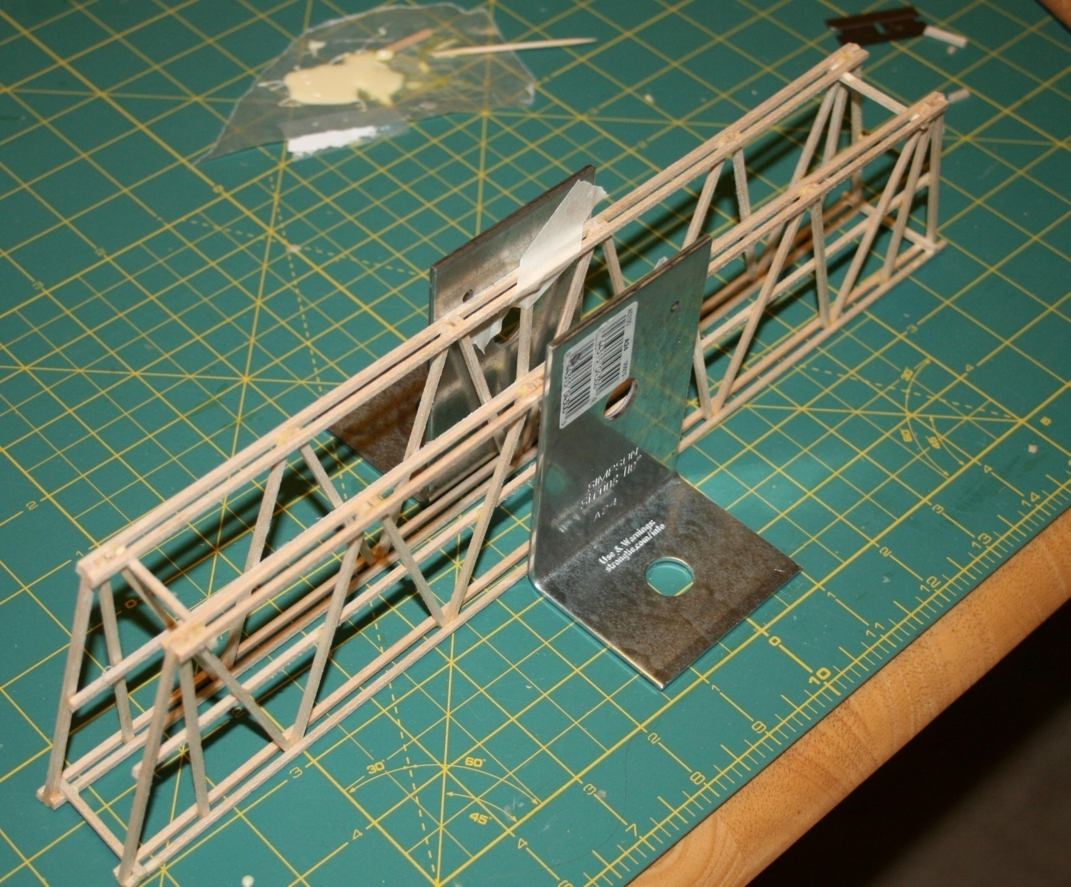
Carefully Position Each Side

Slide 28
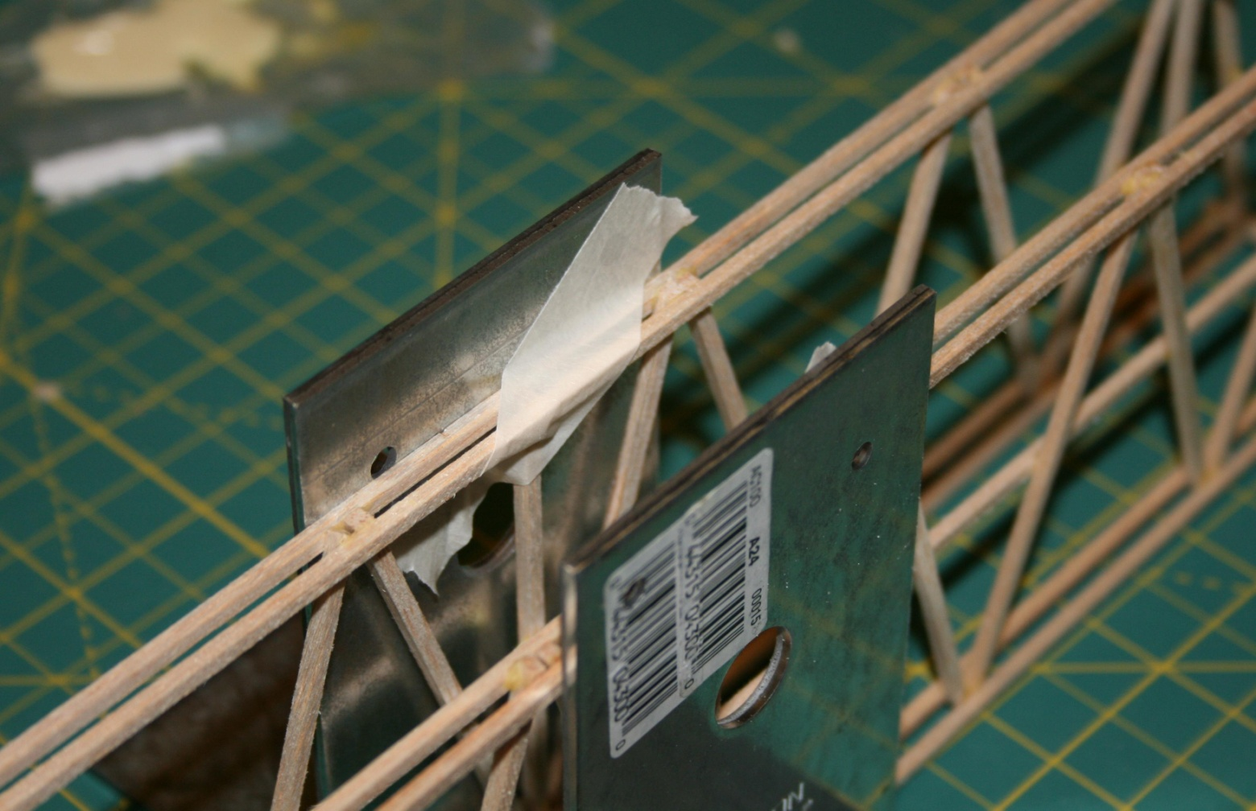
Attach Sides to Angles

Slide 29
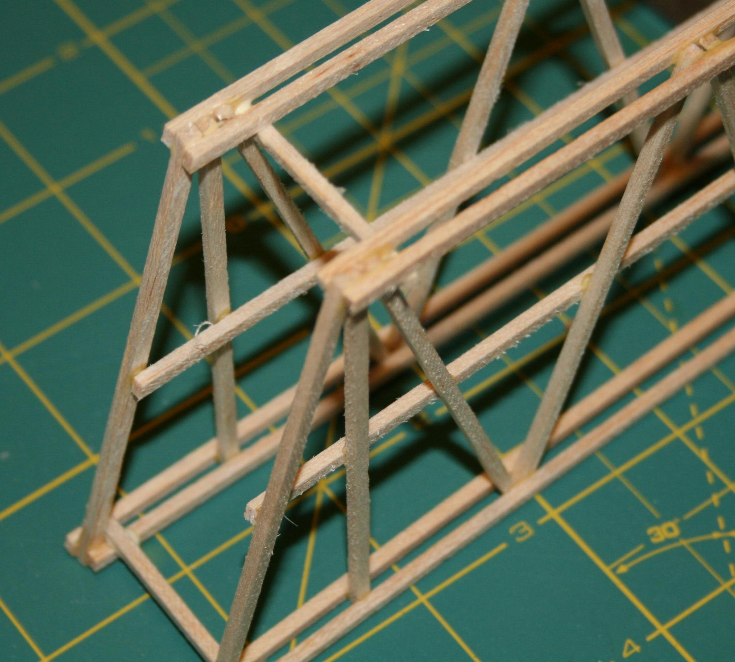
Glue Cross Members Top and Bottom

Slide 30
Simple Bridge Testing System

Slide 31
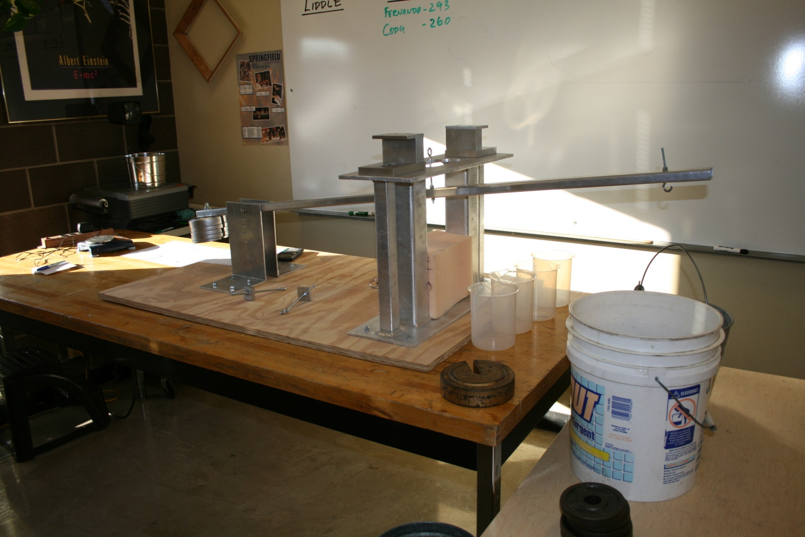
New Bridge Testing System

