Slide 1



University of Oregon
Travel Round Table

Slide 2
Where are we today...
As we begin to return to travel, it’s essential to understand the industry is faced with massive changes that are likely to continue as vaccinations and treatments continue globally. No event in the modern era has required a worldwide pandemic response and prompted a global economic shutdown. This has made it necessary to develop a new industry road-map.
Factors to consider:
• Airlines have reduced some flight schedules by up to 90%
  Many carriers have retired large blocks of their fleet and may be forced to make further reductions if demand does not recover.
  The flight schedules you use to take may not be there or maybe smaller aircraft equipment.
Over 30,000 hotels have closed, with approx. 27,000 returning to business. Hotels are faced with staffing shortages, pricing reductions, new cleaning costs, protocols, and processes that prioritize both traveler - health and safety.
New guidelines are being implemented for air, hotel, and ground transportation vendors to introduce new practices to support contact-less services.
States and Municipalities have implemented evolving guidelines on both a state-by-state and regional level, which will add to the complexity as companies resume employee business travel, as more Americans become vaccinated from COVID-19
“Health Passports,” PPE, and quarantine requirements yet to be announced at a national level as entry/passport requirements are still evolving.

Slide 3
Where are we today...
U.S. Centers for Disease Control and Prevention (CDC) announced April 2nd that people who have received an FDA-authorized COVID-19 vaccine could travel safely domestically.
The new CDC ruling said fully vaccinated tourists will no longer be required to get tested before or after travel—unless they are required by the destination—nor will they be forced to follow previous self-quarantine protocols.
On May 13th, the Centers for Disease Control and Prevention on said fully vaccinated people no longer need to wear masks indoors and don’t have to physically distance in that setting either. The Transportation Security Administration will adhere to the federal rule that requires that all air, rail and bus travelers over the age of 2 to wear a mask is still in effect. They are also required in bus and rail stations as well as airports. That policy is set to expire Sept. 14.

Slide 4
Where are we today...
The European Union has provisionally approved an EU Digital COVID-19 Certificate, to provide information on whether a person has been vaccinated against the Coronavirus, has recovered from the virus, or has a recent negative test result. This certificate will not be a precondition of travel, and at the same time, will not be considered as a travel document.
Airlines are bringing back furloughed staff, as they add new flights to meet anticipated summer travel demand, including up-gauging to wide body aircraft for domestic service and introducing new long haul international flights.
Travel corridors “bubbles” for global markets. Ex. Australia - New Zealand, Taiwan - Palau, Hong Kong – Singapore (on hold due to recent spikes in region - TBD), New York – London, U.K.

Slide 5

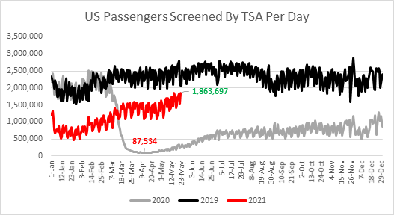
State of Travel Industry
An Unprecedented Impact on Society, Business, & the Travel Industry
As of May 23rd, traveler count broke the record with the highest number of travelers screened in a single day since the pandemic began with 1,863,967 travelers
processed through TSA airport checkpoints. This was the 74th consecutive day with > 1 million travelers screened.
YTD travel volumes are 99.7% of 2020 and 52% of 2019 levels.

Slide 6

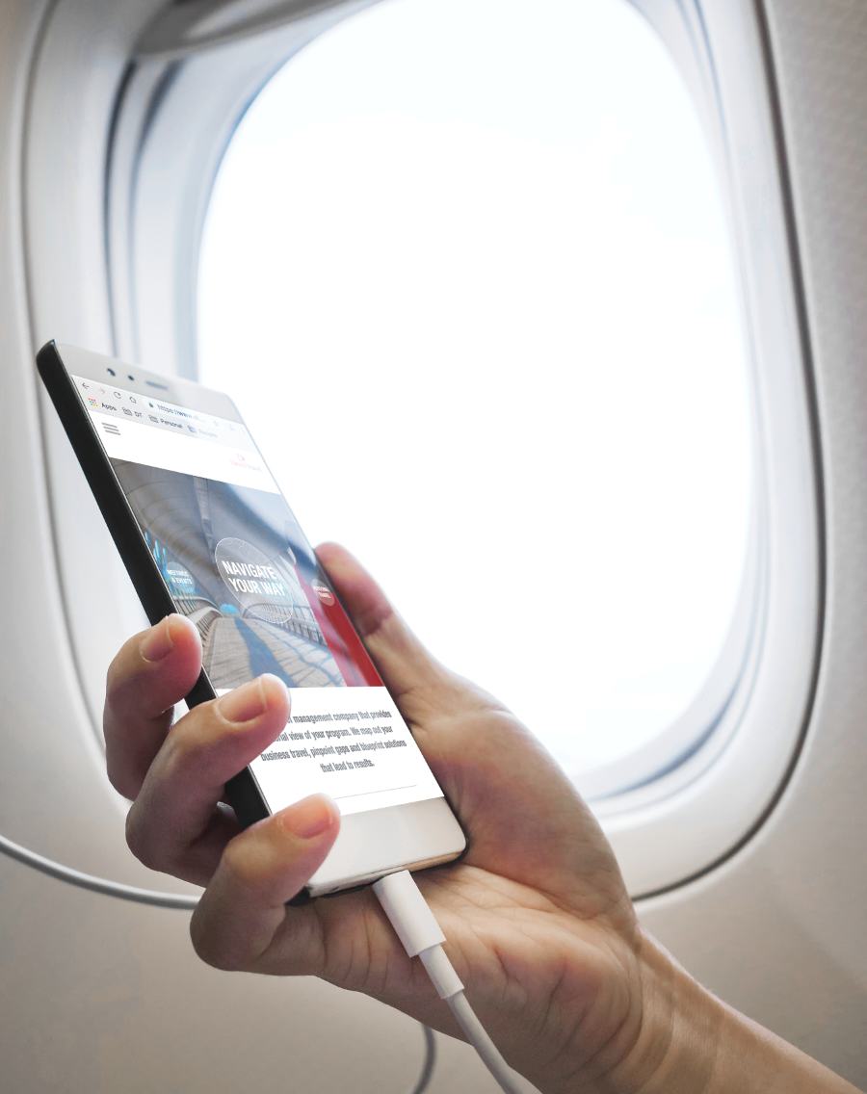






Technology & Privacy
Travelers store trusted, verifiable health credentials in digital identity wallets, Known Traveler Digital Identity (KTDI)
TRACING
Suppliers could use personal data, health conditions and travel history to compile an individual risk profile.
HEALTH PASSPORTS
TOUCHLESS
Touchless automation across the entire sector will become the new norm & biometrics will replace fingerprint and hand scanners.

Slide 7
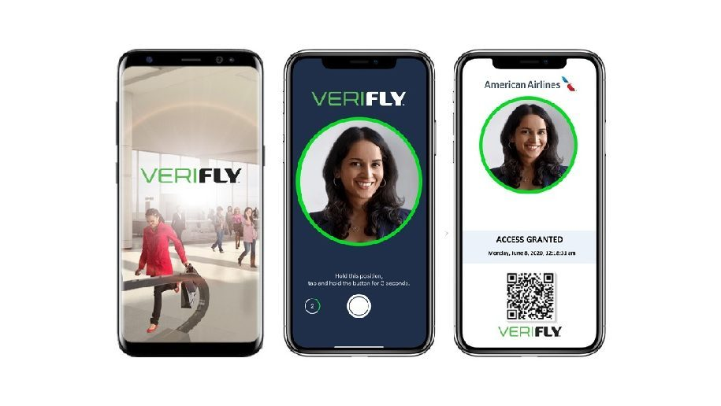
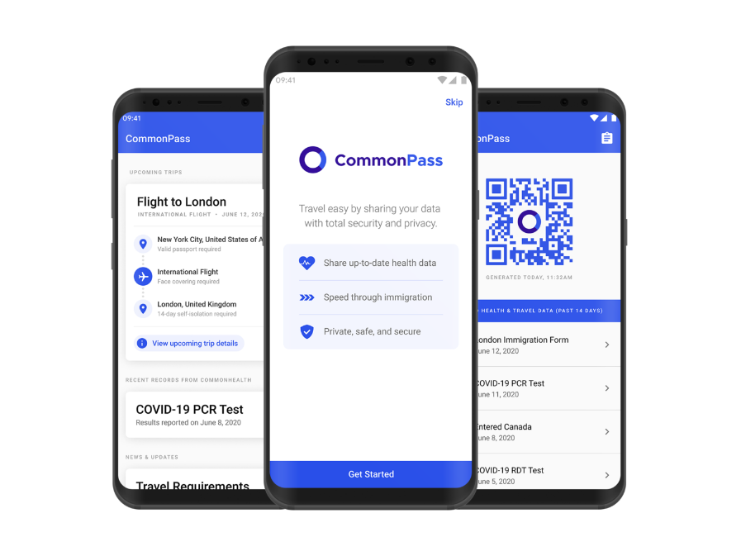
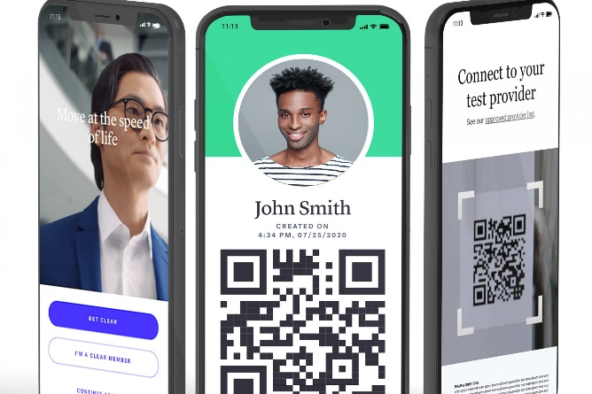
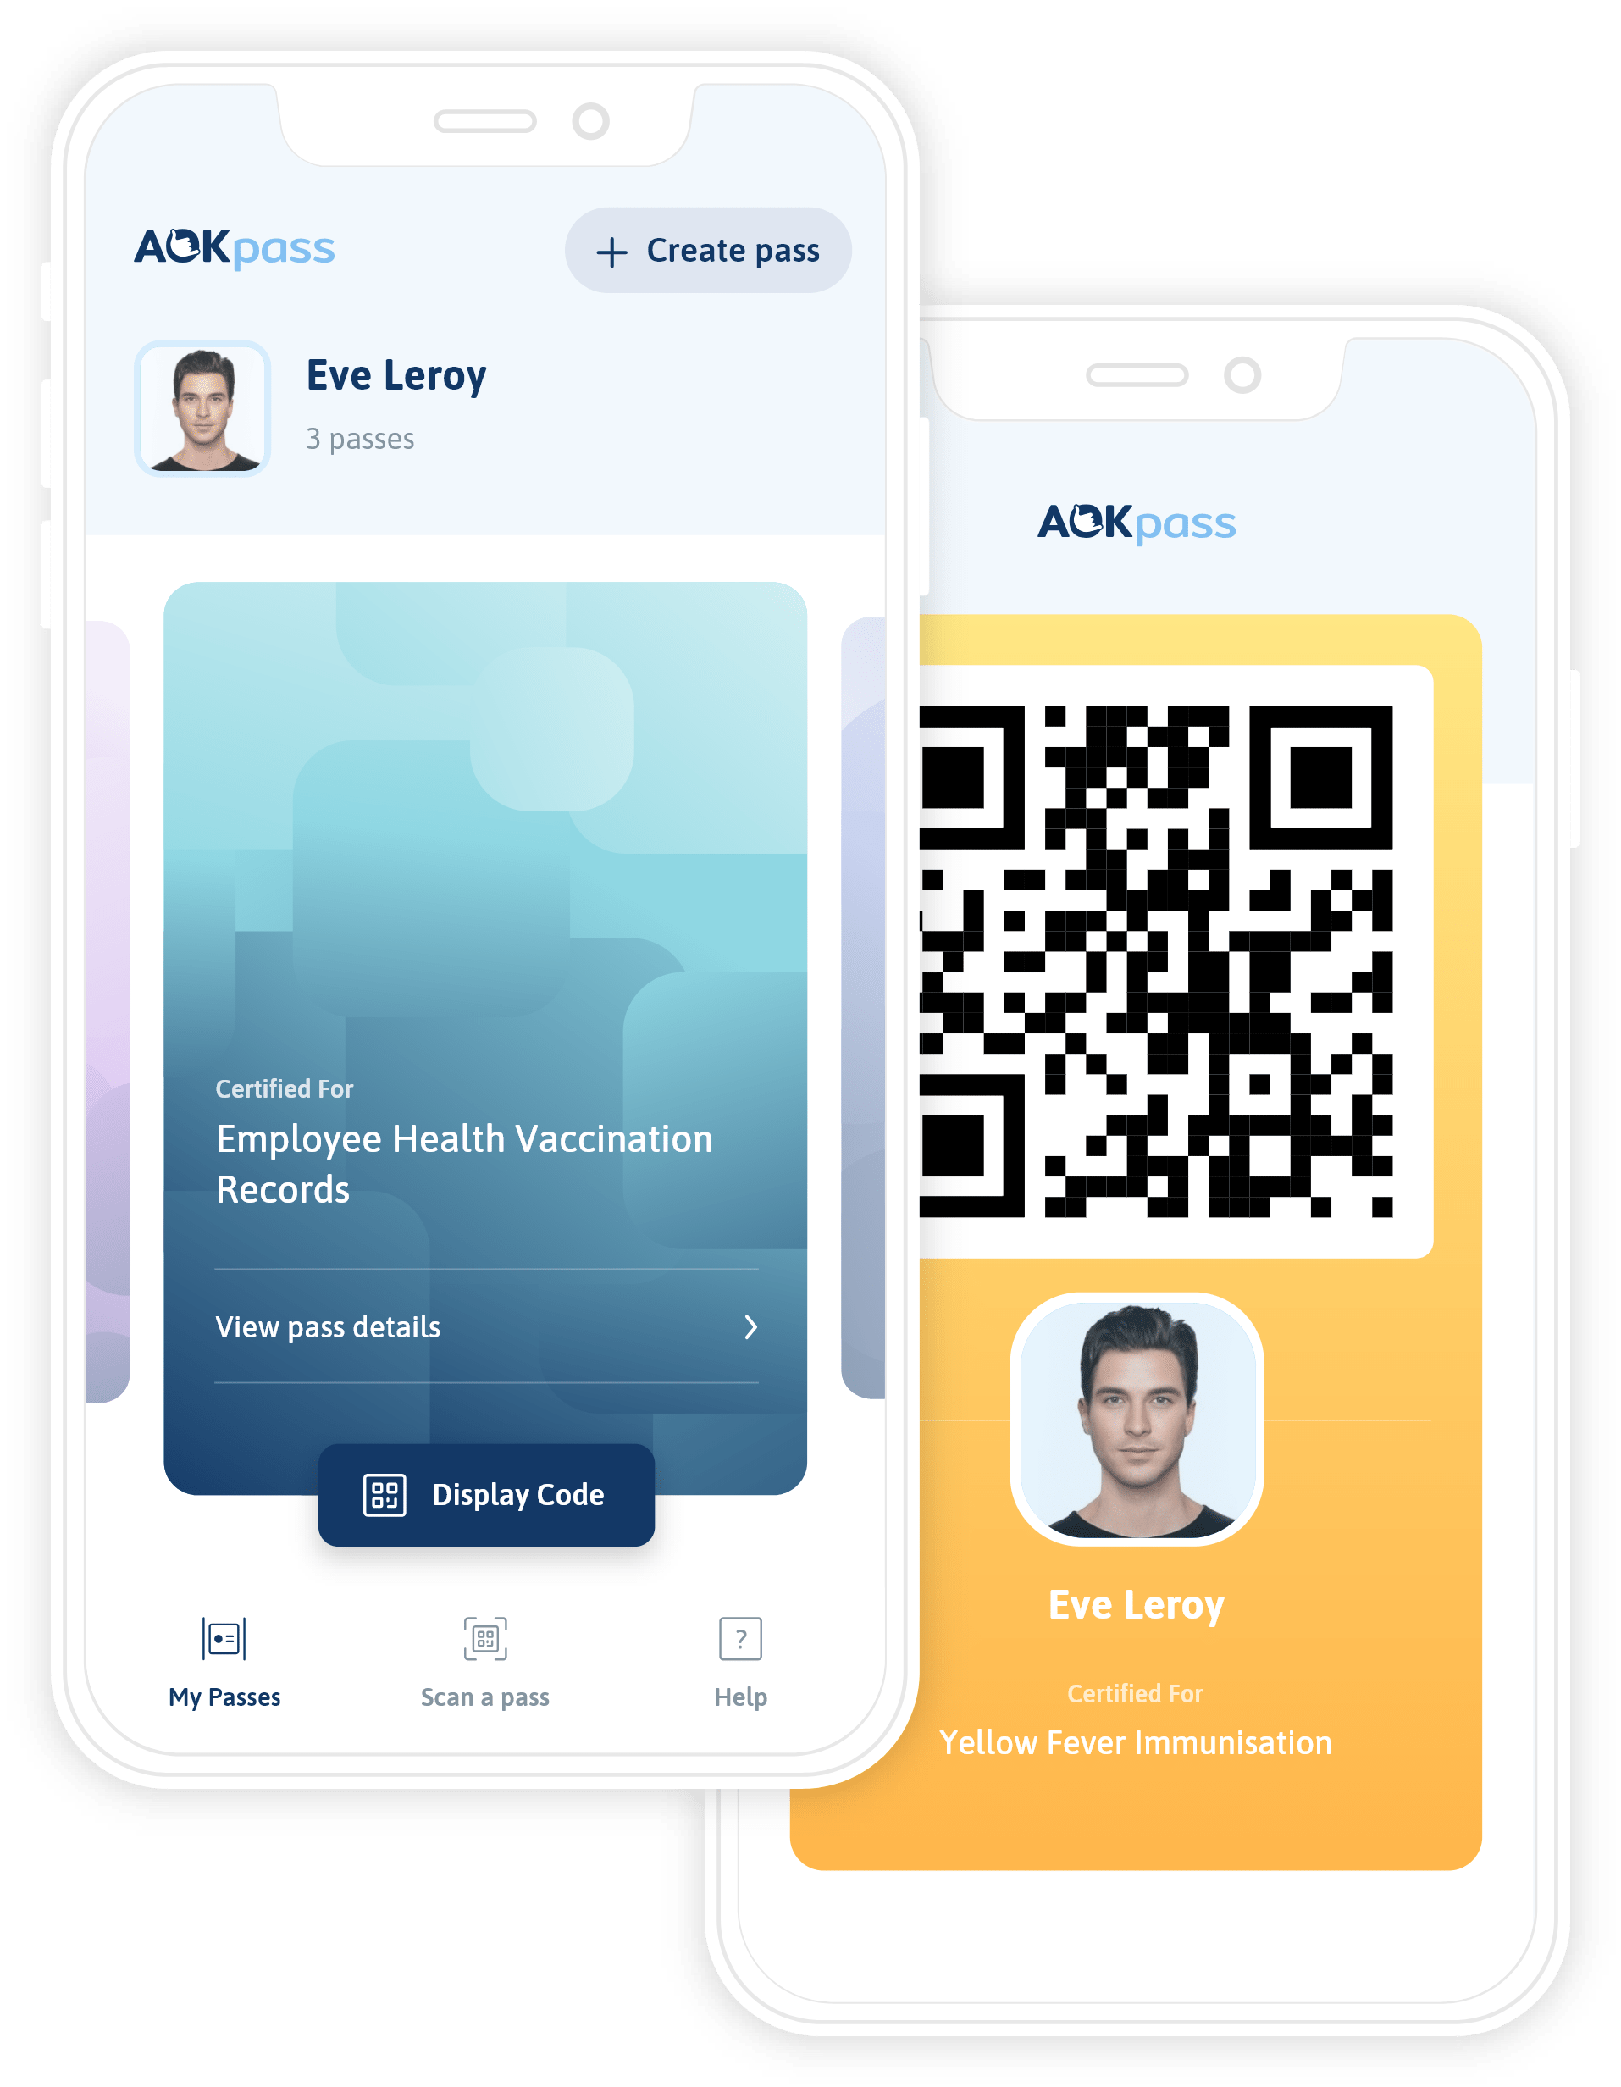
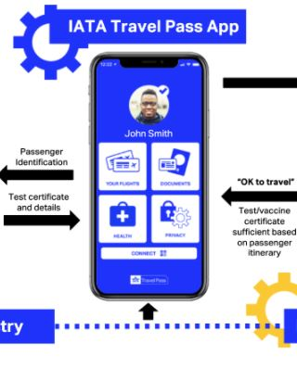
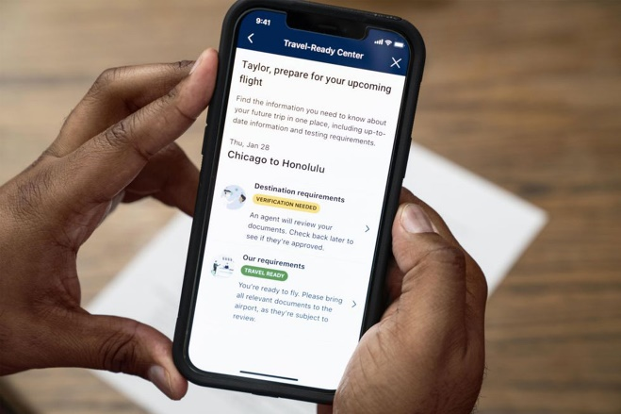
Digital Health Passports

Slide 8
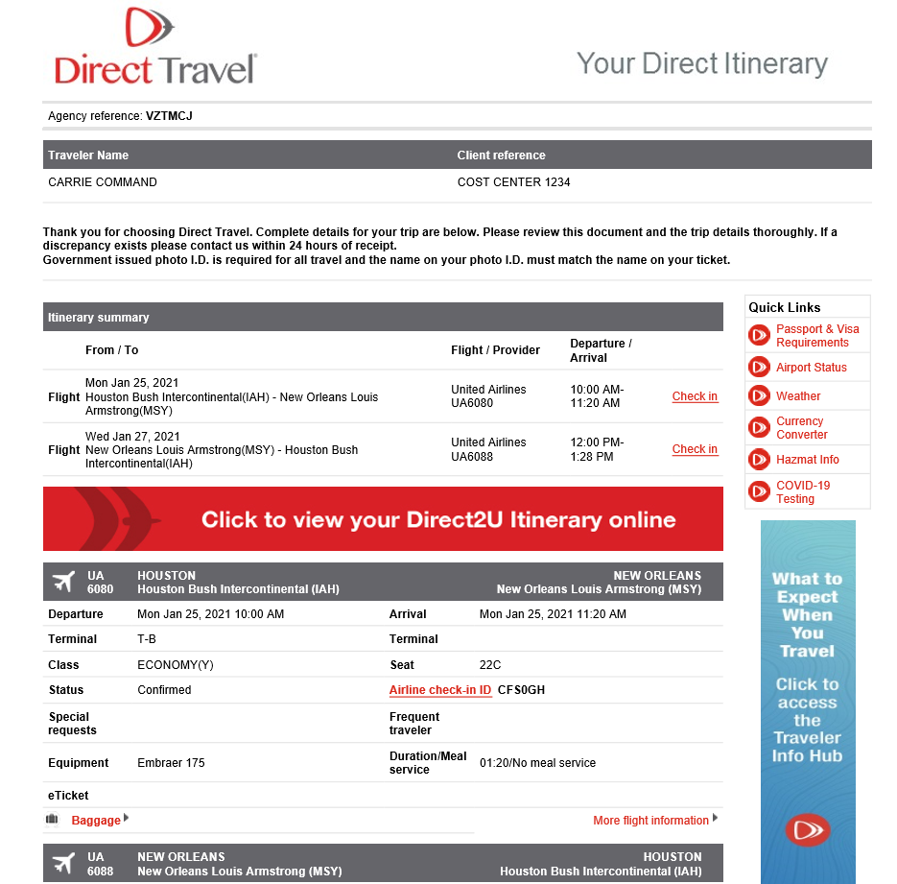
Click on the COVID-19 Testing Link – in red on the right side
It will take you to the COVID site map
Enter a zip code where you need to be tested
A map will appear and locations will display where testing is available
This is also available from the D2U App

Slide 9

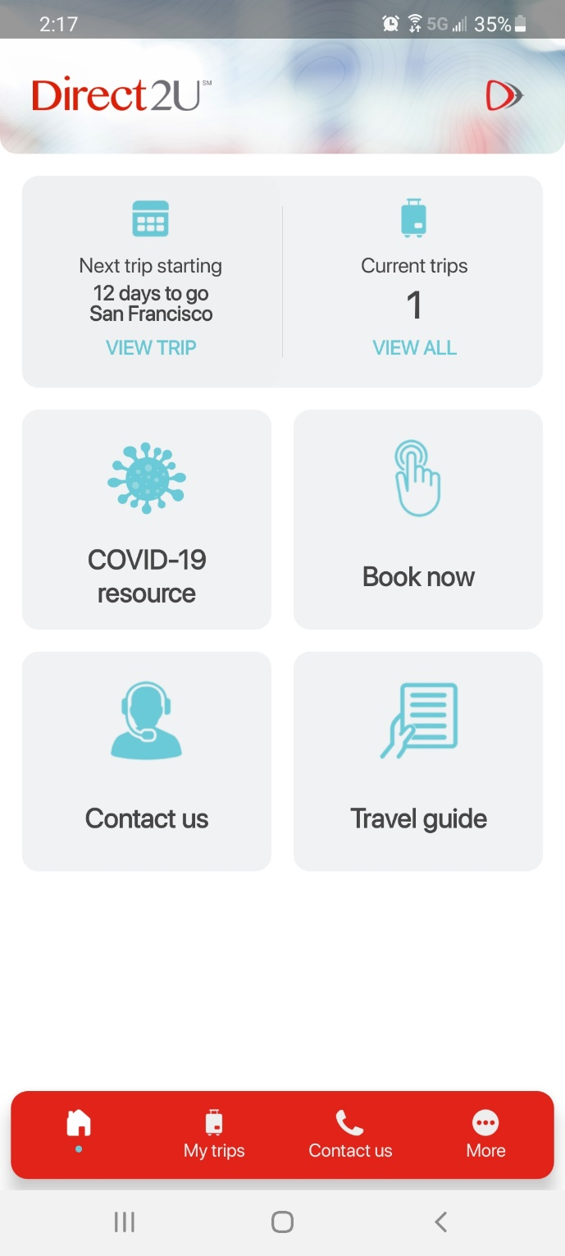
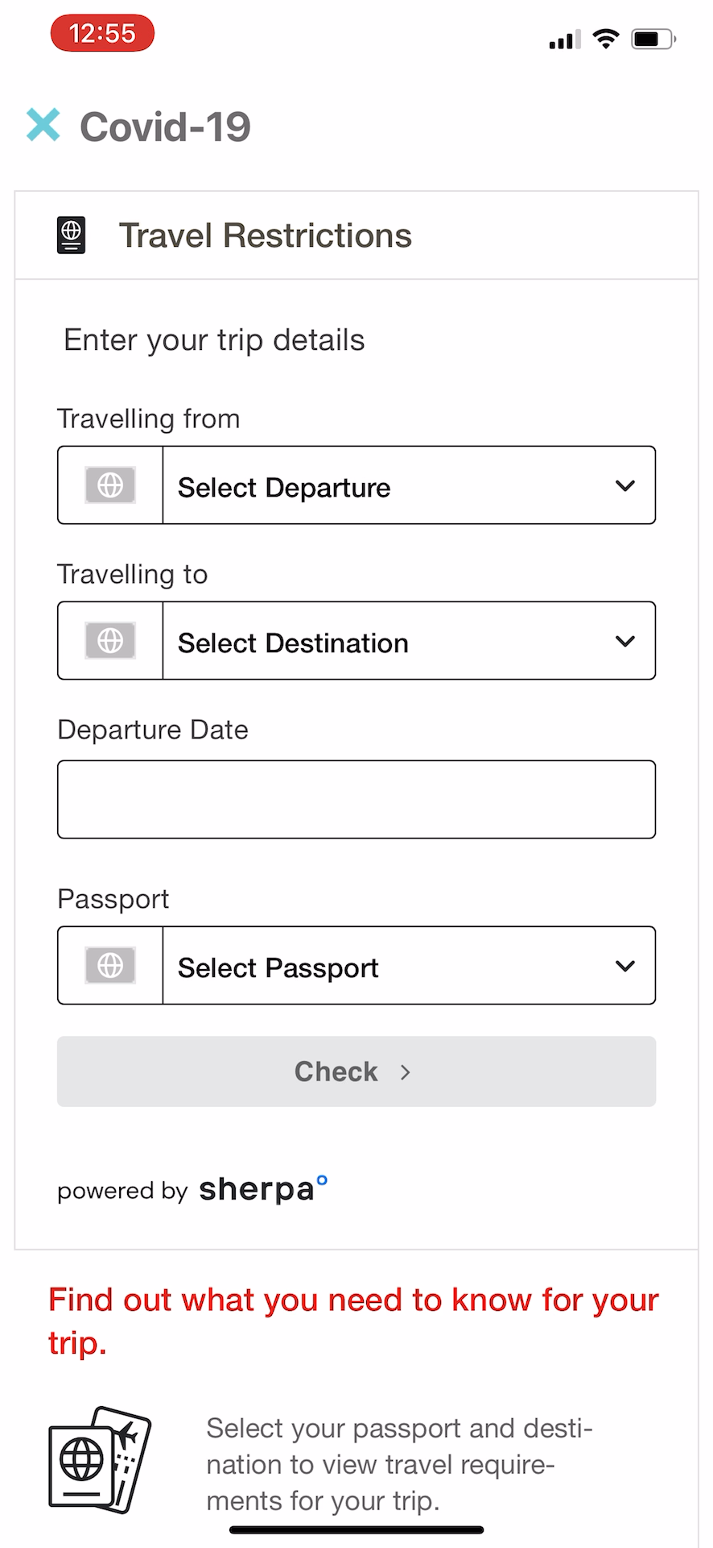

Direct2U Mobile App Demonstration
PREVIEW

Slide 10
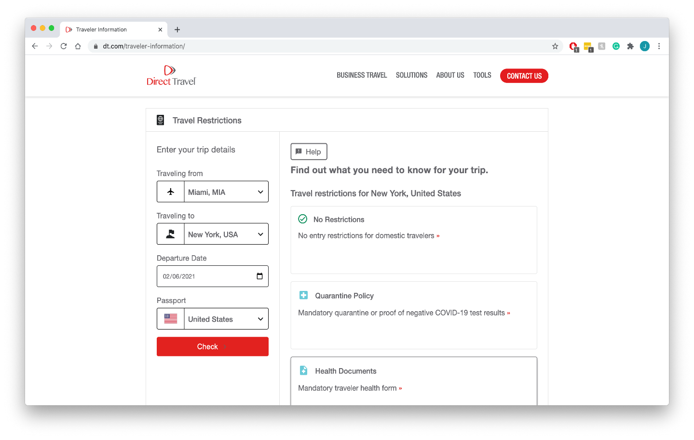
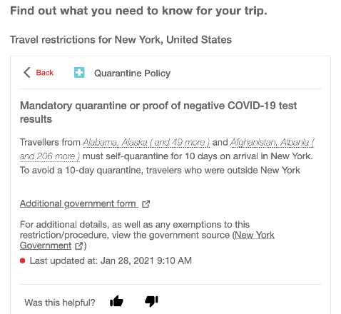
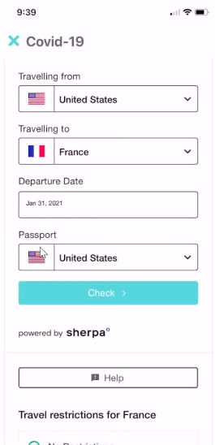
Helping Your Travelers Navigate through Travel Restrictions
Guide your travelers safely and confidently through the COVID-19 travel landscape by providing the information they need and documentation they require with Sherpa.
✓ Display both domestic and international travel restrictions
✓ Fully responsive for any device size
✓ Automatic updates so information is always accurate.
✓ Available on D2U Mobile* and www.dt.com/traveler-information/
* Direct Travel is TMC first to integrate Sherpa on mobile.

Slide 11
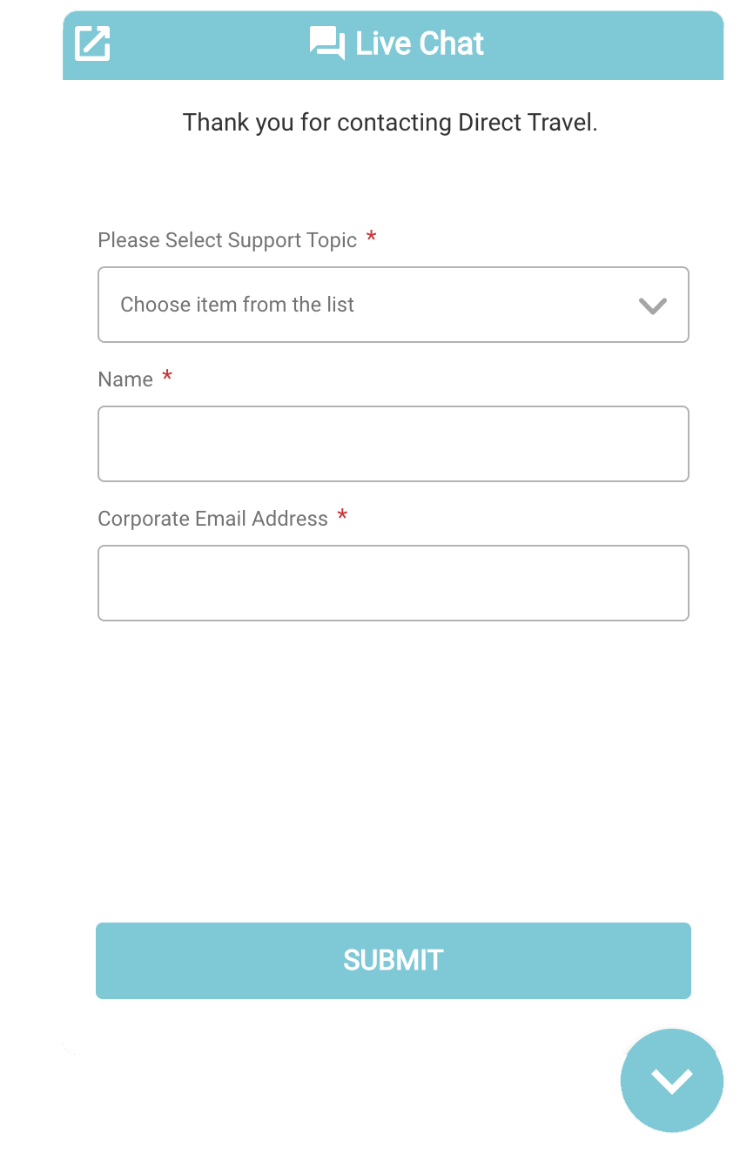
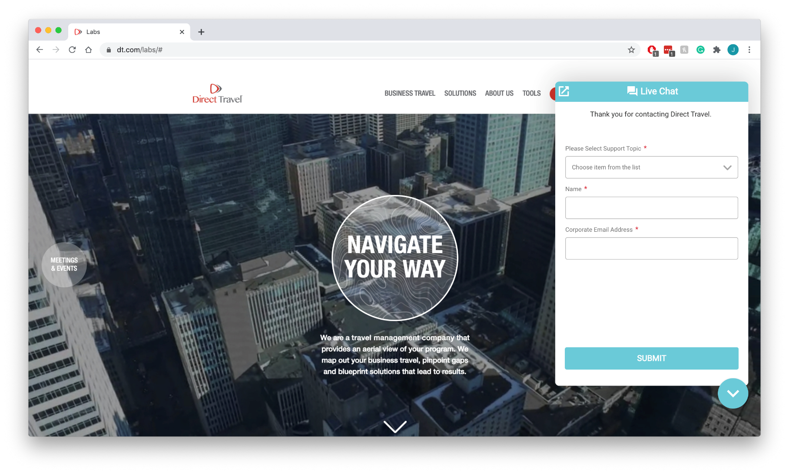
Direct Agent Chat
Offering both automated and live chat experiences
Integration of customer record for personalized interactions
Support Topics:
COVID-19 Information
Itinerary or Invoice Copies
Online Booking Password Reset
Reservation Assistance
Traveler Profile Update
And More
Currently in beta testing

Slide 12

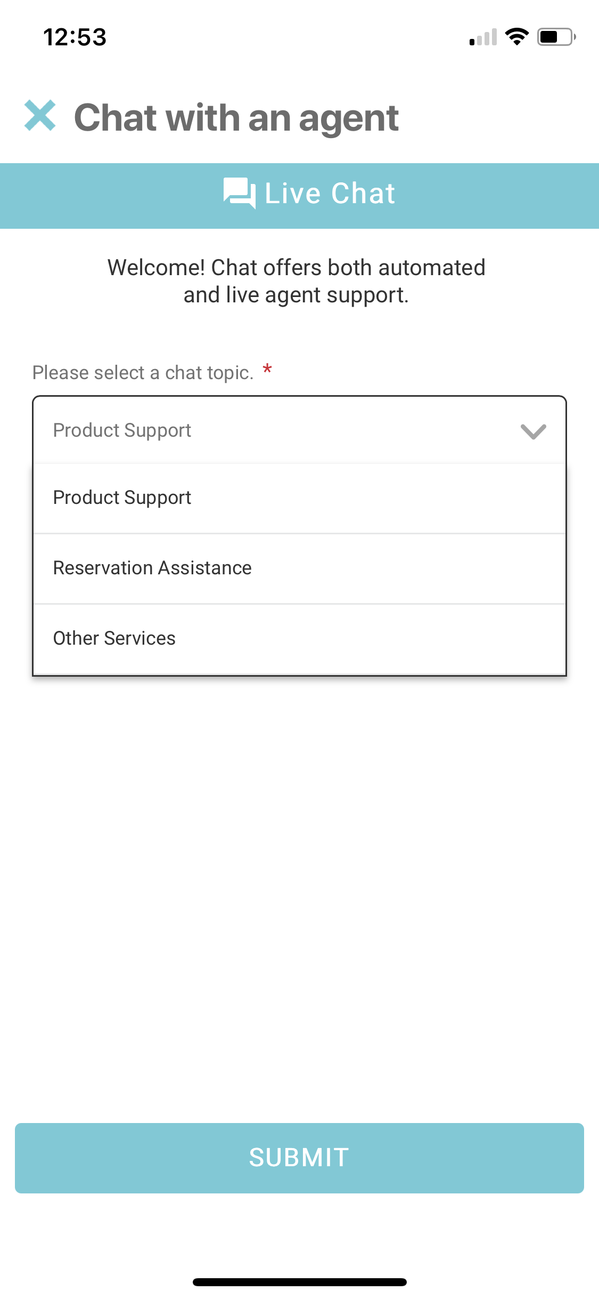
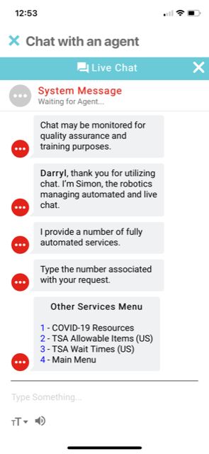
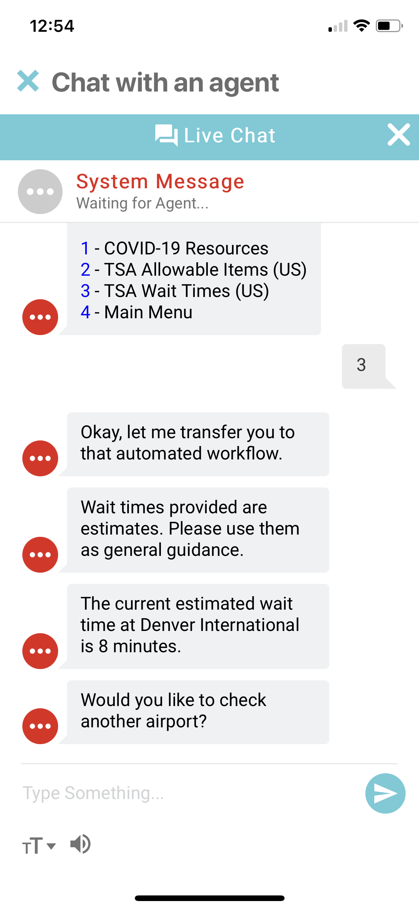
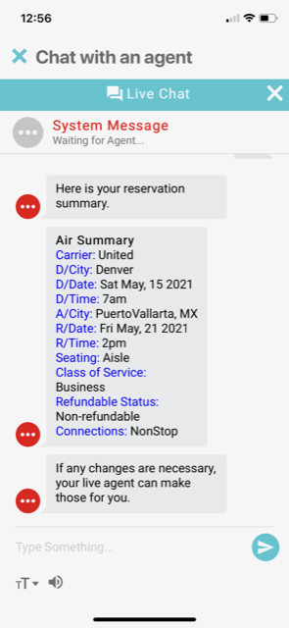
Direct Agent Chat : Offering both automated and live chat experiences. Integration of customer record for personalized interactions
Support Topics:
COVID-19 Information
Itinerary or Invoice Copies
Online Booking Password Reset
Reservation Assistance
Traveler Profile Update
And More
Currently in beta testing

Slide 13

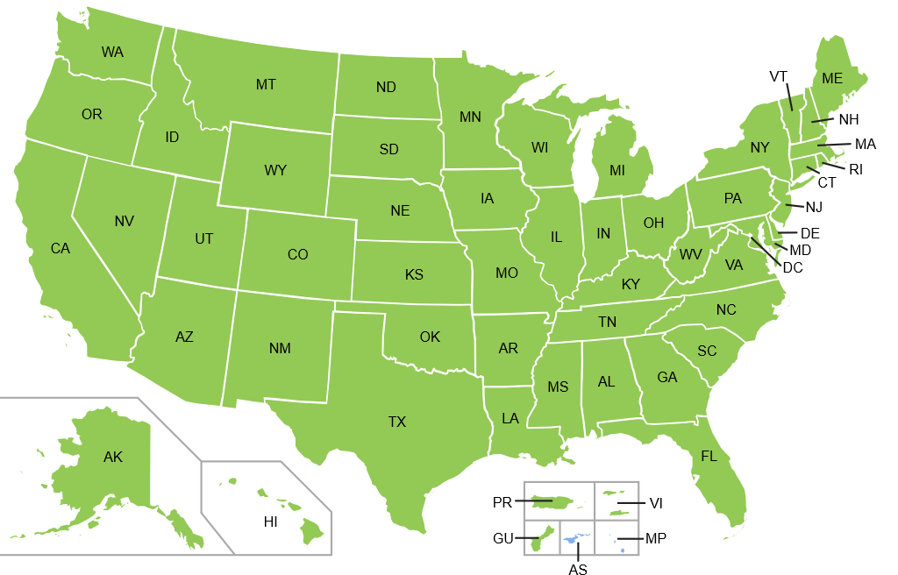
TSA / REAL ID – Travel Update : Extension to May 3rd, 2023
Announced April 27th, 2021:
As of, May 3rd, 2023, US air travelers 18 and older who do not have a license from a compliant state or a state that has been granted an extension will be asked to provide alternate acceptable identification. If the traveler cannot provide an acceptable form of identification, they will not be permitted through the security checkpoint.
Starting May 3, 2023, every state and territory resident will need to present a REAL ID compliant license/ID, or another acceptable form of identification, for accessing Federal facilities, entering nuclear power plants, and boarding commercial aircraft. The card, itself, must be REAL ID compliant unless the resident is using an alternative acceptable document such as a passport.
To stay informed of the latest updates you can visit the DHS website and your state’s DOT website.
For the DHS REAL ID Act information site visit: www.dhs.gov/real-id
For U.S. Passports: www.travel.state.gov
(new US Passport cost: $110, Passport Card: $30)

Slide 14




Getting Back to Travel – Post Company Readiness
What travelers can expect in the “new norm”
Permissible
Location Limitations
Know Before You Go
Reasons for travel will be closely observed. Does the benefit balance any potential risk? Are you an experienced traveler who can find your way through the variances of rules and regulations of travel suppliers and airports.
Travel will depend on what regions, countries and cities are allowing out of state travelers without quarantining upon arrival. Is it a high risk COVID-19 destination and does the government maintain restrictions? All of this will be predicated on what the capacity is for air, rail, hotel, car and ground transportation suppliers. Inventory of travel suppliers will be very different in the “new norm”.
Know what to expect before you travel. Travelers must take responsibility for knowing and underlying health/pre-existing conditions & the impact post trip, airport requirements, entry/exit & restriction regulations of where they are traveling to and from, quarantine regulations, and accommodation policies.
Airports - There will be more restrictions. Security lines will be longer, there will be more requirements for entries, exits, quarantines and limitations
Air/Rail Carriers – Airlines and rail carriers are rolling out new policies to protect passengers and crew from COVID-19 – All of the major carriers, nearly all carriers are requiring crew and passengers to wear masks.
Hotels - Hotels are implementing new standards for sanitizing their properties, how robots are now delivering food and housekeeping items
Ground Transportation – Ground transportation should experience an initial increase as they have significantly fewer controls and restrictions than air. Ride Share/Taxis ae enforcing vehicle cleaning

Slide 15




Developing Evolving Framework
Company Readiness
Supply Chain
Program Management
Create incident Management Team to include Travel, HR, legal, security, risk management, communications and Sr. Leadership. Establish protocols, collect data and communicate.
Design a comprehensive, consistent and proactive approach to protecting employees.
Consider modifications to your current policy to meet today’s new norm, including Meeting & Events.
Ensure a solid traveler communication plan. It’s important they are well informed and comfortable hitting the road again.
Review preferred suppliers to understand safety readiness and changes to key services.
Understand how fundamental changes will continue in the recovery stage and beyond i.e. supply in top city-pairs
Focus on preferred hotels to understand their re-opening strategies and services, i.e.. food service, housekeeping, transportation
Work with your DT Acct. Mgr. to monitor your 2021 preferred hotel program.
Assess and limit risks with ride share partners
Monitor the utilization and tracking of unused tickets and vouchers.
Review and implement:
  policy guidelines
  POS management strategies
  Duty of Care responsibilities
  new reporting requirements
Partner with DT to forecast an appropriate timeframe for returning to travel and ensure service expectations are met.
Notes:
I modified some of the verbiage here under program management since most of the unused ticket work is in place.
By now companies should already have Established cross-functional teams to establish evolving framework (includes policy, demand. If they are large enough to do this.
Per the CDC, “social distancing is difficult on crowded flights and you may have to sit near others (within 6 feet) sometimes for hours.” (2 carriers committed to blocking middle seat)
Added Traveler knowledge – sharing of information and learnings as travel resumes – consider company travel blogs for your travelers to share their experience, tips, tricks, airport insights etc. TMC’s may help support this area, where desired.

Slide 16


Reducing the Environmental Impact of Corporate Travel
Pre-Trip
During-Trip
Post-Trip
Travel Policy and Preferred Suppliers
Enable Travelers to Make Informed Decisions
Change and Demand Management
Reporting and Carbon Offsetting
Engage Marketing to promote a company culture of sustainability
Update Policy to encourage:
  Technology vs. Travel (i.e. video conferencing etc.)
  Greener transport options i.e. Rail, Public Transport etc.
  - Greener Hotels and compliance to hotel initiatives i.e. re-use of towels/toiletries, recycling waste etc.
  Use of Hybrid, Electric or smaller vehicles
Include sustainability questions in RFP’s and use responses in the selection process
Use of Direct Messaging to inform travelers of environmentally friendly options
Messaging in the Online Booking Tool to guide travelers booking choices
Encourage or incentivize travelers to explore alternative options to travel
Distribute department level CO2 emissions reporting to create a competitive culture that supports Company sustainability goals
Partner with a third party Carbon Offsetting company i.e. South Pole who understands Corporate Travel and will work with you to support your preferred Carbon Offsetting initiatives
Highlight sustainable travel suppliers as ‘Company Preferred’ on your Online Booking Tool
Enable CO2 emissions to be displayed on your Online Booking Tool
Promote the use of Carbon Calculators
Third party software i.e. Tripkicks can be used to highlight the most environmentally friendly travel options

Slide 17
UO : Q & A
Can you speak to the scarcity that the pandemic created in certain supply chains (airlines, hotels, rental cars), and how this has affected the industry and will continue to affect the industry as business resumes?
Both airlines and hotels have been able to secure inventory/volume to match the significant increase in demand. The one challenge has been in the area of rental cars, as there is a backlog of demand for new vehicles and they have not been able to purchase sufficient inventory to meet demand. We are working with vendors to meet the demand; however, the key is booking as early as possible. This will ensure that travelers are guaranteed a rental car. Airfare should be fine, although last-minute prices are becoming very expensive. Hotels are the area that appears to have the largest inventory.
University of Oregon travelers tend to book too far in advance. What is the ideal timing for booking air, hotel and car reservations?
We continue to advocate that business travelers should book between 21 and 28 days in advance. With all suppliers adding new inventory each week, we think staying within this timeframe should be sufficient after the summer months. Over the next few months, we advocate a little longer purchase time.

Slide 18
UO : Q & A
Is there is a day(s) of the week where airlines are known to make major fare adjustments? If so, does booking earlier still equate to lower fares?
International: Fare loads are hourly, so 24 times a day.
North American: Fare loads are 4 times per day M-F (approx. 1000,1300,1600,2000 ET) and once a day Sat-Sun (approx. 1700 ET).
The most economical days of the week to travel are usually Tuesdays and Wednesdays.
This month, global capacity was 266.8m, 43% below seats in April 2019. During the month, carriers removed 6.9m seats as demand faltered due to ongoing lockdowns across various parts of the world.
The latest schedule for the full month of May 2021 is showing 3m fewer seats than it did one week ago, a downward revision of 1%. This means for the full month, capacity has fallen by 12m so far, down to 280m seats from 292m.
As seen in recent weeks, with markets beginning to reopen in Europe, the UK and Spain continue to see capacity growth week on week. Carriers have added 133,000 seats in the UK, a 20% increase from last week, but the UK is still 79.2% behind the same week in 2019. US capacity also continues to grow, seeing 0.6%, or 101,000 more seats this week versus last week.
Capacity is very volatile since the beginning of the pandemic with many external factors, such as those mentioned above, having impact. Regions of the world and specific carriers are all very different.

Slide 19



Thank you for your business!
Direct Travel is committed to continually
investing in your program to exceed both your
service and financial expectations!
~ Your Direct Travel Team

Slide 20
Frequently Asked Questions
Q: Will vaccination requirements be listed?
A: They will add vaccination requirements as they outlined by the respective governments.
Q: How often is the information updated?
A: Daily.
Q: Will this auto populate based on itinerary already booked?
A: No, though we are looking into what development costs for this would look like.
Q: Will a D2U user need to update the app to see the covid-19 resource tile?
A: If the user’s phone is set to automatically update apps, then there’s no action required on the user’s behalf. If not, then the user would need to update the app.
Notes:
Internal Only / Do Not Distribute

Slide 21
Frequently Asked Questions
Q: I see the restrictions traveling to France, but does Sherpa show the restrictions for returning back to the USA for example?
A: No, however we have suggested to the Sherpa team that a reverse type button be integrated and they have responded that we are not the only company to suggest this. Hopefully a feature coming soon.
Q: Does the widget show testing locations?
A: No, but our itineraries link to testing locations.
Q: Will the Sherpa link be on the global ATPI On the Go app?
A: Yes.
Notes:
Internal Only / Do Not Distribute

Slide 22
Frequently Asked Questions
Q: Will there be a link on our D2U itineraries that takes travelers to Sherpa?
A: Yes, a link can be added to Quick Links per request. However, the Sherpa widget will be available on the D2U Mobile app and DT websites.
Q: Is there a way to switch languages?
A: Sherpa supports English, and on February 19th will also support French Canadian.
Q: Are there any integrations with the OBTs?
A: No.
Notes:
Internal Only / Do Not Distribute

