Slide 1
Concur Reports and Banner Documents
How to Easily Identify Transaction Created By Concur

Slide 2
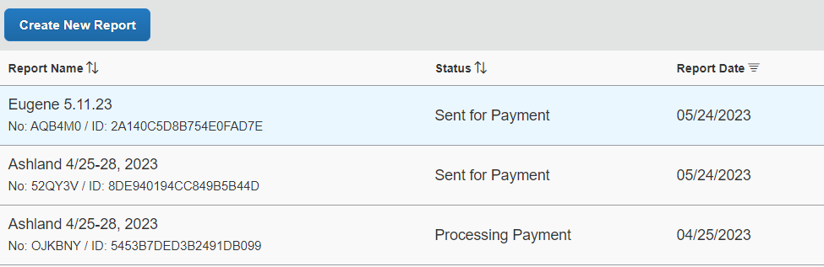
Concur to Banner-An overnight process
Concur expense report has been processed = Payment Status: Processing Payment
Overnight process transfers to Banner = Payment Status: Sent for Payment

Slide 3
Banner Documents
C documents-Invoices payable to the traveler (Example C0050869)
  Debit to the department index, account code appropriate to item
ZK Journal Voucher-Airfare transaction paid with the Lodge Card (Example ZK043766)
  Debit department index, Account code 35130 or 35330
  Credit fund 001100, Account code A5103
Z3 Journal Voucher-One Card transaction (Z3043771)
  Debit department index, Account code (appropriate to item)
  Credit fund 001100, Account code A5102
Z4 Journal Voucher-Foreign Travel Insurance (Example Z4043770)
  Debit department index, Account code 28701
  Credit Z0RMPC, Account code 28701

Slide 4
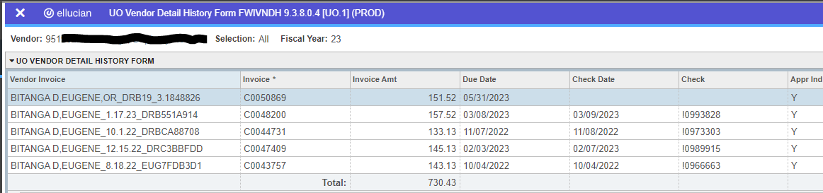
Banner Clues-Vendor File
FWIVNDH

Slide 5
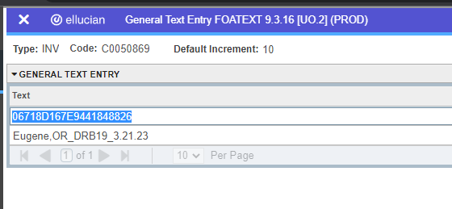
Banner Clues-Report References
FAAINVE and FOATEXT

Slide 6
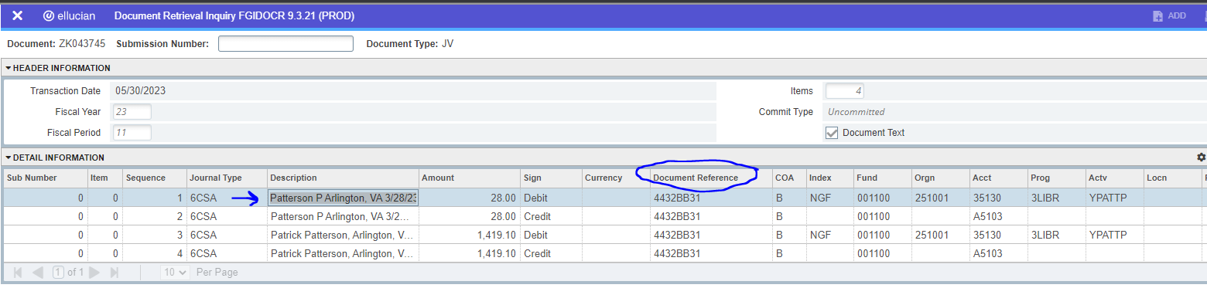
Banner Clues-Document References (JV)
FGIDOCR (ZK043745)
  Description: Traveler name and trip name (from Concur)
  Document Reference field lists last 8 characters of the Concur Report ID
  FOATEXT will have complete report ID

Slide 7
Questions?

