Slide 1
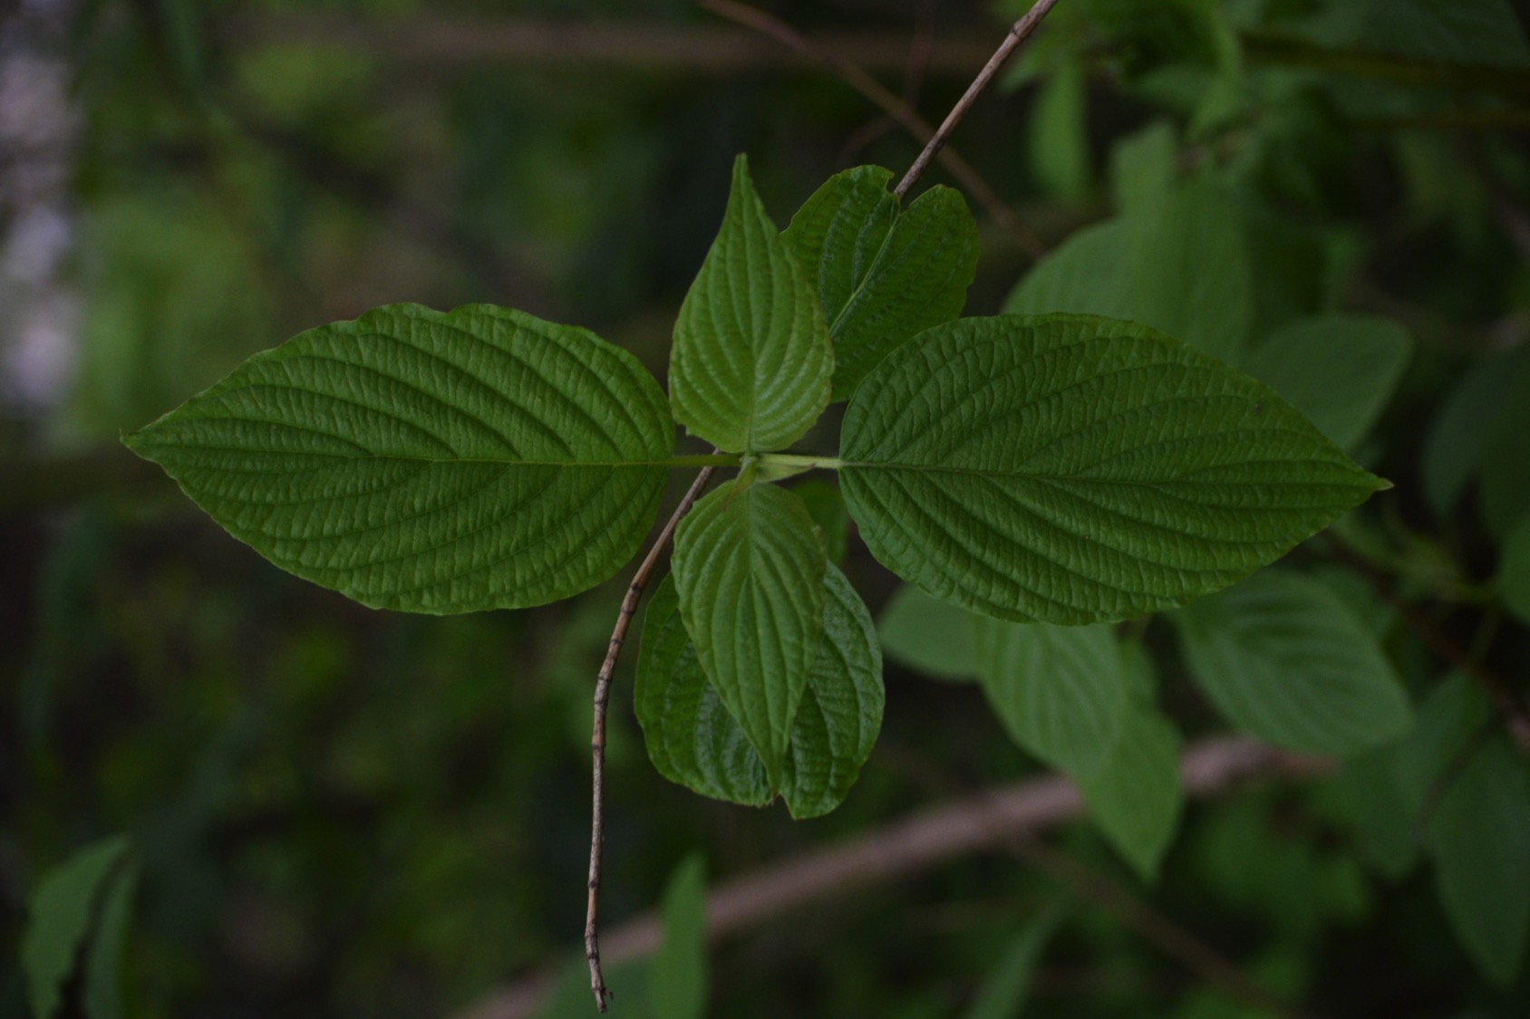
Succession at the Eugene Millrace Pond
Tanner Wentlandt

Slide 2
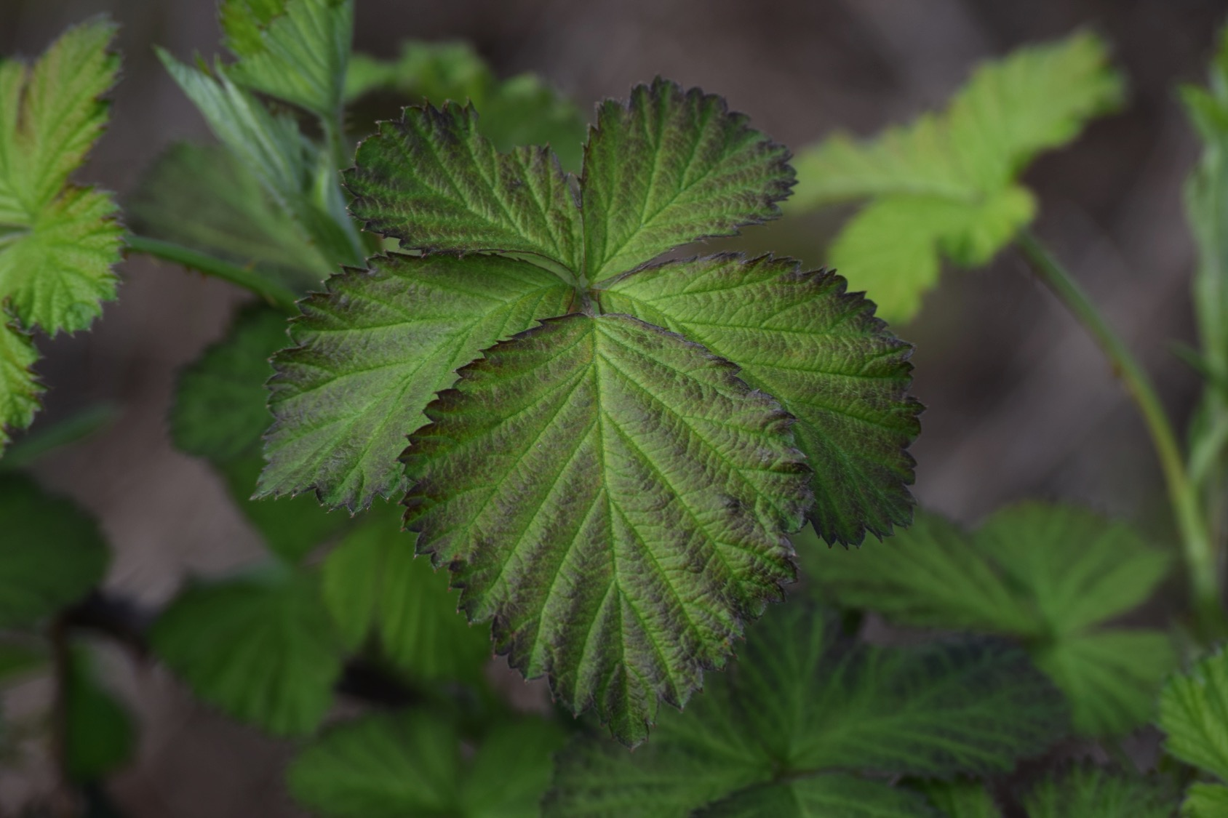
Question:
How does today’s Millrace Pond compare with what it was 50 years ago? 500 years ago?

Slide 3
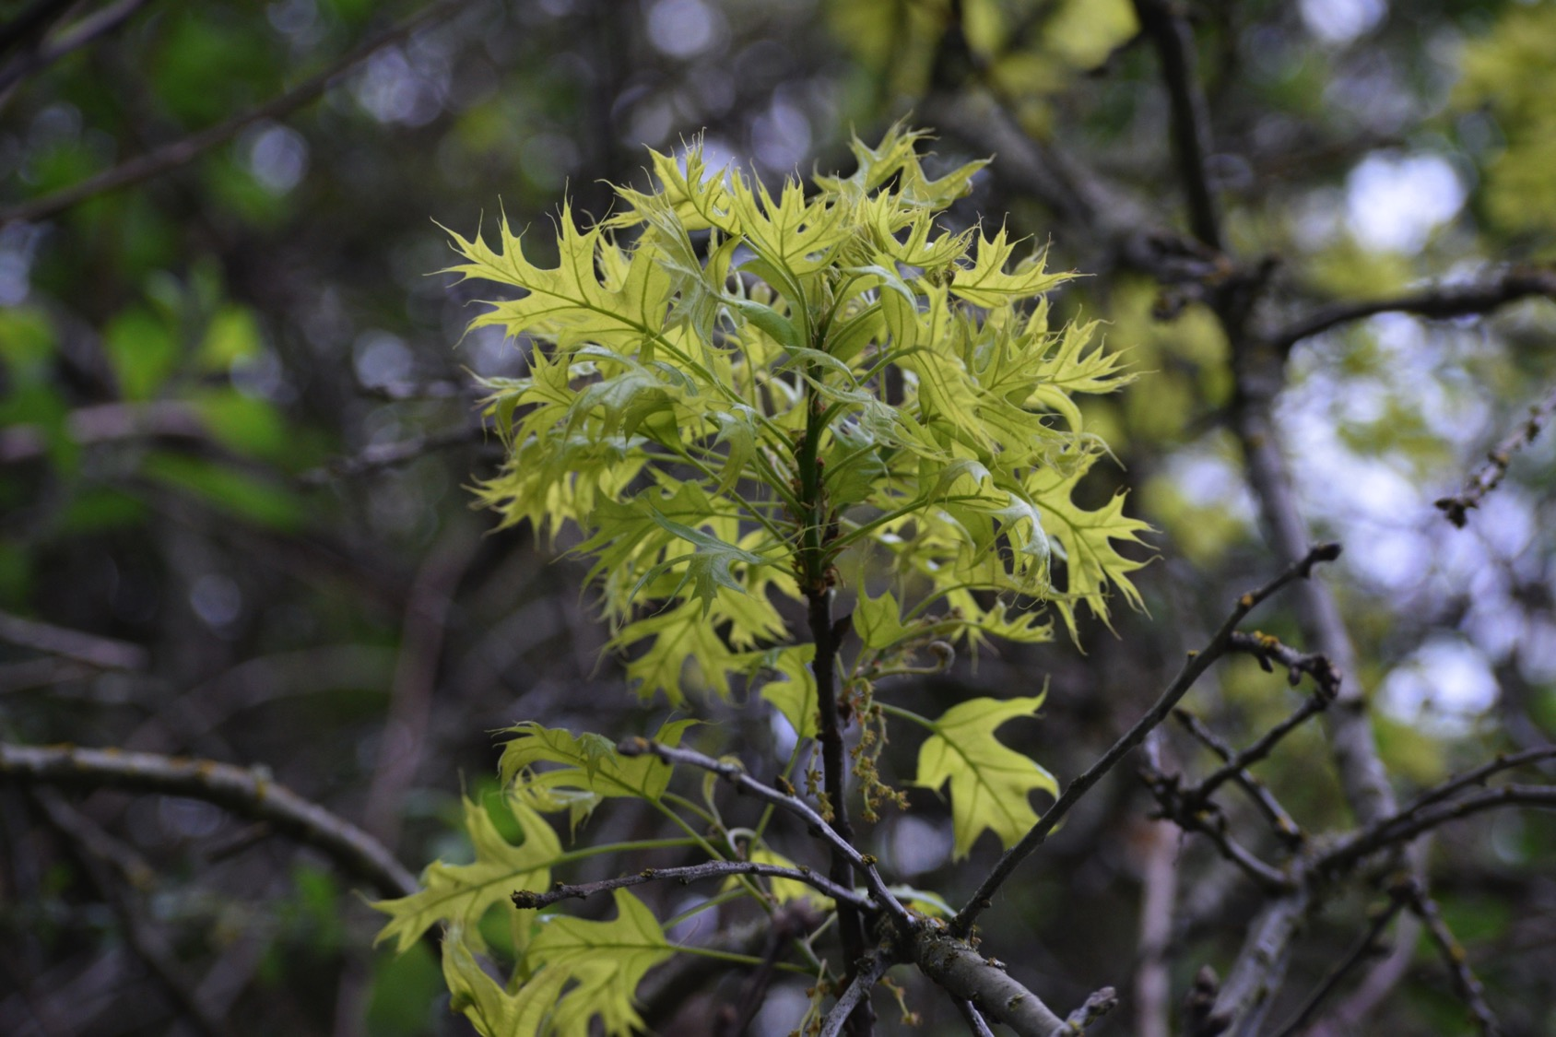
Today’s Pond vs. the Pond of the 1960s

Slide 4
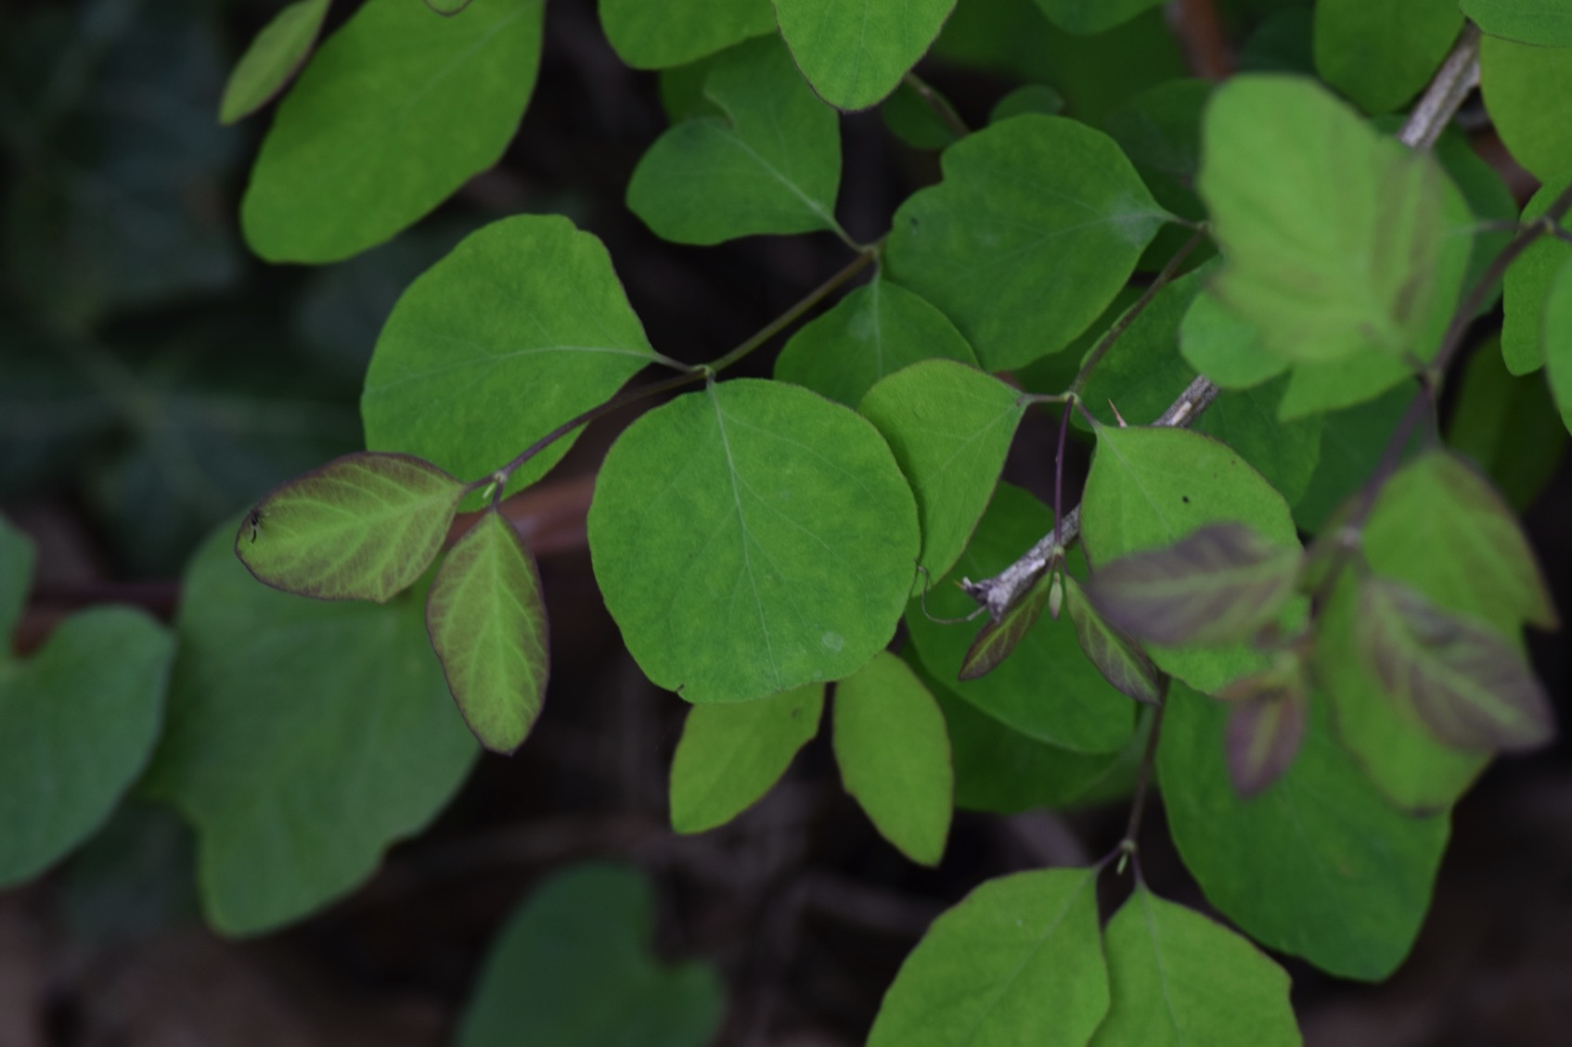
Method:
Scour the internet and local resources for old pictures of the Millrace Pond
  Lane County Historical Society
    Don Hunter Collection
Take “before and after” style pictures
Identify plants in old pictures

Slide 5
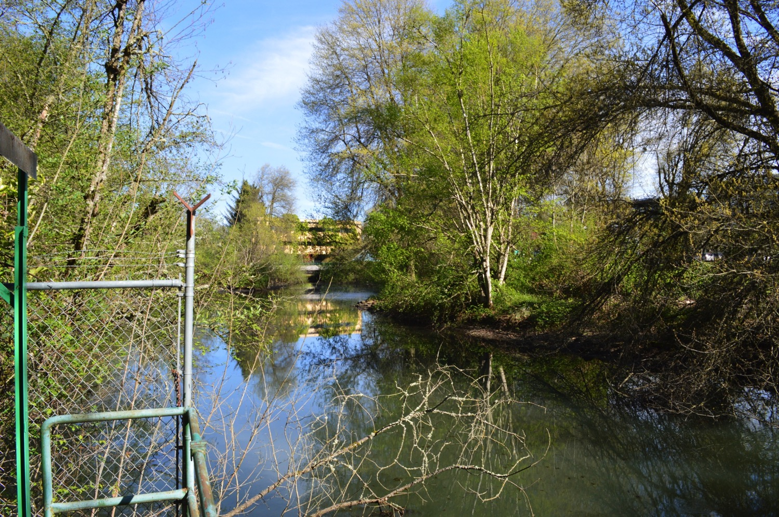
2017

Slide 6
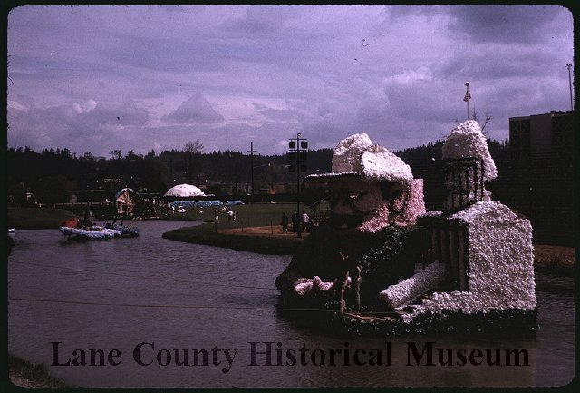
1963
Don Hunter

Slide 7
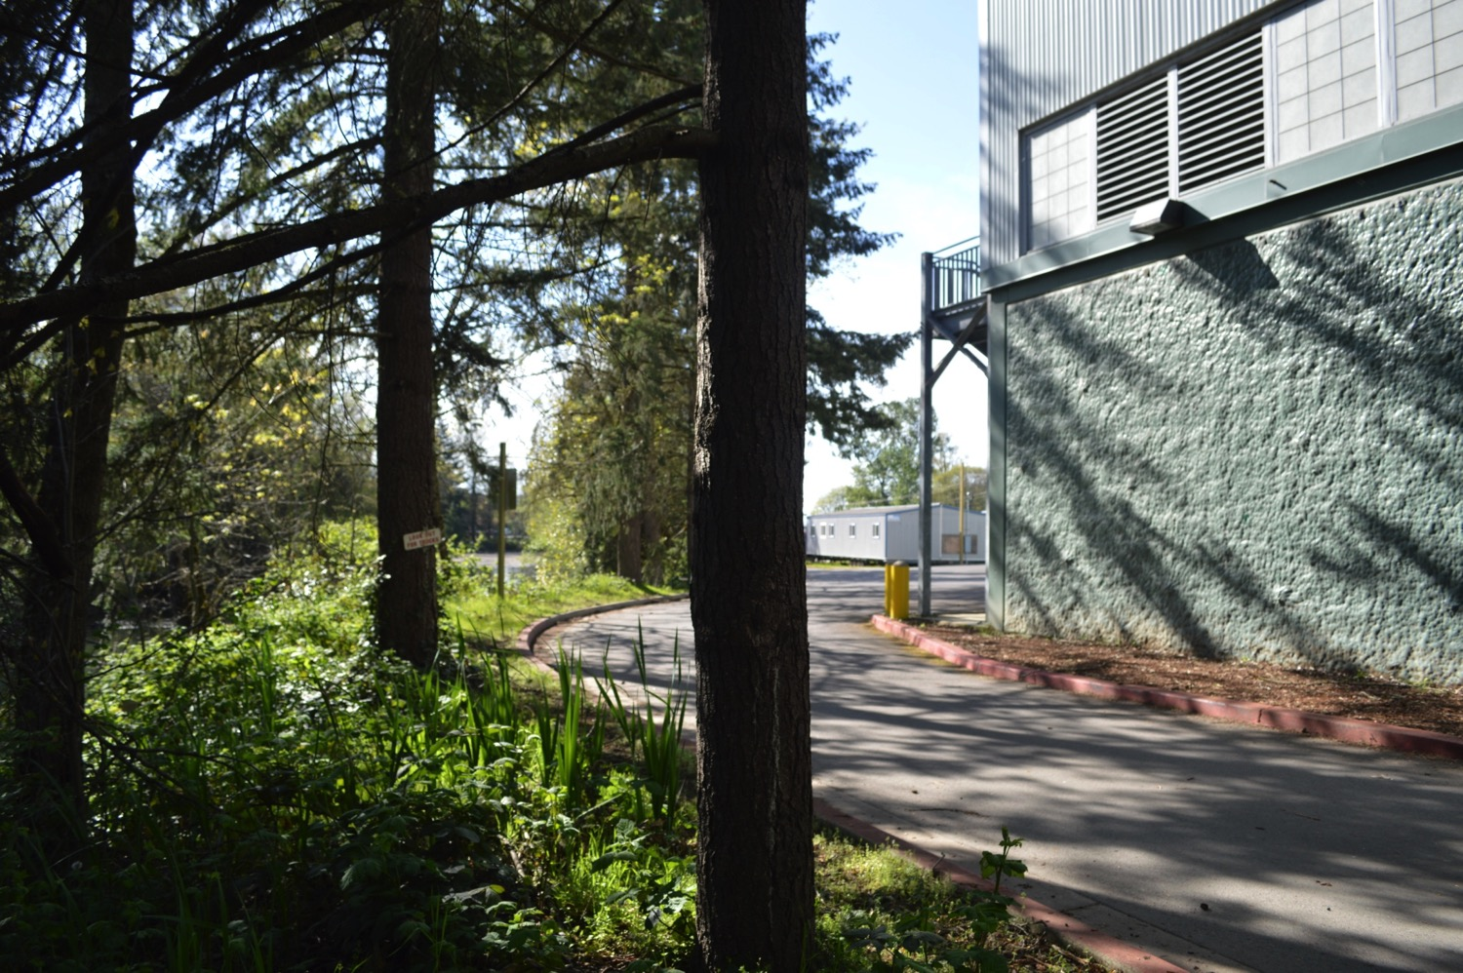
2017

Slide 8
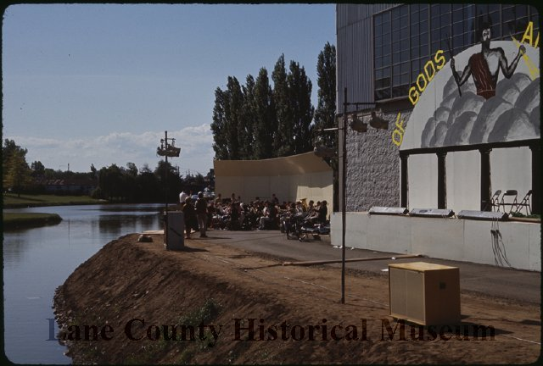
1963
Don Hunter

Slide 9
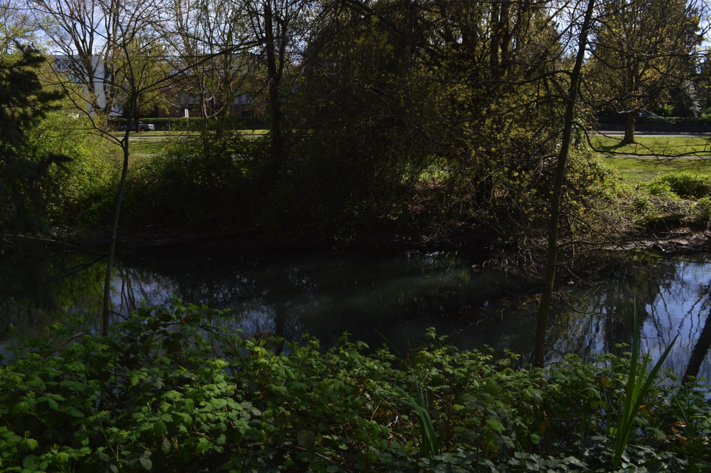
2017

Slide 10
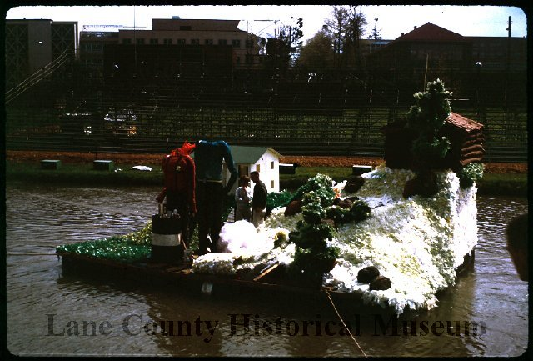
1963
Don Hunter

Slide 11
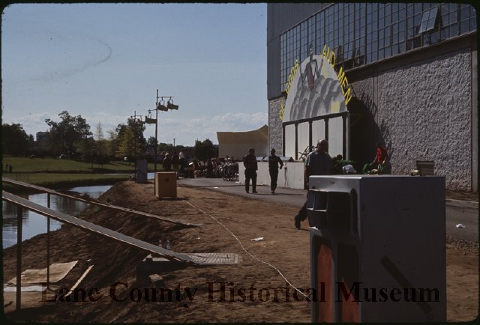
1963
Don Hunter

Slide 12
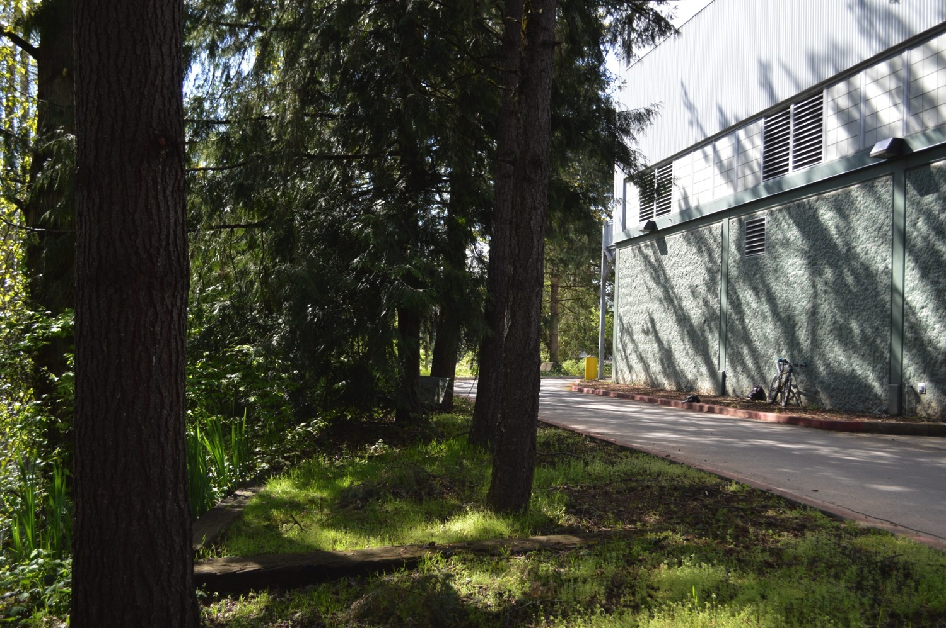
2017

Slide 13
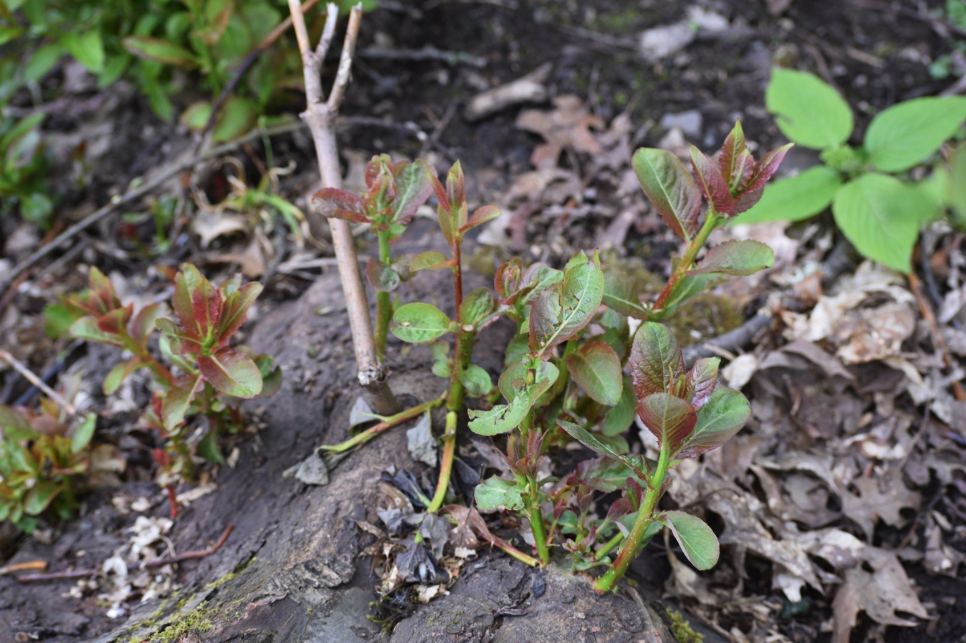
Grass and Dirt to Canopy in 54 years
I had assumed that the vegetation was far older than that
Made plant ID easy

Slide 14
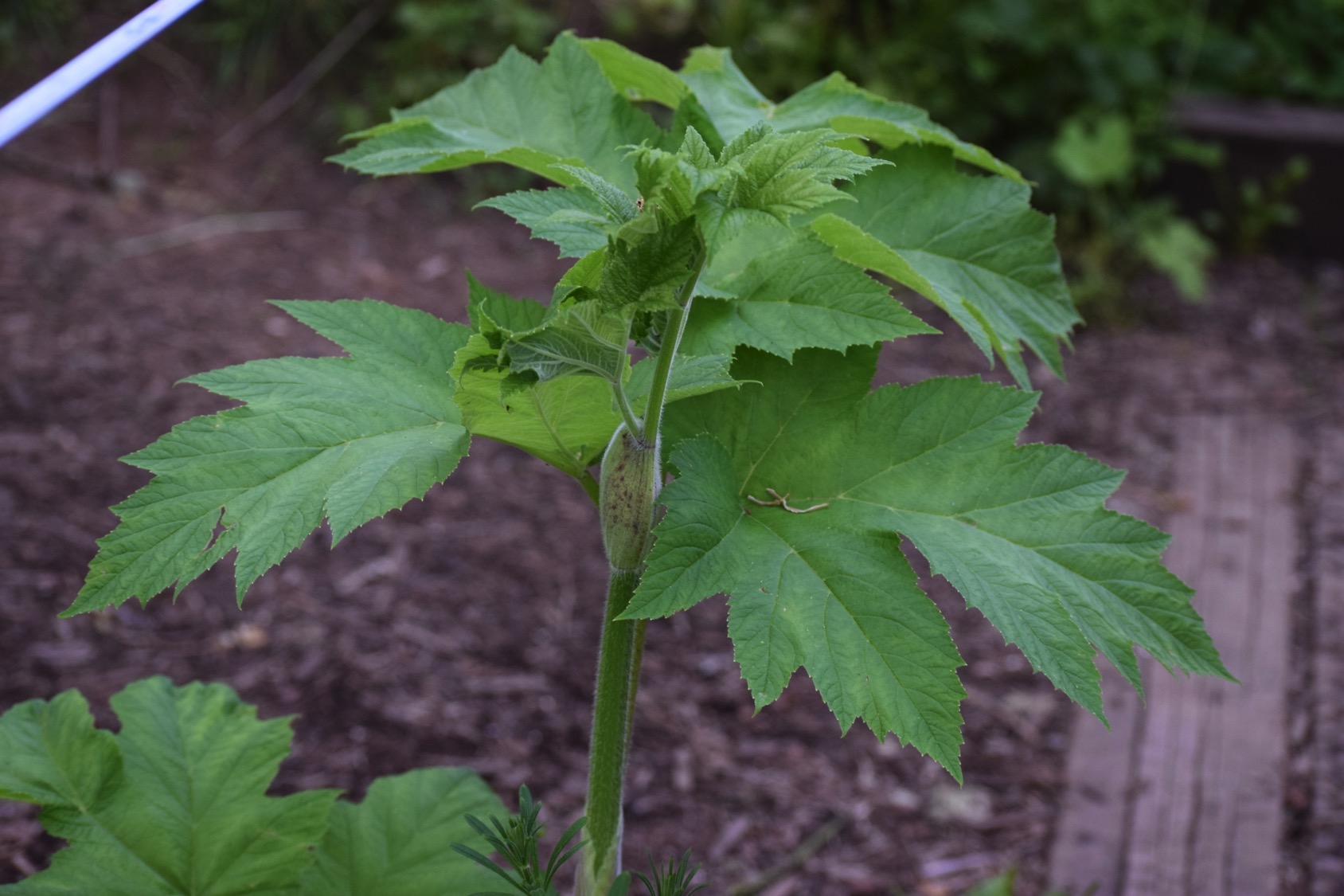
Today’s Pond vs. the Pond of 500 Years Ago:
The Quest for Analogous Ponds
(and Hydrocortisone)

Slide 15
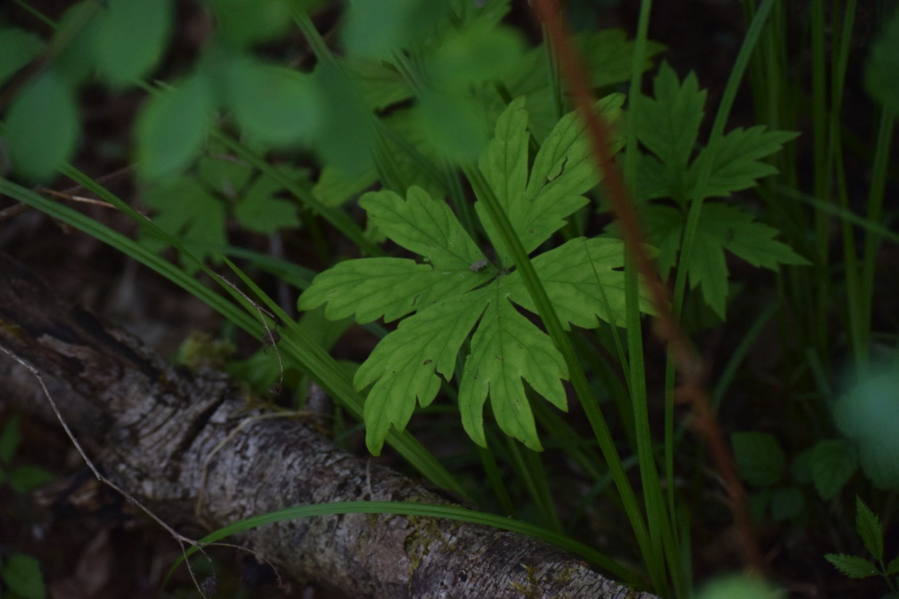
On Analogous Ponds:
I needed to find a pond/slough that would be a
good representation of what the Millrace Pond
would have looked like 500 years ago.
I was looking for a pond that had not been
altered much since then, and I was told about
two.

Slide 16
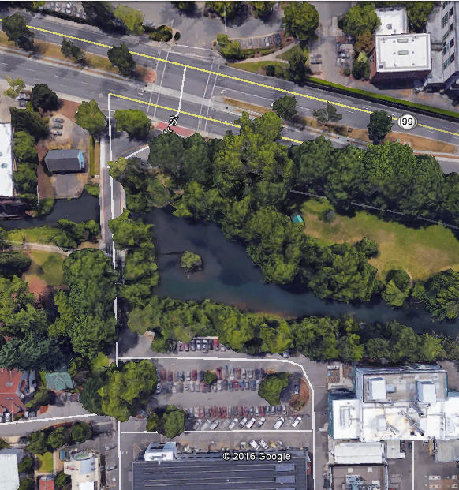
Millrace Pond
What’s there?
How much?

Slide 17
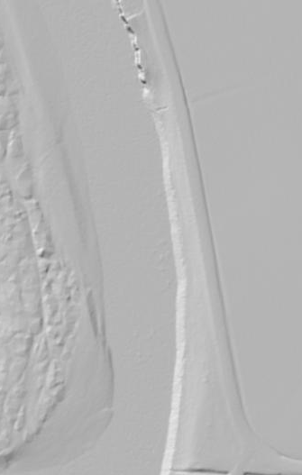
Method:
Belt Transect
One 30-meter transect parallel to water’s edge
One 5-meter transect perpendicular to water’s edge every 5 meters along the 30-meter transect

Slide 18
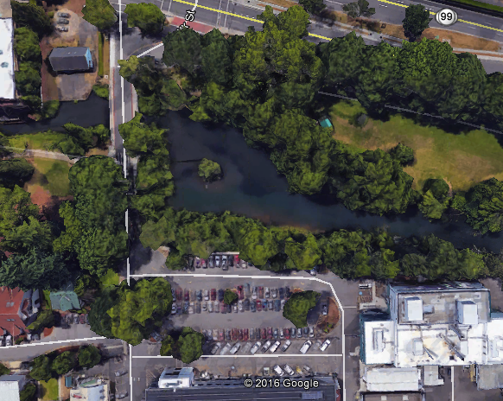
Millrace Pond Transect

Slide 19
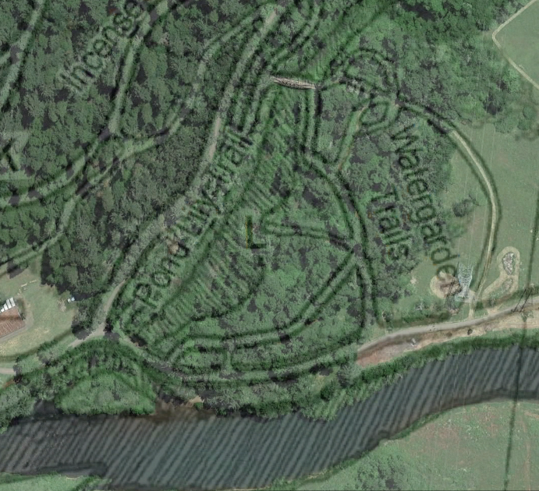
Analog 1: Mt. Pisgah Water Garden
(Approx.)

Slide 20
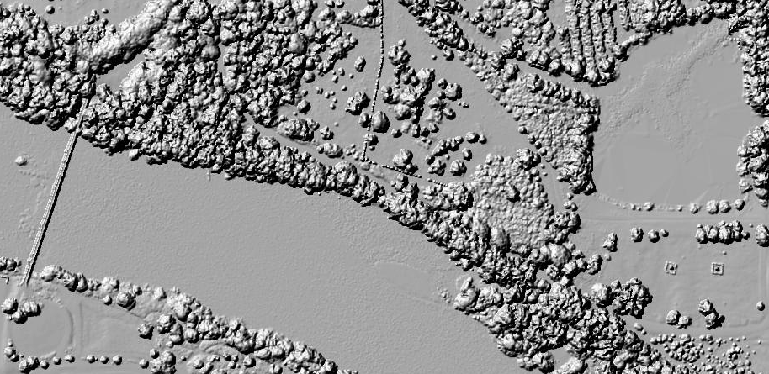
Analog 2: Willamette River Slough

Slide 21
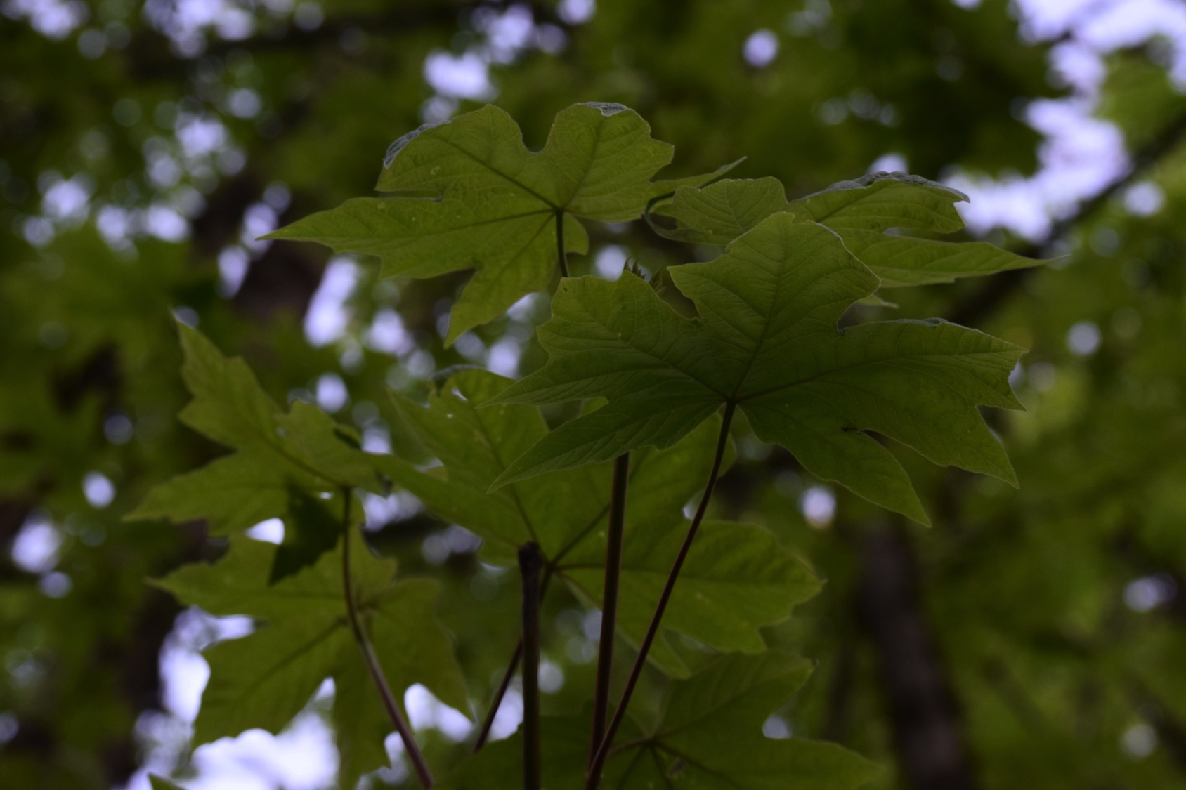
Initial Observations and Changing Ideas
Initial findings showed no obvious change in vegetation type in lateral transects
Decided to break parallel transect up into 5-meter sections and add percent cover calculations from those to lateral transect data

Slide 22
Results

Slide 23
Results

Slide 24
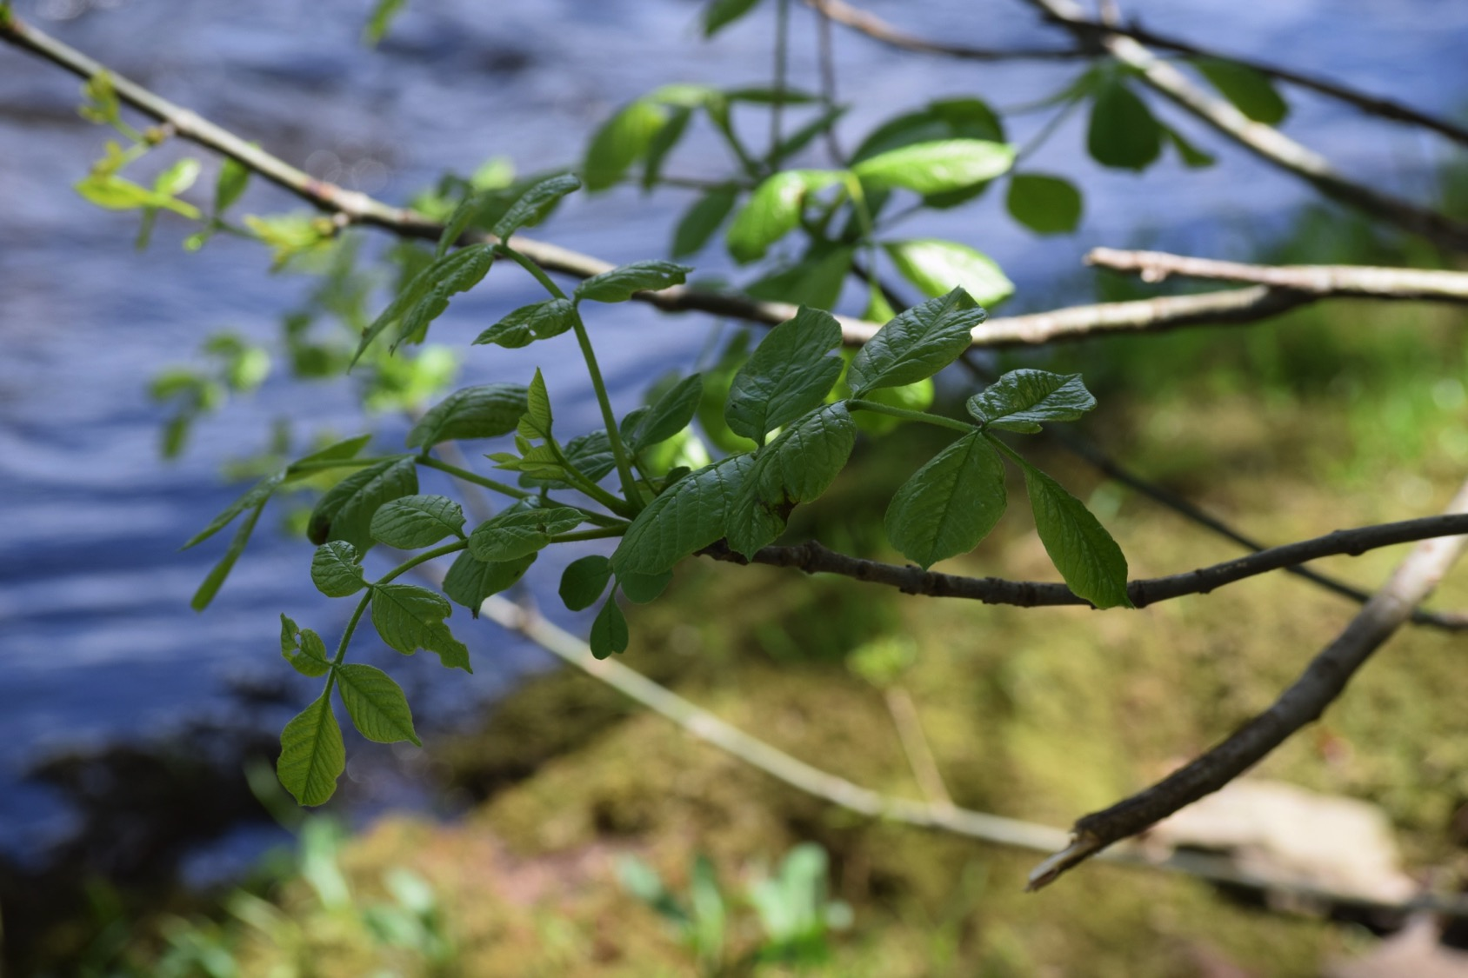
Conclusion
The Millrace Pond was largely planted
  Less native species
Would have had far more canopy cover from F. latifolia and A. macrophyllum
Would have had a shrub layer of S. albus
Wouldn’t have any R. bifrons or non-native Quercus sp.

