Slide 1
MILLRACE
WE ALL KNOW THE HISTORY

Slide 2
Issue:
$30,000+ a year
Energy waste
Not enough water

Slide 3
Two Possible for Sustainability
Ram Pumps
Reconnect Mouth to Willamette

Slide 4
Ram Pumps
Uses kinetic energy of river to pump water uphill.
Easy/inexpensive to build and maintain

Slide 6
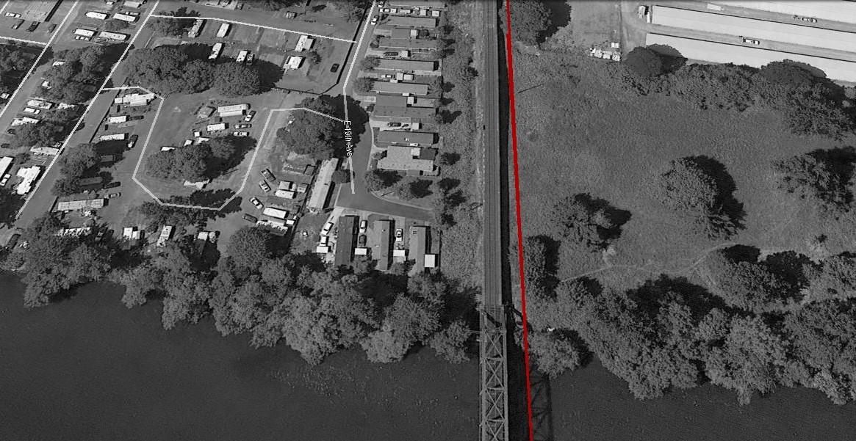
Section 1
418 feet long
Average depth 11 feet

Slide 7
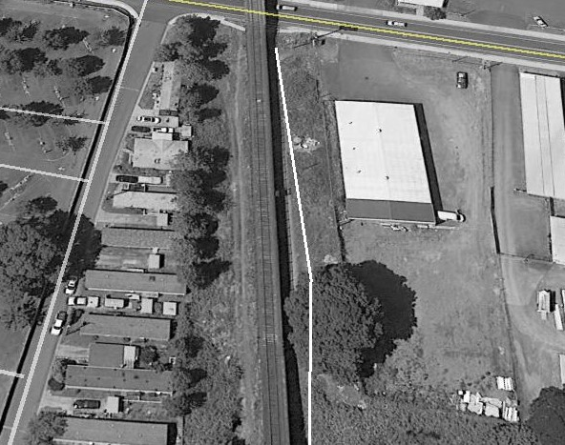
Section 2
361 Feet long
Average depth 14 feet

Slide 8
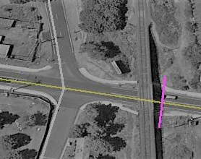
Section under Franklin Blvd
96 Feet Long
Average 13 feet depth

Slide 9
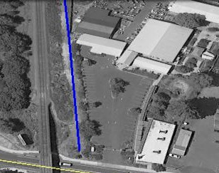
Section 4
570 Feet Long
9 Feet Average Depth

Slide 10
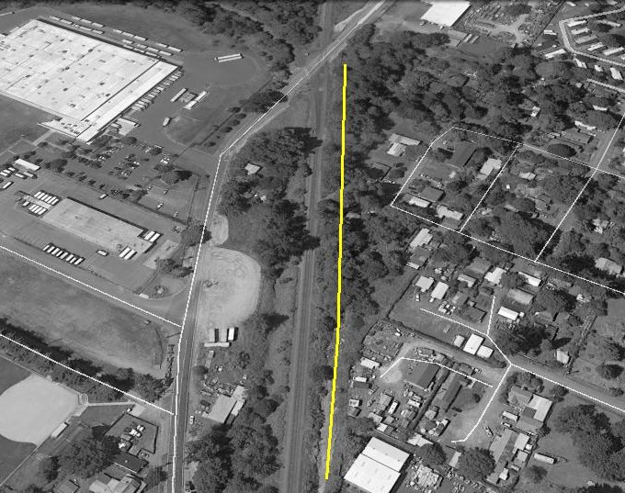
Section 5
1,147 Feet Long
5 Feet deep

Slide 11
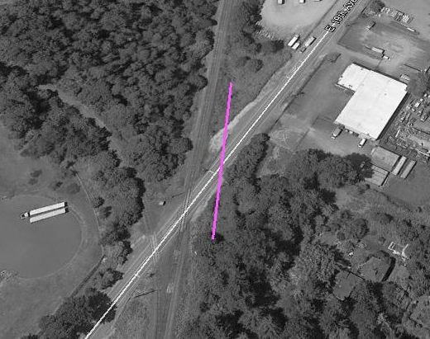
Section under 19th street
360 Feet Long
15 Feet Deep

Slide 12
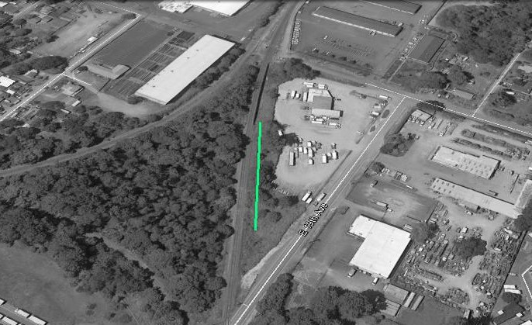
Section 7
450 Feet Long
9 feet deep

Slide 13
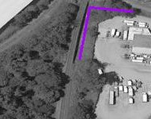
Creek Section A
359 feet long
First 244 feet open down 13 feet
Last 195 feet Could Be Open Canal, at
Elevation 428 feet.

Slide 14
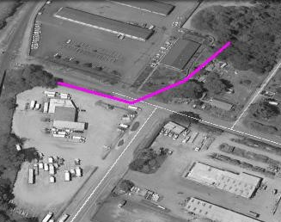
Section Under Henderson St.
585 Feet open Canal
Average 9 feet deep
Bridge

Slide 15
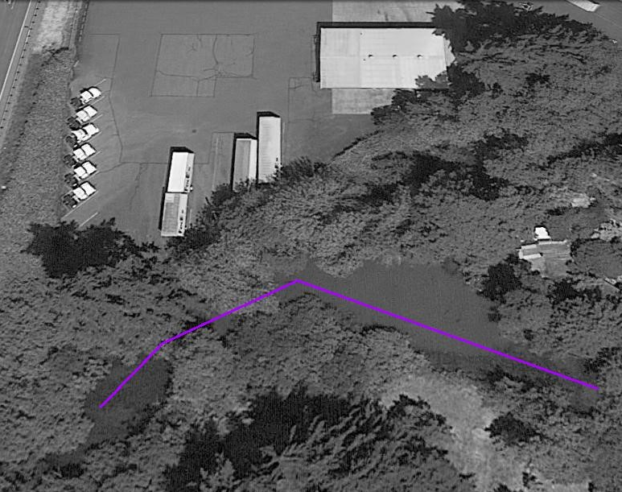
Creek Section B
287 Feet open cannal

Slide 16
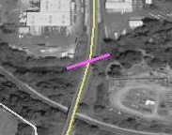
Section Under Glenwood Dr.
12 feet long average
8 feet deep
10 foot wide open canal
Bridge

Slide 17
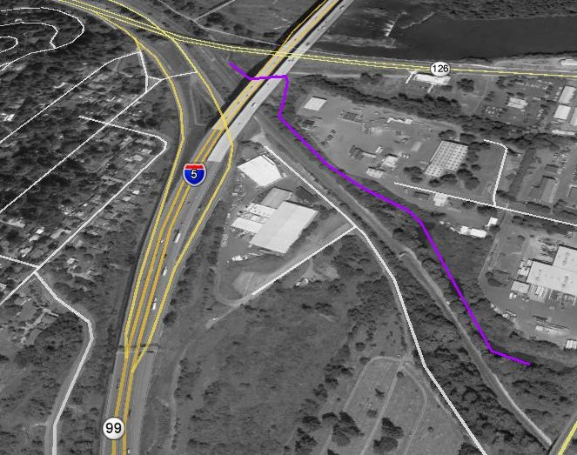
Creek Section C
2,611 Feet Of Open Canal
10 to 15 feet wide

Slide 18
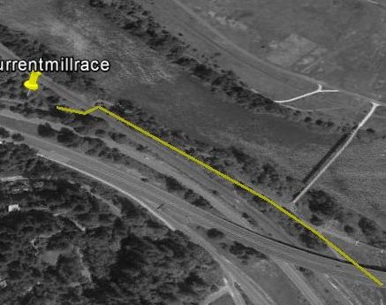
New Canal Section
422 feet of new canal connecting creek to
Mill race at elevation 428.

Slide 19
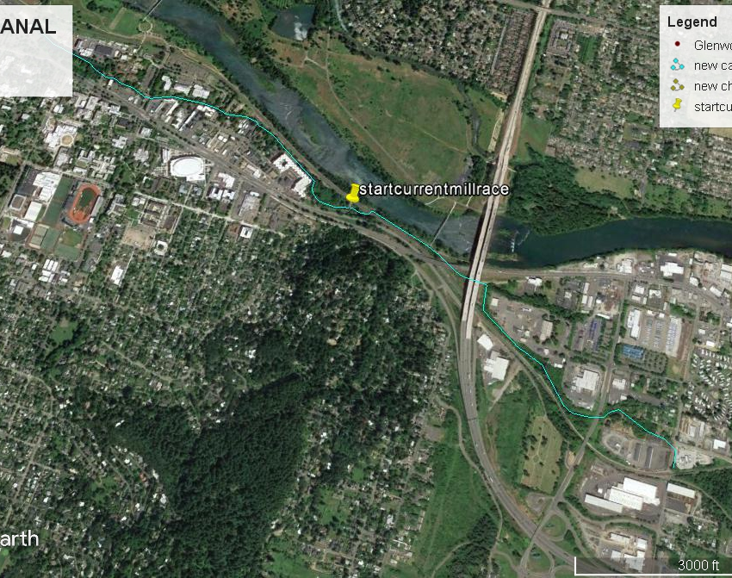
Total canal Route
2.3 miles of canaL

