Slide 1
Eugene Millrace
Past, Present, & Future of Recreation

Slide 2
Past: How did recreation emerge along the Millrace? What did people do? Who participated? What’s the societal context?
Present: Why did it decline? Do people still use it and how?
Future: Who wins & who loses? Where does money come from? And Other considerations?

Slide 3
Why consider Outdoor Recreation?
-Recreation: “refreshment of strength and spirits after work”, a “hobby” (Merriam-Webster)
-Some of people fondest memories are along the Millrace…
-Being outside and moving can keep people healthy and happy
-Personal Interest in Outdoor recreation
-Industry declining by the turn of the , but water was still flowing through
Notes:
Reword? Or rearrange?

Slide 4
Recreation on the Millrace: 1880’s-today
-ice skating/hockey: the beginning of recreation in 1880’s
-skiff, canoe & boathouse: 1st boathouse opens in 1890, and 2 others in early 1900’s
-swimming
-fishing in the early days
-Canoe Fete parade: begins in 1915,
-Millrace Olympics
(Dietz, Diane. “University of Oregon Architect Michael Harwood revives talk of rehabilitating Eugene Millrace”, The Register Guard, Dec 2016)
Notes:
Canoe fete and Millrace Olympics : uring parents weekend (significance), brought out creativity , during jR. weekend(?), drew national attention and praise?
also during JR weekend, fun, community events- more on why or how it helped?

Slide 5
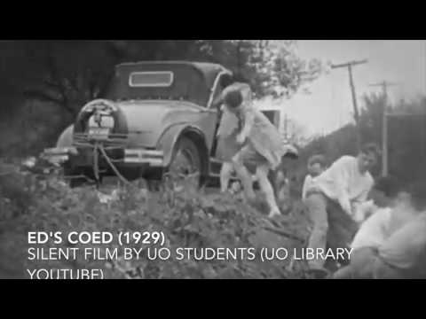
Video: Millrace Recreation
Sources:
Lane Historical Society Digital Archive, Canoe Fete video
University of Oregon Archives
Oregana Yearbooks
Youtube: Ed’s Coed, Millrace

Slide 6
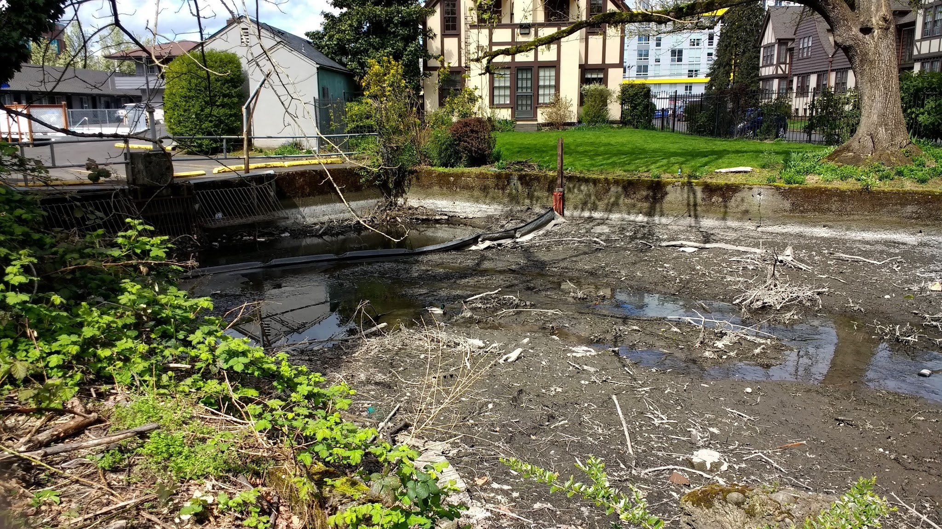
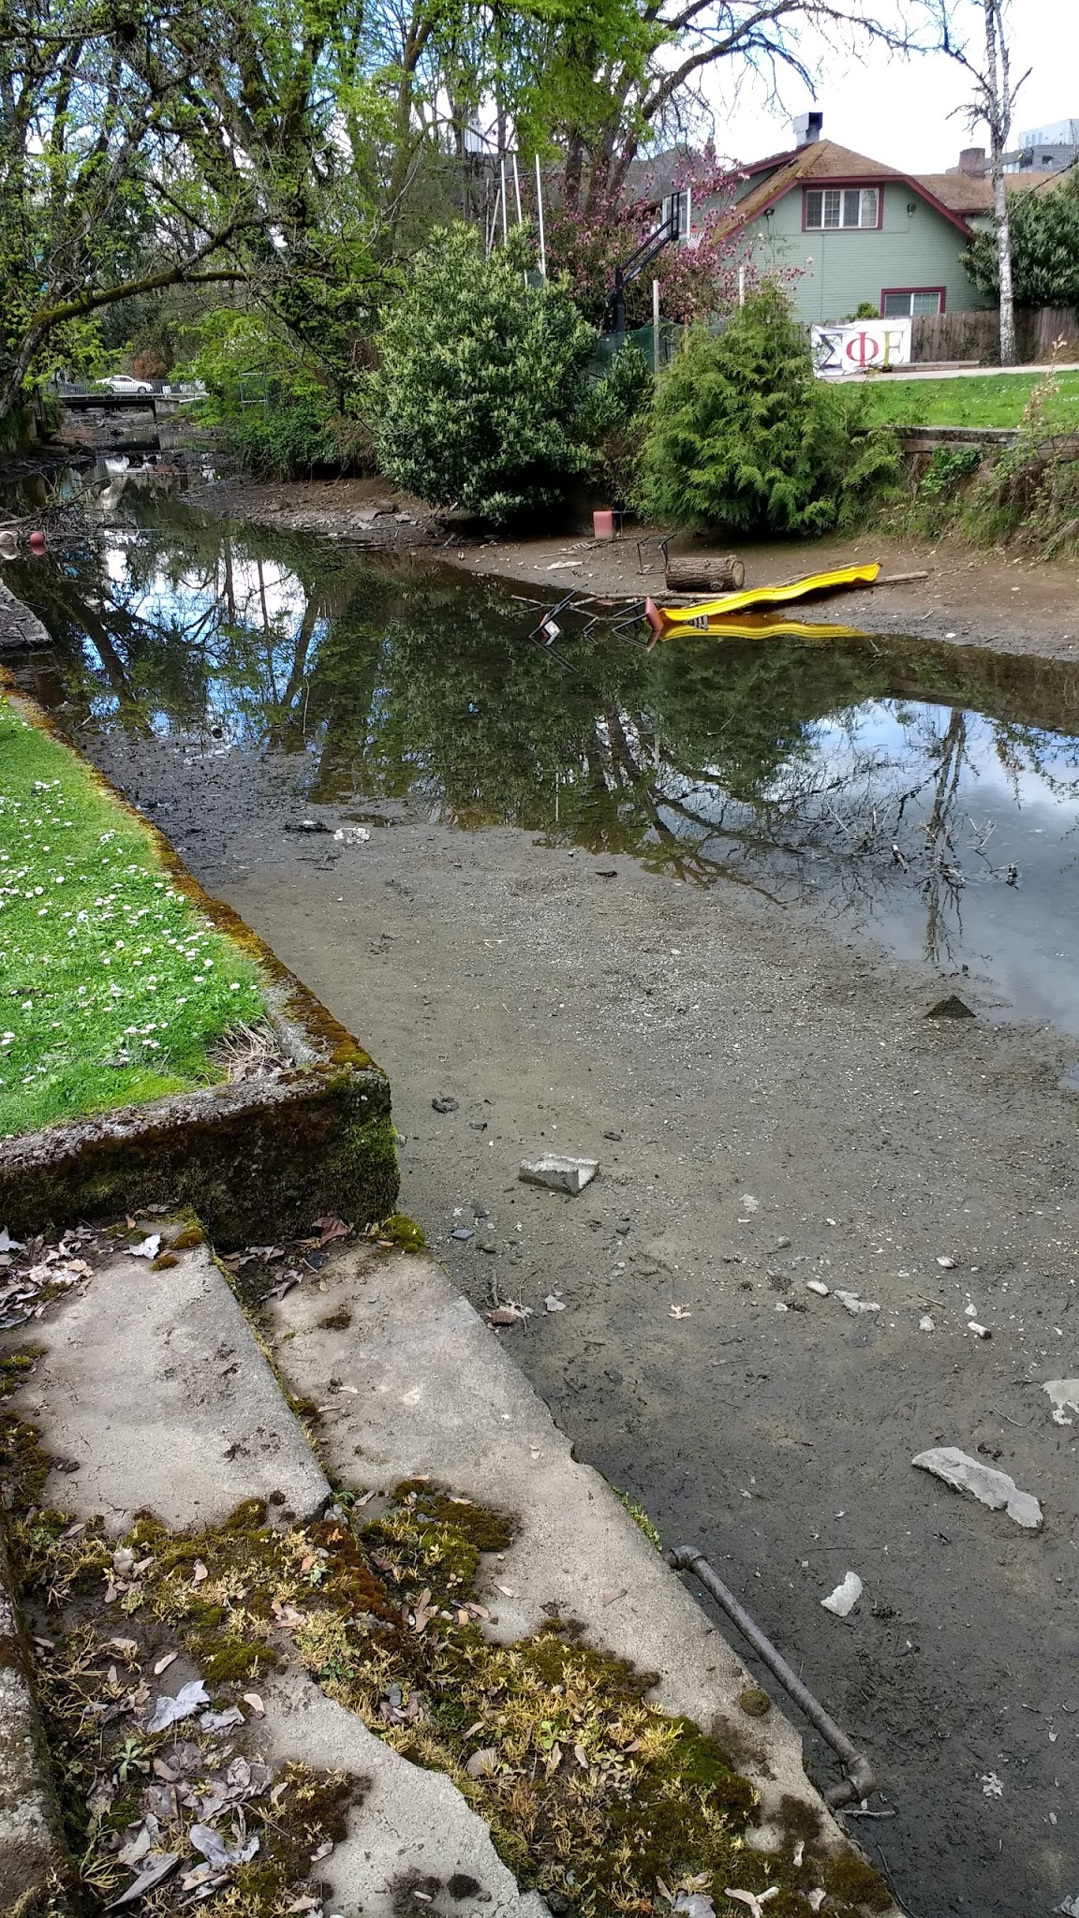
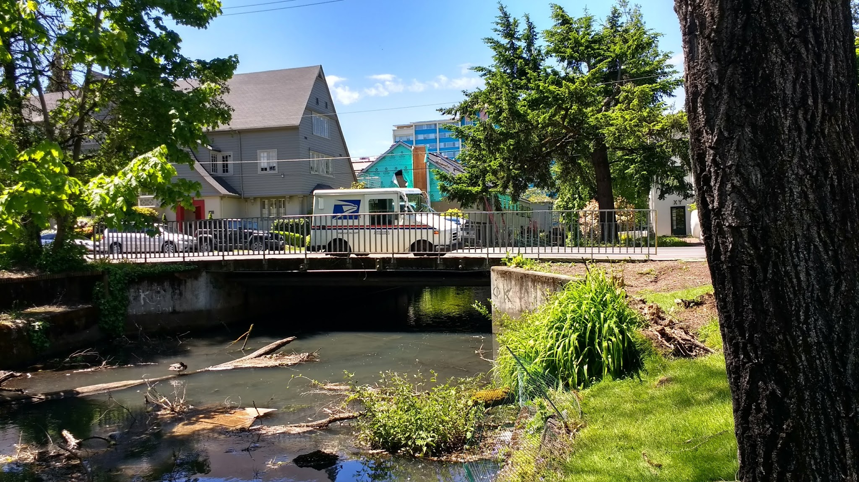
Notes:
This is often what people see, may not stop to appreciate other spots like the Pond. During times the pump isn’t running, and rainfall hasn’t been high, this is what the Millrace looks near Hilyard and Patterson
Ice storm brought in a lot of debris
Lawns--- new houses have no lawns (Alpha Phi, Theta)

Slide 7
Present day: shift in use and abuse
-1952- Mill described as “half-filled muddy slough,clogged with debris”(Register Guard Dec 2016)
-1976-declared “most unsanitary” place for swimming in Lane County(Register Guard Dec 2016)
Video of Alpha Omega house Millrace “Race”
“It smells like...soo bad”- UO Soph at Gamma Phi who recently ventured into the millrace to take a picture in nature, then sunk in
Notes:
-quotes about declines, muddy: context of world war shift in consumerism, ideals
-video: 20 seconds- 1:20, mid
-recent uses and stories, explanations
-Students are no longer enjoying the Millrace like they did before- but they are still using it.

Slide 8
Long-standing perception of the Millrace
“When I was a freshman, the millrace was just like it is today- slow, sluggish, and muddy. They were talking about improving it just like they are now. I’ve been here four years and I’ve heard the same complains. The Millrace is still the same and always will be until a substantial sum of money can be used” - UO Student (Oregana Spring 1962 Yearbook)

Slide 9
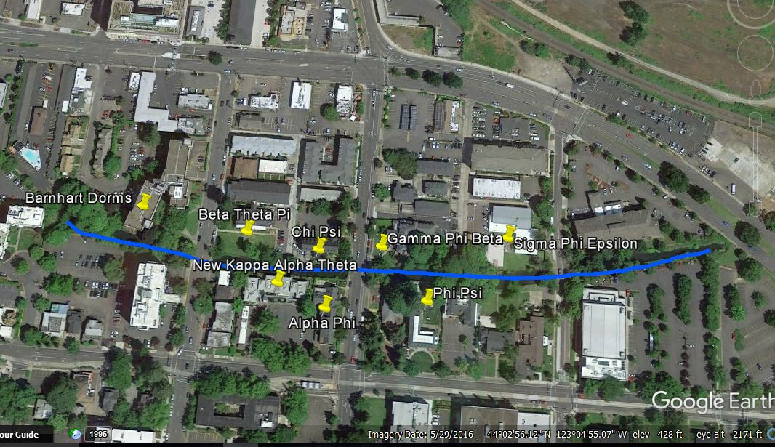
Fraternity & Sorority Life: Opportunity?
-Seven Fraternity & Sorority Houses are houses on the Millrace.
“The way we saw ourselves effected the Millrace” Jeannie Webb, UO alumni, Gamma Phi 1960’s
Notes:
Between Alder, Hilyard, and Patterson
Previously, much of the recreation was done by those in fraternity and sorority life. The Canoe fete and Millrace Olympics was a huge event, mostly for FSL. Pinning ceremonies ending in fraternity brother’s “millracing” their brother and everyone hanging out on the Millrace.
-Today, these people have support from alumni to revamp the Millrace
-The millrace has previously been a factor that drew people in, and it still could be
-Oppurtunity to revamp it with their interests, educate them about the Millrace’s history and biology

Slide 10
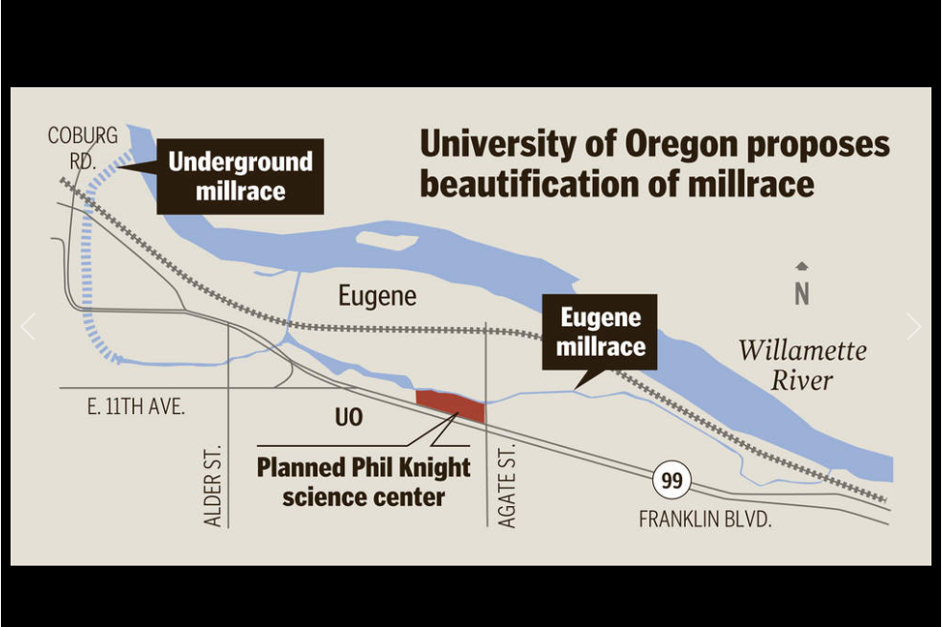
Future: Recreation- a draw to get stuff done?
-Mike Harwood’s desire to revitalize:
“The scientists we’re going after could work anywhere they want to, so our goal would be to make the millrace and some other aspects of Eugene and the University of Oregon look so attractive that it’s a compelling reason to come (here),” Harwood said.
-Other river success
-
Register Guard 2016

Slide 11
Considerations
-Economic: Where to get money from/ assistance? (UO Knight campus, City of Eugene, EWEB project, City & Lane County Parks, Historical Societies, FSL, Outdoor Program, Local Env. Groups)
-Biologic: We know it’s not just a dirty sludge..but do others? Recreational “learning”,
-Accessibility to all
-Safety
-Academic Potential: PE classes? others?
Notes:
-Economic: last estimate was near $22 million- may be the best timing with Knight Campus and EWEB renovations
-Biological: Place project and these projects taught us as individuals about the Millrace unique and evident biology… other’s don’t realize
-Accessibility: important that it's accessible and advertised as available and encouraged to be use by a variety of people
-Safety: One person died in the early 1900’s- but overall safer than the Willamette River

