Slide 1
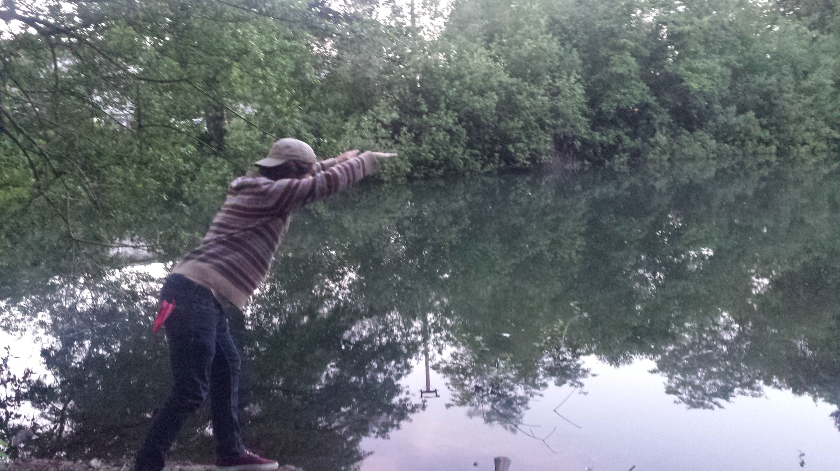
Swimming the Milllrace
Casey Erickson

Slide 2
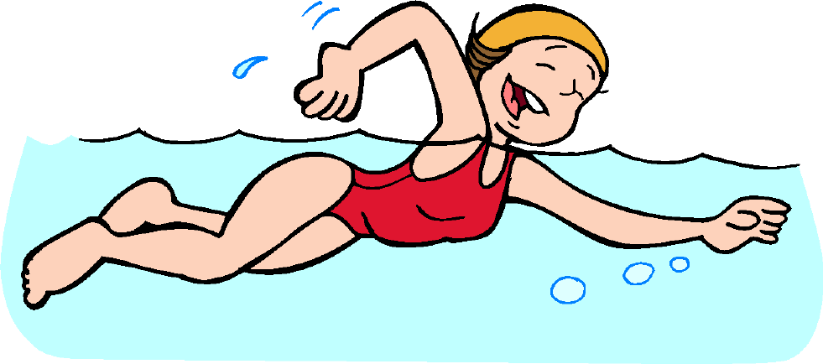
Why do we need a swimming hole?

Slide 3
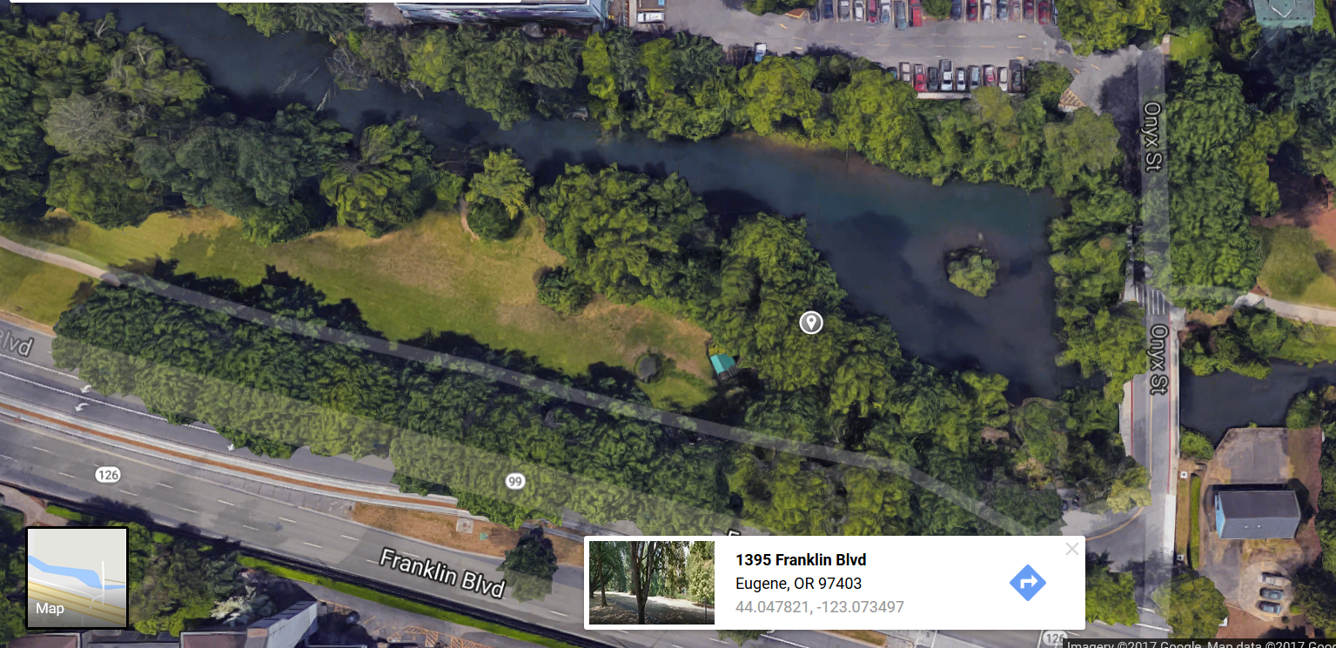
Where on the millrace?

Slide 4
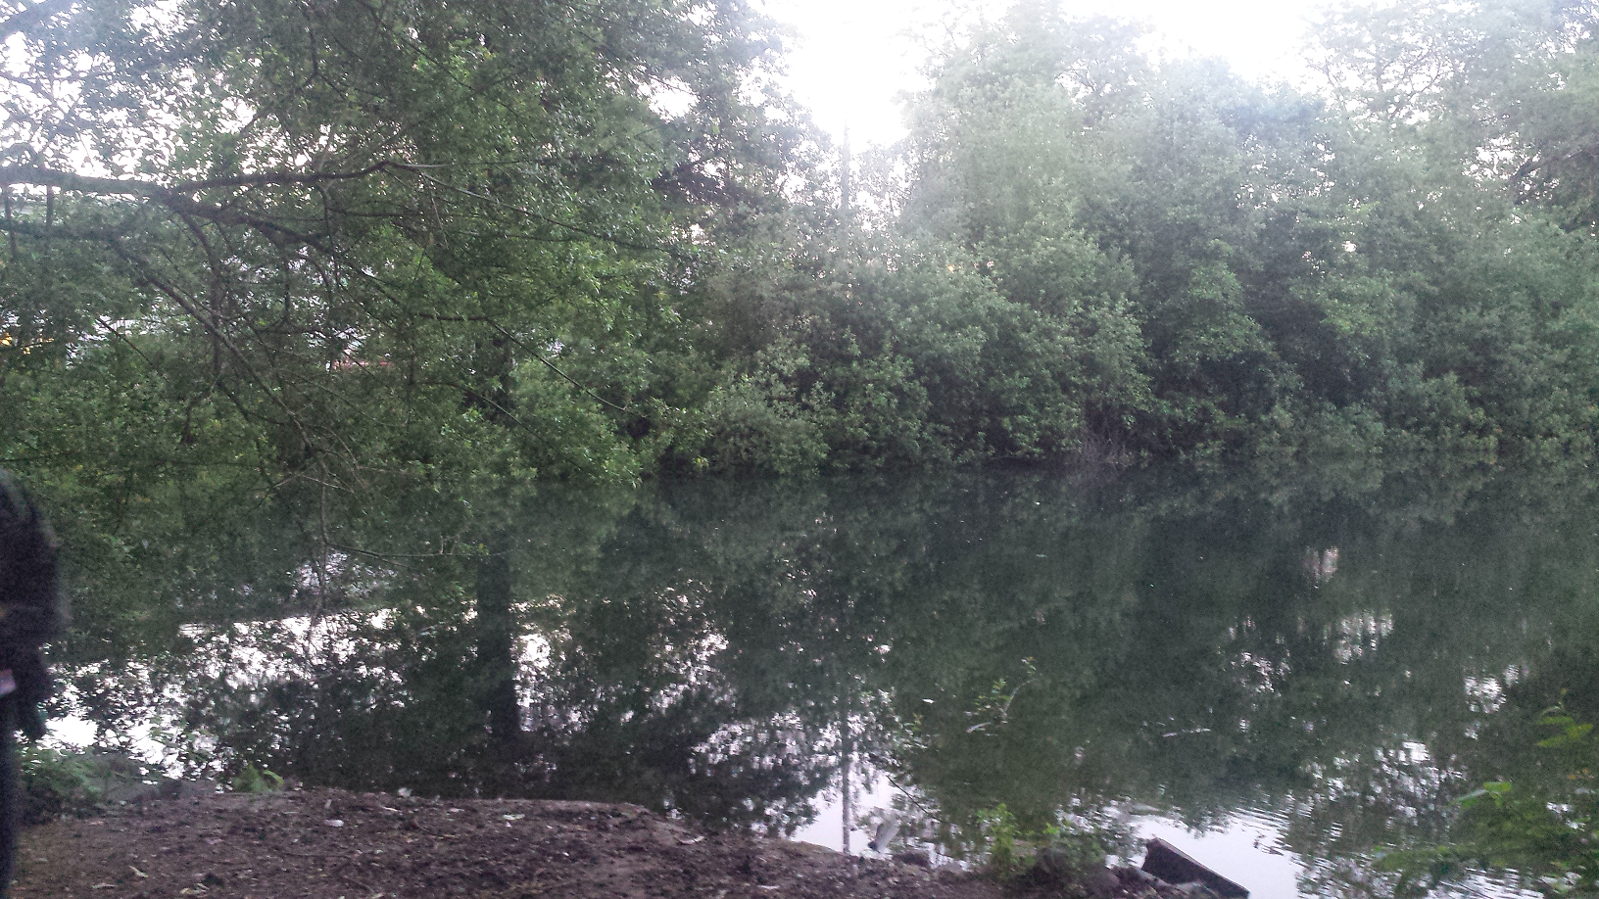
The Spot

Slide 5
Considerations
Erosion
Animals and plants
Human Safety
Maintenance of site

Slide 6
Erosion
Beach
Riverbed

Slide 7
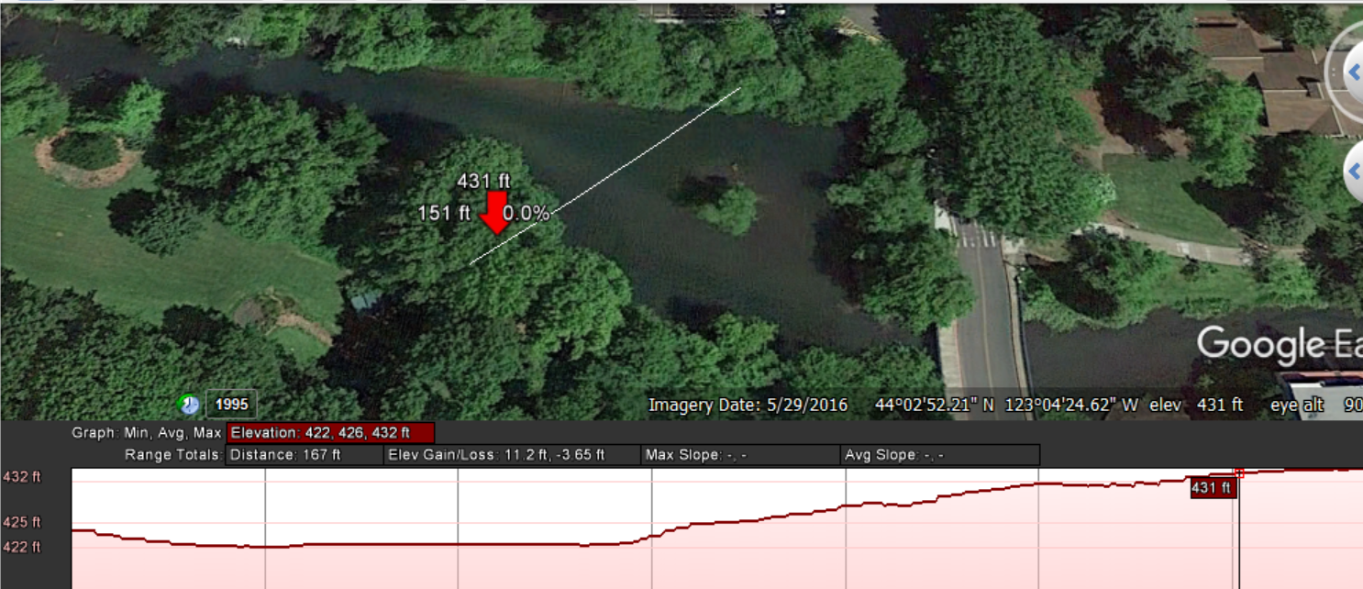
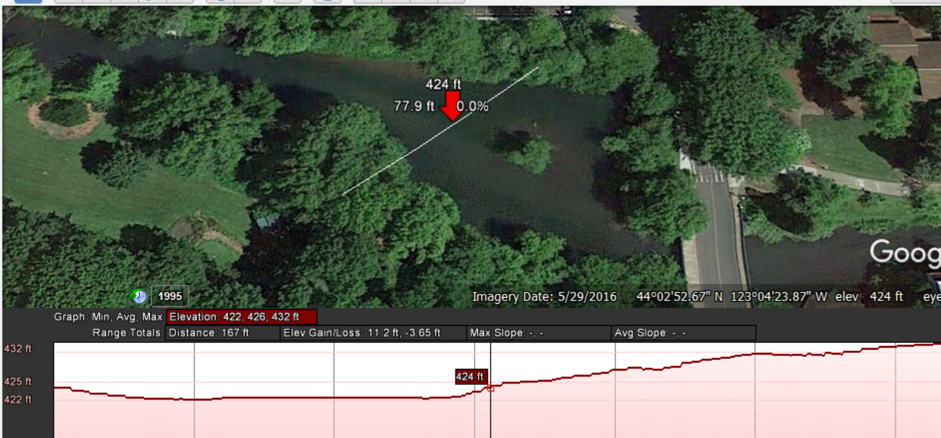
Riverbed Erosion

Slide 8
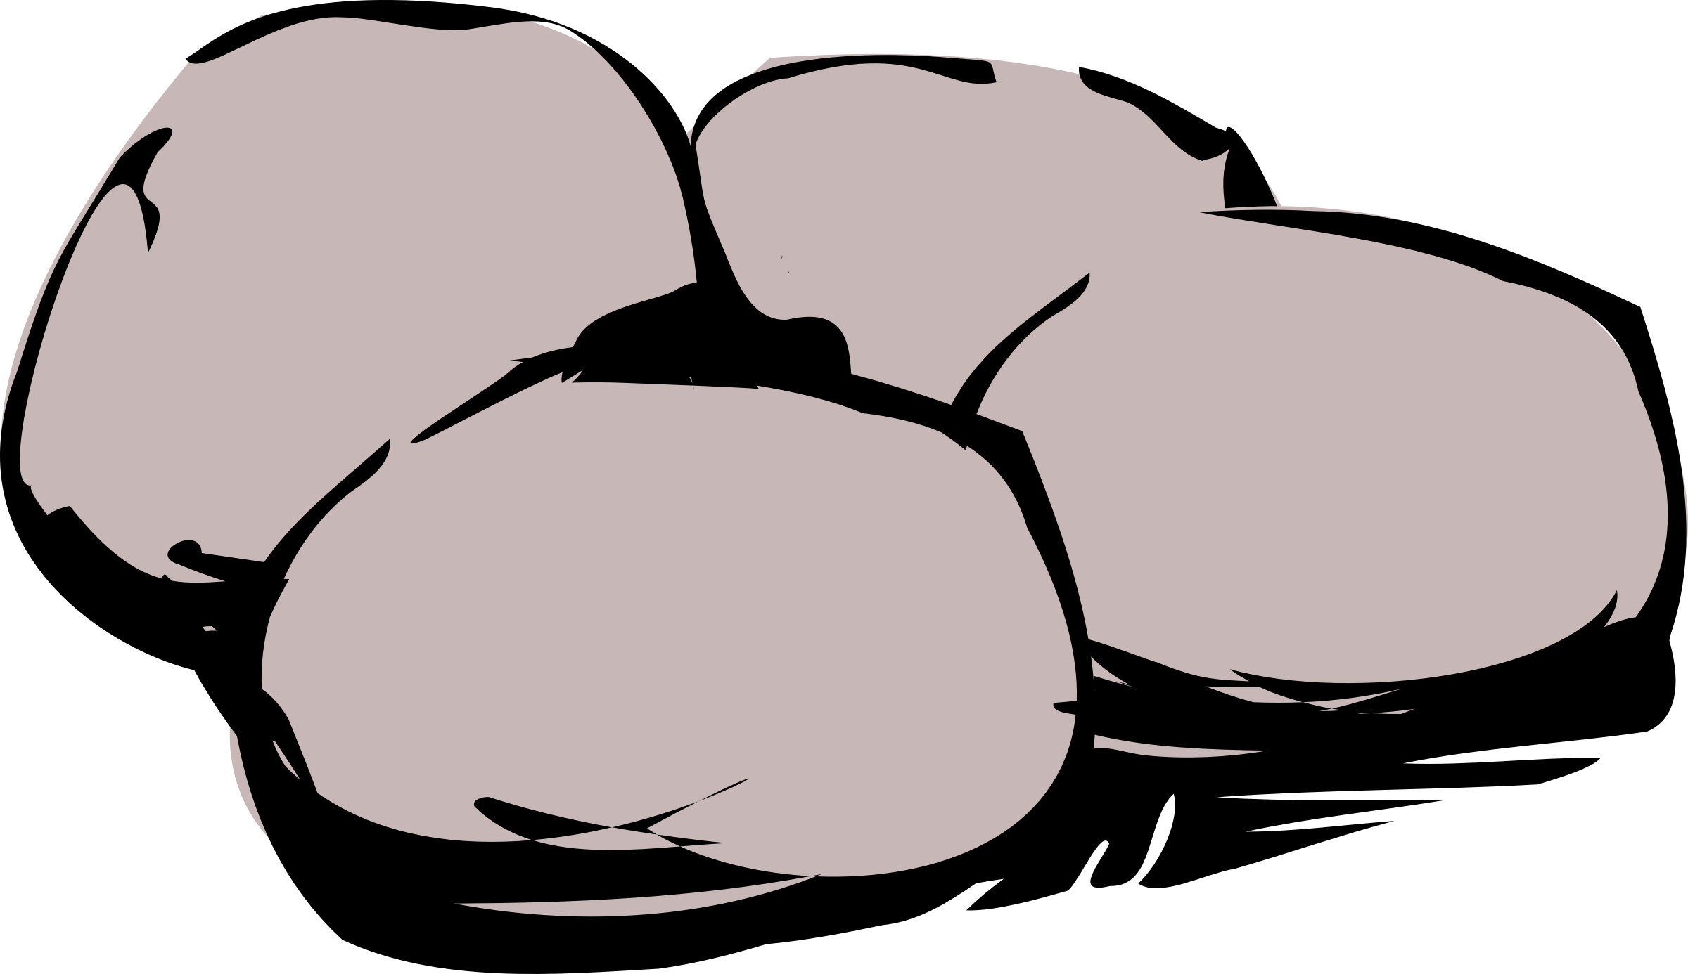
Beach Erosion

Slide 9
Animals and Plants

Slide 10
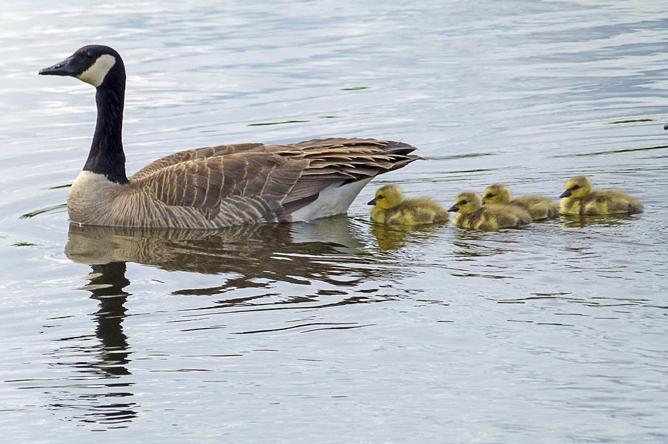
Geese

Slide 11
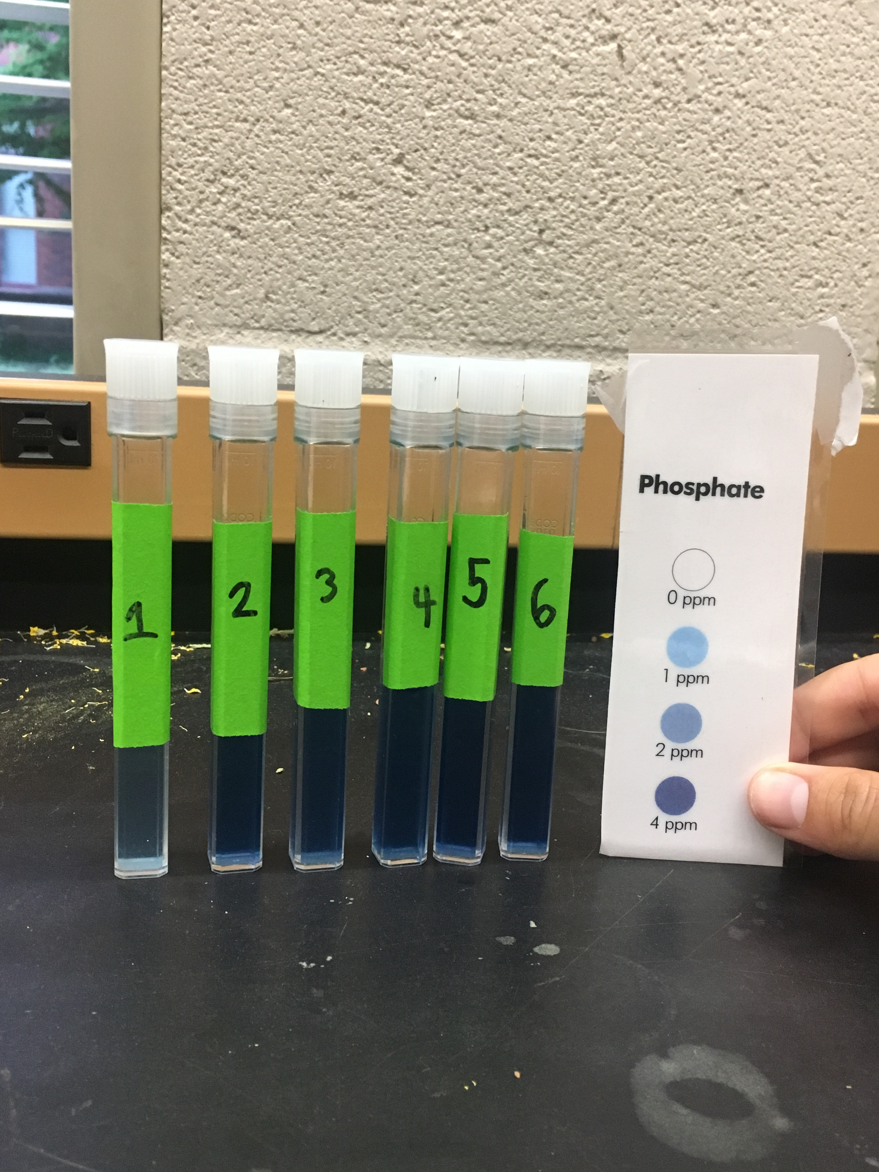
Is it safe to swim?

Slide 12
Tests Ran
Copper
Nitrate
Nitrite
Phosphate
Ammonia
Iron

Slide 13


Slide 14
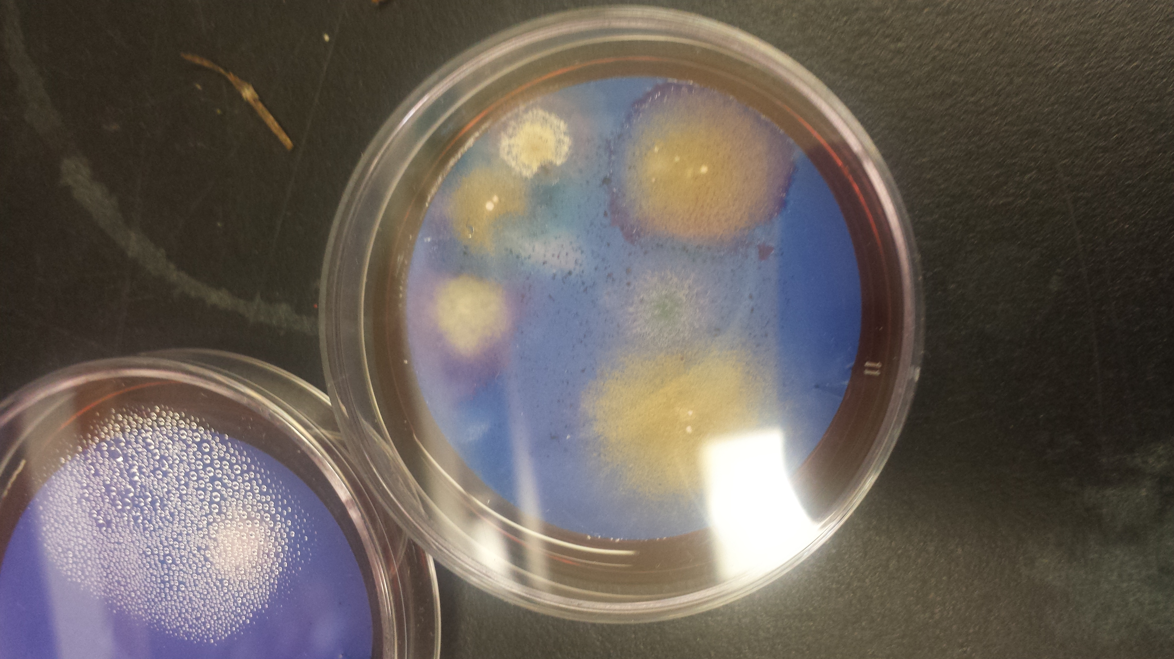
Fecal Coliform Bacteria

Slide 15
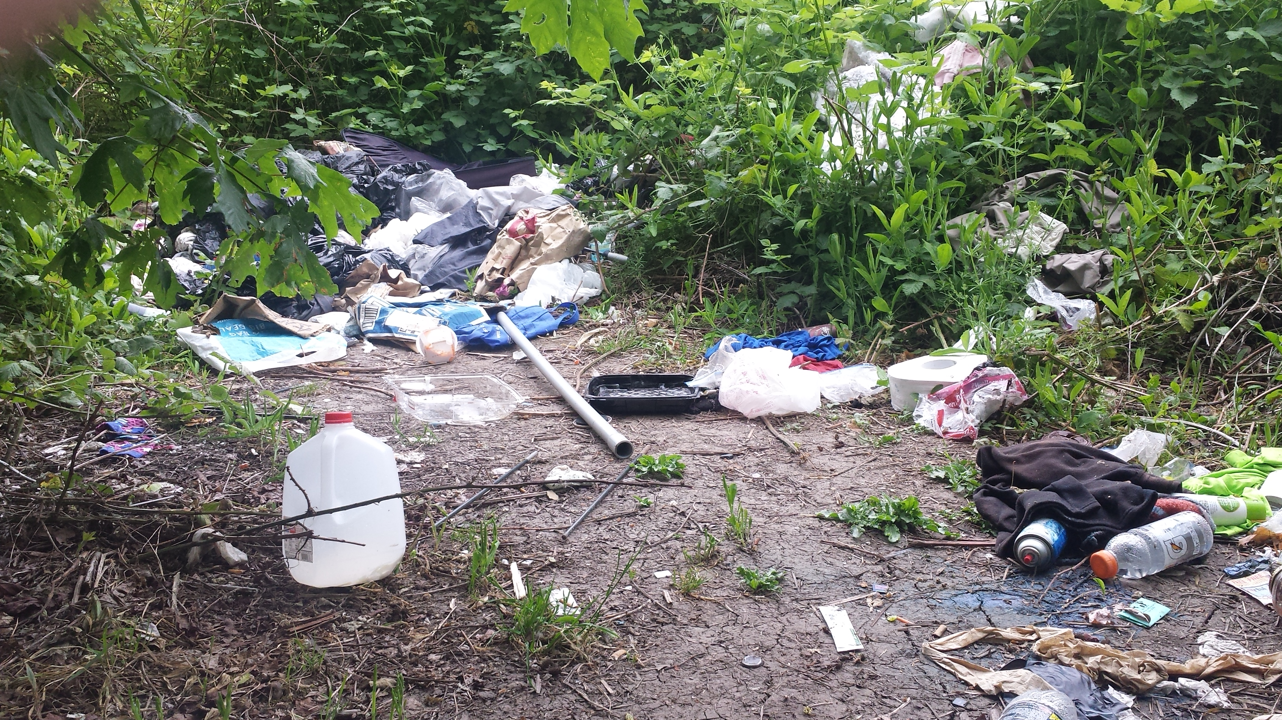
Management and Maintenance

Slide 16


