Slide 1

Quest for the best
Campus Connections
Jane Brubaker Dave Harris
Kai Adams Donny Addison
Esther Foss Dave Musgrove
Vanessa Abbott Jeff Madsen

Slide 2
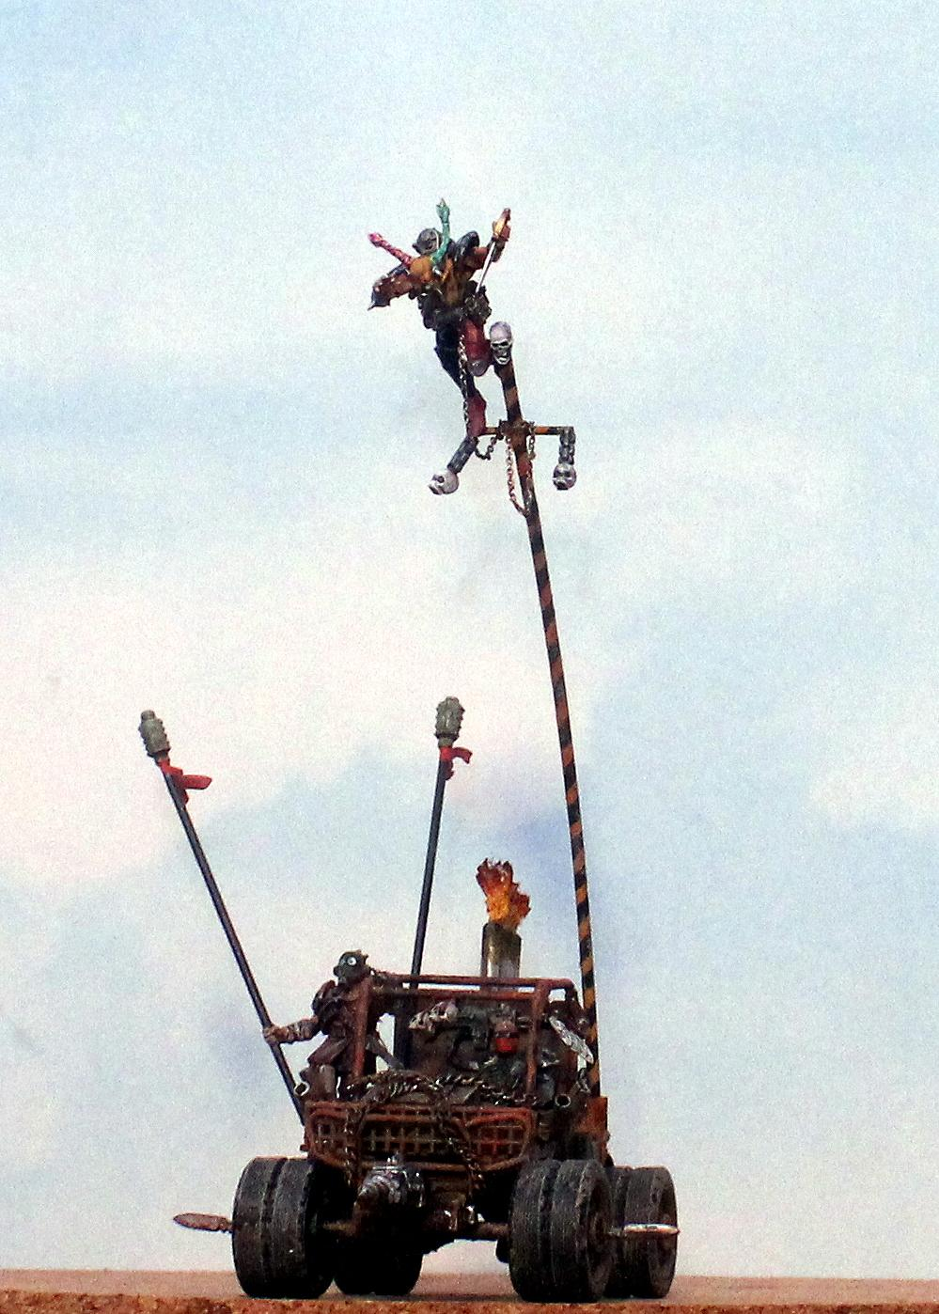
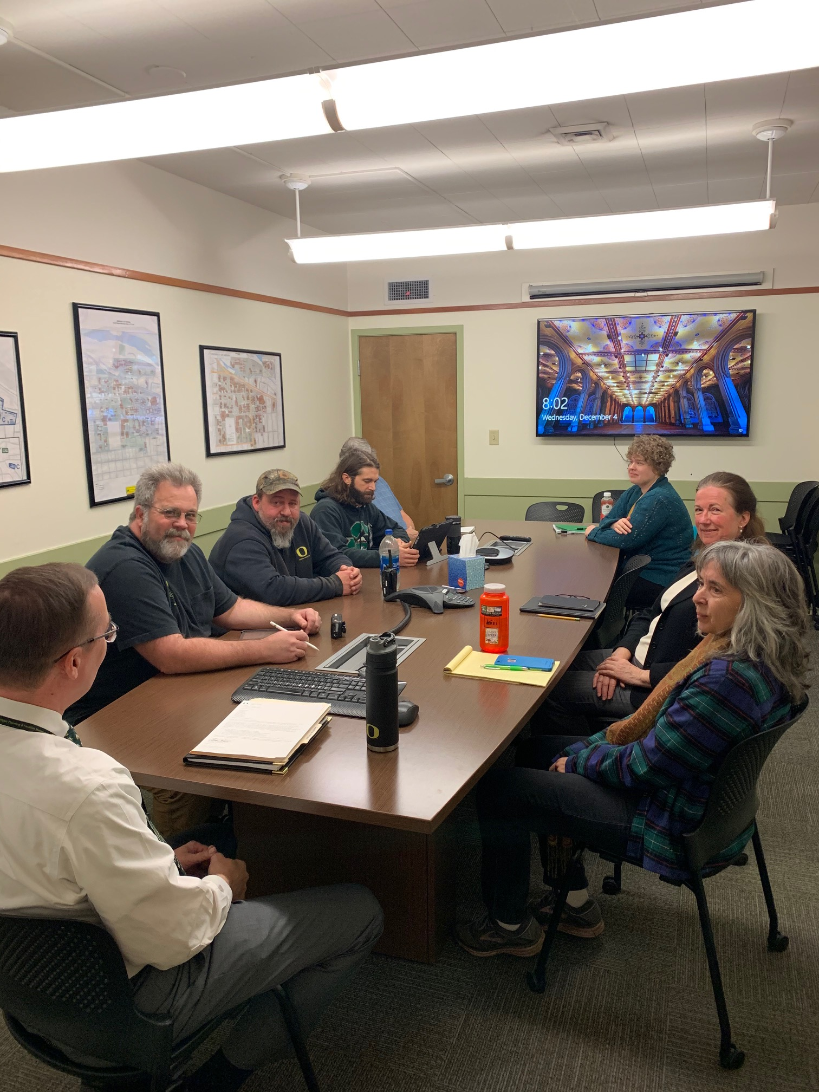

Remember to follow social distancing guidelines

Slide 3
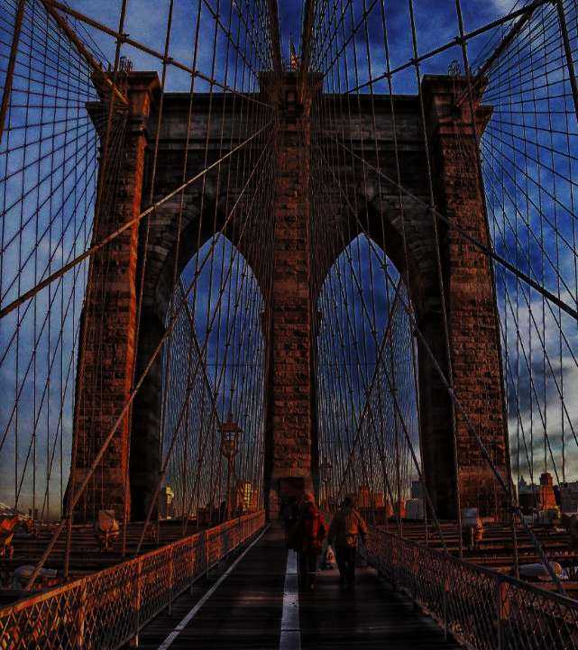
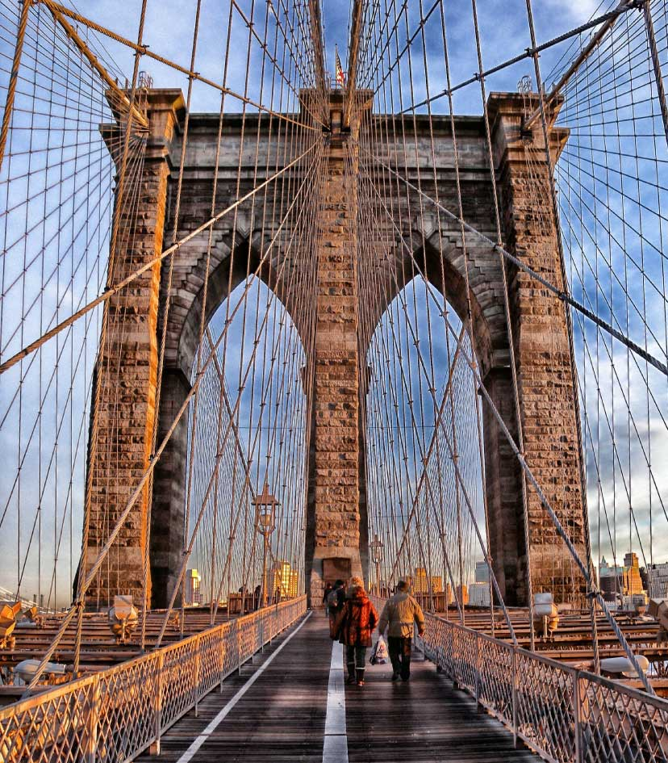
Questions for consideration
What are the concerns of staff related to connecting with campus?
How can we promote the work of CPFM across campus?
Are there successful examples we could copy from other units?
How can we learn more about other units on campus?
How well are we communicating with other units on campus and could those improve?

Slide 4

Outreach for feedback
Building Manager Interviews
Department Surveys
Review Quest Session Notes
Roundtable discussions
Notes:
© Copyright Showeet.com – Free PowerPoint Templates

Slide 5


How should we connect with campus?
Day-to-Day & Beyond
  Supply Complete Information
  Make Campus Community Aware
  Positive and Visible Presence
  Provide support and assistance
  Integration with Campus partners
  Provide Clear Identity

Slide 6

what we heard: appreciation and recognition
Call log is easy to use
One-on-One Aim Training
In Person Check-ins
Notes:
© Copyright Showeet.com – Free PowerPoint Templates

Slide 7
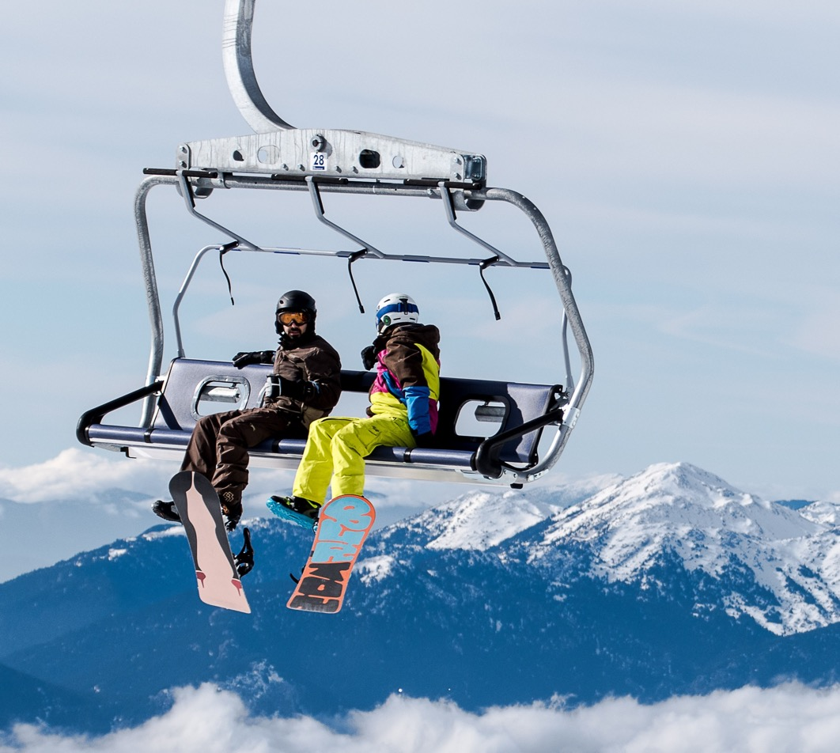
what we heard: opportunities for improvement
consistency
  Tasks
  Presenting information
  Presenting ourselves
Work Orders
  Phase Closeout
  Actual closeout
Less Notices
Use Liaisons more effectively
Notes:
© Copyright Showeet.com – Free PowerPoint Templates

Slide 8
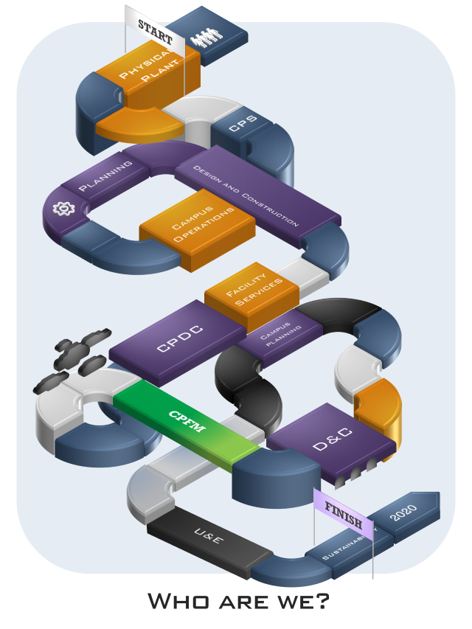

Confusion about who we are
Changes over time not communicated
Confusing Internally and Externally
Identification Inconsistent

Slide 9

Recommendations:
Short term (0-6 M0s)
SUBTITLE GOES HERE
Customer AIM Training
Post Work Order Survey
Provide ETA for Jobs
Use Call Log
Consistent Updates Across Shops
Use Aim notes
Easier Cost Tracking for Work Orders
DB for campus contacts by building
Promote and educate about Work Control
Notes:
© Copyright Showeet.com – Free PowerPoint Templates

Slide 10
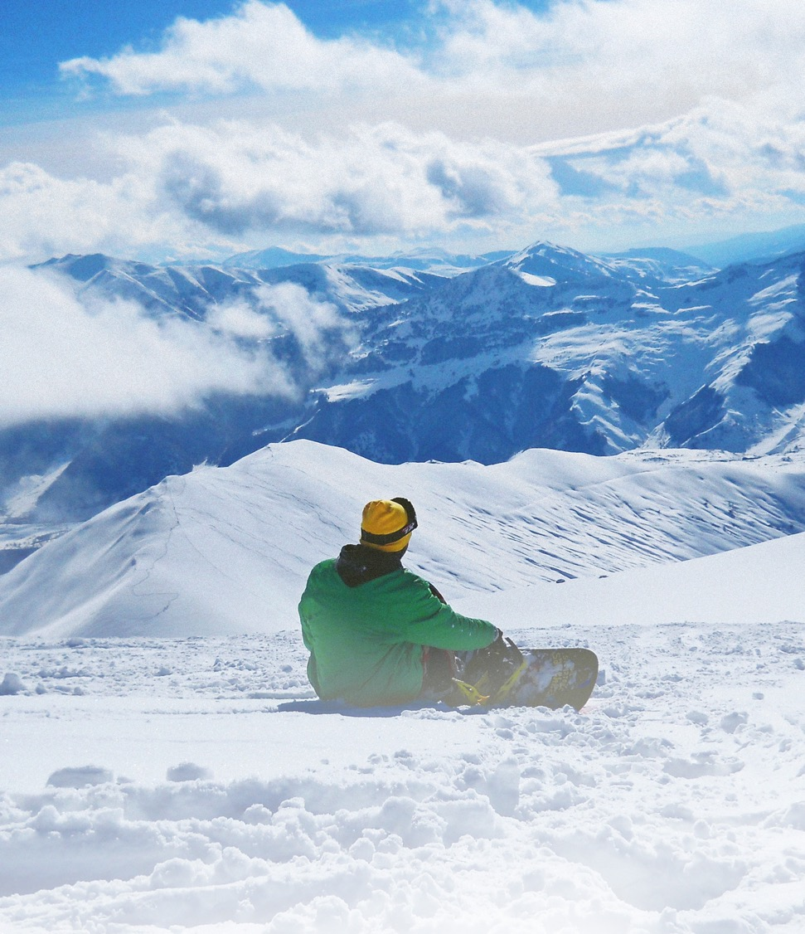

Recommendations:
Medium term (7-18 M0s)
Participate in Campus Orientation Tour
Update Website
  Personnel Updates
  User Friendly
  More Information
  Dynamic
  Promote Work Control
UVA Example https://www.fm.virginia.edu/
Notes:
© Copyright Showeet.com – Free PowerPoint Templates

Slide 11
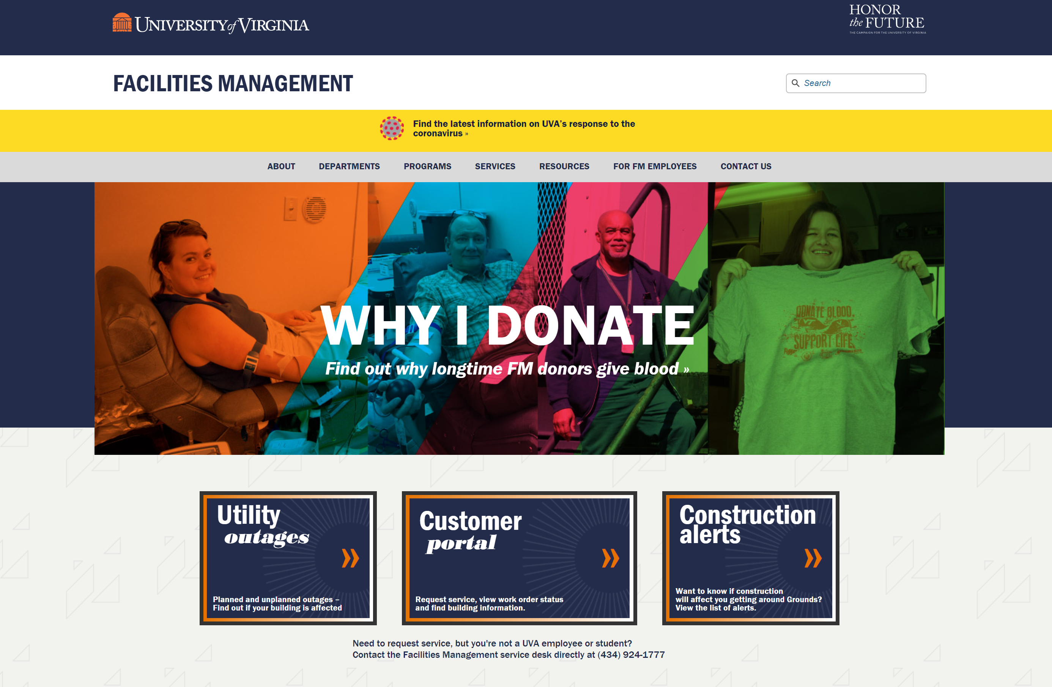
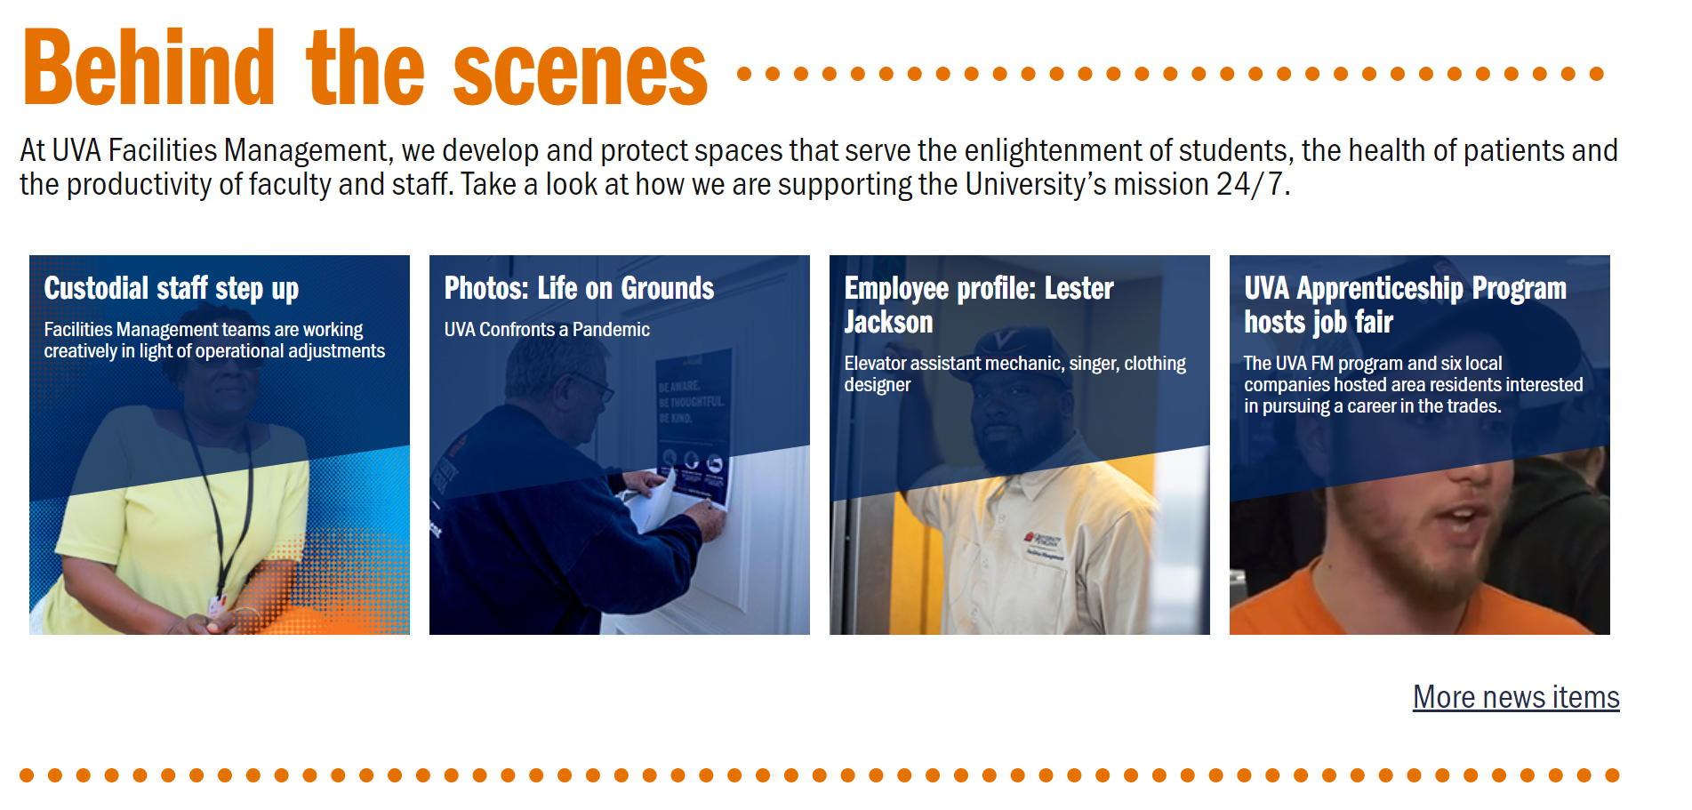
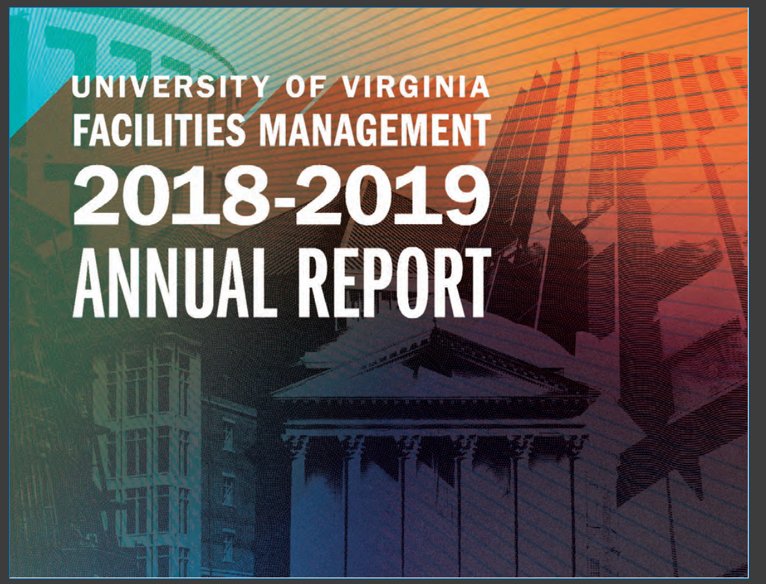
How others connect
UVA Website

Slide 12
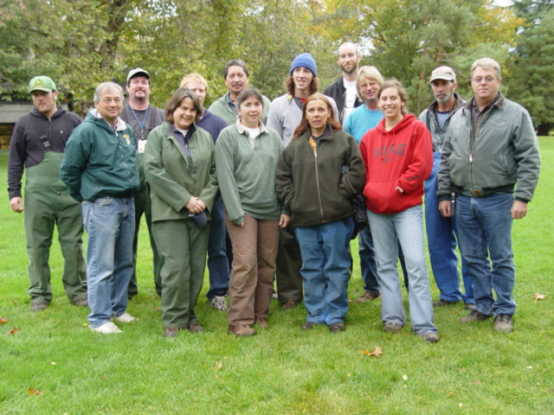
Recommendations:
Long term (18M0s)
Table at IntroDucktion
Participate in Career Fair
Greater Student Engagement
Tours
    CPFM Staff
    CPFM hosted
    Campus Partner Hosted
CPFM Ambassadors
    Meet with Campus Partners
    Present at Staff Meetings
    Lunch and Learns
Annual Report for campus
Need Consistency with Uniforms and Identification
Notes:
© Copyright Showeet.com – Free PowerPoint Templates

Slide 13
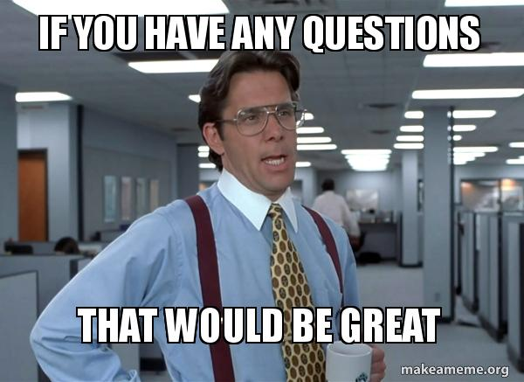
Large Image slide

Slide 14
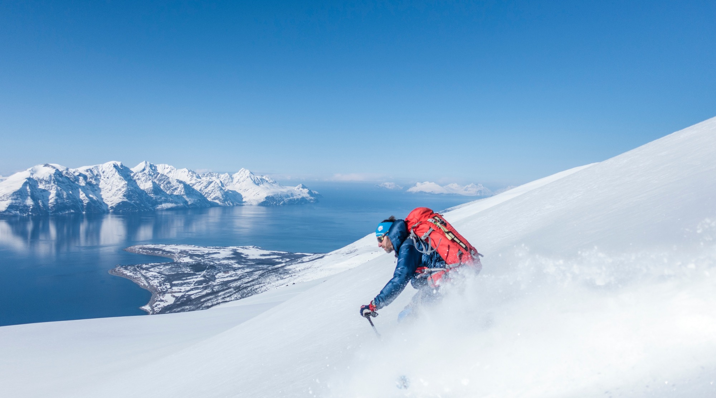
Large Image slide
  Campus Connections
  Day-to-Day & Beyond

