Slide 1

You're Not on Your Own: Student Supports & Tricky Topics
2026 GE Day of Teaching

Slide 2
Welcome! Our focus today:
The University of Oregon has strong student supports and instructional policies to help students thrive in your classes and beyond. We want you to feel confident about how to approach the five questions below and who to contact when they come up:
What should I know about disability-related accommodations at UO?
What should I do if I'm concerned about a student (for a non-academic reason)?
What should I do if I think a student might be committing academic misconduct?
What academic support exists for students that I can share with them?
How should I handle student absences and late work?

Slide 3
Panelists:
Norma Kehdi, Senior Director, Accessible Education Center
Jimmy Howard, Associate Vice President and Dean of Students
Dianne Tanjuaquio, Senior Associate Dean of Students, Director of Student Conduct and Community Standards
Kenyon Plummer, Senior Learning Specialist, Tutoring and Academic Engagement Center

Slide 4
What should I know about disability-related accommodations at UO?

Slide 5
Institutional Responsibilities for Equal Access
UO is required by federal law (including the Americans with Disabilities Act and Section 504 of the Rehabilitation Act) to provide reasonable accommodations for individuals with disabilities​
AEC is the office designated to determine disability eligibility for students and support the provision of accommodations​
Entire university community shares a collective responsibility to facilitate access and inclusion of students with disabilities

Slide 6
Disability Experiences
Learning disabilities
ADHD
Psychological disabilities
Autism Spectrum
Vision
Mobility
Hearing
Chronic health conditions
16.2%
of undergraduate students work with AEC
Notes:
At the University of Oregon, disability is an important part of our campus diversity. About 16% of undergraduate students are currently registered with AEC.

Slide 7
Roles/Responsibilities Related to Accommodations
Student | AEC | Instructors/GE’s
Self-identify to AEC for disability-related services. Provide supporting documentation of disability. Request accommodations and notify instructors of accommodations in a timely manner. Notify AEC if they encounter additional access barriers or accommodation issues. | Assess students' requests for accommodations. Provide information about policies, procedures, rights, and responsibilities. Facilitate appropriate accommodations through collaboration with instructors and other staff. Address accommodation implementation issues. | Implement AEC-approved accommodations. Maintain student confidentiality. Review Notification letters and complete testing agreement Contact AEC if they have concerns about the reasonableness of an accommodation.
Notes:
A notification letter emailed to an instructor from AEC activates their legal responsibility to implement the listed accommodations.

Slide 8
Additional Information
Instructors of Record & AEC Connect Access
GE accommodations
Notes:
IOR’s get notification letters and can access AEC Connect
If not an IOR but play a role in accommodation implementation, you can have the IOR reach out to us to have you added as an instructor for the class

Slide 9
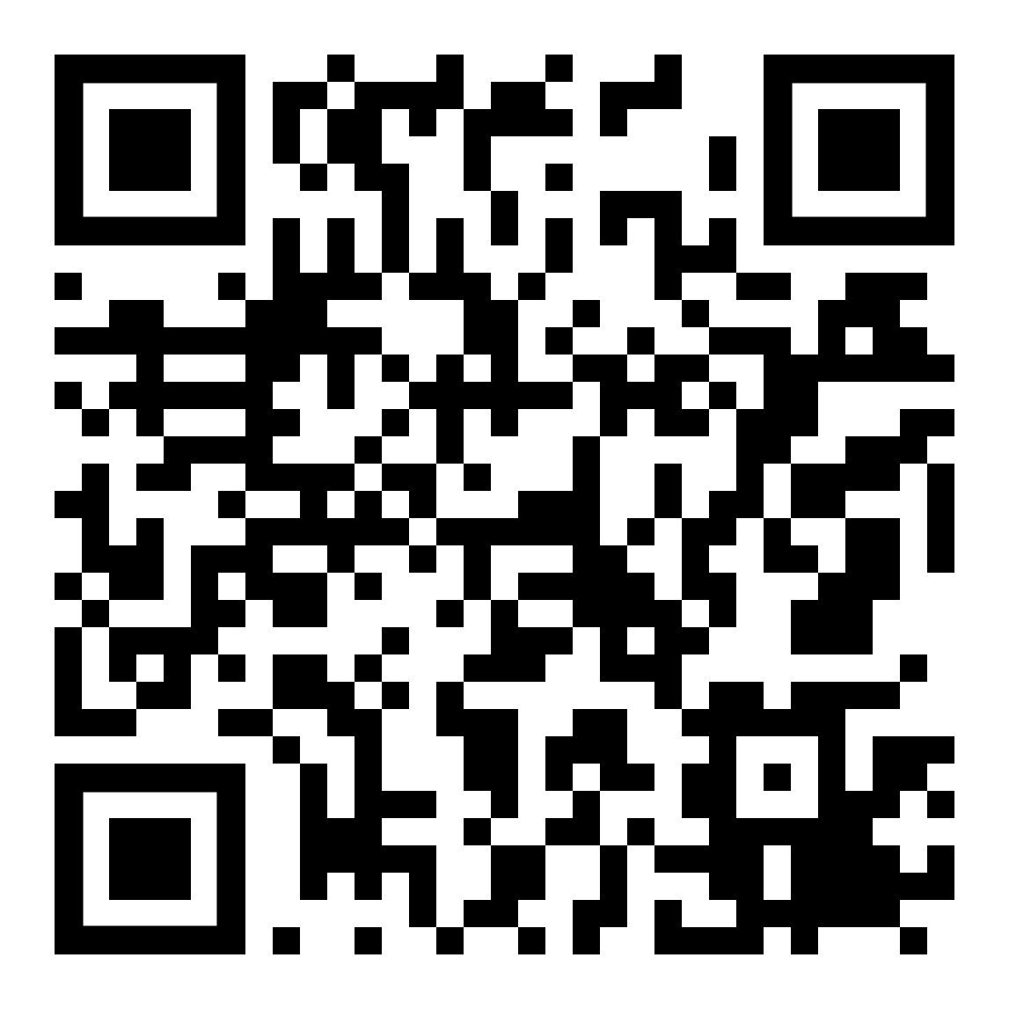
Contact the AEC
aec.uoregon.edu
aec.uoregon.edu/make-appointment-aec
541-346-1155
uoaec@uoregon.edu
¿Habla español? Para preguntas en español:
  Elvia Pelayo: epelayo@uoregon.edu

Slide 10
What should I do if I’m concerned about a student (for a non-academic reason, such as a mental health crisis, food insecurity, etc.)?

Slide 11
Distress and crisis are a part of​ every student's life.​

Slide 12
COMMON Student Concerns
Anxiety
Depression
Academic stress
Difficult or unexpected life experiences
Cultural identity
Trauma
Alcohol and drug misuse
Body image and disordered eating
Thoughts of suicide

Slide 13
How can you help?
Notice
Engage
Refer

Slide 14
Helpful Resources for Students – Counseling Services
Mental Health Care Coordination Services
Integrated MH department at UHS
Student's access point for MH services
Counseling Services - counseling.uoregon.edu
Short-term therapy
Let's Talk – drop-in one-on-one informal consultation
Consultation
Consult when concerned about a student
Office Hours with CS (on Zoom) M and Th noon-1PM
Crisis support
Group therapy
Case management/referrals
Psychiatry
After-Hours Support and Crisis Line (main line)
Notes:
Mariko

Slide 15
Helpful Resources for Students – Dean of Students
Care and Advocacy Program
https://dos.uoregon.edu/help
https://safe.uoregon.edu/
Primary confidential advocacy team for students who have experienced sexual violence, domestic violence, and other forms of gender-based harassment
Resources and support needed to navigate personal crises
Basic Needs Program
https://basicneeds.uoregon.edu/
Financial Insecurity
Food Insecurity
Housing Insecurity
Child Care Subsidy
Textbook Subsidy
Mental health concerns
Unexpected life events that disrupts their academic pursuits.

Slide 16
Helpful Resources for Students
Student Conflict Resolution Center
https://scrc.uoregon.edu/
Roommate concerns
Student Advocacy Program
https://asuo.uoregon.edu/advocacy
Grievance/dispute with a faculty or academic dept.
ASUO Legal Services
http://asuolegal.org/
Students with personal legal questions or concerns (Not TIX related)
Other disputes between students
Communication and conflict strategizing
Any concern wherein an office or UO is the adversary to a student
Assistance with Registrar academic petitions
Disagreement with a policy or UO decision

Slide 17


Office of the Dean of Students
Phone: 541-346-3216
Office: Oregon Hall, Room 185
Email: uodos@uoregon.edu
https://dos.uoregon.edu

Slide 18
What should I do if I think a student might be committing academic misconduct?

Slide 19
What academic support exists for students that I can share with them?

Slide 20
The Tutoring and Academic Engagement Center (TAEC)
Centralized Academic Support
Referrals
40% of first-year students used a TAEC service last year
Tutoring – math, writing, Spanish
Class Encore – weekly, facilitated study groups
  natural sciences, CS, math, business courses
Academic coaching
Details on TAEC’s website (engage.uoregon.edu)
The earlier the better
Tutoring or Class Encore
  “I’m just not getting …”
  “I’m stuck on this writing assignment”
Academic coaching
  “I study for hours but still bomb exams”
  “I can’t stay organized and keep missing deadlines”
  “I sit down to work but can’t stay focused”
Notes:
5 min
Centralized support
Help students reach their academic goals whether they are struggling or ambitious
Headquartered on 4th floor Knight Library
Services are free
about 40% of first year students visited our center at least once
We see a lot of students
Subject specific support and study skills support
Subject specific
Undergraduate student staff, trained, continual professional development
Math, writing, Spanish language tutoring – drop-in or appointments
Study groups – meet weekly – sign up at any point in term
Academic coaching – help students become confident, self-regulated learners
Pro staff
1-1 appointments, centers the student’s academic goals, strengths focused
Referrals –
You don’t need to do it all
If a student is struggling academically, don't wait until they're failing. Normalize support early by referring them to TAEC.
Early referral - students will benefit more if they can access our services early and multiple times
Tutoring or CE
Missing knowledge about the subject matter
Academic coaching
Overwhelmed with academics
Struggling with independent learning
Ambitious goals
Uncertain - don’t know what the problem is but it’s affecting academics

Slide 21
What should I know about UO’s approach to student absences and late work ?

Slide 22
Attendance and Engagement Policy
At UO, attendance policies must be “reason neutral”--there are no “excused” or “unexcused” absences.
Instructors who require attendance should follow UO’s Course Attendance and Engagement legislation, which says instructors “shall not ask for reasons for absences and shall not distinguish between ‘excused’ and ‘unexcused’ absences since there is no equitable way to confirm the veracity of student-provided reasons or documentation outside the university context.”

Slide 23
Attendance and Engagement Policy (cont)
Instructors who require attendance usually do this because a particular level of attendance is necessary to meet learning goals. If you are the instructor of record and require attendance, choose one of the following approaches:
Create a life-absorbent attendance policy that allows the maximum number of absences a student could have and still reach the course learning objectives, or
Set your attendance policy with common reasons students would need to miss in mind, and include a clause in the policy letting students know that in “extraordinary circumstances” they can request an exception without disclosing details.
Check out the Syllabus Database for example language!

Slide 24
Exceptions to this policy include:
Disability-related Accessible Education Center accommodations specific to attendance or late work. AEC sends an accommodation letter.
Accommodations for religious observances. The Office of Equal Opportunity and Access (OEOA) will notify instructors. If a student mentions needing to be absent for a religious observance, let them know they should submit a form to OEOA.
Accommodations for military and federal agency deployment. The Office of Equal Opportunity and Access (OEOA) will notify instructors.
Pregnancy-related modifications. The Office of Equal Opportunity and Access (OEOA) will notify instructors.

Slide 25
What questions do you have for our panelists?

Slide 26

Closing Slide with the University of Oregon Logo
Contact us at tep@uoregon.edu, or on our website, teaching.uoregon.edu

