Slide 1
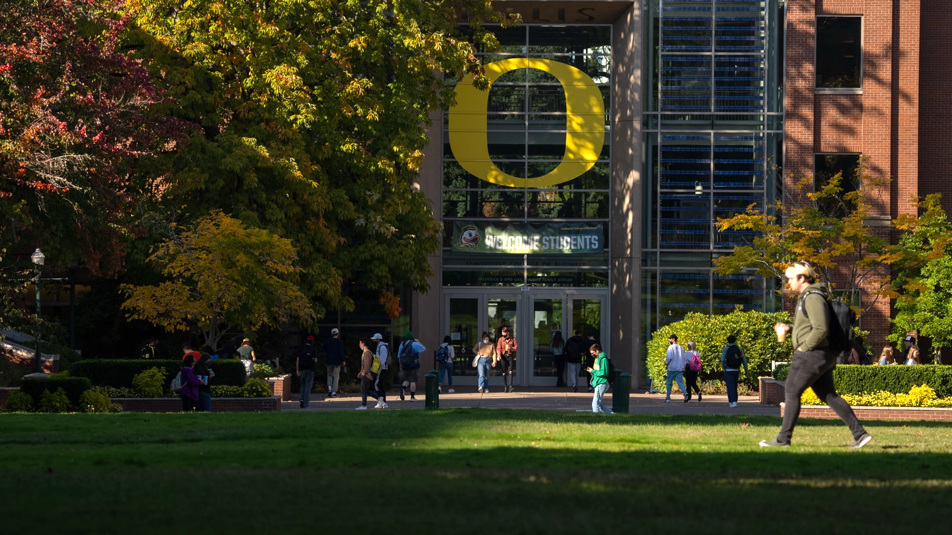

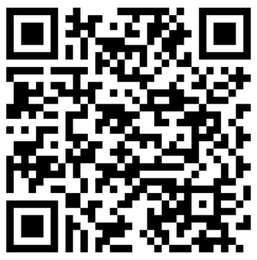

Welcome to Teaching at UO!
As you enter, make a nametag & take
a schedule. Then, please sign in …
on the sheets,
or with the QR code,
or at the URL below
https://forms.cloud.microsoft/r/3YHszfqen0

Slide 2
What We Are Doing Today
Learn foundational teaching skills, get teaching resources, build community, feel confident on your first day.
Session Objectives
Session Agenda
We hope you'll feel confident:
Recognizing aspects of good teaching at UO
Finding resources to support you and your teaching
Attending workshops throughout today
Who is in the room?
What is good teaching?
Where can you find support for your teaching?
GE = “Graduate Employee”

Slide 3
Who is in the room?

Slide 4
You Are!
Departments Represented
19%
Accounting
Anthropology
Architecture
Bioinformatics & Genomics
Biology
Clinical Pyschology
Computer Science
Communication & Media Studies
Counseling Psychology
Creative Writing
Data Science
East Asian Languages & Literatures
Earth Science
Ecology & Evolution
Geography
Global Studies
History
Human Physiology
Journalism
Linguistics
Marketing
Marine Biology
Microbiology
Music Composition
Music Theory
Neuroscience
Philosophy
Physics
Planning, Public Policy & Management
Prevention Science
Psychology
Romance Languages
Sociology
Taught
at UO
41%
Have not
taught before
40%
Taught somewhere else
25% are new international GEs

Slide 5
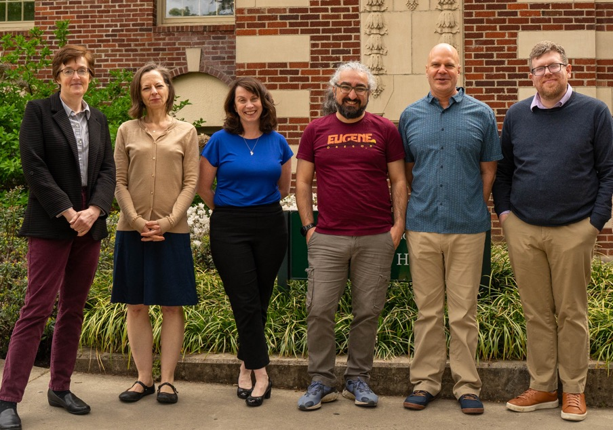
We are! Teaching Engagement Program (TEP)
TEP provides teaching support to GEs across campus through:
Individual consultations
Teaching workshops and course
Graduate Teaching Initiative certificate
Our website (teaching.uoregon.edu)
GE Teaching Newsletter
Teaching Awards honoring GEs
TEP offices are located in Straub Hall—4th Floor. Visit us!

Slide 6
What is good teaching?

Slide 7
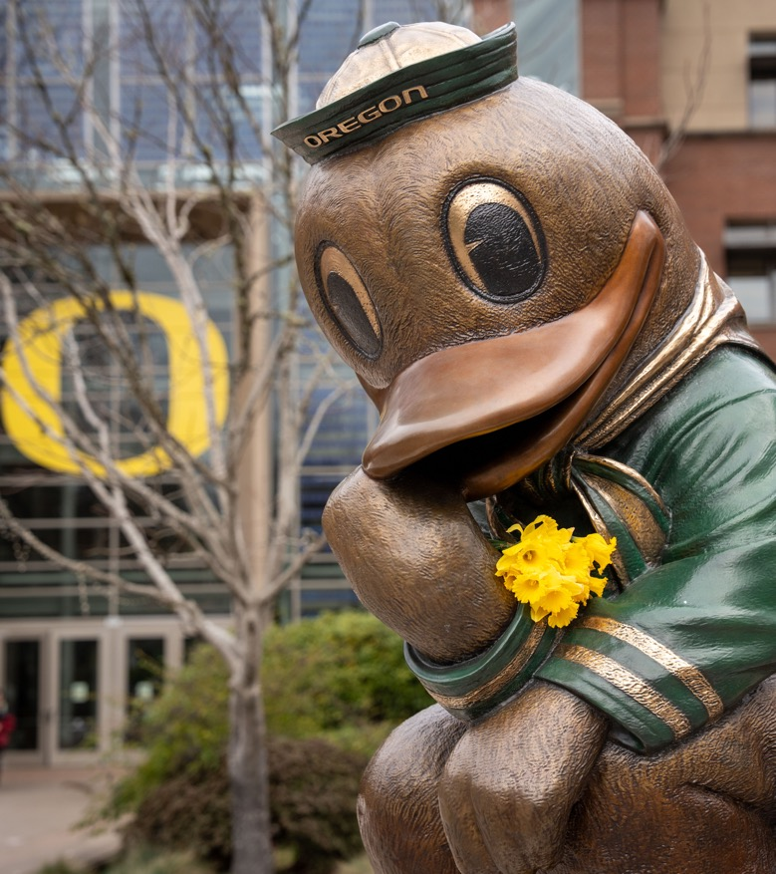
What Skills Does an Excellent Instructor Have?
Are these skills innate, or can they be developed?
Notes:
Our ideas:
Enthusiastic
Organized
Fair
Responsive
An effective communicator
Perceptive
Skilled in guiding students to understanding
Prompt
Empathetic
Safe
Students feel they belong

Slide 8
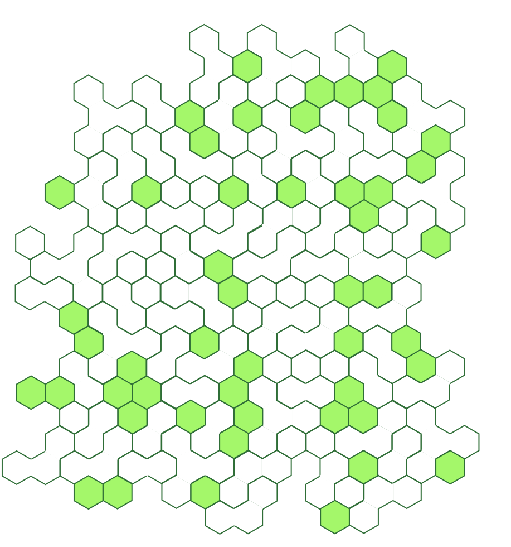




UO Defines Good Teaching As…
Professional: Basic practices necessary for a high-quality course (e.g. well organized; clear & timely communication).
Inclusive: Every student belongs and is valued. Materials are diverse and evolving.
Engaged: Instructors reflect on and revise their course and teaching strategies.
Research-informed:
Evidence-based teaching strategies
Models a process or culture of inquiry.
Learn more: https://teaching.uoregon.edu/PIERS
Notes:
Professional: Course is organized. Communication is timely and clear. Activities maximize student learning.
Note that these are not just internal TEP definitions. This is a definition the University created and are how faculty teaching is evaluated. These are the criteria for teaching awards from both faculty and GEs.
Each of these have specific actions associated with them to guide instructors in how to be a good teacher. Learn more at link!

Slide 9
Where can you find support for your teaching?

Slide 10

Support from All Over Campus
Teaching Knowledge & Practice
Campus Resources
  TEP and UO Online
  GTFF (GE union)
  Student Support
  Tutoring & Academic Engagement Center
  Accessible Education Center
  Counseling Center
  Safety
  UO Police (911)
  Safety & Risk Services
  Workshops
  Consultations
  Class Observations
  Reading Groups
  Teaching Courses
  Podcasts, Journals, Blogs
Specifics of Course and Discipline
  Lead Instructor
  Head TA
  Other GEs on team
  Your Peers
  Support Staff
  Courses/Seminars
Notes:
Gtff – help with work stuff, manages GE health insurance, social aspects

Slide 11
Your Next Steps to Grow Your Teaching…
Attend the rest of the sessions today!
Attend a TEP workshop or event this term
Join the Graduate Teaching Initiative (GTI)
Consult with us on any teaching-related questions, goals, or challenges
Find all of our GE-specific teaching support at
teaching.uoregon.edu/GEs
Notes:
Note that this links to engaged teaching.

Slide 12
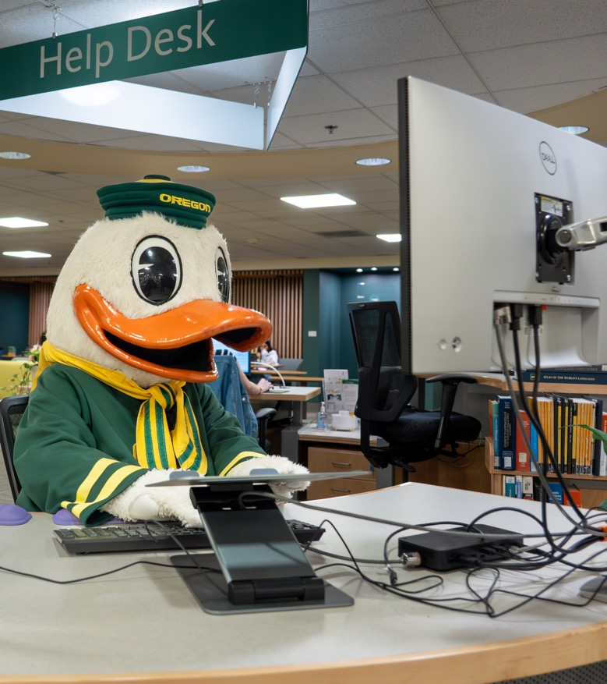
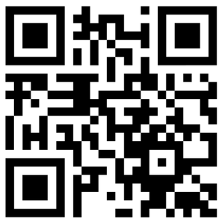
What Will Help You?
Right now, visit our GE teaching support page. Explore it a bit and identify one thing that you might want to investigate further.
teaching.uoregon.edu/GEs
What is something you want to know about that you didn’t see?

Slide 13
Fall Teaching Events Specifically for GEs
Event | Description | Day & Location
GTI Kickoff | Meet other GEs while learning about the Graduate Teaching Initiative, our teaching certificate program. | Tues Sep 29 @ 10am Straub Hall, Room 417
International GE Success: Lesson Planning & Active Learning | A space for international GEs to think and talk about lesson planning and active learning strategies. | Mon Oct 5 @ 2pm Knight Lib Dream Lab
Tips for Efficient Grading | Discuss tips for getting through that stack of exams, homework, lab reports, or assignments quickly. | Mon Oct 12 @ 11am Zoom
Grading with Canvas | Learn more about Canvas’s SpeedGrader. Practice using it in our closed Grading Practice Sandbox. | Tues Oct 13 @ 11am Knight Lib Dream Lab
Grading with Gadescope | Learn more about Gradescope, a new grading tool at UO. Practice grading fake student work! | Wed Oct 14 @ 11am Knight Lib Dream Lab
Coffee Hour for International GEs | Pause, connect, and share how teaching is going during an informal coffee hour for international GEs. | Wed Nov 4 @ 10am Mills International Center
Register and learn more about all our events at: teaching.uoregon.edu/events
Notes:
Remind them that GEs are welcome to (almost) all our events, not just the ones listed.
Other Fall GE Programming new GEs don’t need to know about:
Teaching Philosophy Statements
Grad Pedagogy Course

Slide 14
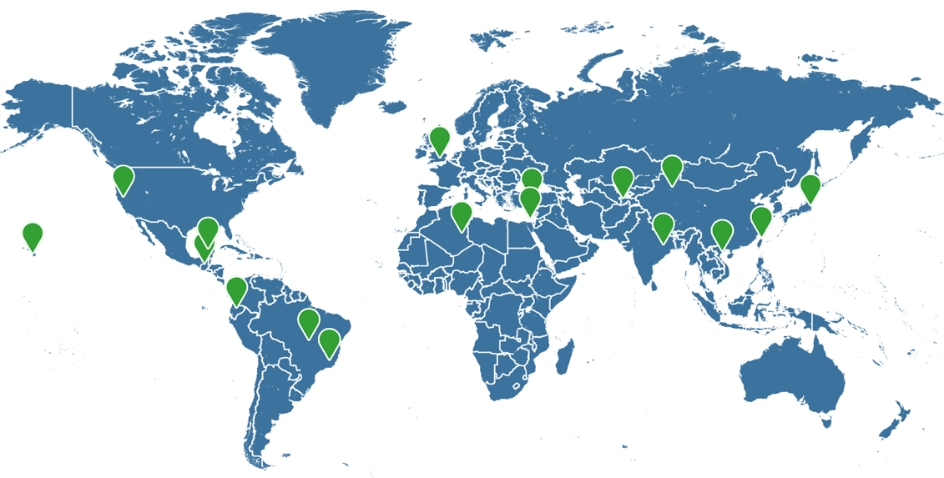
International GE Support
TEP Events
International GE Success Series
  Mon Oct 5, 2-3:30pm
Coffee Hour for International GEs
  Wed Nov 4, 10-11:30am
  International Student and Scholar Services (ISSS)
and more for international students and GEs. Advising, resources, scholarships, emergency funding, visa compliance, programming,
  GTFF Support: International GE Resource Page and International GE Caucus
Participants at the International GE Success event (Winter 2025)
Notes:
Invite Ali to introduce sessions
Caucus – Space for community building, support and organizing for folks with similar interests, concerns, backgrounds, or beliefs.

Slide 15

Graduate Teaching Initiative (GTI)
TEP’s self-paced GE Teaching Program
Attend workshops and review literature that align with your interests and needs
Reflect on the teaching experiences & faculty mentorship you already have at UO
Observe, and be observed, by other GEs
Develop a portfolio of materials that you can draw on for future job applications
Earn a certificate of completion!
Notes:
Invite Nanosh to Speak for a moment

Slide 16

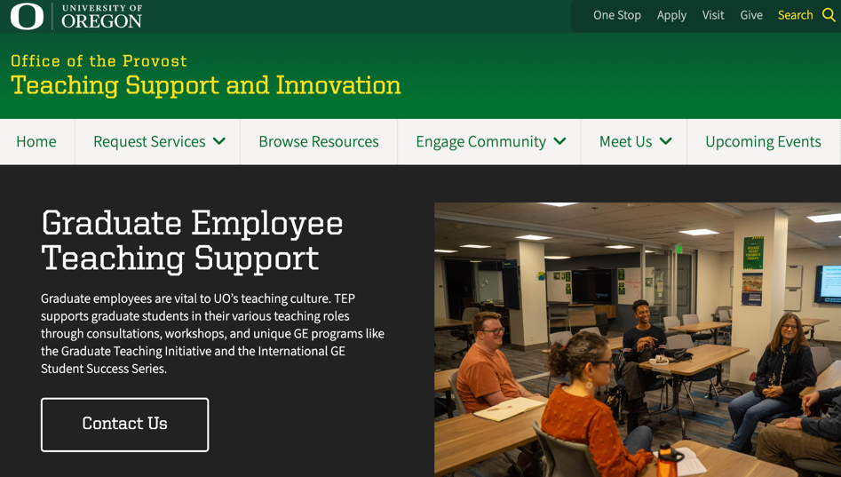
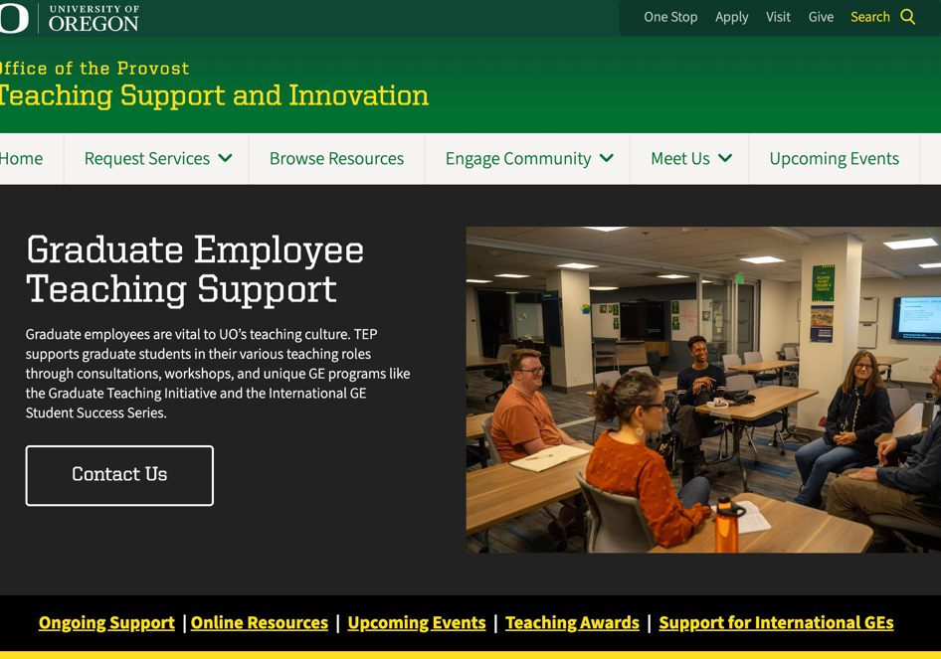
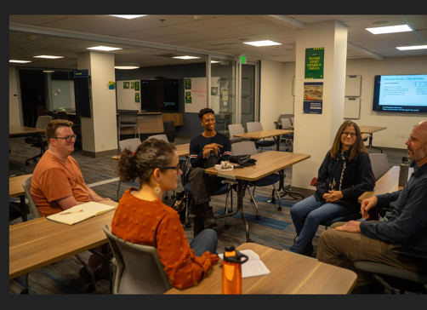
Key Teaching Resources At UO
Website: teaching.uoregon.edu
GE-specific resources at teaching.uoregon.edu/GEs
Term Resources are updated a few weeks before each new term begins
Syllabus Essentials Guide
Event Calendar of workshops and teaching communities
UO Online runs support for Canvas and online teaching environments.

Slide 17
Closing Slide with the University of Oregon Logo
Contact us at tep@uoregon.edu, or on our website, teaching.uoregon.edu

