Slide 1
Teaching Undergrads in the US
TEP-GE Day of Teaching Part 2
Alicia Going University of Oregon
Sep 23, 2026

Slide 2
Agenda
Ice-breaker
Public Service Announcements
First Day Teaching

Slide 3
Warm-up
Raise your hand if....
Notes:
You are excited to be here
You are nervous about being a GE
Taught before
You've been to the US before
You have been to Oregon before
Came with your family
You have found a good restaurant in Eugene yet
You have found a good place to spend free time
You know why Oregon's mascot is the Duck
You brought too much stuff with you
You are returning to school after being away from academia for a while

Slide 4
Public Service Announcement
SPEAK Test
Who Needs It?
  International students who…
    plan to teach as GEs
    have a speaking score lower than 26 on TOEFL or lower than 7 on IELTS
    have no scores at all
What is the deadline?
  BEFORE Fall term starts
How can you schedule it?
  Email Alicia argoing@uoregon.edu
  See me after this session!
For more information: https://ylc.uoregon.edu/aeis/speak-test

Slide 5

4 credits CRN 16749
For international graduate students who expect to teach or serve as GEs during their time at UO. In this course, we focus on communication skills, understanding the U.S. university culture, and basic teaching skills at the university level.

Slide 6
First Day of Teaching

Slide 7
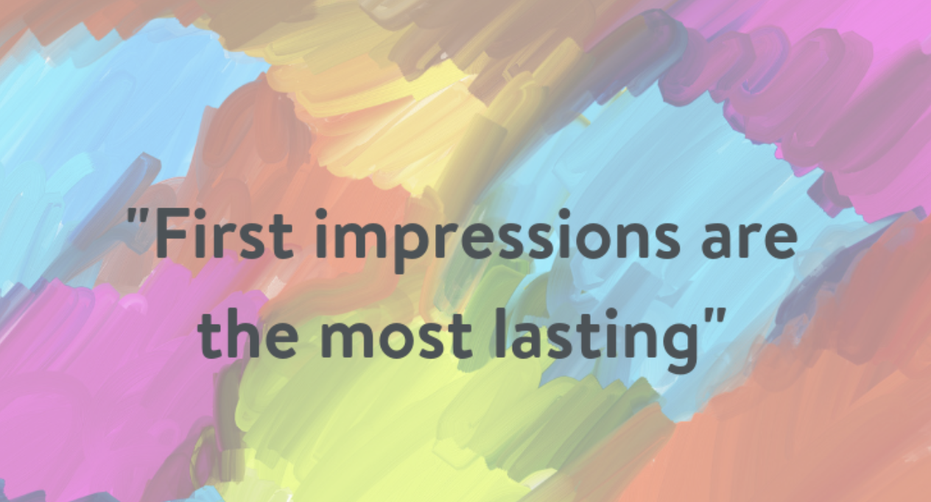
What should happen on the first day of class?
From: https://theralph.vet/first-impressions-count/

Slide 8
Welcome to GRST 610
US Teaching: Culture & Communication

Slide 9
Instructor Intro
Alicia Going
uh-LEE-shuh
(she/her/hers)

Slide 10
Office Hours
Office: McKenzie 160
Email: argoing@uoregon.edu
Office Hours: Tuesday and Wednesday 10-12, or by appointment

Slide 11
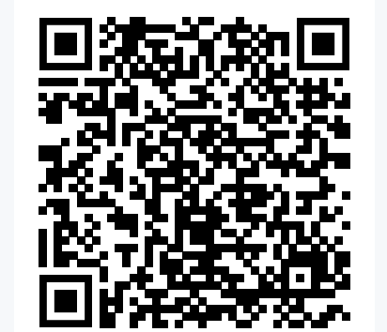
At this point in the class, I would do name tents and a nice breaker (or 2) of some sort…just like we did at the beginning of this session…
For ideas about icebreakers

Slide 12
Learning Objectives
By the end of this 610 course, you’ll be able to…
demonstrate strategies to communicate clearly with your students
use multiple teaching techniques that work effectively with U.S. undergrads
design and create effective slides for teaching
create interactive lessons that engage and motivate students
identify and access UO resources that are available to students and teachers

Slide 13
Essential Course Information
This is a hybrid course.
  Two hours in person weekly (Thursdays).
  All other work on Canvas.
This course is Pass/No Pass.
Active participation in class is expected.
Questions are welcome!

Slide 14
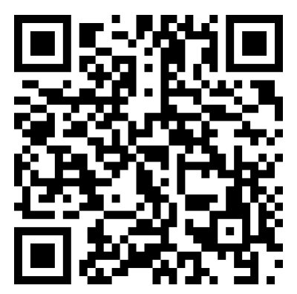
Pronouns
Avoid assumptions about gender
What pronouns do the presenters use—how do you know?
Many students use "they” instead of “she/he”
Best practice: If a student hasn’t revealed their gender, use ‘they’.
Add pronouns to your name tent, if you wish.
See details at UO's Division of Student Life
studentlife.uoregon.edu/pronouns

Slide 15
Teaching: First Day of Class
How will you introduce yourself and the course?
☐ Tell students what to call you (important!) (Hint: first names are the most common.)
☐ Share a bit about yourself.
☐ Find out a bit about your students. (Simple questions or self-introductions work or you could do a longer ice-breaker.)
☐ Make clear that questions are welcome. Point out your UO email and office hours.
☐ Share a bit about class expectations.
☐ Most important: Share one or two real assets that you are bringing to the course and the students’ learning.

Slide 16
First Day of Class: Practice
Task: In groups of 3-4, practice introducing yourself on the first day of class.
    Ask for feedback:
    What worked well?
    Any suggestion for improvement?
1-2 minutes per person

Slide 17
Closing Slide with the University of Oregon Logo

