Slide 1
Teaching Undergrads in the US
TEP-GE Day of Teaching Part 1
Alicia Going, Ali Söken, University of Oregon
Sep 22, 2026

Slide 2

Agenda
Part 1: Sep 22, 2:30-4:30
Part 2: Sep 23: 1:00-1:50
Ice-breaker
First Day Teaching
Introduction [10 min]
Check in activity [15 min]
Teaching scenarios [20-30 min]
Break [10 min]
TEP: Growth mindset [10 min]
IGE Panel [45 min]

Slide 3
Introduction (10 min)

Slide 4
Introduction
Alicia Going, she/her
MA in TESOL, 1993
Started at UO 2003
Passions – The outdoors, knitting, reading, live jazz, cooking, travel

Slide 5
Introduction
Ali Söken, he/his, Faculty Consultant, Teaching Engagement Program
1st gen, international student. Coming from a low-income family
Ph.D in Teacher Education and Curriculum Studies (9 year grad school)
Family – 7 year old daughter, love cooking

Slide 6
Name Tent
Please write:
Name you want to be called
Department & program
Place you call HOME
Favorite free time activity

Slide 7
Check-in (15 min)

Slide 8
Group Check-in
How are you feeling about teaching at UO?
Chat about the following:
What are you most looking forward to?
What are you feeling anxious about?
What challenges might international GEs face teaching or working with undergraduate students from the United States?
Form a group with 3 or 4 of your neighbors.​ Briefly introduce yourself (your name & department)

Slide 9
Teaching Scenarios

Slide 10
Teaching Scenarios
Scenario 1
Scenario 2
Students are not paying attention to your lessons. How can you get them more interested in what you are teaching? Or when you ask a question, no one answers. What can you do?
Students are eating during class, not responding when you make requests, and sometimes complain or ask annoying or off-topic questions while you are teaching. You are feeling disrespected. What can you do?
Scenario 3
A student finds spelling and grammar errors in your sentences on the board with embarrassing consistency, and she comes around after class to give you her critical opinion of the course. When she’s in class, you feel like you’re being constantly monitored. How can you handle this?

Slide 11
Teaching Scenarios
First round:
Read the scenario you are assigned.
Discuss the scenario assigned to your group and write ideas on the big paper.
Second Round:
Get together with people from a group that has the same scenario and compare answers:
(Groups 1,2,3) (Groups 4,5,6) (Groups 7,8,9)
Third Round:
Get together with people from a different group and share your scenario and solutions: (Groups 1,4,7) (Groups 2,5,8)(Groups 3,6,9)
Notes:
In round 2, number students at each poster by 3s (1-3 number them by 1,2,3) (4-6 number them by 4,5,6) (7-9 number them by 7,8,9)
In round 3 number students in each scenario from 1-9 so that they end up with some people with different scenarios.

Slide 12
Break (10 min)

Slide 13
TEP + Growth Mindset (15 min)

Slide 14
First thing first
You are ENOUGH!
You are not alone…
You already have what it takes to succeed.

Slide 15
Asset vs. Deficit Based Approach
Asset Based | Deficit Based
Strengths Driven | Needs Driven
Opportunity focus | Problems focused
Internally focused | Externally focused
What is present that we can build upon? | What is missing that we must go find?
May lead to new, unexpected responses to community wishes? | May lead to downward spiral of burnout, depression, or dysfunction?
Reference: https://www.memphis.edu/ess/module4/page3.php

Slide 16
Navigating Emotional Labor
Teaching in a new setting is real work
Struggle ≠ failure—it means you care
Emotional labor → empathy, insight, growth

Slide 17
Building a Supportive Community
Quick check-ins → trust & care
You bring global perspectives
Polls & feedback = shared ownership
Belonging grows with presence + structure

Slide 18
Humanize Your Teaching Practice
You're a facilitator
Everyone teaches and learns
“I don’t know”—models curiosity
Grow with your students

Slide 19
Teaching Engagement Program [TEP]
We provide teaching support to GEs and faculty across campus through:
Individual consultations
Teaching workshops
Graduate Teaching Initiative certificate
Teaching Support and Innovation website
Teaching awards for GEs
TEP offices located in Straub Hall—4th Floor
Notes:
Very brief—one minute or less.

Slide 20
You are not alone!
For teaching support, in addition to your unit:
In supporting your students:
Connect with TEP and UO Online for
Consultations (aka any teaching related questions or discussion)
Workshops
Course observations
Graduate Teaching Initiative certificate and community
Connect with AEC for any questions on student accommodations in your courses
You can always reach out or refer your students to:
Dean of Students, including their Student Care Team
Tutoring and Academic Engagement Center (TAEC)
Counseling Services
Not sure where to refer a student or what to do? Contact the Dean of Students.

Slide 21
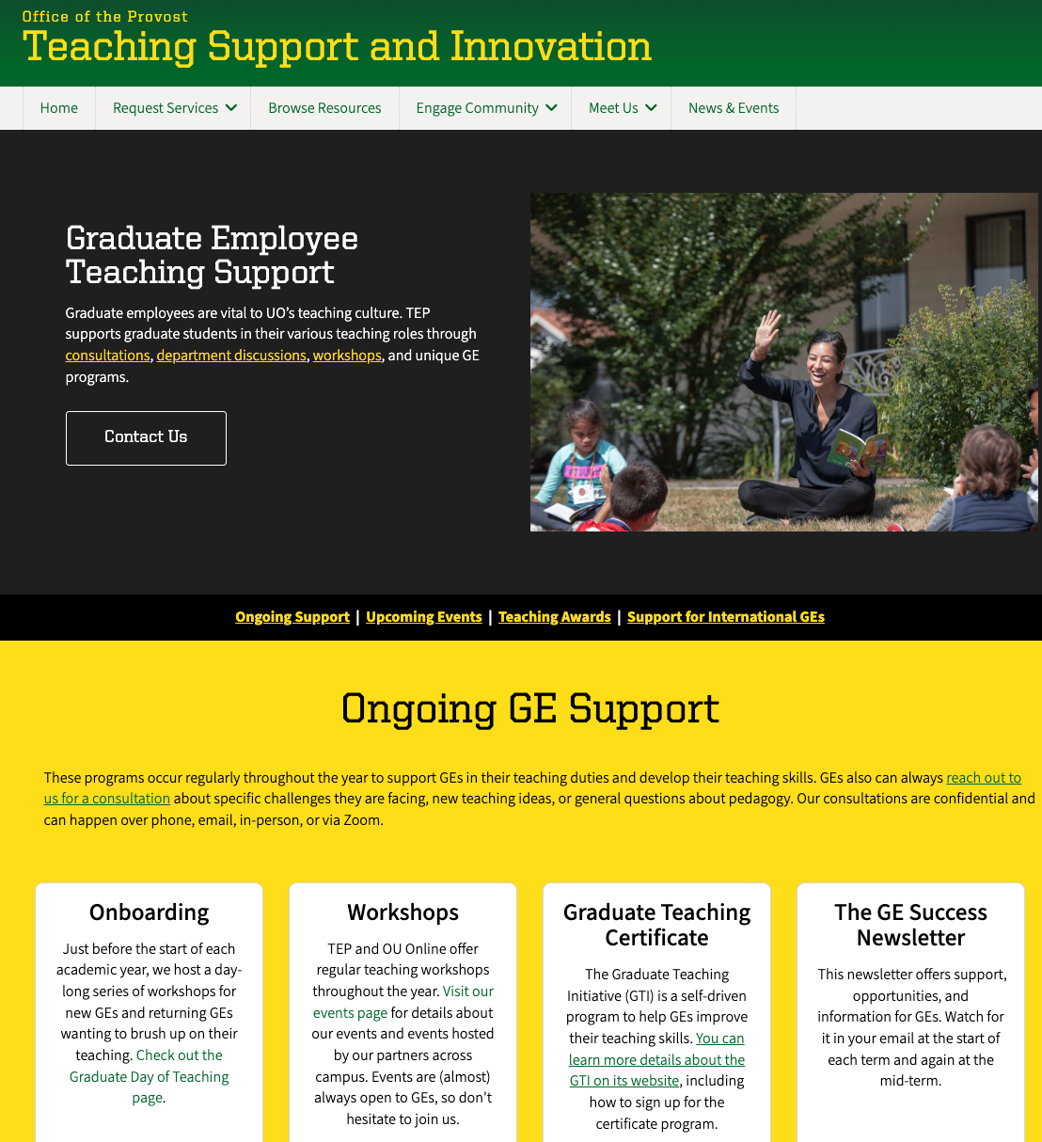

TEP – GE Support

Slide 22
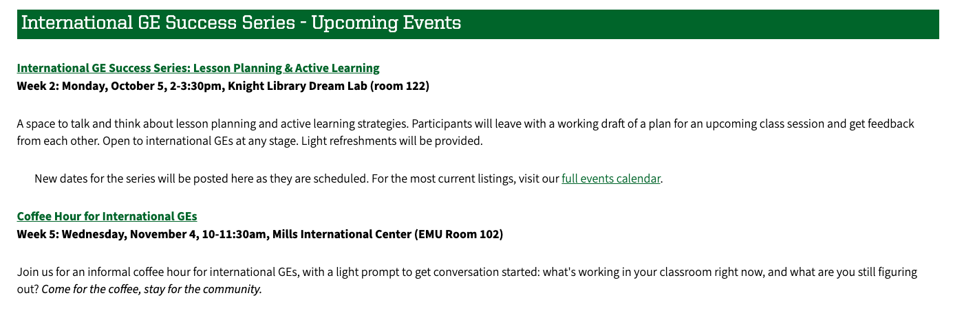
TEP International GE Series
teaching.uoregon.edu/services/graduate-employee-teaching-support

Slide 23
You are not alone!
Please reach out! alisoken@uoregon.edu
Straub Hall – Room 404
Contact us at tep@uoregon.edu with any questions
Visit teaching.uoregon.edu for more resources

Slide 24
AI and Teaching

Slide 25
AI and Teaching: Frequently Asked Questions
What's my role in AI policy as a GE?
Every faculty member has the flexibility to build their own AI policy, check in with your instructor about their expectations for AI use.
If you are the sole instructor (instructor of record), you can use these sample course policy statements.
Can I penalize work I suspect is AI-generated?
You can grade down work that's weak on its own merits, but a penalty specifically for suspected AI misuse requires a finding from the Office of Student Conduct and Community Standards (SCCS).
For more details, check TEP's AI Policy & Principled Practice for Instruction: FAQ

Slide 26
AI and Teaching: Frequently Asked Questions
Can I use an AI detector?
UO does not provide a central AI detection tool. SCCS does not use AI detection tools and notes that a detection tool finding is not dispositive of student AI use.
Can I use GenAI to build teaching materials?
Yes. Brainstorming topics, drafting activities, or generating question sets are reasonable uses, with your judgment staying in the loop.
Can I use AI to help generate feedback on student work?
While no existing UO policies specifically prohibit faculty from using AI to generate feedback on student work, faculty must retain human judgment in the assignment of grades.
Don't enter student work into any tool other than UO's CoPilot Chat/Premium with data protection.
For more details, check TEP's AI Policy & Principled Practice for Instruction: FAQ

Slide 27
GenAI Vicious Cycle Threatens Learning
Use AI for the task
Skip the productive struggle
This is especially dangerous for writing, reasoning, and problem-solving — the skills that matter most.
Rely on AI even more
Skill does not develop
Generated by ChatGPT

Slide 28
Teaching Advice
Motivate your students: explain why the assignment matters and why AI is or isn't part of it
Communicate Transparently: share AI State your AI expectations at the point of the task. Explain why, not just what. Explicitly invite student questions, so asking doesn't feel like admitting guilt.
  Diverse student profiles: There is no single audience in the room. Make sure you speak to everyone.
  Silence pattern: *1 in 10 students mentioned they felt comfortable asking an instructor to clarify AI use. (Source: TEP GenAI CAIT 2025-2026)

Slide 29
Teaching Advice
Two skills can protect critical thinking in the age of AI
Metacognitive Habits: Students should ask: do I need this, or am I reaching for it out of habit? 4 questions help them slow down and monitor their thinking.
  Before: What did I already know before I asked AI?
  During: What will I keep, change, or reject and why? What’s still unclear, and how will I find out?
  After: Could I explain this without AI’s help?
AI Literacy: A working understanding of how AI tools work, students can judge its output rather than defer to it. Resource: UO Library AI Resources
Design with intention — anchor tasks to real context, make process visible, verify skill directly
Details and examples on the handout (Link)​

Slide 30
Resources
Full resource guide: teaching.uoregon.edu/ai

Slide 31
IGE Panel (45 min)

Slide 32
IGE Panel
JY Lin
Sociology
Luis Claveria Cambon
Political Science
Sophia Suo
East Asian Languages & Literatures

Slide 33
Panel Questions
Please briefly introduce yourself (name, department, where is home for you, teaching experience)
What is one piece of advice you have for someone new to teaching at UO?
What do you wish you had known when you first started teaching?
What is one challenge you’ve experienced while teaching, and how did you overcome it?

