Slide 1

Teaching as the Instructor of Record
Julie Mueller, (she/her)
Senior Faculty Consultant
Sept. 23, 2026
Notes:
Be

Slide 2
Access supporting materials
Session materials: teaching.uoregon.edu/ge-day-teaching-resources​
​
Course Builder: teaching.uoregon.edu/course-builder​

Slide 3

Teaching as the Lead Instructor
Introduce yourselves: Name, what you’ll be teaching, what kinds of teaching you’ve done before.
How is teaching as the lead instructor different from other GE assignments? What will you need to do that you haven’t done before?
3 min
Find a partner.
One be prepared to report out.
Teaching Toolbox
Icebreaker

Slide 4
Our learning objectives for today: practical
By the end of the workshop, I hope you’ll feel confident:
Developing lesson plans that align with course objectives and engage students.
Implementing active learning strategies in your teaching.
Assessing student performance and providing constructive feedback.
Implementing strategies to create a welcoming classroom.
Identifying the key components of an effective course syllabus.

Slide 5
Designing a course: Principles and practices

Slide 6

Students must be engaged in their learning
“Learning is not a spectator sport. Students do not learn much just by sitting in classes listening to teachers, memorizing prepackaged assignments, and spitting out answers. They must talk about what they are learning, write about it, relate it to past experiences and apply it to their daily lives. They must make what they learn part of themselves.”
- Chickering and Gamson, 1987

Slide 7









What factors shape student engagement?
Information & Ideas
Environment
Value
Student Engagement
Reflection
Experiences
Self-Efficacy
Synthesized from Barkley (2020), Fink (2013), and Ambrose (2010).

Slide 8
Checklist for Planning: Learning activities
Active Learning
Information and Ideas: How are students engaging content? [lecture, reading, research, discussion, etc.]
Experiences: What are students doing or observing to bring content to life and make it “theirs”? [activities, exercises, assignments, etc.]
Reflection: How are students being asked to determine, for themselves, the meaning and significance of their learning experiences? [debriefs, journals, portfolios, metacognitive exercises, etc.]

Slide 9
Checklist for Planning: Motivation
Motivation
Value: How has the value of the course, and particular aspects of it, been articulated? [goals, purpose, relevance, interest, significance, etc.]
Self-Efficacy: How do students develop a realistic sense of agency, confidence, and progress about their performance in the course? [expectations, rigor, feedback, strategies for success, etc.]
Environment: How has a supportive learning environment been cultivated? [communications, approachability, organization, check-ins, etc.]

Slide 10
Aligned “Backward” Design
Goals
What will students learn?
Learning Outcomes
What should students know or be able to do?
Summative Assessment
What evidence will demonstrate student learning?
Formative Assessment
How can students get feedback about their learning?
Activities
How will you help students meet goals?
Adapted from Wiggins & McTighe (2005)
Notes:
Backward design is an approach to course design that focuses on student learning rather than on teacher performance. It is called “backward” because it starts with what students should know, understand or be able to do by the end of the unit/course/degree and works backward from there to inform development of course materials that specifically target successful achievement of the learning goals.
-The first step is to identify the learning goals/outcomes. Next, determine what evidence will convince you that students achieved the desire goals which become the course assessments. And, finally, with the achievement target clearly defined, create learning activities that will help students achieve the desired goals.

Slide 11
Key questions to ask
5 min
Try it for a topic you might teach
What should students know or be able to do?
How do students demonstrate what they know or can do?
How do students prepare for demonstrating their knowledge or skills?
How are students introduced to the content they’ll be using?
[What is the learning outcome?]
[What kind of assessment?]
[What kinds of experiences – activities, interactions, etc?
[How exposed to – retrieve or receive – the content?]

Slide 12
“Backward” design
Design (and follow) a study plan that uses strategies whose effectiveness is supported by research.
1
Students create a study plan that details which strategies they will use.
2
3
Instructor Planning Steps
Answer questions about prep material, practice recalling information about strategies, work in groups to define strategies and identify places to use them.
Student Learning Experience
3
2
Watch a video, read an article, class discussion.
4
1

Slide 13
Creating a lesson: Have a
Creating a lesson: Have a through line
Pre-class prep
Required for
In-class activities
Required for
Post-class work
What activities might happen in each of these time frames?
How can we be sure students do the work?
Assign points to it
Link it to things they are interested in

Slide 14
Creating a lesson: Make it active
Information and Ideas
Primary / secondary
Accessing them in-class, out-of-class, online
Reflection
On what one is learning and how one is learning
Alone and with others
Experiences
Doing, observing
Actual, simulated
Fink, L.D. (2003). Creating significant learning experiences: An integrated approach to designing college courses. San Francisco: Jossey-Bass.

Slide 15

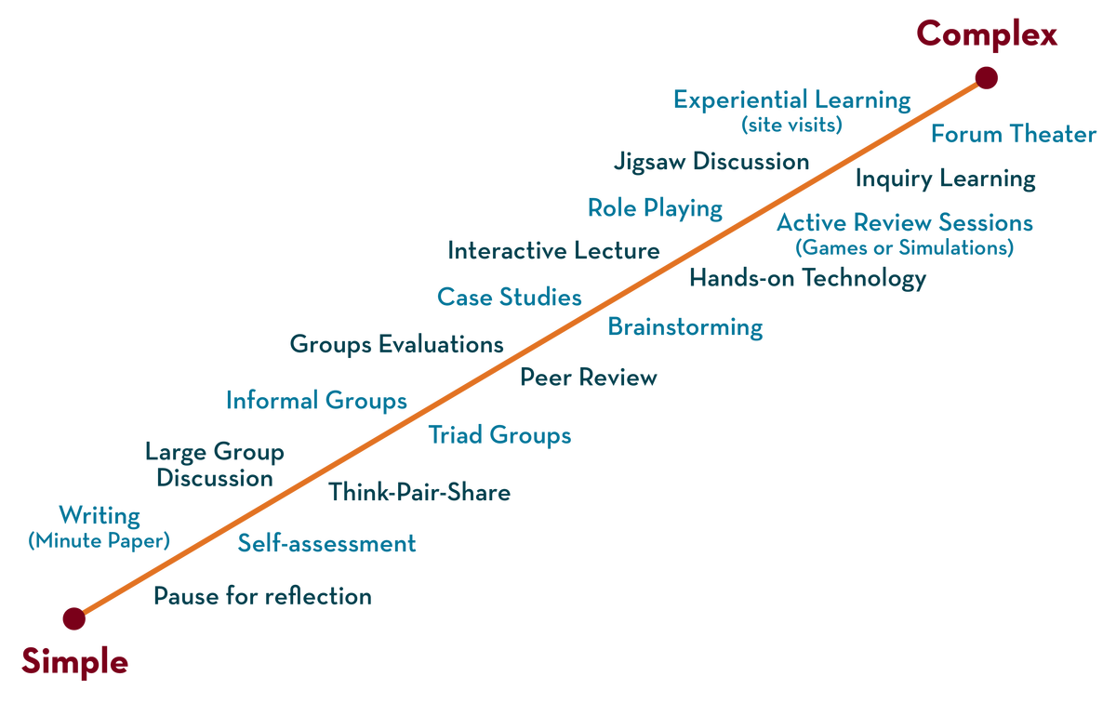
Types of activities
teaching.uoregon.edu/resources/student-engagement-techniques
Why not just lecture?
Provide opportunities for all students to engage with the material
Underprepared and historically excluded students benefit most from structure and active learning.
https://cei.umn.edu/teaching-resources/active-learning

Slide 16
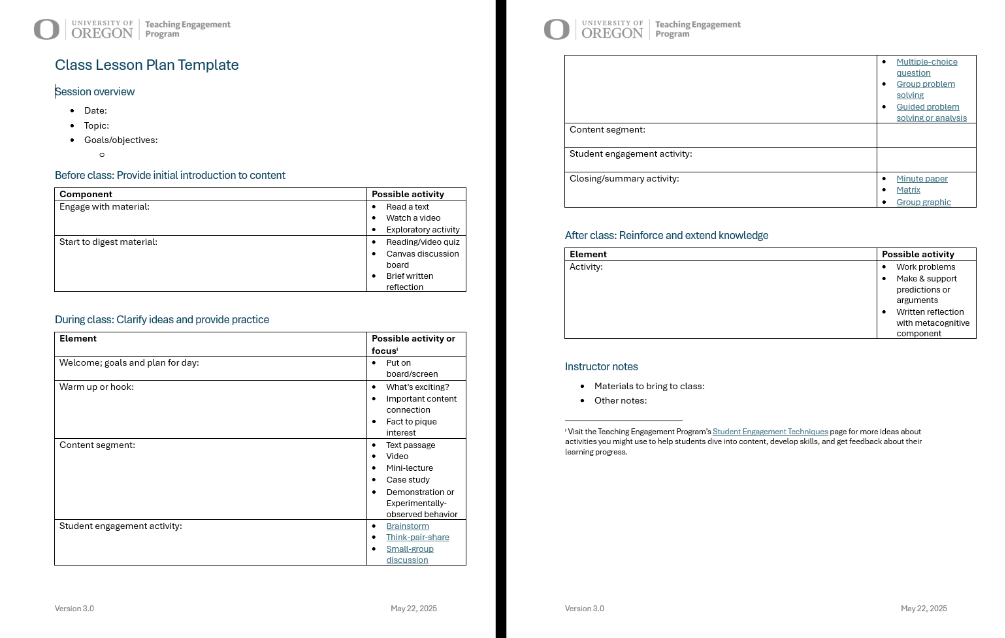
How to integrate it all?
tinyurl.com/class-session-planner-v-3
Try it! Sketch out a lesson for your course.
10 min
Worksheet

Slide 17
How to integrate it all? Plan across the term
Instructional strategy
Include variety!
Major topics
In class
1.
Out of class
2.
In class
Out of class
Overall course structure
3.
In class
Out of class
4.
In class
Out of class
Adapted from Fink, Creating Significant Learning Experiences.

Slide 18

Creating assignments: Focus effort on the learning task
What questions arise for you when you get an assignment?
Minute paper
“What am I supposed to do, and how am I supposed to do it?”
“How will I be graded?”
“When is it due and where?”
“Why are we doing this?”
(aka “Why should I care?”)

Slide 19

What is transparency?
Over 25,000 students…
…in hundreds of courses…
…at more than 40 institutions…
…in seven countries.
A framework for assignment design:
Purpose, Task (or Process), Criteria

Slide 20
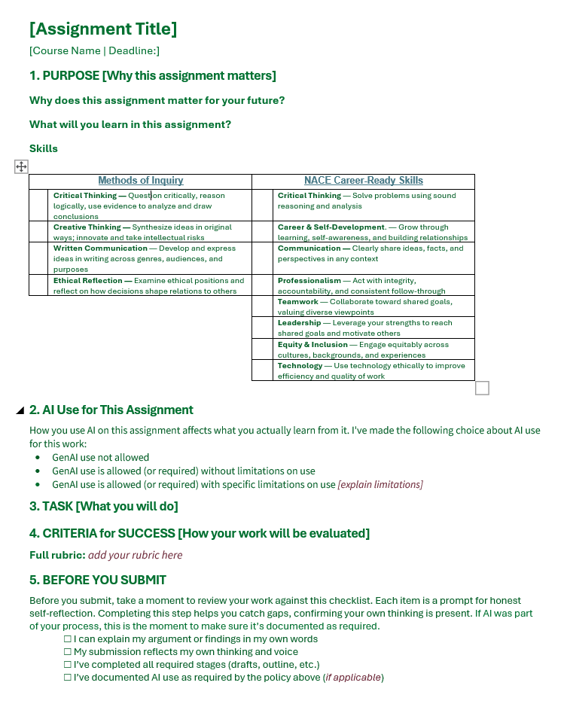
The AI-Aware Transparent Assignment Template
“When is it due and where?”
“Why are we doing this?”
(aka “Why should I care?”)
“What am I supposed to do and how am I supposed to do it?”
“How will I be graded?”
https://tinyurl.com/aiatat
Adapted from Winkelmes, 2016

Slide 21
Assessment

Slide 22
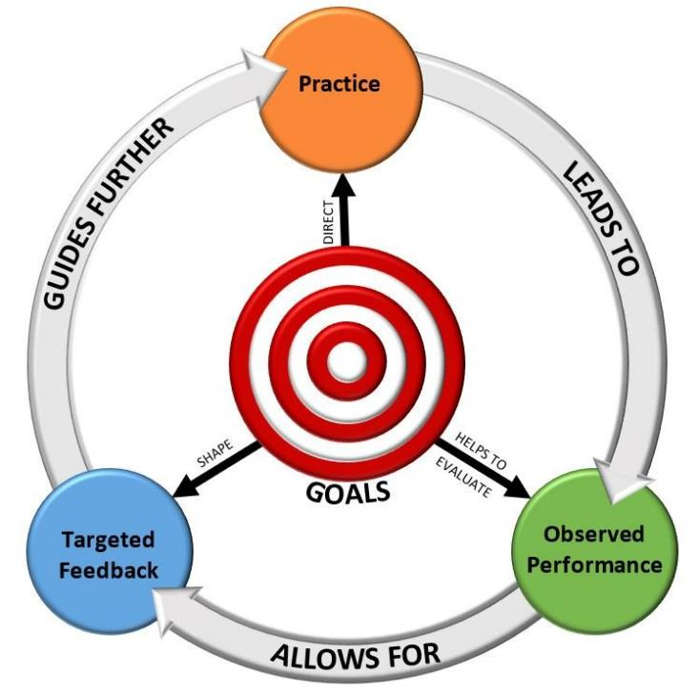
Cycle of Practice and Feedback
Encounter material
Assessment:
Can be Formative or Summative.
https://ecampusontario.pressbooks.pub/ticl/chapter/10-2-importance-of-feedback/

Slide 23
Types of Assessment
Formative
Helps students learn and practice
Summative
Final assessment of progress toward learning objectives
Happens throughout the course
Identifies gaps and improves learning
Focuses on the process
Happens at the end of an instructional period
Collect evidence of student knowledge and skills
Focuses on end result
More feedback needed
Less feedback needed

Slide 24


Formative assessment: Examples
Usually low-stakes, relatively frequent
Poll questions
Low-stakes quizzes
Think-pair-share
Minute paper
Muddiest point
Exit ticket
Reflections
Etc.
(Wise)
https://elearningindustry.com/types-of-learner-feedback-tools-and-goals
Brainstorm

Slide 25

Summative assessment: Examples
Often higher-stakes, individual or group
Written exams
Oral exams
Papers
Projects
Presentations
Portfolios
If possible, include variety and choices.

Slide 26
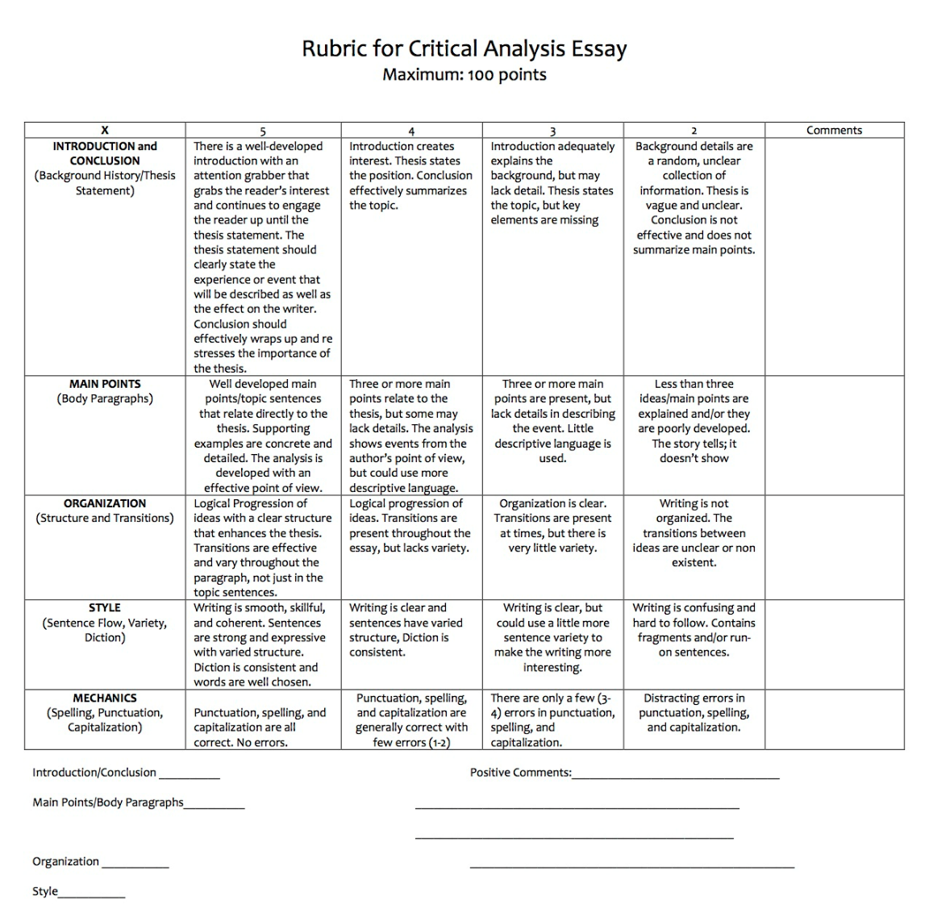
How to assess with more transparency?

Slide 27
AI: The Elephant in the Room

Slide 28



How students might use AI
Extend human abilities
Develop human abilities
Magic answer box
GenAI “is the biggest issue confronting… pedagogy in my lifetime.” (David Chamberlain, Classics)

Slide 29

The Gen AI Vicious Cycle threatens learning
Deskilling: AI does the work. Skills never develop, and maybe erode.
Magic Answer Box​
THE VICIOUS CYCLE:
when the Magic Answer Box becomes the default
Use AI for the task
Skip productive struggle
Skill does not develop
Rely on AI even more
especially dangerous for essential skills: writing, reasoning, problem-solving

Slide 30
Develop assessments with AI in mind
Reassess learning outcomes: Consider how AI is used in your students' future field, then ask:
  What should students know/do independently of AI?
  What skills do they need to critically use and evaluate AI?
  What may no longer be central to teach or assess the same way?
Make assessment choices
  Decide deliberately when to restrict, permit, or require AI
  Decide where and how to assess
Assess your assessments: Test with multiple AI tools and iterative prompting
Prepare to communicate transparently with students
  Explain WHY, not just WHAT
  Discuss how AI could undermine OR support this assignment

Slide 31
Designing AI-resilient assignments
Build in human experience
Interviews, fieldwork, real lab data, observations, collaborative projects
Creative, hands-on tasks
Emphasize process + connection
Require links to course-specific discussion
Use scaffolded sequences (later work builds on earlier work)
Include reflection on learning & decision-making
Personalize + situate
Connect to student interests
Start with personal interpretation, then bring in evidence
Push beyond “regurgitation”
Prioritize analysis, creation, evaluation
STEM: Error correction, code optimization
Broaden audience + format
Share work beyond classroom (peer/public)
Use multimodal outputs (audio, video)
These things address motivation.
No magic bullets!

Slide 32
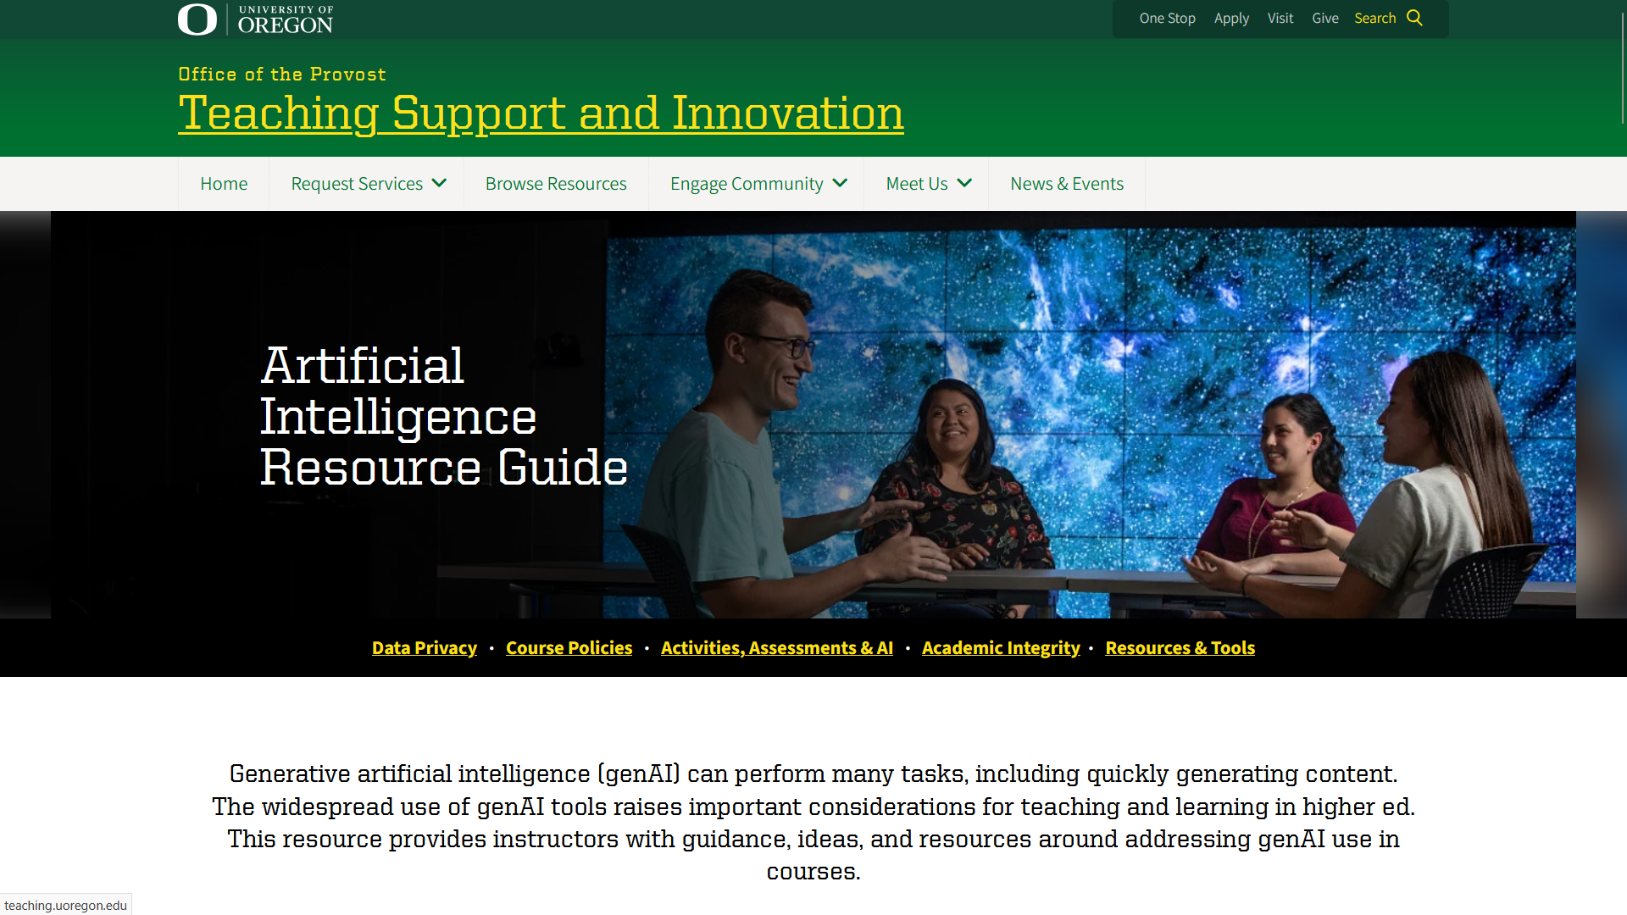
Artificial Intelligence Resource Guide
teaching.uoregon.edu/ai

Slide 33
Build a sense of belonging and connection

Slide 34
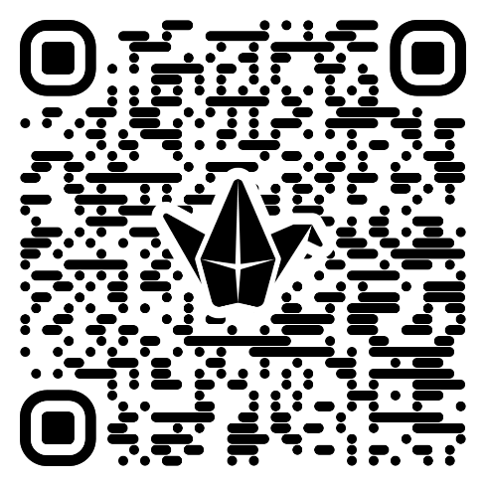
Help people feel they belong
Activity
With one or two partners, discuss HOW to implement the strategy.
Enter ideas into Padlet.
Learn about each other
Everyone has something valuable to contribute
Use names
Foster student-student relationships
Positive error climate
Be flexible where possible
5 min
Divide and conquer

Slide 35
Course Materials

Slide 36

The Syllabus
Consider:
Content: Required and recommended elements
Tone: What impression does it give?
Design: Make it easy to read, digitally accessible

Slide 37
The Syllabus: Required elements
Instructor information and office hours (specifies what information)
Course objectives, including approved learning outcomes (with additional info for undergraduate courses that meet Core Ed requirements)
Required materials and activities, such as a list of required readings, materials, assignments, exams
Absence policy (if attendance is required or counted) that is reason-neutral and pedagogically appropriate for the specific course
Classroom behavior description in terms of expectations
Grade policy describing grading criteria, expectations, standards
University Policies and Course Accommodations statement (new--include set language)
teaching.uoregon.edu/syllabus

Slide 38
The Syllabus: Recommended elements
Course Description
Technical Requirements
Communicating with Me: How and Why
Student Workload and Time Use
Course Deadlines and Late Work
Generative Artificial Intelligence Use Policy
Content Warnings
Class Recording
AI-Enabled Digital Wearables (smart glasses, etc.)

Slide 39
The Syllabus: Tone
Read example late submission policies:
We design our schedule so everyone stays on track and gets graded feedback quickly. For this reason, late submissions cannot be accepted. If you feel overwhelmed or stuck, please see me during student hours or send me a note before the due date—I want to help you succeed before work is due."
Deadlines are final. Submissions entered after the designated closing time will automatically receive a grade of zero. No partial credit, extensions, or make-up assignments will be granted.
3 min
With a neighbor: What’s different? Advantages and disadvantages?
Sample analysis
Warm tone: Students see instructor as more approachable, more motivated to teach.

Slide 40
The Syllabus: Key takeaways
Tone:
Positive, friendly language
  “I welcome…”
  “Please feel free to…”
Provide rationale
Share personal experiences
Use humor
Convey compassion
  “I understand…”
  “I care…”
Show enthusiasm for course
  “I’m excited…”
Resource: TEP’s Accessible Syllabus Template
teaching.uoregon.edu/syllabus
Make document digitally accessible
teaching.uoregon.edu/guidance-making-your-syllabus-accessible

Slide 41
The Canvas Site
Design so students spend their energy on learning content, not figuring out what to do, how to find materials.
Canvas Course Templates
How-To Guides
https://teaching.uoregon.edu/uo-canvas-course-templates
teaching.uoregon.edu/browse-resources#how-to

Slide 42
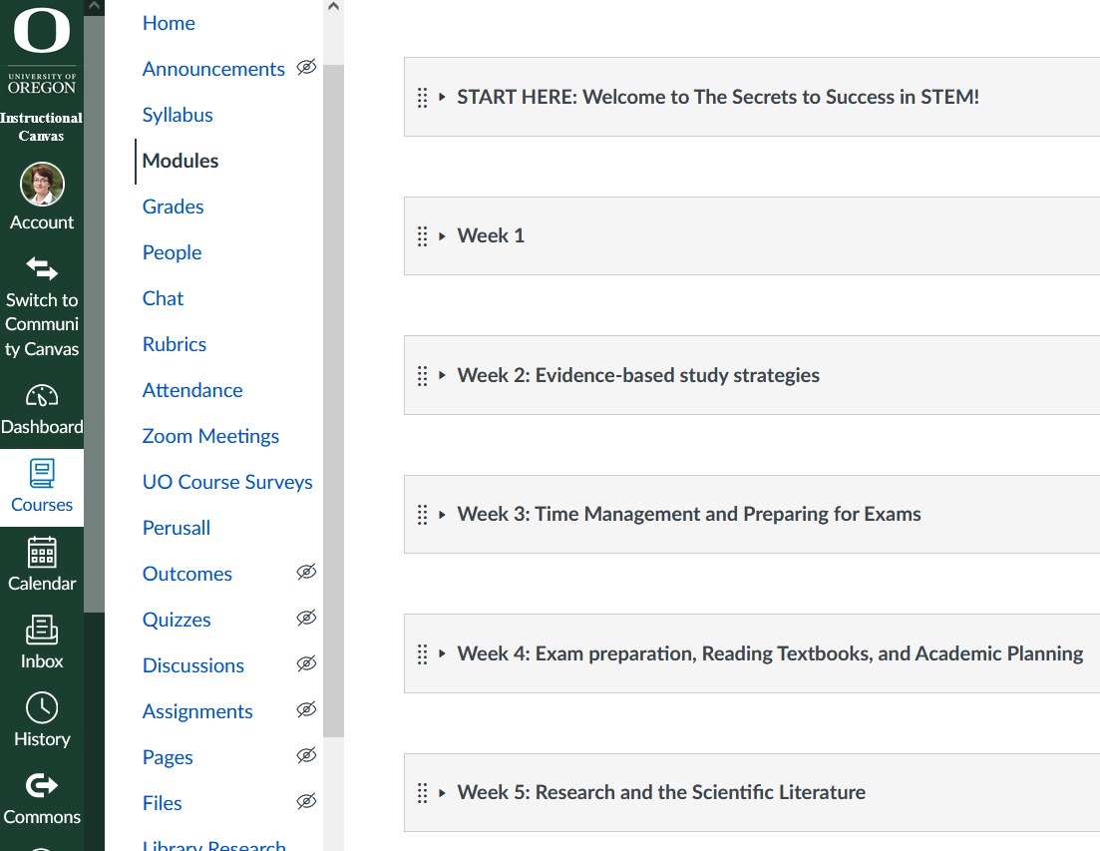
Recommended Canvas design: Use modules
One module per week/unit/chapter
Consistent module structure
Streamline blue course navigation menu

Slide 43
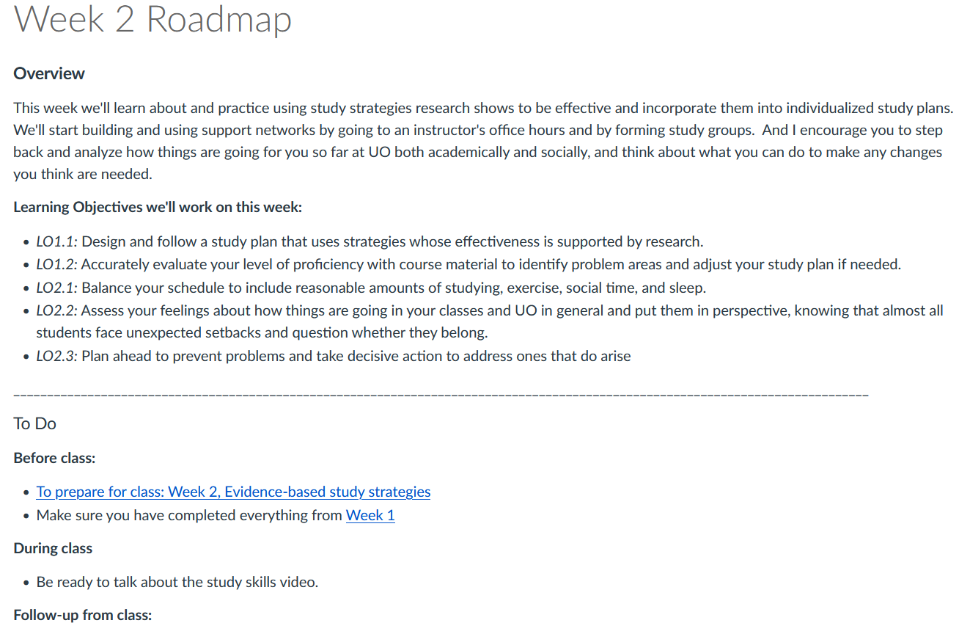
Recommended Canvas design: Stable wayfinder
Where students learn “the plan” for the week
Overview
Learning objectives
Tasks
teaching.uoregon.edu/resources/providing-clear-path-through-your-course

Slide 44
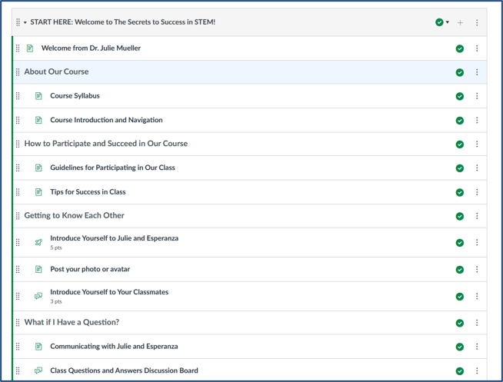
Recommended Canvas design: “Start here” module
Intro to the course
How to navigate the Canvas site
Start to build community
How (& why) to communicate with you
Resource: Providing a clear path through your course.

Slide 45
Course Policies/Requirements

Slide 46
Policies/requirements to be aware of
ADA accommodations:
  Letters from AEC.
  Can’t ask about nature of disability.
  Legal requirement.
  Can consult with AEC on how to accommodate.
Course attendance and engagement policy: Reason neutral.
Academic misconduct: Refer all suspected cases to Office of Student Conduct and Community Standards.

Slide 47
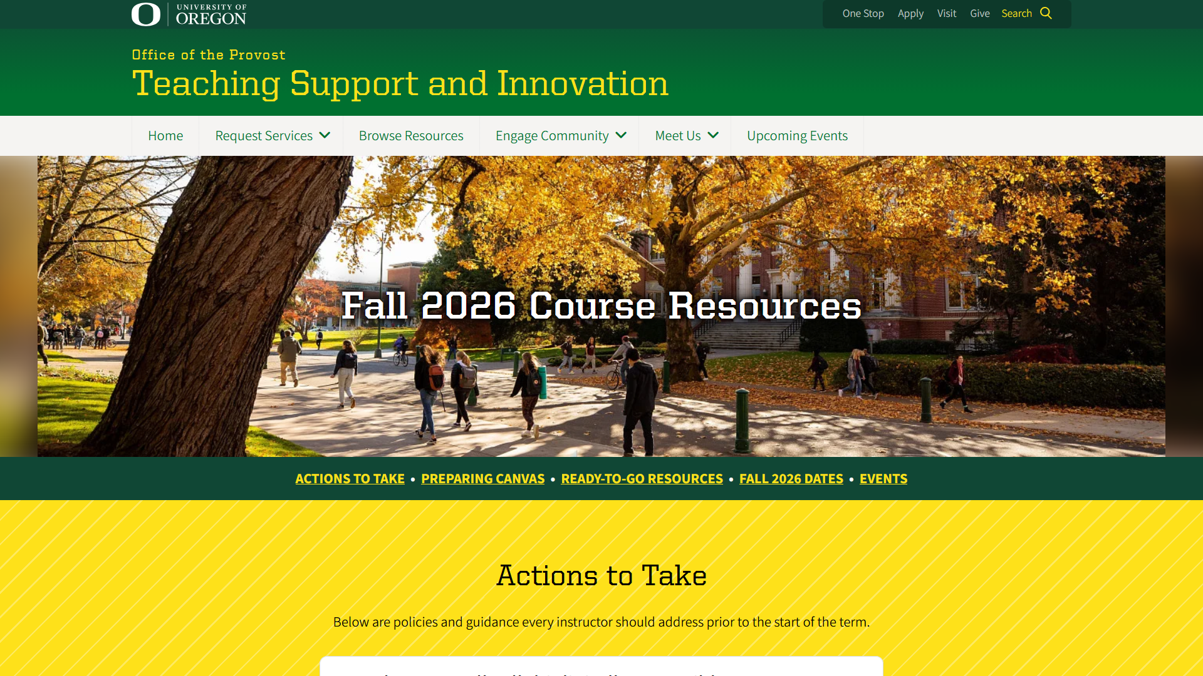
TEP’s Course Resources webpage
https://teaching.uoregon.edu/term-resources

Slide 48

Improvement through feedback
Gather feedback about specific assignments or activities during term.
Mid-term Student Experience Survey (MSES)
  Only you see results
  No university-level messaging
End-Student Experience Survey (ESES)
  Results viewable by department committee
  University messaging
  Grade hold for non-completion
Talk to students about results and how you’ll use them
Feedback for me!
What was most helpful or most supported your learning?
What could we do next time to improve the learning experience?
Exit Ticket

Slide 49

Any questions?

Slide 50
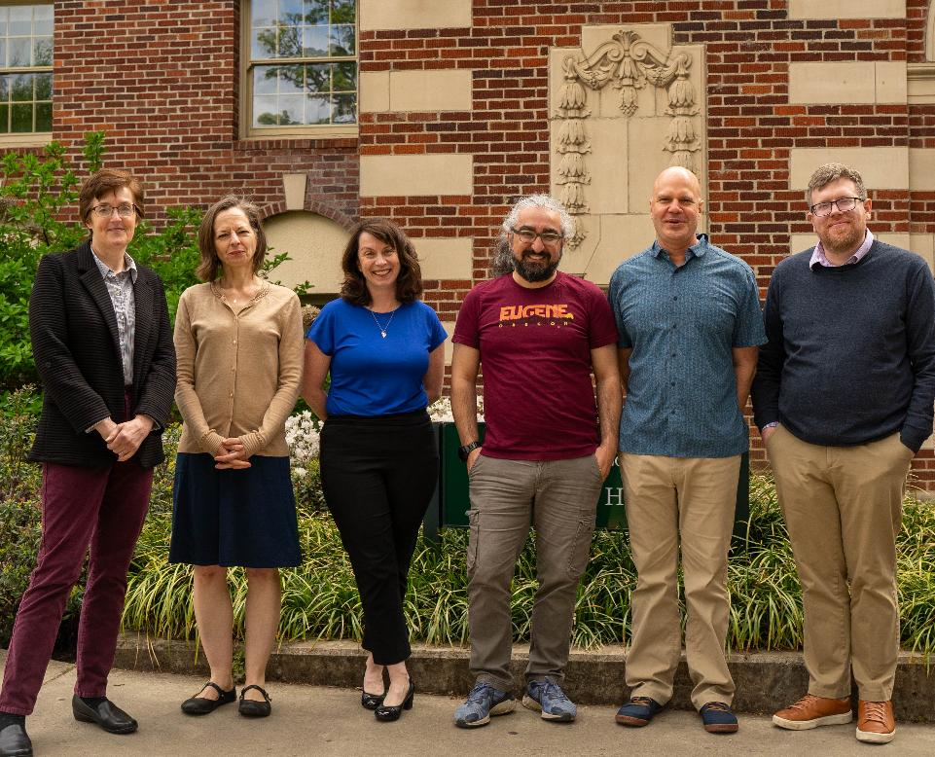
TEP is here to support you!
Questions? Email jmueller@uoregon.edu or tep@uoregon.edu
Individual consultations
Teaching workshops
Graduate Teaching Initiative certificate
Teaching Support and Innovation website
Class observations
Teaching awards honoring GEs
TEP offices located in Straub Hall—4th Floor. Visit us!
Notes:
Very brief—one minute or less.

Slide 51
Before you leave
Write down at least two things you need to decide, get more info about, or discuss with an experienced colleague as you get ready to teach.
Out-the-door activity

Slide 52
Citations
Ambrose, S.A., Bridges, M.W., DiPietro, M., Lovett, M.C., and Norman, M.K. (2010). How learning works: Seven research-based principles for smart teaching. San Francisco: Jossey-Bass.
Barkley, E. F., & Major, C. H. (2020). Student engagement techniques : a handbook for college faculty (Second edition.). John Wiley & Sons, Inc.
Chickering, A. W., and Gamson, Z. F. (1987). “Seven principles for good practice in undergraduate education.” AAHE Bulletin, 39, 3-7.
Fink, L.D. (2013). Creating significant learning experiences: An integrated approach to designing college courses. San Francisco: Jossey-Bass.
Harnish, R. J., & Bridges, K. R. (2011). Effect of syllabus tone: Students’ perceptions of instructor and course. Social Psychology of Education, 14(3), 319-330.
Wiggins, G. P., & McTighe, J. (2005). Understanding by design. Ascd.
Winkelmes, Mary-Ann. “Transparency in Teaching: Faculty Share Data and Improve Students’ Learning.” Liberal Education 99,2 (Spring 2013)
Winkelmes et al, “A Teaching Intervention that Increases Underserved College Students’ Success.” Peer Review 18,1/2 (Winter/Spring 2016).

Slide 53
Closing Slide with the University of Oregon Logo

