Slide 1
Welcome to
Leading Labs at UO!
Richard Wagner
richardw@uoregon.edu
Accounting
Anthropology
Architecture
Biology
Cliniical Psychology
Data Science
Earth Science
Geography
Human Physiology
Linquistics
Music Theory
Neuroscience
Planning & Public Affairs
Physics
Psychology
teaching.uoregon.edu
Notes:
Introduce me.
Call out of registrants departments
”Lab” is a big umbrella covering hands-on learning by students. Many folks are likely from natural sciences and STEM fields. Also have some art, architecture, and music folks who certainly lead students in learning physical techniques in arts. Social science and humanities – sociology, anthropology, disability studies – teaching students to design studies, analyze governmental data sets, examine artifacts.

Slide 2

Getting to Know You
Talk with a few neighbors (who you don’t already know)…
3 minutes
Name
What about UO appealed to you?
What teaching experience do you have, if any? Such as…
  Tutoring
  Learning assistant
  Teaching assistant
  Grader
  Lead instructor
Teaching Technique Toolbox
Icebreaker

Slide 3
Getting to Know Your Feelings
How do you feel about the prospect of teaching?
1
Paralyzed with nervousness and/or worry
4
Confident and eager to get started
Throat Vote
Notes:
Possible discussion: Experience with teaching?

Slide 4

Today’s Agenda
Goal: Help you feel more prepared to
teach
Implement strategies for building community in your class​
Applying best practices for helping students learn in lab
Preparing for labs
Knowing where to go when you need help or to get support with teaching

Slide 5
Building Community

Slide 6
Build A Community & A Sense of Belonging
Why?
How?
Discuss with someone you haven’t talked to yet and be prepared to share ideas
Easier to ask questions, take risks
More engaged
Work harder
Higher persistence
Harder to be dishonest
Builds trust (student-student and student-instructor)
Better matches real-world career experiences
Learn about your students
Let them know you
Facilitate student-student interaction
Show care, respect
Use names
Communicate that everyone brings unique and valuable experiences. Everyone has something to contribute.
Put content in context
Speak with everyone, everyday
Think-Pair-Share
Notes:
What benefits are there for student learning to building a community in our classes?

Slide 7

What aspects of identity affect how students engage with your class?
Job?
First generation in college?
Residency
Income level
Year in school
New events
Major
Kids?
Age
Attitude toward learning
Ethnicity
All these attributes affect a
student’s point of view!
Your students may not be like you!
How else can you learn about
your students to promote
a sense of belonging?
Brainstorm
Notes:
What aspects of students’ backgrounds might affect their attitude, how they view chemistry and the work you’re asking them to do?
New events – example is freshman living away from parents for first time, have to figure out laundry, navigate social things.
How else to learn about students - Survey, talk to them, etc.

Slide 8
Applying Best Practices

Slide 9
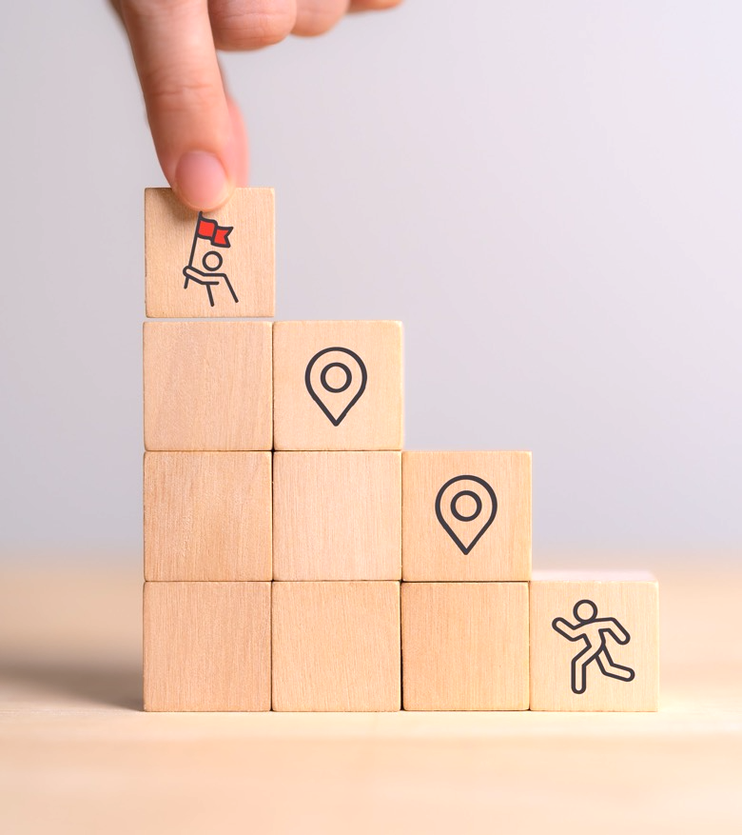
Constructivism
People learn by constructing their own knowledge
Prior knowledge affects learning
Research shows active learning helps most people along that path
Active Learning Methods!
Notes:
Learn better if you grapple with problems on your own rather than just being told about them.
Our teaching toolbox are demonstrations of active learning techniques!

Slide 10
When Asking Questions
Try to be specific
Rather than:
Did everybody get that?
Ask:
How do we know if the sample is acidic?
How much water should you add if your clay feels too dry?
Use adequate wait time
How long should we wait for answers?
How long do
people wait?
Wait 7-10 seconds for replies, not 0.5-3 seconds.
Get input from multiple voices.
Probe further to confirm understanding.
Prediction
Notes:
More specific questions force folks to retrieve information instead of just having them agree that things make sense.
How long do people wait – not unusual for folks to wait for less than a second (0.5-3 seconds is common)
Try actually counting on your fingers behind your pack

Slide 11

When Answering Questions
Answer Directly
Course policies and procedures:
When is this assignment due?
Safety:
Where is the fire extinguisher?
Answer indirectly
Foster independence: it’s okay to refer students to lab manual or their group mates.
Lead students through the critical thinking process: How does an expert in your field approach a problem?
Aim to spur critical thinking, not to accept sage wisdom
Notes:
Your job is not to make sure students have right answer. It’s to help them understand concepts, think for themselves.
Model the way a scientist/expert approaches solving a problem. What kinds of questions do you ask to help you figure things out? Is there a routine you can demonstrate?

Slide 12

Spur Deeper Thinking in Your Students
Ask yourself: What could you do to get students to think deeper about the content or methodology rather than accept black boxes?
Review the Deeper Thinking Questions handout
  Which can I imagine using?
  How can I modify some for my discipline?
  When/how would I use them?
5 minutes
Document Analysis
Notes:
Black box – question goes in, box goes brrrr, answer comes out. Want students to put together what is going in INSIDE the box.
GEs from non-mathematical fields may way to focus on the middle question. What are some similar questions that you could ask for your discipline?

Slide 13

Will Students Get Frustrated by Non-Direct Answers?
Maybe!
  Try these:
  Reflect their thinking back to them by paraphrasing what they’ve already told you
  Highlight where a misconception happened
  Offer students other ideas, principles, etc. to consider to help clear up confusion
  Walk away - give space for them to think without you - and then follow up later.

Slide 14

During Lab Sessions…
Circulate around the room
Observe & decide: how much should I help?
Don't talk too much with other GEs.
Be conversational. Encourage input from all in the group.
Get at student’s level – sit or kneel down, don’t just stand over them.
Don’t be afraid to say “I don’t know” but don’t leave it at that: talk through the idea, invite students to share their ideas, or suggest a plan to find out and follow up.
Explain concepts in everyday language.

Slide 15

Using Everyday Language
Avoid common language versions of class terms
Analogies - good with real connections to life, bad when tenuous or specialized
Reference familiar objects and situations
Welcome student ideas and descriptions
Connect to previous knowledge including from class, prerequisites, or student backgrounds
Drawings and images can be helpful
Invite students to try explaining to each other
Read student reactions to your words
Invite questions & normalize uncertainty:
  “What have I left unclear for you?”
Notes:
“energy” is a colloquial term that has lots of meaning. Be careful not to rely on any of them if explaining something with physics energy
Invite students try to explain their understanding. Point out strong pieces or subtlties they might not appreciate.
If you are struggling to connect an idea, having students use their shared novice thinking can help bridge gaps if you are struggling to connect. Especially powerful in group work.

Slide 16
Challenging Situations
Scenarios are on walls around the room
Visit different scenarios, discuss:
  What are the issues involved?
  What are some appropriate courses of action?
  What are the implications of these actions?
  How could the situation have been prevented or muted?
Write your ideas on the sheets
There is usually no single right answer!
16 minutes
Gallery Walk
Notes:
Debrief by asking about situations that stood out to you. Courses of actions that others wrote or said to about that were interesting to you.

Slide 17
Scenario F
Part of your lab this week is to have students read and interpret a figure which is color-coded on a red/green scale. One of your students seems frustrated with the assignment and is making comments about how dumb the class is. The student is not usually so negative.

Slide 18
Scenario A
Soledad is meeting with Krista, a student who has missed several classes. After talking for a while, Krista explains that she is feeling anxious and that financial problems require her to work 30 hours a week. Furthermore, she says that she is having difficulty adjusting to the university and feels she doesn’t belong here.

Slide 19
Scenario G
Sergei’s student Catalina didn’t show up to their Thursday afternoon lab. She emailed him on Friday afternoon to say that she had gotten appendicitis and had needed emergency surgery, but that she was now recovering and hoped to be back at school sometime the following week. Catalina asked if she could make up the missed lab when she gets back, but Sergei knows that by Monday the previous week’s lab is taken down and the new one set up. What should he do?

Slide 20
Scenario B
Diego is an active student in your class who seems to be a hard worker. After failing the first major assignment in your class Diego comes to talk to you about how he can improve. He still fails the second major assignment even after he had tried to complete the assignment properly. You realize that Diego just doesn't seem to have the skills needed to pass your class.

Slide 21
Getting Ready For Lab

Slide 22
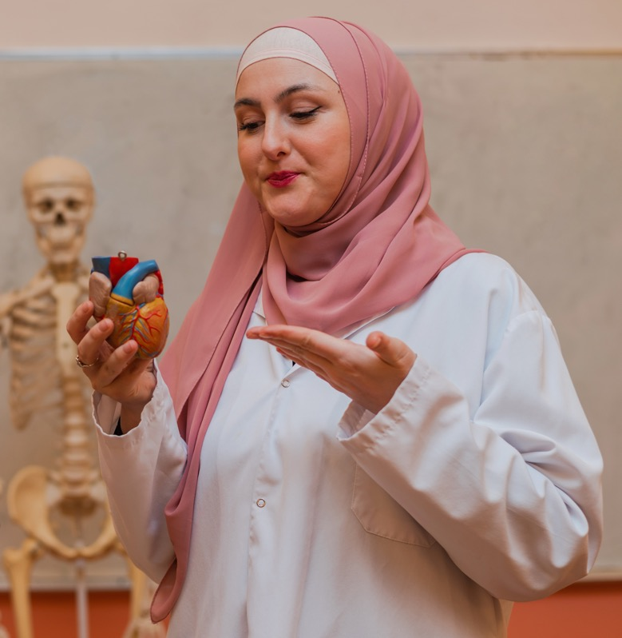
Getting Ready
Tips for GEs Teaching For the First Time
Which tips seem particularly well suited
for labs or for your discipline?
Working with a Teaching Team
Know your responsibilities, what to expect
Be professional
Don’t be afraid to admit uncertainty, ask questions
Review (on your own) the document on Setting Expectations
Document Analysis

Slide 23
Getting Support

Slide 24
Teaching: You Are Not Alone
Teaching Knowledge & Practice
Campus Resources
  TEP and UO Online
  Student Support
  Tutoring & Academic Engagement Center
  Accessible Education Center
  Counseling Center
  Safety
  UO Police (911)
  Safety & Risk Services
  Workshops
  Consultations
  Class Observations
  Reading Groups
  Teaching Courses
  Podcasts, Journals, Blogs
Science Teaching Journal Club
Tues 9am, LISB 217
Specifics of Course and Discipline
  Lead Instructor
  Head TA
  Other GEs on team
  Your Peers
  Support Staff
  Courses/Seminars

Slide 25
Getting Help from TEP
Me - Richard (richardw@uoregon.edu)
TEP website (teaching.uoregon.edu)
General Questions: tep@uoregon.edu
Upcoming GE-focused TEP Events
Workshop | Description | Time & Location
GTI Kickoff | Meet other GEs while learning about the Graduate Teaching Initiative, our teaching certificate program. | Tues Sep 29 @ 10am Straub Hall room 417
International GE Success: Lesson Planning & Active Learning | A space for international GEs to think and talk about lesson planning and active learning strategies. | Mon Oct 5 @ 2pm Knight Lib Dream Lab
Tips for Efficient Grading | Discuss tips for getting through that stack of exams, homework, lab reports, or assignments quickly. | Mon Oct 12 @ 11am Zoom
Grading with Canvas | Learn more about Canvas’s SpeedGrader. Practice using it in our closed Grading Practice Sandbox. | Tues Oct 13 @ 11am Knight Lib Dream Lab
Grading with Gadescope | Learn more about Gradescope, a new grading tool at UO. Practice grading fake student work! | Wed Oct 14 @ 11am Knight Lib Dream Lab
Coffee Hour for International GEs | Pause, connect, and share how teaching is going during an informal coffee hour for international GEs. | Wed Nov 4 @ 10am Mills International Center

Slide 26

Next Steps
Supporting Your Professional
Teaching Development
Attend a TEP teaching workshop or request a consultation - teaching.uoregon.edu
Join the TEP Graduate Teaching Initiative
Participate in the Science Teaching Journal Club
9:00 am Thursdays, LISB 217 or
via Zoom ID 369 256 082

Slide 27
Closing Slide with the University of Oregon Logo

