Slide 1
Fall 2026 GE Day of Teaching: Leading Discussion Sections
Ali Söken - Faculty Consultant
Notes:
LR

Slide 2
Leading Discussion Sections
Objectives
After the session, we hope you'll feel confident:
Defining good teaching
Use strategies to build class community
Designing activities to maximize learning
Creating a lesson plan
Knowing where to go for support
Agenda
Welcome & introductions (10 min)
Teaching and leading discussion sections (15 min)
Feedback and grading (5 min)
Supporting belonging & building community (10 min)
Lesson Planning (10 min)
Break (5 min)
Active learning & student engagement techniques (15 min)
AI and Teaching (10 min)
First Day Prep (15 min)
Resources and Support (5 min)
Feedback (5 min)
Notes:
AS

Slide 3
Introductions (10 min)
Notes:
LR

Slide 4
Who I am
Ali Söken, he/his
Faculty Consultant, Teaching Engagement Program
First-gen, international student from Turkey. Coming from a low-income family
Ph.D Degree in Teacher Education and Curriculum Studies
Family – 7 year old daughter, love cooking
Notes:
Very brief AS

Slide 5
Who you are
Make yourself a name tent with:
Name (+how to pronounce it)
Pronouns if you wish
Choose one of the following to share:
  A favorite snack, film, or album
  Something you recently learned how to do
Turn to someone nearby and:
Introduce yourself and 1 thing you chose to share
Ask the other person 1 follow up question (can be related or unrelated to what they shared)
2 min
3 min
Notes:
AS

Slide 6
Who the Teaching Engagement Program is
We provide teaching support to GEs and faculty across campus through:
Individual consultations
Teaching workshops
Graduate Teaching Initiative certificate
Teaching Support and Innovation website
Teaching awards for GEs
TEP offices located in Straub Hall—4th Floor
Notes:
Very brief—one minute or less.
Lee

Slide 7
Teaching & Leading Discussion Sections at UO (15 min)
Notes:
LR

Slide 8
What do effective teachers do?
Think of a teacher who taught you something truly important to you—would you share a word or phrase that describes their approach?
Notes:
Lee

Slide 9




How does UO define "good teaching"?
At UO, good teaching is professional, inclusive, engaged, and research informed
Course is organized.
Communication is timely and clear.
Everyone can participate.
Lived experience matters.
Materials reflects diversity of practitioners.
Instructors reflect on and revise their course and teaching strategies.
Evidence-based teaching strategies.
Models a process or culture of inquiry.
Notes:
Lee

Slide 10
What is a discussion section at UO?
Purpose: provide opportunities for interactive review, discussion, application of knowledge and skills brought up in lecture or course readings.
Typical section characteristics:
  Smaller class, usually less than 25 students
  Meets separately from lecture, usually once a week for fifty (50) minutes
  Forms a percentage of the final course grade (often between 10-20%)
There is variety in section structure and teaching methods.
  Some sections engage students mainly through (structured) discussion
  Some discussion sections don't do discussions much or at all, but instead use other types of student engagement techniques for active learning.
Notes:
Ali

Slide 11
What does a discussion leader typically do?
Attends lectures
Plans and prepares for discussion sections
Holds weekly office hours
Provides grading and feedback for coursework (section, midterms, finals)
Communicates with students regularly
Meets with professor and other GEs to calibrate teaching and grading
Notes:
Ali

Slide 12
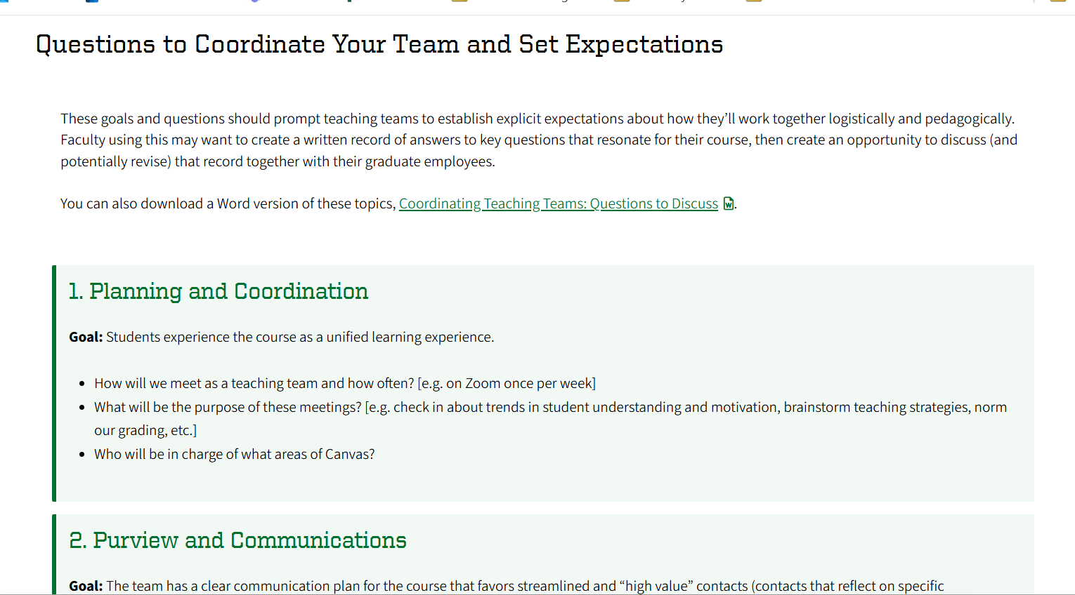
What might I proactively ask faculty?
https://teaching.uoregon.edu/resources/coordinating-teaching-teams
Notes:
LR

Slide 13
Providing feedback and grading (5 min)
Notes:
AS

Slide 14
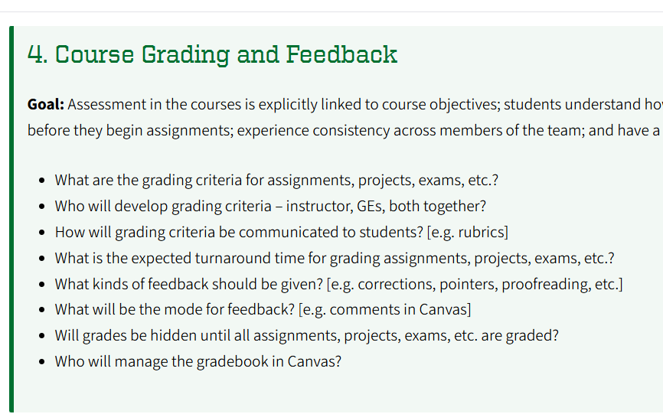
Two actions we'd encourage
Ask faculty proactive questions about grading and feedback norms
Attend a grading workshop this Fall
Tips for Grading Efficiently
Mon Oct 12, 11am
Zoom
Grading with Gradescope
Wed Oct 14, noon
Knight Library DREAM Lab (122)
Registration link
Registration link
Grading with Canvas
Tue, Oct 13, 11am
Knight Library DREAM Lab (122)
https://teaching.uoregon.edu/resources/coordinating-teaching-teams
Registration link
Notes:
Ali

Slide 15
Effective feedback and grading:
Focuses on the learning objectives—what do we want students to know/know how to do?
Has clear (for us and them) criteria for success—how would we know if they were meeting the objectives? What would we notice?
Grades or provides feedback focused on that criteria to help them along
Notes:
LR

Slide 16
Grading and feedback tips:
Use rubrics that are clear (to you and students) and that are focused on learning objectives.
Norm feedback and grading with others (faculty or other section leaders)
Consider allowing students choose areas for feedback or pose direct questions for your feedback.
Give feedback reasonably close to submission date, so it can be applied
Choose several areas for targeted feedback and set yourself a timer for each student submission
If assessments are question-based, grade one question at a time instead of one student at a time.
Use Speedgrader in Canvas
Teach students where to find feedback and how to use it to further their learning.
Notes:
Ali

Slide 17
Supporting belonging and building community (10 min)

Slide 18
Inclusive teaching and belonging
At UO, inclusive teaching is defined as:
Instruction designed to ensure every student can participate fully and that their presence and participation is valued.
The content of the course reflects the diversity of the field's practitioners, the contested and evolving status of knowledge, the value of academic questions beyond the academy and of lived experience as evidence, and/or other efforts to help students see themselves in the work of the course.
All our students have earned a place at UO and can succeed.
Notes:
Hold a growth-mindset approach
Communicate a strengths-based growth mindset in your “instructor talk”
Emphasize formative and summative assessments that allows for early no/low-stakes practice
Lee

Slide 19
Teaching practices that support belonging
Get into groups of 4-6 and introduce yourselves to each other.
What teaching practices have you noticed--as student or instructor--that helped build belonging and community?
We'll ask you to share some ideas with the full group. (optional)
5 min
Notes:
First student discussion
Lee [make a determination about time—maybe one of two shares

Slide 20
Highlighted belonging & community practices
Our short list:
Know that every one of your students earned their place and can succeed with hard work and support.
Learn and use names, and encourage students to use each other's names.
Learn about your students, and offer opportunities to learn about each other.
Consider using small groups students consistently work together in.
Co-create class agreements.
Check out our Building Community in Your Class page for more ideas!
Notes:
Ali

Slide 21

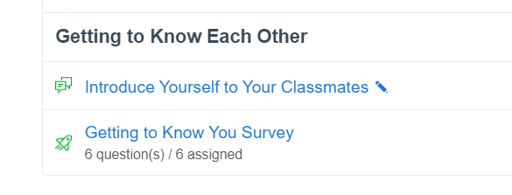
Learning about your students
Name:
Pronouns (optional):
Respond to two of the questions below:
What's a strength you bring with you?
What's a skill you hope to work on?
Describe a class you loved
If your life was made into a movie, what’s one song/artist that would be on the soundtrack?
Notes:
Ali
Images are of two ways to survey students (hard copy and digital canvas survey—in commons). Prompt any other ideas. Brief. Ali

Slide 22
Use small groups to support peer connections
Help students build connections in small, recurrent groups by:
Assigning the groups randomly, so they meet new people
Taking 2-3 minutes at the beginning of some classes for them to choose a question and answer together.
  Ex: What is the most useful app on your phone? What's your go-to winter drink? What is one of your favorite places to spend time on campus?
If working on some activities as a team is useful, consider whether you want to invite groups to name themselves, choose a theme song, self-assign roles for the day, or other actions that might build group cohesion.
Notes:
Brief.
Ali

Slide 23
Creating class agreements
Purpose:
Transparently decide how the class will engage in ways that support participation and learning and invite student responsibility for how they engage with each other.
Examples of how to create them with students from Berkley's CTL
Examples:
Assume peers hold a wide range of different experiences and beliefs
Challenge ideas, not people
Seek to understand. Ask a question to prompt the other person to clarify.
Question your assumptions. How can other points of view help inform your own stance?
Demonstrate your reasoning. How are you building connections between evidence?
Connect the discussion to prior course material and discussions.
More examples at Sheridan Center site
Notes:
What 2-3 behaviors seem necessary to create a class where we can learn together, get curious together, and where we can voice and consider different perspectives with respect?” Lee

Slide 24
Lesson Planning (10 min)

Slide 25
Why make a lesson plan?
Lesson plans are for you, though it's great to share them or parts of them with students.
They help us focus activities, content, and feedback on what students should learn, help save planning time, and can help reduce instructor anxiety.
There's no one way to do them, but there are common components of them.
Notes:
Ali

Slide 26
Components of a lesson plan
In most/all sessions, you will want to have:
The learning objectives
An agenda or outline (can share on a slide or hard copy)
A way to warm up: an authentically interesting question or problem, a moment for peer-to-peer connection, a moment to retrieve info from prior class
Main learning activities that relate to the learning objectives: structured small group discussions, reflections, large group discussions, case studies
A way to wrap up: summarizing key concepts, muddiest points, new questions
Notes:
Ali

Slide 27
Lesson Plan – Learning Objectives
Learning objectives
What should students know or be able to do by the end of the course/unit/lesson?
By the end of the lesson, students will be able to [verb] [skill or knowledge]
Why Learning Objectives Matter
Help us understand what content and activities to choose
Save planning time
Decide what students and you are doing
Help you stay focus on what students should learn.
Reduce anxiety
Good learning objectives help students:
Know what’s expected and stay focused
Practice skills in meaningful ways
Track their own learning progress
Apply what they’ve learned in new situations
Source: crlt.umich.edu/sites/default/files/resource_files/GSI_Guidebook/GSI_Guidebook_40-43.pdf
Notes:
Ali

Slide 28
Lesson Plan Components
How will I use the start of the class to engage or focus attention, connect with existing knowledge, or build community?
Warm-up
For example:
Share a fact, quote, or big question related to the topic of the day
Have choice of icebreaker questions for small groups to talk about for a couple minutes at the beginning of class
Start with a real-life scenario or problem connected to the topic and spend the first five minutes trying to solve it
Share excerpts of student work from a recent submission that are working well
Notes:
Ali

Slide 29
Lesson Plan Components
Activities
What student engagement activities would help students make progress on the learning objectives for the day?
Examples: explore activities in the Student Engagement Techniques page.
Where things you observe during the activity can become supportive feedback for the class as a whole, share it, and debrief select activities.
Notes:
Ali

Slide 30
Lesson Plan Components
Content
What information or content will students need to meet the objectives and engage in activities? How will you provide it?
Examples: mini-lecture, video, readings, demonstration, faculty's prior lecture.
Notes:
Ali

Slide 31
Lesson Plan Components
How will I use the end of the class to help students solidify learning, check for group understanding, or link learning to what’s coming next?
Examples: Minute paper, Matrix, Group graphic
Wrap-up
Notes:
Ali

Slide 32
Example lesson plan
Learning objectives
Students will learn to "plan presentations based on audience needs and expectations"
Think/pair/share question: think of a presentation that totally missed what you needed or felt tailor-made for you- what contributed to this?
Warm-up
Case studies of audiences and needs in small groups. Groups do audience analysis with framework, draft outline, be ready to share a rationale for choices. Debrief as a full group; provide feedback.
Activities
Content
Mini-lecture on audience analysis framework and student-generated recap of key points from faculty lecture on audience differentiation.
Wrap-up
Exit ticket

Slide 33
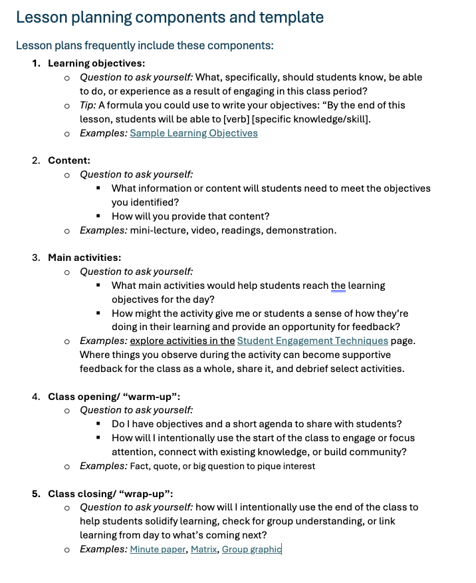
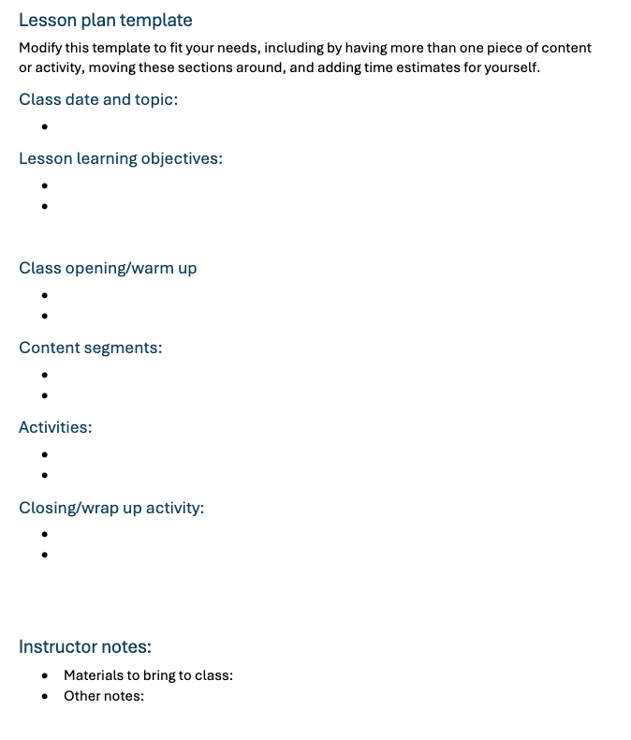
Lesson planning template
Lesson Plan Template
Notes:
Ali

Slide 34
Take a 5-minute break!

Slide 35
Active learning: "student engagement techniques" & discussion (15 min)
Notes:
Ali

Slide 36
How do we learn?
People learn by constructing their own knowledge
  Connecting new information to prior knowledge
Research shows inclusive active learning helps most people
In addition, the following things really help:
  The purpose or objective of the activity (or assessment) is clear
  What success looks like and how we're evaluated is clear
  We have recurrent opportunities to practice that are low-to-no risk
  We get feedback that helps us make progress
Full framework and more strategies: Active Learning & Metacognition
Notes:
LR

Slide 37
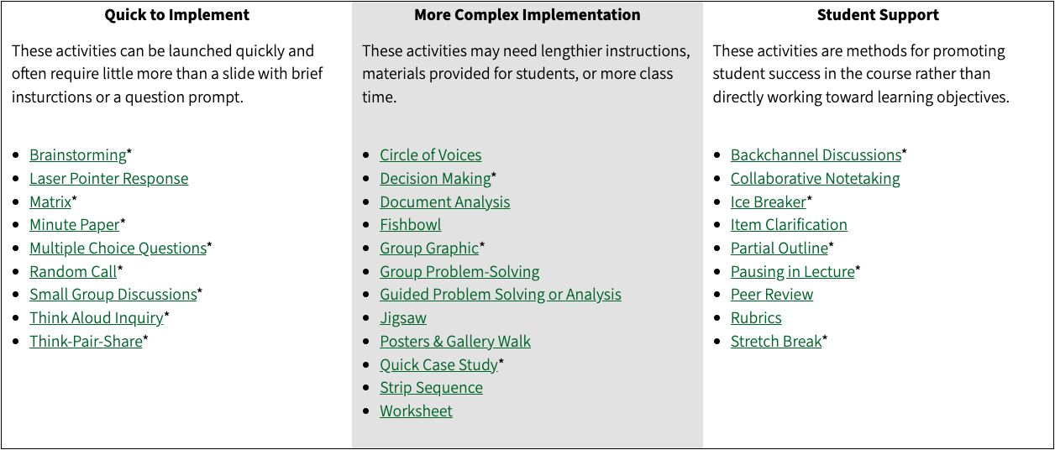
Active Learning Strategies
Individual exploration of the handout (5 min )
Option A: Reflect on one active learning strategy you’ve tried as a learner or teacher.
Option B: Explore the handout of active learning strategies and find one that feels meaningful or useful to you.
Take a few notes to capture your thoughts.
Handout: Student Engagement Techniques
Notes:
Ali

Slide 38
Live think-pair-share
Pose a real question, give 30 sec to think, 30 sec to turn to a neighbor, then take a couple verbal answers.
"Turn to the person next to you — what's one word for a teacher who taught you something that mattered? 30 seconds, go." (pause, then take 2–3 shares)
One-minute paper
Give a prompt, 60 seconds of silence, then ask a couple people to read theirs aloud.
"Take one minute — write one sentence on what surprised you about UO's teaching framework today." (silence, then ask for 1–2 volunteers to share)
Muddiest point
Ask what's still unclear, then show what you'd do with the answer.
"At the end of section I'd ask: 'What's the muddiest point from today?' Say someone writes 'I don't get why we needed the second proof.' I wouldn't answer it right then — I'd note it and open next class with it."

Slide 39
Discussion Resources
Check out our Designing Discussions page.
Notes:
Lee

Slide 40
AI and Teaching (10 min)

Slide 41
AI and Teaching: Frequently Asked Questions
What's my role in AI policy as a GE?
Every faculty member has the flexibility to build their own AI policy, check in with your instructor about their expectations for AI use.
If you are the sole instructor (instructor of record), you can use these sample course policy statements.
Can I penalize work I suspect is AI-generated?
You can grade down work that's weak on its own merits, but a penalty specifically for suspected AI misuse requires a finding from the Office of Student Conduct and Community Standards (SCCS).
For more details, check TEP's AI Policy & Principled Practice for Instruction: FAQ

Slide 42
AI and Teaching: Frequently Asked Questions
Can I use an AI detector?
UO does not provide a central AI detection tool. SCCS does not use AI detection tools and notes that a detection tool finding is not dispositive of student AI use.
Can I use GenAI to build teaching materials?
Yes. Brainstorming topics, drafting activities, or generating question sets are reasonable uses, with your judgment staying in the loop.
Can I use AI to help generate feedback on student work?
While no existing UO policies specifically prohibit faculty from using AI to generate feedback on student work, faculty must retain human judgment in the assignment of grades.
Don't enter student work into any tool other than UO's CoPilot Chat/Premium with data protection.
For more details, check TEP's AI Policy & Principled Practice for Instruction: FAQ

Slide 43
GenAI Vicious Cycle Threatens Learning
Use AI for the task
Skip the productive struggle
This is especially dangerous for writing, reasoning, and problem-solving — the skills that matter most.
Rely on AI even more
Skill does not develop
Generated by ChatGPT

Slide 44
Teaching Advice
Motivate your students: explain why the assignment matters and why AI is or isn't part of it
Communicate Transparently: share AI State your AI expectations at the point of the task. Explain why, not just what. Explicitly invite student questions, so asking doesn't feel like admitting guilt.
  Diverse student profiles: There is no single audience in the room. Make sure you speak to everyone.
  Silence pattern: *1 in 10 students mentioned they felt comfortable asking an instructor to clarify AI use. (Source: TEP GenAI CAIT 2025-2026)

Slide 45
Teaching Advice
Two skills can protect critical thinking in the age of AI
Metacognitive Habits: Students should ask: do I need this, or am I reaching for it out of habit? 4 questions help them slow down and monitor their thinking.
  Before: What did I already know before I asked AI?
  During: What will I keep, change, or reject and why? What’s still unclear, and how will I find out?
  After: Could I explain this without AI’s help?
AI Literacy: A working understanding of how AI tools work, students can judge its output rather than defer to it. Resource: UO Library AI Resources
Design with intention — anchor tasks to real context, make process visible, verify skill directly
Details and examples on the handout (Link)​

Slide 46
Resources
Full resource guide: teaching.uoregon.edu/ai
Coming up next: as you build your First Day Prep worksheet, you'll be asked for one AI-related consideration for your own section.

Slide 47
First Day Prep (15 min)
Notes:
Ali

Slide 48
First Day Prep
Time to plan your actual first day of section.
Individual prep (6 min): Work through the worksheet — think through your real first day, not a hypothetical one.
Small group (4 min): Share your thinking with 2–3 others. What ideas do you want to steal?
Whole group (3–4 min): A few volunteers share a highlight or a sticking point with the room.
Notes:
Ali

Slide 49
Worksheet: Planning Your First Day
Opening: How will you open your first section? What do you want students to feel or know before you move on?
Learning about your students: What's one way you'll find out something real about who's in the room — their prior experience, what's confusing them?
Belonging practice: Pick one practice from today's session, how will you actually use it on day one, specifically?
AI consideration: How you'll use AI in your own prep/grading, how you'll talk to students about the course's AI policy, or something else? Name one concrete thing you'll do or say.
Notes:
Ali

Slide 50
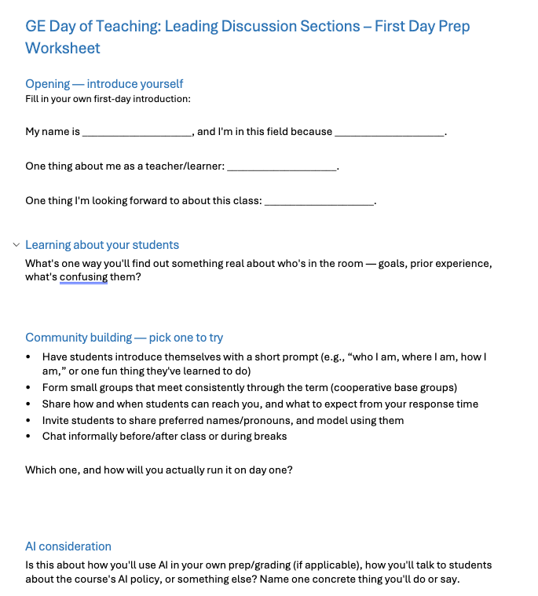
Worksheet: Planning Your First Day
First Day Prep Worksheet
Notes:
Ali

Slide 51
Resources and support
Notes:
Lee

Slide 52
Your go-to resource to stay up to date on teaching:
https://teaching.uoregon.edu/term-resources-page
Notes:
Lee

Slide 53
Your one-stop UO guidance for syllabi:
This page will be helpful when teaching your own class, but even before then, the example language and guidance will be informative if you have questions around policies and practices that are most likely to come up for students.
https://teaching.uoregon.edu/syllabus-essentials
Notes:
Lee

Slide 54
TEP-GE Support Page
teaching.uoregon.edu/services/graduate-employee-teaching-support
Notes:
Ali

Slide 55
What are some next steps to support your teaching?
Fenton Hall, room 110
  2-2:50 Grading Fundamentals
  3-3:50: Canvas Features and Tools
  4-4:50pm: Teaching Insights Panel
Attend a TEP workshop this term (teaching.uoregon/events)
Join the Graduate Teaching Initiative (GTI)
Participate in the Science Teaching Journal Club
Contact us at tep@uoregon.edu with any questions
Visit teaching.uoregon.edu for more resources
Notes:
Ali

Slide 56
You are not alone!
For teaching support, in addition to your unit:
In supporting your students:
Connect with TEP and UO Online for
Consultations (aka any teaching related questions or discussion)
Workshops
Course observations
Graduate Teaching Initiative certificate and community
Connect with AEC for any questions on student accommodations in your courses
You can always reach out or refer your students to:
Dean of Students, including their Student Care Team
Tutoring and Academic Engagement Center (TAEC)
Counseling Services
Not sure where to refer a student or what to do? Contact the Dean of Students.
Notes:
Lee

Slide 57
Reflection on our session and feedback
We value your feedback!
Our goals: help you feel even more confident
Defining good teaching
Use strategies to build class community
Designing activities to maximize learning
Creating a lesson plan
In knowing where to go for support
Notes:
LR

Slide 58
Fall Teaching Events Specifically for GEs
Event | Description | Day & Location
GTI Kickoff | Meet other GEs while learning about the Graduate Teaching Initiative, our teaching certificate program. | Tues Sep 29 @ 10am Straub Hall, Room 417
International GE Success: Lesson Planning & Active Learning | A space for international GEs to think and talk about lesson planning and active learning strategies. | Mon Oct 5 @ 2pm Knight Lib Dream Lab
Tips for Efficient Grading | Discuss tips for getting through that stack of exams, homework, lab reports, or assignments quickly. | Mon Oct 12 @ 11am Zoom
Grading with Canvas | Learn more about Canvas’s SpeedGrader. Practice using it in our closed Grading Practice Sandbox. | Tues Oct 13 @ 11am Knight Lib Dream Lab
Grading with Gradescope | Learn more about Gradescope, a new grading tool at UO. Practice grading fake student work! | Wed Oct 14 @ 11am Knight Lib Dream Lab
Coffee Hour for International GEs | Pause, connect, and share how teaching is going during an informal coffee hour for international GEs. | Wed Nov 4 @ 10am Mills International Center
Register and learn more about all our events at: teaching.uoregon.edu/events

Slide 59
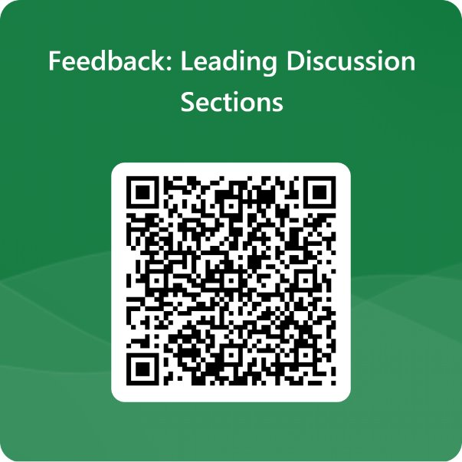
Contact us any time tep@uoregon.edu, or on our website, teaching.uoregon.edu.
Have a GREAT fall term!
Notes:
both

