Slide 1
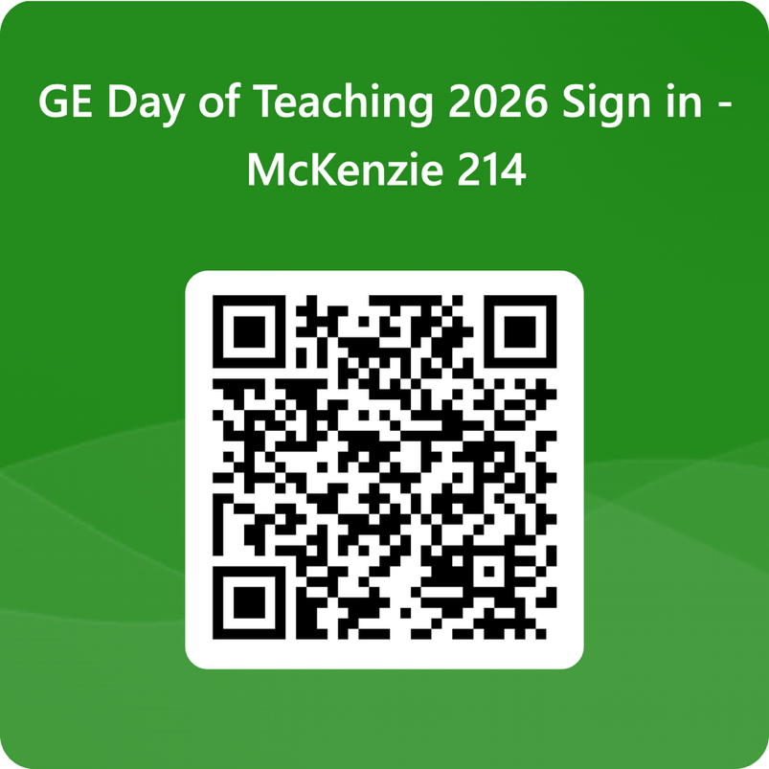
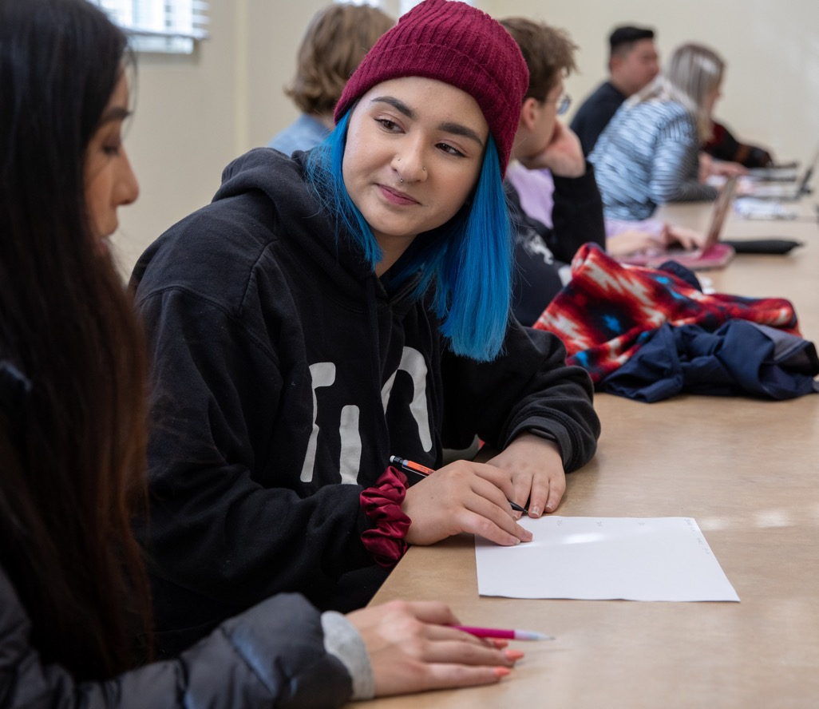
Leading Discussion Sections
Nanosh Lucas - Faculty Consultant
Notes:
LR

Slide 2
Leading Discussion Sections
Objectives
  What is a discussion section, what are my role and responsibilities as a GE, and where can I get help?
How do I plan a basic lesson, and how can I build at least one active learning strategy into it?
Agenda
Welcome & introductions
Discussion sections and your role
Principles of good teaching
Building Community
Break!
Planning a lesson
Active learning
Where to get support
Feedback

Slide 3
Introductions
Notes:
Orienting items- as people enter and at very beginning of session:
Have slide of Agenda and Learning objectives up
Have note written up on wall such as “Welcome! Please get some snacks and make yourself comfortable"
(10) Introductions
Who I am [facilitator]
Who you are (a brief “think/pair/share”)
Who we are as a group (group polling)
Who TEP is (facilitator)

Slide 4
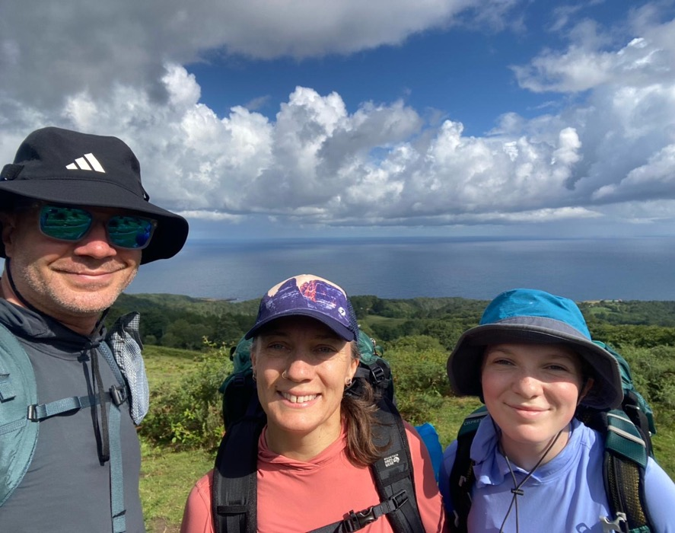
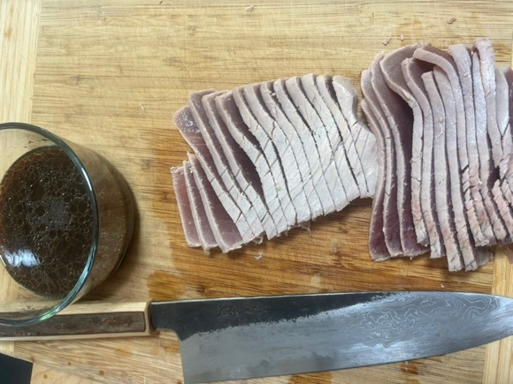
Who I am
I’m Nanosh.
Former GE—Department of History
Former high school Spanish Teacher
Former Peace Corps volunteer (Mozambique)
@bemusedgourmand
I like zombies more than vampires.
1
2
3
4
5
6
7
8
Welcome
Your Role
Teaching
Community
Planning
Active Learning
Support
Feedback
Notes:
Very brief

Slide 5
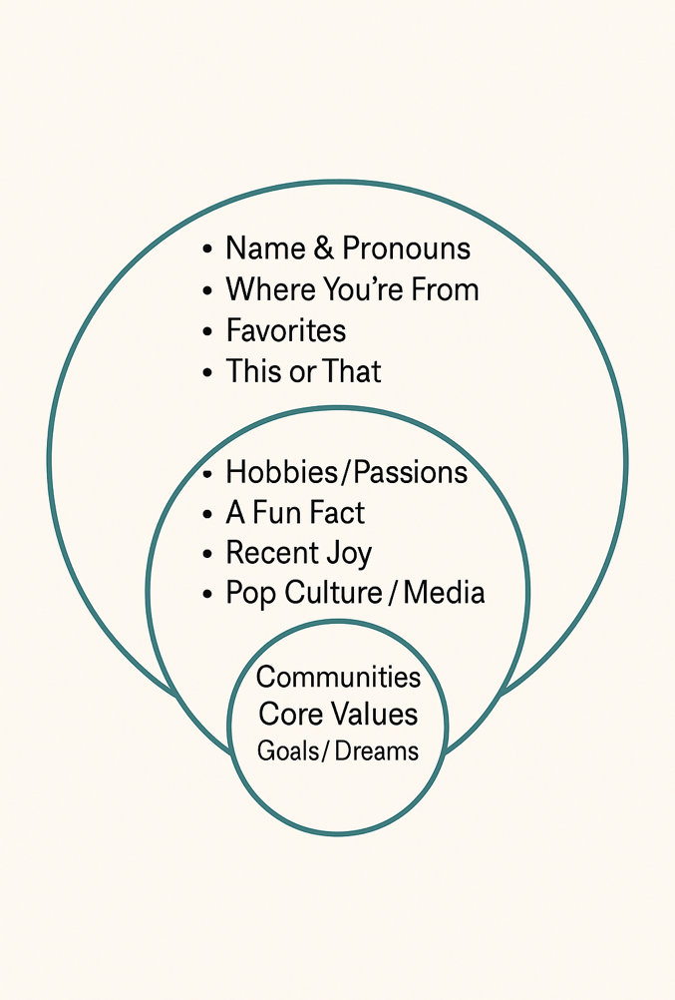
Who you are
Round 1—In pairs:
1min: Introduce yourself to one other person with any information you feel comfortable sharing.
1min: Switch partners.
1
2
3
4
5
6
7
8
Welcome
Your Role
Teaching
Community
Planning
Active Learning
Support
Feedback

Slide 6
Who you are
Round 2— In groups of four:
Join your pair with another pair.
Introduce yourselves.
1
2
3
4
5
6
7
8
Welcome
Your Role
Teaching
Community
Planning
Active Learning
Support
Feedback

Slide 7
What is a discussion section?
What does a discussion section leader do?
Notes:
(15) What is "good teaching"?
What do effective teachers do? (think/pair/share with share being person from each group writes on board)
Synthesis of actions GEs wrote on board
What patterns do you see in what your peers noted? What is missing from what we noted?
Highlight a couple of important actions (facilitator)
How does UO define good teaching? (facilitator)
(5) What does it mean to lead a discussion section?
Overview of commonalities and variety in what a discussion section is and what the role does (facilitator)
How to find out what norms are for your sections--coordinating teaching teams questions to ask (facilitator)

Slide 8
What is a discussion section?
≤25
students
50 min
every week
10–20%
of the final grade
Purpose: help students make sense of lecture and readings
Review
Discuss
Apply
Format varies by department and instructor
Mostly discussion
Mix of active learning strategies
1
2
3
4
5
6
7
8
Welcome
Your Role
Good Teaching
Community
Planning
Active Learning
Support
Feedback

Slide 9
What does a section leader typically do?
For the lecture
With your team
For your section
Attend lecture
Do the readings
Be the “eyes and ears”
Guest lecture, if asked
Meet weekly
Review and synchronize plans
Troubleshoot together
Agree on planning role
Share the classroom pulse
Flag integrity concerns
Plan and prep
Lead weekly sections
Office hours
Answer messages
Grade and give feedback
Update Canvas
Accommodations
Refer to resources
1
2
3
4
5
6
7
8
Welcome
Your Role
Good Teaching
Community
Planning
Active Learning
Support
Feedback

Slide 10
What is the workload like?
A typical week: 16–20 hours
In class
~1/3 of your time
Grading
~1/3 of your time
Everything else
~1/3 of your time
Leading sections
Assignments, midterms, finals
Prep, office hours, meetings
Section leaders typically work 0.40–0.49 FTE, which is about 16–20 hours a week
Expected hours are set in your department's GDRS and in your contract
Many departments use a workload allocation form to estimate your hours
1
2
3
4
5
6
7
8
Welcome
Your Role
Good Teaching
Community
Planning
Active Learning
Support
Feedback

Slide 11

Working in Teaching Teams
Questions to ask your professor and fellow GEs early in the term
Planning
Communication
Teaching
Grading
Policies
How often will we meet, and for what purpose?
Who is students’ first contact? When should I loop you in?
What should section focus on? Can I plan my own?
What are the criteria? How fast should I return work?
How much flexibility do I have on extensions?
Full question list: Coordinating Teaching Teams
Scan the code, or download the Word version to bring to your first team meeting.
1
2
3
4
5
6
7
8
Welcome
Your Role
Good Teaching
Community
Planning
Active Learning
Support
Feedback

Slide 12
Effective Teaching
Notes:
(15) What is "good teaching"?
What do effective teachers do? (think/pair/share with share being person from each group writes on board)
Synthesis of actions GEs wrote on board
What patterns do you see in what your peers noted? What is missing from what we noted?
Highlight a couple of important actions (facilitator)
How does UO define good teaching? (facilitator)
(5) What does it mean to lead a discussion section?
Overview of commonalities and variety in what a discussion section is and what the role does (facilitator)
How to find out what norms are for your sections--coordinating teaching teams questions to ask (facilitator)

Slide 13
What do effective teachers do?
In your groups of four:
On your own, think of a time you learned something new from someone else (understanding or applying a new concept, playing an instrument, conversing in a new language, etc.).
Together in your group, make a short list of things effective teachers do, in your experience.
Have one volunteer from your group share your group’s responses
Looking together at what groups wrote:
  What patterns do you see?
  What's missing?
1
2
3
4
5
6
7
8
Welcome
Your Role
Good Teaching
Community
Planning
Active Learning
Support
Feedback

Slide 14




How does UO define teaching excellence?
Course is organized.
Communication is timely and clear.
Everyone can participate.
Lived experience matters.
Materials reflect a diversity of practitioners.
Instructors reflect on and revise their course and teaching strategies.
Evidence-based teaching strategies.
Models a process or culture of inquiry.
1
2
3
4
5
6
7
8
Welcome
Your Role
Good Teaching
Community
Planning
Active Learning
Support
Feedback

Slide 15
Supporting belonging
Building community
Classroom Agreements
Notes:
(2) Inclusive teaching and belonging (facilitator-- brief)
(8) Teaching practices that support belonging: brainstorm ways instructors build community
(5) Highlighted practices [facilitator’s choice]

Slide 16

Inclusive teaching & belonging at UO means
Participation
Representation
Every student can take part fully, and their presence is valued.
Students see themselves in the work of the course.
IN YOUR SECTION
IN YOUR SECTION
Learn and use names
Set group agreements together
Offer more than one way to take part
Draw on a range of scholars and contexts
Invite lived experience as evidence
Show that knowledge is contested and evolving
All our students have earned a place at UO and can succeed.
1
2
3
4
5
6
7
8
Welcome
Your Role
Good Teaching
Community
Planning
Active Learning
Support
Feedback
Notes:
Hold a growth-mindset approach
Communicate a strengths-based growth mindset in your “instructor talk”
Emphasize formative and summative assessments that allows for early no/low-stakes practice

Slide 17
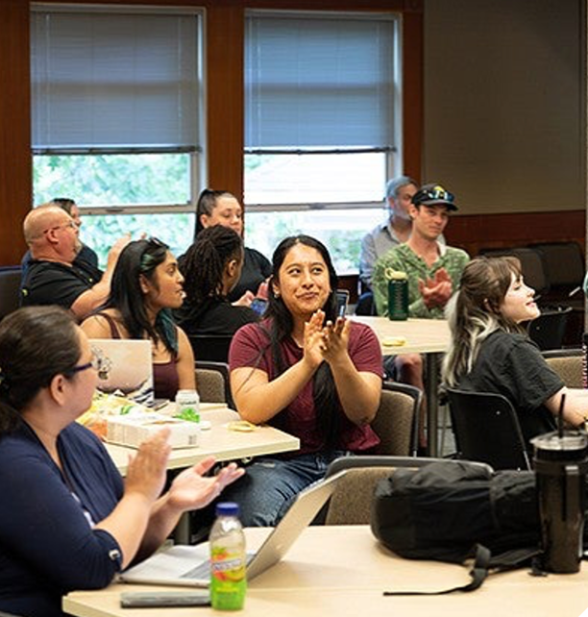
Teaching Practices that support belonging
Small-group share
5 min
1
Form groups of 4–5.
2
Take turns sharing your name and one practice that built community or belonging for you.
3
Passing is OK — anything you share helps your group.
4
Listen for an idea that resonates, and remember who shared it.
1
2
3
4
5
6
7
8
Welcome
Your Role
Good Teaching
Community
Planning
Active Learning
Support
Feedback
Notes:
First student discussion

Slide 18
Belonging & community brainstorming "report-out"
What's one practice you heard about that sparks your interest or resonated with you (and would you cite who shared it?)
1
2
3
4
5
6
7
8
Welcome
Your Role
Good Teaching
Community
Planning
Active Learning
Support
Feedback

Slide 19
Highlighted belonging & community practices
Know that every one of your students earned their place and can succeed with hard work and support.
Learn and use names, and encourage students to use each other's names.
Learn about your students, and offer opportunities to learn about each other.
Consider using small groups students consistently work together in.
Co-create class agreements.
Check out our Building Community in Your Class page for more ideas!
1
2
3
4
5
6
7
8
Welcome
Your Role
Good Teaching
Community
Planning
Active Learning
Support
Feedback

Slide 20
Highlighted belonging & community practices
Start here: every student earned their place and can succeed with hard work and support.
Use names
Get to know students
Keep small groups
Co-create agreements
Learn students’ names and help them learn each other’s.
Learn about them and let them learn about each other.
Have students work in the same groups over time.
Set class norms together, early in the term.
More ideas: Building Community in Your Class
1
2
3
4
5
6
7
8
Welcome
Your Role
Good Teaching
Community
Planning
Active Learning
Support
Feedback

Slide 21

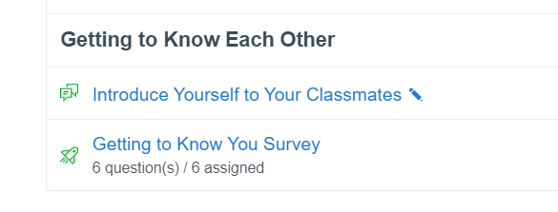
Learning about your students
Name:
Pronouns (optional):
Respond to two of the questions below:
What's a strength you bring with you?
What's a skill you hope to work on?
Describe a class you loved
If your life was made into a movie, what’s one song/artist that would be on the soundtrack?
1
2
3
4
5
6
7
8
Welcome
Your Role
Good Teaching
Community
Planning
Active Learning
Support
Feedback
Notes:
Images are of two ways to survey students (hard copy and digital canvas survey—in commons). Prompt any other ideas. Brief. LR

Slide 22
Creating class agreements
Purpose:
Transparently decide how the class will engage in ways that support participation and learning and invite student responsibility for how they engage with each other.
Examples of how to create them with students from Berkley's CTL
Examples:
Assume peers hold a wide range of different experiences and beliefs
Challenge ideas, not people
Seek to understand. Ask a question to prompt the other person to clarify.
Question your assumptions. How can other points of view help inform your own stance?
Demonstrate your reasoning. How are you building connections between evidence?
Connect the discussion to prior course material and discussions.
More examples at Sheridan Center site
1
2
3
4
5
6
7
8
Welcome
Your Role
Good Teaching
Community
Planning
Active Learning
Support
Feedback
Notes:
What 2-3 behaviors seem necessary to create a class where we can learn together, get curious together, and where we can voice and consider different perspectives with respect?”

Slide 23
Creating class agreements
Purpose:
Transparently decide how the class will engage in ways that support participation and learning and invite student responsibility for how they engage with each other.
Examples of how to create them with students from Berkley's CTL
Examples:
When one person is talking to the group, we should face the person and listen.
More examples at Sheridan Center site
1
2
3
4
5
6
7
8
Welcome
Your Role
Good Teaching
Community
Planning
Active Learning
Support
Feedback
Notes:
What 2-3 behaviors seem necessary to create a class where we can learn together, get curious together, and where we can voice and consider different perspectives with respect?”

Slide 24
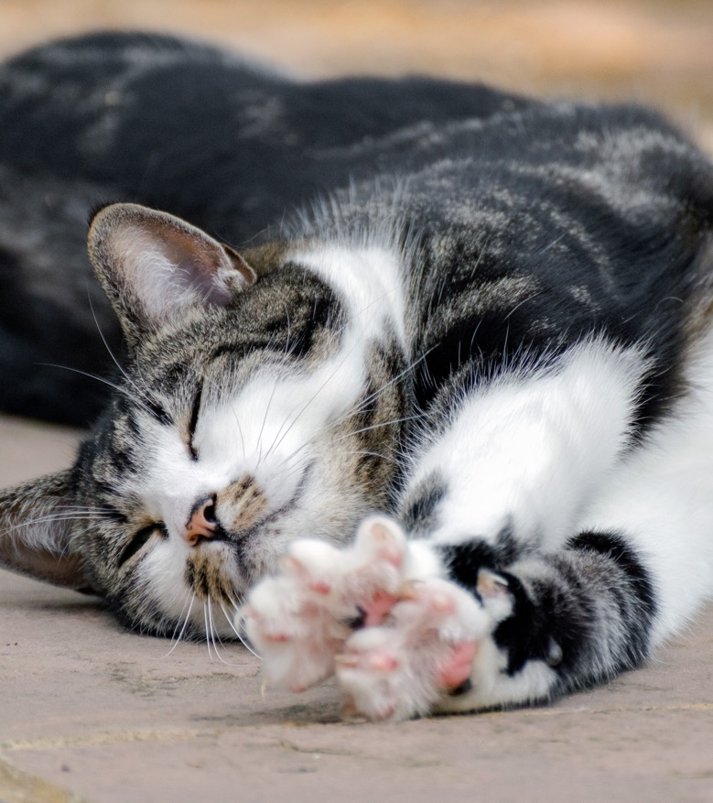
Take a five minute break!

Slide 25
Lesson Planning
Notes:
Up to 10 min. Mini-lecture; not discussion. Have handouts printed off.

Slide 26
Why make a lesson plan?
Lesson plans are for you, though it's great to share them or parts of them with students.
They help us focus activities, content, and feedback on what students should learn, help save planning time, and can help reduce instructor anxiety.
There's no one way to do them, but there are common components of them.

Slide 27
Example lesson plan
Learning objectives
Students will learn to "plan presentations based on audience needs and expectations"
Think/pair/share question: think of a presentation that totally missed what you needed or felt tailor-made for you- what contributed to this?
Warm-up
Case studies of audiences and needs in small groups. Groups do audience analysis with framework, draft outline, be ready to share a rationale for choices. Debrief as a full group; provide feedback.
Activities
Content
Mini-lecture on audience analysis framework and student-generated recap of key points from faculty lecture on audience differentiation.
Wrap-up
Exit ticket

Slide 28
Active learning: "student engagement techniques" & discussion
Notes:
How we learn
Choosing and using “student engagement techniques”
Start with your goal/learning objective
Examples of activities GEs have experienced/tried OR facilitator highlight ones they use and why
Examples from the Student Engagement Techniques page

Slide 29
How do we learn?
Active learning says that "humans learn by actively using new information and experiences to modify their existing models of how the world works.” (Theobold et al, 2020).
When we construct knowledge, we connect it to prior knowledge
It really helps when
  The purpose or objective of the activity (or assessment) is clear and what success looks like is clear
  We have recurrent opportunities to practice that are low-to-no risk
  We get feedback that helps us make progress
Notes:
Facilitator share--brief

Slide 30
Active learning/student engagement techniques
Read through your Active Learning and Student Engagement Technique handout and note, for yourself:
Which techniques you have done or experienced before
Any student engagement techniques you've found effective that isn't listed
What active learning we've done so far together

Slide 31
Let’s try it!
Purpose: To explore reasons for the Montgomery Bus Boycott.

Slide 32
Let’s try it!
True/False: The Montgomery Bus Boycott was primarily because African Americans wanted to sit anywhere they liked on the bus.

Slide 33
Let’s try it!
1. A city law that would make it possible for Negroes to sit from back toward front, and whites from front toward back until all the seats are taken.
2. That Negroes not be asked or forced to pay fare at front and go to the rear of the bus to enter.
3. That busses stop at every corner in residential sections occupied by Negroes as they do in communities where whites reside.

Slide 34
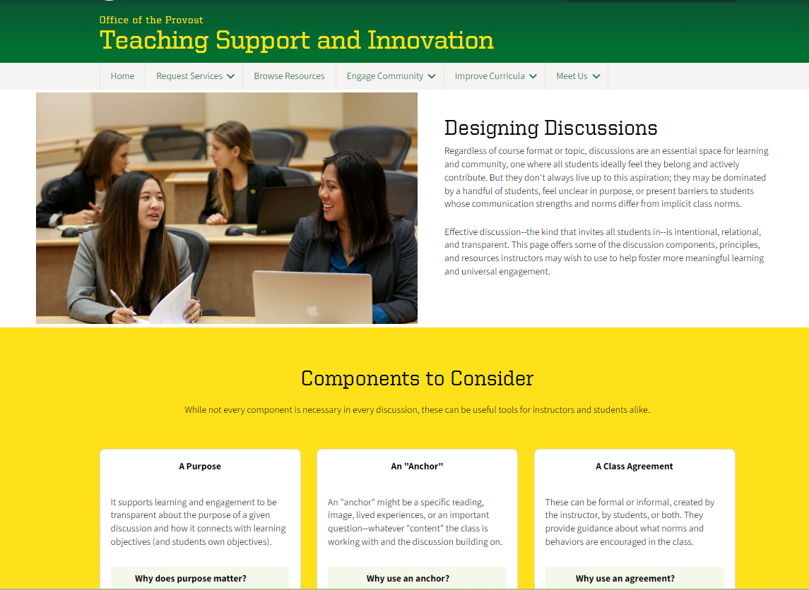
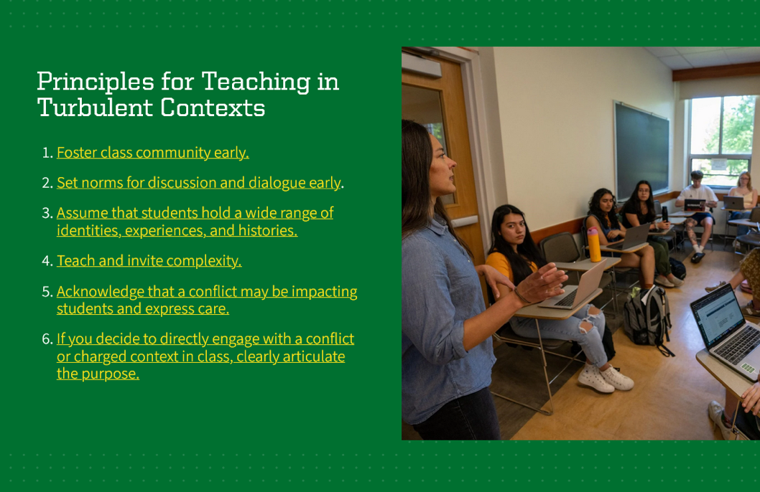
Discussion as active learning
Check out our Teaching in Turbulent Times Guide principles and Designing Discussions page for discussion resources

Slide 35
Putting it all together: teaching practices "gallery walk"

Slide 36
Teaching practices "gallery walk"
Instructions:
In a group of 4-5
Grab a marker or pen for your group.
Around the room are question stations.
At your station, discuss and
  Add ideas to the post-it to answer one of the questions
  Add ideas to your lesson plan template
Rotate when time is called.
We'll shoot for all four but arrive where we arrive.
Notes:
Ali+Lee

Slide 37
Teaching practices- questions
How do you want to introduce yourself to your students? What details about your interests, hobbies, or expertise feel positive to share?
How do you want to spark interest in or invite students into your course or discipline on the first day, or what is a “warm up” you want to try?
What active learning or student engagement technique could you imagine using on the first day or in the first few weeks? Why?
How might you use the end of the class to help students solidify learning or check for group understanding? What "wrap up" activity might you use?

Slide 38
Resources and support

Slide 39
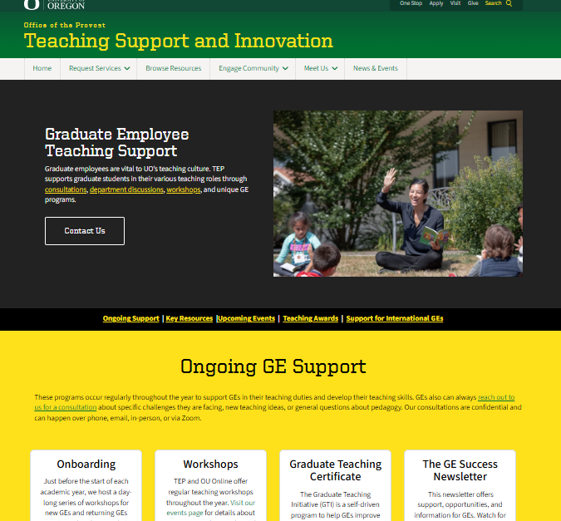
Key GE teaching resources
At teaching.uoregon.edu, you can find
Graduate Employee Teaching Support
  teaching.uoregon.edu/ges
Term Resources
Syllabus Essentials
Upcoming workshops and communities

Slide 40
Fall Teaching Events Specifically for GEs
Event | Description | Day & Location
GTI Kickoff | Meet other GEs while learning about the Graduate Teaching Initiative, our teaching certificate program. | Tues Sep 29 @ 10am Straub Hall, Room 417
International GE Success: Lesson Planning & Active Learning | A space for international GEs to think and talk about lesson planning and active learning strategies. | Mon Oct 5 @ 2pm Knight Lib Dream Lab
Tips for Efficient Grading | Discuss tips for getting through that stack of exams, homework, lab reports, or assignments quickly. | Mon Oct 12 @ 11am Zoom
Grading with Canvas | Learn more about Canvas’s SpeedGrader. Practice using it in our closed Grading Practice Sandbox. | Tues Oct 13 @ 11am Knight Lib Dream Lab
Grading with Gradescope | Learn more about Gradescope, a new grading tool at UO. Practice grading fake student work! | Wed Oct 14 @ 11am Knight Lib Dream Lab
Coffee Hour for International GEs | Pause, connect, and share how teaching is going during an informal coffee hour for international GEs. | Wed Nov 4 @ 10am Mills International Center
Register and learn more about all our events at: teaching.uoregon.edu/events

Slide 41
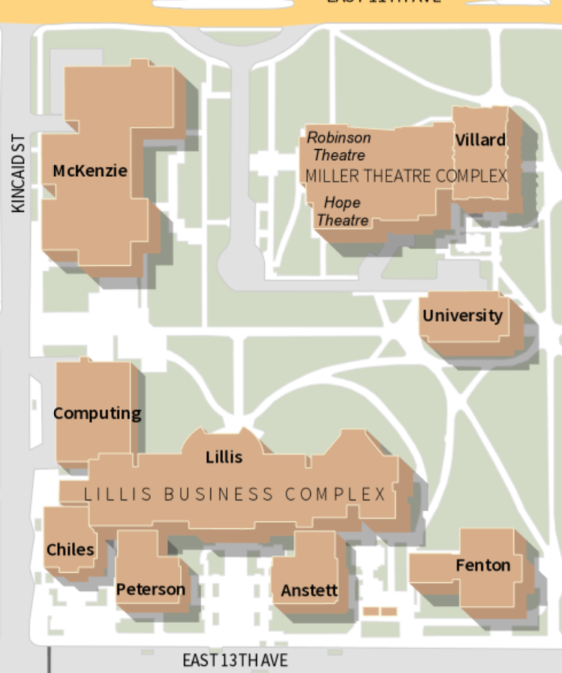
Coming up Next…
McKenzie
12-12:50pm: Break & Light Lunch
McKenzie Hall
1-1:50pm: Two concurrent sessions
Student Supports & Tricky Topics
Fenton 110 (here!)
Teaching Undergrads in the US, Part 2
McKenzie 240C
2-2:50pm: Grading Fundamentals
Fenton 110
3-3:50pm: Canvas Features & Tools
Fenton 110
Fenton
4-4:50pm: Teaching Insights Panel
Fenton 110

Slide 42
Closing Slide with the University of Oregon Logo
Contact us at tep@uoregon.edu, or on our website, teaching.uoregon.edu

