Slide 1
Leading Discussion Sections
Objectives
After the session, we hope you'll feel confident:
Defining good teaching
Use strategies to build class community
Choosing activities to maximize learning
Creating a lesson plan
In knowing where to go for support
Agenda
Welcome & introductions
Teaching at UO
Supporting belonging & building community
Active learning
Break!
Preparing for classes
Knowing where to get support
Feedback for us

Slide 2
Introductions
Notes:
Orienting items- as people enter and at very beginning of session:
Have slide of Agenda and Learning objectives up
Have note written up on wall such as “Welcome! Please get some snacks and make yourself comfortable"
(10) Introductions
Who I am [facilitator]
Who you are (a brief “think/pair/share”)
Who we are as a group (group polling)
Who TEP is (facilitator)

Slide 3
Who you are
Make yourself a name tag with:
Name (+how to pronounce it)
Pronouns if you wish
Choose one of the following to share:
  A favorite snack, film, or album
  Something you recently learned how to do
Turn to someone nearby and:
Introduce yourself and 1 thing you chose to share
Ask the other person 1 follow up question (can be related or unrelated to what they shared)
3 min
3 min

Slide 4
Who we are: range of experience and discipline
Experience teaching
Departments you're in
1/3 no experience yet
1/3 experience at other institutions or UO
1/3 not listed
Counseling Psychology
Biochemistry
Indigenous, Race, and Ethnic Studies
Human Physiology
Global Studies
Geography
Linguistics
Environmental studies​
Economics​
Sociology​
School of Journalism and Communication​
Psychology​
Prevention science​
Philosophy
and more...

Slide 5
Who we are: which region holds the place you call home?
Share by holding up the # of fingers that match:
#1: Africa
#2: Americas
#3: Asia
#4: Europe
#5: Oceania

Slide 6
Who we are: as a student, which statement best describes you?
1.
I tend to participate actively during class activities and discussions. Participation comes easily to me.
2.
I tend to not participate actively during class activities and discussions. Participating does not come easily to me.

Slide 7
Who we are: How do you feel about teaching?
1
Feeling very nervous, worried, or overwhelmed!
2
Feeling confident, excited, and ready to go!

Slide 8
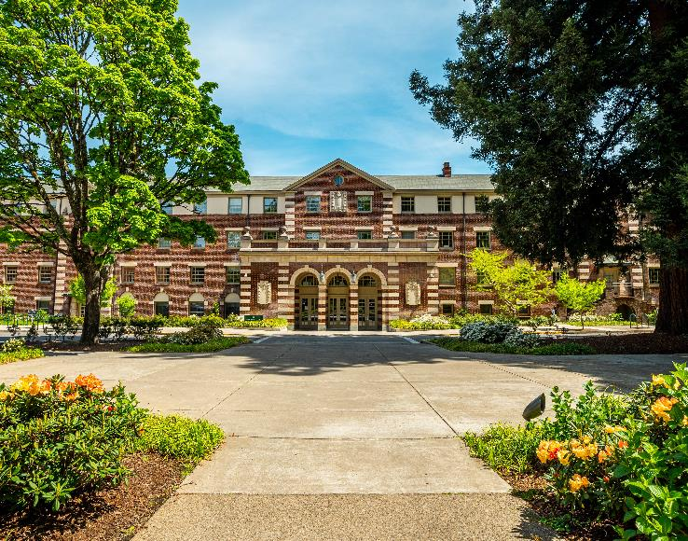
Who the Teaching Engagement Program is
We provide teaching support to GEs and faculty across campus through:
Individual consultations
Teaching workshops
Graduate Teaching Initiative certificate
Teaching Support and Innovation website
Teaching awards, like the Kimble Award for GEs
TEP offices located in Straub Hall—4th Floor
Notes:
Very brief—one minute or less.

Slide 9
Teaching & Leading Discussion Sections at UO
Notes:
(15) What is "good teaching"?
What do effective teachers do? (think/pair/share with share being person from each group writes on board)
Synthesis of actions GEs wrote on board
What patterns do you see in what your peers noted? What is missing from what we noted?
Highlight a couple of important actions (facilitator)
How does UO define good teaching? (facilitator)
(5) What does it mean to lead a discussion section?
Overview of commonalities and variety in what a discussion section is and what the role does (facilitator)
How to find out what norms are for your sections--coordinating teaching teams questions to ask (facilitator)

Slide 10
What do effective teachers do?
Think of a time you learned something new from someone else (understanding or applying a new concept, playing an instrument, conversing in a new language, etc.).
With one or two people next to you, come up with a short list of things effective teachers do, in your experience.
Have one volunteer from your group come up to the board and write up your group's responses (please write big enough that people sitting could read).
Looking together at what groups wrote:
  What patterns do you see?
  What's missing?

Slide 11




How does UO define "good teaching"?
At UO, good teaching is professional, inclusive, engaged, and research informed
Course is organized.
Communication is timely and clear.
Everyone can participate.
Lived experience matters.
Materials reflects diversity of practitioners.
Instructors reflect on and revise their course and teaching strategies.
Evidence-based teaching strategies.
Models a process or culture of inquiry.

Slide 12
What is a discussion section at UO?
Purpose: provide opportunities for interactive review, discussion, application of knowledge and skills brought up in lecture or course readings.
Typical section characteristics:
  Smaller class, usually less than 25 students
  Meets separately from lecture, usually once a week for fifty (50) minutes
  Forms a percentage of the final course grade (often between 10-20%)
There is variety in section structure and teaching methods.
  Some sections engage students mainly through (structured) discussion
  Some discussion sections don't do discussions much or at all, but instead use other types of student engagement techniques for active learning.

Slide 13
What does a discussion leader typically do?
Attends lectures
Plans and prepares for discussion sections
Holds weekly office hours
Provides grading and feedback for coursework (section, midterms, finals)
Communicates with students regularly
Meets with professor and other GEs to calibrate teaching and grading

Slide 14
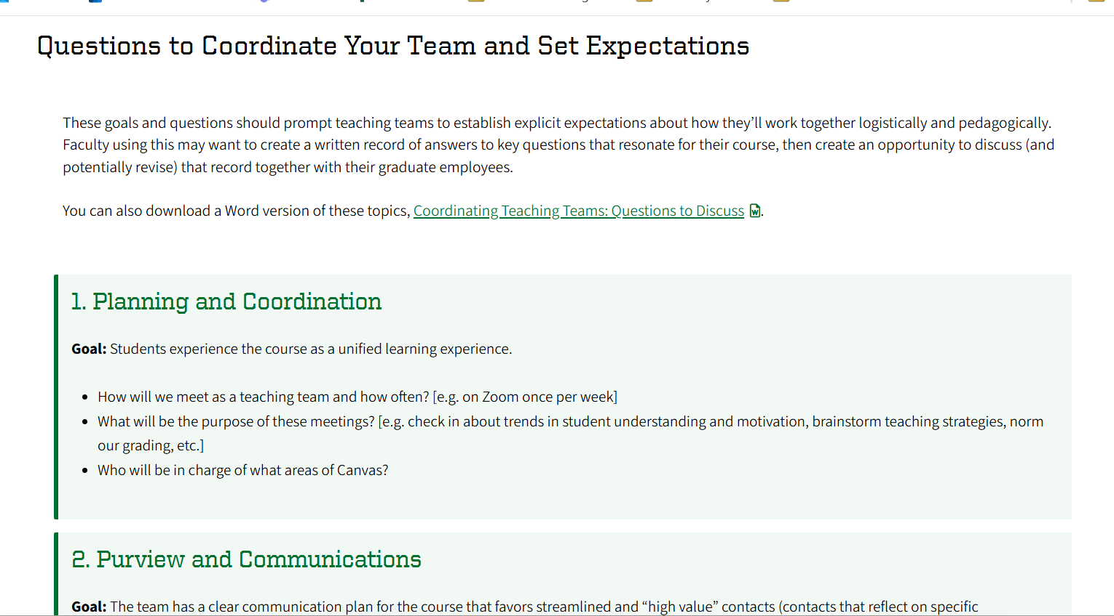
What might I proactively ask faculty?
From Coordinating Teaching Teams

Slide 15
Providing feedback and grading
Notes:
5 min total for section
Acknowledgement that grading is significant part of GE work for many, and that because assessment and grading practices and faculty guidance will vary, not addressing in depth.
Encourage 2 actions: asking faculty for clarity when needed and signing up for fall workshops on grading
8 feedback and grading tips (slide)

Slide 16
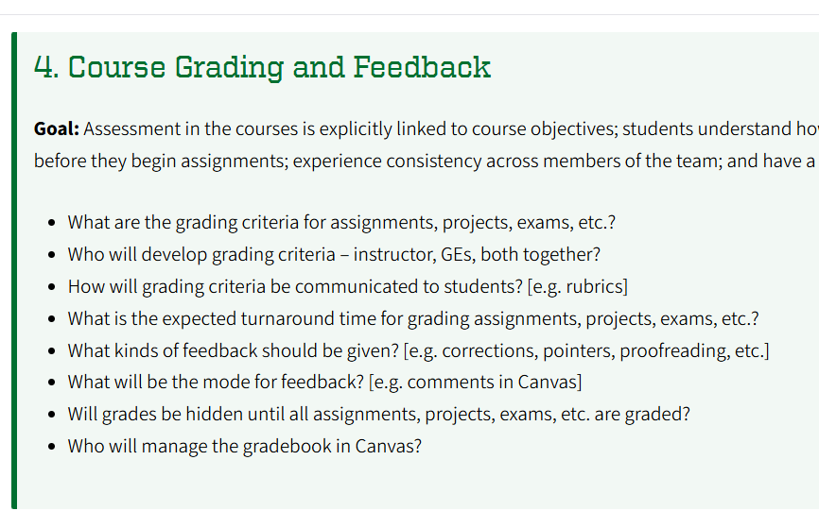
Two actions we'd encourage
Ask faculty proactive questions about grading and feedback norms
Attend a grading workshop this Fall
Grading with Canvas
Wednesday, Oct 8
11am
LOCATION
Grading 601:
Efficient Grading
Wed, Oct 15
10am on Zoom

Slide 17

Effective feedback and grading:
Focuses on the learning objectives—what do we want students to know/know how to do?
Has clear (for us and them) criteria for success—how would we know if they were meeting the objectives? What would we notice?
Grades or provides feedback focused on that criteria to help them along

Slide 18
General grading and feedback guidance:
Use rubrics that are clear (to you and students) and focused on learning objectives.
Norm feedback and grading with others (faculty or other section leaders)
Consider allowing students choose areas for feedback or pose questions for feedback.
Give feedback reasonably close to submission date, so it can be applied
Choose several areas for targeted feedback and set yourself a timer for each student
If assessments are question-based, grade one question at a time instead of one student at a time.
Use Speedgrader in Canvas
Teach students where to find feedback and how to use it to further their learning.

Slide 19
Supporting belonging and building community
Notes:
(2) Inclusive teaching and belonging (facilitator-- brief)
(8) Teaching practices that support belonging: brainstorm ways instructors build community
(5) Highlighted practices [facilitator’s choice]

Slide 20
Inclusive teaching and belonging at UO means
Instruction designed to ensure every student can participate fully and that their presence and participation is valued.
The content of the course reflects the diversity of the field's practitioners, the contested and evolving status of knowledge, the value of academic questions beyond the academy and of lived experience as evidence, and/or other efforts to help students see themselves in the work of the course.
All our students have earned a place at UO and can succeed.
Notes:
Hold a growth-mindset approach
Communicate a strengths-based growth mindset in your “instructor talk”
Emphasize formative and summative assessments that allows for early no/low-stakes practice

Slide 21
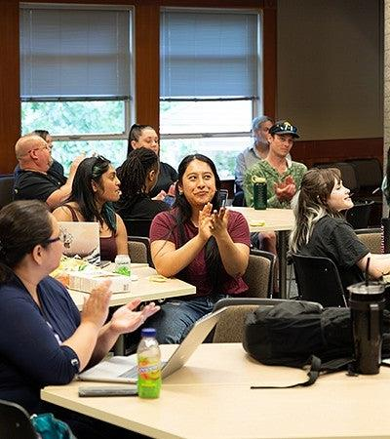
Teaching practices that support belonging
Get into groups of 4-5.
One by one, going in a circle, share your name and one teaching practice you've experienced or used that helped to build community and increase belonging.
It's ok to pass, though anything you share will add for your group.
Listen for an idea from someone else that interests or resonates with you and try to remember their name.
5 min
Notes:
First student discussion

Slide 22
Building knowledge together
What's one practice someone heard that sparked your interest or felt resonant to you (and would you cite who shared it?)
Listening to this practice,

Slide 23
Highlighted belonging & community practices
Know that every one of your students earned their place and can succeed with hard work and support.
Learn and use names, and encourage students to use each other's names.
Learn about your students, and offer opportunities to learn about each other.
Consider using small groups students consistently work together in.
Co-create class agreements.
Check out our Building Community in Your Class page for more ideas!

Slide 24

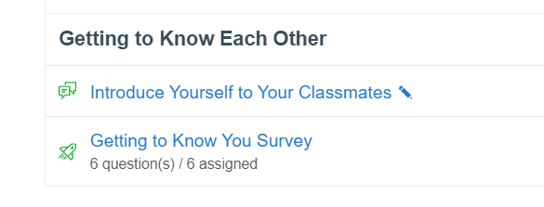
Learning about your students
Name:
Pronouns (optional):
Respond to two of the questions below:
What's a strength you bring with you?
What's a skill you hope to work on?
Describe a class you loved
If your life was made into a movie, what’s one song/artist that would be on the soundtrack?
Notes:
Images are of two ways to survey students (hard copy and digital canvas survey—in commons). Prompt any other ideas. Brief. LR

Slide 25
Use small groups to support peer connections
Help students build connections in small, recurrent groups by:
Assigning the groups randomly, so they meet new people
Taking 2-3 minutes at the beginning of some classes for them to choose a question and answer together.
  Early in the term this might be an icebreaker question to help the group members get to know each other. Ex: What is the most useful app on your phone? What's your go-to winter drink? What is one of your favorite places to spend time on campus?
If working on some activities as a team is useful, consider whether you want to invite groups to name themselves, choose a theme song, self-assign roles for the day, or other actions that might build group cohesion.
Notes:
Images are of two ways to survey students (hard copy and digital canvas survey—in commons). Prompt any other ideas. Brief.
LR

Slide 26

Creating class agreements
Purpose:
Transparently decide how the class will engage in ways that support participation and learning and invite student responsibility for how they engage with each other.
Examples of how to create them with students from Berkley's CTL
Examples:
Assume peers hold a wide range of different experiences and beliefs
Challenge ideas, not people
Seek to understand. Ask a question to prompt the other person to clarify.
Question your assumptions. How can other points of view help inform your own stance?
Demonstrate your reasoning. How are you building connections between evidence?
Connect the discussion to prior course material and discussions.
More examples at Sheridan Center site
Notes:
What 2-3 behaviors seem necessary to create a class where we can learn together, get curious together, and where we can voice and consider different perspectives with respect?”

Slide 27
Lesson Planning
Notes:
Up to 10 min. Mini-lecture; not discussion. Have handouts printed off.

Slide 28



Why make a lesson plan?
Lesson plans are for you, though it's great to share them or parts of them with students.
They help us focus activities, content, and feedback on what students should learn, help save planning time, and can help reduce instructor anxiety.
There's no one way to do them, but there are common components of them.

Slide 29
What is commonly in a lesson plan?
Learning objectives
Warm-up
Activities
Content
Wrap-up

Slide 30
Common parts of a lesson plan: objectives
Learning objectives
What should students know or be able to do by the end of the course/unit/lesson?
For example:
  Plan presentations based on audience needs and expectations
  Identify and describe the three basic etiological systems and assess each in terms of different dimensions of medical efficacy.
  Articulate and critically analyze positions held by Frege, Russell, and members of the Vienna Circle;
Discuss how the history between the United States and Mexico (from 1821) has impacted and continues to impact Mexican immigration and responses to it
Apply microeconomic principles (a) to explain why environmental problems occur and (b)to determine economically efficient allocations of environmental resources

Slide 31
Common parts of a lesson plan: warm up
Warm-up
How will I use the start of the class to engage or focus attention, connect with existing knowledge, or build community?
For example:
Share a fact, quote, or big question related to the topic of the day
Have choice of icebreaker questions for small groups to talk about for a couple minutes at the beginning of class
Start with a real-life scenario or problem connected to the topic and spend the first five minutes trying to solve it
Share excerpts of student work from a recent submission that are working well

Slide 32
Common parts of a lesson plan: activities
Activities
What student engagement activities would help students make progress on the learning objectives for the day?
Examples: explore activities in the Student Engagement Techniques page.
Where things you observe during the activity can become supportive feedback for the class as a whole, share it, and debrief select activities.

Slide 33
Common parts of a lesson plan: content
Content
What information or content will students need to meet the objectives and engage in activities? How will you provide it?
Examples: mini-lecture, video, readings, demonstration, faculty's prior lecture.

Slide 34
Common parts of a lesson plan: wrap up
How will I use the end of the class to help students solidify learning, check for group understanding, or link learning to what’s coming next?
Examples: Minute paper, Matrix, Group graphic
Wrap-up

Slide 35
Example lesson plan
Learning objectives
Students will learn to "plan presentations based on audience needs and expectations"
Think/pair/share question: think of a presentation that totally missed what you needed or felt tailor-made for you- what contributed to this?
Warm-up
Case studies of audiences and needs in small groups. Groups do audience analysis with framework, draft outline, be ready to share a rationale for choices. Debrief as a full group; provide feedback.
Activities
Content
Mini-lecture on audience analysis framework and student-generated recap of key points from faculty lecture on audience differentiation.
Wrap-up
Exit ticket

Slide 36
Active learning: "student engagement techniques" & discussion
Notes:
How we learn
Choosing and using “student engagement techniques”
Start with your goal/learning objective
Examples of activities GEs have experienced/tried OR facilitator highlight ones they use and why
Examples from the Student Engagement Techniques page

Slide 37
How do we learn?
Active learning says that "humans learn by actively using new information and experiences to modify their existing models of how the world works.” (Theobold et al, 2020).
When we construct knowledge, we connect it to prior knowledge
It really helps when
  The purpose or objective of the activity (or assessment) is clear and what success looks like is clear
  We have recurrent opportunities to practice that are low-to-no risk
  We get feedback that helps us make progress
Notes:
Facilitator share--brief

Slide 38

Active learning/student engagement techniques
Read through your Active Learning and Student Engagement Technique handout and note, for yourself:
Which techniques you have done or experienced before
Any student engagement techniques you've found effective that isn't listed
What active learning we've done so far together

Slide 39

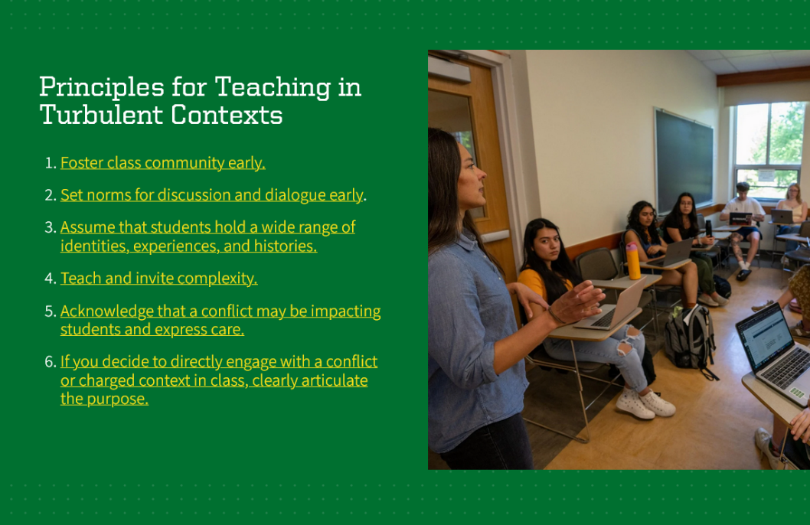
Discussion as active learning
Check out our Teaching in Turbulent Times Guide principles and Designing Discussions page for discussion resources

Slide 40
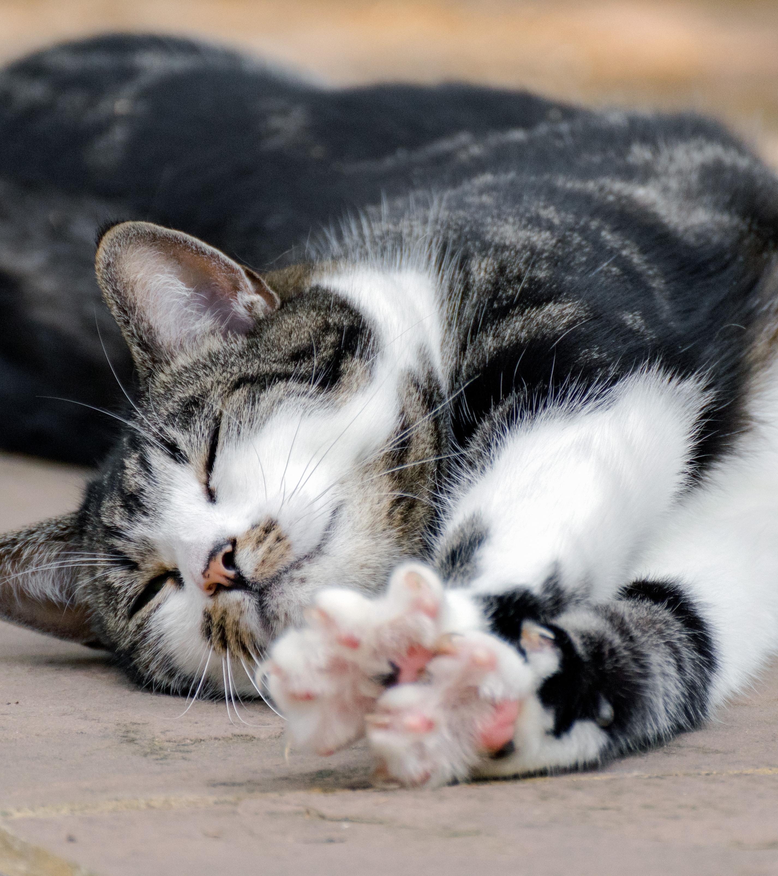
Take a five minute break!

Slide 41
Putting it all together: teaching practices "gallery walk"

Slide 42
Teaching practices "gallery walk"
Instructions:
In group of 4-5
Grab a marker for your group.
Around the room are question stations.
Start at a station without a group already there.
At your station, discuss and
  Add one or more ideas to the post-it to answer one of the questions
  Add one idea to your lesson plan template
Rotate when time is called.
Each group will visit 3 stations total.
Notes:
Ali+Lee

Slide 43
Teaching practices- questions
How do you want to introduce yourself to your students? What details about your interests, hobbies, or expertise feel positive to share?
How do you want to spark interest in or invite students into your course or discipline on the first day, or what is a “warm up” you want to try?
What active learning or student engagement technique could you imagine using on the first day or in the first few weeks? Why?
How might you use the end of the class to help students solidify learning or check for group understanding? What "wrap up" activity might you use?

Slide 44
Resources and support

Slide 45

Key teaching resources for GEs
At teaching.uoregon.edu, you can find
Graduate Employee Teaching Support
  teaching.uoregon.edu/ges
Term Resources
Syllabus Essentials
Upcoming workshops and communities

Slide 46
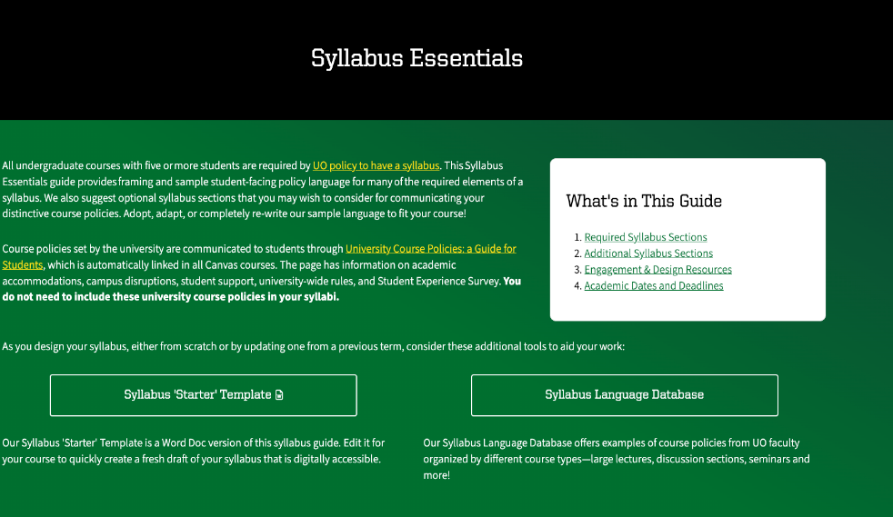

Course Resources & Syllabus Essentials
Example language and guidance is informative for issues that are most likely to come up for students.
teaching.uoregon.edu/syllabus
Updated before every term with "actions to take" that every instructor should know,
important dates, ready-made resources.
Teaching.uoregon.edu/course-resources
Notes:
Lee

Slide 47
Fall Teaching Events Specifically for GEs
Event | Day & Location | Description
GTI Meet & Greet | Mon, Oct 6 @ 10am Knight Lib Dream Lab | Meet other GEs and learn about our teaching certificate program: the Graduate Teaching Initiative.
Grading with Canvas | Wed, Oct 8 @ 11am Knight Lib Dream Lab | Learn more about Canvas’s SpeedGrader. Practice using it in our closed Grading Practice Sandbox.
International GE Success Thriving in the U.S. Classroom | Thurs, Oct 9 @ 11am EMU Diamond Lake Rm | Build community and share ways to navigate teaching challenges in the US with confidence and care.
Grading 601 – Tips for Efficient Grading | Wed., Oct 15 @ 10am On Zoom | Discuss tips for getting through that stack of exams, homework, lab reports, or assignments quickly.
International GE Midterm Check-In | Mon, Oct 27 @ 1pm On Zoom | Join us for an informal conversation about how your teaching is going. Drop in when you can!
International GE Coffee Hour | Thur, Nov 12 @ 10am Straub 401 | A space to pause, enjoy coffee or tea and light snacks, and connect with fellow international GEs.
Register and learn more about all our events at: teaching.uoregon.edu/events
Notes:
Remind them that GEs are welcome to (almost) all our events, not just the ones listed.
Other Fall GE Programming new GEs don’t need to know about:
Teaching Philosophy Statements
Grad Pedagogy Course

Slide 48
What are some next steps to support your teaching?
Join us at 3pm today for Canvas Features and Tools and at 4pm for the Teaching Insights Forum (Pacific Hall 123)
Attend a TEP workshop this term
Join the Graduate Teaching Initiative (GTI)
Consult with us on any teaching-related questions, goals, or challenges
Aim for the Kimble First-Year Teaching Award

Slide 49
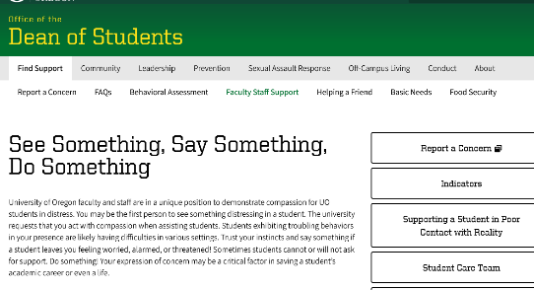
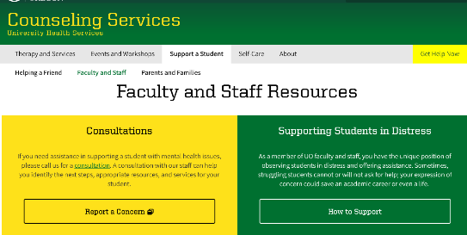


Where to refer when students need support
UO has strong student support units staffed by dedicated colleagues.
If you have a student needing support or that you're concerned about for any reason, contact the Office of the Dean of Students.
Other units to refer students to include:
Counseling Services
Accessible Education Center
Tutoring and Academic Engagement Center

Slide 50
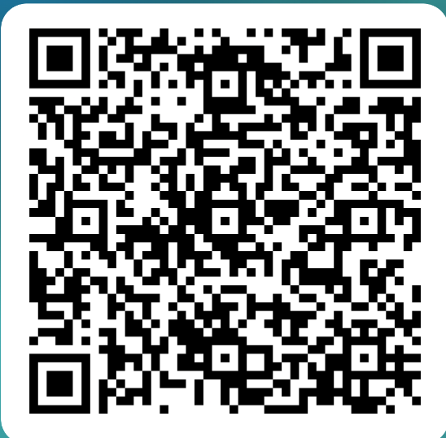
Closing Slide with the University of Oregon Logo
Contact us at tep@uoregon.edu or on our website, teaching.uoregon.edu. Have a GREAT fall term!

Slide 51
Share out:
In pairs: share a couple of things about the environment or the actions you/your teachers took that helped you learn.
As a full group, let's merge our lists! Please call out 1-2 things that helped you learn, adding only what hasn't been said:
Left side of room—what supported learning?
Center of room—what supported learning?
Right of room—what supported learning?
5 min
Notes:
Debrief together—Ali is thinking 10 minutes total
Setting the timer for

