Slide 1







Promising Practices: Course Level Strategies
Much research on closing equity gaps in higher ed falls in one or more of these broad categories:
1. Growth Mindset
2. Inclusive & Structured Active Learning
3. Social Belonging
4. Task Value &
Transparency
5. Reduced
Logistical Barriers
Notes:
- Have people find and read their own goals at their tables

Slide 2

Promising Practices: Course Level Strategies
What “Growth Mindset” is:
Growth mindset holds that our traits are malleable and can expand with effort, persistence, adopting useful strategies.
Fixed mindset holds that traits are unchanging—a student either has a trait or capability or doesn’t.
Notes:
Hold a growth-mindset approach
Communicate a strengths-based growth mindset in your “instructor talk”
Emphasize formative and summative assessments that allows for early no/low-stakes practice

Slide 3
Promising Practices: Course Level Strategies
Why Growth Mindset matters:
Studies indicate an increase in academic achievement and closing of equity gaps when both students and instructors hold growth mindsets
Instructors who hold a fixed mindset have larger racial achievement gaps in their courses, and their students have lower belonging and self-confidence, higher anxiety and distress, and lower academic achievement.
An instructor’s mindset “predicted student achievement and motivation above and beyond any other faculty characteristic, including their gender, race/ethnicity, age, teaching experience, or tenure status” (Muenks et al, 2020).
Notes:
Hold a growth-mindset approach
Communicate a strengths-based growth mindset in your “instructor talk”
Emphasize formative and summative assessments that allows for early no/low-stakes practice

Slide 4
Promising Practices: Course Level Strategies
Growth Mindset: Research to Practice:
Hold & communicate a growth-mindset approach. Look at include language and tone of syllabus and assignments and narratives of how people become experts and knowledge is created in the discipline.
Align assessments and grading structure to growth mindset approach. Increase formative assessments that allow for multiple opportunities of no/low-stakes practice, and decrease use of high-stakes exams. Remove grading curves.

Slide 5
Promising Practices: Course Level Strategies
What Inclusive & Structured Active Learning is:
Active learning “holds that humans learn by actively using new information and experiences to modify their existing models of how the world works.” (Theobold et al, 2020)
Inclusive teaching is “instruction designed to ensure every student can participate fully and that their presence and participation is valued. The content of the course reflects the diversity of the field's practitioners, the contested and evolving status of knowledge […] and/or other efforts to help students see themselves in the work of the course”
“Structure” entails using a pattern of elements prior to and during each class, such as preparatory homework and in-class activities applying primary concepts and higher-order thinking skills.
Notes:
Hold a growth-mindset approach
Communicate a strengths-based growth mindset in your “instructor talk”
Emphasize formative and summative assessments that allows for early no/low-stakes practice

Slide 6
Promising Practices: Course Level Strategies
Why Inclusive & Structured Active Learning Matters:
Three decades of research have established the benefits of active learning for student success.
However, to close equity gaps, active learning must also incorporate inclusive teaching practices and consistent structure.
Notes:
Hold a growth-mindset approach
Communicate a strengths-based growth mindset in your “instructor talk”
Emphasize formative and summative assessments that allows for early no/low-stakes practice

Slide 7
Promising Practices: Course Level Strategies
Inclusive & Structured Active Learning: Research to Practice
Choose course materials with representative diversity in authors, experts, & context. If diversifying content and experts cited feels challenging, how might you prioritize learning more about disciplinary experts in the field who hold underrepresented identities?
Consider impact of your course or disciplinary context on student identity, and how that context might shape participation patterns for different students. Use both structure and multiple options for expression to support universal participation.
Structure your course so that each class includes prework, in-class focus on applying concepts & higher-order thinking
Notes:
Hold a growth-mindset approach
Communicate a strengths-based growth mindset in your “instructor talk”
Emphasize formative and summative assessments that allows for early no/low-stakes practice

Slide 8
Promising Practices: Course Level Strategies
What Social Belonging is:
“Social Belonging” strives to counter belonging uncertainty from students who are members of groups that commonly experience stereotype threat, discrimination, and/or microaggressions. Black students and other students of color, first generation students, international students, and/or nontraditional students have lower sense of belonging than peers with other identities at UO.
The intervention offers a diverse representation of who belongs and normalizes struggle, so students can more readily interpret challenge as common, temporary, and a cue to keep learning (as opposed to a cue to stop because they don’t belong).
Notes:
Hold a growth-mindset approach
Communicate a strengths-based growth mindset in your “instructor talk”
Emphasize formative and summative assessments that allows for early no/low-stakes practice

Slide 9
Promising Practices: Course Level Strategies
Why Social Belonging Matters:
Lower sense of social belonging correlates to lower academic success.
While formal belonging interventions are usually centrally administered, faculty are key to retaining and strengthening student sense of social belonging.
The intervention impact does not persist if students do not experience belonging within their courses.
Notes:
Hold a growth-mindset approach
Communicate a strengths-based growth mindset in your “instructor talk”
Emphasize formative and summative assessments that allows for early no/low-stakes practice

Slide 10
Promising Practices: Course Level Strategies
Social Belonging: Research to Practice:
Consider explicitly addressing belonging by designing activities or assignments where students engage with counter-stereotypical examples of experts in the field (see an illustration of this approach, “Scientist Spotlight,” which closed gaps in an intro Biology course)
Consider sources for student feedback that already exist in your unit/course. What might students already be naming about practices which encourage or inhibit their sense that they and others with their identities belong?
Learn more about who our students are and their experiences of belonging on campus by exploring the Student Wellbeing and Success Initiative, a longitudinal assessment measuring aspects of belonging, disaggregated by race, gender, and other identities.
Notes:
Hold a growth-mindset approach
Communicate a strengths-based growth mindset in your “instructor talk”
Emphasize formative and summative assessments that allows for early no/low-stakes practice

Slide 11
Promising Practices: Course Level Strategies
What “Task Value” and “Transparency” is:
Task value interventions communicate to students the value of the knowledge or skills they’re learning, providing examples of the relevance and usefulness of academic tasks for personal goals, and encouraging students to identify value for themselves through reflective activities.
Transparency in teaching and learning (TILT) offers an explicit, consistent template to communicate both value of knowledge/skills and methods to successfully learn them through identifying the purpose, tasks, and criteria for success.
Notes:
Hold a growth-mindset approach
Communicate a strengths-based growth mindset in your “instructor talk”
Emphasize formative and summative assessments that allows for early no/low-stakes practice

Slide 12
Promising Practices: Course Level Strategies
Why “Task Value” and “Transparency” matters:
A number of studies indicate that task value interventions increase student performance in a course and interest in the field for first generation students (FG), underrepresented students of color (URM), and those students with both identities (FG-URM).
Transparency in teaching and learning (TILT) "demonstrably enhances students' success, especially that of first-generation, low-income, and underrepresented college students" (Winkelmes, M. et al., 2016).
Notes:
Hold a growth-mindset approach
Communicate a strengths-based growth mindset in your “instructor talk”
Emphasize formative and summative assessments that allows for early no/low-stakes practice

Slide 13
Promising Practices: Course Level Strategies
“Task Value” and “Transparency”: Research to Practice:
Make the purpose and value of your course and its activities transparent, including by having learning objectives that have meaning for you and for students, and by using a framework like TILT to articulate the purpose, task, and criteria for success in your assessments and activities.
Align your assessments and grading structure transparently. Ensure assessments are an extension of learning objectives and directly connected to and scaffolded from activities.
Create opportunities for students to write/reflect on the relevance of course or task to their own goals and life.
Notes:
Hold a growth-mindset approach
Communicate a strengths-based growth mindset in your “instructor talk”
Emphasize formative and summative assessments that allows for early no/low-stakes practice

Slide 14
Promising Practices: Course Level Strategies
What we mean by “Reduced Logistical Barriers":
Removal of logistical barriers that impact equity may not always occur at the course level, but two notable ones which can be acted on include:
Pivoting from textbooks and software students must purchase to quality, free (or low-cost) Open Educational Resources (OERs)
Improving Canvas navigability and organization so that students can orient and access what they need with greater ease.
Notes:
Hold a growth-mindset approach
Communicate a strengths-based growth mindset in your “instructor talk”
Emphasize formative and summative assessments that allows for early no/low-stakes practice

Slide 15
Promising Practices: Course Level Strategies
Why “Reduced Logistical Barriers" matters:
A large-scale study found that after shifting to free textbooks, “Pell-eligible students, underserved populations, and part-time students” saw “DFW rates decrease dramatically,” helping to close the equity gap (Colvard, N. et al, 2018).
UO students identified Canvas organization and navigability as both the #1 contributor to accessibility (where present) and the #1 barrier to accessibility (where absent) in their courses (explore the Practitioner Guide for more information)
Notes:
Hold a growth-mindset approach
Communicate a strengths-based growth mindset in your “instructor talk”
Emphasize formative and summative assessments that allows for early no/low-stakes practice

Slide 16
Promising Practices: Course Level Strategies
Reduced Logistical Barriers: Research to Practice:
Adopt an open educational resource in place of a textbook or software students must pay for. Find out more at the Open Educational Resources & Textbook Affordability at UO webpage, and contact Rayne Vieger for support, including assistance locating an OER.
Design your Canvas to be easily and consistently navigable. Want support for your unit or yourself? Contact UO Online and the Teaching Engagement Program for more information.
Notes:
Hold a growth-mindset approach
Communicate a strengths-based growth mindset in your “instructor talk”
Emphasize formative and summative assessments that allows for early no/low-stakes practice

Slide 17
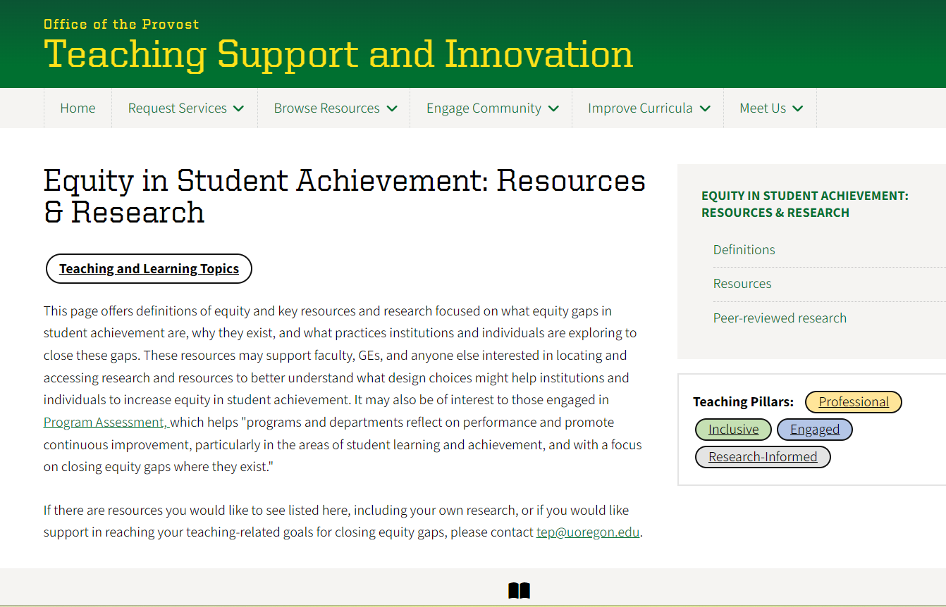
Promising Practices: Course Level Strategies
We are here to support your teaching and we are committed to helping to close equity gaps in student achievement.
Equity in Student Achievement: Resources & Research webpage
Notes:
- Have people find and read their own goals at their tables

