Slide 1
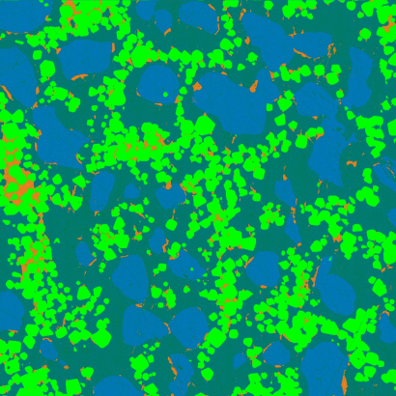

Quantitative WDS Compositional Mapping Using the Electron Microprobe
Publication in American Mineralogist, November, 2021
John J. Donovan¹, Julien M. Allaz², Anette von der Handt³, Gareth G. E. Seward⁴, Owen Neill⁵, Karsten Goemann⁶, Julie Chouinard¹ and Paul Carpenter⁷
1. CAMCOR, University of Oregon, Eugene, Oregon, 97403, USA
2. Institute of Geochemistry and Petrology, ETH Zürich, 8092 Zürich, Switzerland
3. Department of Earth Sciences, University of Minnesota, Minneapolis, MN 55455, USA
4. Department of Earth Science, University of California Santa Barbara, Santa Barbara, CA 93101, USA
5. Department of Earth and Environmental Sciences, University of Michigan, Ann Arbor, MI 48013, USA
6. Central Science Laboratory, University of Tasmania, Hobart, Tasmania 7001, Australia
7. Department of Earth and Planetary Sciences, Washington University in St. Louis, One Brookings Drive, St. Louis, Missouri, 63130 USA

Slide 2
Why Quantify?
Point Analyses: Raw Intensities
ELEM: na ka si ka k ka al ka mg ka fe ka ca ka
227G 11.4 10334.7 -5.8 31.2 3903.3 8.2 9616.8
228G 12.7 10353.6 -7.0 33.2 3935.6 10.1 9645.1
229G 11.1 10337.8 -1.4 28.5 3916.5 9.6 9563.8
230G 10.5 10384.0 2.0 25.1 3938.1 10.4 9580.3
AVER: 11.4 10352.5 -3.1 29.5 3923.4 9.6 9601.5
SDEV: .9 22.5 4.1 3.5 16.5 1.0 36.5
Point Analyses: Concentrations
ELEM: Na2O SiO2 K2O Al2O3 MgO FeO CaO SUM
227 -.008 55.982 -.016 .019 18.707 .012 26.182 100.827
228 .002 56.108 -.019 .028 18.860 .062 26.262 101.105
229 -.010 55.992 -.004 .006 18.749 .048 26.042 100.593
230 -.015 56.269 .005 -.009 18.877 .070 26.084 101.218
AVER: -.008 56.088 -.008 .011 18.798 .048 26.142 100.936
SDEV: .007 .134 .011 .016 .083 .025 .099 .281

Slide 3
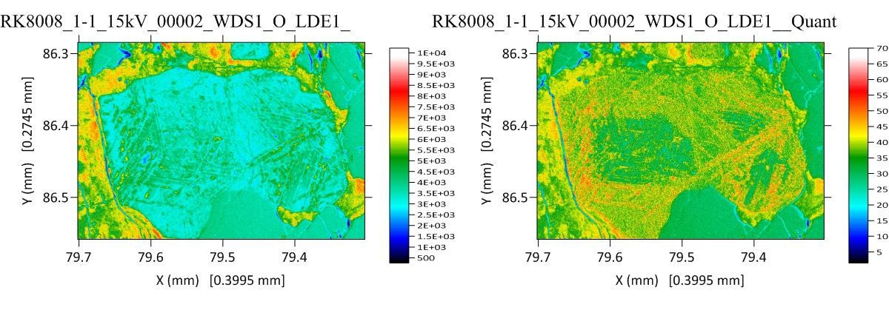
Raw data (left) vs. Quantified data (right)
Oxygen maps of Fe-Ti oxide from von der Handt

Slide 4
Why WDS Quantitative Compositional Mapping?
We want spatial concentration data in image format (WYSIWYG)
  Zoning, solid solutions, complex samples with multiple phases
  Variable chemistry at constant avg-Z (no BSE contrast)
Emitted intensities do not represent concentration, C = k * ZAF
  Average Z affects zero intensity, matrix affects major element intensities
  Spectral interferences affects trace and minor elements
Detection limits in x-ray intensity maps is ~ C/ZAF
  Spectrometer, crystal, standard and phase dependent
SEM-EDS mapping: Spectrum imaging is an excellent tool
  SDD throughput, but P/B issues for light elements, traces
EPMA-WDS: WDS multiple serial spectrometer passes combined in quant
  Excellent P/B, use stage mapping to avoid Bragg defocus, beam damage (use TDI)

Slide 5
Calibration Curve?
Works quite well for single phase x-ray maps, but then why bother mapping?
Traces? But without a background correction, what’s the point?
The physics of electron solid interactions tells us:
  In multi-phase materials, every phase (with a different average Z) will produce a different intensity for a zero concentration (Kramer’s law).
  Also the same concentration will produce a different intensities in different phases, i.e., different ZAF or φ(ρz) matrix physics.
  Likewise, the same intensity in different phases can represent different concentrations, again, different ZAF or φ(ρz).

Slide 6
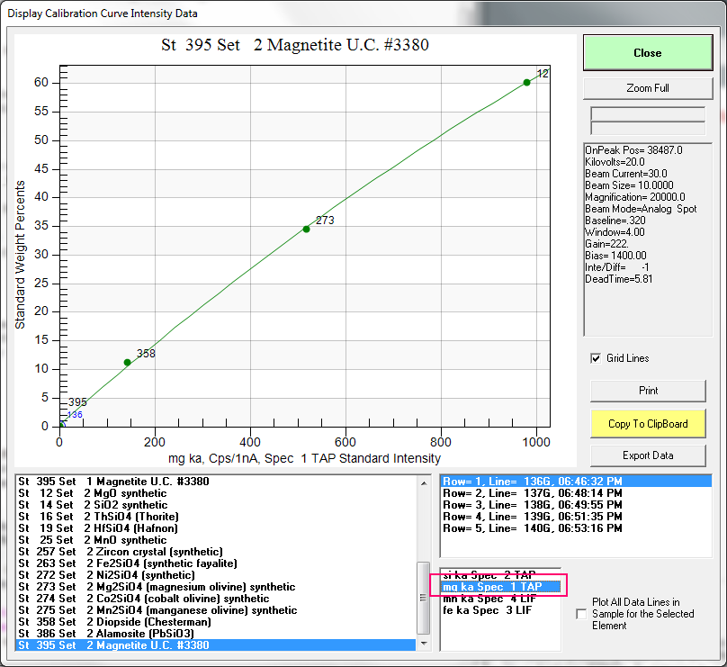
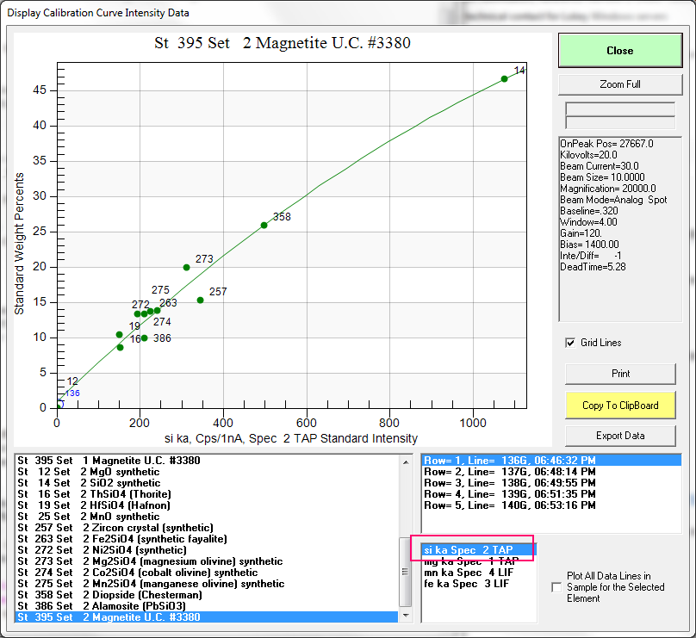
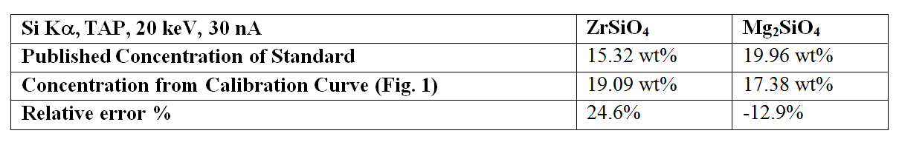
Calibration curves and accuracy (or lack thereof)

Slide 7
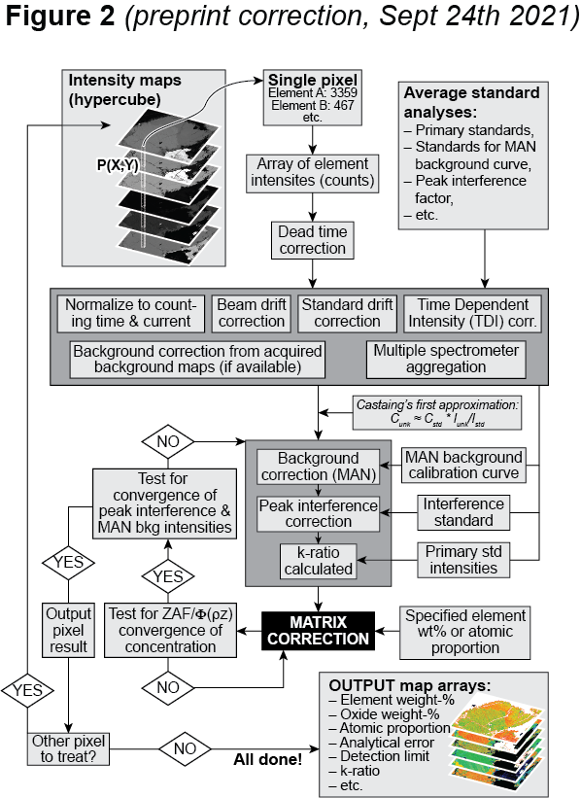
Solution: Treat Pixels as Points
Deadtime corrections
Normalization for beam current
Normalization for integration time
Beam drift corrections
Standard intensity drift corrections
Background corrections
Matrix corrections
Spectral interference corrections
Optionally, time dependent intensity (TDI) corrections for beam sensitive samples

Slide 8
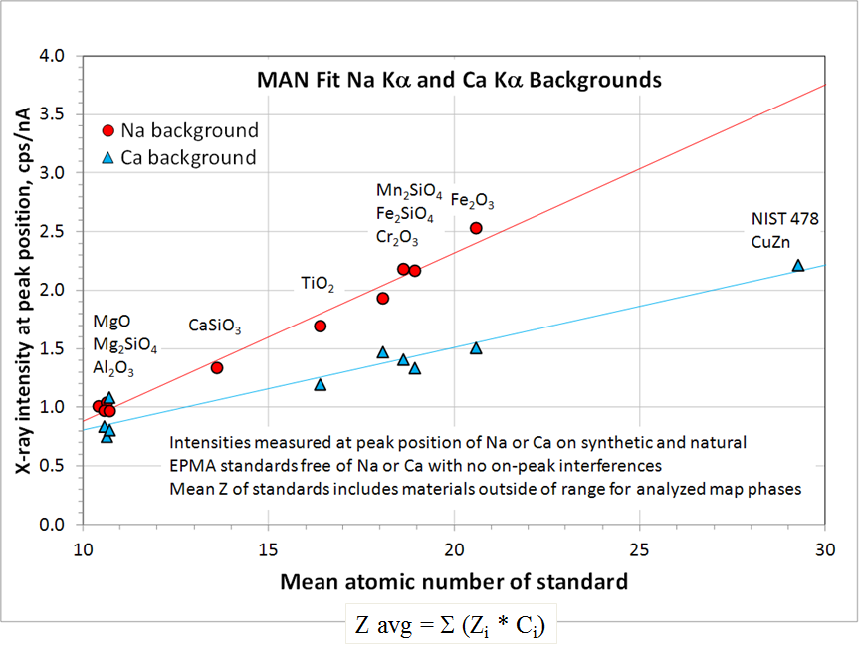
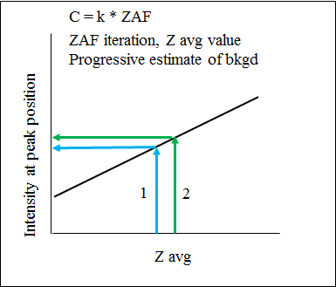
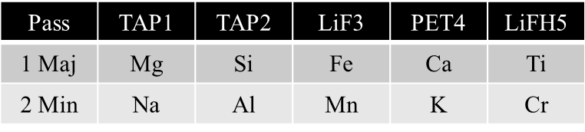
Typical EPMA quantitative mapping procedure
Setup/Calibration
Normal standardization in Probe for EPMA
Off-Peak or Mean Atomic Number (MAN) bgds
WDS stage mapping (fixed beam) or beam scanning
Probe Image or JEOL/Cameca software
Multiple pass WDS mapping
2-18 hours per map, depending on resolution/dwell
Quant correction of x-ray maps
CalcImage (stds + maps = quant maps)
Full Φ(ρz) correction each pixel
1024 x 1024 map req. ~ 1-4 hr
Data visualization
Surfer for contouring of data
Data processing
Surfer BASIC scripts
Quant, polygon, line, strip, modal, etc. (CalcImage)
Matlab: generate quantitative .tif images
Cluster analysis
ImageJ Xlib plug-in (Beat, Cluster image)
ENVI / IDL
Example Multiple Pass WDS Setup

Slide 9
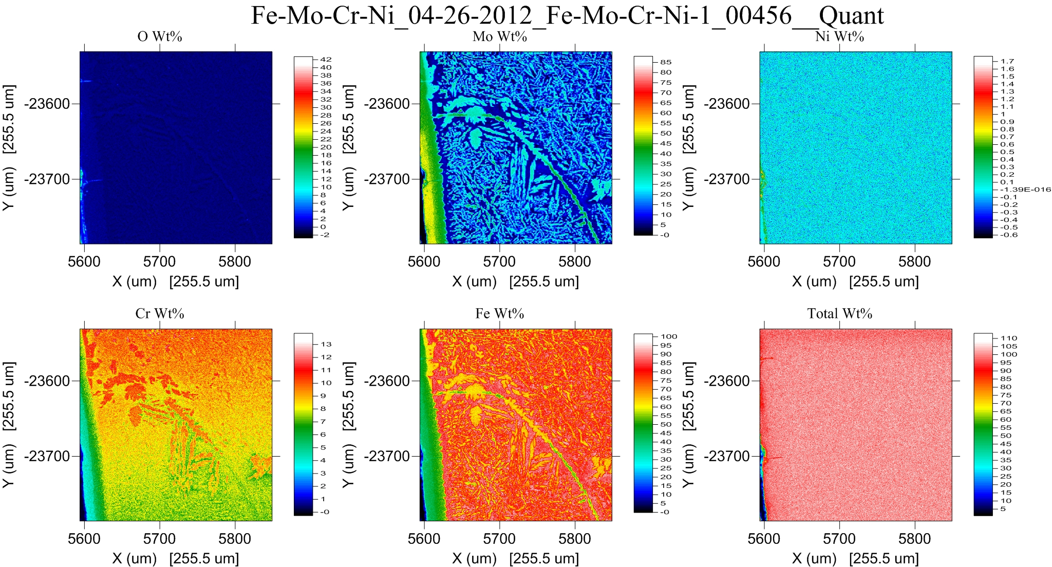
Quantitative Mapping of Multi-Phase materials with *totals*
Yes, we need a “totals” map, just as for point analyses!

Slide 10
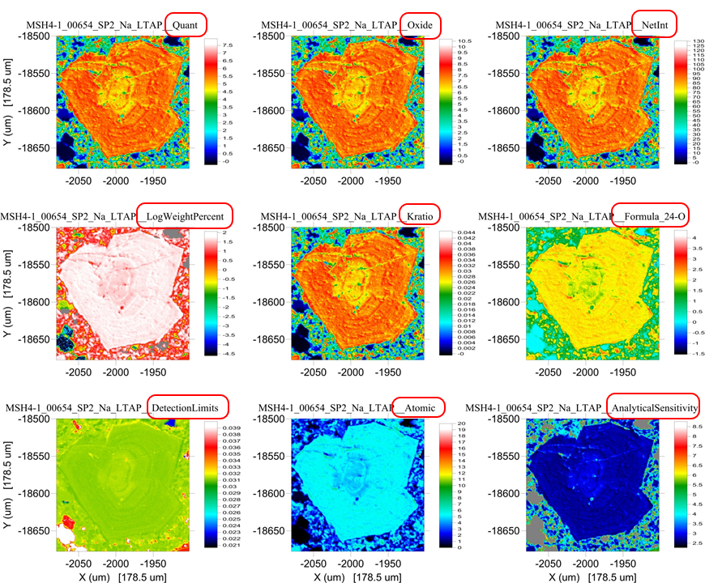
Now that we’re quantitative, let’s see all the data types, just as we do for point analyses

Slide 11
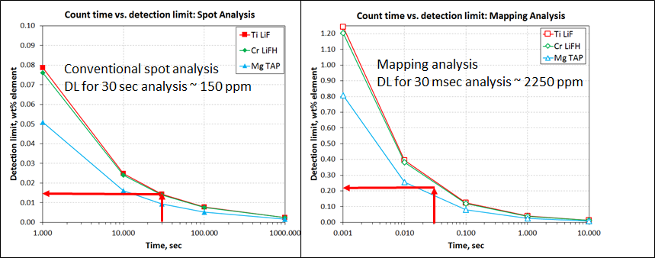
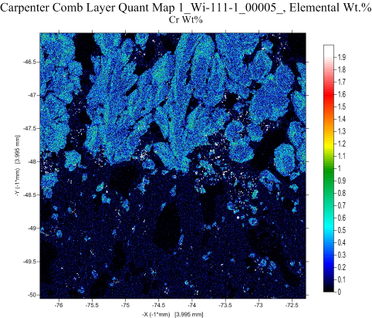
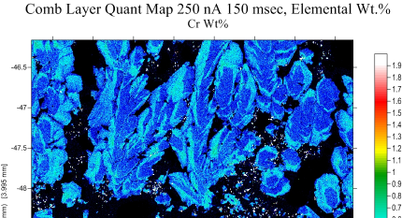
Detection limit vs. analytical conditions
Cr LiF 800x800, 100 nA 50 msec
Cr LiF 800x800, 250 nA 150 msec
DL 0.33 wt%
DL 0.12 wt%
Detection Limit
Conventional spot analysis comparatively high precision
10 nA, 100 sec, Dose equivalent = 10³ nA-sec
Mapping analysis significantly lower precision per pixel
100 nA, 100 msec/pixel, Dose equivalent = 10¹ nA-sec
Compared to point analyses:
Lower dose by factor of ~100 (time and current scale)
But detection limit is only lower by factor of ~30
Precision improved through pixel averging…
Accuracy is same for points or pixels!

Slide 12
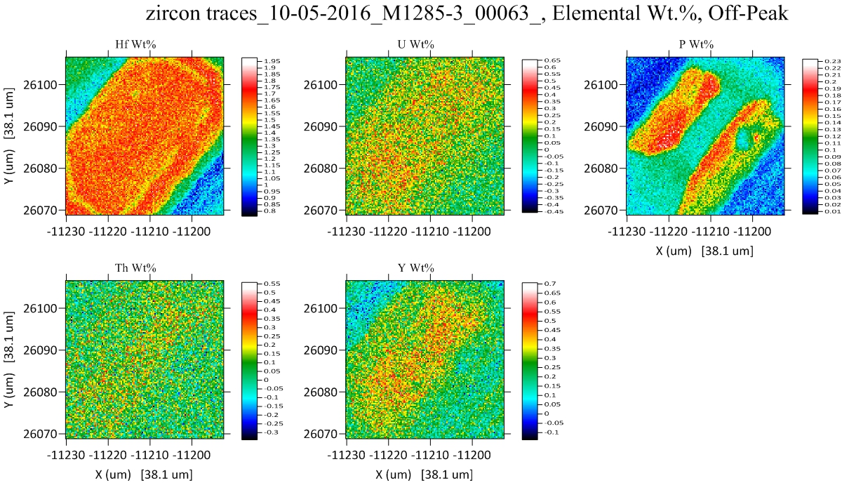
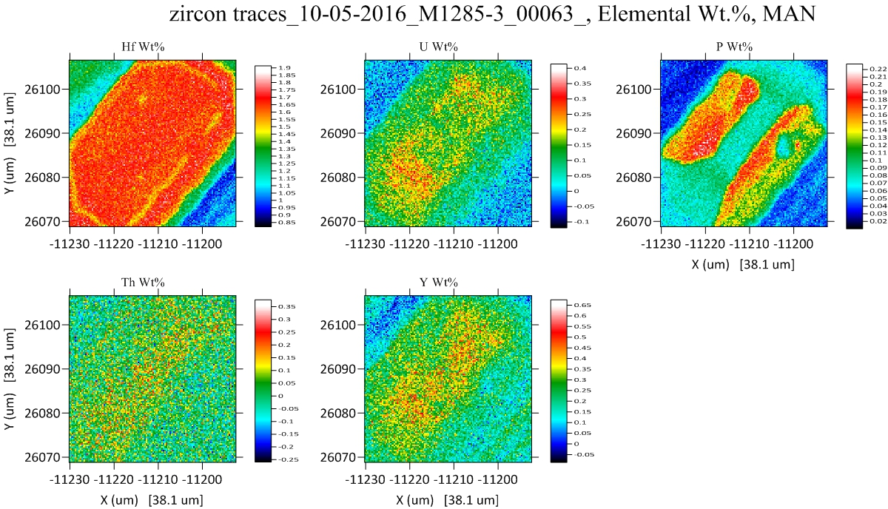
Off-Peak
MAN
1/2 acquisition time
40% better sensitivity
Donovan, Singer and Armstrong, Amer. Min., 2016

Slide 13
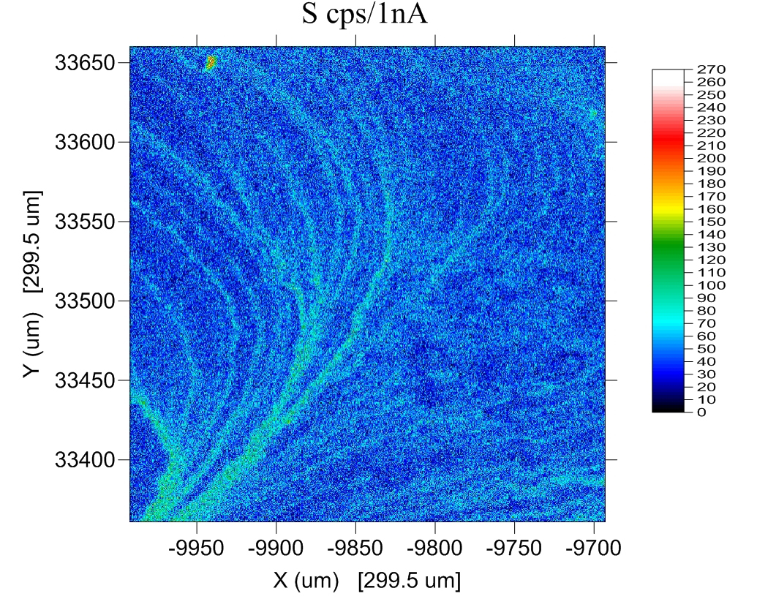
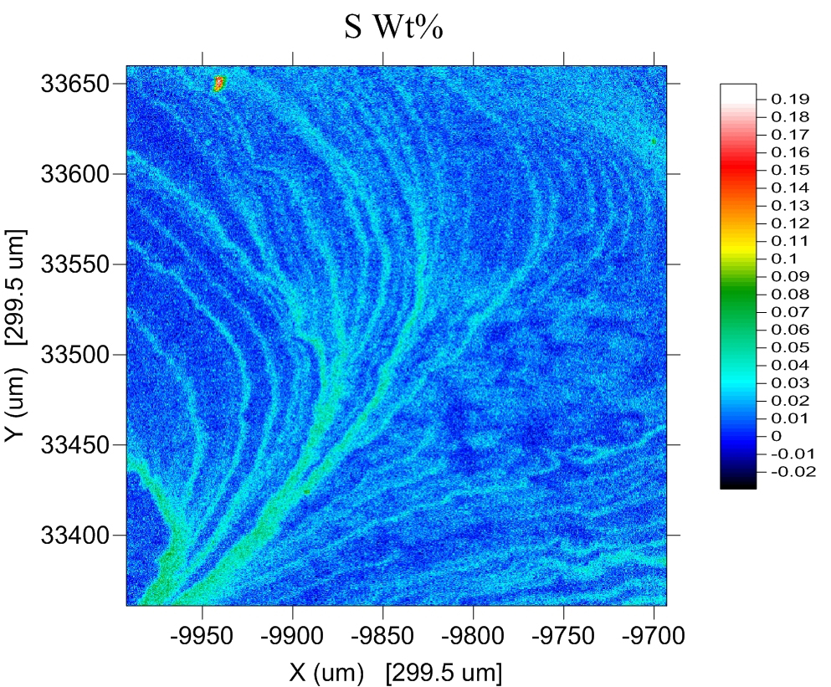
Intensity aggregation from multiple spectrometers
Single spectrometer
(raw data)
Multiple spectrometers
(quantitative)
From Mcfadden, University of Adelaide

Slide 14
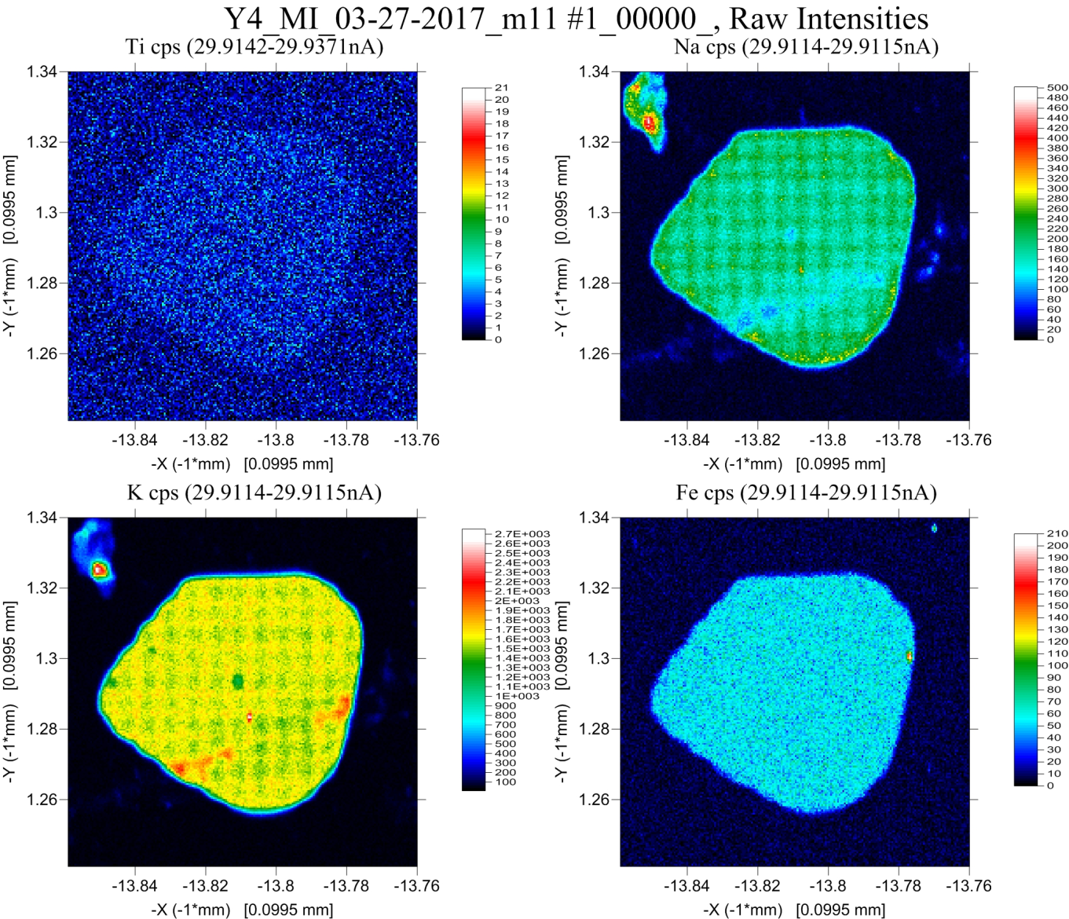
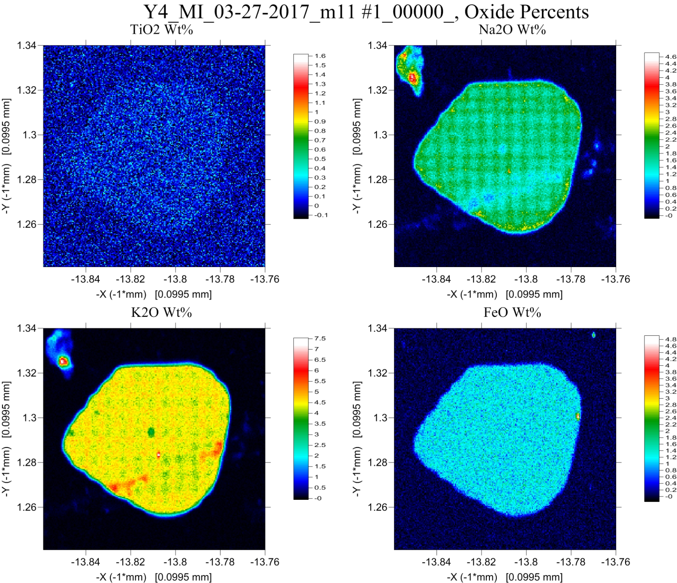
Time Dependent Intensity (TDI) Corrections for Beam Sensitive Samples
Raw Intensities
Oxide Quant (without TDI Correction)

Slide 15
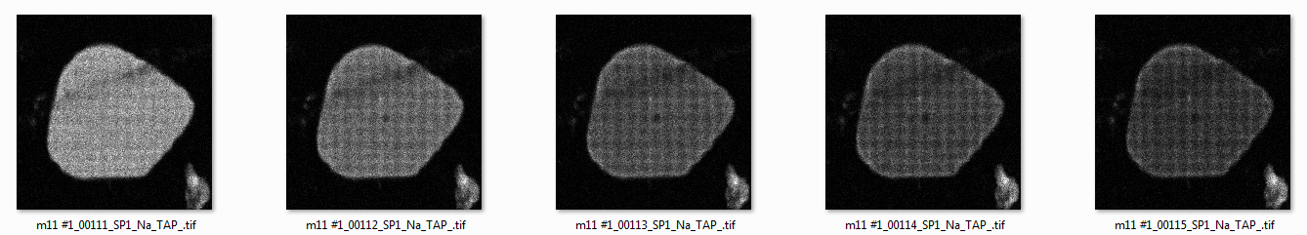
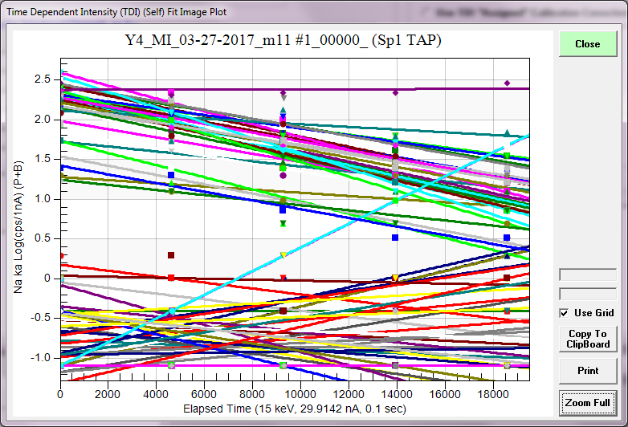
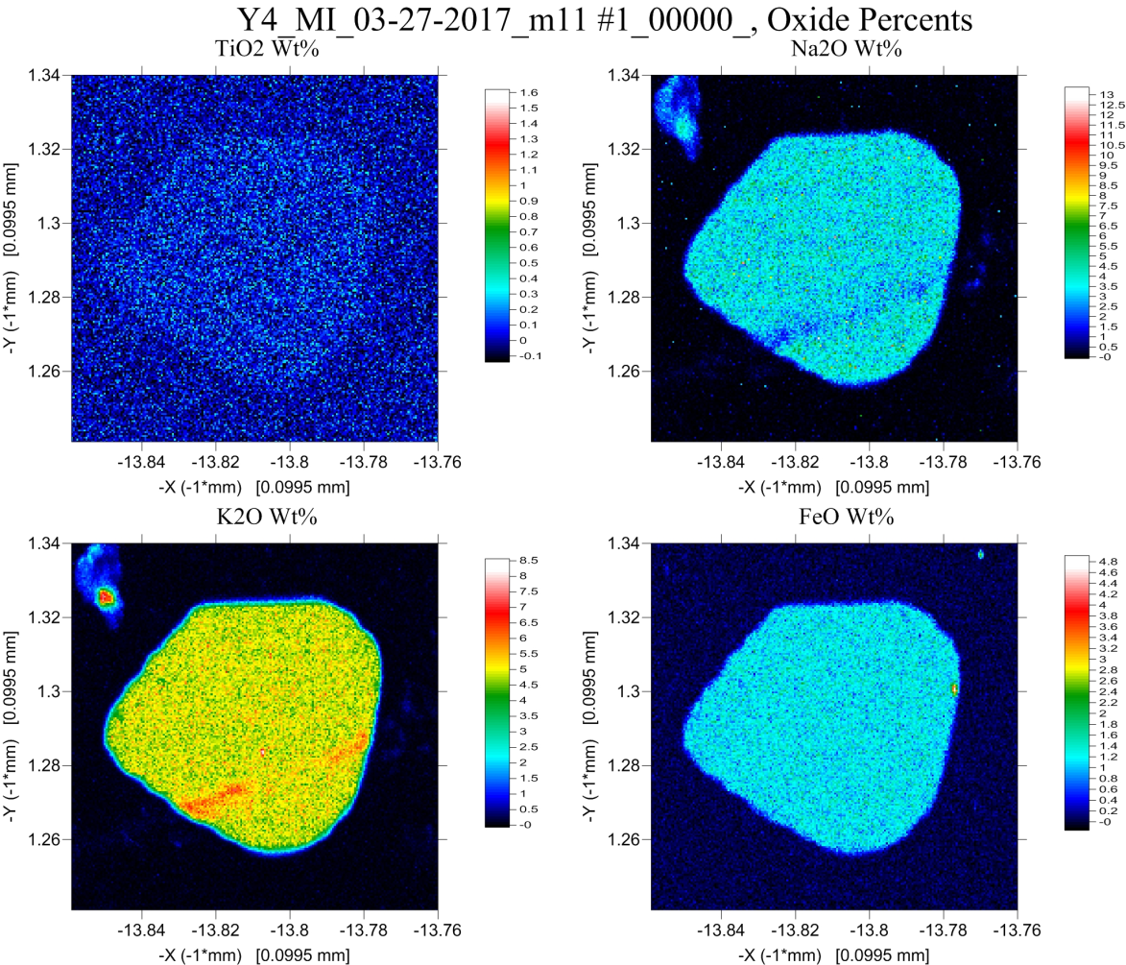
Na Intensities 100 msec pixel dwell time (5 frames)
Quant Oxide *with* TDI Correction)

Slide 16
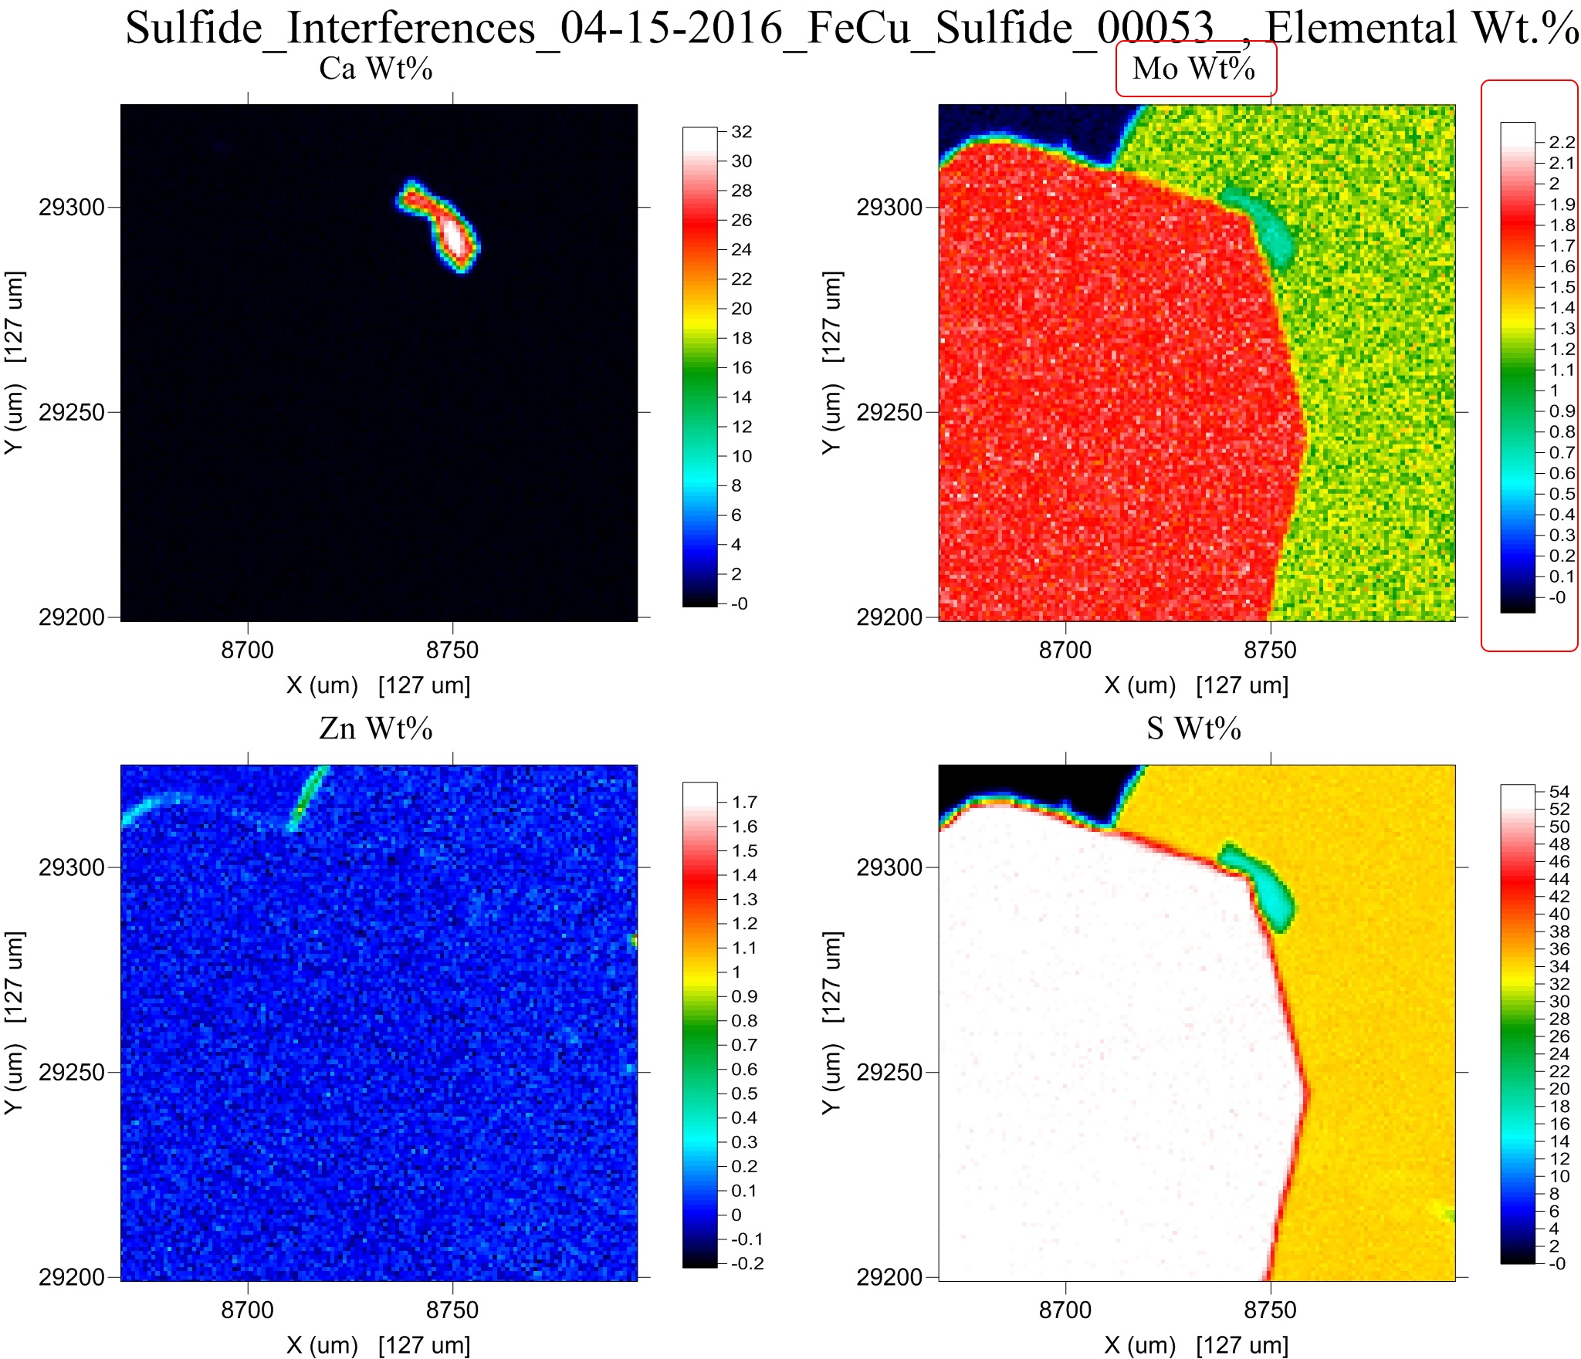
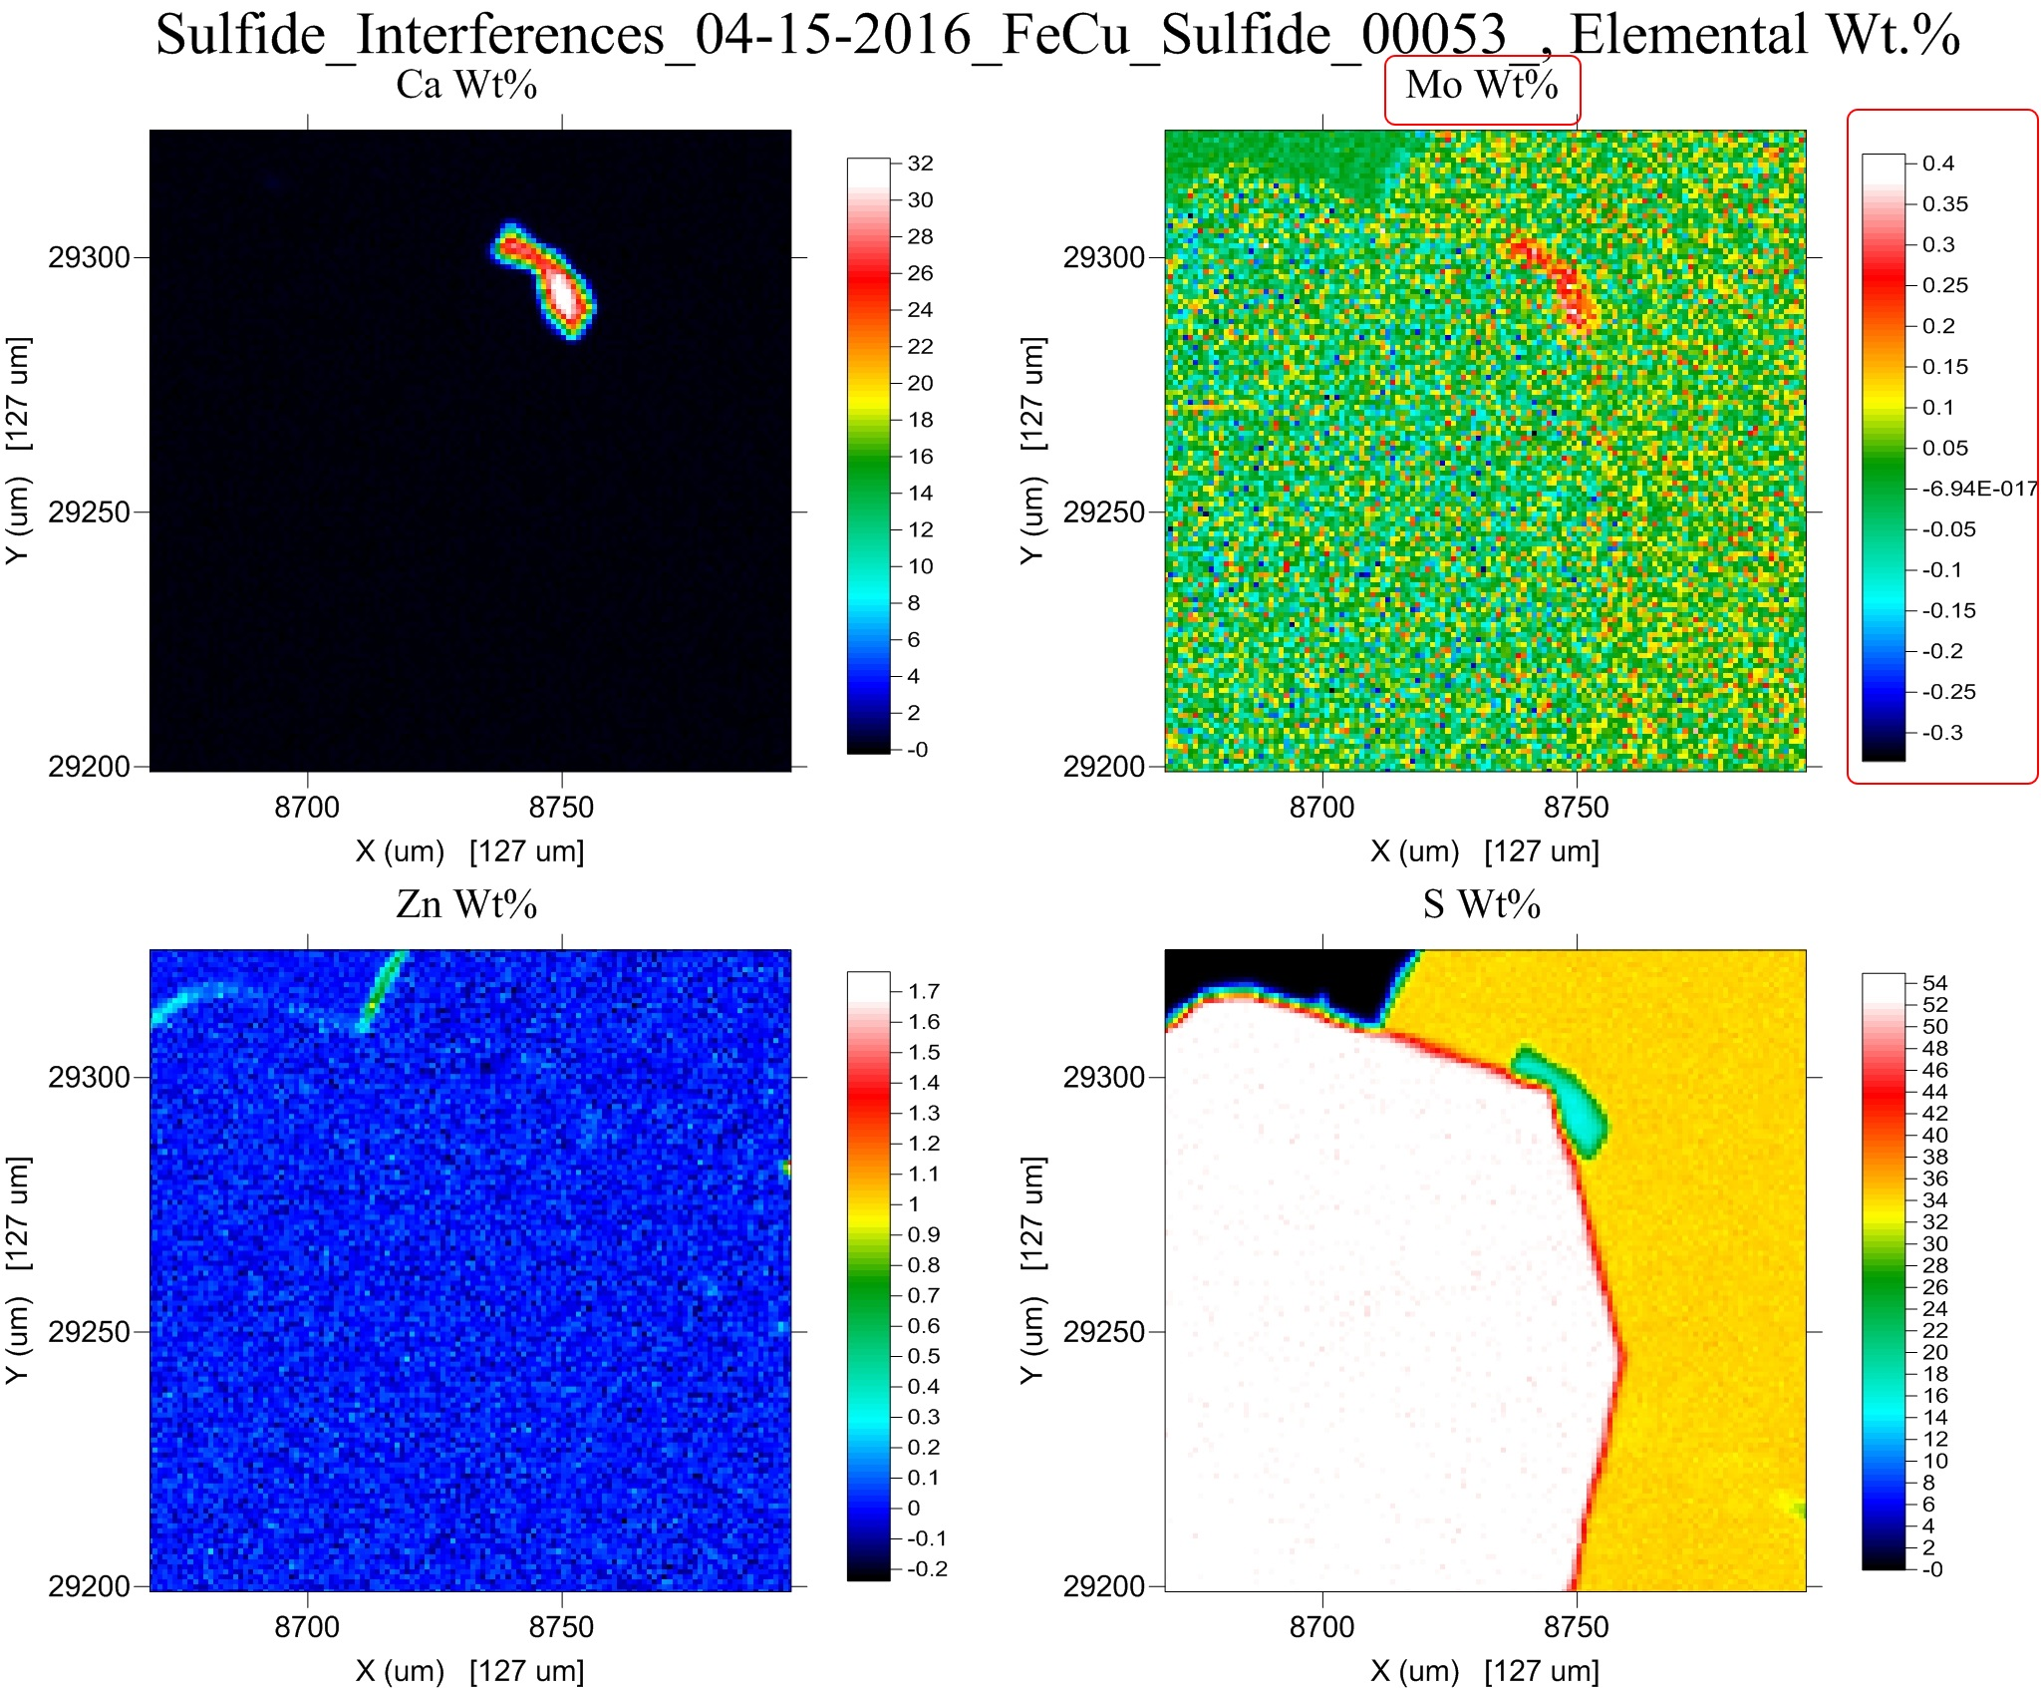
Quantitative Spectral Interference Corrections
w/o interference correction
w/ interference correction
Mo concentrations in the two phases are statistically similar

Slide 17
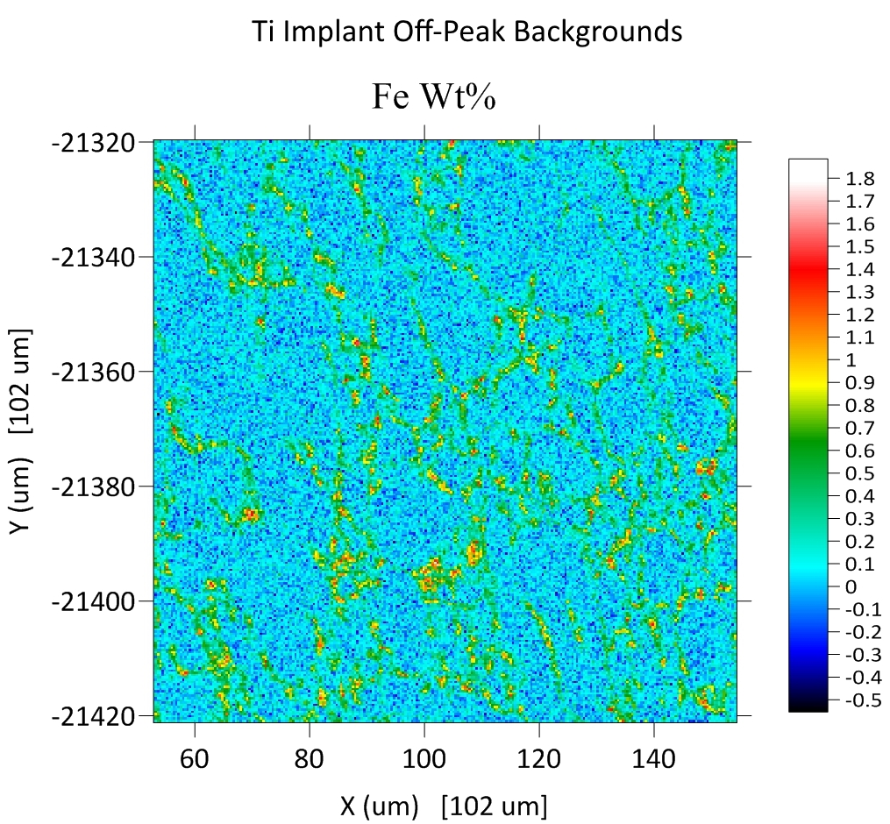
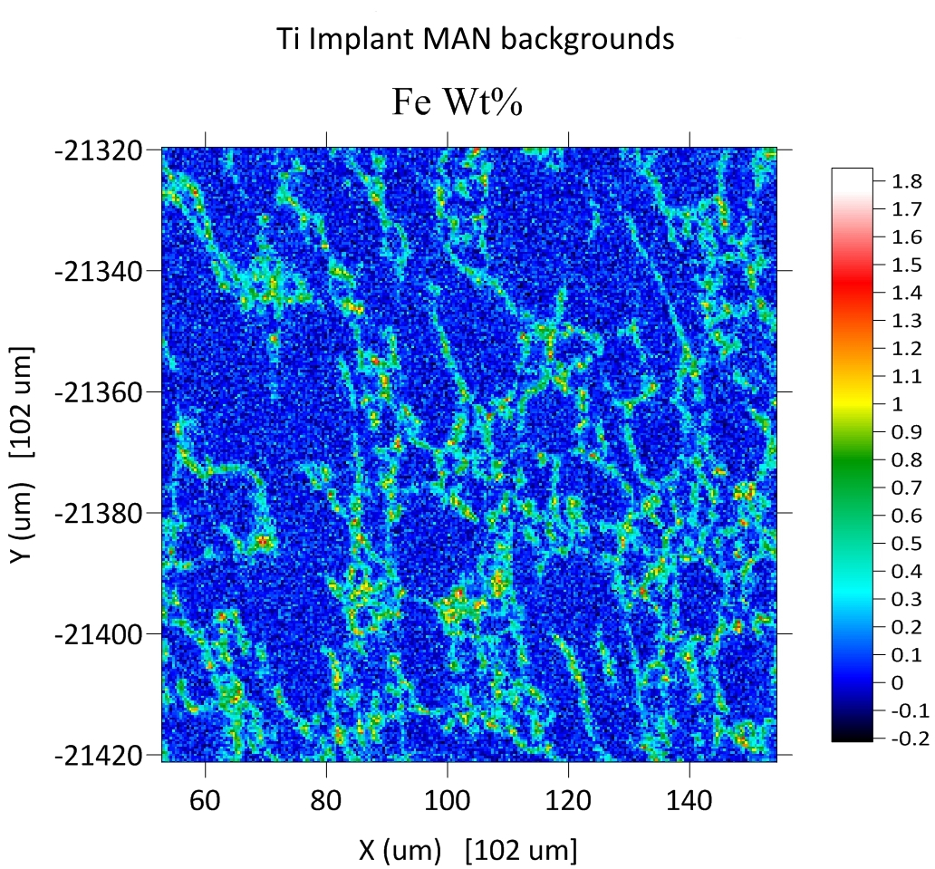
Color palettes and scaling effects

Slide 18
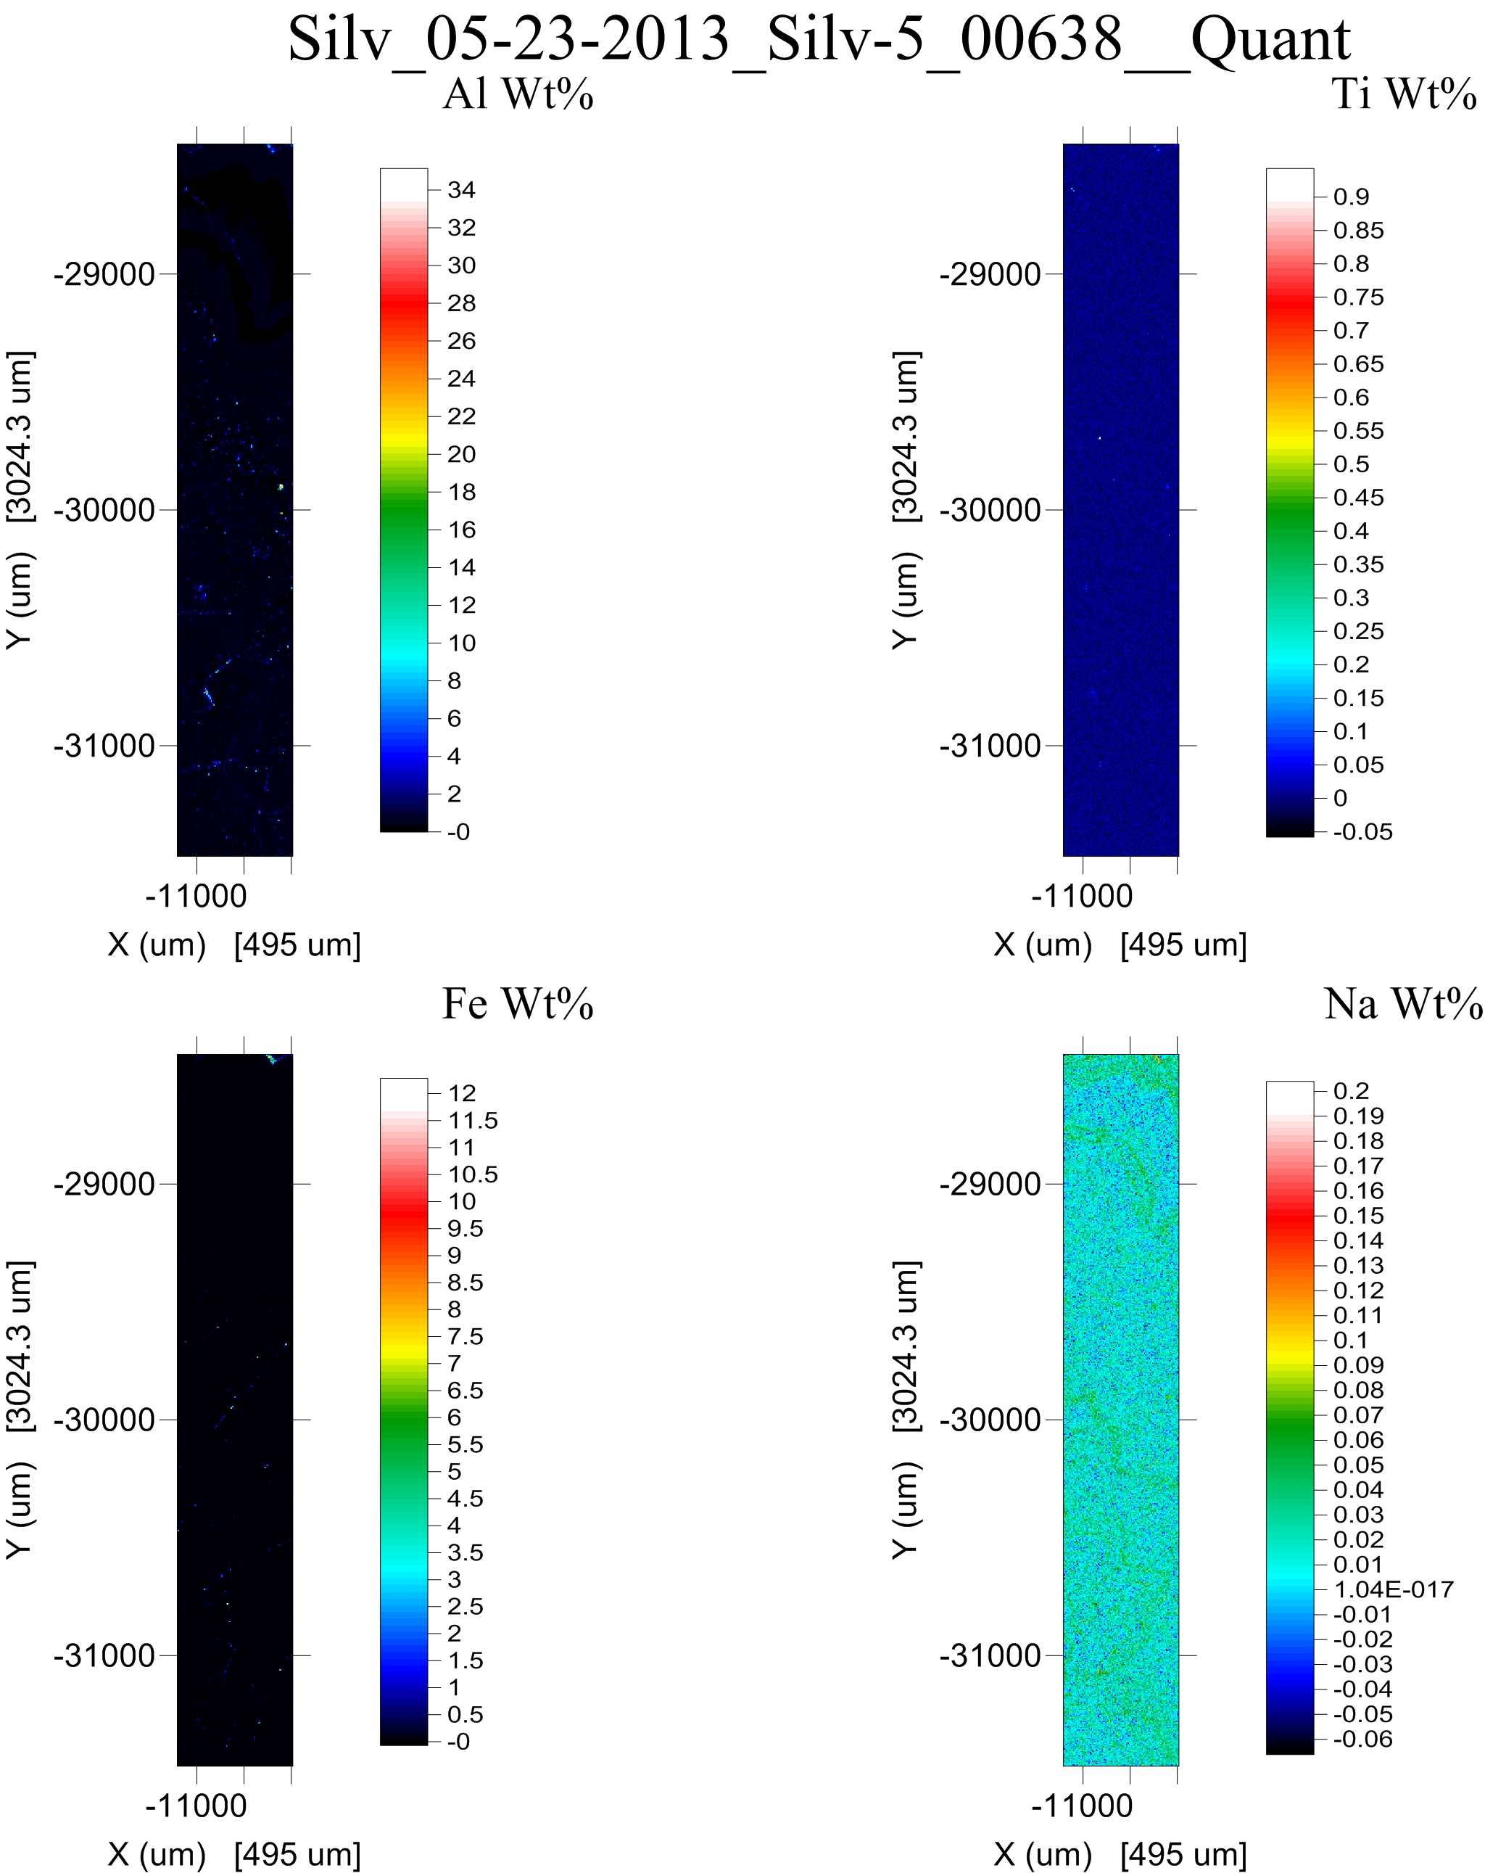
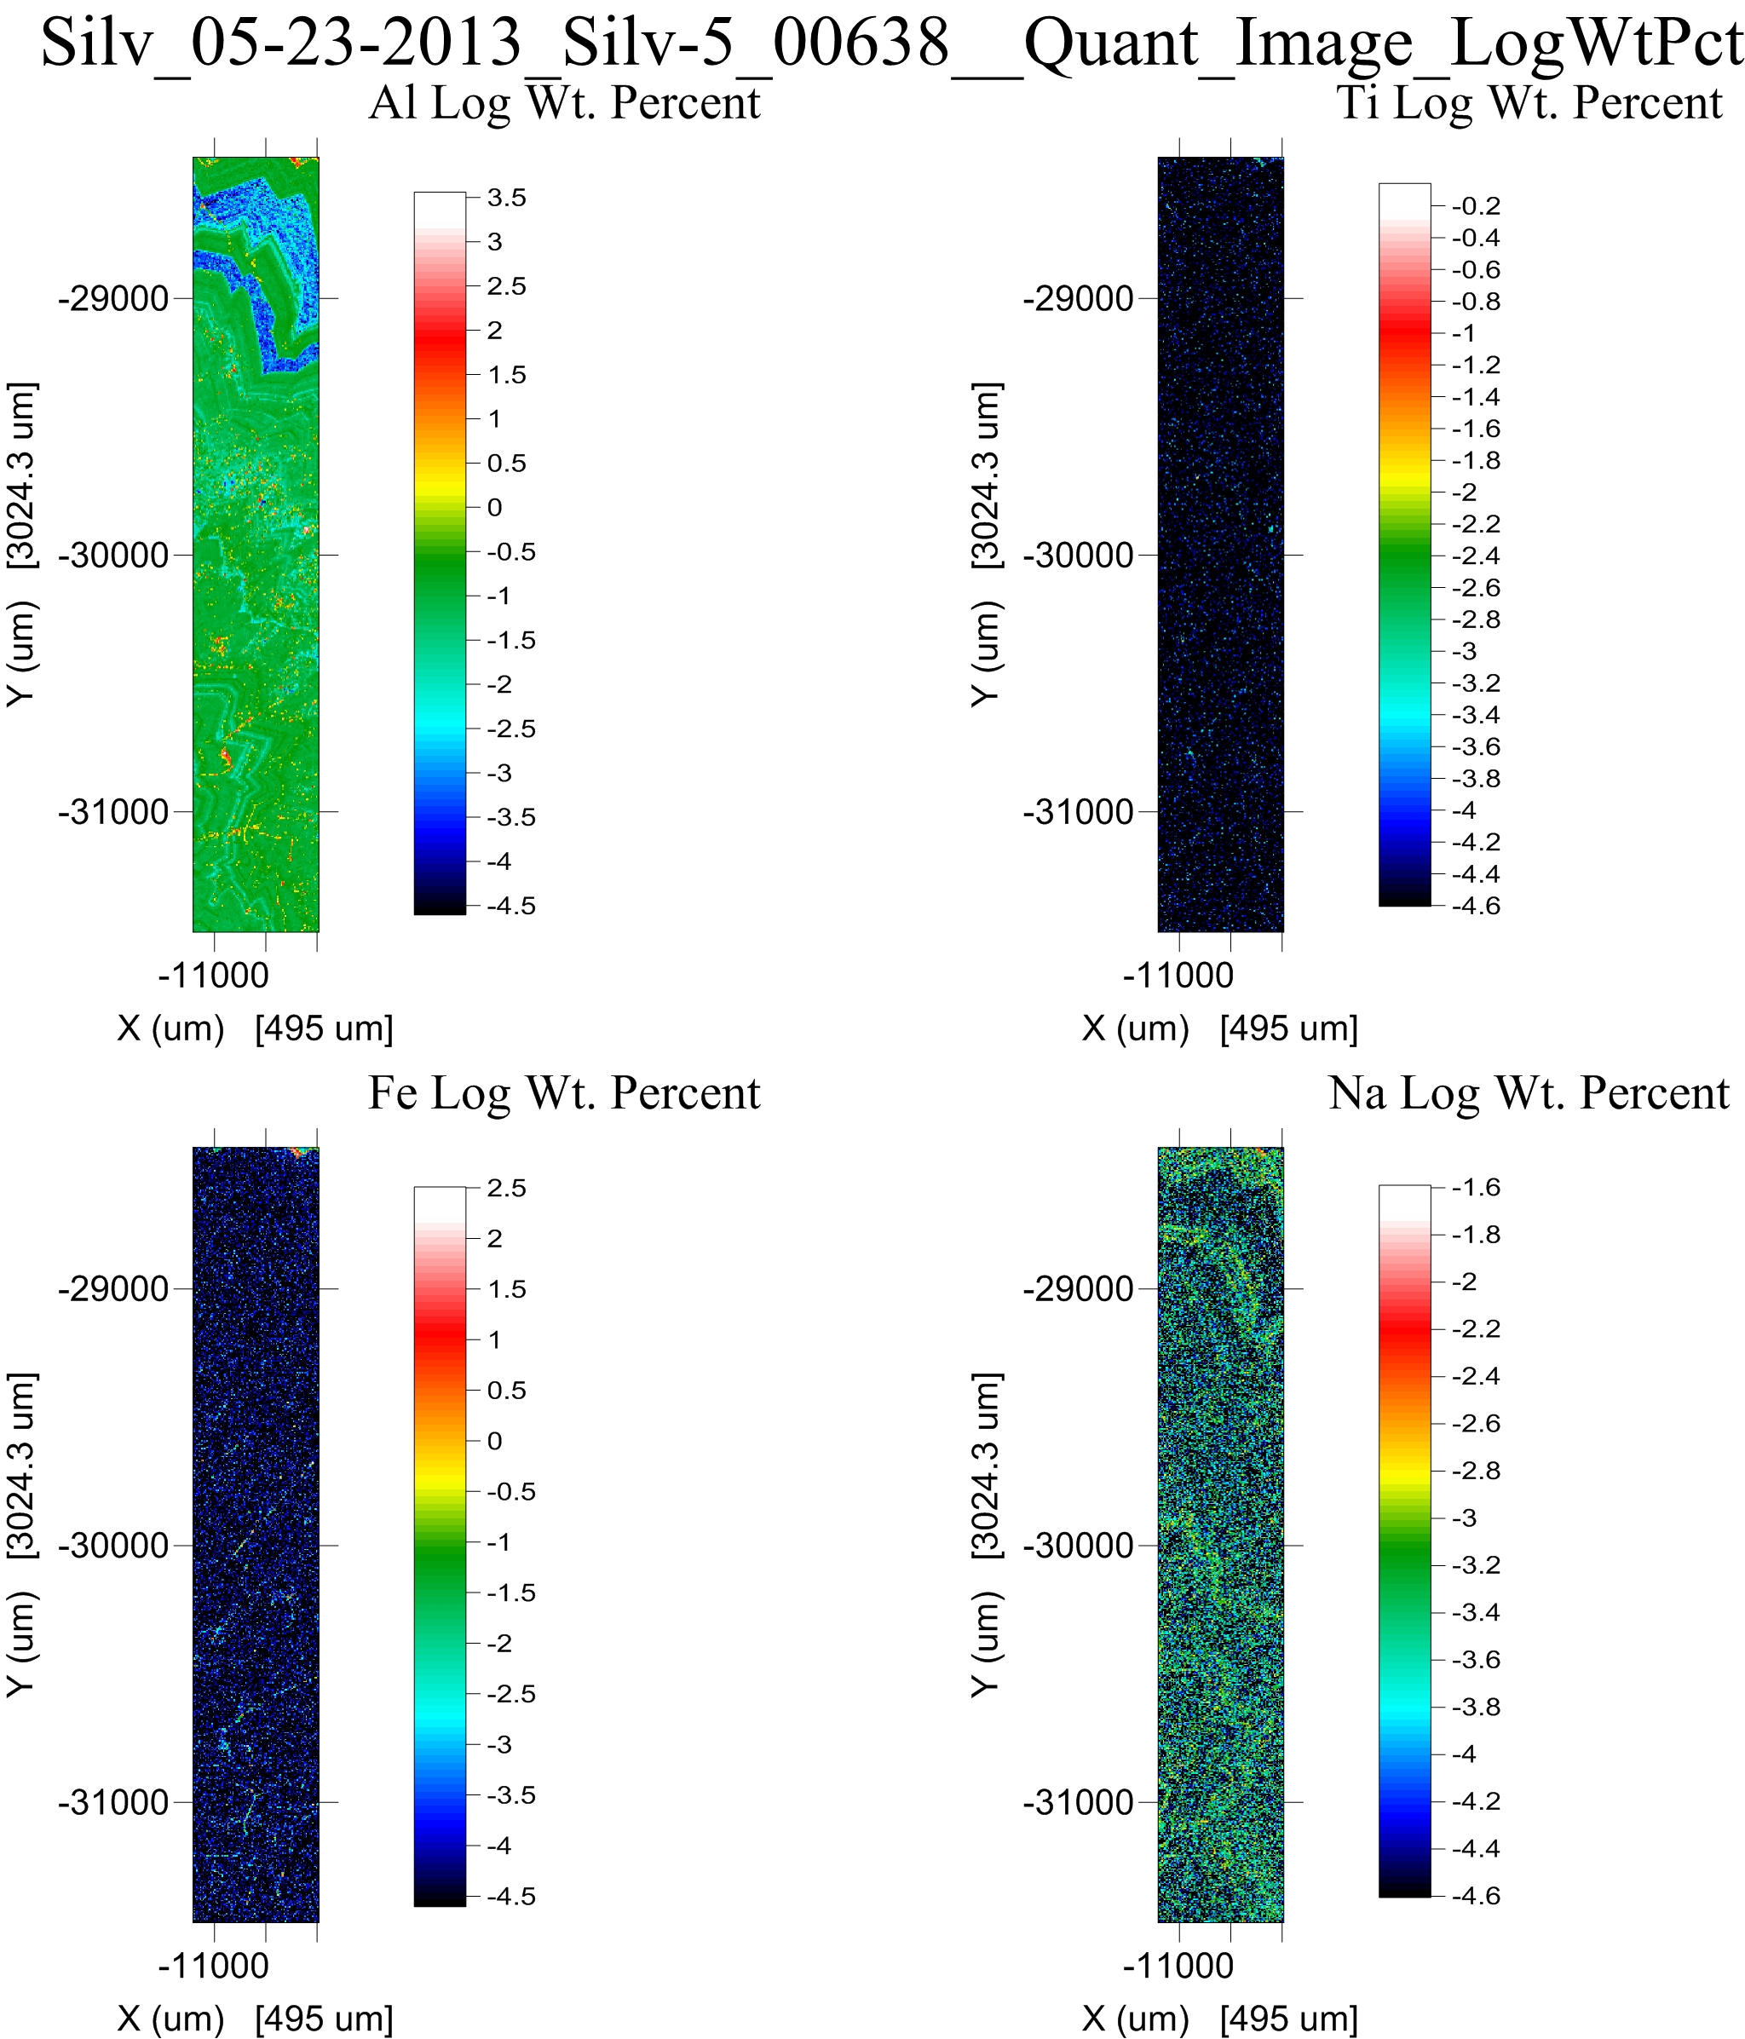
“Hot” pixels can obscure interesting data
Elemental wt%
LOG Elemental wt%

Slide 19
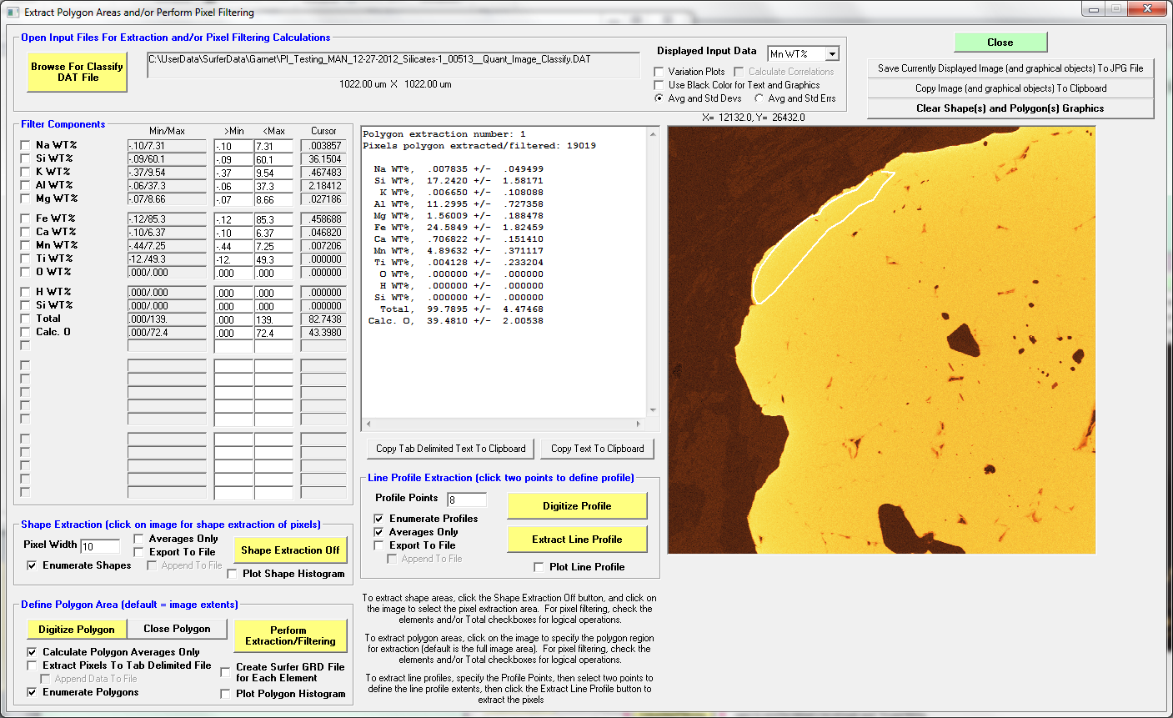
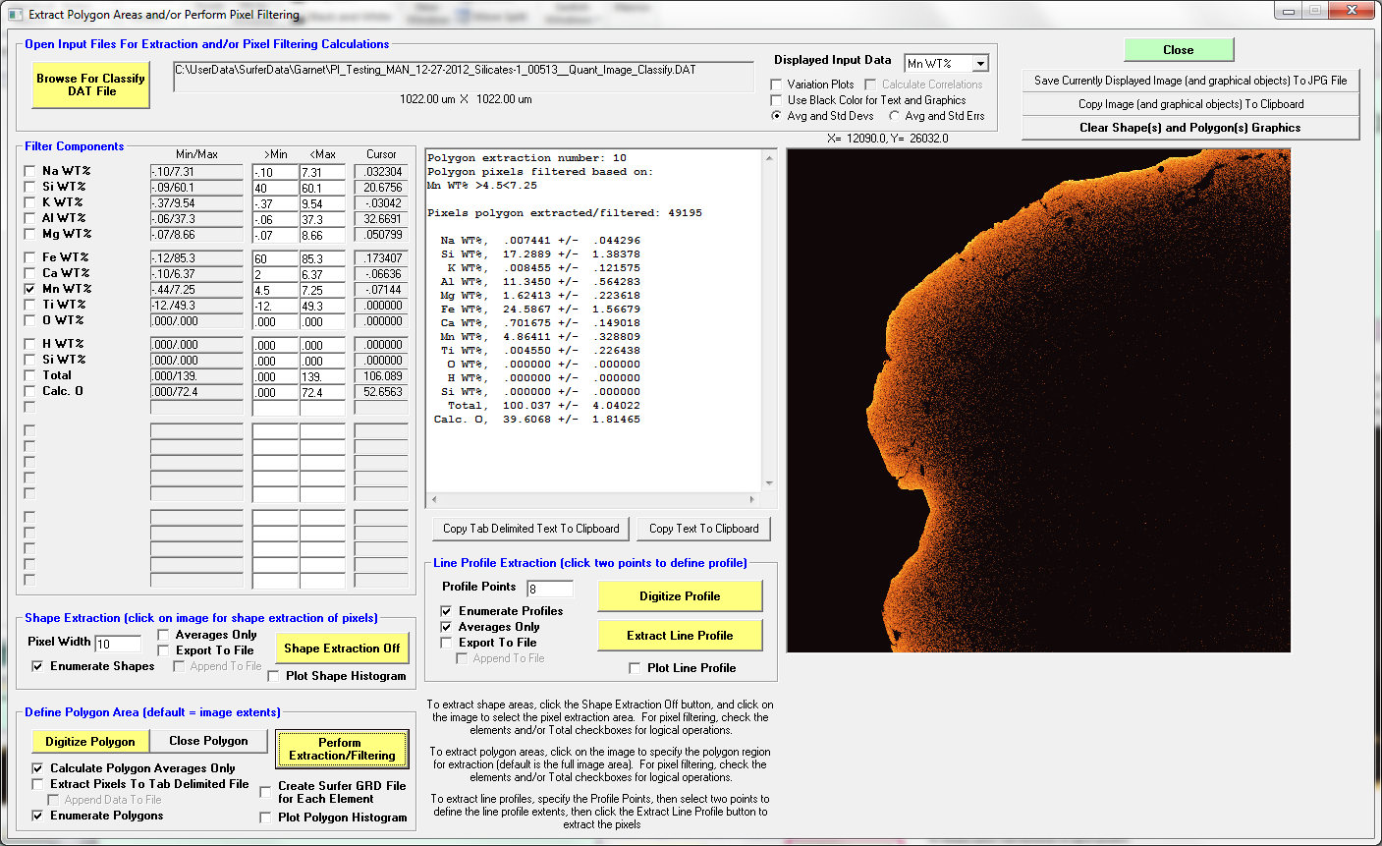
Now that we have quantitative data, let’s filter them spatially or by concentrations:

Slide 20
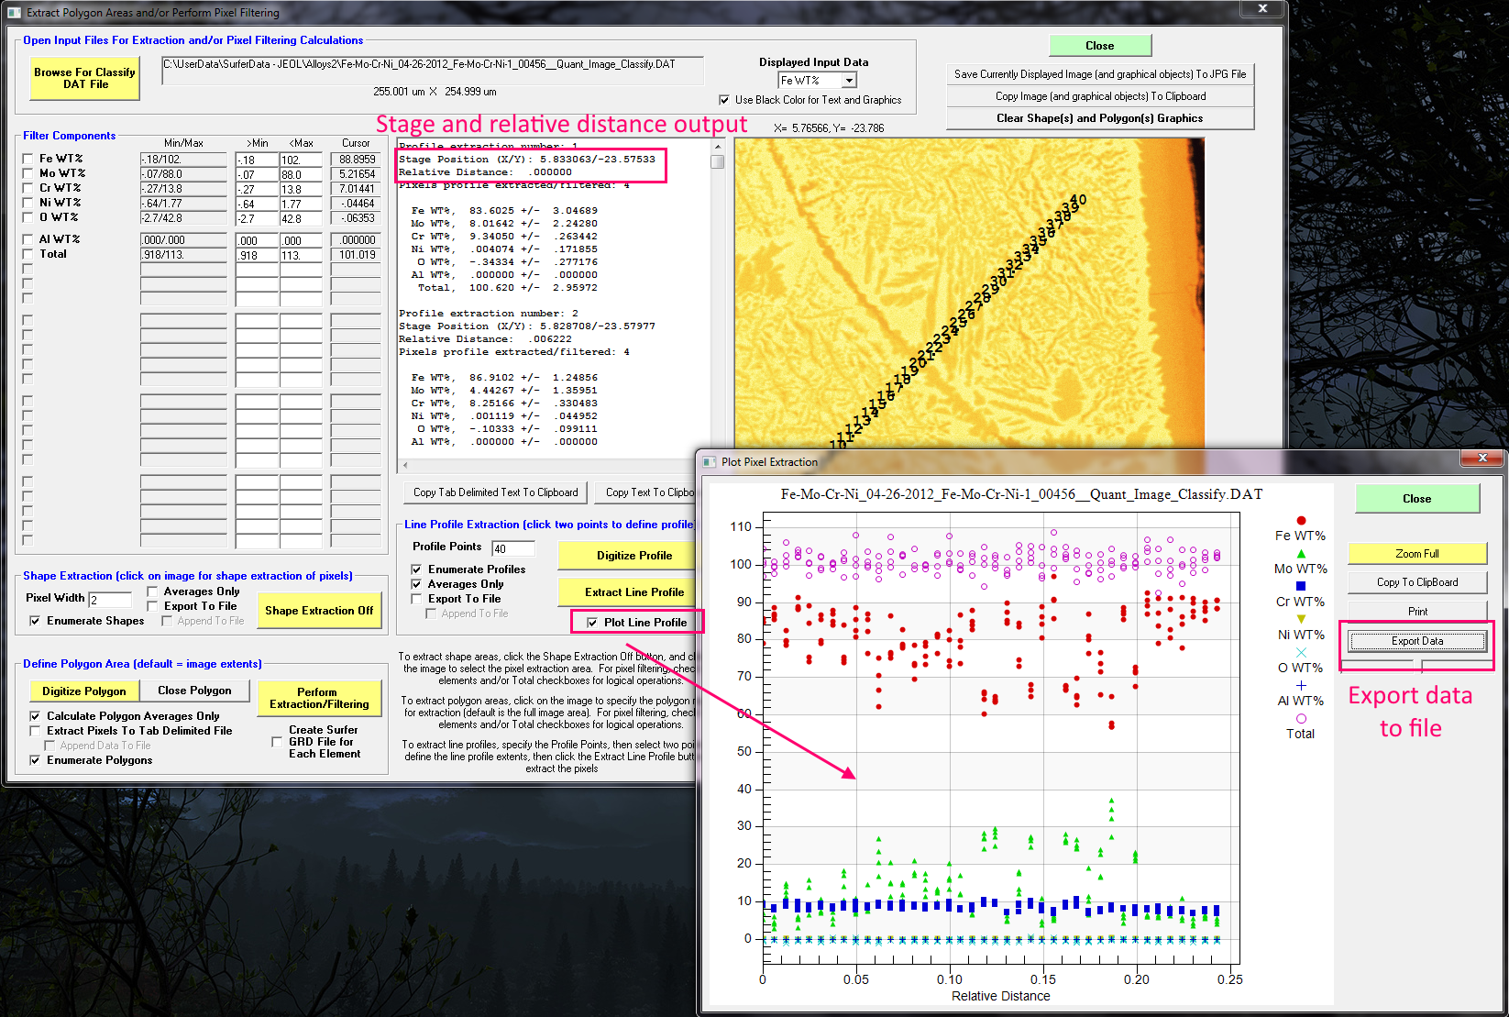
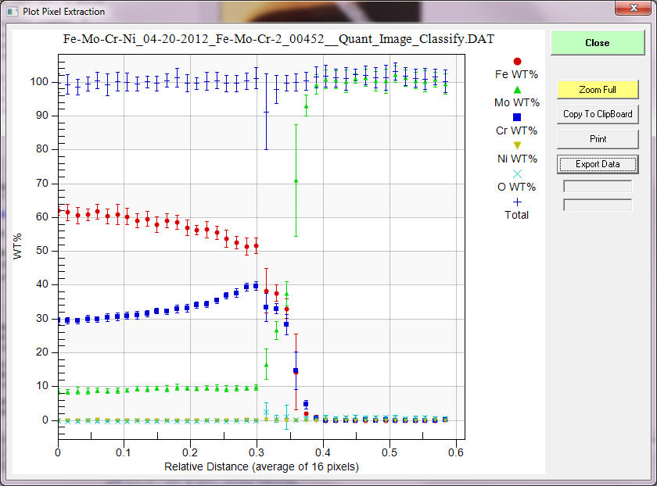
Or plot up our quantified pixels as profiles:

Slide 21
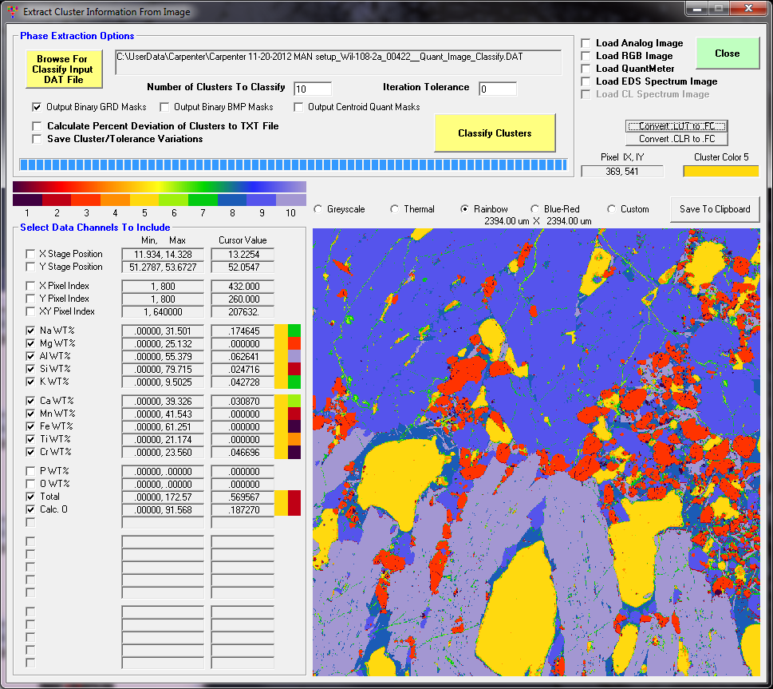
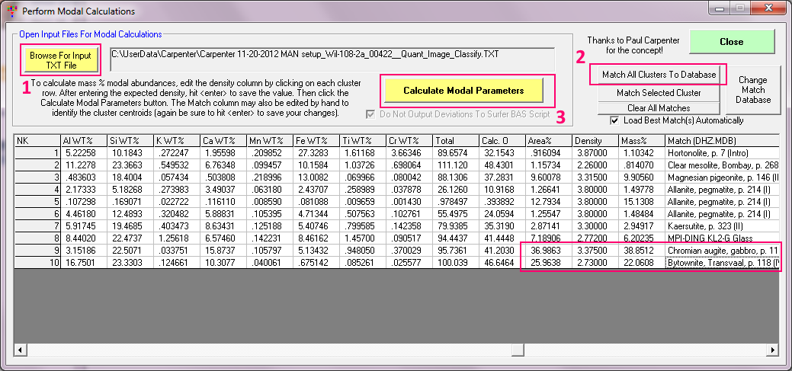
Modal Analysis/Classification
Classify by wt%, at%, oxide, formula, etc.

Slide 22
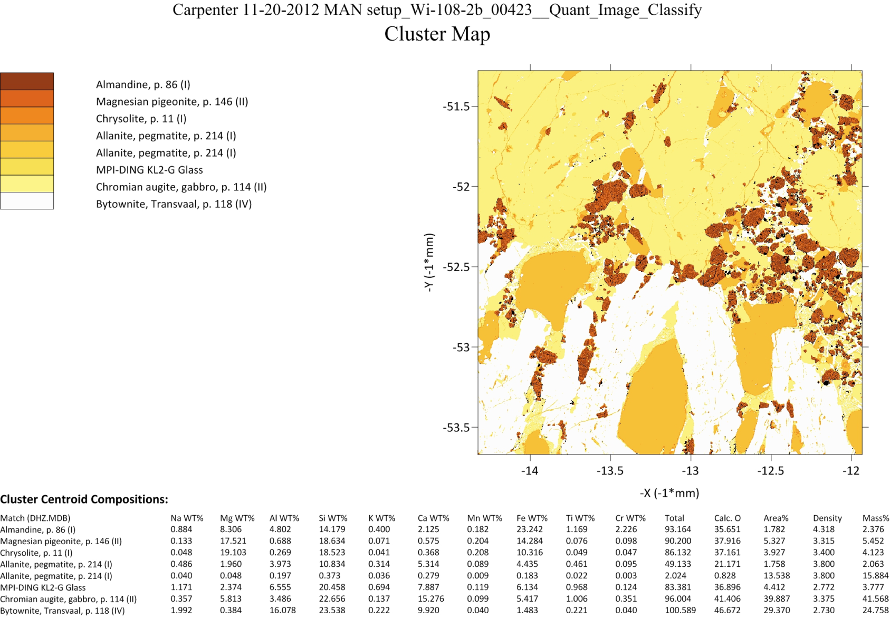
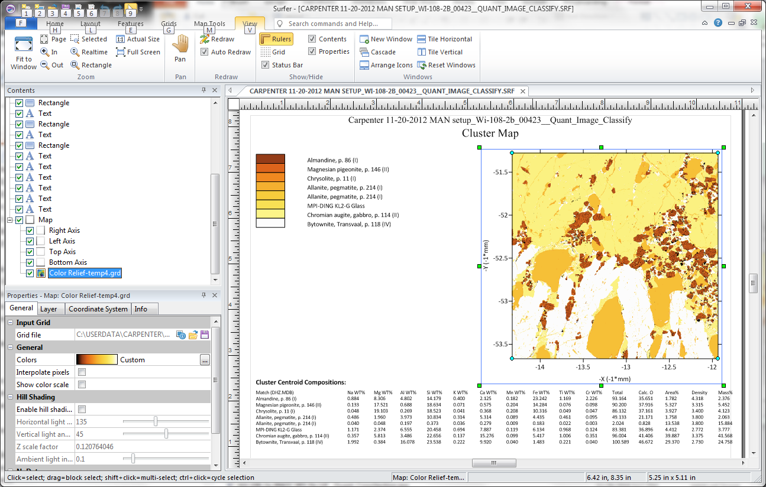
Output of quantitative classification results
We want to classify our compositions manually or automatically…
We want to automate scripting and customize our output…

Slide 23
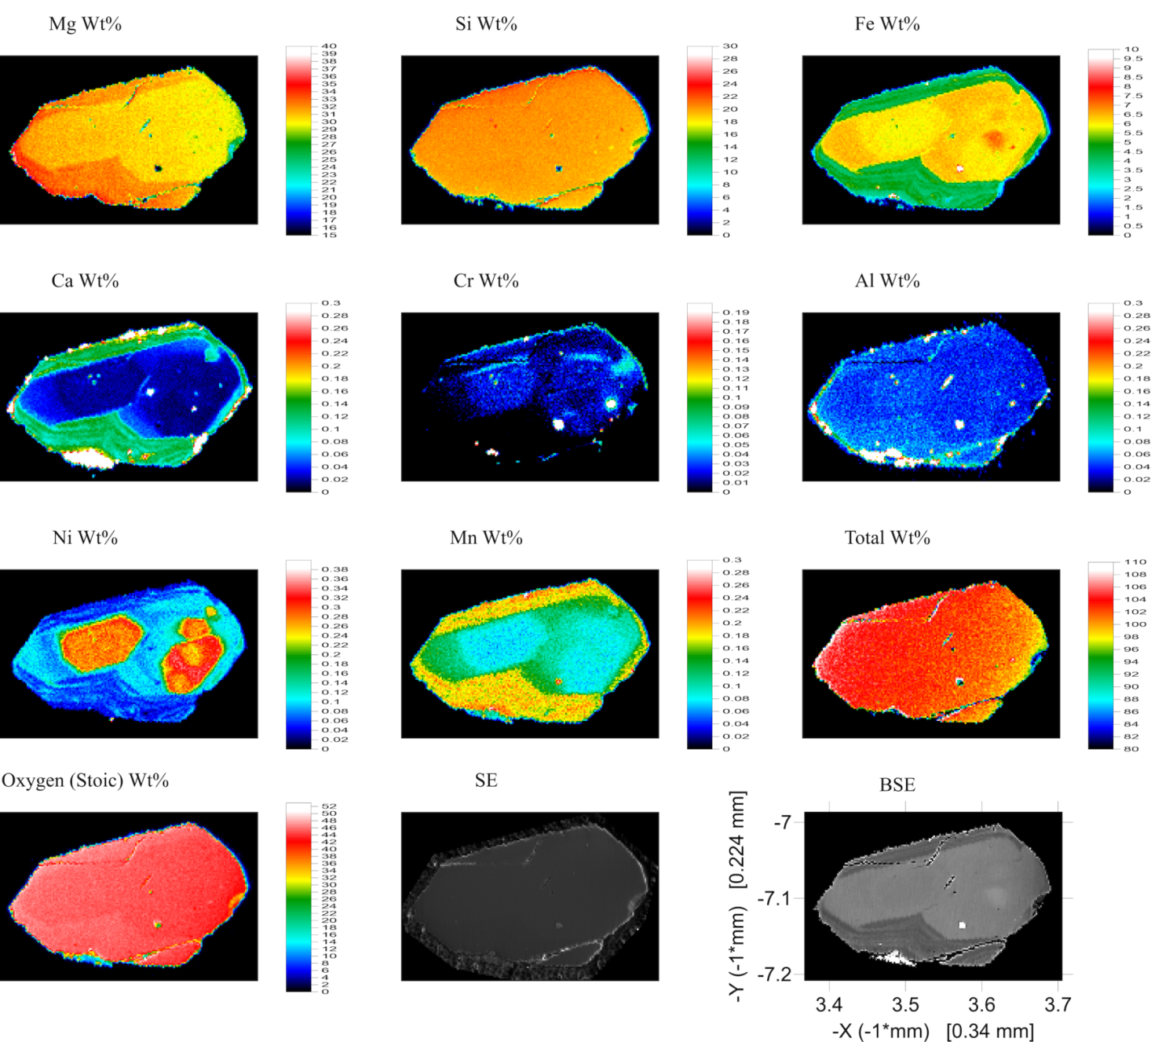
So let’s give our pixels some respect! They deserve to be treated just like points.
From Karsten Goemann

Slide 24
Conclusions
X-ray maps without quantification is as unscientific as attempting to evaluate raw intensities from point analyses, therefore…
Perform the same quantification to each pixel as we would each point analysis.
This includes deadtime, beam drift, standard intensity drift, background, matrix, spectral interferences and optionally TDI for sample sensitivity.
Extract information based on spatial and/or compositional relationships (manually or automatically).
Thank-you!

