Slide 1
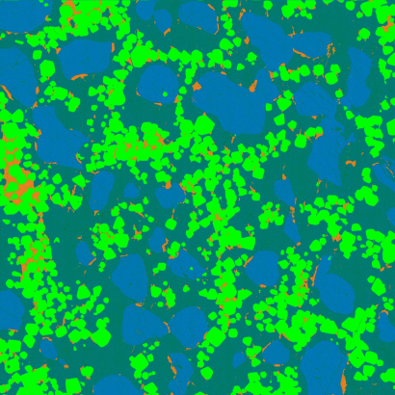

Quantitative WDS Compositional Mapping Using the Electron Microprobe http://www.minsocam.org/MSA/Ammin/AM_Preprints/7739DonovanPreprint.pdf
John J. Donovan¹, Julien M. Allaz², Anette von der Handt³, Gareth G. E. Seward⁴, Owen Neill⁵, Karsten Goemann⁶, Julie Chouinard¹ and Paul Carpenter⁷
1. CAMCOR, University of Oregon, Eugene, Oregon, 97403, USA
2. Institute of Geochemistry and Petrology, ETH Zürich, 8092 Zürich, Switzerland
3. Department of Earth Sciences, University of Minnesota, Minneapolis, MN 55455, USA
4. Department of Earth Science, University of California Santa Barbara, Santa Barbara, CA 93101, USA
5. Department of Earth and Environmental Sciences, University of Michigan, Ann Arbor, MI 48013, USA
6. Central Science Laboratory, University of Tasmania, Hobart, Tasmania 7001, Australia
7. Department of Earth and Planetary Sciences, Washington University in St. Louis, One Brookings Drive, St. Louis, Missouri, 63130 USA

Slide 2
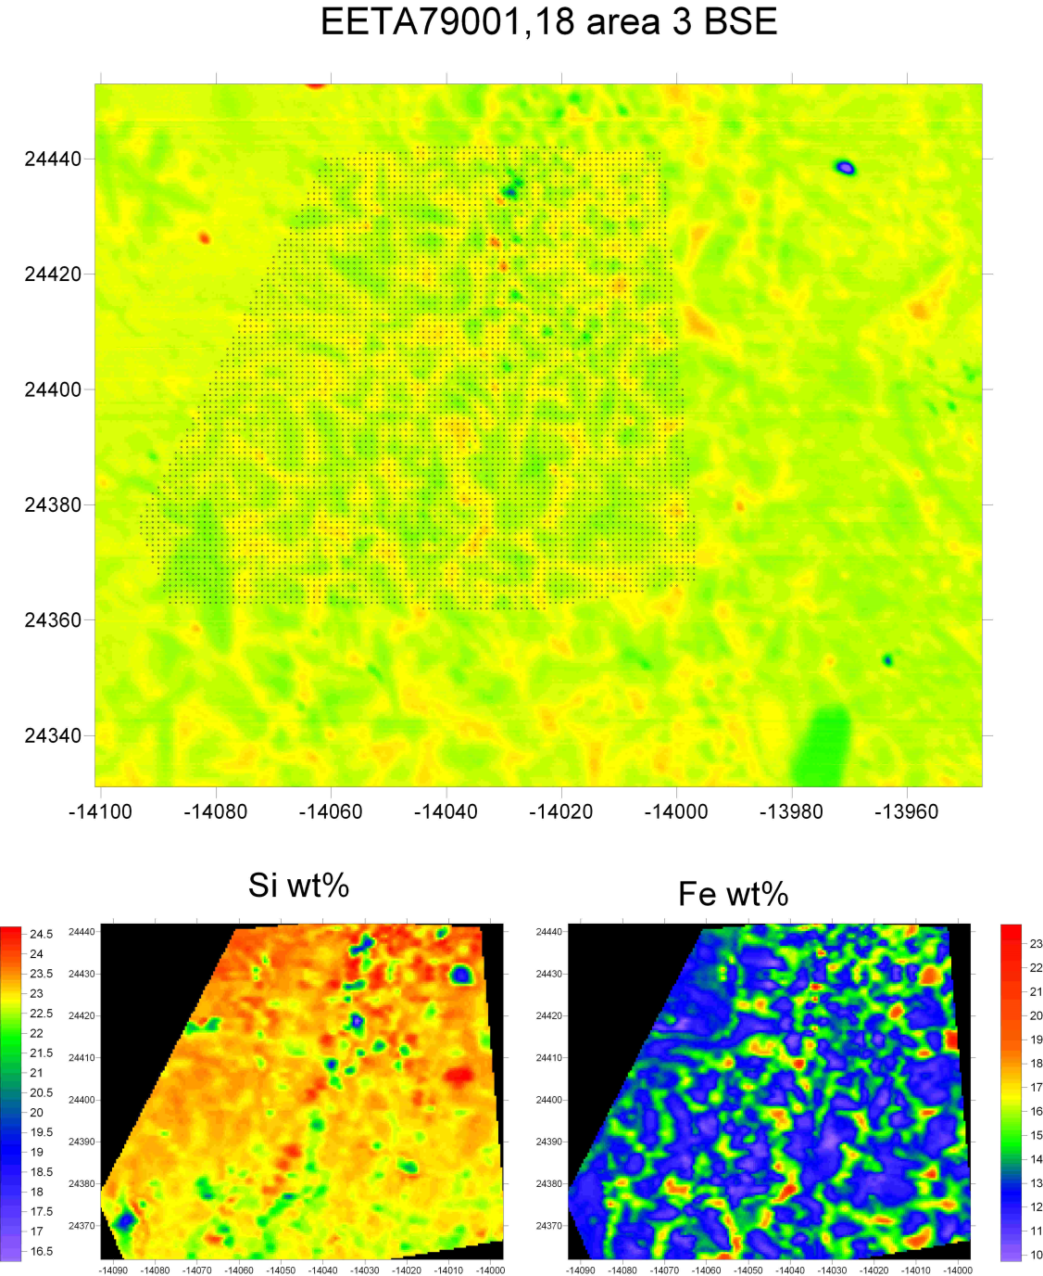
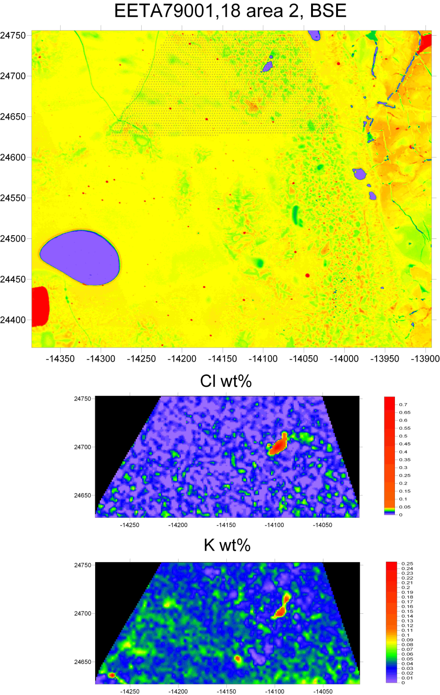
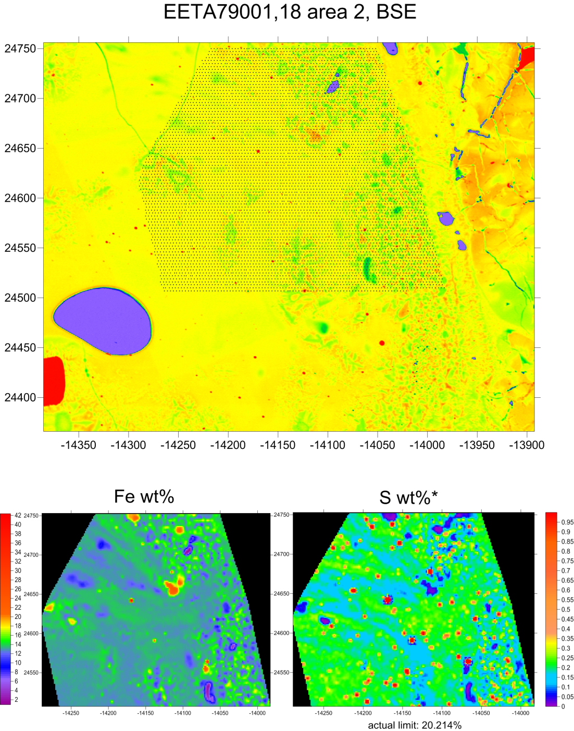
Single point mapping
Circa 2011, Vicenzi and Donovan

Slide 3
Why Quantify?
Point Analyses: Raw Intensities
ELEM: na ka si ka k ka al ka mg ka fe ka ca ka
227G 11.4 10334.7 -5.8 31.2 3903.3 8.2 9616.8
228G 12.7 10353.6 -7.0 33.2 3935.6 10.1 9645.1
229G 11.1 10337.8 -1.4 28.5 3916.5 9.6 9563.8
230G 10.5 10384.0 2.0 25.1 3938.1 10.4 9580.3
AVER: 11.4 10352.5 -3.1 29.5 3923.4 9.6 9601.5
SDEV: .9 22.5 4.1 3.5 16.5 1.0 36.5
Point Analyses: Concentrations
ELEM: Na2O SiO2 K2O Al2O3 MgO FeO CaO SUM
227 -.008 55.982 -.016 .019 18.707 .012 26.182 100.827
228 .002 56.108 -.019 .028 18.860 .062 26.262 101.105
229 -.010 55.992 -.004 .006 18.749 .048 26.042 100.593
230 -.015 56.269 .005 -.009 18.877 .070 26.084 101.218
AVER: -.008 56.088 -.008 .011 18.798 .048 26.142 100.936
SDEV: .007 .134 .011 .016 .083 .025 .099 .281

Slide 4
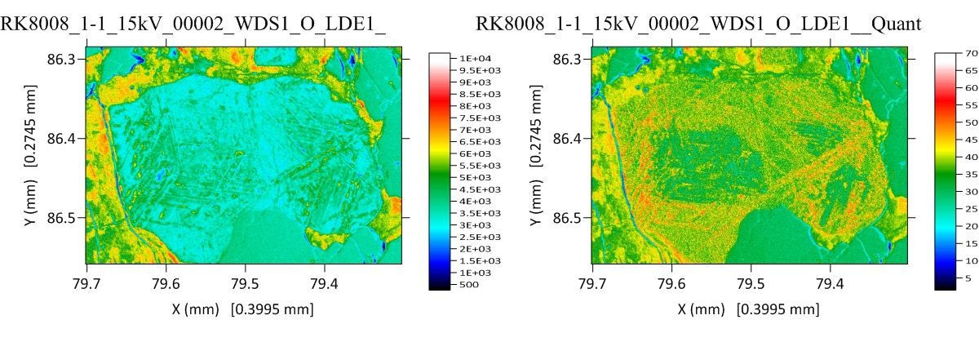
Raw data (left) vs. Quantified data (right)
Oxygen maps of Fe-Ti oxide from von der Handt

Slide 5
Why WDS Quantitative Compositional Mapping?
We want spatial concentration data in image format (WYSIWYG)
  Zoning, solid solutions, complex samples with multiple phases
  Variable chemistry at constant avg-Z (no BSE contrast)
Emitted intensities do not represent concentration, C = k * ZAF
  Average Z affects zero intensity, matrix affects major element intensities
  Spectral interferences affects trace and minor elements
Detection limits in x-ray intensity maps is ~ C/ZAF
  Spectrometer, crystal, standard and phase dependent
SEM-EDS mapping: Spectrum imaging is an excellent tool
  SDD throughput, but P/B issues for light elements, traces
EPMA-WDS: WDS multiple serial spectrometer passes combined in quant
  Excellent P/B, use stage mapping to avoid Bragg defocus, beam damage (use TDI)

Slide 6
Fully Quantitative Pixels
Pec et al, 2015;
Pec et al, in review
From von der Handt

Slide 7
Calibration Curve?
Works quite well for single phase x-ray maps, but then why bother mapping?
Traces? But without a background correction, what’s the point?
The physics of electron solid interactions tells us:
  In multi-phase materials, every phase (with a different average Z) will produce a different intensity for a zero concentration (Kramer’s law).
  Also the same concentration will produce a different intensities in different phases, i.e., different ZAF or φ(ρz) matrix physics.
  Likewise, the same intensity in different phases can represent different concentrations, again, different ZAF or φ(ρz).

Slide 8
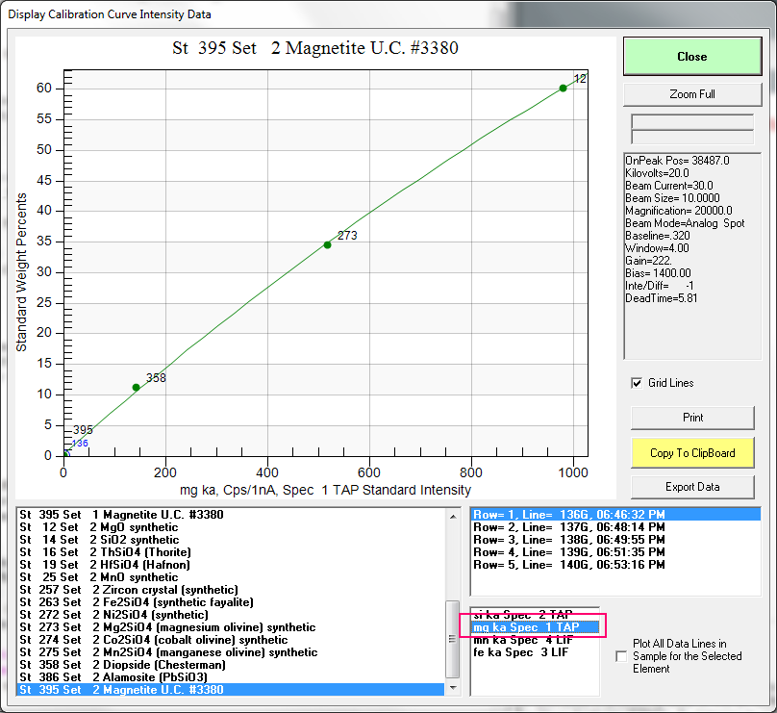
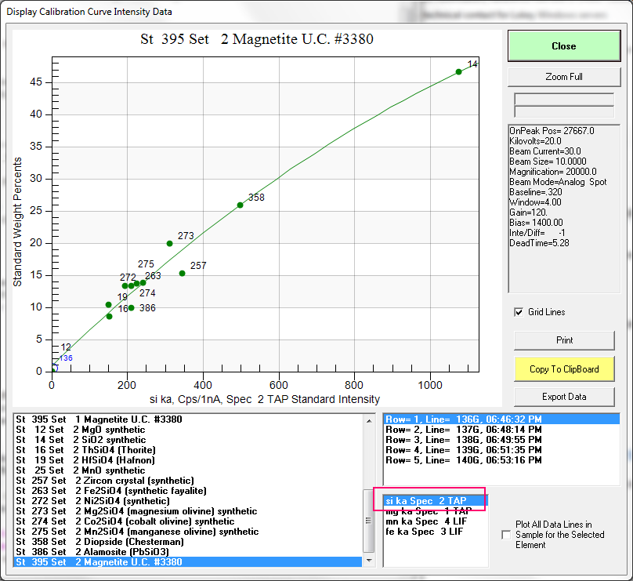
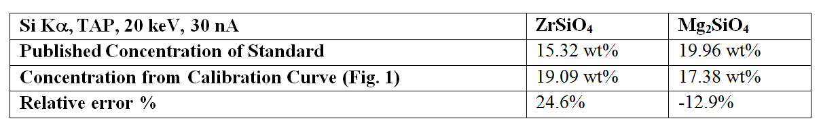
Calibration curves and accuracy (or lack thereof)

Slide 9
St 257 Set 2 Zircon crystal (synthetic), Results in Elemental Weight Percents
ELEM: Si Mg Mn Fe Th Hf Pb Co Ni Zr Al Ca Ti O
TYPE: ANAL ANAL ANAL ANAL SPEC SPEC SPEC SPEC SPEC SPEC SPEC SPEC SPEC SPEC
BGDS: MAN MAN MAN MAN
TIME: 60.00 60.00 60.00 60.00 --- --- --- --- --- --- --- --- --- ---
BEAM: 30.13 30.13 30.13 30.13 --- --- --- --- --- --- --- --- --- ---
ELEM: Si Mg Mn Fe Th Hf Pb Co Ni Zr Al Ca Ti O SUM
96 19.071 .480 .045 .058 .000 .000 .000 .000 .000 49.764 .000 .000 .000 34.913 104.331
97 19.131 .480 .048 .052 .000 .000 .000 .000 .000 49.764 .000 .000 .000 34.913 104.388
98 19.082 .480 .036 .059 .000 .000 .000 .000 .000 49.764 .000 .000 .000 34.913 104.334
99 19.065 .478 .046 .055 .000 .000 .000 .000 .000 49.764 .000 .000 .000 34.913 104.321
100 19.075 .478 .044 .058 .000 .000 .000 .000 .000 49.764 .000 .000 .000 34.913 104.333
AVER: 19.085 .479 .044 .057 .000 .000 .000 .000 .000 49.764 .000 .000 .000 34.913 104.342
SDEV: .027 .001 .004 .003 .000 .000 .000 .000 .000 .000 .000 .000 .000 .000 .027
SERR: .012 .001 .002 .001 .000 .000 .000 .000 .000 .000 .000 .000 .000 .000
%RSD: .14 .27 10.17 5.09 .00 .00 .00 .00 .00 .00 .00 .00 .00 .00
PUBL: 15.323 n.a. n.a. n.a. n.a. n.a. n.a. n.a. n.a. 49.764 n.a. n.a. n.a. 34.913 100.000
%VAR: 24.55 --- --- --- --- --- --- --- --- .00 --- --- --- .00
DIFF: 3.762 --- --- --- --- --- --- --- --- .000 --- --- --- .000
Calibration curve methods are simply not accurate!

Slide 10
Solution: Treat Pixels as Points
Normalization for integration time
Normalization for beam current
Deadtime corrections
Beam drift corrections
Standard intensity drift corrections
Background corrections
Matrix corrections
Spectral interference corrections
Optionally, area peak factor corrections (APF) for light elements, and time dependent intensity (TDI) corrections for beam sensitive samples

Slide 11
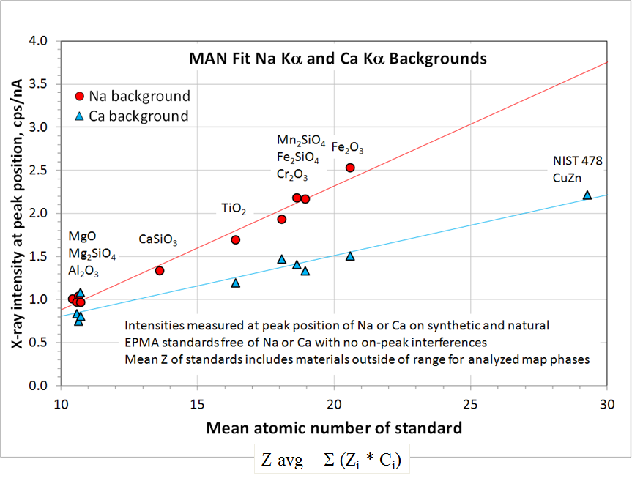
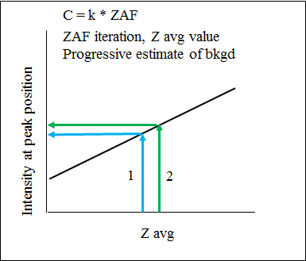
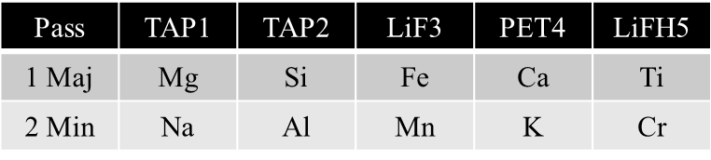
Typical EPMA quantitative mapping procedure
Setup/Calibration
Standardization in Probe for EPMA
Off-Peak or Mean Atomic Number (MAN) bgds
WDS stage mapping (fixed beam) or beam scanning
Probe Image or JEOL/Cameca software
Multiple pass WDS mapping
4-18 hours per map, various resolutions
Quant correction of x-ray maps
CalcImage (stds + maps = quant maps)
Full Φ(ρz) correction each pixel
1024 x 1024 map req. ~ 5-7 hr
Data visualization
Surfer for contouring of data
Data processing
Surfer BASIC scripts
Quant, polygon, line, strip, modal, etc. (CalcImage)
Matlab: generate quantitative .tif images
Cluster analysis
ImageJ Xlib plug-in (Beat, Cluster image)
ENVI / IDL
Example Multiple Pass WDS Setup

Slide 12
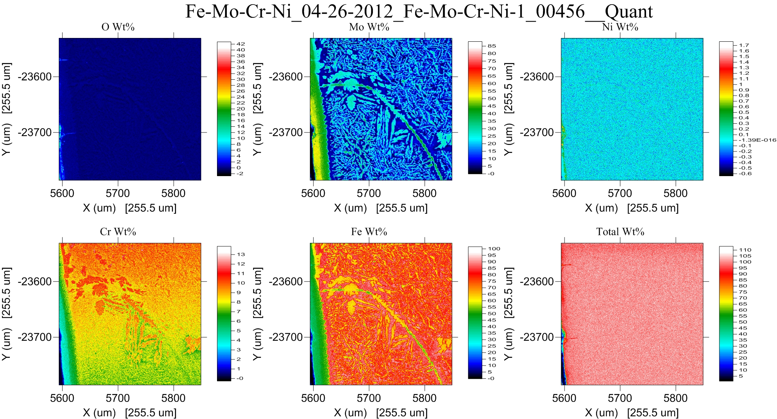
Quantitative Mapping of Multi-Phase materials with *totals*
Yes, we need a “totals” map, just as for point analyses!

Slide 13
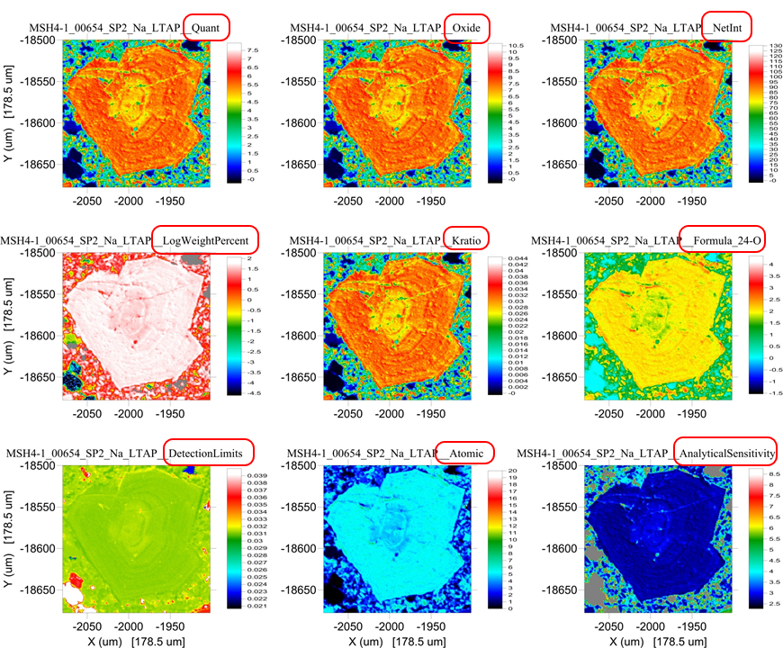
Now that we’re quantitative, let’s see all the data types, just as we do for point analyses

Slide 14
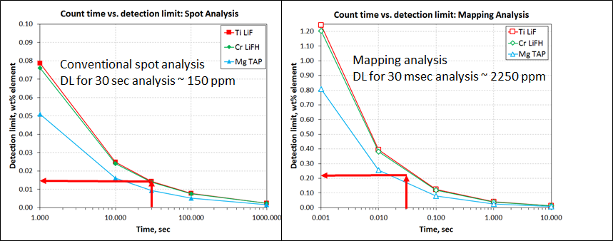
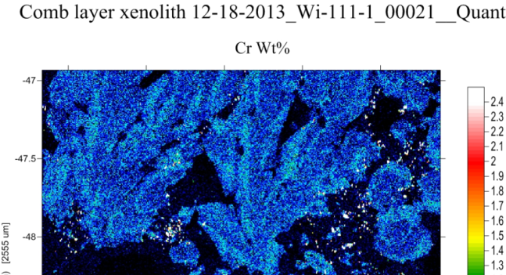
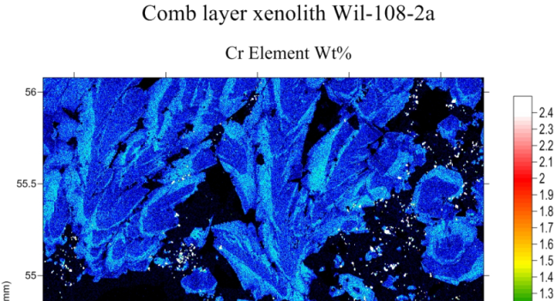
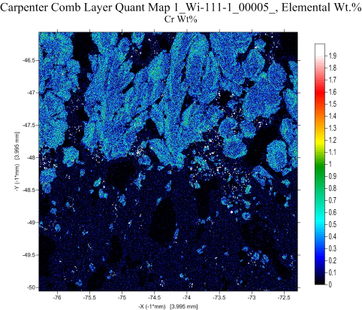
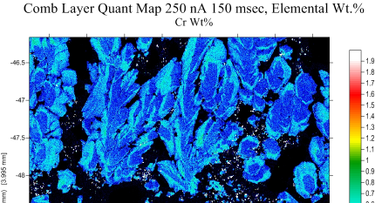
Detection limit vs. analytical conditions
Cr LiF 512x512, 50 nA 100 msec
Cr LiFH 800x800, 100 nA 50 msec
Cr LiF 800x800, 100 nA 50 msec
Cr LiF 800x800, 250 nA 150 msec
Detection Limit
Conventional spot analysis comparatively high precision
10 nA, 100 sec
Dose equivalent = 10³ nA-sec
Mapping analysis significantly lower precision per pixel
100 nA, 100 msec/pixel
Dose equivalent = 10¹ nA-sec
Compared to point analyses:
Lower dose by factor of ~100 (time and current scale)
But detection limit is only lower by factor of ~30
DL 0.33 %
DL 0.12 %
Analytical Conditions
Probe current and count time scale equivalently
Increase in probe current offsets shorter count time
Spectrometer and crystal selection important
Compare LiF vs LiFH-type spectrometer
Note visual sensitivity and detection limit for Cr
Accuracy is same for points or pixels!

Slide 15
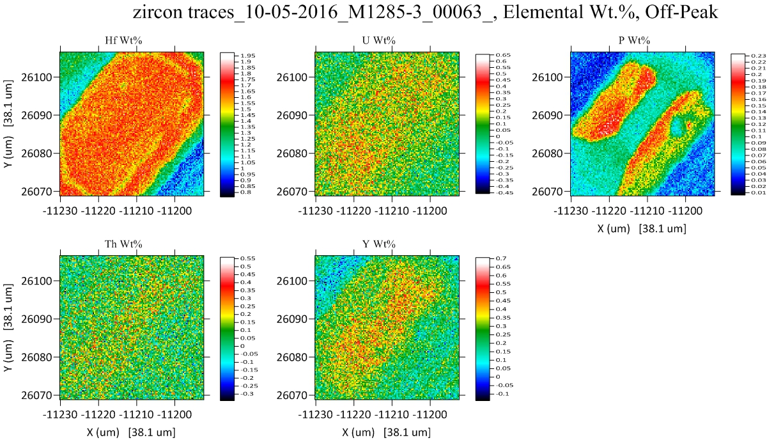
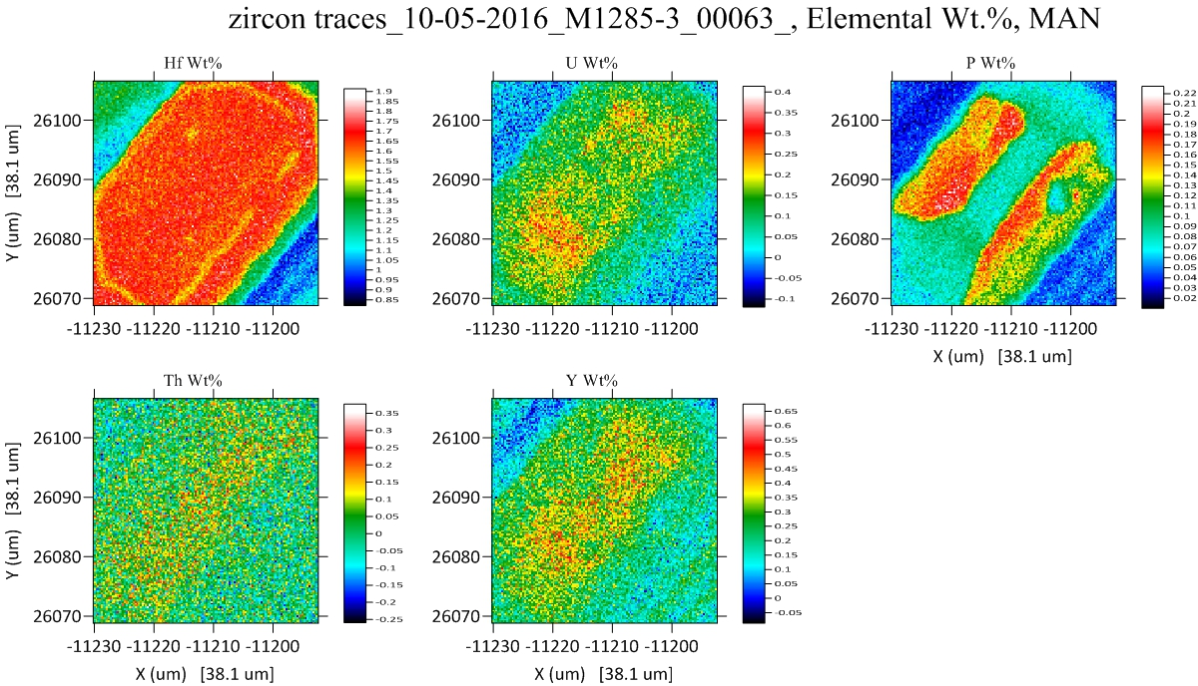
Off-Peak
MAN
1/2 acquisition time
40% better sensitivity
Donovan, Singer and Armstrong, Amer. Min., 2016

Slide 16
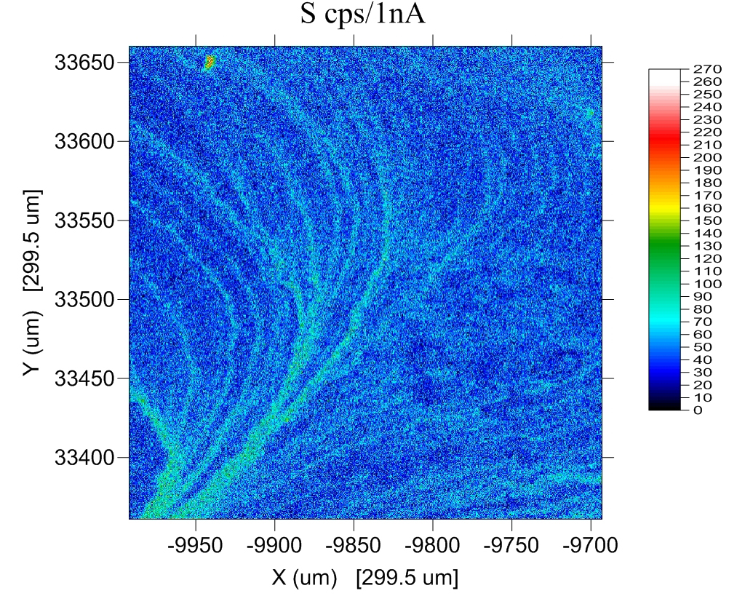
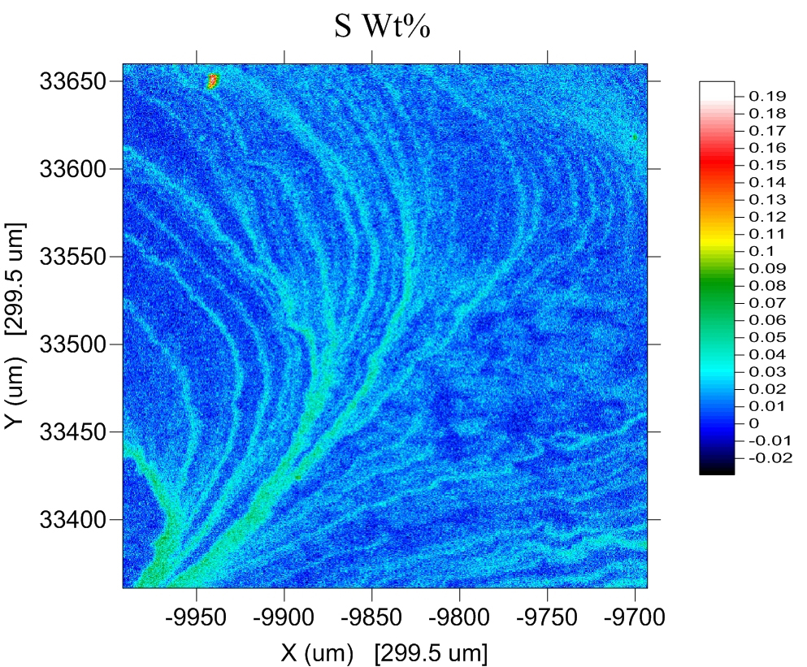
Intensity aggregation from multiple spectrometers
Single spectrometer
(raw data)
Multiple spectrometers
(quantitative)
From Mcfadden, University of Adelaide

Slide 17
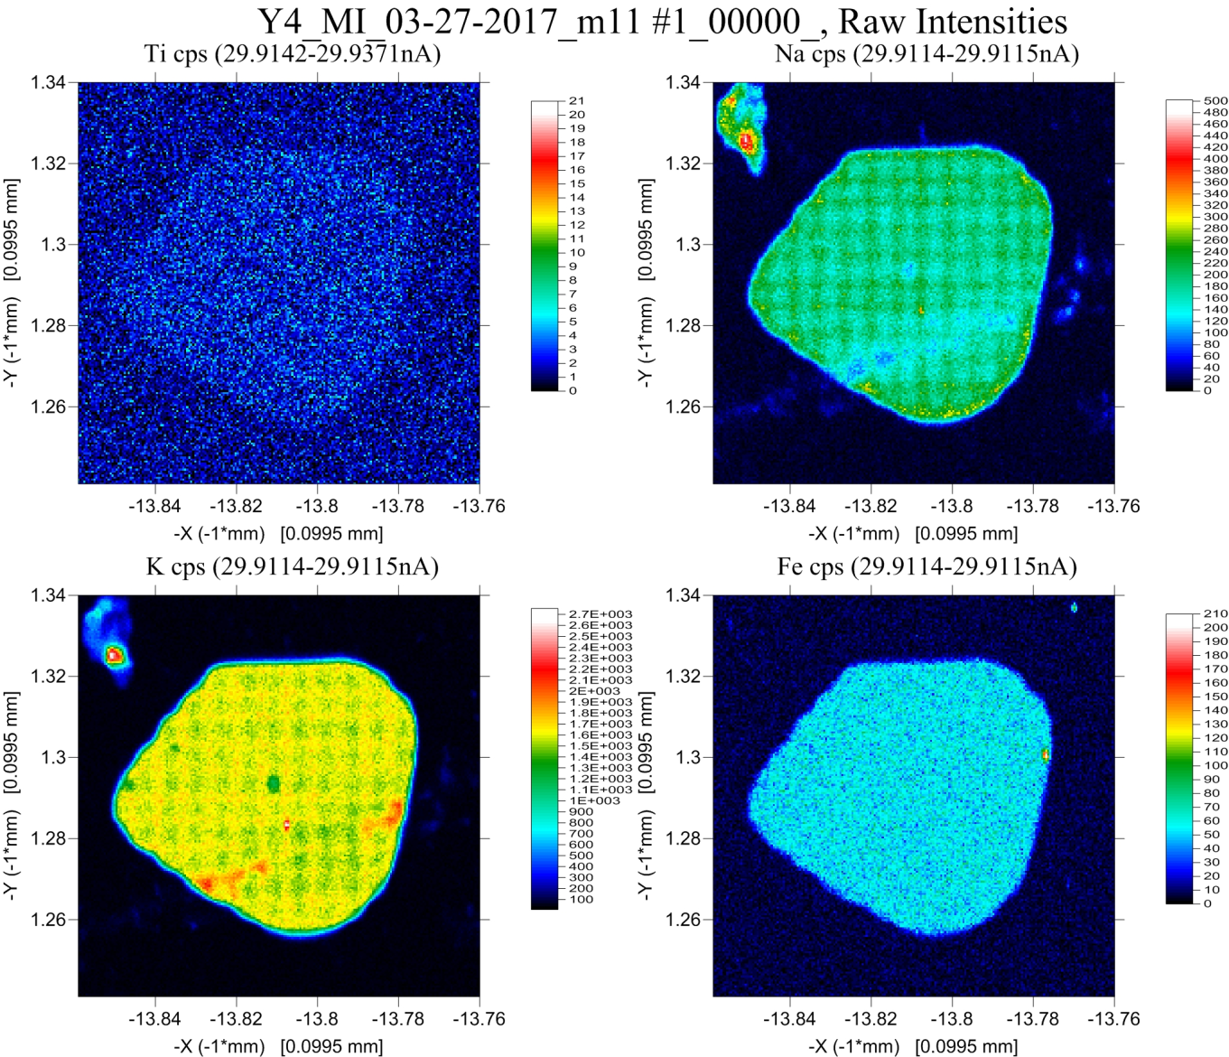
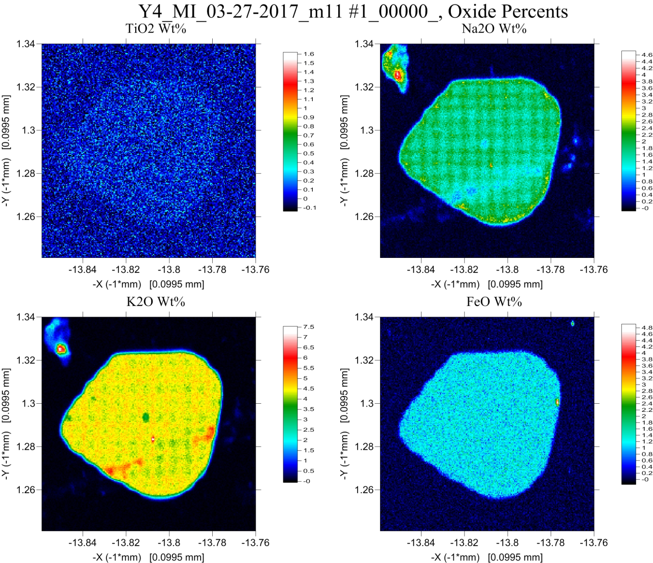
Time Dependent Intensity (TDI) Corrections for Beam Sensitive Samples
Raw Intensities
Oxide Quant (without TDI Correction)

Slide 18
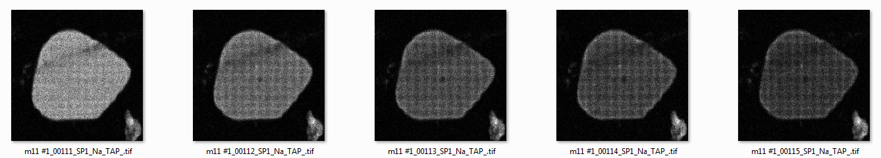
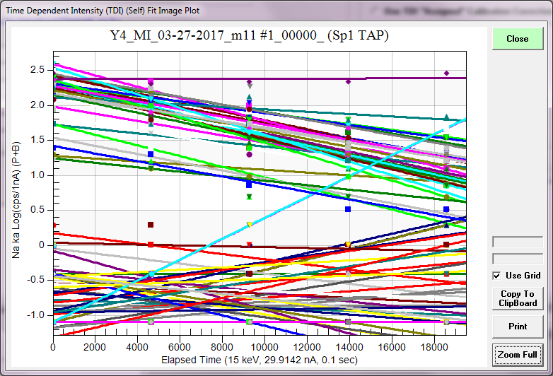
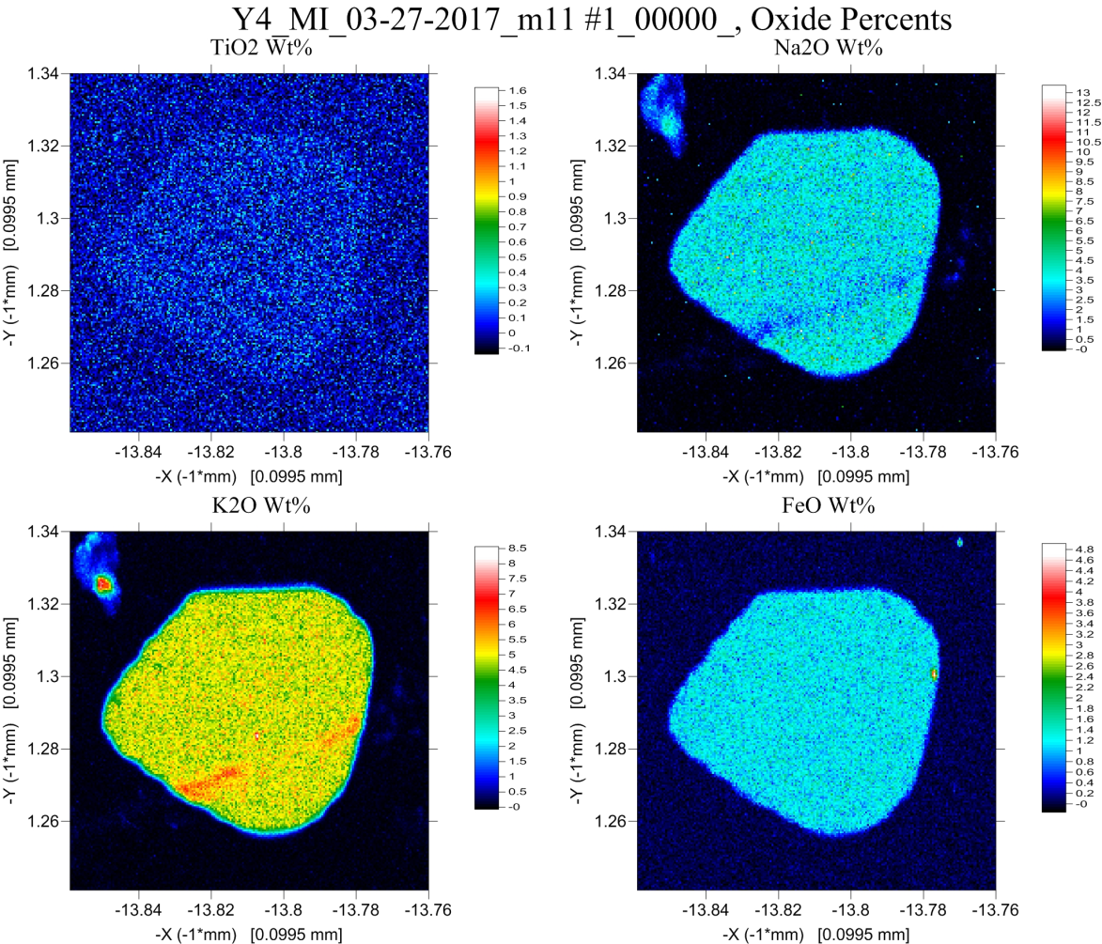
Na Intensities 100 msec pixel dwell time (5 frames)
Quant Oxide *with* TDI Correction)

Slide 19
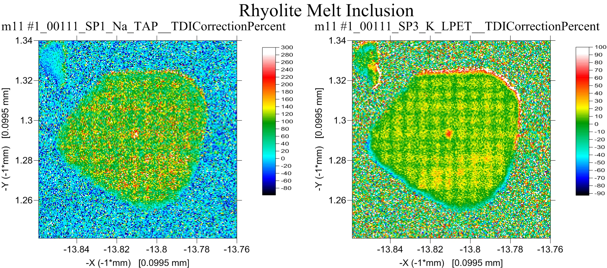
TDI Correction in Relative Percent

Slide 20
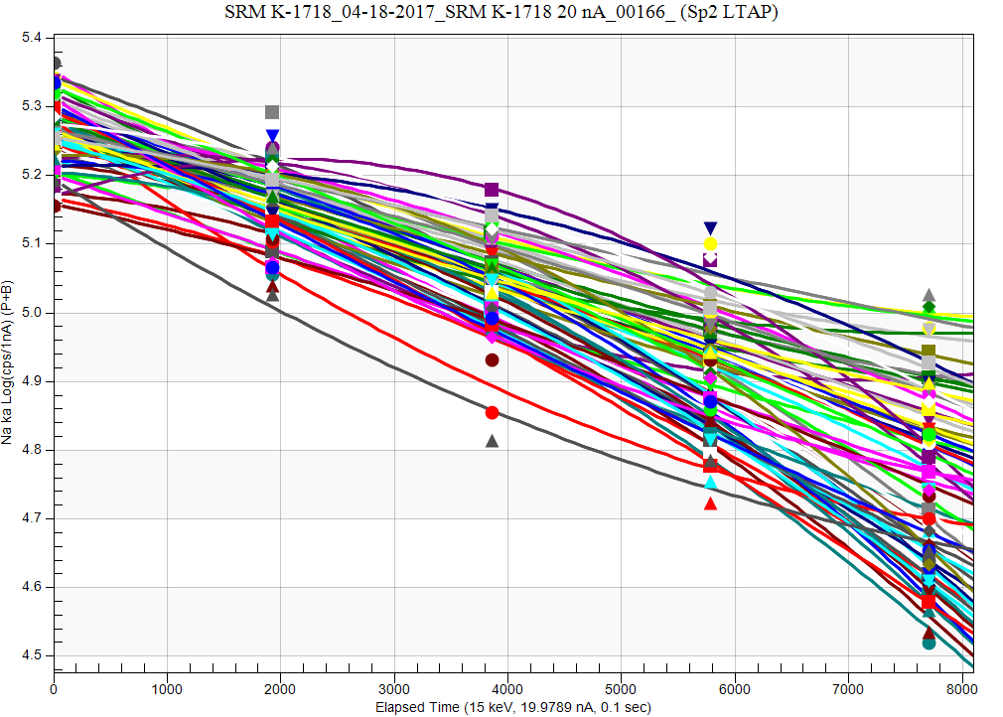
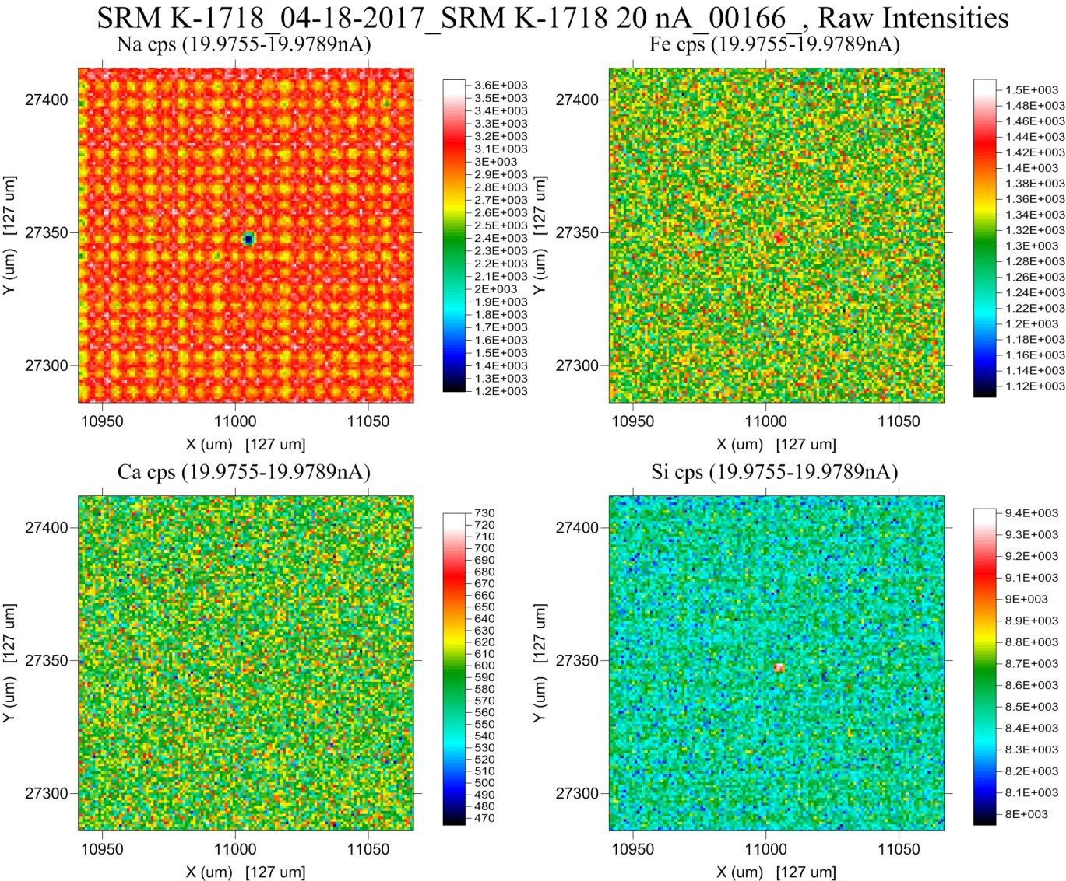
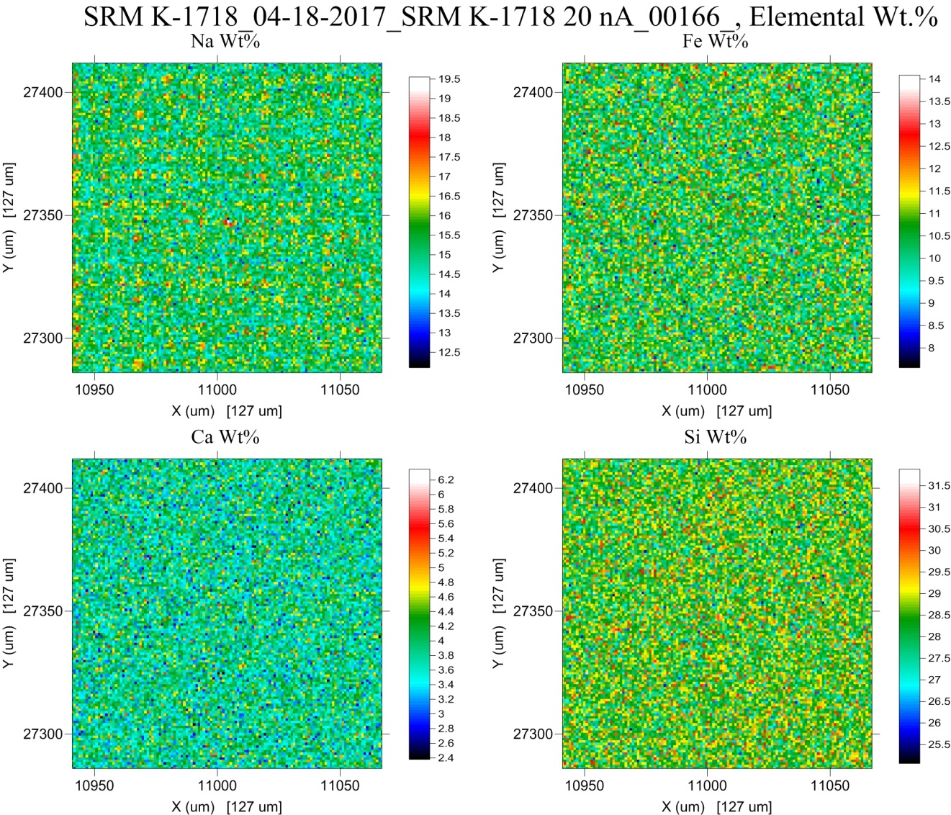
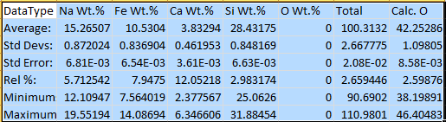

Slide 21
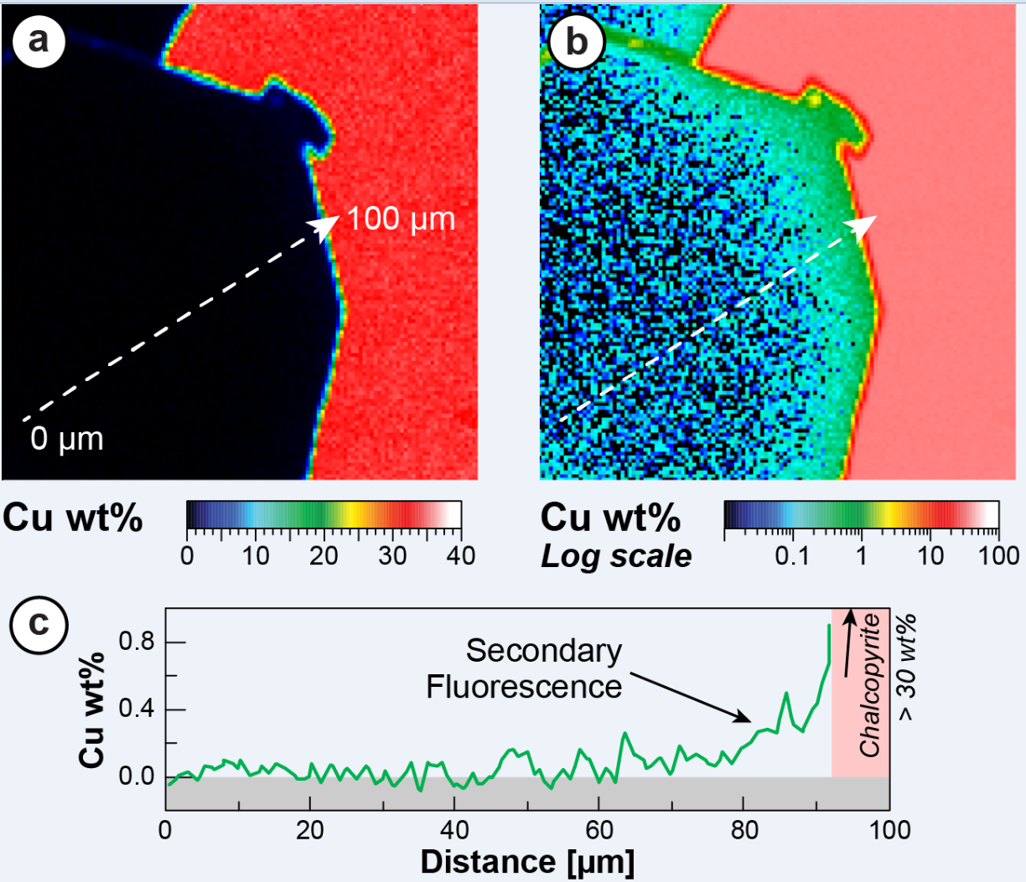
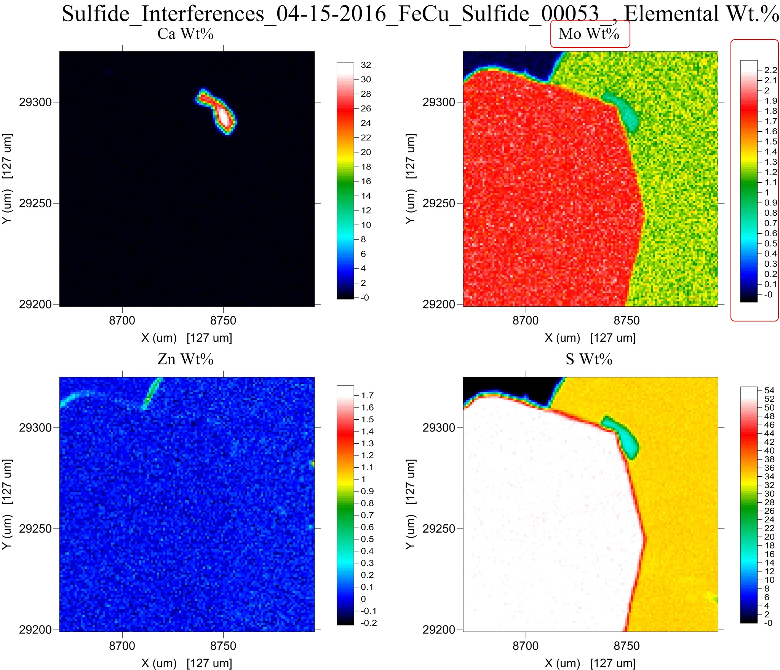
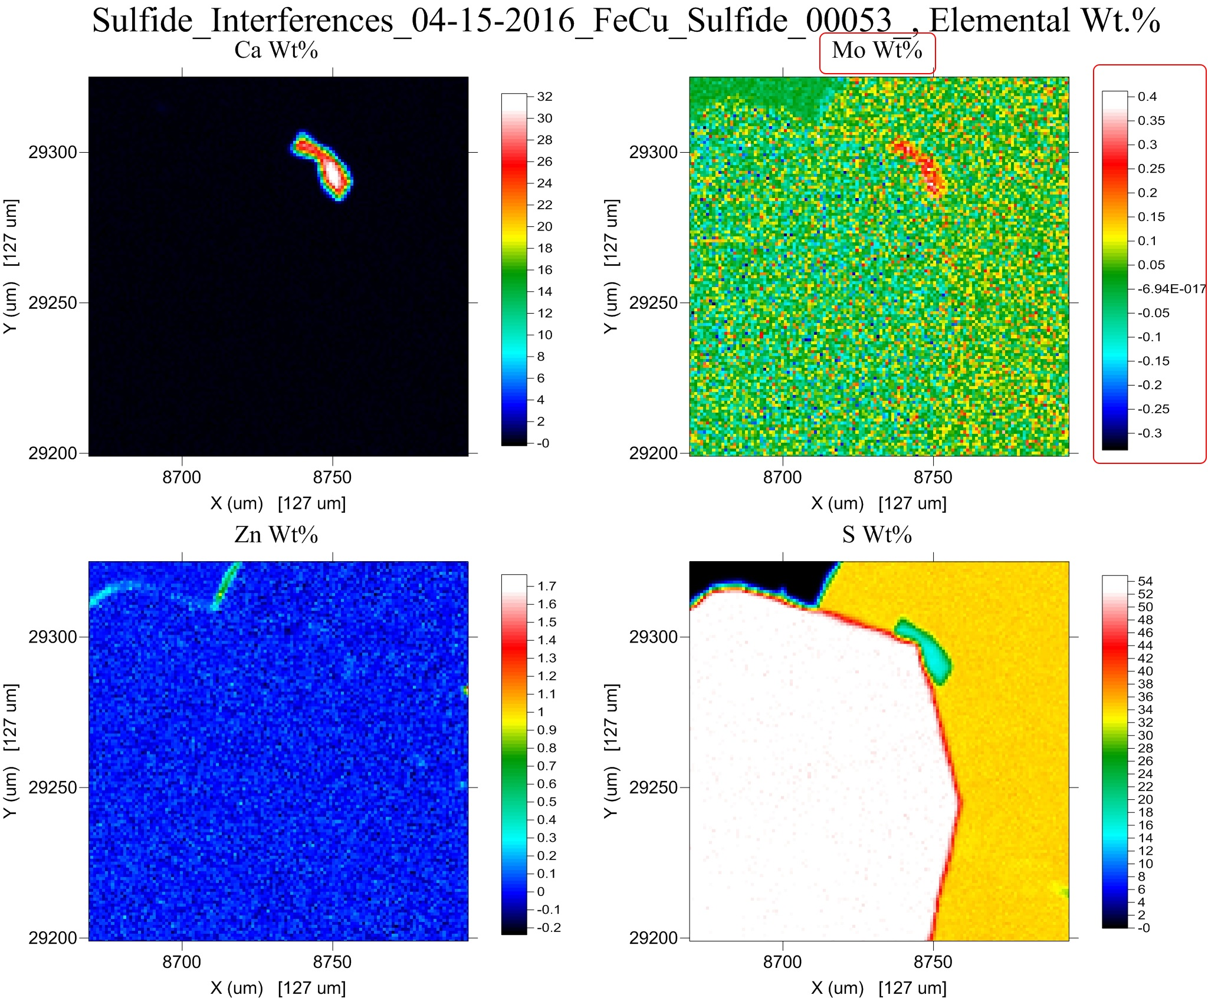
Quantitative Spectral Interference Corrections
w/o interference correction
w/ interference correction
Mo concentrations in the two phases are statistically similar

Slide 22
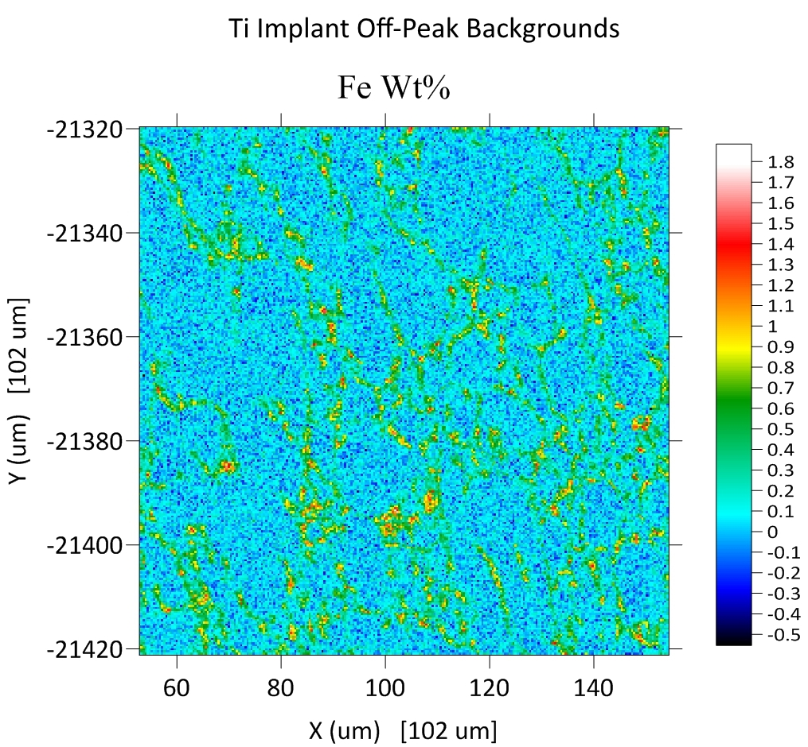
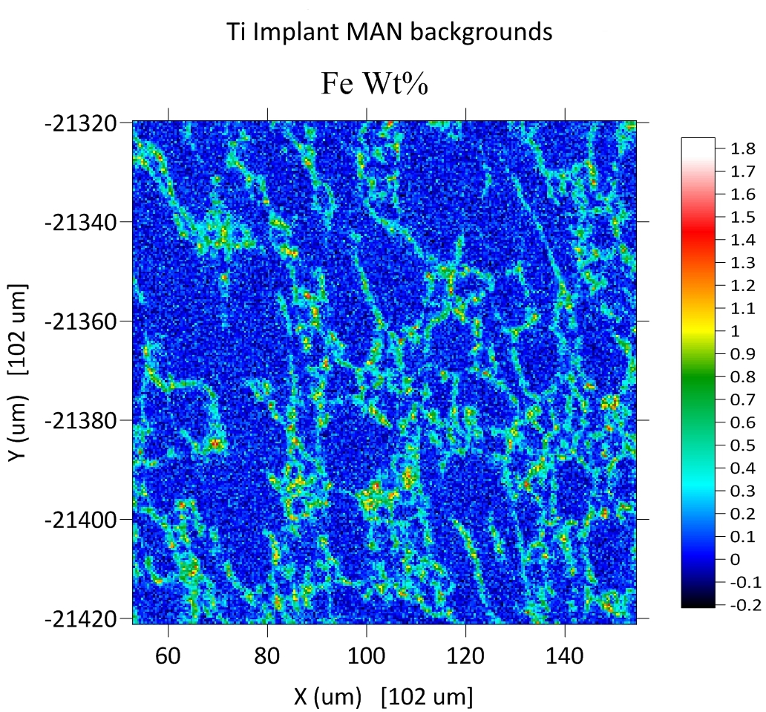
Color palettes and scaling effects

Slide 23
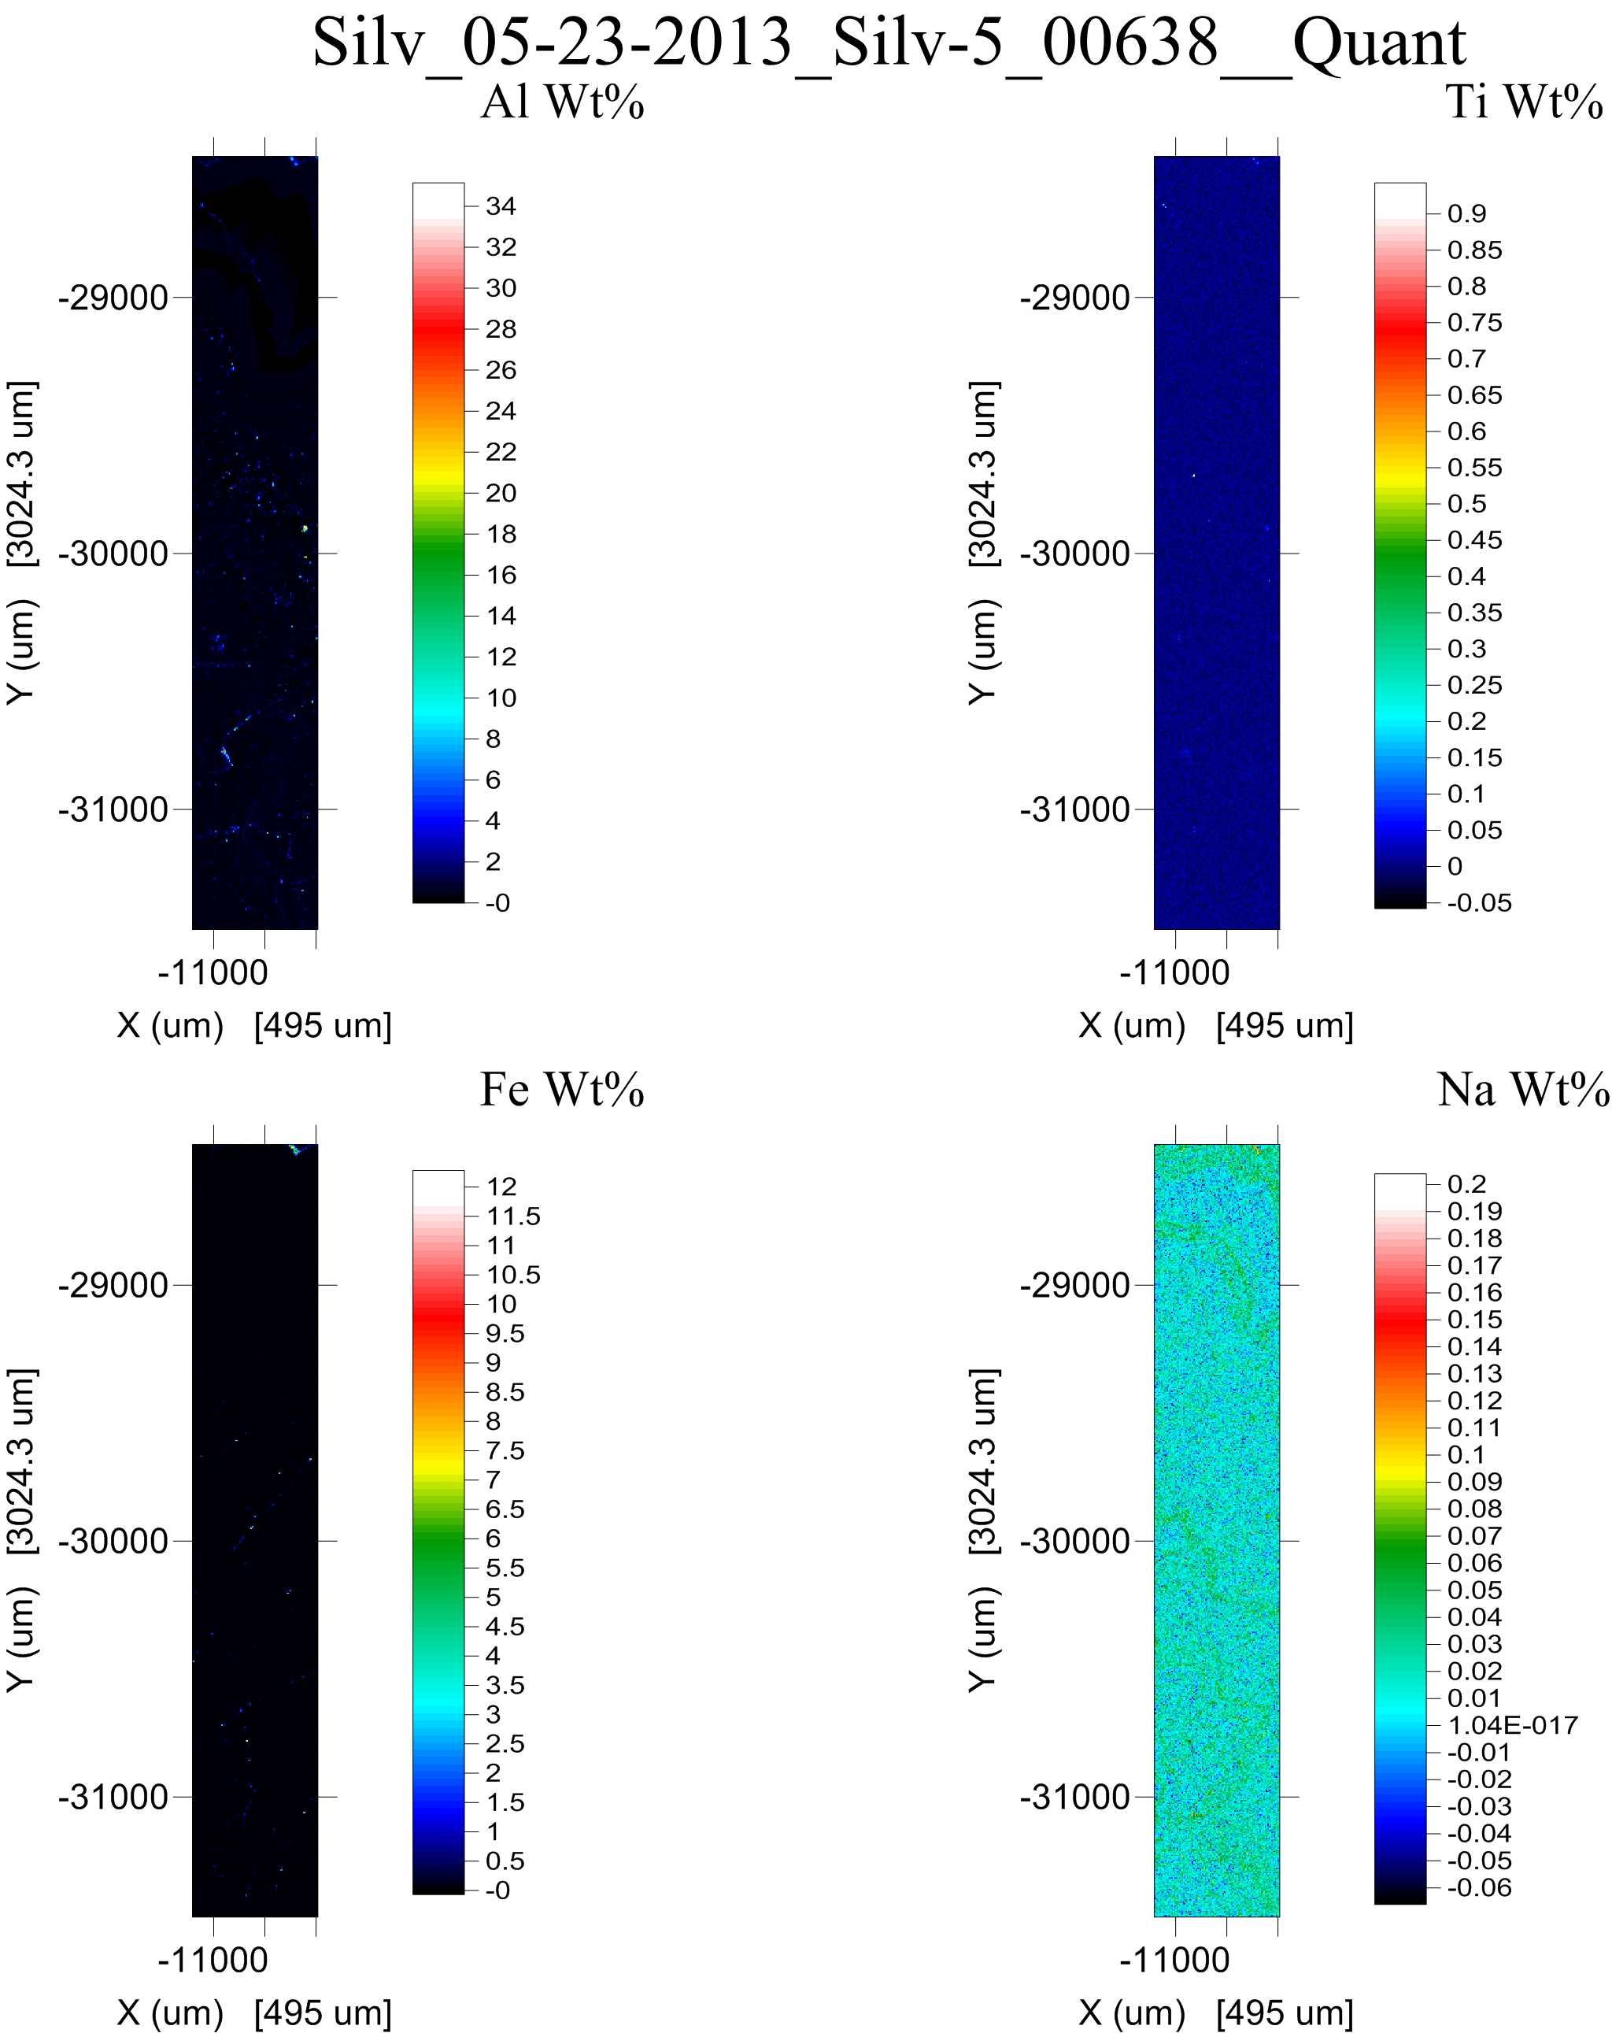
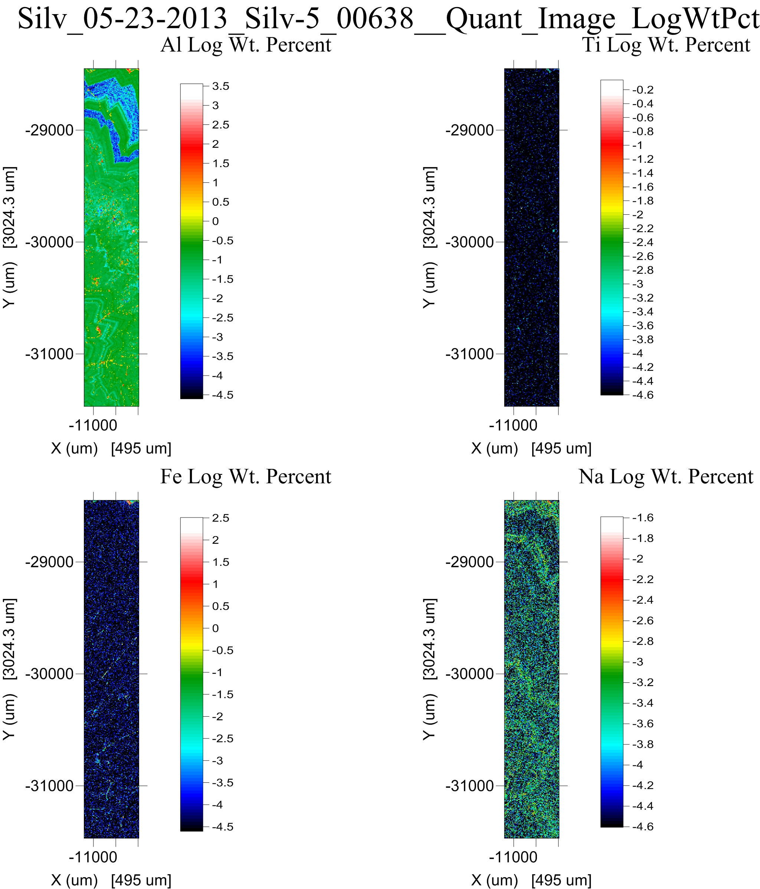
“Hot” pixels can obscure interesting data
Elemental wt%
LOG Elemental wt%

Slide 24
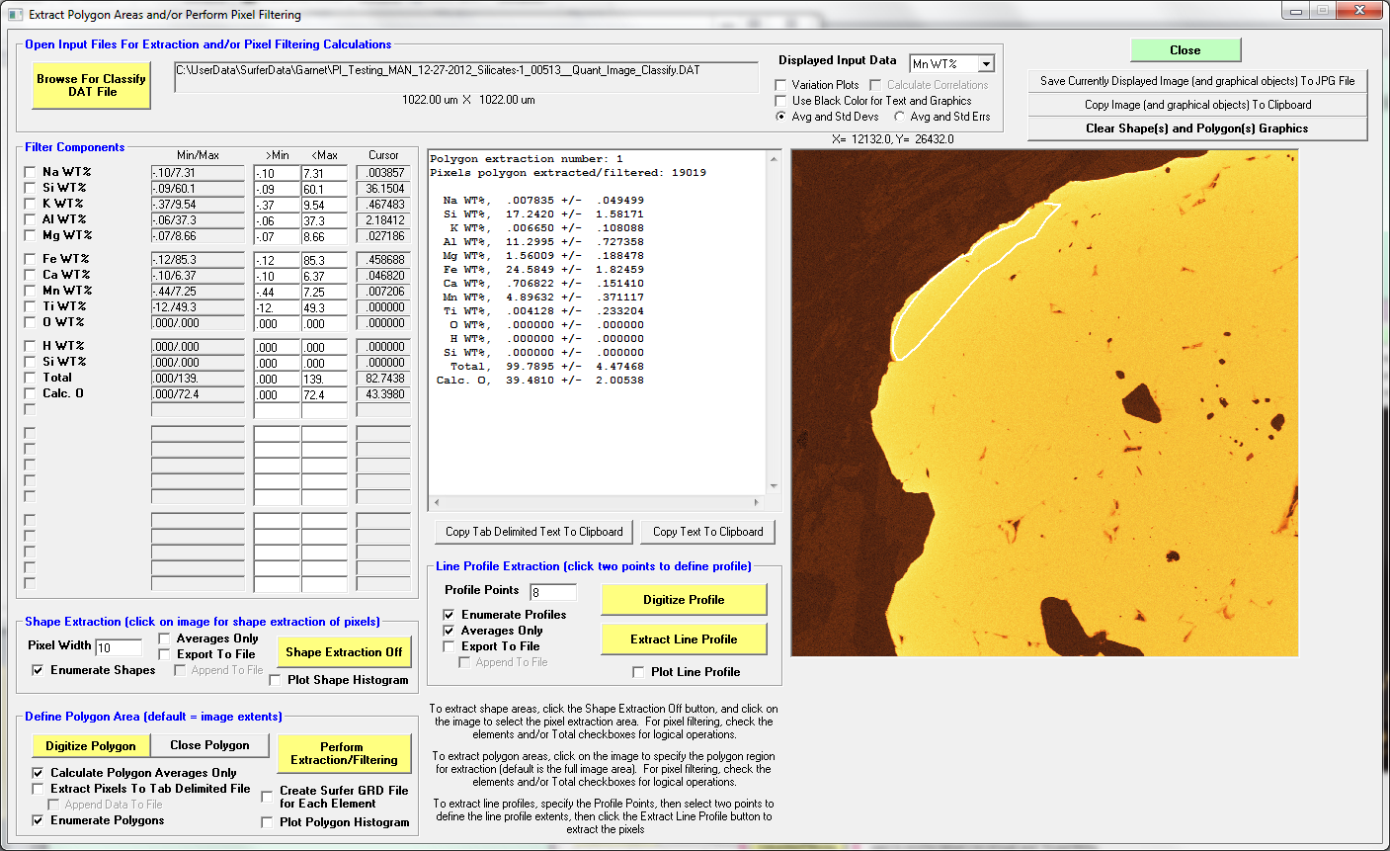
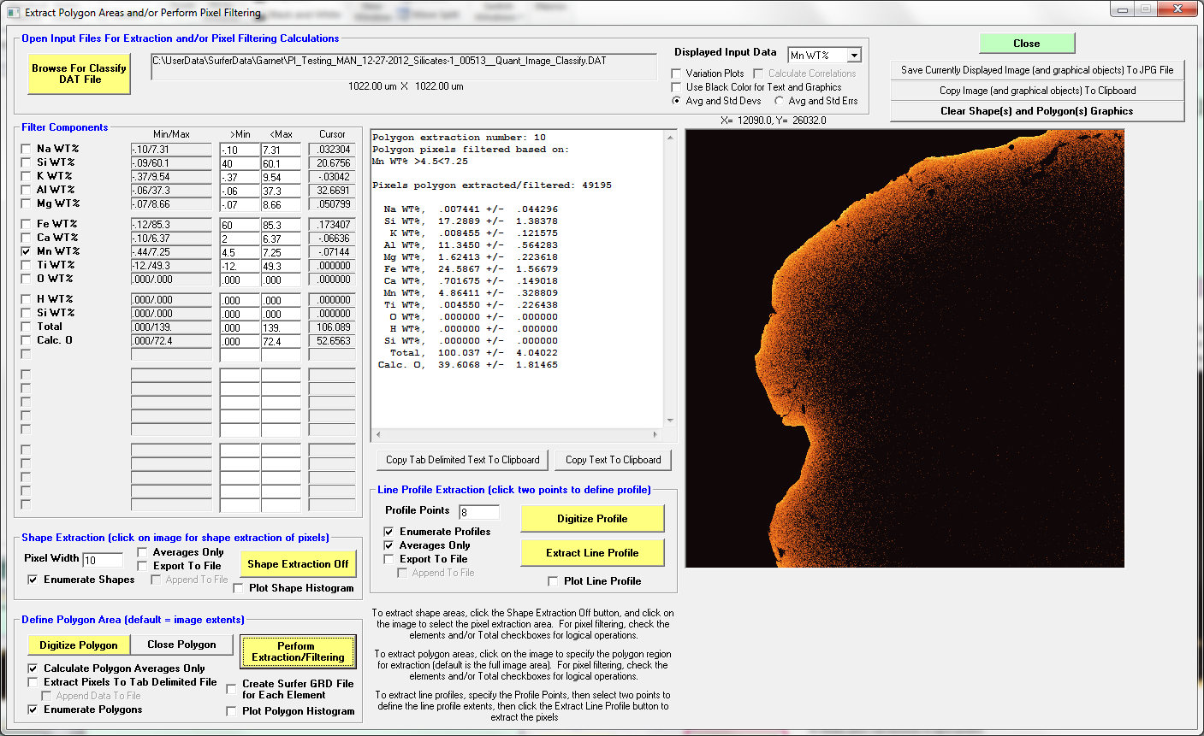
Now that we have quantitative data, let’s filter them spatially or by concentrations:

Slide 25
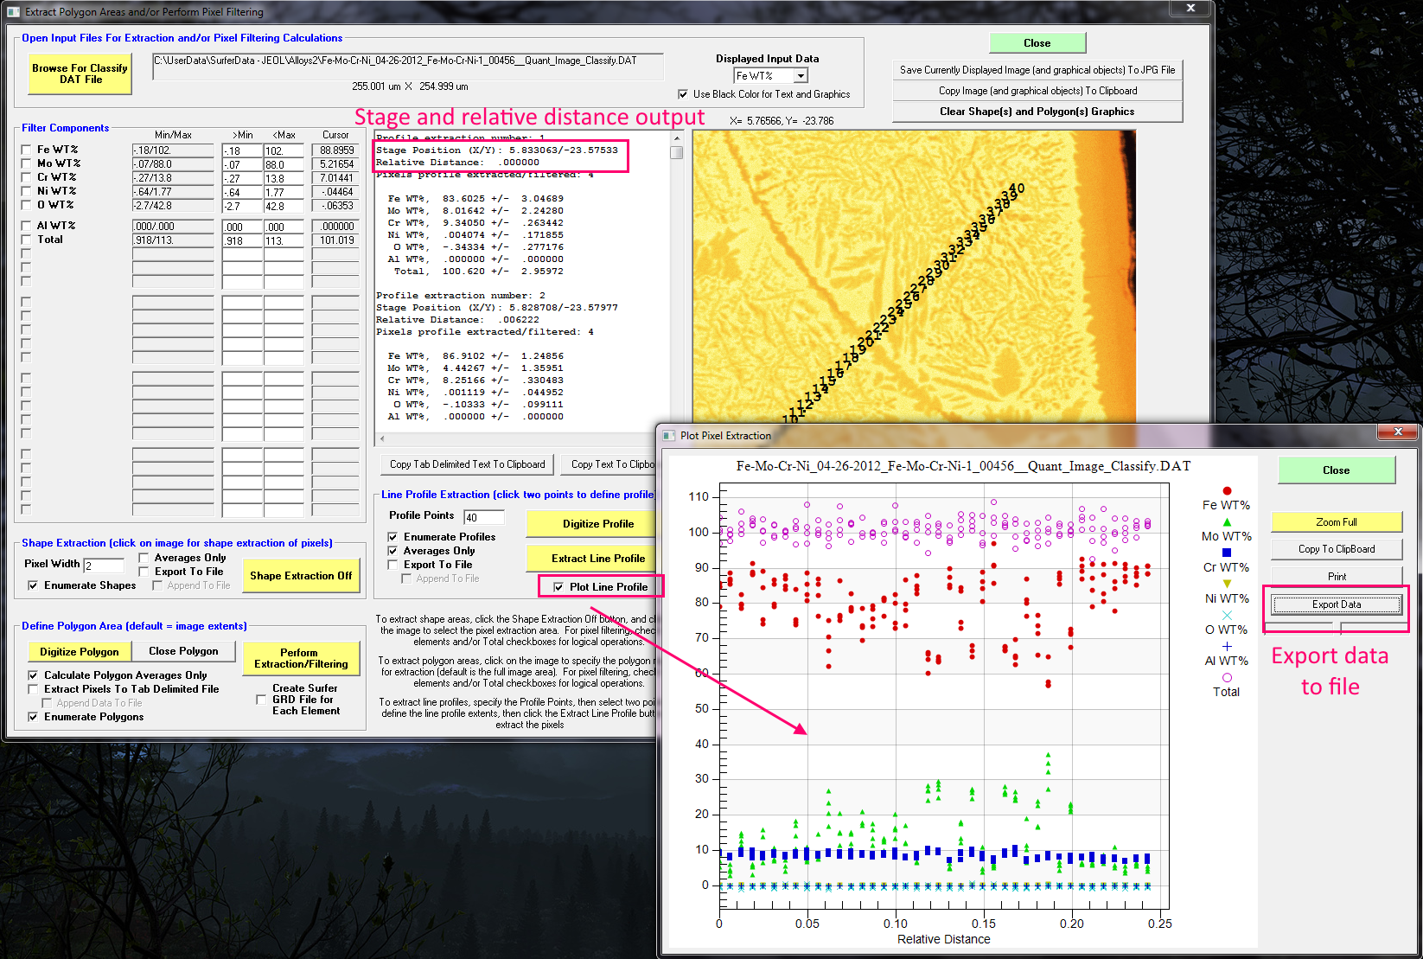
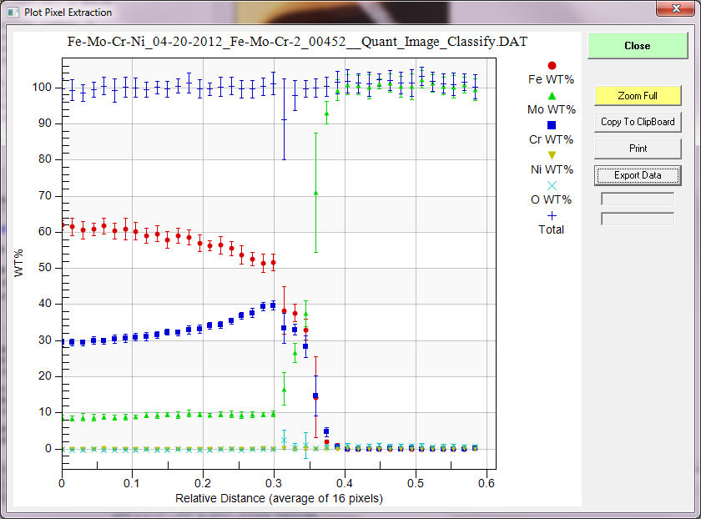
Or plot up our quantified pixels as profiles:

Slide 26
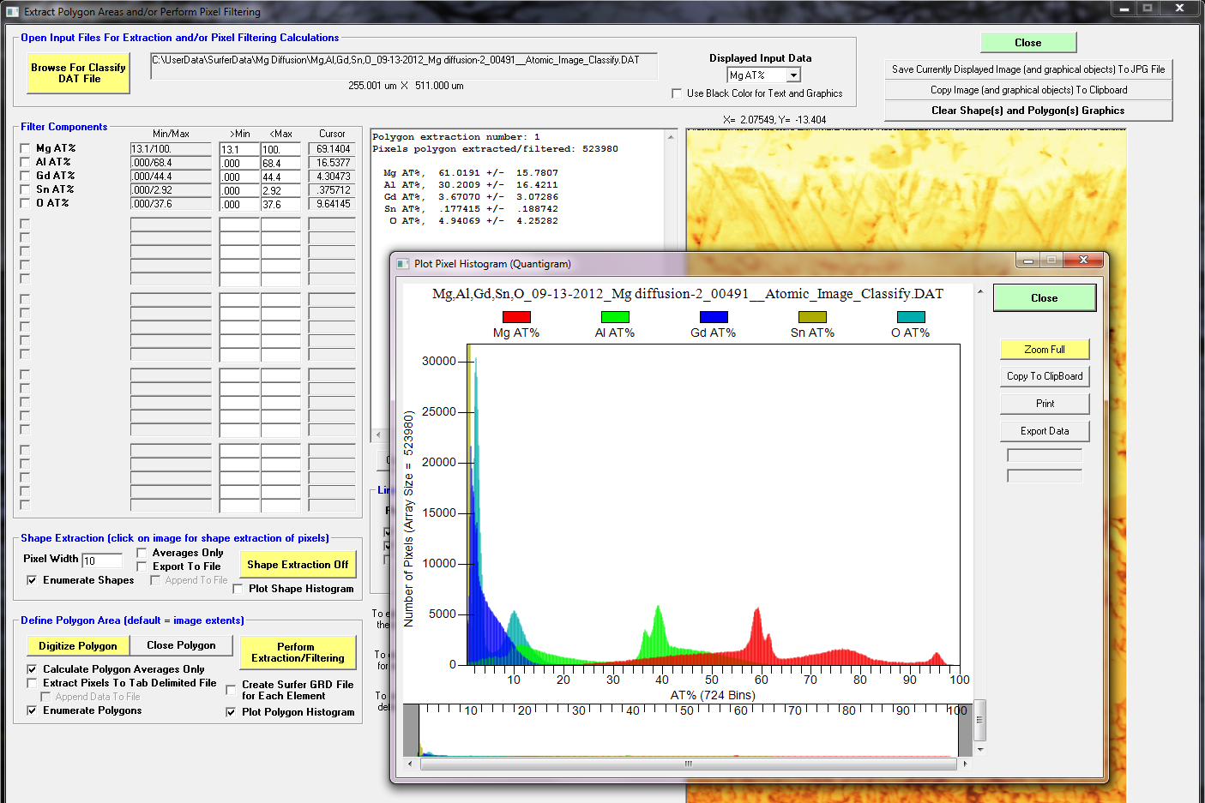
Complex samples benefit from histogram plotting, e.g., quantitative histogram or “quantigram”

Slide 27
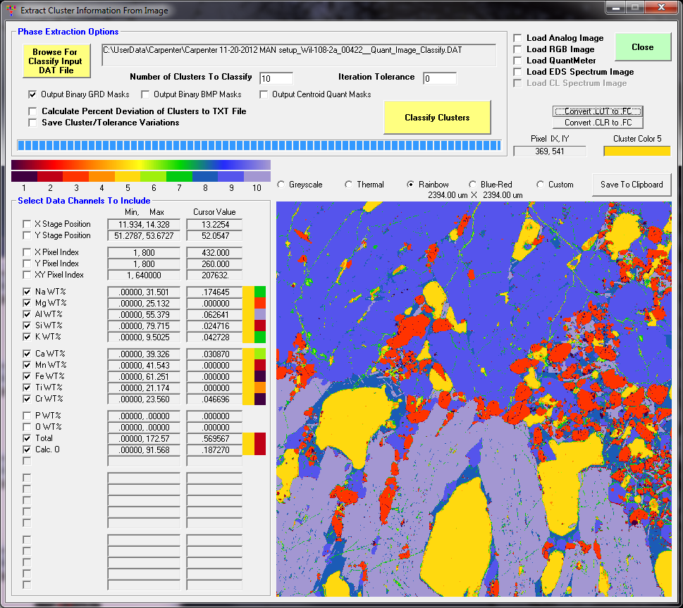
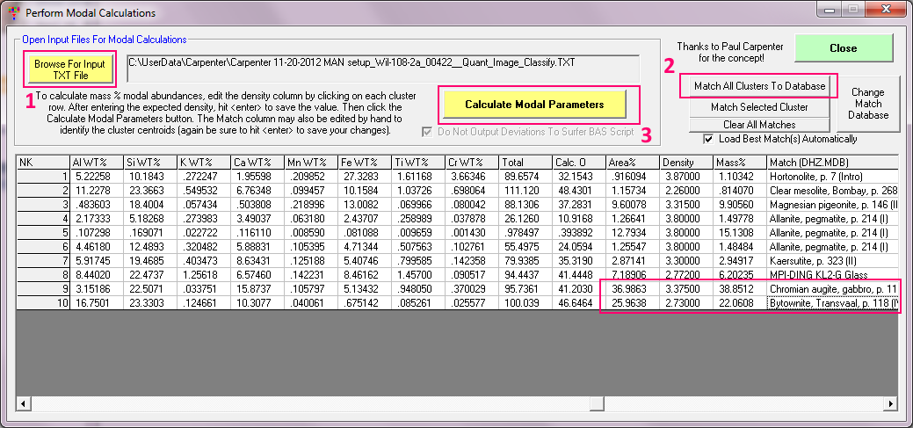
Modal Analysis/Classification
Classify by wt%, at%, oxide, formula, etc.

Slide 28
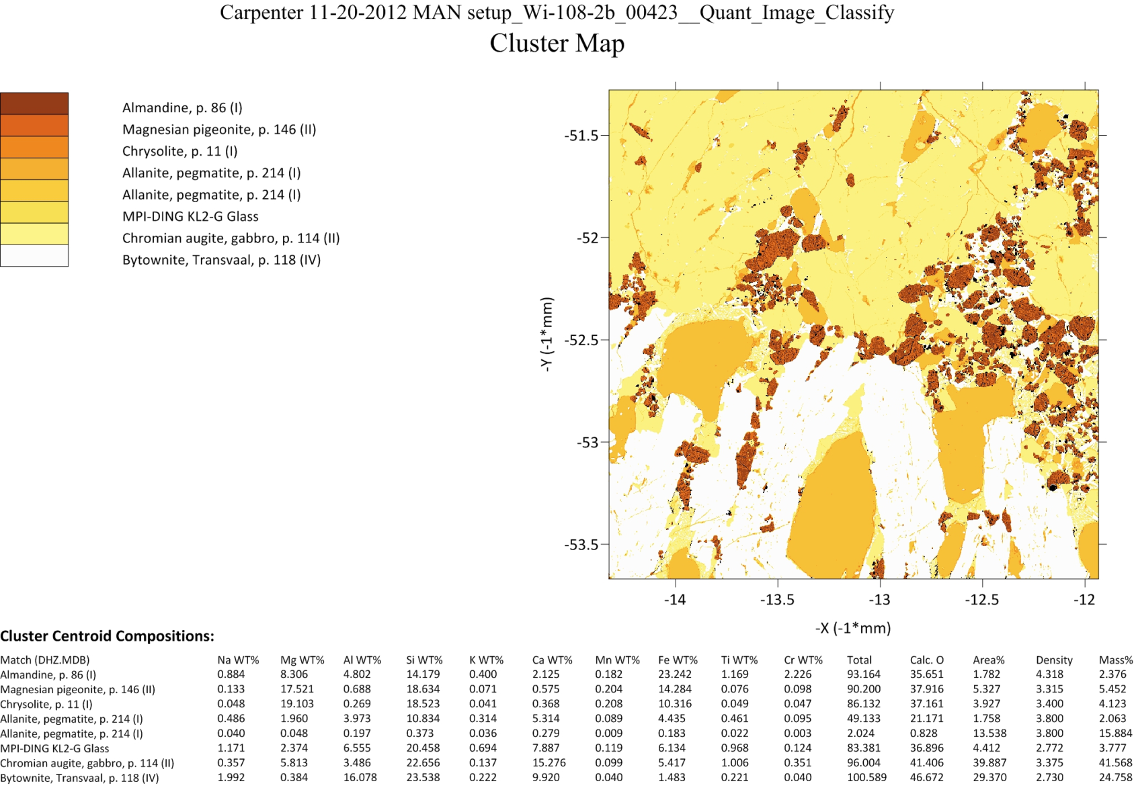
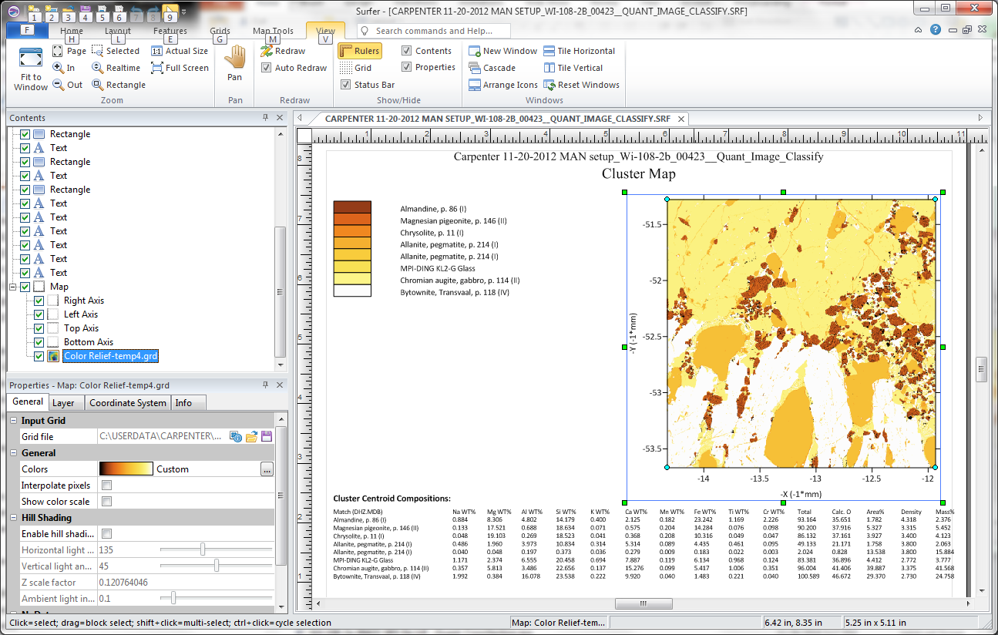
Output of quantitative classification results
We want to classify our compositions manually or automatically…
We want to automate scripting and customize our output…

Slide 29
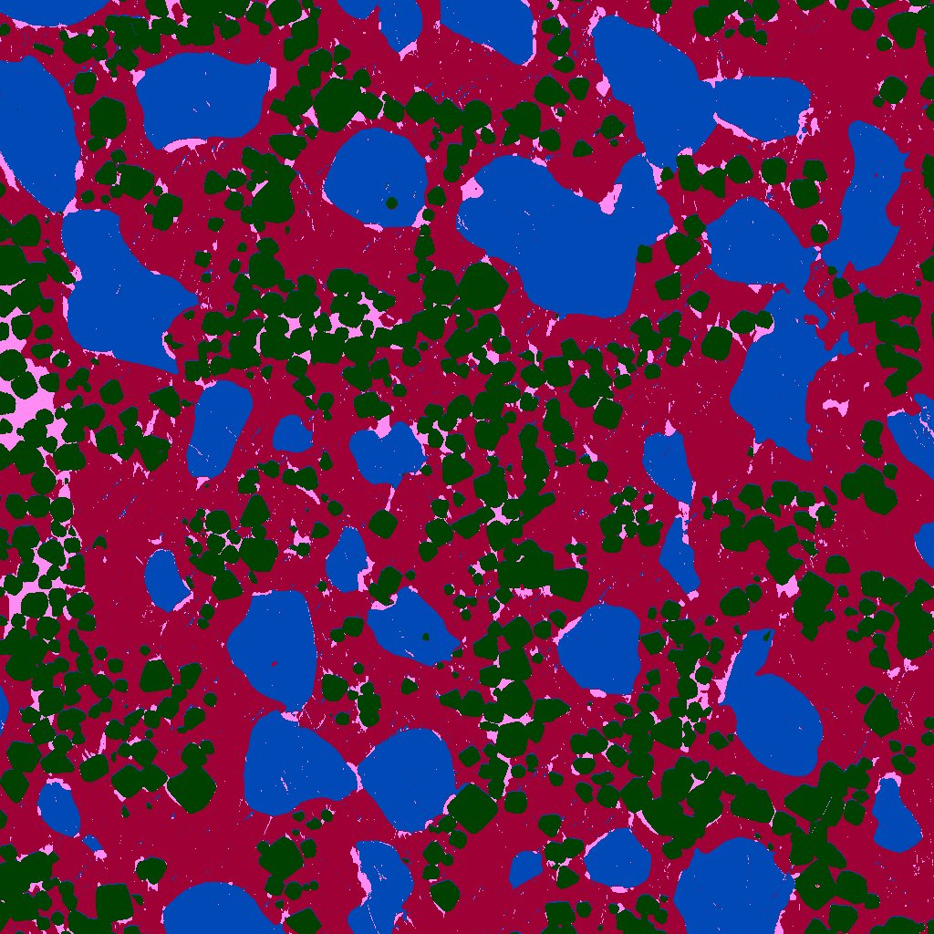
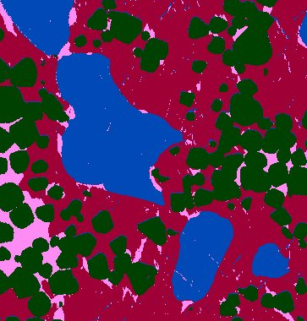
Fiji Xlib unsupervised K-means – simplified 4 cluster constraint
Export quantitative results and perform additional modal analysis using other tools
Orthopyroxene
Chromite
Ca-pyroxene
Olivine
Clustering works well due to distinct chemistry and spatially large crystals
Multiphase pixels at phase boundaries – olivine and orthopyroxene, chromite and Ca pyroxene

Slide 30



Cluster results using all pixels (no data filtering, 4 clusters only)
Clusters are quantitative composition of phases
Analytical total allows inspection of accuracy
Effect of cracks/pits: low totals
Multiphase pixel sampling:
Chromite + Ca pyroxene: Cr and Si
Area % known from number of pixels
Sum of density * area fraction = bulk density
Normalized density * area fraction =
density-weighted wt% of each phase
Note wt% / area % for phases with density:
Below bulk density: over represented by area
Above bulk density: under represented by area
Phase cation formula shows high quality of analyses
End member compositions used to interpolate density

Slide 31

So let’s give our pixels some respect! They deserve to be treated just like points.
From Goemann

Slide 32
Conclusions
X-ray maps without quantification is as unscientific as attempting to evaluate raw intensities from point analyses, therefore…
Perform the same quantification to each pixel as we would each point analysis.
This includes deadtime, beam drift, standard intensity drift, background, matrix, spectral interferences and optionally TDI for sample sensitivity, and/or blank corrections.
Extract information based on spatial and/or compositional relationships (manually or automatically).
Thank-you!

