Slide 1
Quantification of Light Elements
Emission lines below 1 keV, e.g., K emissions for Z < 11
Also L and M emissions for higher Z elements (even more problematic)
Requires LDE Bragg crystals (optimized for each emission line?)
Significant Absorption Effects (large MACs, matrix matched stds?)
Peak shape effects (requires integrated intensity acquisitions or Area Peak factors (specified or compound)
Beam sensitivity effects (ion migration or contamination, requires time dependent intensity (TDI) corrections)
Interference corrections (quantitative matrix correction relative to interference std)
Coating corrections (differential absorption and/or electron energy loss)
John Donovan, University of Oregon/Probe Software

Slide 2
EDS vs. WDS
eV
Contributed by Jon Fellowes

Slide 3
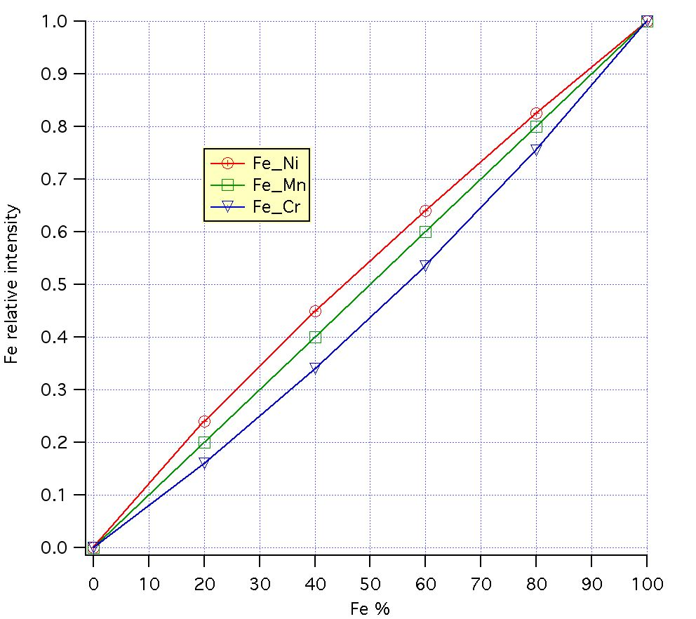
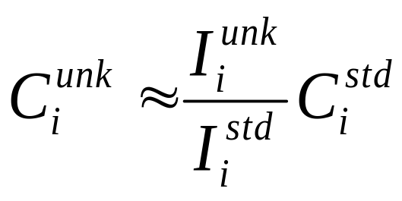
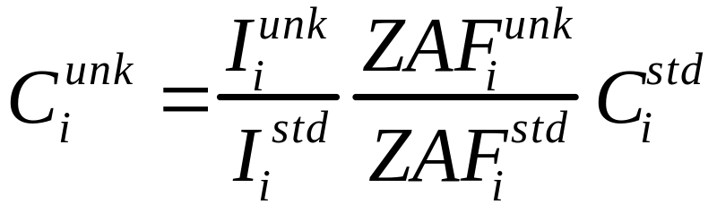
Matrix Correction
Light Element Absorption

Slide 4
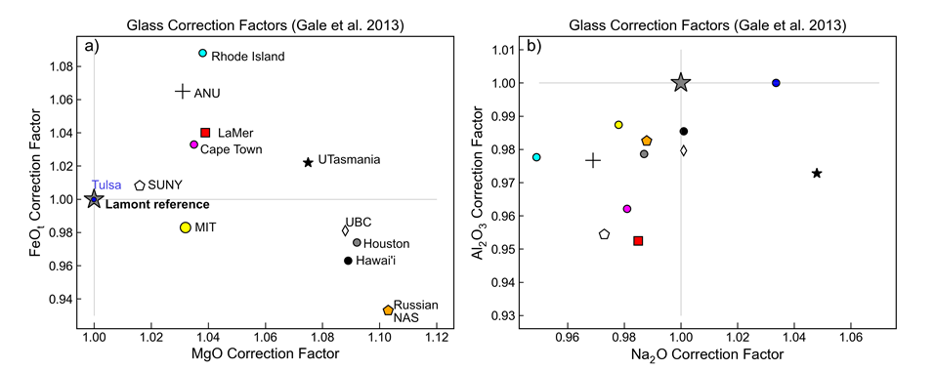
What about “matrix matched” standards?
A reminder: this effort hasn’t worked hasn’t worked out so well for other elements, so it’s going to be worse for light elements where the matrix effects are even larger!
Wieser, P. E., Kent, A. J., Till, C. B., Donovan, J., Neave, D. A., Blatter, D. L., & Krawczynski, M. J. (2023). Barometers Behaving Badly I: Assessing the Influence of Analytical and Experimental Uncertainty on Clinopyroxene Thermobarometry Calculations at Crustal Conditions. Journal of Petrology, 64(2), egac126.
What oxygen standard do I use? OK, I’ll tell you: MgO!
I’ll explain why later, but first let’s talk about Bragg diffraction…

Slide 5
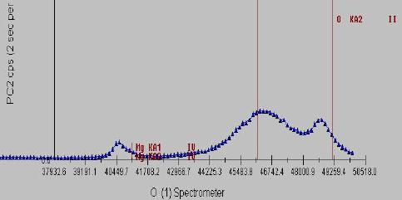
LDE Diffractors and Refractive Index
Fournelle, John, et al. "The Significance of Refractive Index “K” Values of 45 to 200 Å 2d LSMs, or, Why Your Long Wavelength Peak Markers May Not Line Up Correctly." Microscopy and Microanalysis 12.S02 (2006): 836-837.
… How well can n>1 interferences be accurately identified if markers not correctly aligned?
Bragg eq 1:
nλ = 2d sinθ (1-k/n²)
Bragg eq 2:
nλ = 2d sinθ (1-k/n²)
Where k is refraction index, n is order of diffraction
- LDE1 (60 Å): 2d = 61.3 Å / k = 0.014 O Ka (and N Ka and C Ka?)
- LDEC (100 Å): 2d = 102.8 / k = 0.031
- LDEB (150 Å): 2d = 150.0 / k = 0.041
CalcZAF spectrometer position calculator
Spectro position for o ka on WSi60 (140 mm), is 110.0517 (with refractive index correction, k= 0.01483)
Spectro position for n ka on WSi60 (140 mm), is 147.2326 (with refractive index correction, k= 0.01483)
Spectro position for c ka on WSi60 (140 mm), is 208.2691 (with refractive index correction, k= 0.01483)

Slide 6
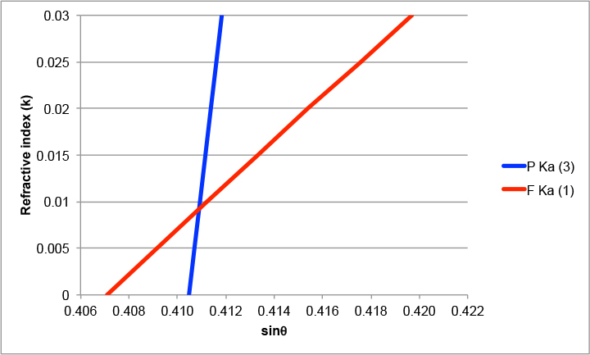
TAP
Contributed by John Fournelle and Julien Allaz
See:
https://probesoftware.com/smf/index.php?topic=197.msg1732#msg1732
https://probesoftware.com/smf/index.php?topic=375.msg1988#msg1988
For more details on the EPMA User Forum
F Ka
3 P Ka
W/Si 45Å
3 P Ka
F Ka
W/Si 60Å
3 P Ka
F Ka
Sin θ

Slide 7
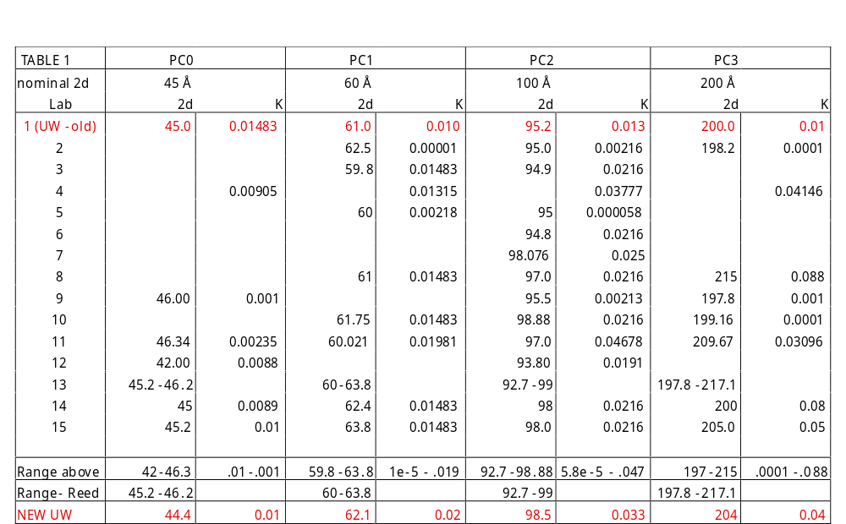
From survey of 15 probe labs…
Presumably many LSMs are supplied by same manufacturer (e.g. Osmic/Ovonix) … so how could they have such differences? Therefore you will need to characterize the specific LDE (PC) diffractors on your instrument!
Contributed by John Fournelle

Slide 8
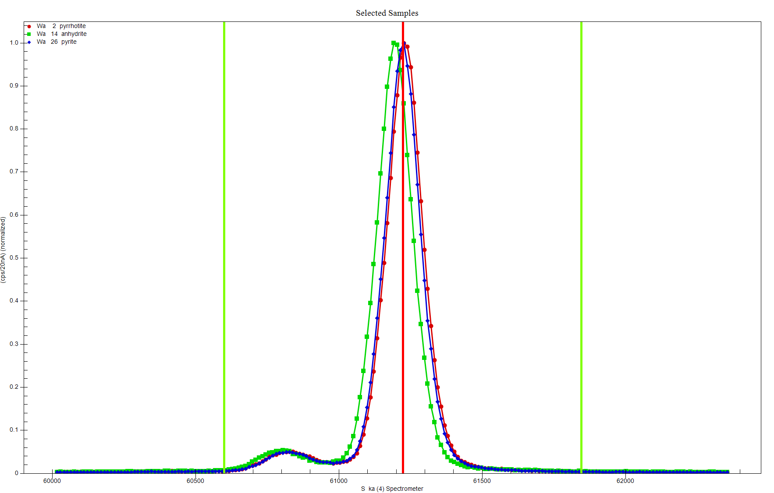
Peak Shift Effects
S Ka valences
can range from
6+ to 2-

Slide 9
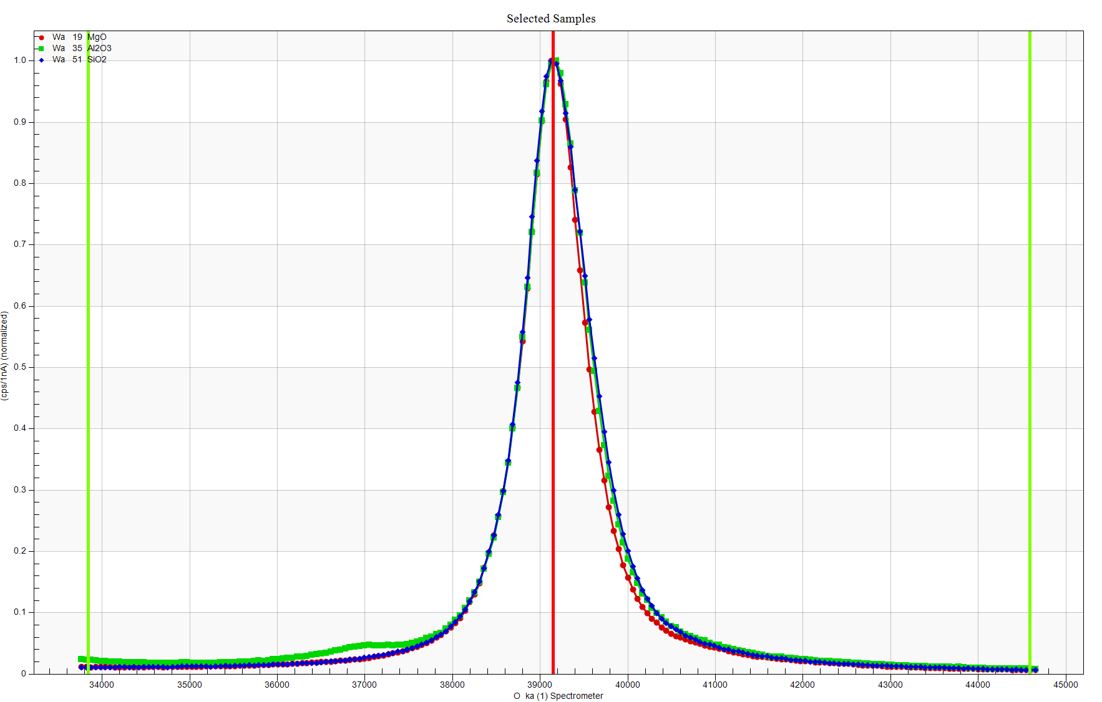
Peak Shape Effects
For O Ka in oxides the differences are smaller and more seen as peak shape rather than peak shift changes.
Still these peak shape effects are ~5 to 10% for simple oxides.
This may be due to differences in coordination rather than valance
So why MgO?
We know exactly what its composition is (50/50)
It is very beam stable
It is inexpensive, high purity and easy mount and polish

Slide 10
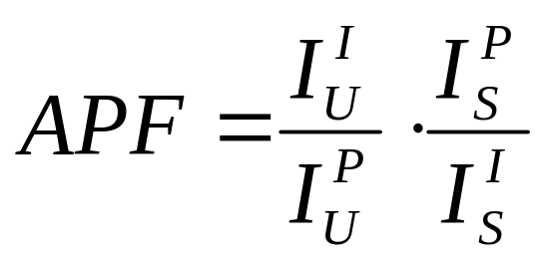




Area Peak factor (APF) Calculations
APF of emitted line in compound relative to standard:
  where: is the integrated intensity for the “unknown”
  is the peak intensity for the “unknown”
  is the peak intensity for the “standard”
  is the integrated intensity for the “standard”
Bastin, G. F., and H. J. M. Heijligers. "Quantitative electron probe microanalysis of ultra-light elements (boron-oxygen)." Electron probe quantitation. Boston, MA: Springer US, 1991. 145-161.

Slide 11
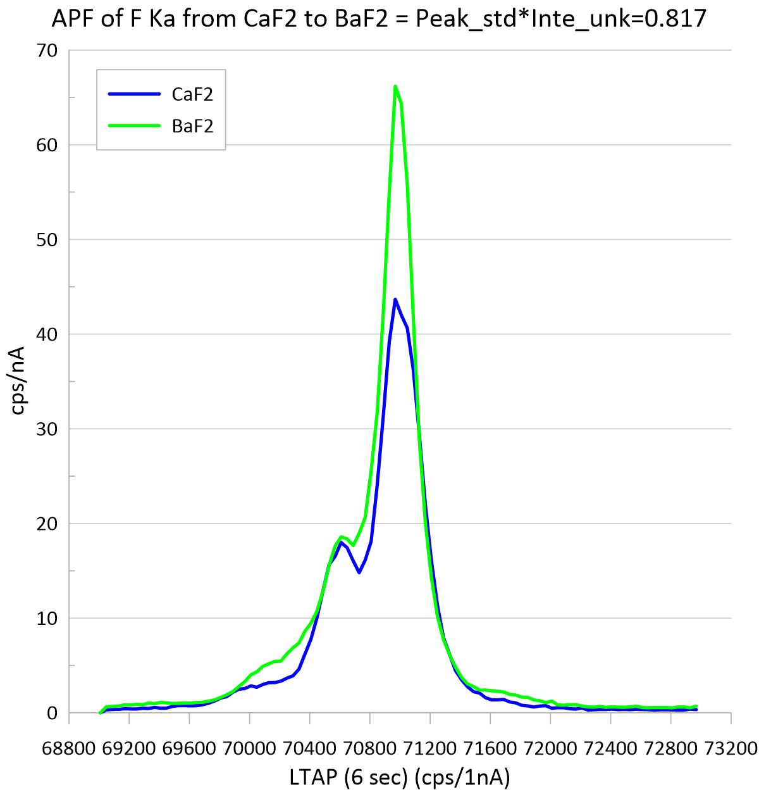
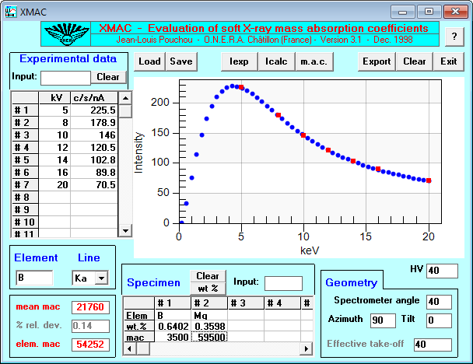
F wt% = 21.670 835 BaF2 (barium fluoride)
F wt% = 48.800 831 Fluorite U.C. #20011
Here are the various MACs for F Ka in Ba:
MAC value for F Ka in Ba = 3155.43 (LINEMU Henke (LBL, 1985) < 10KeV / CITZMU > 10KeV)
MAC value for F Ka in Ba = 3140.00 (CITZMU Heinrich (1966) and Henke and Ebisu (1974))
MAC value for F Ka in Ba = .00 (MCMASTER McMaster (LLL, 1969) (modified by Rivers))
MAC value for F Ka in Ba = 3232.77 (MAC30 Heinrich (Fit to Goldstein tables, 1987))
MAC value for F Ka in Ba = 7408.73 (MACJTA Armstrong (FRAME equations, 1992))
MAC value for F Ka in Ba = 2913.02 (FFAST Chantler (NIST v 2.1, 2005))
MAC value for F Ka in Ba = 3160.00 (USERMAC User Defined MAC Table)
Although there is one outlier, the MACs for F Ka in Ba are all in fairly close agreement and also not terribly large values. However, the MACs for F Ka in Ca are much higher and surprisingly are pretty much in agreement (with Armstrong again a bit a an outlier):
MAC value for F Ka in Ca = 12415.20 (LINEMU Henke (LBL, 1985) < 10KeV / CITZMU > 10KeV)
MAC value for F Ka in Ca = 12370.00 (CITZMU Heinrich (1966) and Henke and Ebisu (1974))
MAC value for F Ka in Ca = .00 (MCMASTER McMaster (LLL, 1969) (modified by Rivers))
MAC value for F Ka in Ca = 12623.93 (MAC30 Heinrich (Fit to Goldstein tables, 1987))
MAC value for F Ka in Ca = 14236.12 (MACJTA Armstrong (FRAME equations, 1992))
MAC value for F Ka in Ca = 12132.31 (FFAST Chantler (NIST v 2.1, 2005))
MAC value for F Ka in Ca = 12400.00 (USERMAC User Defined MAC Table)

Slide 12
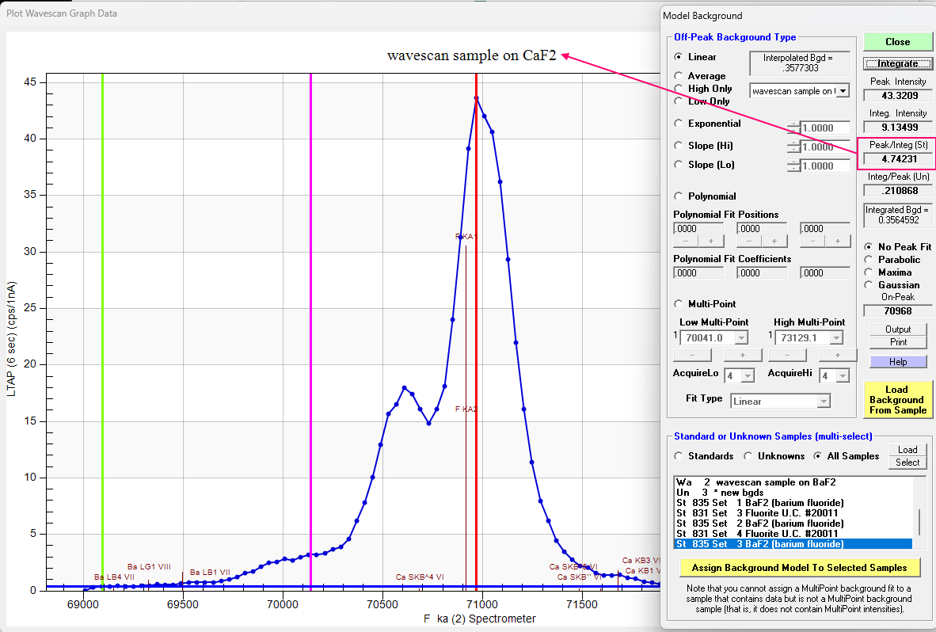
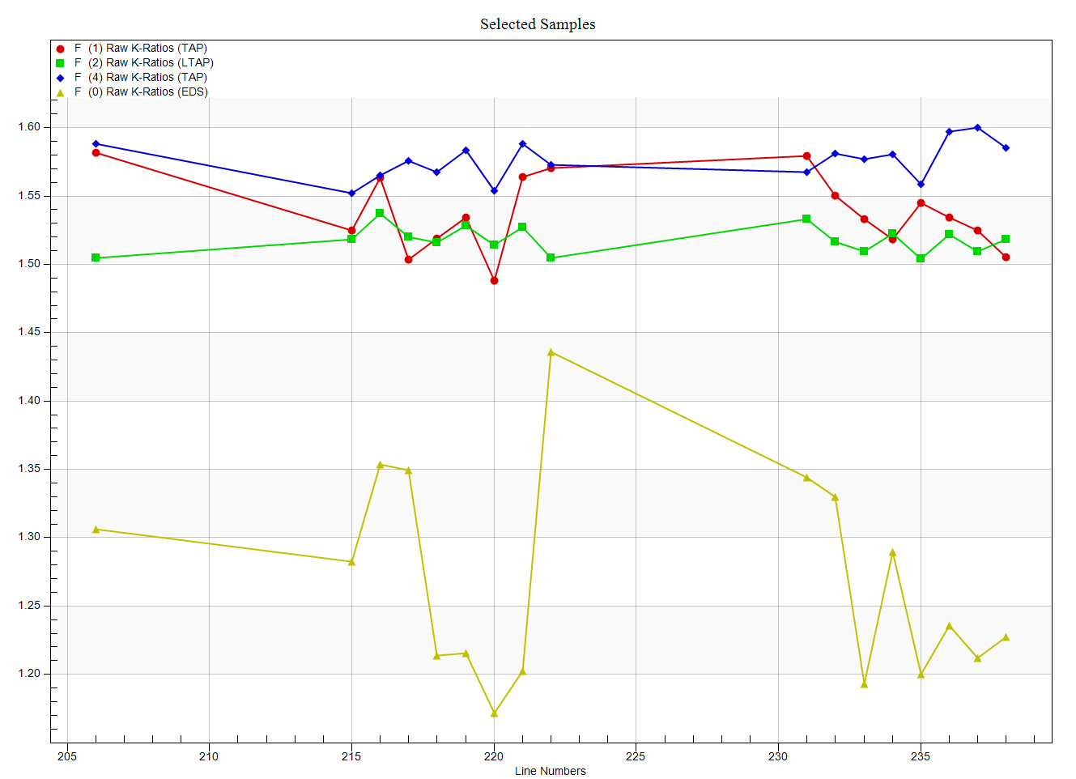
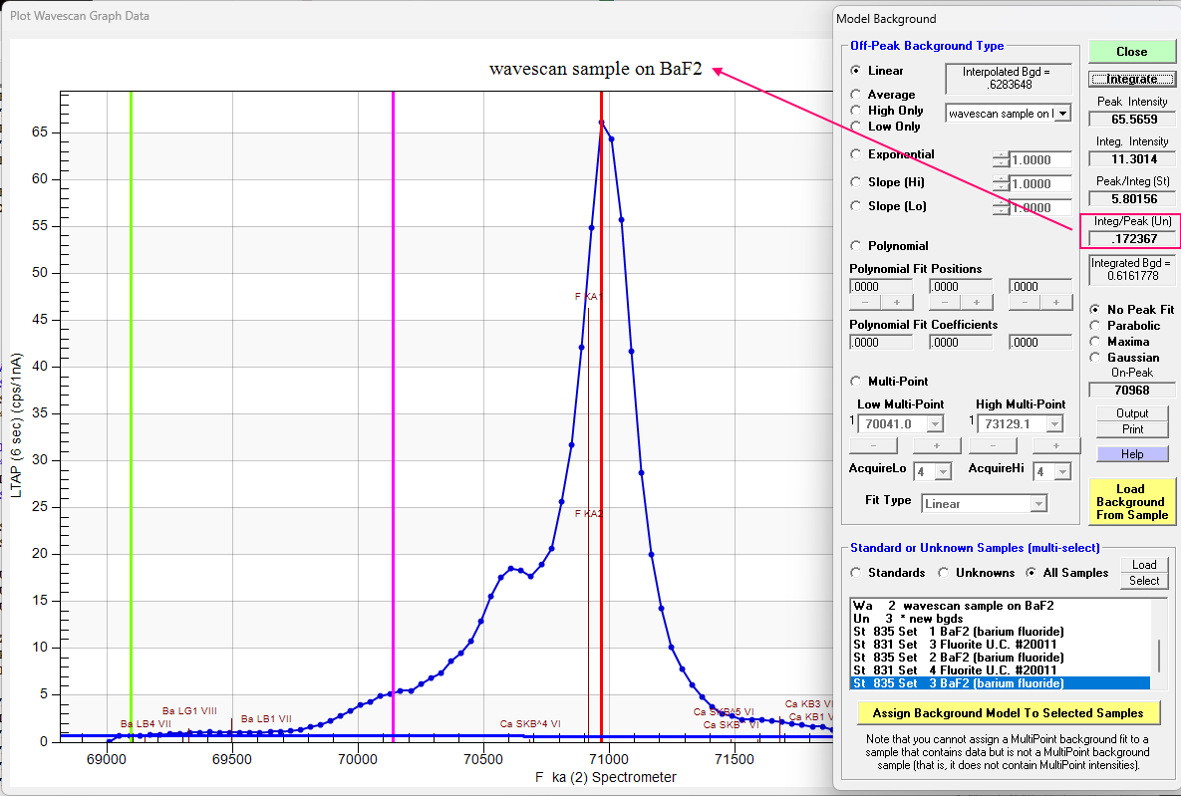
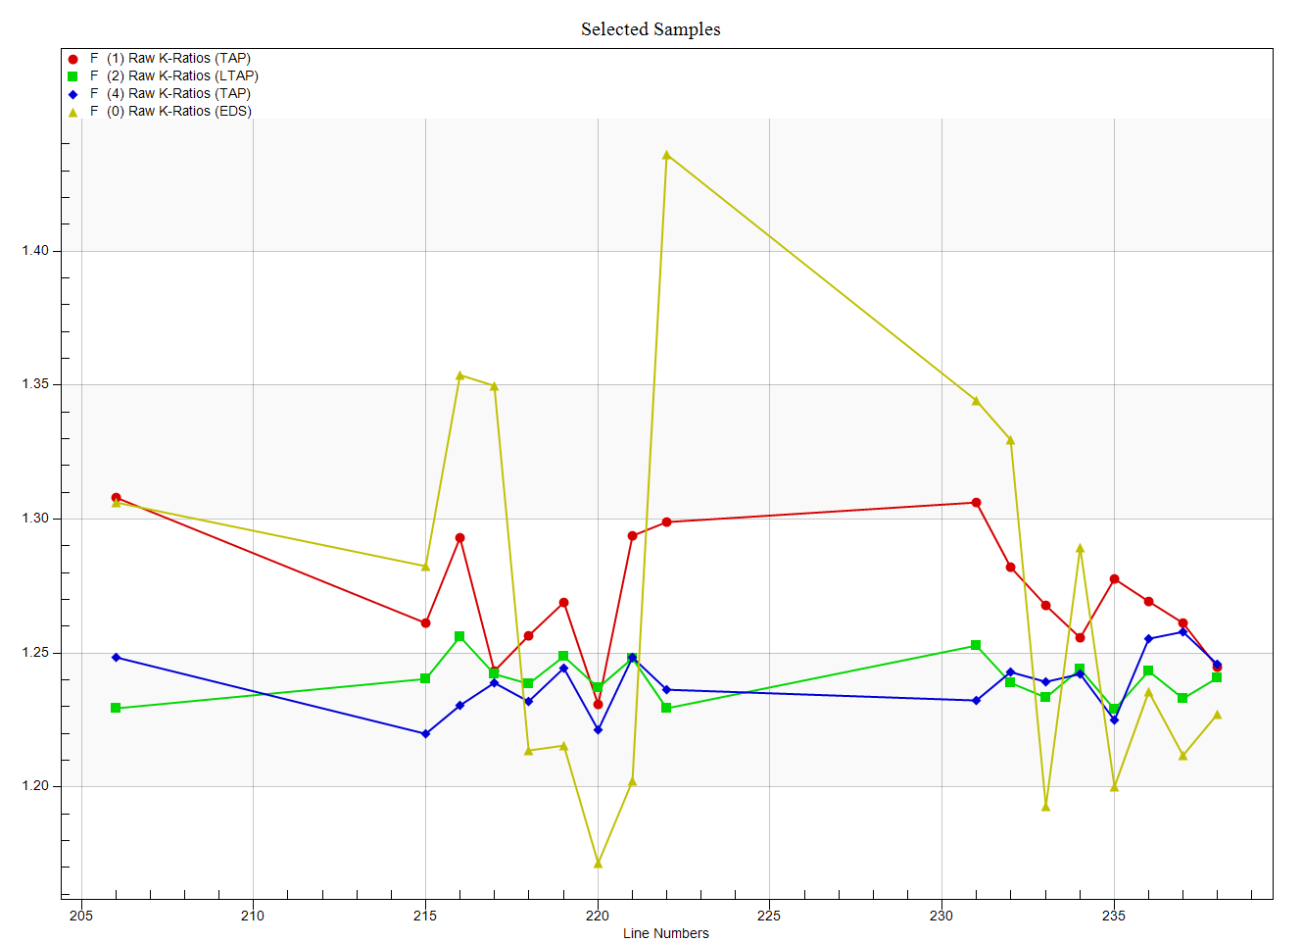
Multiplying these two values together we obtain ~0.817 or almost a 20% correction!

Slide 13
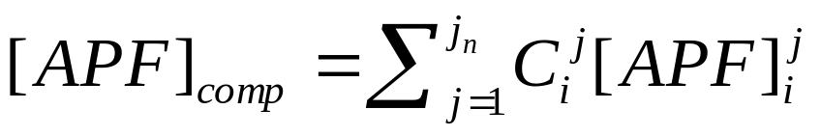
Compound APFs are measured for an emission line in binary borides, carbides, oxides or nitrides and then “compounded” for the specific chemistry under consideration:
Compound APF of element i in elements j (1 to n)
If UseAPFFlag And UseAPFOption% = 0 Then
RowUnkAPFCors!(linerow%, chan%) = 0#
temp! = 0#
For j% = 1 To sample(1).LastChan%
If chan% <> j% Then temp! = temp! + analysis.WtPercents!(j%) ‘ calculate partial sum (not including affected element)
Next j%
If temp! <> 0# Then ' was "If temp! > 0# Then" but caused problem when temp was slightly negative
For j% = 1 To sample(1).LastChan%
If chan% <> j% Then
Call EmpLoadMACAPF(Int(2), sample(1).AtomicNums%(chan%), sample(1).XrayNums%(chan%), sample(1).AtomicNums%(j%), apf!, tstring$, tfactor!, tstandard$)
If ierror Then Exit Sub
RowUnkAPFCors!(linerow%, chan%) = RowUnkAPFCors!(linerow%, chan%) + apf! * analysis.WtPercents!(j%) / temp! ' sum APFs based on relative abundance
End If
Next j%
' Perform APF normalization based on partial sum (added 02/22/2009 to deal with Si Ka peak shift Si -> SiO2)
If analysis.WtPercents!(chan%) <> 0# Then
temp3! = 1# / (temp! / analysis.WtPercents!(chan%)) ' calculate scaling factor based on partial sum
If Abs(temp3!) >= 1# Then RowUnkAPFCors!(linerow%, chan%) = 1# + (RowUnkAPFCors!(linerow%, chan%) - 1) / temp3!
End If
uncts!(chan%) = uncts!(chan%) * RowUnkAPFCors!(linerow%, chan%) ' perform compound APF correction to intensities
End If

Slide 14
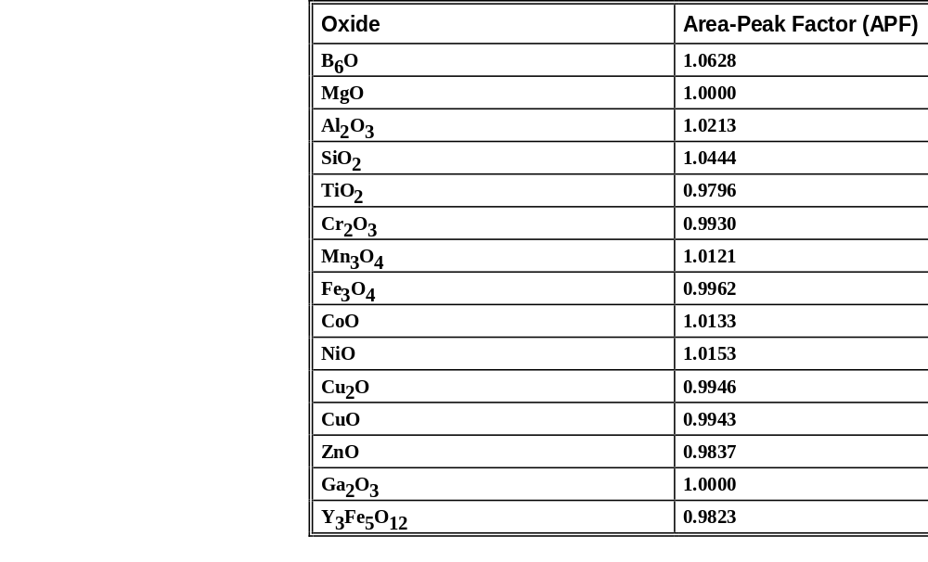
Compound (Binary) APFs from Bastin
Oxygen Area Peak Factors (APF)
  Relative to Fe₂O₃ or MgO using W/Si LDE (2d = 59.8)
Bastin, G.F. and Heijligers, H.J.M (1991) Quantitative electron probe microanalysis of ultra-light elements (boron - oxygen), in Electron Probe Quantitation, ed K.F.J. Heinrich and D.E. Newbury, Plenum Press, NY, 145-161
Need to measure these on your own instrument, but any correction (in the right direction) is better than no correction!

Slide 15
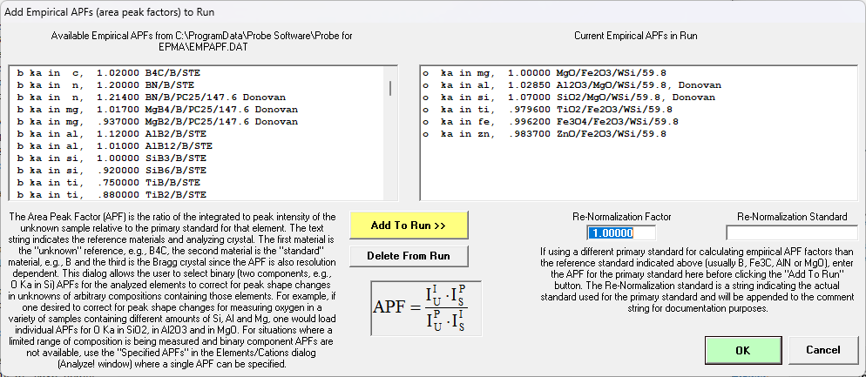
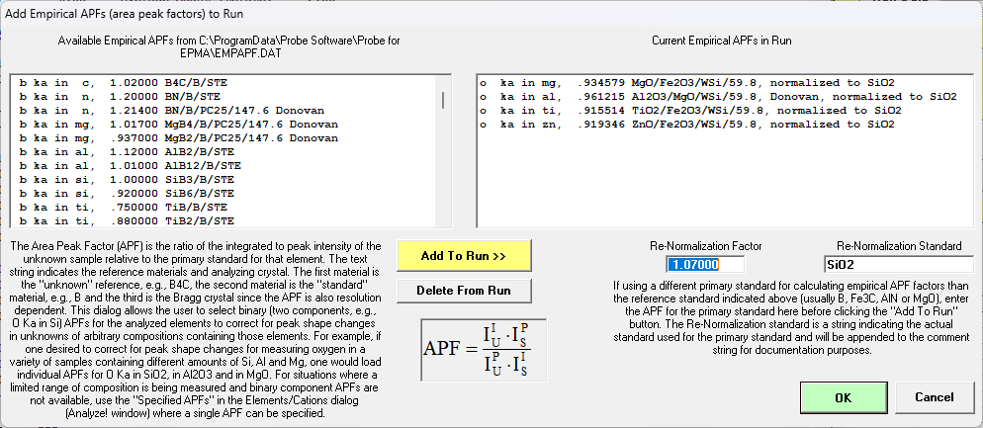
Re-normalization of APF factors to a different primary standard

Slide 16
APF compound (binary) measurements, UCB, SX-51, 10/22/2000
APF data
MgO (std) Al2O3 (APF) SiO2 (APF)
#1 (P/I) 0.000951 0.000927 1.026 0.000890 1.068
#1 (I/P) 1051.6 1078.9 1123.4
#2 (P/I) 0.000951 0.000925 1.028 0.000889 1.069
#2 (I/P) 1051.3 1080.6 1124.9
#3 (P/I) 0.000952 0.000923 1.031 0.000890 1.070
#3 (I/P) 1049.9 1083.2 1124.1
#4 (P/I) 0.000952 0.000925 1.029 0.000889 1.071
#4 (I/P) 1050.3 1081.4 1125.4
Average:
(P/I) 0.0009515 0.000925 1.0285 0.0008895 1.070
(I/P) 1050.8 1081 (1.0213 Bastin) 1124.5 (1.0444 Bastin)
LDE/PC fabrication has improved over time: smoother deposition equals higher resolution- but not always desirable!

Slide 17
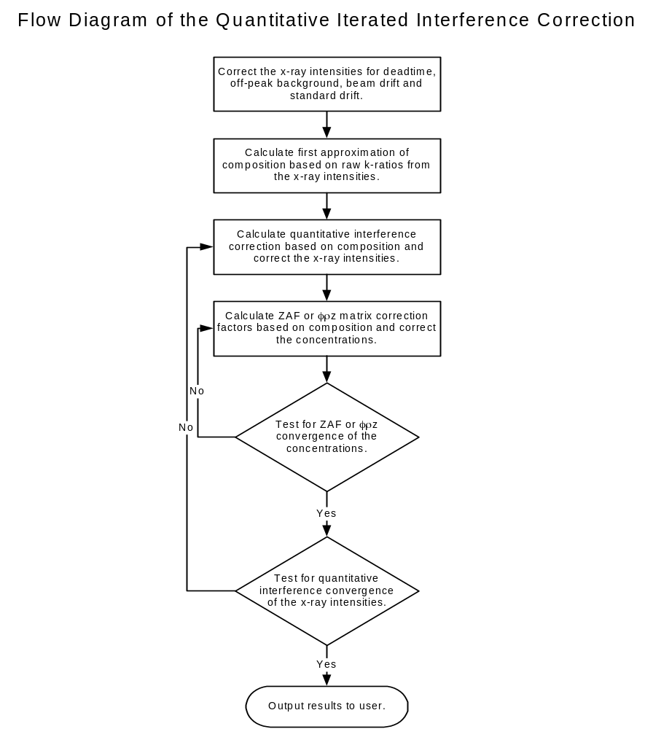
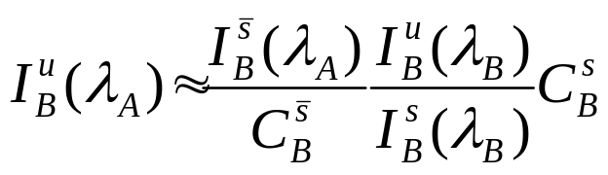
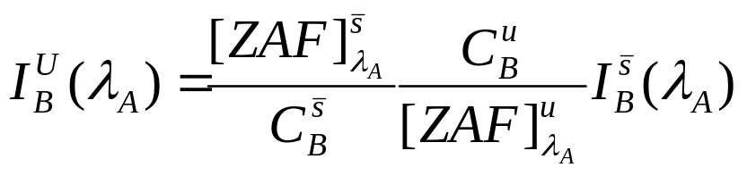
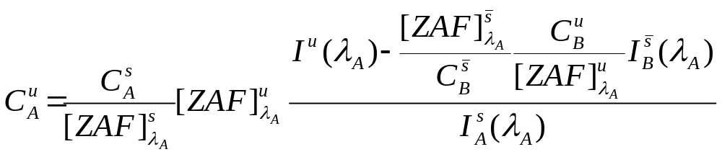
Quantitative Interference Corrections in the Matrix Iteration
Eq. 1
Gilfrich, et al., 1978
Eq. 2
Donovan, Rivers and Snyder, 1993

Slide 18
Measuring oxygen in Fe-Ti Oxides
TakeOff = 40.0 KiloVolt = 12.0 Beam Current = 50.0 Beam Size = 0
Results in Oxide Weight Percents
SPEC: H2O
TYPE: SPEC
AVER: .000
SDEV: .000
ELEM: SiO2 MgO TiO2 MnO FeO Cr2O3 Al2O3 O CaO SUM
283 .084 2.657 6.561 .926 80.498 .390 3.426 4.990 .028 99.559
284 .088 2.660 6.633 .898 80.480 .247 3.422 5.041 .033 99.501
285 .108 2.649 6.617 .894 80.359 .189 3.392 5.003 .035 99.246
286 .110 2.646 6.577 .938 80.284 .123 3.400 5.071 .030 99.178
287 .091 2.654 6.695 .940 80.758 .086 3.438 5.178 .029 99.869
288 .085 2.622 6.852 .959 80.740 .022 3.411 5.623 .040 100.355
AVER: .094 2.648 6.656 .926 80.520 .176 3.415 5.151 .033 99.618
SDEV: .012 .014 .107 .026 .194 .131 .017 .241 .005
SERR: .005 .006 .044 .010 .079 .053 .007 .098 .002
%RSD: 12.3 .5 1.6 2.8 .2 74.3 .5 4.7 14.3
INT%: ---- ---- ---- -.02 .00 ---- ---- ---- ----
APF: ---- ---- ---- ---- ---- ---- ---- .996 ----

Slide 19
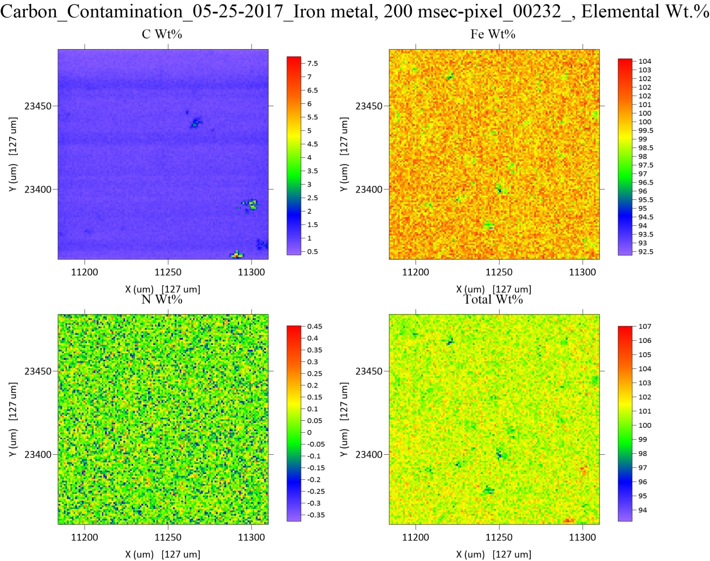
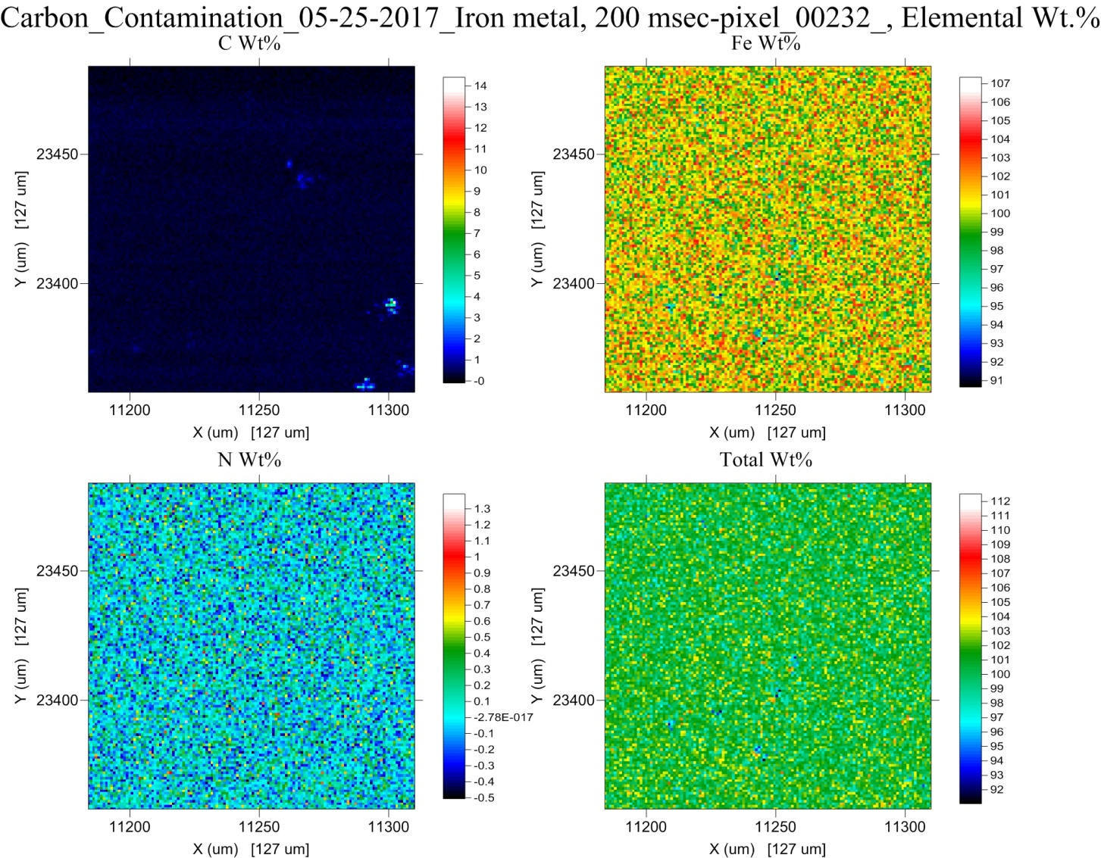
TDI Effects- Carbon contamination
Without TDI
~1 wt% carbon
Without TDI
~0 wt% carbon
With TDI
With TDI

