Slide 1
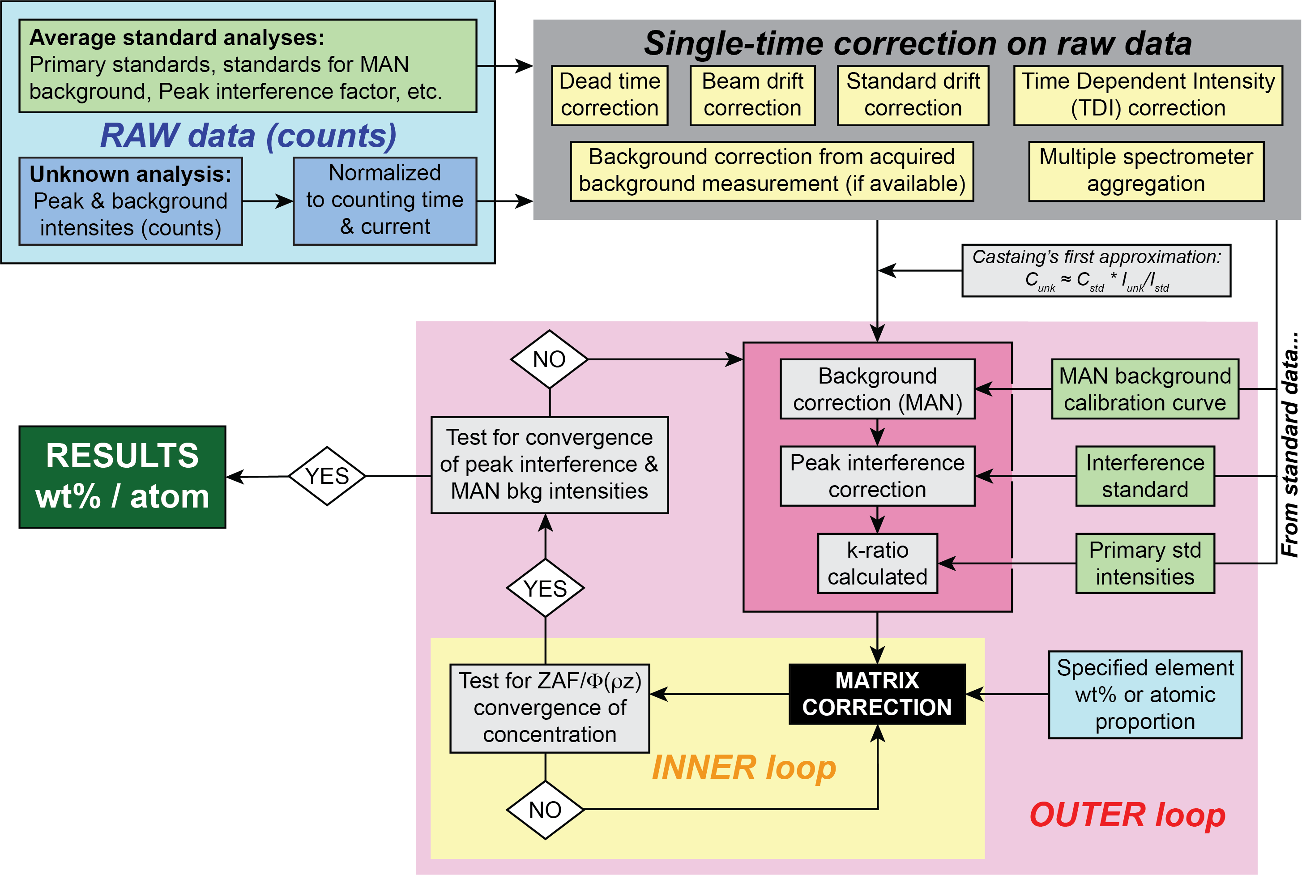
How to Test and Correct for Systematic Errors in EPMA
John Donovan, University of Oregon/Probe Software, https://probesoftware.com

Slide 2
Houston, we have a problem… actually more than one!
We require High Accuracy Primary and Secondary Standards (synthetic, homogeneous, replicable, global) to check accuracy (also as interference and blank correction standards)
We require advanced Dead Time calibrations and corrections (to correct for non-linear effects in electronics)
We require physics based Matrix Corrections (Z based backscatter loss and absorption corrections)
We require modern Background Modeling (to support curved fit and complex backgrounds)
We require K-Ratio Consensus agreement (intra-instrument and inter-laboratory k-ratio comparisons)
We require thoughtful PHA Tuning (with large area Bragg crystals we need to re-think our traditional approach!)
We require accurate Trace Element determinations (using quantitative matrix iterated spectral interference and zero blank corrections)

Slide 3
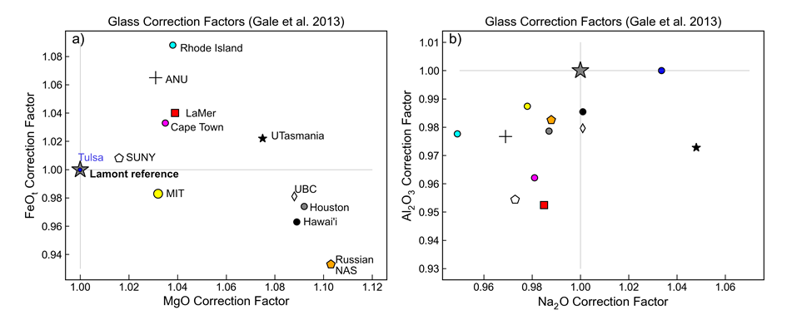
“Cpx composition measured at MIT by Mike Krawcynski - and calculates the Cpx-only pressure and Temp, and takes a paired Cpx-Glass composition and calculates the Cpx-Liq pressure. We then use the interlaboratory comparisons of Gale to say 'well what if Mike had instead measured that glass and Cpx at other labs'. And then we take these corrected compositions and calculate the P and T again. This shows that just the lab you measure the sample in can change the pressure and temperature by 2.5-6 kbar, this is comparable to the stated error on these expressions. But this is a systematic offset. If a set of samples was measured at Lamont not MIT, you could think the Cpx were crystallized on average 6 kbar deeper.”
Wieser, P. E., Kent, A. J., Till, C. B., Donovan, J., Neave, D. A., Blatter, D. L., & Krawczynski, M. J. (2023). Barometers Behaving Badly I: Assessing the Influence of Analytical and Experimental Uncertainty on Clinopyroxene Thermobarometry Calculations at Crustal Conditions. Journal of Petrology, 64(2), egac126.

Slide 4
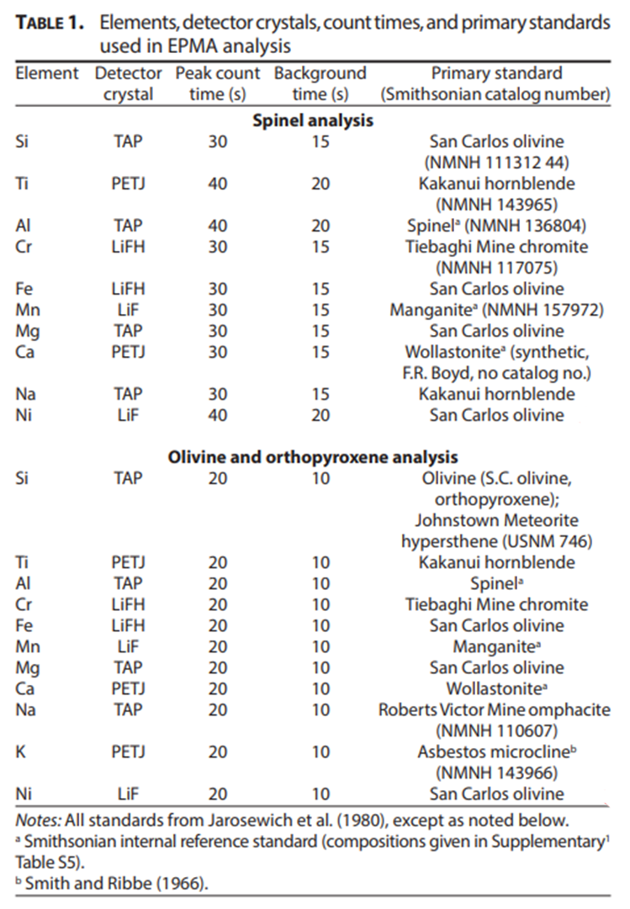

Abuse of standards in EPMA!
A colleague of ours performed analysis of trace Ni in olivine using San Carlos olivine as a *primary* Ni standard. (MMM=matrix matching mania!)
But the Ni concentration in San Carlos olivine is only ~0.3 wt%!
For best precision standards should be the highest intensity per wt%
Which is the pure oxide or metal…
Davis, F. A., Cottrell, E., Birner, S. K., Warren, J. M., & Lopez, O. G. (2017). Revisiting the electron microprobe method of spinel-olivine-orthopyroxene oxybarometry applied to spinel peridotites. American Mineralogist, 102(2), 421-435.

Slide 5
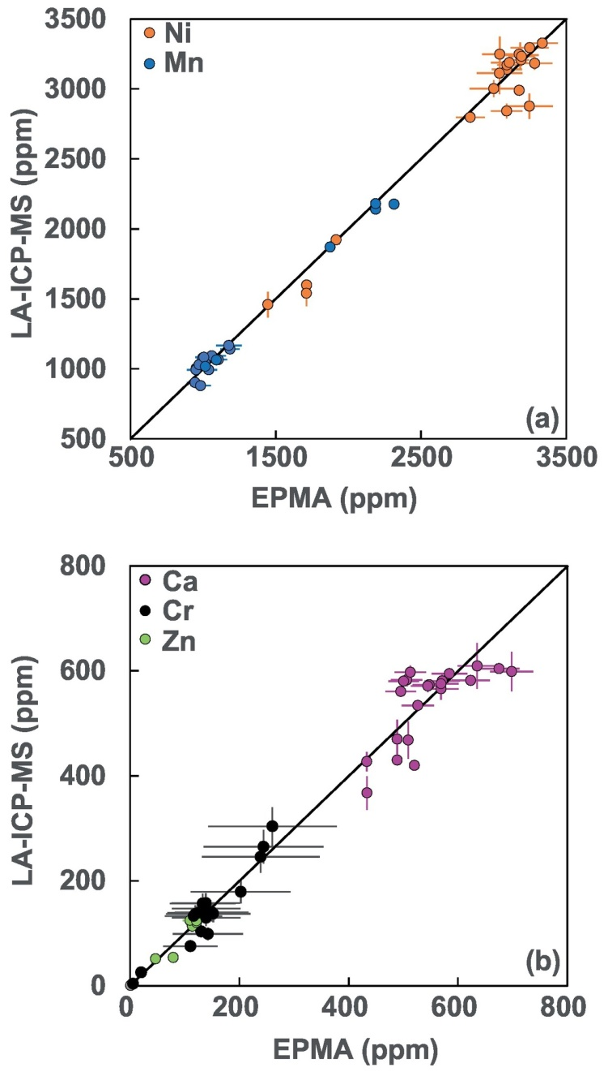
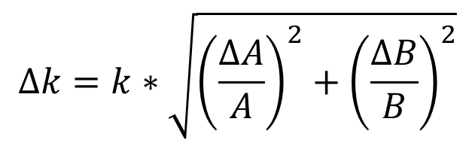
There are two problems with this…
San Carlo olivine
The variance measured from a trace primary standard is propagated proportionally to the unknown concentration via the k-ratio.
Where A = unknown, B = primary standard…
$$∆k=k∗\sqrt{{\left(\frac{∆A}{A}\right)}^{2}+{\left(\frac{∆B}{B}\right)}^{2}}$$
2. The “known” concentration of the Ni in San Carlos olivine is itself highly uncertain, as seen here in the orange points:
Solution: Use a pure nickel or NiO primary standard with an accurately known concentration (high intensity = high precision)!
Sarah Lambart, Sarah Hamilton, Otto I. Lang,
Compositional variability of San Carlos olivine,
Chemical Geology, Volume 605, 2022,

Slide 6
Schematic of Concentration versus Intensity
Trace Elements
(check zero blank)
Dominant effects:
Background
Interferences
Primary standard (multiplicative)
Fluorescence
Intensity
Major Elements
(check analytical total)
Dominant effects:
Standard
Matrix
Dead time
Absorption
Background correction (subtractive)
0
0
Concentration
100

Slide 7
Major Elements: standard, matrix, dead time corrections (multiplicative)
A 2% relative accuracy error at 100 wt% yields a 2 wt% absolute error.
A 2% relative accuracy error at 100 ppm yields a 2 PPM (multiplicative) error for trace elements.
Not important corrections
for trace elements
Error propagation
Major Elements
(check analytical total)
Dominant effects:
Standard
Matrix
Dead time
Intensity
Check major element accuracy using a (roughly) matrix matched secondary standard!
0
0
Concentration
100

Slide 8
Trace Elements: background/interference corrections (subtractive)
Check trace accuracy using a zero blank with a (roughly)
matrix matched high purity synthetic material!
Trace Elements
(check zero blank)
Dominant effects:
Background
Interferences
Intensity
A 100 ppm absolute accuracy error at 100 ppm yields a 100 % relative error.
This 100 ppm background accuracy error (subtractive) yields an insignificant error at 100 wt%.
Not important for major elements!
Error propagation
0
0
Concentration
100

Slide 9
Best Practices for Standard Selection For Major Elements…
Single/poly crystal, homogeneous, synthetic minerals of known composition for the primary standard (our modern matrix corrections generally work quite well!).
Use a primary standard with the highest concentration you expect to measure (do not extrapolate!).
For example, to determine Mg ka in natural olivines: synthetic MgO primary standard or a synthetic Mg2SiO4 secondary standard.
For checking accuracy, use a secondary standard of known composition (only roughly matrix matched!). And of course examine your analytical totals to be sure you have included all non-analyzed elements, e.g., water, hydroxyl, ferric oxygen, etc.
For major element accuracy, what matters is the standard composition, the matrix correction and the dead time correction!

Slide 10
Best Practices for Standard Selection For Trace Elements…
High concentration, synthetic minerals of known composition for the primary standard (the matrix correction doesn’t matter, the background correction does!).
For checking accuracy, use a high purity secondary standard of known composition (roughly matrix matched) with a zero level of the element of interest to check zero accuracy (apply a blank correction!) Do *not* utilize so called “doped” trace standards (they tend to be of uncertain accuracy and homogeneity).
For example, for Ti Ka in quartz: synthetic TiO2 primary standard, synthetic SiO2 secondary standard (check accuracy at zero concentration!).
Check for possible secondary boundary fluorescence situations (use free CalcZAF/Standard software to model boundary fluorescence artifacts) and also check for possible spectral interferences and use a quantitative interference correction!
For trace element accuracy what matters is the background correction and spectral interference corrections…

Slide 11
The Problem With Standards…
“by Standards kept by each particular workman, without any agreement or reference to one another”
-Edmond Halley, 1693
Problem: In too many situations, the greatest source of inaccuracy in chemical microanalysis (using WDS and EDS on EPMA and SEM instruments) involves compositional standards.
Standards are required for accurate quantitative analysis, but there are many, widely-known problems with minerals, glasses, and metals commonly used for calibrating measurements. Heterogeneity, inclusions, limited supply, oxidation, beam sensitivity, etc.
It has been 70 years since Castaing’s first X-ray spectrometry experiments, and over 40 years since the Smithsonian Microbeam Standards have been made freely available. Time for a global approach for standards.
Inaccuracies from compositional standards are propagated into models and interpretations that utilize measurement results.

Slide 12
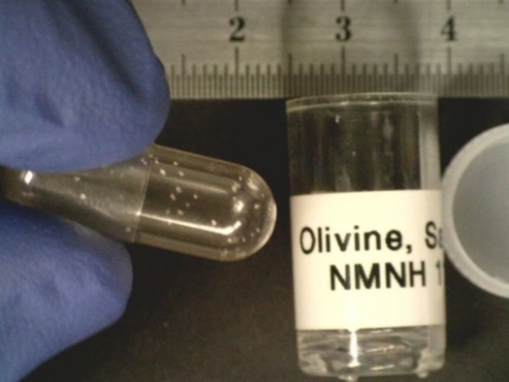
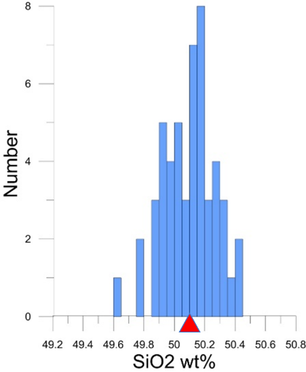
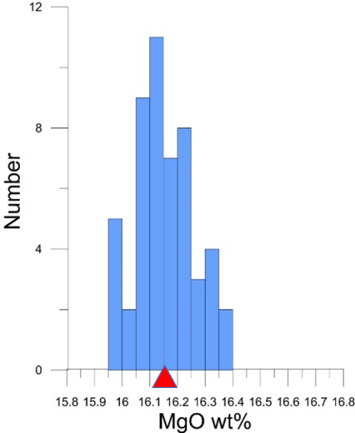
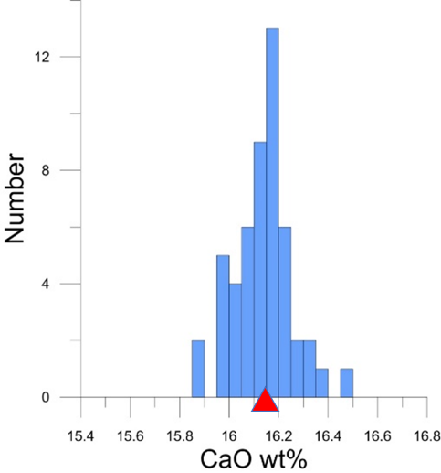
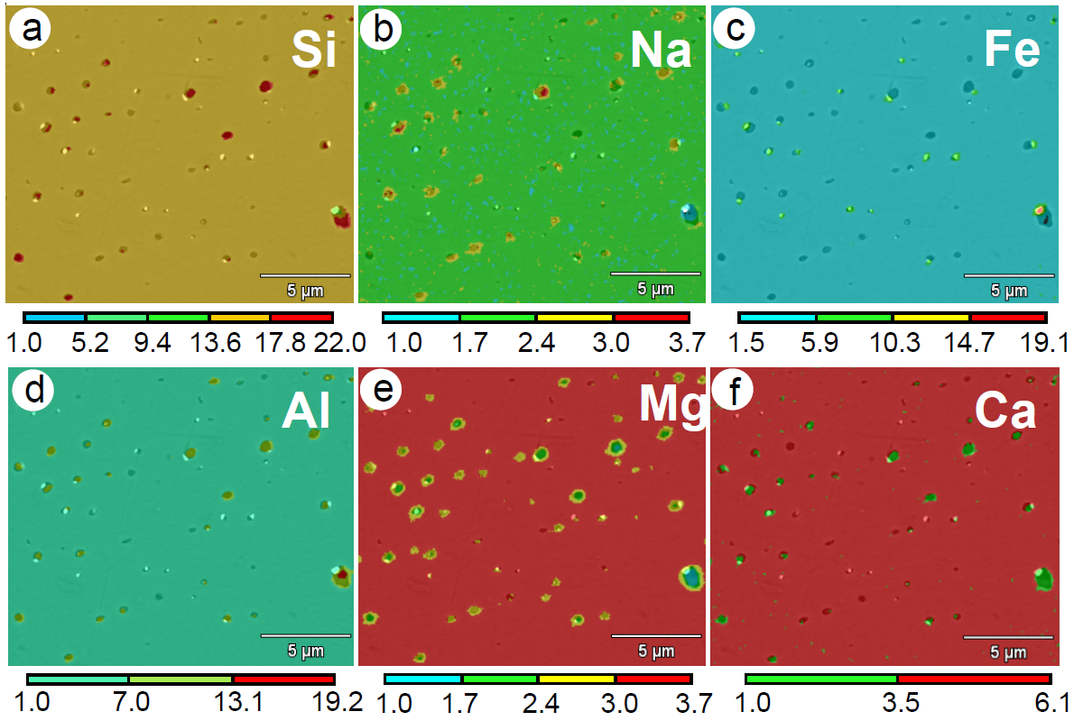
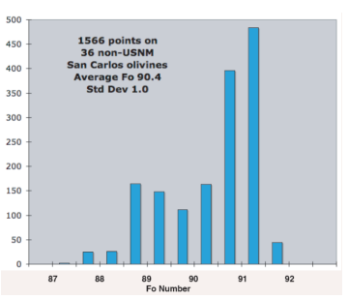
SMS minerals and glasses – several well-known problems
Nachlas et al., 2022
San Carlos Olivine (NMNH 111312-44) received from SMS showing “generous” sample of several <1 mm grains statically-dispersed to walls of gel capsule.
Sub-micron heterogeneities in Kakanui hbl revealed through FE-EDS mapping (Vicenzi and Rose, 2008).
Oxide compositions measured by EPMA on 54 NMNH 122142 Kakanui augite grains (270 analyses in total) (Fournelle, 2012).
Compositions of 36 commercially available (non-NMNH) olivine crystals labeled as San Carlos olivine (Fournelle, 2011).

Slide 13
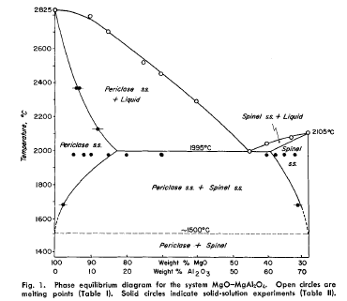
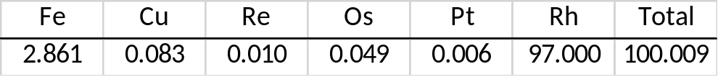
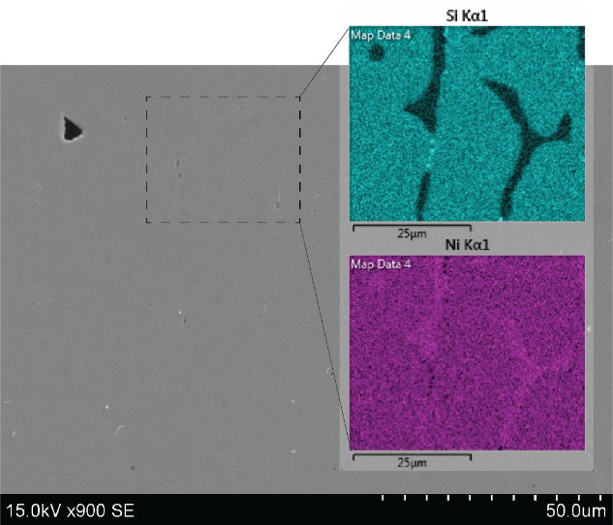
Problems with other commercially available standards
Nachlas et al., 2022
Synthetic materials sold as standards often have reported compositions based on stoichiometry (i.e. formula), not chemistry.
Some simple oxides (MgO-MgAl2O4) can exhibit considerable solid solution (Alper et al. 1962).
WDS analysis (weight % elemental) of a commercial standard labeled as “Rh100” shows considerable abundance of impurities.
Commercial standard of epidote comes with a certificate composition derived from EDS.
Normalization of EDS data can lead to significant errors for quantification of hydrous phases, as shown here with comparison analysis by WDS including analysis of O.
Heterogeneities in Nickel Silicide Standard

Slide 14
This is a global scientific scandal!
To remedy this situation we propose that a modest to moderate investment by our international microanalysis community can provide high purity, high accuracy, synthetic standards for current and future generations of microanalysts.
These synthetic should materials, procured in ~kilogram quantities, so every microanalytical laboratory in the world can have access to the same standards. Such end-member single crystals of high purity can be, unlike glass standards which require further compositional characterization, a priori already known in composition!
E.g., high purity, single crystal Mg₂SiO₄ should be exactly Mg: 34.55 Si: 19.96 O: 45.49 weight percent (assuming accepted terrestrial isotopic distributions!). And it is grown industrially today for electronic substrates. Paired with SiO2 and MgO we now have two (or four including oxygen) k-ratio measurements for global comparison.
We propose to invest in high purity, stoichiometric (thermodynamically constrained end-member), synthetic standard materials produced in kilogram quantities that are already being produced commercially.
Specifically, pure enough single crystals so that homogeneity is not in question (though both purity and homogeneity can be checked), and enough quantity so that *every* microanalytical laboratory in the world has access to the *same* primary standards.
Extract from “An Open Letter to the Microanalysis Community”…

Slide 15
But many materials are already available commercially:
E.g., SiO₂, MgO, Al₂O₃, MgAl₂O₄, Mg₂SiO_{4,} YAG, YIG, Fe₂O₃, TiO₂, SrTiO₃, RbTiOPO₄, KTiPO4, MnO, Fe₃O₄, NiO, ZnO, LaAlO₃, MnPSe₃, LiTaO₃, etc., and can be bought "off the shelf".
Other synthetic minerals may require further research and development, e.g., ZrSiO₄ (zircon), ZrO₂ (zirconia), HfO₂ (halfnia), ThSiO₄ (tetragonal thorite), ThSiO₄ (monoclinic huttonite), Fe₂SiO₄ (fayalite), Mn₂SiO₄ (tephroite), CaMgSi₂O₆ (diopside), Al₂SiO₅ (sillimanite), NaAlSiO₄ (nepheline), KalSi₃O₈ (sanidine), KAlSi₂O₆ (leucite), KAlSi₃O₈ (orthoclase), NaAlSi₃O₈ (albite), CaAl₂Si₂O₈ (anorthite), Fe₃Al₂Si₃O₁₂ (almandine), PbSiO₃ (alamosite), CaAl₂O₄ (krotite), CaAl₄O₇ (grossite), HfSiO₄ (hafnon), CaAl₁₂O₁₉ (hibonite), CaSiO₃ (wollastonite), MgSiO₃ (enstatite), FeSiO₃ (ferrosilite).
Also sulfides (which are seriously lacking since the pioneering days at the USGS-Reston in the 1970s by researchers including Barton, Skinner, Czamanske, Bethke, Toulmin, among others), tellurates, arsenides, niobates, tantalates, etc. Let’s do more research on what might be possible at a reasonable cost.
We might guess that the average cost of “custom” synthesis per kilogram of such high purity synthetic standard materials might average around $5K to $10K each (pers. comm., Marc Schrier, Calchemist).
Do you have access to such materials in your laboratory, or know of materials located elsewhere, that you would be willing to share with your colleagues worldwide in this important endeavor? If so, we would welcome your participation and ask that you contact the MAS FIGMAS (standards) with any information that can advance our "quest for fire"!
a plea from Dale Newbury

Slide 16
It should be noted that such high purity materials could also serve additional purposes such as:
1. Primary standards to check the compositions of the current standards in every microanalytical lab. If we all are not utilizing the *same* primary standards, how do we know the relative accuracy between laboratories?
2. Primary and secondary standards as a test bed for the community “consensus k-ratio” database as proposed by Nicholas Ritchie. This means we should strive for at least two standards per element in this effort!
3. "Blank" materials for trace element analysis and also for mean atomic number (MAN) background standard materials. Five or six “nines” purity is required for use as a trace element “zero” blank.
4. Having these end member high purity synthetics (and maybe some glasses) will stress our EPMA matrix corrections, dead time calibrations, beam current (Faraday Cup) linearity, not to mention effective takeoff angles and stage tilt on SEM instruments. This is really a blessing in disguise. Such “failure mode analysis” is essential if we are to make progress in improving these areas of instrumental calibration.
5. It should also be noted that unlike the “historical accidents” of many of our current standards available today (which are very unlikely to ever be re-created with the same exact compositions), the future production of high purity, single crystal, and thermodynamically constrained standard compositions can always be repeated in the future if necessary. E.g., high purity, stoichiometric, Mg2SiO4 can always be produced in the future as high purity, stoichiometric, Mg2SiO4.

Slide 17
Best Practices for Major Element Analysis
Use high accuracy synthetic end-member standards available (not natural materials!) with a concentration higher than your unknowns (interpolate, do not extrapolate!)
Utilize high purity synthetic secondary standards to check accuracy
Use modern matrix corrections (Armstrong, PAP, XPP, etc.) with updated (Henke, NIST FFAST) mass absorption coefficients. Ideally, run multiple matrix corrections and compare.
Calibrate your spectrometer dead times and avoid count rates over 50 kcps if using the traditional dead time correction expression. Check your dead time calibrations using the new “constant k-ratio”, as will be discussed.
Avoid large area Bragg crystals for major elements that can easily produce count rates over 100 to 200 kcps at even moderate beam currents (or use a modern non-linear dead time expression as will be discussed: Donovan et al., 2023, Microscopy & Microanalysis)

Slide 18
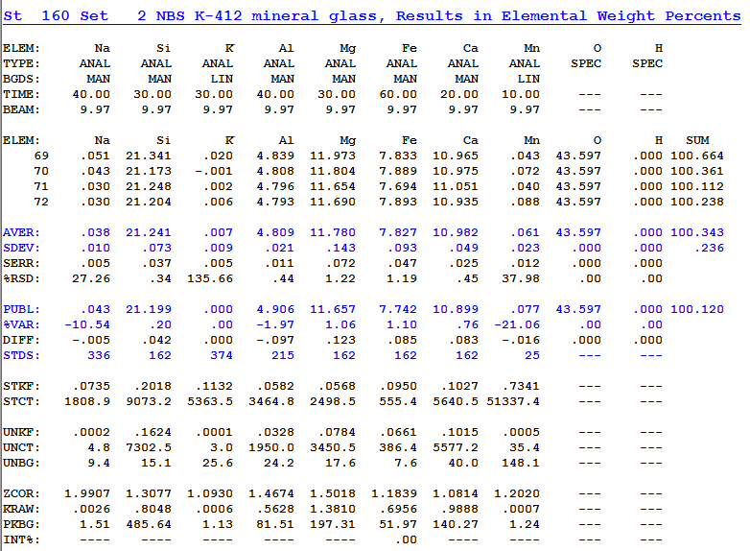
Errors in Secondary Standards – Accuracy Check Using Secondary Standards!
Major/Minor Element Accuracy
336 = Nepheline
162 = SRM K411
374 = orthoclase
215 BIR-1G syn. glass
The NIST mineral glasses are excellent for checking accuracy, not just for glasses but also minerals with similar matrices!

Slide 19
From X-ray Counts to Weight Percent
Points or Pixels!
Double-iteration for:
MAN bkg and peak interference corrections and k-ratio calculation (outer loop)
Matrix correction (inner loop)

Slide 20
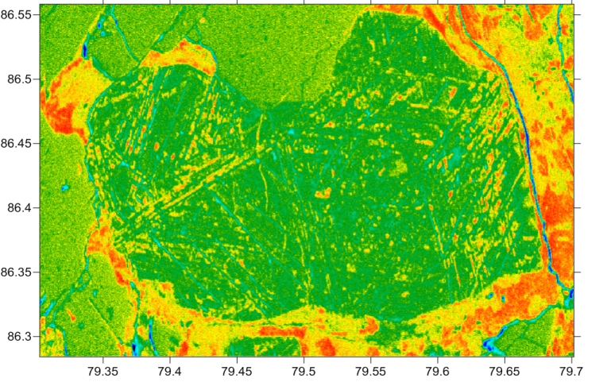

Traditional maps: raw oxygen counts
We must perform high accuracy quantitative x-ray mapping on a pixel by pixel basis (just as with our point analyses).
This not only provides major/trace quantification, but also x-ray map quantification of even low energy emission lines such as oxygen, nitrogen, carbon, etc.
Quantitative Mapping: background, dead time, matrix and interference corrected!

Slide 21
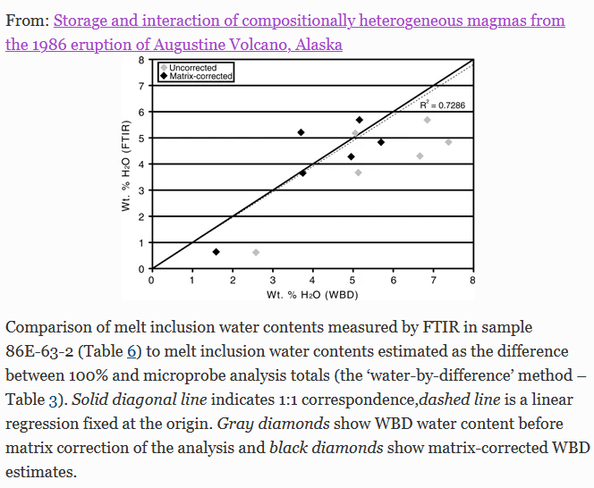
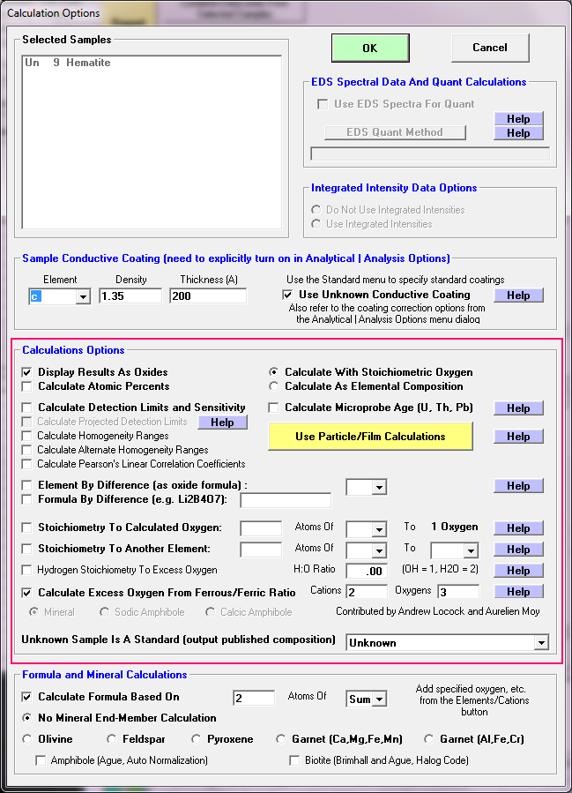
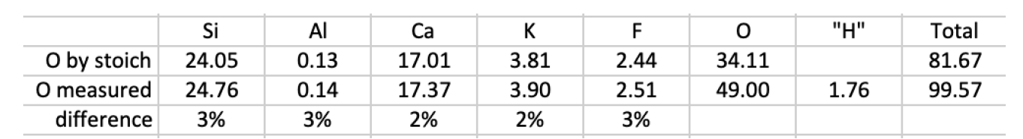
Errors due to “unanalyzed” elements!
Examples:
Excess oxygen when ferric iron is present
When water or hydroxyl are present in minerals and glasses
Carbon in carbonates
Boron, lithium, etc.
Also “excess” oxygen when halogens are present and oxygen is calculated by stoichiometry, e.g., fluor-phlogopite!
Roman et al., 2006
Fournelle et al., 2020

Slide 22
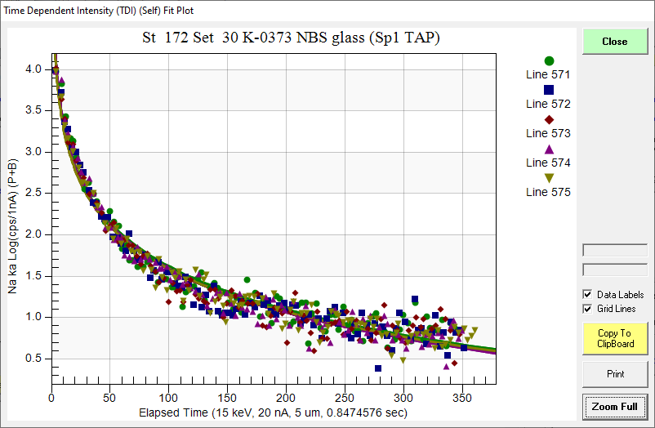
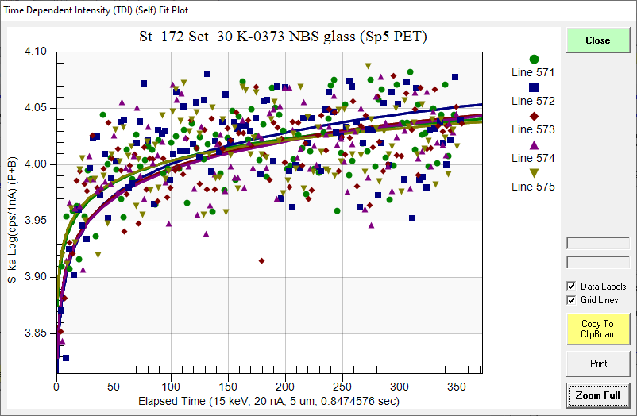
Beam Sensitivity for Major and Minor Elements
Y axis: Log Scale!
Na Ka
Si Ka

Slide 23
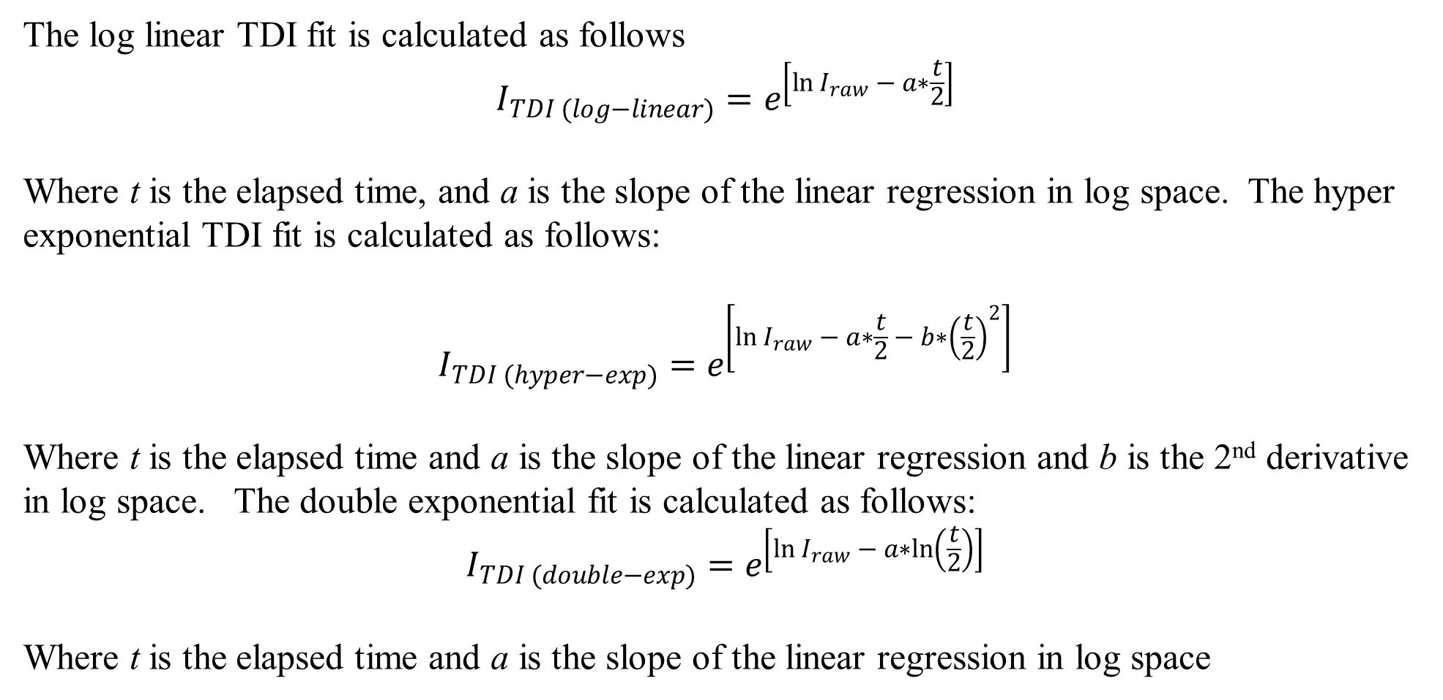
Time Dependent Intensity (TDI) Corrections
The log linear TDI fit is calculated as follows
$$I_{TDI (log−linear)}=e^{\left[\ln{I_{raw} − a∗\frac{t}{2}}\right]}$$
Where t is the elapsed time, and a is the slope of the linear regression in log space. The hyper exponential TDI fit is calculated as follows:
$$I_{TDI (hyper−exp)}=e^{\left[\ln{I_{raw} − a∗\frac{t}{2}} − b∗{\left(\frac{t}{2}\right)}^{2}\right]}$$
Where t is the elapsed time and a is the slope of the linear regression and b is the 2nd derivative in log space. The double exponential fit is calculated as follows:
$$I_{TDI (double−exp)}=e^{\left[\ln{I_{raw} − a∗ln\left(\frac{t}{2}\right)}\right]}$$
Where t is the elapsed time and a is the slope of the linear regression in log space

Slide 24
Beam Sensitivity, continued
Beam sensitive samples: require care, such as lower current (e.g. 1-6 nA) and/or defocused beam (10-25 μm), and/or a correction for intensity changes with time (e.g., “volatile element” or time dependent intensity (TDI) correction in the Probe for EPMA software)
This TDI correction should be performed iteratively with the matrix correction. Not off-line in Excel, because as the Na, K, Si and Al concentrations change, so does the matrix correction!
Glasses with alkalis (esp. Na), particularly hydrous glasses: Na drops precipitously, K somewhat, with Al and Si counts increasing over time!
Alkali feldspars, particularly albite: Na counts decrease
Carbonates and anhydrite: easily decompose with 10 nA
Apatite/micas: not as fragile, but some grains will crater with moderate currents (60 nA) after 40-60 seconds. Different orientation of apatite/micas for standard and unknown will have different TDI effects

Slide 25
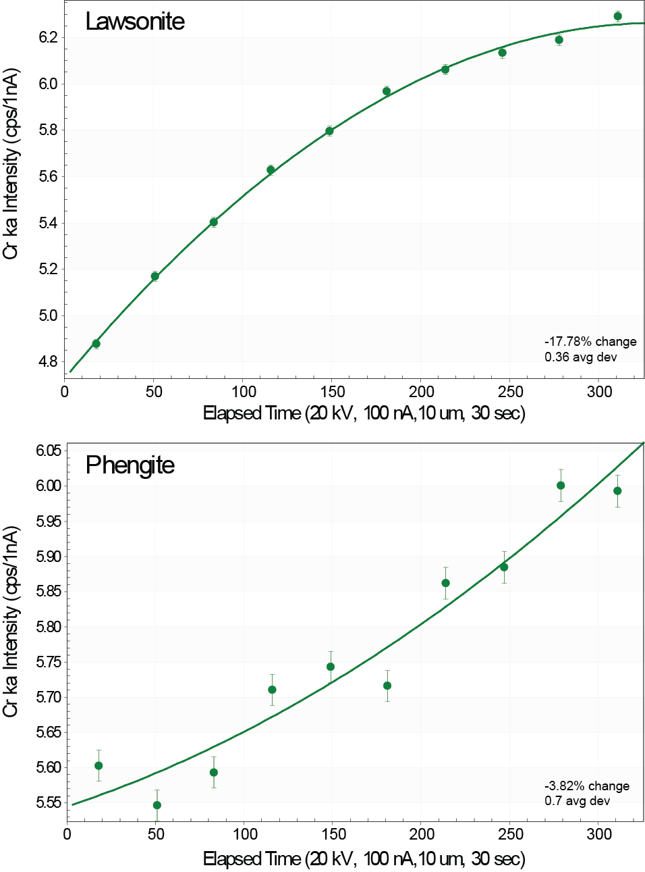
TDI curves for trace levels of Cr in lawsonite and phengite
Trace elements can be beam sensitive also!

Slide 26
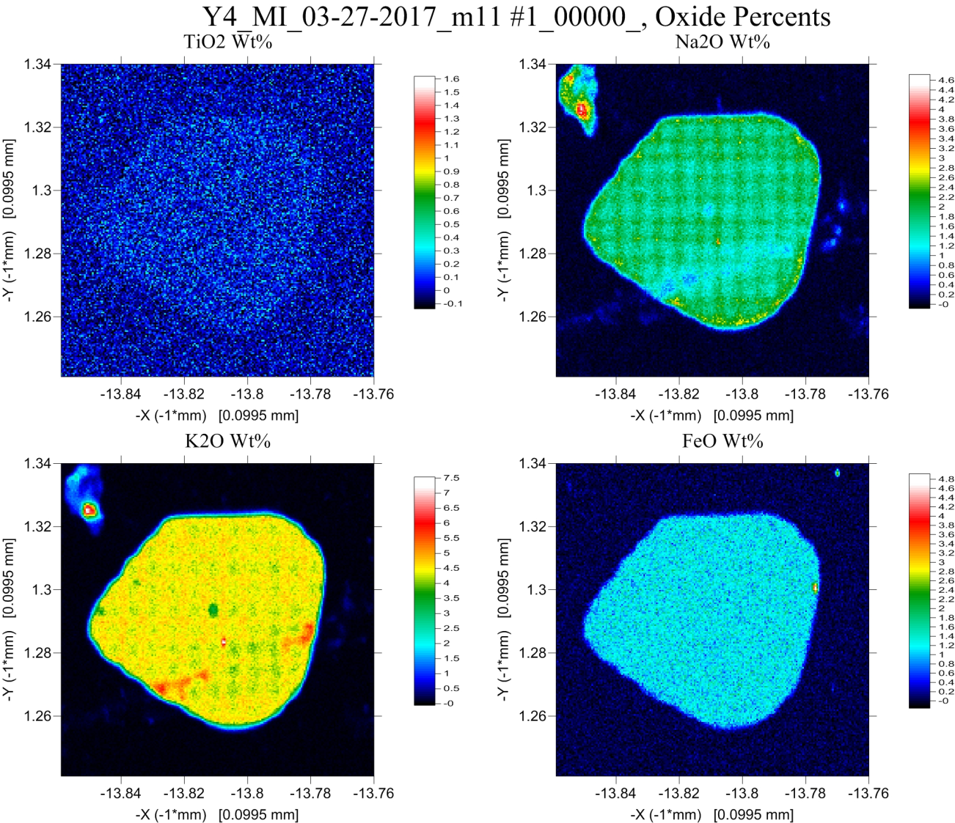
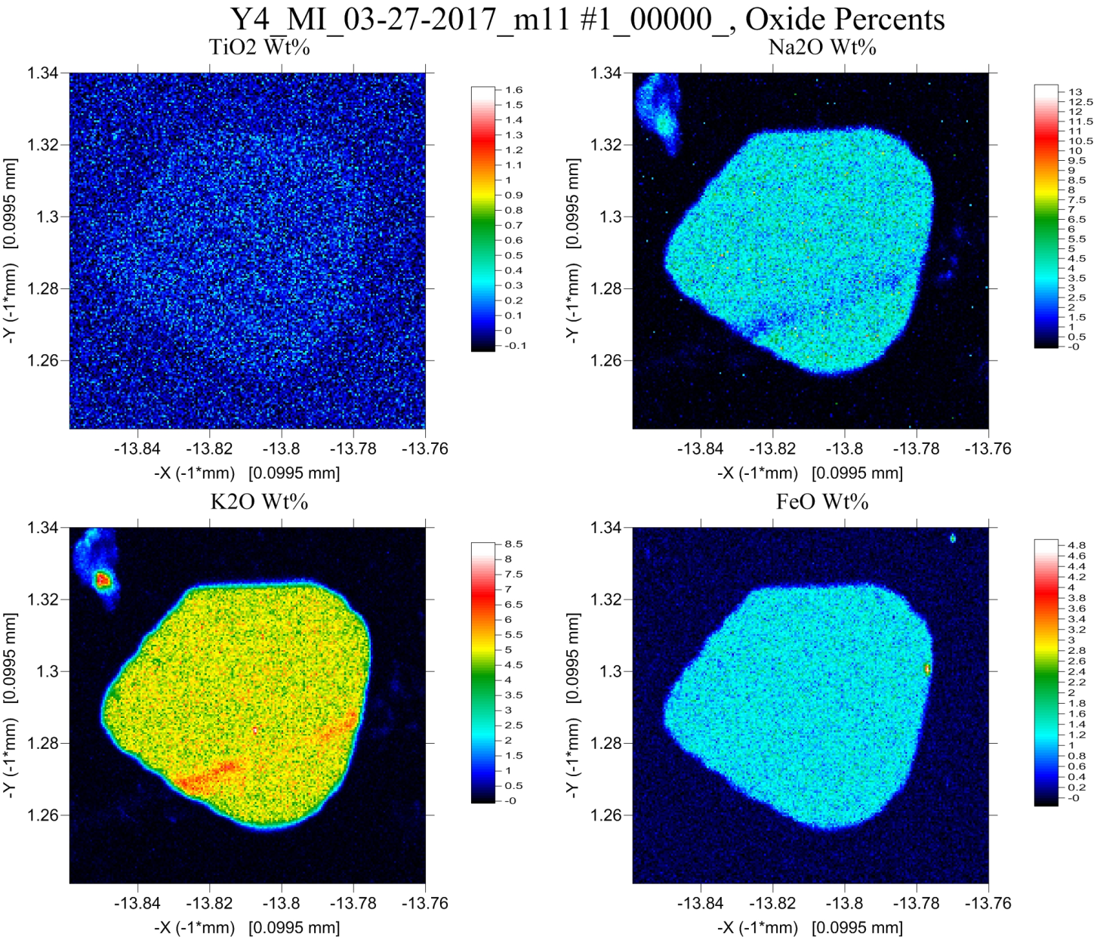
~1.8 wt% Na)
With TDI
Without TDI
~3.5 wt% Na)

Slide 27
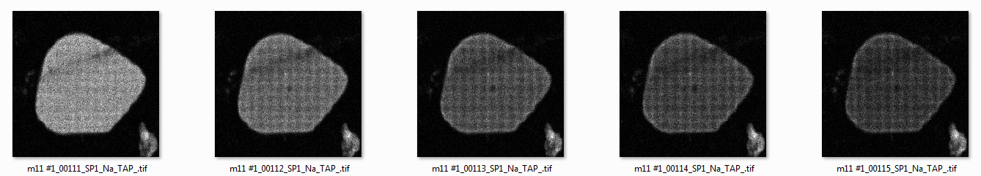
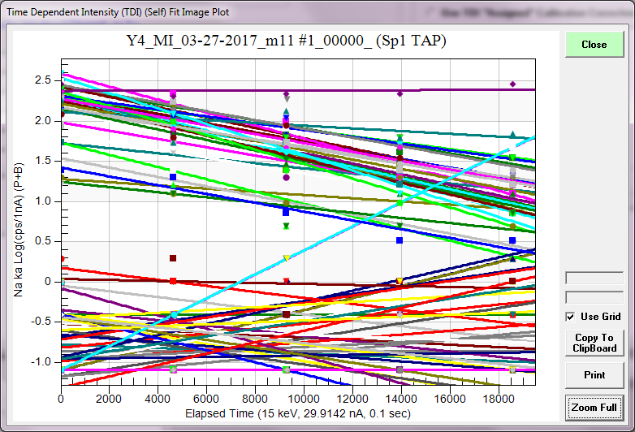
Na Intensities 100 msec pixel dwell time (5 frames)
BSE
glass
quartz

Slide 28
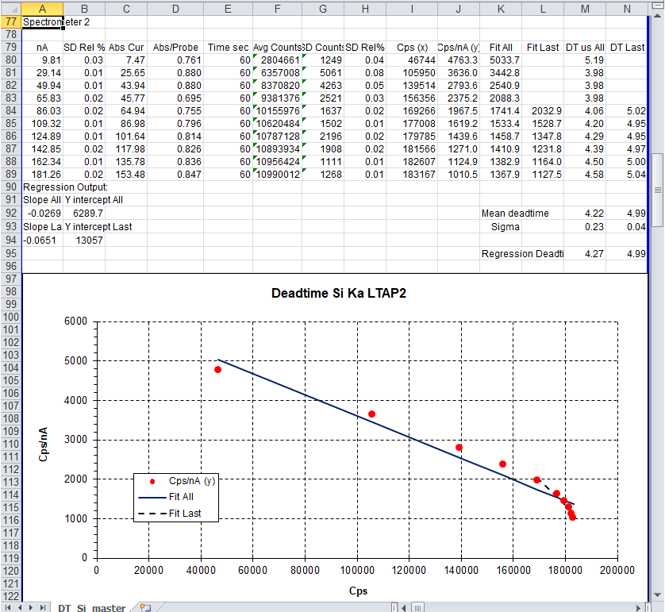
Dead Time in WDS Spectrometers Must be Routinely Re-Calibrated!
Because the WDS dead time correction is performed in software, how can we calibrate it accurately?
One cannot correct for non-linear response using a linear dead time expression.
We’ve had the evidence for these non-linear dead time effects in front of us for years, but never did anything about it.
Let examine how we might deal with these WDS non-linearities at higher count rates (higher beam currents).
From Paul Carpenter’s Excel DT spreadsheet

Slide 29
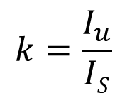
We all know what a k-ratio is…
K-ratio: the ratio of intensities between two materials measured using the same emission line, same electron beam energy, same detector take off angle (corrected for dead time and background).
$$k=\frac{I_{u}}{IS}$$
Problem: our most basic instrumental measurement, i.e., k-ratios, may not agree with one instrument to another instruments, but also not even within the same instrument on multiple spectrometers.
So aside from problems using different standards, in different labs and different matrix corrections in different software packages, we cannot always agree on simple intensity ratios when using the same standards!
What are the causes of these instrumental issues? Dead time calibrations (differences in count rates between standards and unknowns) and PHA adjustments (pulse height depression) are two sources of disagreement.
Spectrometer alignment, sample tilt and asymmetrical Bragg crystal diffraction (differences in effective take off angle) are other causes.
But here’s a question: should the intensity k-ratio remain *constant*
as a function of count rate, i.e., beam current?

Slide 30
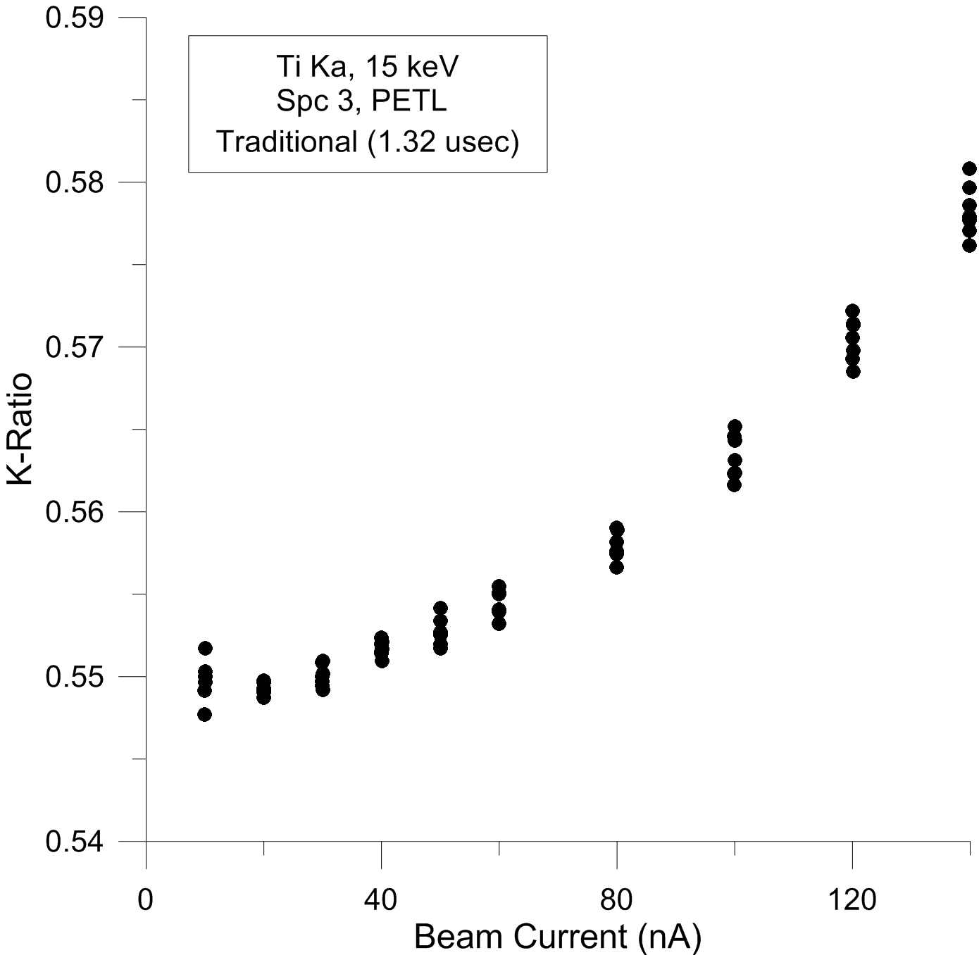
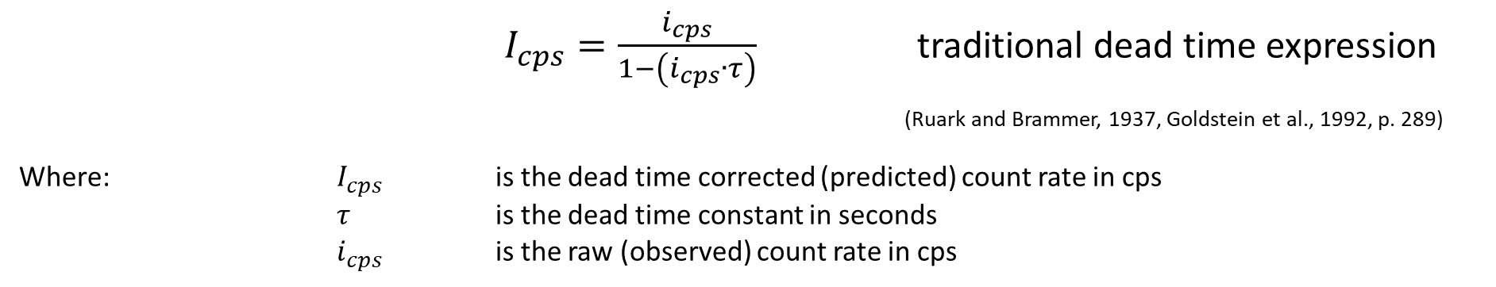
$I_{cps}=\frac{i_{cps}}{1−\left(i_{cps}∙τ\right)}$ traditional dead time expression
(Ruark and Brammer, 1937, Goldstein et al., 1992, p. 289)
Where: $I_{cps}$ is the dead time corrected (predicted) count rate in cps
$τ$ is the dead time constant in seconds
$i_{cps}$ is the raw (observed) count rate in cps
Ti Ka k-ratios from TiO₂/Ti metal from 10 nA (~28 kcps) to 140 nA (~400 kcps) on a PETL Bragg crystal at 15 keV. Depending on the value of the dead time constant, the measured k-ratios either increase or decrease with beam current because the Ti metal intensities in the denominator of each k-ratio are affected more than the TiO₂ secondary standard intensities (due to the difference in concentrations of Ti). Therefore dead time effects are observed more severely in the Ti metal primary standard intensities than in the TiO₂ secondary standard intensities providing the algorithmic leverage for determining the correct dead time constant.
Utilizing the traditional dead time correction expression with a dead time constant of 1.32 ms using the JEOL calibration works well at count rates under 30 nA (~80 kcps) but starts to fail at higher count rates. Until now, analysts have had to limit themselves to such low count rates for quantitative analysis.
Why is this?
JEOL calibration
~ 50 kcps

Slide 31
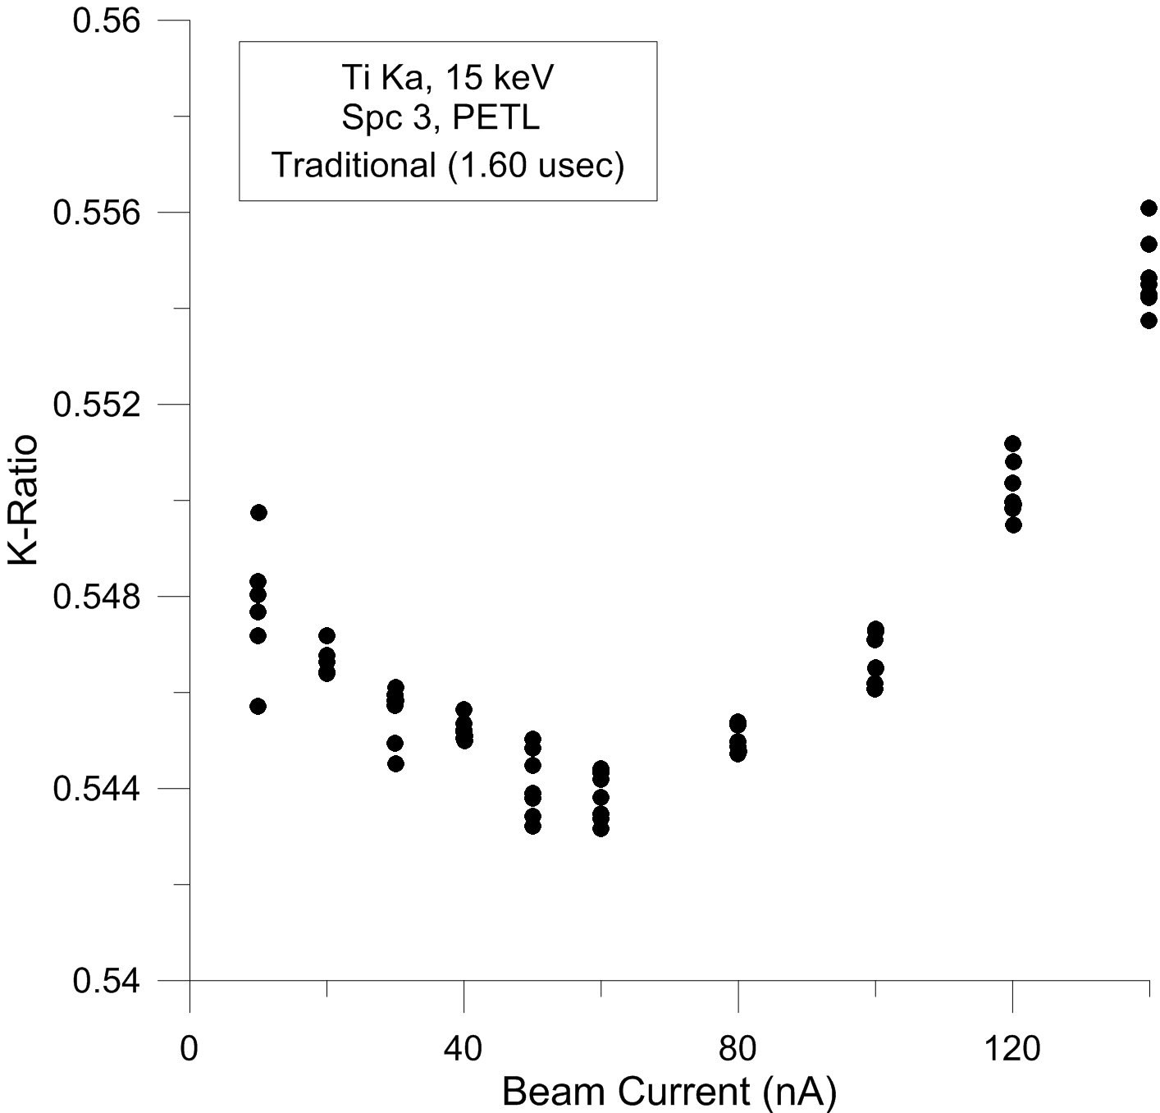
Over correction at low count rates, under correction at high count rates!
Attempting to correct high count rates using the traditional dead time expression by arbitrarily increasing the dead time constant, causes low count rates to be over corrected, and higher count rates to still be under corrected.
Demonstrating the non-linear response of the counting system which must therefore be corrected using a non-linear approach.

Slide 32
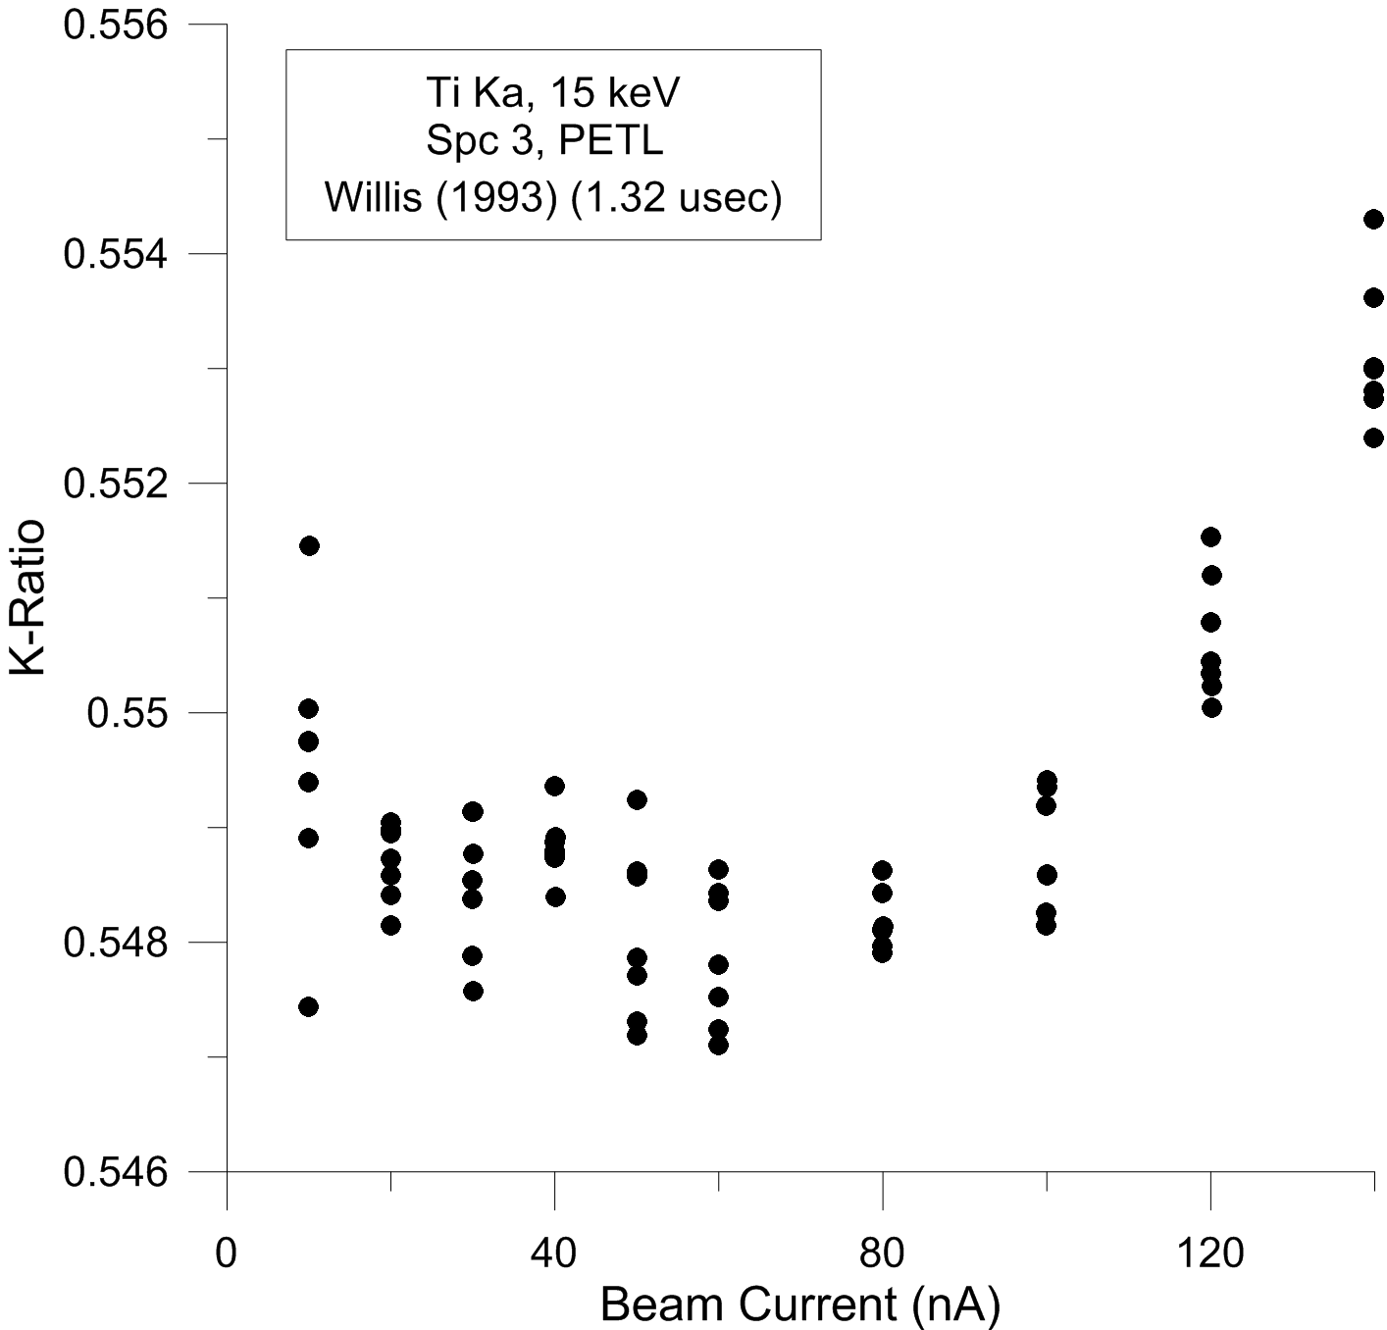
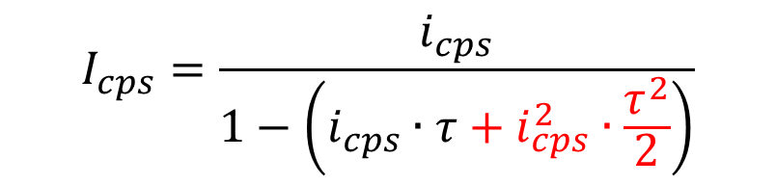
$$I_{cps}=\frac{i_{cps}}{1−\left(i_{cps}∙τ+i_{cps}^{2}∙\frac{τ^{2}}{2}\right)}$$
A significant improvement in dead time prediction accuracy at these higher count rates has been described by the use of an additional term in the traditional expression as shown here from Willis (1993).
This expression was originally developed for calculating work function “dead time” for training of early neural networks and has now been applied to microanalysis and found useful for correction of observed count rates up to roughly 100 kcps.
Plotting the same Ti Ka k-ratio data from before, the Willis (1993) two term dead time expression properly corrects the data at low to moderate count rates, but still fails at count rates over ~200 kcps (~280 kcps on Ti metal at 100 nA).
~ 100 kcps

Slide 33
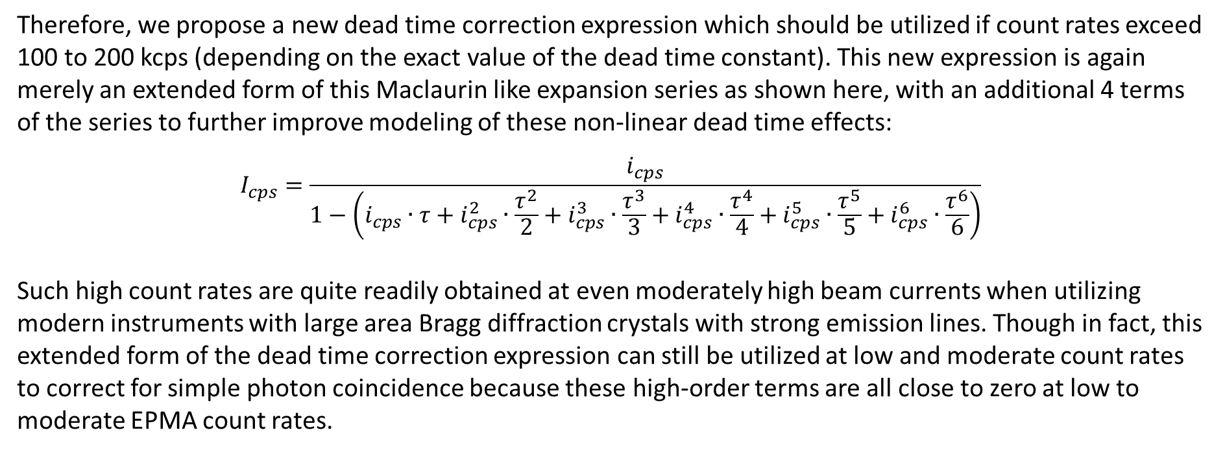
The probabilities are infinite…
Upon recognizing that the Willis expression is merely the first two terms of an infinite Maclaurin expansion series, we can simply increase the number of infinitesimal terms to effectively deal with even higher count rates.
Therefore, we propose a new dead time correction expression which should be utilized if count rates exceed 100 to 200 kcps (depending on the exact value of the dead time constant). This new expression is again merely an extended form of this Maclaurin like expansion series as shown here, with an additional 4 terms of the series to further improve modeling of these non-linear dead time effects:
$$I_{cps}=\frac{i_{cps}}{1−\left(i_{cps}∙τ+i_{cps}^{2}∙\frac{τ^{2}}{2}+i_{cps}^{3}∙\frac{τ^{3}}{3}+i_{cps}^{4}∙\frac{τ^{4}}{4}+i_{cps}^{5}∙\frac{τ^{5}}{5}+i_{cps}^{6}∙\frac{τ^{6}}{6}\right)}$$
Such high count rates are quite readily obtained at even moderately high beam currents when utilizing modern instruments with large area Bragg diffraction crystals with strong emission lines. Though in fact, this extended form of the dead time correction expression can still be utilized at low and moderate count rates to correct for simple photon coincidence because these high-order terms are all close to zero at low to moderate EPMA count rates.

Slide 34
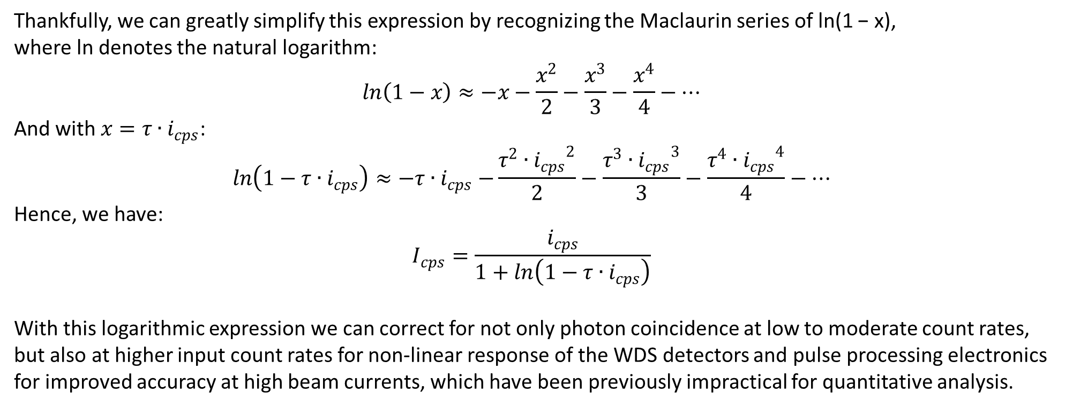
Thankfully, we can greatly simplify this expression by recognizing the Maclaurin series of ln(1 − x), where ln denotes the natural logarithm:
$$ln\left(1−x\right)≈−x−\frac{x^{2}}{2}−\frac{x^{3}}{3}−\frac{x^{4}}{4}−…$$
And with $x=τ{∙i}_{cps}$:
$$ln\left(1−τ{∙i}_{cps}\right)≈−τ{∙i}_{cps}−\frac{τ^{2}{{∙i}_{cps}}^{2}}{2}−\frac{τ^{3}{{∙i}_{cps}}^{3}}{3}−\frac{τ^{4}{{∙i}_{cps}}^{4}}{4}−…$$
Hence, we have:
$$I_{cps}=\frac{i_{cps}}{1+ln\left(1−τ{∙i}_{cps}\right)}$$
With this logarithmic expression we can correct for not only photon coincidence at low to moderate count rates, but also at higher input count rates for non-linear response of the WDS detectors and pulse processing electronics for improved accuracy at high beam currents, which have been previously impractical for quantitative analysis.
John Donovan, Aurélien Moy, Anette von der Handt, Zack Gainsforth, James Maner, William Nachlas and John Fournelle (2023) “A New Method for Dead Time Calibration and a New Expression for Correction of WDS Intensities for Microanalysis”, Microscopy & Microanalysis
Once again, all of these new expressions yield identical results to the traditional expression, at sufficiently low count rates and therefore this logarithmic expression can be applied at low, moderate and high beam currents (proxy for count rates).

Slide 35
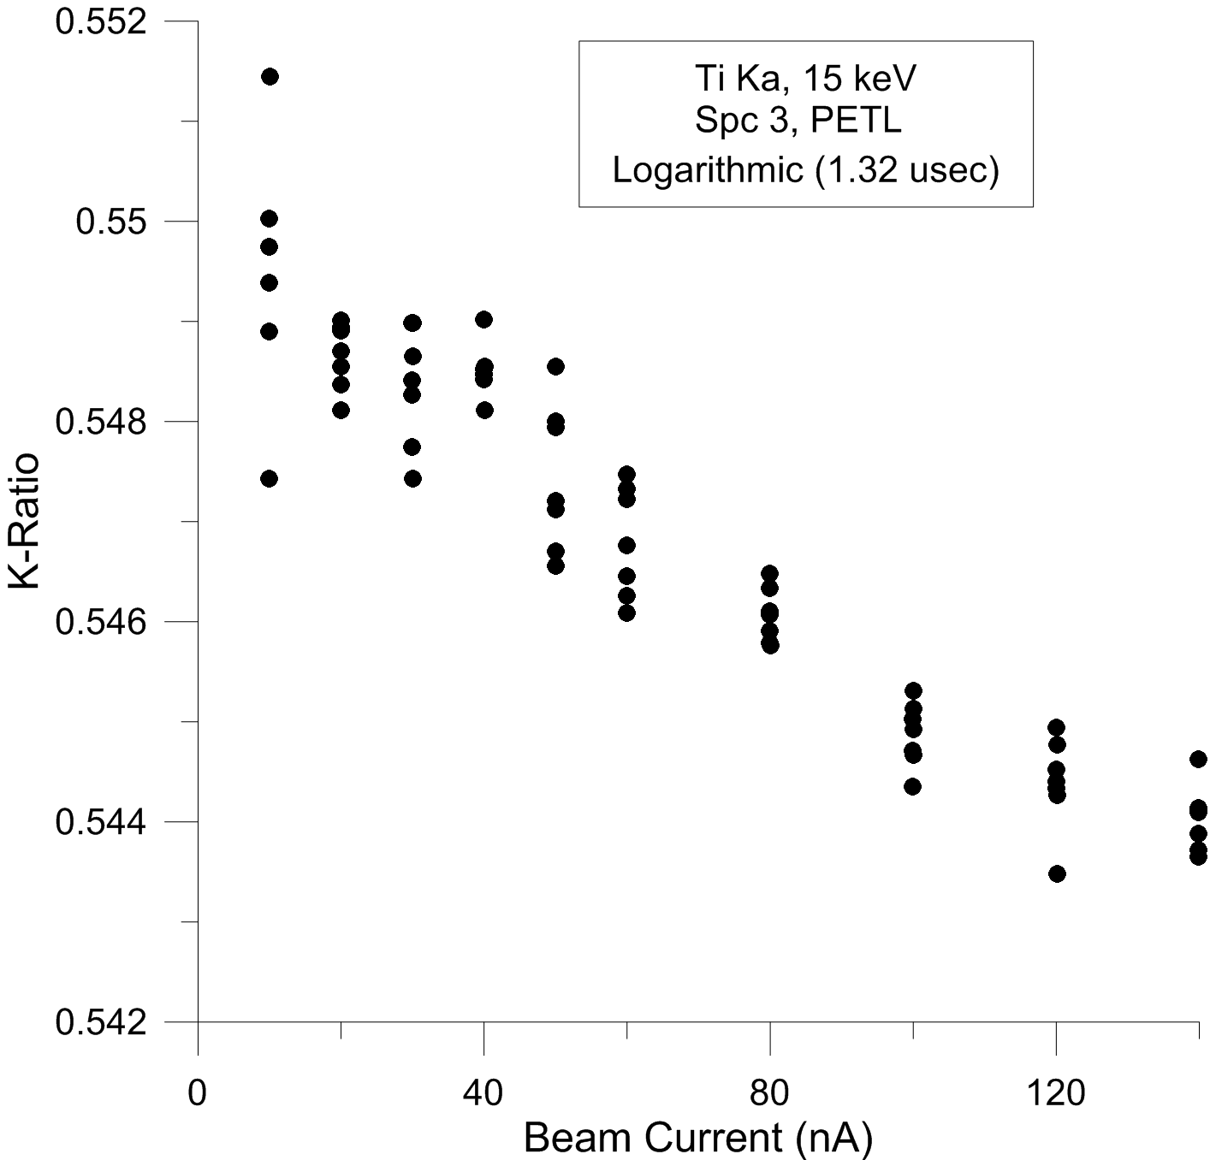
Again plotting the Ti Ka k-ratio data as before, the logarithmic expression slightly over corrects the Ti Ka k-ratios at high count rates when using a dead time constant originally calibrated using the traditional linear fit method.
Due to non-linear effects of the detector and pulse processing electronics at high count rates, the traditional expression produces dead time constants which are slightly biased towards higher values when utilizing count rates over ~50 kcps because these non-linear effects are present even at low count rates to some degree.
In fact the dead time constant is a “parametric” constant since its exact value depends on the form of the dead time expression utilized to measure it.

Slide 36
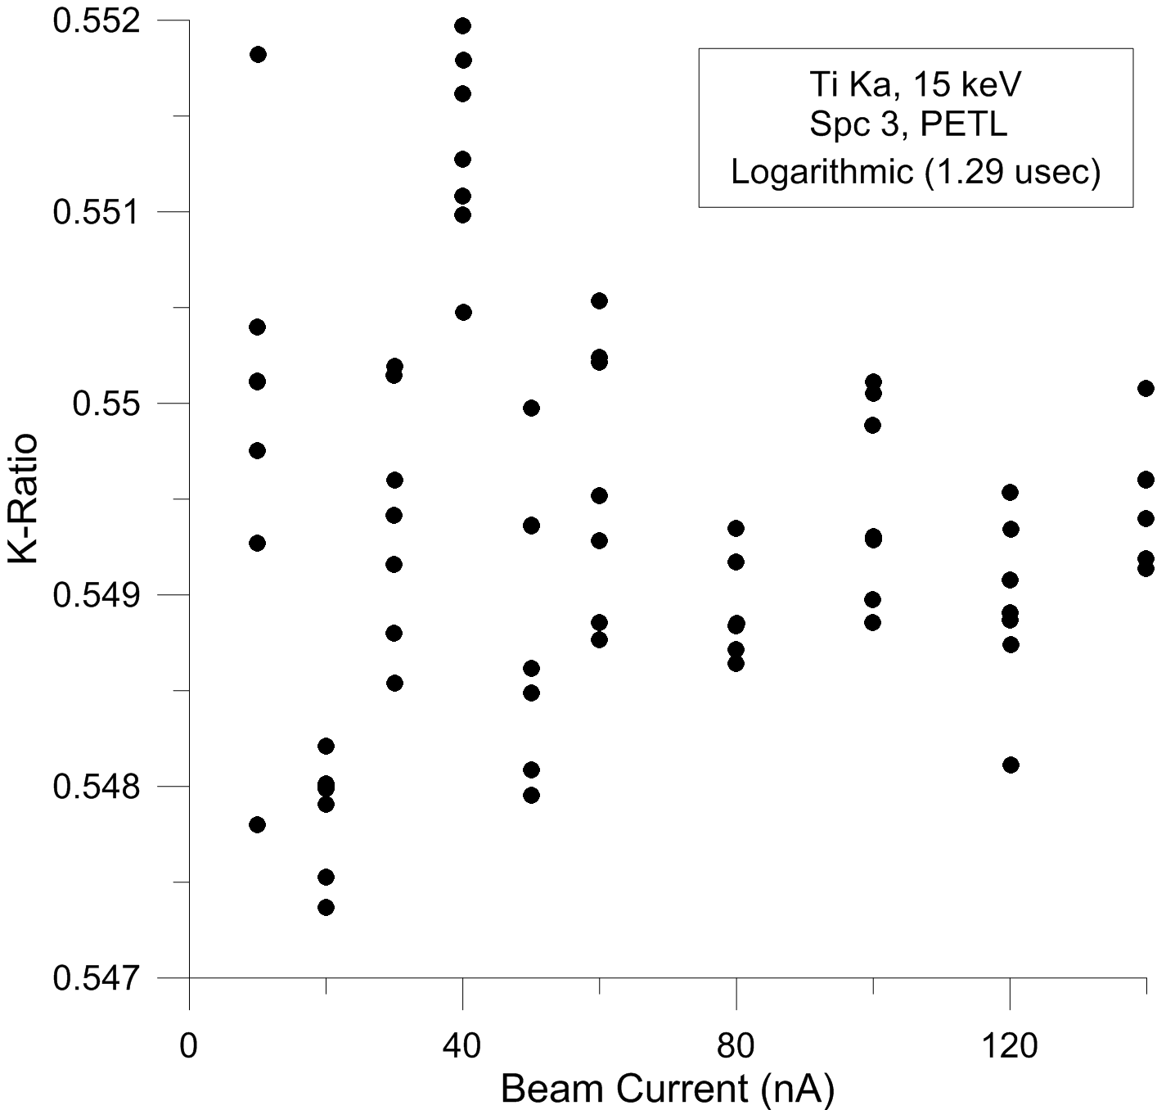
Ti Ka k-ratios corrected using the logarithmic dead time expression where the dead time (parametric) constant was adjusted slightly, from 1.32 µs to 1.29 µs. We now obtain a relatively constant k-ratio (within statistics) over a wide range of count rates/beam currents suitable for quantitative analysis even at count rates up to ~400 kcps.
The sensitivity of the constant k-ratio method is quite apparent in this figure by noting the relatively small range of k-ratios displayed on the y-axis.

Slide 37
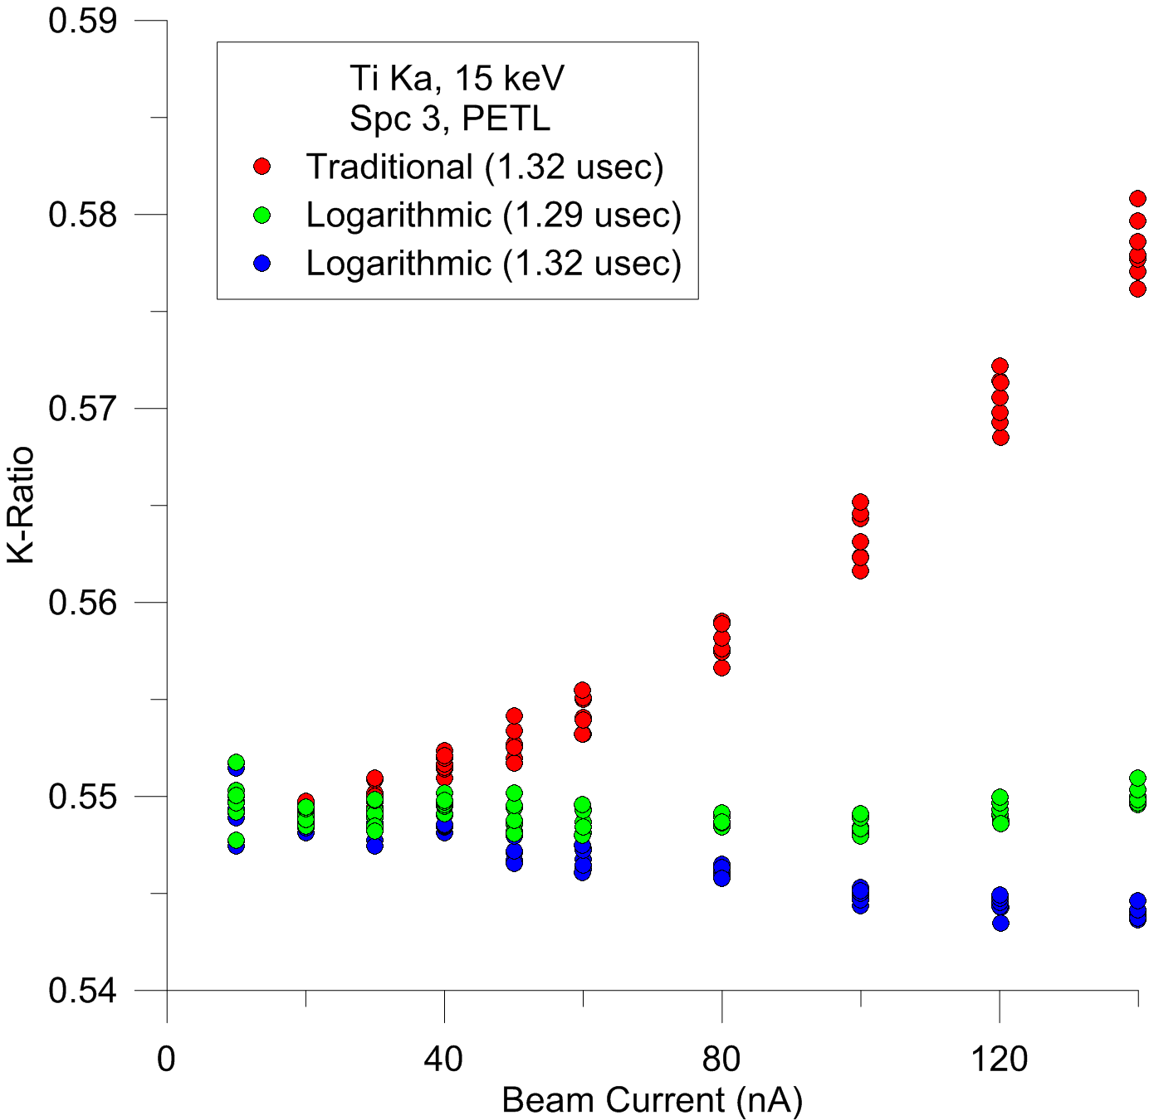
Combined plot of k-ratios versus beam current showing the traditional dead time expression using the dead time constant obtained from the traditional calibration of dead time (per JEOL engineer) of 1.32 µs (red symbols).
The same data plotted using the logarithmic expression also using a dead time constant of 1.32 µs (blue symbols).
And the same data plotted using the logarithmic expression using a dead time constant of 1.29 µs (green symbols) which was adjusted to yield a zero slope regression over a large range of beam currents (count rates from ~28 kcps to ~400 kcps).

Slide 38
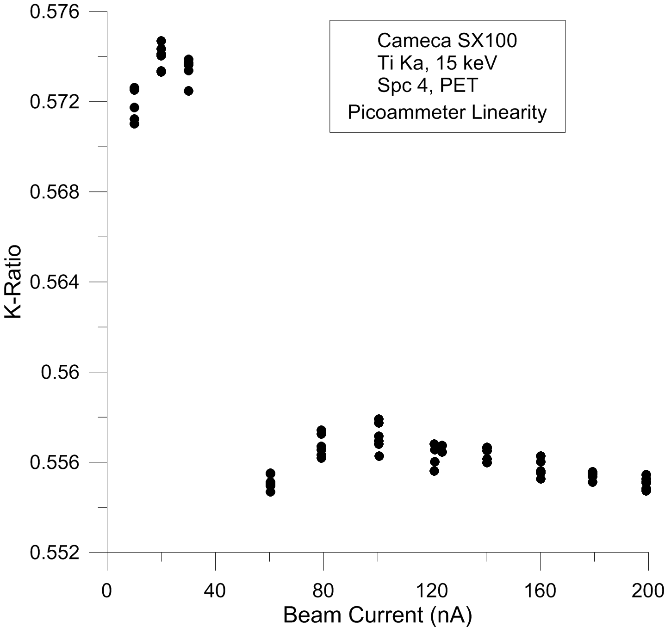
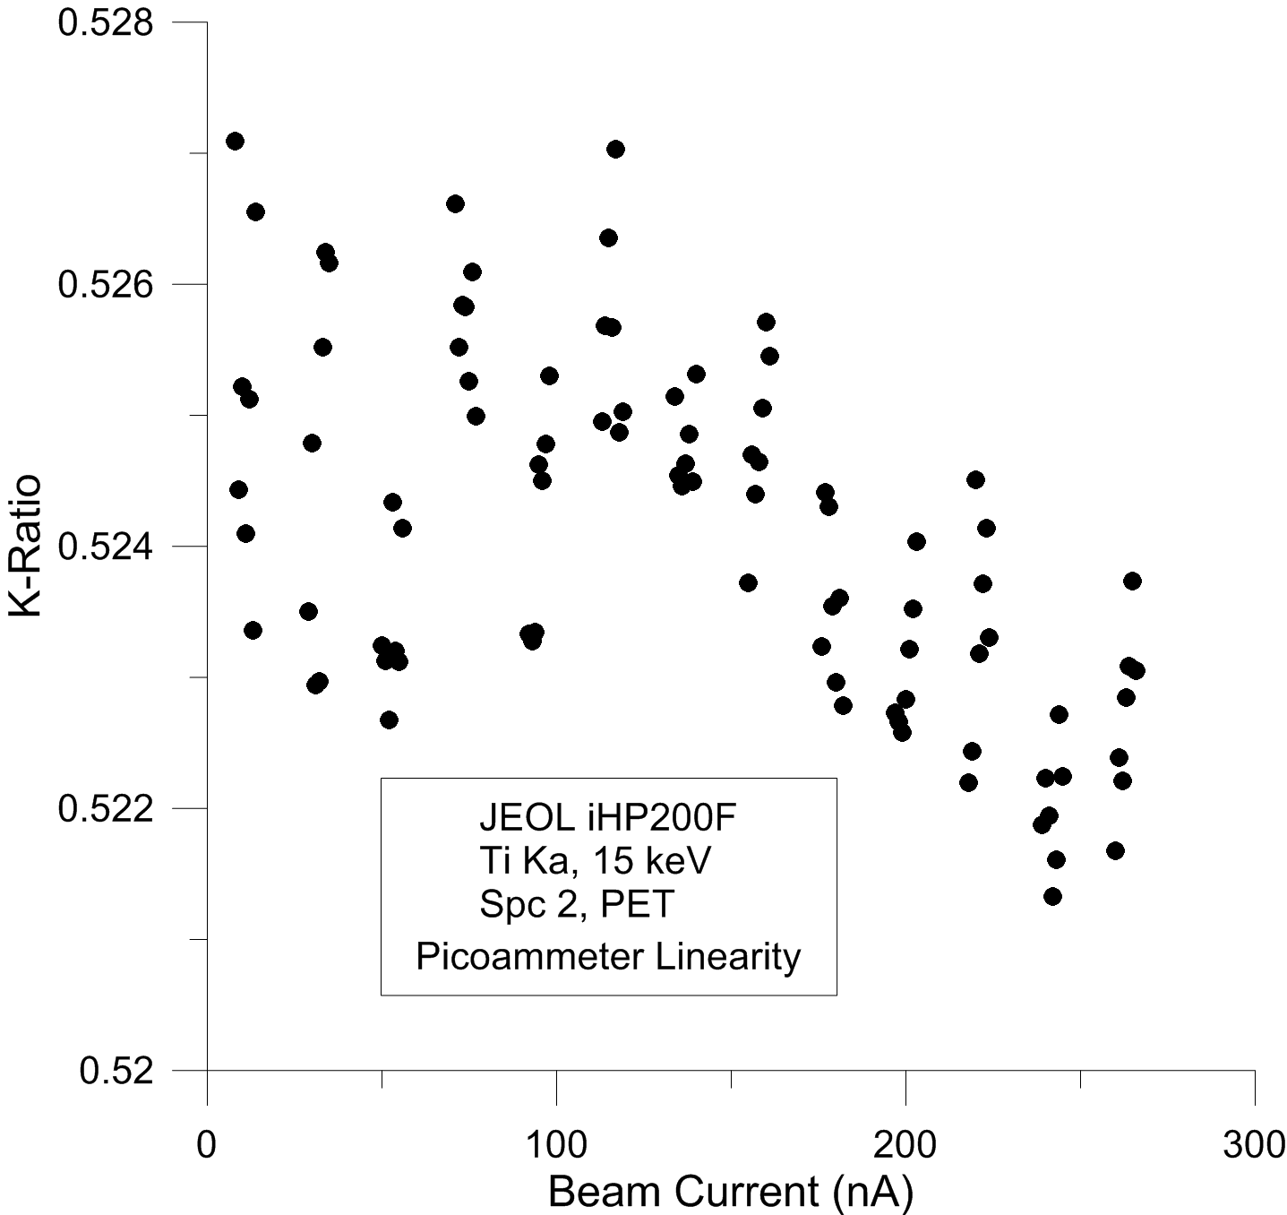
a
Is your picoammeter response linear?
By plotting our secondary (TiO₂) standard k-ratios measured at multiple beam currents, against a single primary standard (Ti metal) measured at a single beam current (10 nA), we can test the linearity of our picoammeter over a range of beam currents by extrapolating from our primary standard.
In (a) the Cameca SX100 instrument picoammeter linearity is plotted from 10 to 200 nA showing excessive non-linearity at the 50 nA “crossover” threshold region, thus requiring adjustment of the picoammeter circuits using a calibrated current source.
In (b) the JEOL iHP200F instrument picoammeter linearity is also plotted from 10 to 200 nA showing relatively low levels of non-linearity over the entire range of beam current.
b

Slide 39
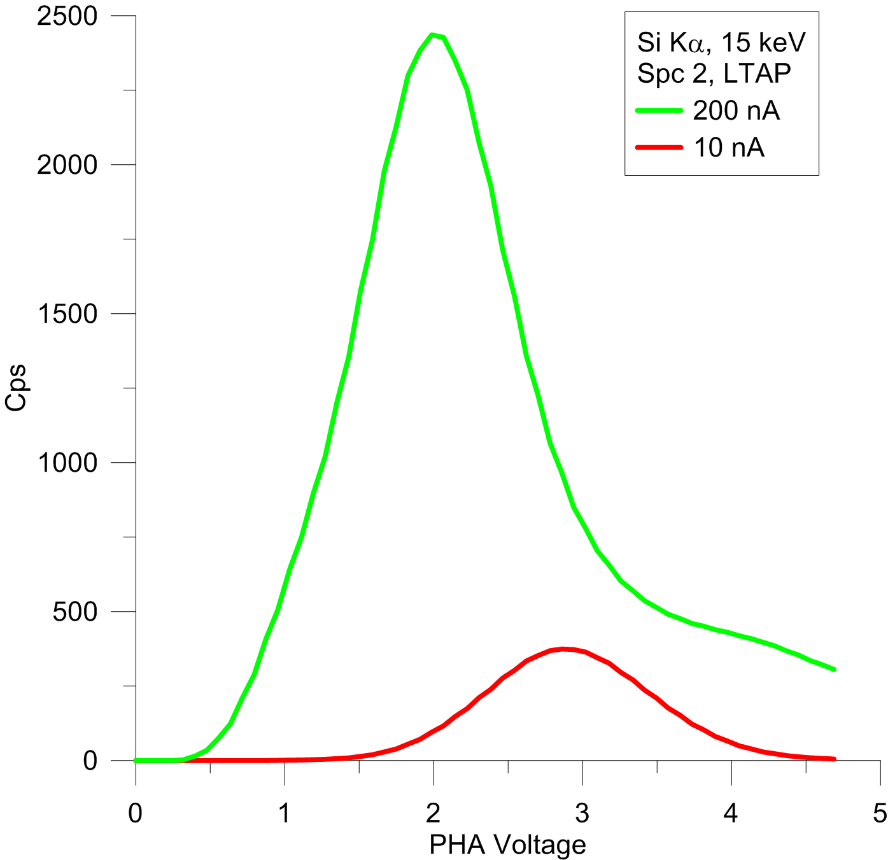
Properly adjusted PHA settings allow quantitative analysis over a large range of beam currents (proxy for count rates). It is critical to adjust ones PHA settings to ensure that at the highest count rates expected to be encountered (highest expected beam current and highest expected concentration), the PHA peak is completely above the baseline setting.
Although the PHA scan at 200 nA appears to be cut off above ~4.7v, surprisingly in “integral” PHA mode all pulses above the baseline level are still integrated for quantitative analysis, as determined by measurements of intensities over range of gain/bias settings on both Cameca and JEOL instruments.
Baseline
voltage
Yes, this is OK in Integral mode!

Slide 40
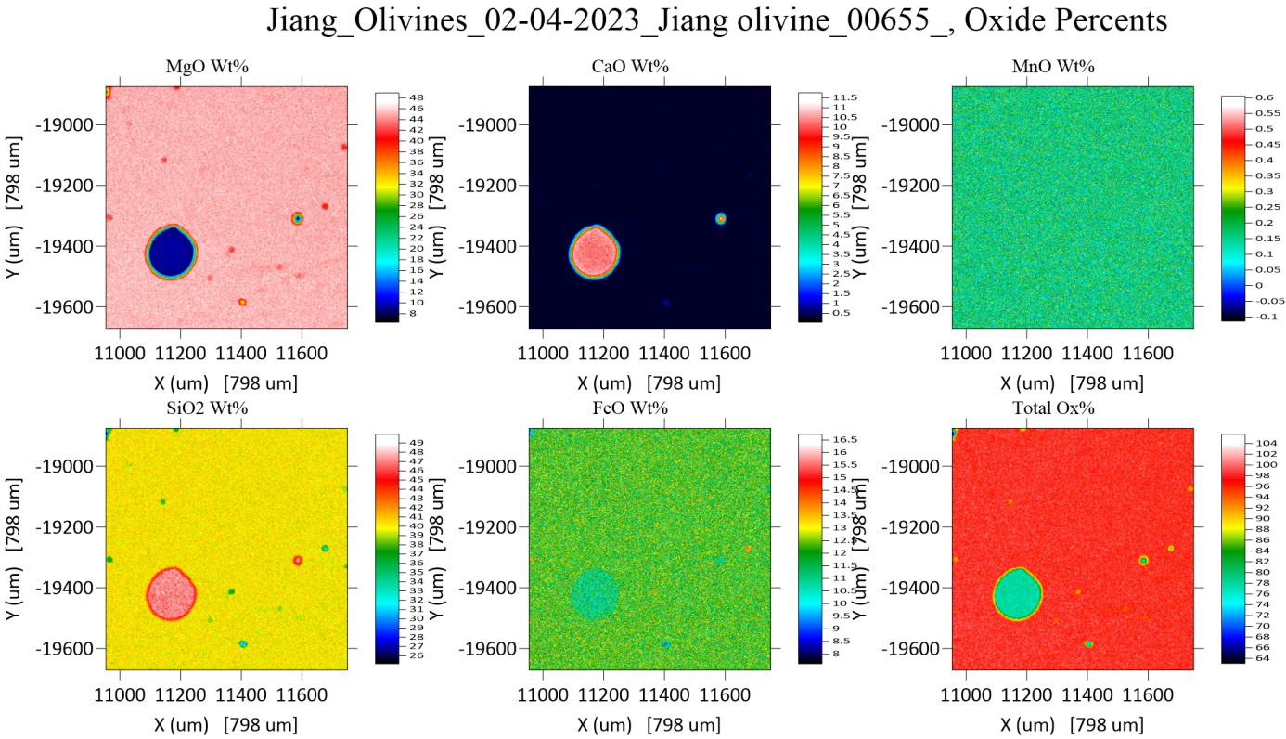
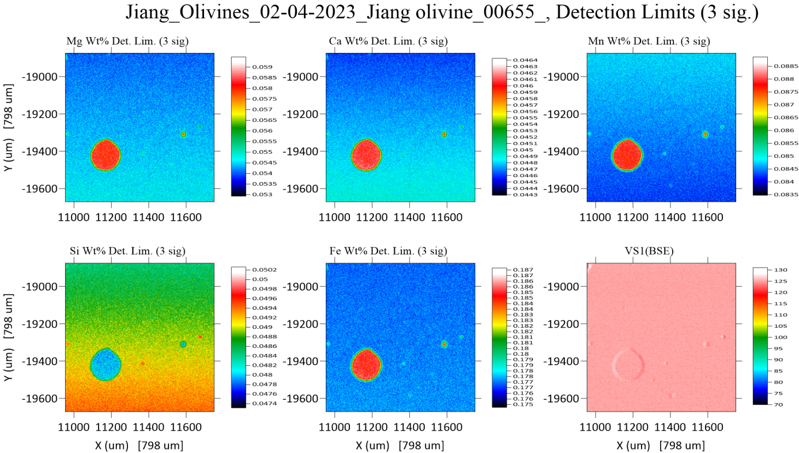
50 ms, 15 keV, stds at 30 nA, unks at 200 nA

Slide 41
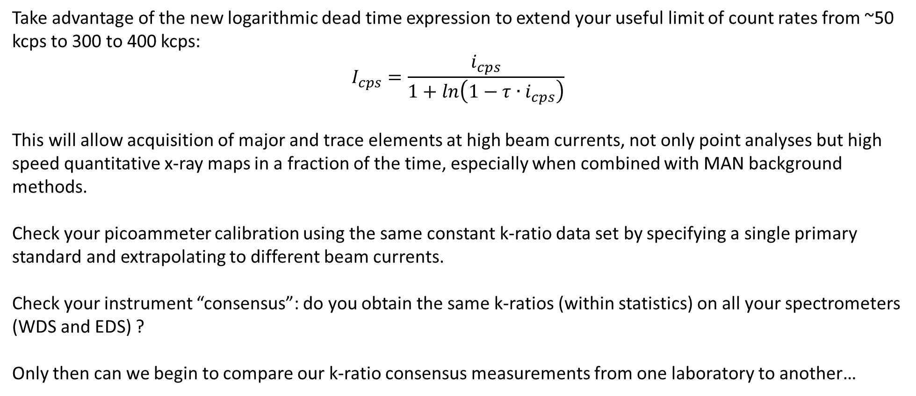
Conclusions (constant k-ratio calibrations)
Utilize the constant k-ratio method to calibrate your instrument dead time values regardless of which dead time expression you may be utilizing.
Donovan, John J., et al. "A New Method for Dead Time Calibration and a New Expression for Correction of WDS Intensities for Microanalysis." Microscopy and Microanalysis 29.3 (2023): 1096-1110.
Take advantage of the new logarithmic dead time expression to extend your useful limit of count rates from ~50 kcps to 300 to 400 kcps:
$$I_{cps}=\frac{i_{cps}}{1+ln\left(1−τ{∙i}_{cps}\right)}$$
This will allow acquisition of major and trace elements at high beam currents, not only point analyses but high speed quantitative x-ray maps in a fraction of the time, especially when combined with MAN background methods.
Check your picoammeter calibration using the same constant k-ratio data set by specifying a single primary standard and extrapolating to different beam currents.
Check your instrument “consensus”: do you obtain the same k-ratios (within statistics) on all your spectrometers (WDS and EDS) ?
Only then can we begin to compare our k-ratio consensus measurements from one laboratory to another…

Slide 42
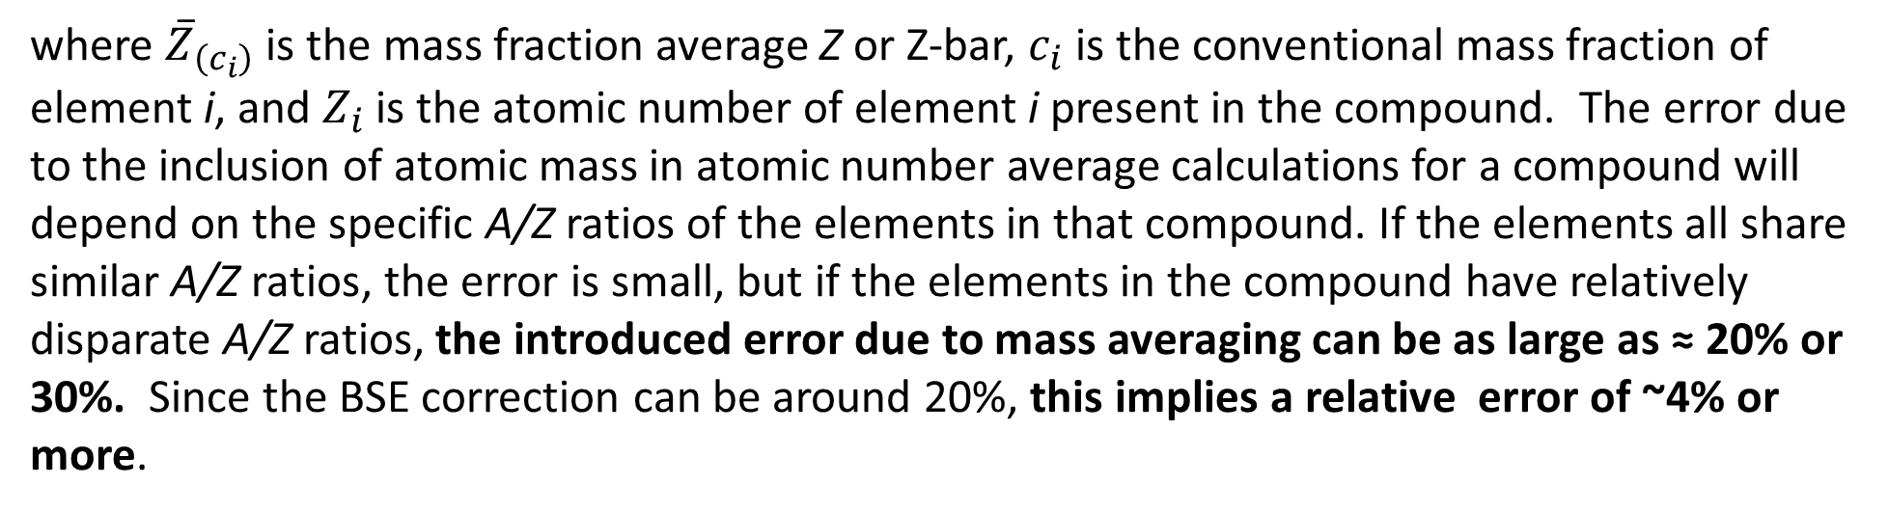
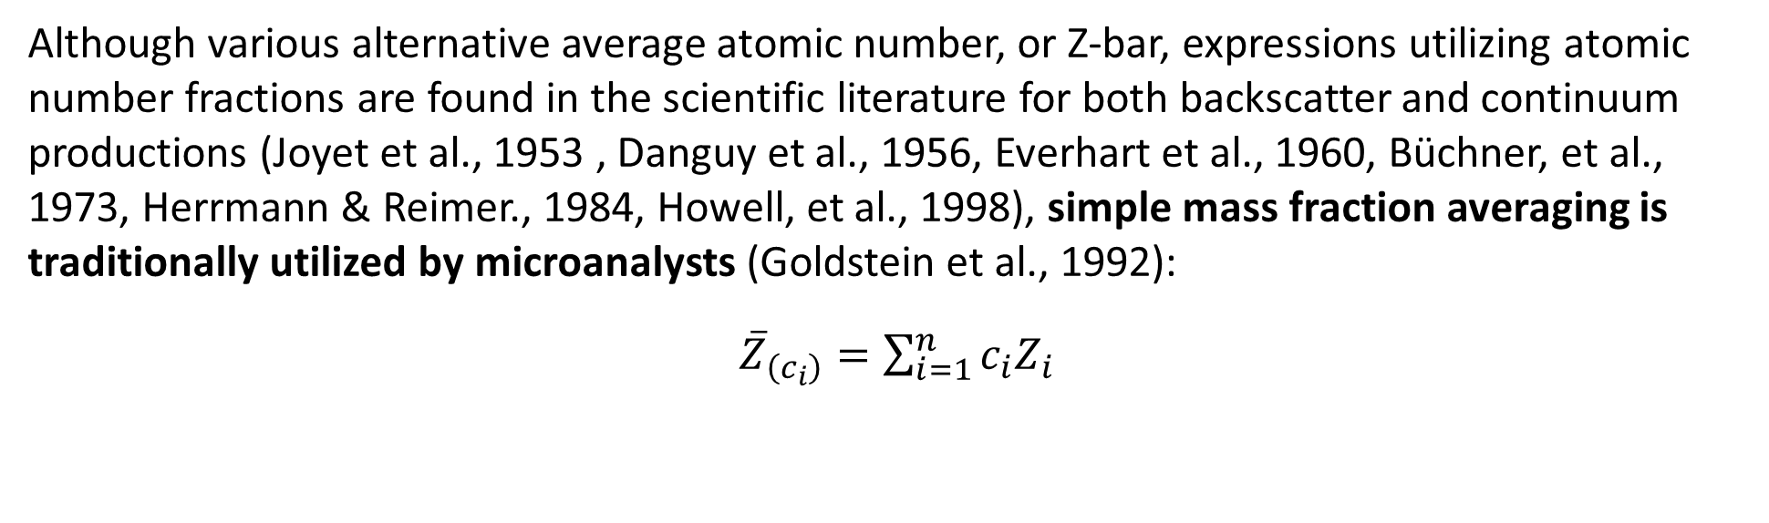
New DAM (Donovan and Moy) Backscatter Correction
Although various alternative average atomic number, or Z-bar, expressions utilizing atomic number fractions are found in the scientific literature for both backscatter and continuum productions (Joyet et al., 1953 , Danguy et al., 1956, Everhart et al., 1960, Büchner, et al., 1973, Herrmann & Reimer., 1984, Howell, et al., 1998), simple mass fraction averaging is traditionally utilized by microanalysts (Goldstein et al., 1992):
${\overline{Z}}_{\left(c_{i}\right)}=\sum_{i=1}^{n}{c_{i}Z_{i}}$
where ${\overline{Z}}_{\left(c_{i}\right)}$ is the mass fraction average Z or Z-bar, $c_{i}$ is the conventional mass fraction of element i, and $Z_{i}$ is the atomic number of element i present in the compound. The error due to the inclusion of atomic mass in atomic number average calculations for a compound will depend on the specific A/Z ratios of the elements in that compound. If the elements all share similar A/Z ratios, the error is small, but if the elements in the compound have relatively disparate A/Z ratios, the introduced error due to mass averaging can be as large as ≈ 20% or 30%. Since the BSE correction can be around 20%, this implies a relative error of ~4% or more.

Slide 43
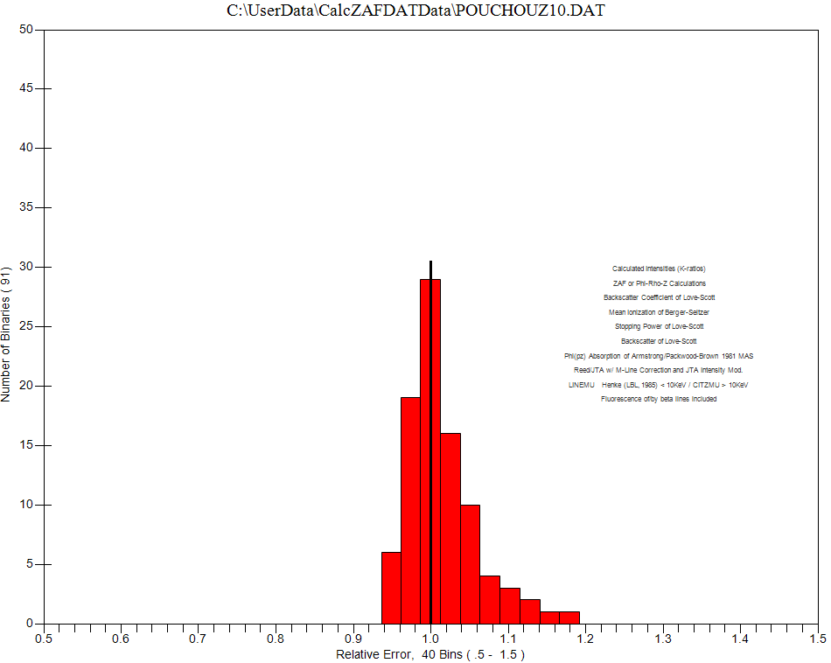
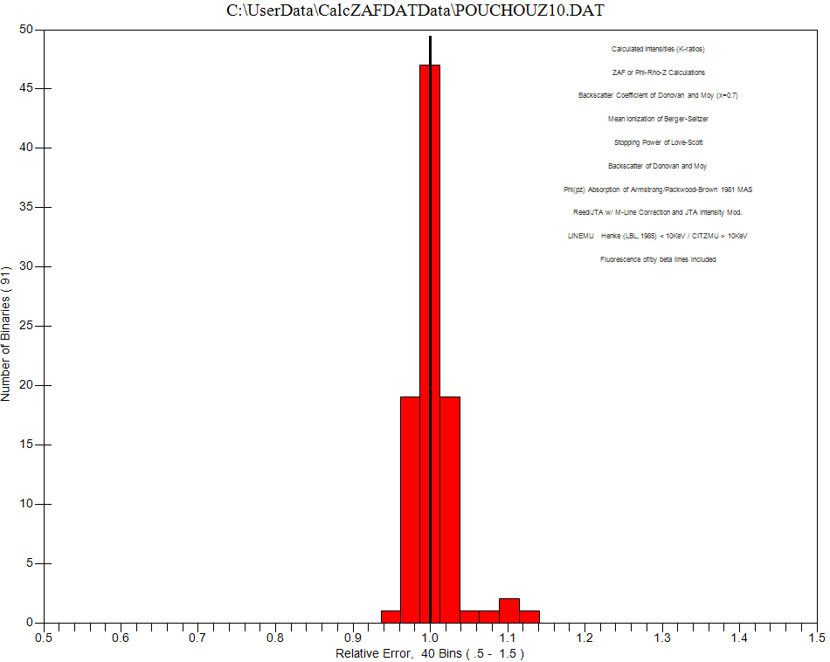
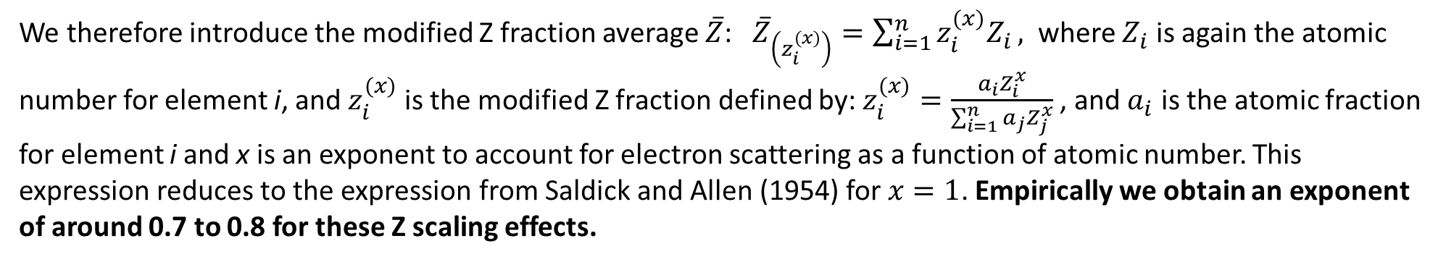
We therefore introduce the modified Z fraction average $\overline{Z}$: ${\overline{Z}}_{\left(z_{i}^{(x)}\right)}=\sum_{i=1}^{n}{z_{i}^{(x)}Z_{i}},$ where $Z_{i}$ is again the atomic number for element i, and $z_{i}^{(x)}$ is the modified Z fraction defined by: $z_{i}^{(x)}=\frac{a_{i}Z_{i}^{x}}{\sum_{i=1}^{n}{a_{j}Z_{j}^{x}}}$, and $a_{i}$ is the atomic fraction for element i and x is an exponent to account for electron scattering as a function of atomic number. This expression reduces to the expression from Saldick and Allen (1954) for $x=1$. Empirically we obtain an exponent of around 0.7 to 0.8 for these Z scaling effects.
Donovan, John, et al. "An Improved Average Atomic Number Calculation for Estimating Backscatter and Continuum Production in Compounds." Microscopy and Microanalysis 29.4 (2023): 1436-1449.
Mass based backscatter correction
Z based backscatter correction

Slide 44
Best Practices for Trace Elements
Use a high concentration primary standard for best trace statistics. The matrix correction and dead time are less dominant when extrapolated to trace levels!
Perform high precision wavescans to check your backgrounds, or use the MAN background correction to avoid off-peak interferences.
Use a zero blank as a “secondary” standard, to test your ability to measure a zero concentration (accuracy). Any trace level below 1 or 2 PPM is essentially a zero in EPMA!
Check for spectral (on-peak) interferences and perform a quantitative interference correction if necessary.

Slide 45



“Trace” Ti in quartz adjacent to rutile (not chemical diffusion!)
Borisova et al., Secondary Fluorescence effects in microbeam analysis, Chemical Geology, 490, 22-29, (2018)
“Trace” Co in copper adjacent to
cobalt (not chemical diffusion!)
https://probesoftware.com/smf/index.php?topic=58.0

Slide 46



Spectral Interferences
Use a fully quantitative matrix corrected and iterated method that is rigorously accurate even for extreme overlap situations such as “cascade” (A -> B -> C) and “pathological” (A <-> B) overlap situations.

Slide 47


Quantitative Spectral Interference Corrections
w/o interference correction
w/ interference correction
Mo concentrations in the two phases are statistically similar after a quantitative (matrix corrected) interference correction!

Slide 48


Quantitative Interference Correction
Without Interference Correction
With Interference Correction
Chalcopyrite
Mo ~1.2 wt.%
Pyrite
Mo ~1.9 wt.%
But wait, what about this phase?
This is the Mo bearing phase
with ~0.2 wt.%!
Now both phases are
statistically similar
~ 600 ppm
J. J. Donovan, D. A. Snyder and M. L. Rivers, "An Improved Interference Correction for Trace Element Analysis" Microbeam Analysis, 2: 23-28, 1993

Slide 49

Complex Backgrounds
Allaz, 2011

Slide 50


Alternative Methods for Background Determination
Mean Atomic Number (MAN) Method
Multi-Point Background (MPB) Method
Donovan, Singer and Armstrong, "A New EPMA Method for Fast Trace Element Analysis in Simple Matrices", American Mineralogist, v101, p1839-1853, (2016)
Jercinovic, M. J., et al. "Trace analysis in EPMA." IOP conference series: materials science and engineering. Vol. 32. No. 1. IOP Publishing, 2012.

Slide 51


Higher Sensitivity in ½ the Time
Natural (Toba) Zircon
~20 hours
~10 hours
Donovan et al., "A New EPMA Method for Fast Trace Element Analysis in Simple Matrices", American Mineralogist, v101, (2016)

Slide 52

Errors in Secondary Standards – Accuracy Check!
Trace Accuracy: How well can you measure zero?
Ti ka in Quartz (200 sec per point)
Self, P.G., Norrish, K., Milnes, A.R., Graham, J. & Robinson, B.W. (1990): Holes in the background in XRS. X-ray Spectrom. 19 (2), 59-61
Reed, S.J.B. (1993) Electron Microprobe Analysis (2nd ed.). Cambridge University Press, Cambridge, UK. 326p.
B.W. Robinson, N.G. Ware and D.G.W. Smith, 1998. "Modern Electron-Microprobe Trace-Element Analysis in Mineralogy". In Cabri, L.J. and Vaughan, D.J., Eds. "Modern Approaches to Ore and Environmental Mineralogy", Short Course 27. Mineralogical Association of Canada, Ottawa 153-180
Remond, G., Myklebust, R. Fialin, M. Nockolds, C. Phillips, M. Roques-Carmes, C. “Decomposition of Wavelength Dispersive X-ray Spectra”, Journal of Research of the National Institute of Standards and Technology (J. Res. Natl. Inst. Stand. Technol., v. 107, 509-529 (2002)
“Holes” in the
continuum!
Requires a “blank” correction for high accuracy traces!

Slide 53
Measuring Trace Ti in Synthetic SiO2
Results in wt.%
Un 30 960 sec on SiO2
TakeOff = 40.0 KiloVolt = 20.0 Beam Current = 200. Beam Size = 20
ELEM: Ti Ti Ti Ti Ti Si O
TYPE: ANAL ANAL ANAL ANAL ANAL SPEC CALC
BGDS: LIN LIN LIN LIN LIN
TIME: 960.00 960.00 960.00 960.00 960.00 --- ---
BEAM: 199.56 199.56 199.56 199.56 199.56 --- ---
ELEM: Ti Ti Ti Ti Ti Si O SUM
XRAY: (ka) (ka) (ka) (ka) (ka) () ()
266 -.00015 -.00111 -.00245 .00003 -.00006 46.7430 53.2545 99.9938
267 .00073 -.00153 -.00321 .00078 -.00006 46.7430 53.2548 99.9945
268 -.00012 -.00100 -.00310 .00037 -.00002 46.7430 53.2544 99.9935
269 .00025 -.00096 -.00289 .00119 -.00034 46.7430 53.2552 99.9954
270 -.00011 -.00086 -.00254 .00114 -.00021 46.7430 53.2553 99.9957
AVER: .00012 -.00109 -.00284 .00070 -.00014 46.743 53.255 99.9946
SDEV: .00038 .00026 .00034 .00050 .00013 .000 .000 .00096
SERR: .00017 .00012 .00015 .00022 .00006 .00000 .00017
Detection Limit (t-test) in Elemental Weight Percent (Average of Sample):
ELEM: Ti Ti Ti Ti Ti
60ci .00022 .00010 .00016 .00005 .00017
80ci .00036 .00017 .00026 .00007 .00028
90ci .00050 .00023 .00036 .00010 .00039
95ci .00065 .00030 .00047 .00014 .00051
99ci .00107 .00050 .00078 .00023 .00084
Analysis of pure synthetic SiO2. Note that different spectrometers give systematically different values for this "blank" measurement ranging from -28 to + 7 PPM. Channels 1 and 3 are spectrometers 2 and 3 with LPET crystals and which have the holes under the Ti peak and yield negative concentrations as expected.
The 99% CI t-test sensitivity is about 2 to 10 PPM for individual spectrometers, but the systematic (accuracy) differences in the different spectrometers are significantly larger.
Precision: Excellent!
Accuracy: But which spectrometer is correct?

Slide 54

The Blank Correction Equation
Note: Blank level (C_{level}) can be non-zero
The "blank" correction is applied iteratively to improve the accuracy of the background calibration within the matrix correction so that the k-ratios (and background for MAN) are properly re-calculated.
Donovan, et. al., "Improved electron probe microanalysis of trace elements in quartz", American Mineralogist, 96, 274­-282, 2011

Slide 55
Blank Correction Applied
Results in wt.%
Un 30 960 sec on SiO2
TakeOff = 40.0 KiloVolt = 20.0 Beam Current = 200. Beam Size = 20
ELEM: Ti Ti Ti Ti Ti Si O
TYPE: ANAL ANAL ANAL ANAL ANAL SPEC CALC
BGDS: LIN LIN LIN LIN LIN
TIME: 960.00 960.00 960.00 960.00 960.00 --- ---
BEAM: 199.56 199.56 199.56 199.56 199.56 --- ---
ELEM: Ti Ti Ti Ti Ti Si O SUM
XRAY: (ka) (ka) (ka) (ka) (ka) () ()
266 .00008 .00021 .00051 -.00028 .00041 46.7430 53.2576 100.002
267 .00095 -.00021 -.00026 .00047 .00041 46.7430 53.2579 100.002
268 .00010 .00032 -.00014 .00006 .00045 46.7430 53.2575 100.001
269 .00047 .00036 .00007 .00088 .00013 46.7430 53.2583 100.003
270 .00011 .00046 .00042 .00083 .00026 46.7430 53.2584 100.004
AVER: .00034 .00023 .00012 .00039 .00033 46.743 53.258 100.002
SDEV: .00038 .00026 .00034 .00050 .00013 .000 .000 .00096
SERR: .00017 .00012 .00015 .00022 .00006 .00000 .00017
BLNK#: 26 26 26 26 26 --- ---
BLNKL: .000142 .000142 .000142 .000142 .000142 --- ---
BLNKV: -.00008 -.00118 -.00282 .000450 -.00033 --- ---
Detection Limit (t-test) in Elemental Weight Percent (Average of Sample):
ELEM: Ti Ti Ti Ti Ti
60ci .00022 .00010 .00016 .00005 .00017
80ci .00036 .00017 .00026 .00007 .00028
90ci .00050 .00023 .00036 .00010 .00039
95ci .00065 .00030 .00047 .00014 .00051
99ci .00107 .00050 .00078 .00023 .00084
Analysis of pure synthetic SiO2 with the quantitative (matrix corrected) blank correction applied (from a different sample measurement).
Note that different spectrometers now give statistically similar average values
The variances and 99% CI t-test values are exactly the same as without the blank correction, but the averages are now in close agreement.
But can we do even better?
~10 ppm t-test sensitivity for all 5 spectrometers

Slide 56
Aggregate Intensities for Improved Sensitivity
Results in wt.%
Un 30 960 sec on SiO2
ELEM: Ti Ti Ti Ti Ti Si O
TYPE: ANAL ANAL ANAL ANAL ANAL SPEC CALC
BGDS: LIN LIN LIN LIN LIN
TIME: 960.00 .00 .00 .00 .00 --- ---
BEAM: 199.56 .00 .00 .00 .00 --- ---
AGGR: 5 --- ---
ELEM: Ti Ti Ti Ti Ti Si O SUM
XRAY: (ka) (ka) (ka) (ka) (ka) () ()
266 .00028 .00000 .00000 .00000 .00000 46.7430 53.2572 100.001
267 .00007 .00000 .00000 .00000 .00000 46.7430 53.2571 100.000
268 .00013 .00000 .00000 .00000 .00000 46.7430 53.2571 100.000
269 .00029 .00000 .00000 .00000 .00000 46.7430 53.2572 100.001
270 .00041 .00000 .00000 .00000 .00000 46.7430 53.2573 100.001
AVER: .00024 .00000 .00000 .00000 .00000 46.743 53.257 100.000
SDEV: .00014 .00000 .00000 .00000 .00000 .000 .000 .00023
SERR: .00006 .00000 .00000 .00000 .00000 .00000 .00004
BLNK#: 26 0 0 0 0 --- ---
BLNKL: .000142 0 0 0 0 --- ---
BLNKV: -.00133 0 0 0 0 --- ---
Detection Limit (t-test) in Elemental Weight Percent (Average of Sample):
ELEM: Ti Ti Ti Ti Ti
60ci .00006 --- --- --- ---
80ci .00010 --- --- --- ---
90ci .00015 --- --- --- ---
95ci .00019 --- --- --- ---
99ci .00031 --- --- --- ---
Blank correction combined with the aggregate intensity calculation option where duplicate elements on multiple spectrometers are combined for even better sensitivity.
Now get 3.1 PPM t-test detection at 99% confidence and 1.9 PPM at 95% confidence!
Actual Ti content of this synthetic SiO2 from ICP-MS is 1.42 PPM!
We are within 1 standard deviation of this value!

Slide 57


Intensity aggregation from multiple spectrometers
Single spectrometer
(raw data)
Multiple (aggregated) spectrometers
(quantitative)
From Mcfadden, University of Adelaide

Slide 58
Thank-you! Some proposed solutions to improve EPMA…
High purity metals, stoichiometric, synthetic, oxide and minerals standards which are globally distributed. See: https://probesoftware.com/smf/index.php?topic=1415.0 and High Purity Secondary Standards to check accuracy (also as interference, MAN and blank correction standards)
Perform K-Ratio Consensus measurements (intra and inter laboratory testing), improved Matrix Corrections (Z based backscatter ) and Mass Absorption Coefficients (modern FFAST)
Improve our Dead Time calibrations and corrections (use log expression correction for non-linear effects in PHA electronics) https://probesoftware.com/smf/index.php?topic=1466.msg11173#msg11173
Use Time Dependent Intensity (TDI) corrections for beam sensitive samples (standards *and* unknowns)
Flexible Background Modeling (we need curved backgrounds, MAN and MPB methods)
Modified PHA tuning procedures (with large area Bragg crystals we need to re-think our traditional approach!)
Quantitative matrix iterated spectral interference and zero blank corrections for trace elements
Contact me (donovan@uoregon.edu or donovan@probesoftware.com) for more information.

