Slide 1
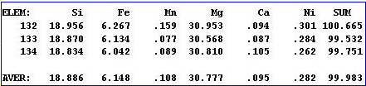
Athens EPMA Workshop, 2022
Errors and Statistics in EPMA
John Donovan
University Of Oregon
CAMCOR
Modified from Fournelle, 2006

Slide 2
What’s the point?
How much can I trust the compositions that the probe computer outputs?
Are two analyses equivalent?
Can I compare my numbers with those published by other researchers using EPMA or other techniques?
What is my detection limit?

Slide 3
Goal and Issues
Goal: achievement of high accuracy and high precision in quantitative analyses, recognizing sources of errors and minimizing them.
Issues involved with achieving this goal:
Standards
Instrumental stability
Sample and standard physical condition
Beam impact on standard/sample complications
Spectral issues
Counting statistics
Matrix corrections

Slide 4
Standards: how “good” are they? Well characterized? Homogeneous?
Instrumental conditions: beam stability; spectrometer reproducibility; thermal stability; detector pulse height stability/adjustment; reflected light optics (stage Z).
Sample and standard conditions: rough surface? polish? etched? tilted?
Background fit issues: curved backgrounds at low sin thetas!
Spectral issues: peak and/or background overlaps?
Sensitivity to beam? C coat thickness if used?
Sample size vs interaction volume: Homogeneous? Small particles? Secondary boundary fluorescence?
Counting statistics: enough counting time for trace elements?
Matrix corrections: e.g., Unanalyzed elements? You need a total close to 100% for accurate matrix corrections! MACs for light elements?

Slide 5
These can be categorized into
“random” and
“systematic” errors.

Slide 6
Random Errors
random nature of x-ray generation and emission
instrumental (random) instability (e.g., spectro reproducibility)
operator inconsistency (e.g. inconsistent optical stage focus)
sample surface roughness
interaction volume intersecting two (or more) phases
secondary fluorescence from hidden (below surface) phases

Slide 7
Systematic errors
incorrect values for composition of standards
instrumental instability (temperature effect on crystal 2d, stage Z drift as it heats up)
inappropriate matrix corrections, “unanalyzed” (missing) elements
poor electrical ground of standard and/or unknown
carbon coat variation (2 effects- one for soft x-ray, another for hard x-rays)
beam change/damage to unknown (e.g. TDI effects for Na, K in glass)
difference in peak shape/position for light elements (standard vs unknown)
on-peak or background (off-peak) spectral interferences
pulse height depression on standards, pulse height gain on traces, dead time calibrations
fluorescence across observed phase boundaries (e.g. diffusion couple)
inaccurate calibration of accelerating voltage (use Duane-Hunt limit)

Slide 8
Precision and Accuracy in Error Analysis
Precision refers to the reproducibility of the counts – and thus the ability to be able to compare compositions, whether within a sample, or between samples, or between analytical sessions. It is directly tied to counting statistics. It is a relative description.
Accuracy refers the “truth” of the analysis, and is directly tied to the standards used and the matrix correction applied to the raw data, as well most of the other variables listed previously that could affect the X-ray intensities (background and peak interferences, beam damage, etc.). It is an absolute description.
EPMA quantitative error analysis is a combination of both, the first being very easy to characterize, the later more difficult. Precision for major elements could easily be <1%, but when combined with accuracy, total EPMA error probably 1-2% in the best cases (for major elements).

Slide 9
Precision and Accuracy
Low Precision
High Precision
Low Accuracy
High Accuracy

Slide 10
Instrumental Errors – instrument stability
Beam current stability: with Faraday cup measurements made for each analysis, long term drift should not be a problem as the counts for each analysis are normalized to a common reference current value (could be 1 or 20 nA). For long count times (> 10 minutes) for trace element work, it is recommended that the peak and background counting be constantly cycled (alternating on/off peaks) so that any longer period drift issues be spread out over the whole time period (P/B more constant).
Spectrometer reproducibility: with modern microprobes, this should not be a serious problem, although problems do crop up with age. Where crystals are flipped, in a small fraction of cases there is an error; generally it is not recommended to flip crystals within analyses. When spectrometer reproducibility is a problem, it is seen as backlash of the gears; to minimize errors, the peaks should always be approached from the same direction
(JEOL only as Cameca utilizes linear encoders for improved spectrometer reproducibility).

Slide 11
Instrumental Errors – instrument stability, cont’d
Thermal stability: Spectrometers could drift if there is a change in the room temperature, though this would presumably be noticeable to the operator (air conditioning failure). PET crystals have the largest thermal expansion, so are most affected. Attempt to keep the room at 68-70°C and the circulating water temperature in the instrument should be close to this. Stage height (Z) can drift due to motor heating in the first few hours, use pre-heat oven for samples in Cameca instruments.
Weather stability: P10 gas pressure is sensitive to the local barometric pressure.
https://probesoftware.com/smf/index.php?topic=1109.0
Detector pulse height adjustment/stability: The bias (voltage) of the gold wire in the detector must be set to the proper value; this is a function of the energy of the X-ray and gas pressure. The operator must verify that the bias, gain and baseline are set properly (the last particularly where the Ar-escape peak is partially resolved).

Slide 12
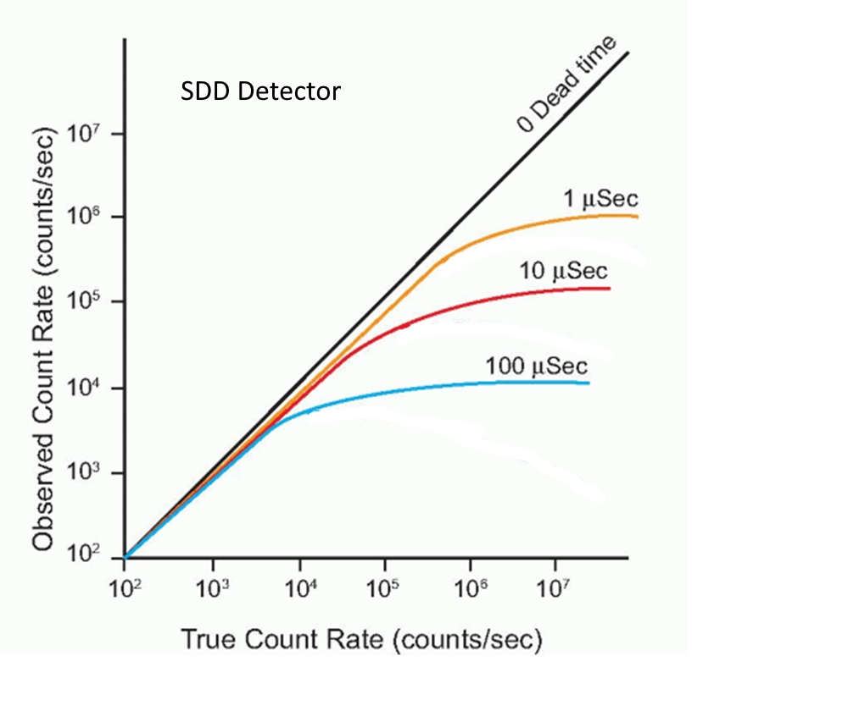
Dead Time in WDS Spectrometers Must be Routinely Re-Calibrated!
BasicMedicalKey.com
Because the WDS dead time correction is performed in software!

Slide 13
Instrumental Errors – Dead Time Constants
Dead time: In WDS, counts are dead time corrected. If dead time is not accurately determined, there could be a systematic error here. Cameca probes operate somewhat differently from JEOL and others, in that Cameca introduces an “imposed” dead time (e.g. 3 μsecs) into the counting circuitry in an attempt to “mask” the intrinsic dead time of the system (one must still calibrate this “effective” dead time and use that value in software to correct the counts.
UofO SX100: 3.8 3.8 3.5 3.5 3.5 "deadtime in microseconds"
All probe labs should verify (at least every few years) that the manufacturer’s “default” dead time factors are correct. This is done by counting on a metal standard (e.g. Si or Ti metal standard) at varying Faraday currents, with the dead time correction turned off. These data can then be plugged into an Excel spreadsheet that which Paul Carpenter (Washington University) has developed to calculate the most accurate dead time actually present on a particular probe. Also, in the Probe for EPMA software, there is an option for an alternate, more complex dead time correction equation, for high count rate (>50K cps)
https://probesoftware.com/smf/index.php?topic=1160.0

Slide 14
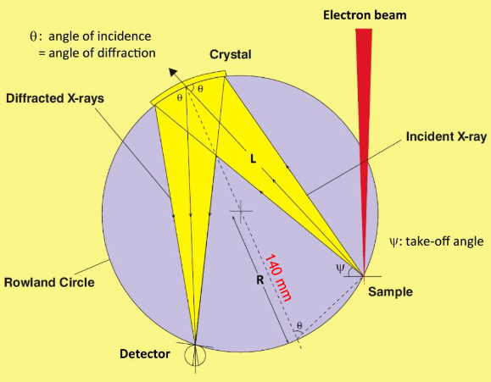
Bragg Defocusing
Chatterjee, 2020

Slide 15
Instrumental Errors – Bragg defocusing
Specimen focus (stage height): Samples and standards must be positioned at the same stage height, so that they will all be at the same position vis a vis the Rowland Circle (in X-ray focus for Bragg diffraction).
Sometimes it is difficult decide within 1-3 um which is the “best” height: this small Z difference is not critical. It becomes critical when it reaches the 5 or 10 um “out of focus” realm, which can occur during unattended overnight runs as the sample and stage heat up (heat from stage motors); this can be addressed by using the stage Z “autofocus” automation (but test it out first, as it must be calibrated).

Slide 16
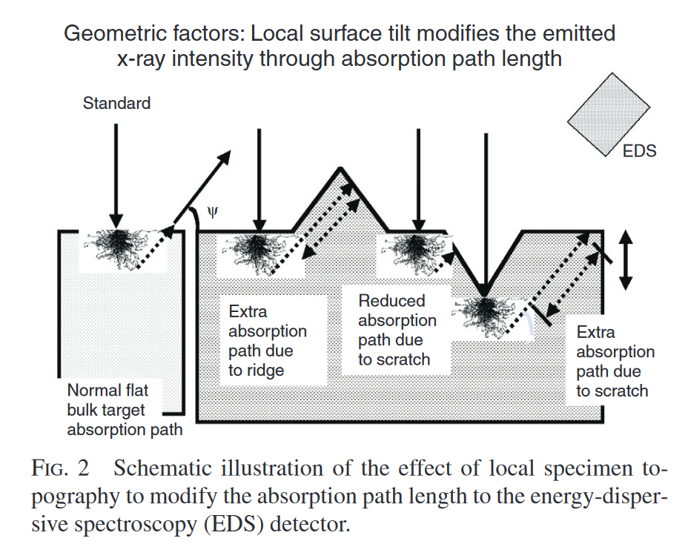
Surface Roughness
Newbury, 2003

Slide 17
Sample/standard Error: Physical issues – surface issues
Surface irregularities: the matrix correction relies upon the correct take off angle to calculate the path length for the absorption correction, and irregular surfaces will have variable path lengths and thus the measured X-ray intensities will not be consistent between analytical spots. Moreover, in using different spectrometers mounted in different directions, the path length will vary between spectrometers for one analytical spot.
  Etched samples: generally, etching may introduce some compositional changes, and should be avoided.
  Polishing: samples should be polished with final stage using 0.05 μm diamond or alumina or silica (mirror finish).

Slide 18
Sample/standard Error: Physical issues – boundary fluorescence
Specimen homogeneity: a key assumption of quantitative EPMA is that the interaction volume is a single phase (is homogeneous).
If more than 1 phase is overlapped by the beam: the matrix correction usually overcompensates and produces an erroneous composition >100 wt.%. This is common for small eutectic (groundmass) phases.
If trace elements are being considered, then also the adjacent surrounding volume (up to ~50-100 μm away) should not contain phases with higher concentrations of the trace elements of interest, which might be secondarily fluoresced (sample extraction using a FIB).
Diffusion couples have similar constraints, in that secondary fluorescence across the boundary can yield X-ray intensities up to a couple of percent (which could also give high totals). Users need to either empirically or theoretically verify this is NOT happening.
Boundary fluorescence can be easily modeled in the free Standard software…

Slide 19
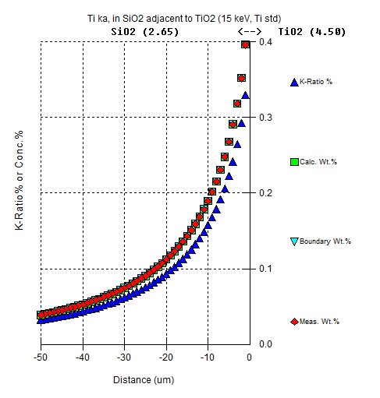
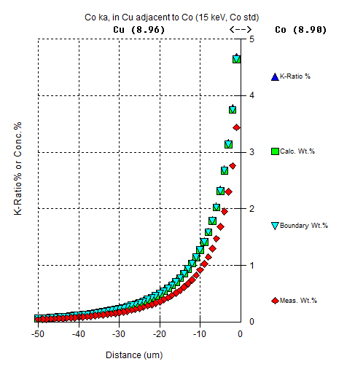
“Trace” Ti in quartz adjacent to rutile (not chemical diffusion!)
Borisova et al., Secondary Fluorescence effects in microbeam analysis, Chemical Geology, 490, 22-29, (2018)
“Trace” Co in copper adjacent to
cobalt (not chemical diffusion!)

Slide 20
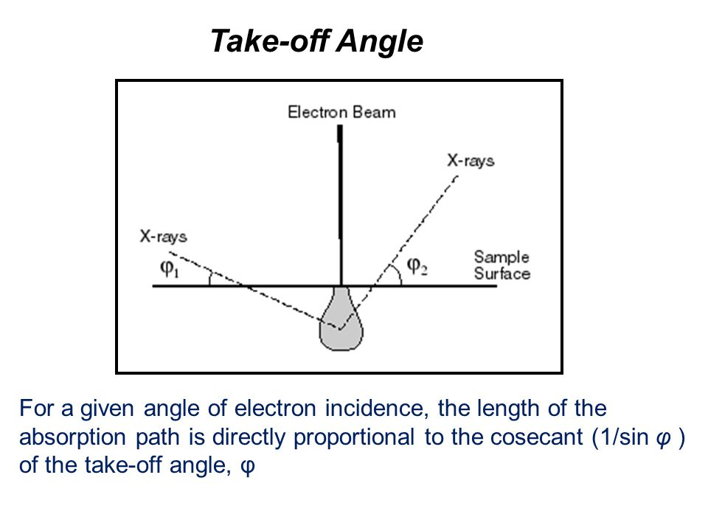
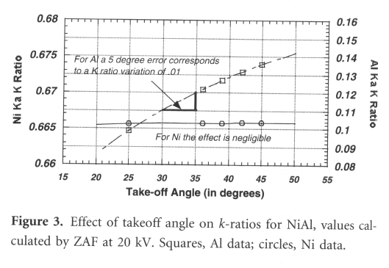
Sample/standard Error: sample tilt
Incorrect geometry (non-orthogonal surface): this occurs too often with 1” diameter plugs that have been automatically polished. For whatever reason, the sample surface ends up at a slant to the cylindrical wall, and when the set screw is tightened in the holder, the surface ends up at an angle to the horizontal. This introduces an error in the take off angle. Also, the area of interest may be too low and impossible to reach stage Z focus.
This Monte Carlo simulation shows that a 5% tilt of the sample will alter the K ratio of Al Ka by .01, which equals a 8% relative error before matrix correction. An Al ZAF of 1.5 would thus increase the error to 12%.
Lifshin and Gauvin, 2001, Fig 3., p. 170.

Slide 21


Sample/standard Error: rounded edges
Incorrect geometry - edge effects: materials mounted in epoxy and then polished with loose polishing compound commonly have differential erosion at the epoxy-material interface, producing a moat or channel in the epoxy, resulting in a rounding of the material at the edge. Efforts to do quantitative EPMA of the edge (rim) will be in error as the absorption path length will be non-uniform and different from the nominal length. Special polishing techniques will minimize or eliminate this problem.
Epoxy
Specimen
Common edge erosion problem, rounding of specimen edges
Epoxy
Specimen
Desired geometry: no rounding of specimen edge

Slide 22
Sample/standard Errors: surface effects
Smear coat: soft materials may smear and cross contaminate other materials that are being polished either in the same holder, or in a subsequent sample, producing a thin ‘smear coat’. For example the Au-Ag and Au-Cu standards from NIST. Noble metals in the K-T boundary…?
Polishing artifacts: Diamond and alumina polishing particles can get caught in pores in the material been polished. E.g., μm sized fragments of brass from a brass polishing holder become lodged in feldspar and biotite.
Charging: this will reduce the effective E₀ in a random manner. Conductive samples in epoxy must be grounded with conductive tape (preferred rather than paint). Semi-conductors conduct OK. Non-conductive samples need to be coated (C, Al, Ag, etc...).
Porosity: There could be 2 errors in porous material: in conductive materials, heterogeneous interaction volumes; and in non-conductive materials, problems with charging as the electrons accumulate on interior pore surfaces.

Slide 23
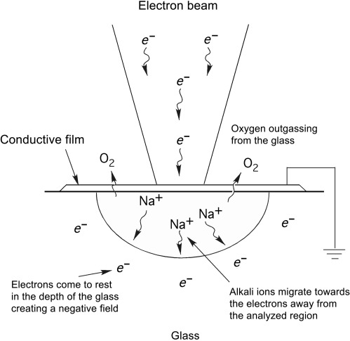
Sample/standard Error: Beam Sensitivity
However, because there are likely different physical mechanisms in different materials, under different conditions,
e.g., volatilization versus ion migration.
we therefore only refer to time-dependent intensities (TDI) effects in general.
Llovet, 2019

Slide 24
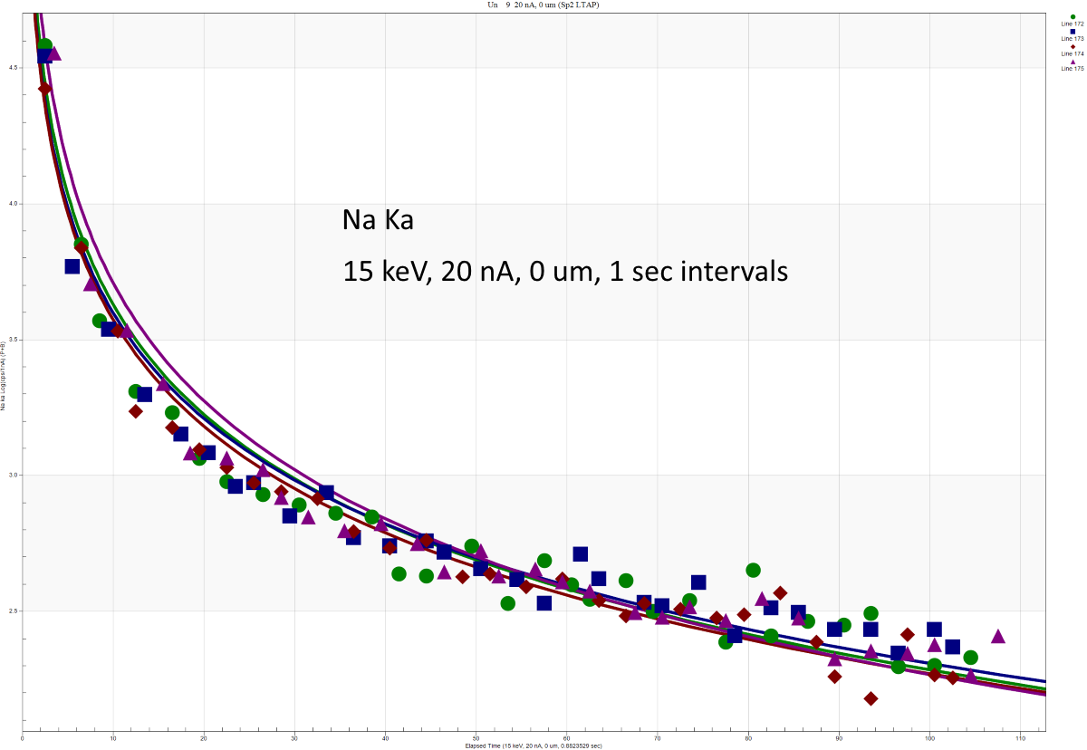
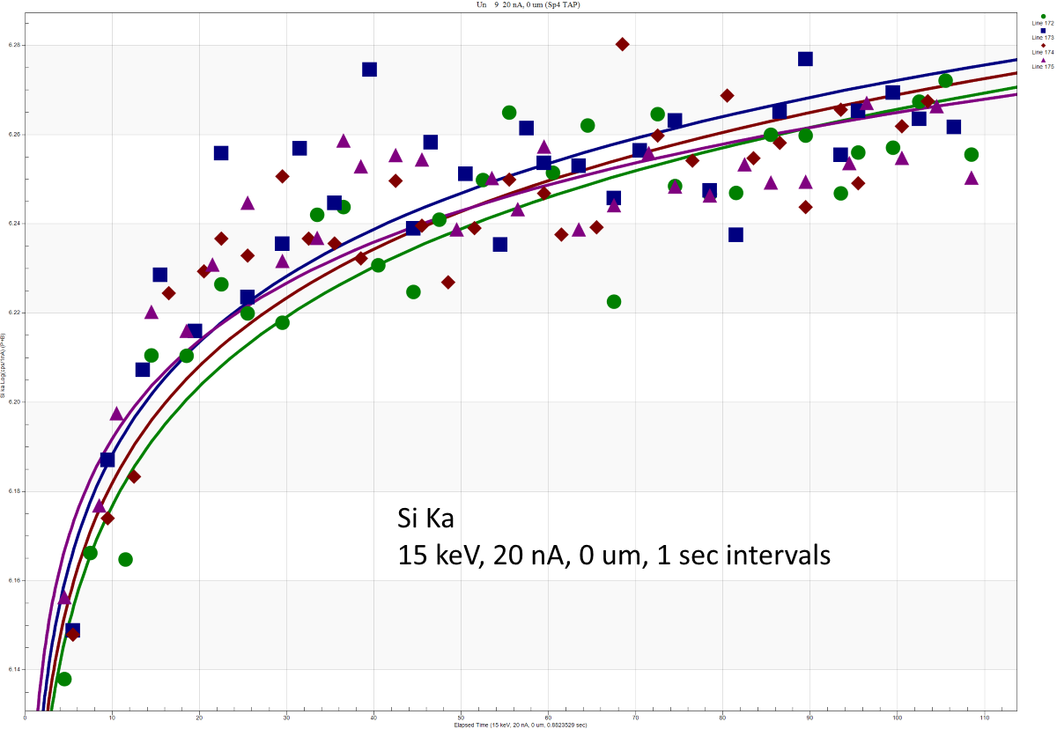
Sample/standard Error: Beam Sensitivity, cont’d
Y axis: Log Scale
SRM K-1718 20 nA, 0 um, 1 sec intervals, Si Ka
SRM K-1718 20 nA, 0 um, 1 sec intervals, Na Ka

Slide 25
Sample/standard Error: Beam Sensitivity, cont’d
Beam sensitive samples: require care, such as lower current (e.g. 1-6 nA) and/or defocused beam (10-25 μm), and/or a correction for intensity changes with time (e.g., “volatile element” or time dependent intensity (TDI) correction in the Probe for EPMA software):
Glasses with alkalis (esp. Na), particularly hydrous glasses: Na drops precipitously, K somewhat, with Al and Si counts increasing over time!
Alkali feldspars, particularly albite: Na counts decrease
Carbonates and anhydrite: easily decompose with 10 nA
Apatite/micas: not as fragile, but some grains will crater with moderate currents (60 nA) after 40-60 seconds. Different orientation of apatite/micas for standard and unknown will have different TDI effects

Slide 26
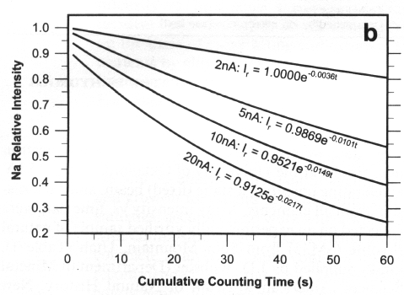
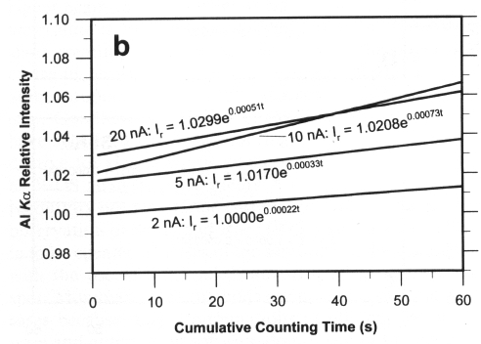
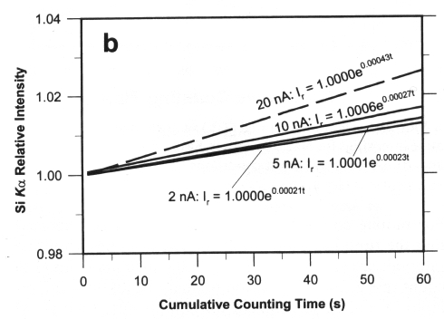
Sample/standard Error: Physical issues - 9
Al
Na
Above, the dramatic drop in Na Ka counts versus time is demonstrate. It is worst at 20 nA, and much less at 2 nA but still present!
Si
The related phenomenon of “grow in” is shown to the right, with Al Ka showing the increase in counts with time more than Si Kα. Both of these effects *must* be corrected for in software and included within the matrix correction!
Morgan and London, 1996, American Mineralogist, 81, 1176-1185.

Slide 27
Sample/standard Error: Physical issues – magnetic samples
Beam deflection: magnetic specimens (e.g. some Fe-Ni alloys) can variously deflect the electron beam, as seen by contamination spots offset from ‘normal’ incident position. This would affect the observed intensities due to Bragg defocusing.
One can try demagnetization, but some have observed an increase in magnetization whenever the beam is incident with the specimen.
There appears no easy solutions to this issue, except very small sample extraction using a FIB.

Slide 28
Sample/standard Error: Procedural issues - 1
Peak interferences: If measured peaks are overlapped by peaks of other elements, obvious errors will result. Such interferences can exist both in standards and unknowns. Such errors in unknowns can yield high totals. Unavoidable peak interferences must be addressed by using interference standards, to subtract the correct fraction of counts attributed to the interfering element.
Background position interferences: Incorrect placement of background counting positions can lead to errors, as the background estimate at the peak position usually is over estimated, yielding less net counts for the element (low totals or k-ratios less than 0.0).
Multiple wavescans should be done on similar phases, and/or EPMA Method Development:
https://probesoftware.com/smf/index.php?topic=743.0

Slide 29
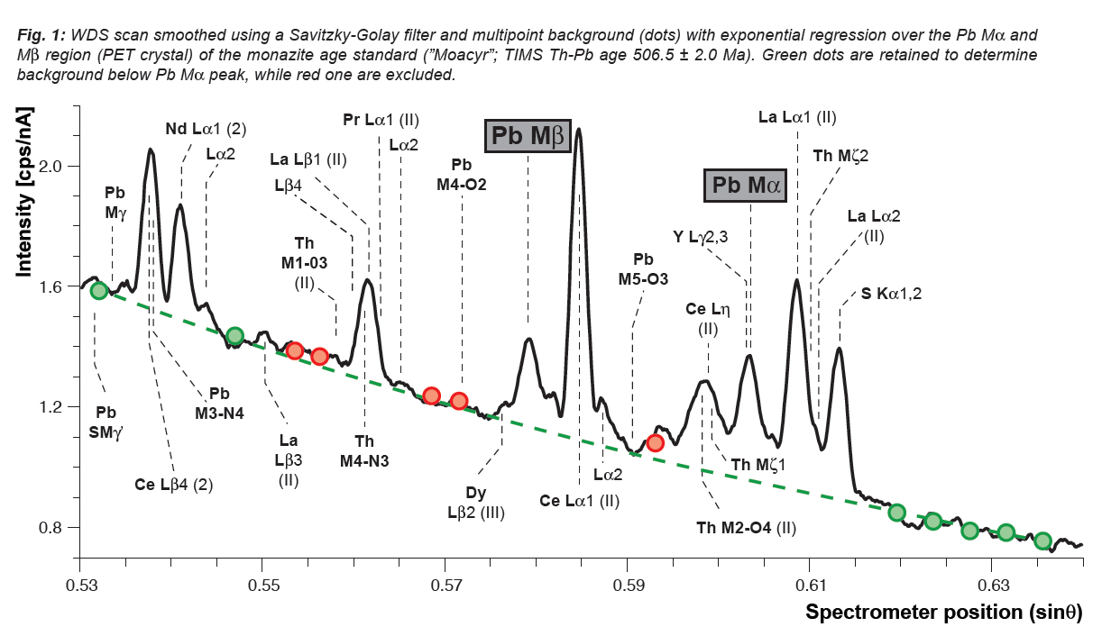
Sample/standard Error: Procedural issues - 2
Allaz, 2011

Slide 30
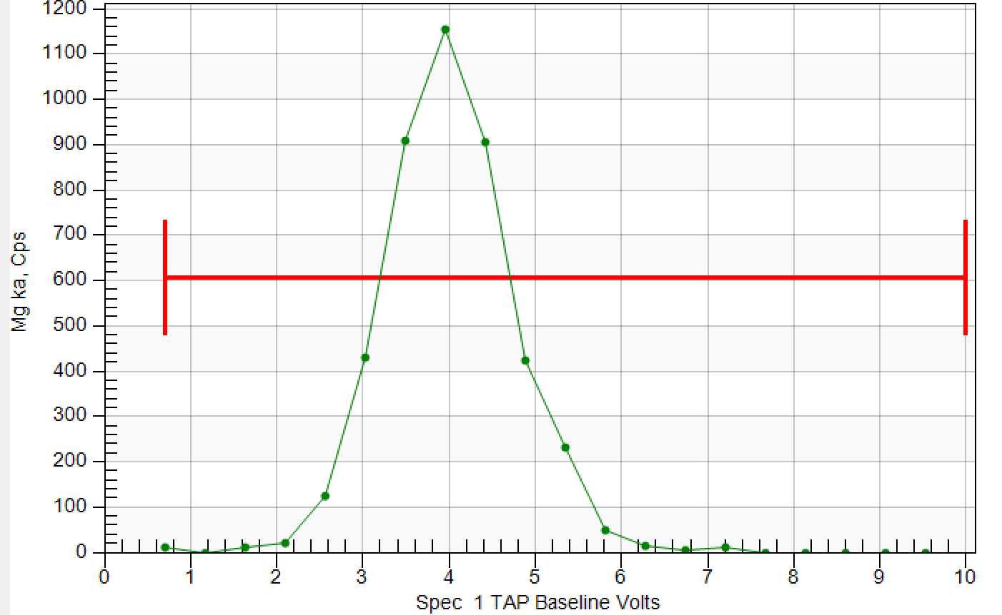
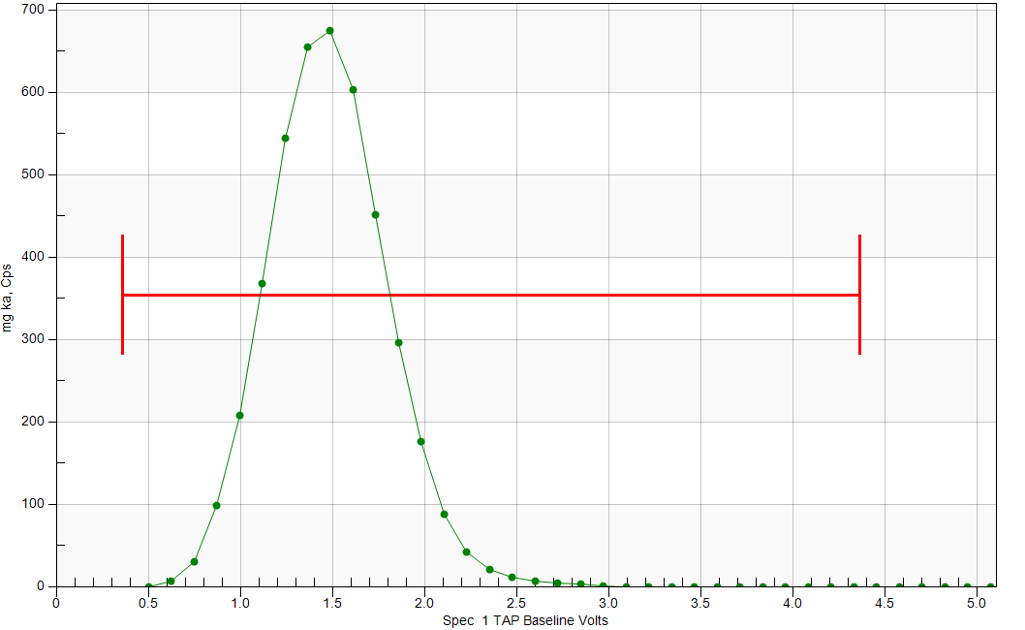
Sample/standard Error: Procedural issues - 3
Peak shift/shape differences: Particularly the case for light elements Z < 11, though sulfur Ka is also subject to significant peak position shifts between elemental and oxidized. Peak shifts can yield small to significant errors (see first presentation on Light Elements).
PHA settings: Bias, gain, and baselines should be checked. Pulse height depression (PHA peak shifts left) occurs mainly where there is a large discrepancy in count rate between standard and unknown. Solution: on your primary standard (high concentration), always place your PHA peak slightly to the left of the center of your PHA distribution.
JEOL ~ 4 volts, Cameca ~ 2.5 volts.
JEOL
Cameca

Slide 31
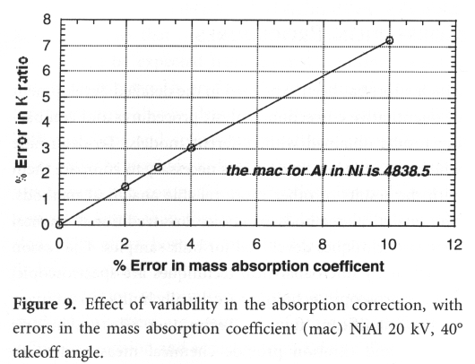
Errors in Matrix Correction
The K-ratio is multiplied by a matrix correction factor. There are various models – alpha, ZAF, φ(ρz) – and versions. Assuming that you are using the appropriate correction type, there may be some issues regarding specific parameters, e.g. mass absorption coefficients, or the φ(ρz) profile.
There is a possibility of error for certain situations, particularly for “light elements” as well as compounds that have drastically different Z elements where pure element standards are used. The figure above shows that a small (2%) error in the mass absorption coefficient for Al in NiAl will yield an error of 1.5% in the matrix correction.
Lifshin and Gauvin, 2001, p. 176.
This is a strong incentive to use secondary standards to verify the accuracy of the EPMA analysis.

Slide 32
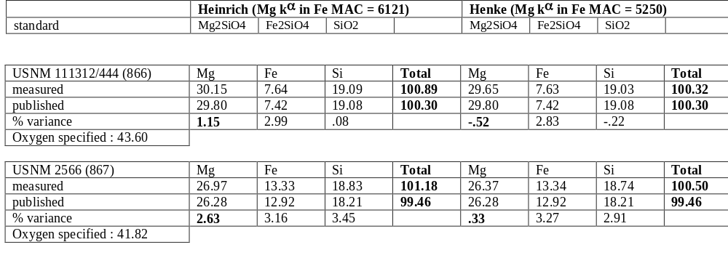
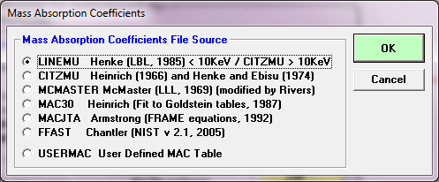
Of “minor interest” to the geological community is the elemental binary pair Mg ka absorbed by Fe.
Or did you ever wonder why your garnet totals are always high?

Slide 33
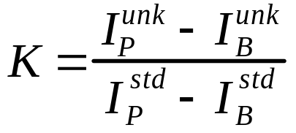
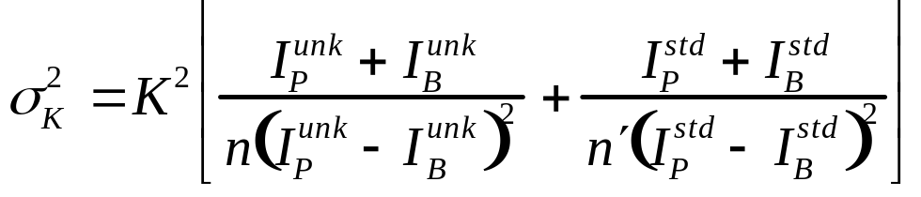
Counting Statistics
The precision of the composition ultimately is a combination of the counting statistics of both standard and unknown, and Ziebold (1967) developed an equation for it.
Recall that the K-ratio is
where P and B refer to peak and background.
The corresponding precision in the K ratio is given by
where n and n’ are the number of repetitions of counts on the unknown and standard respectively. (The rearranged σ_{K}/K -- with square roots taken-- term was sometimes referred to as the ‘sigma upon K’ value.)

Slide 34
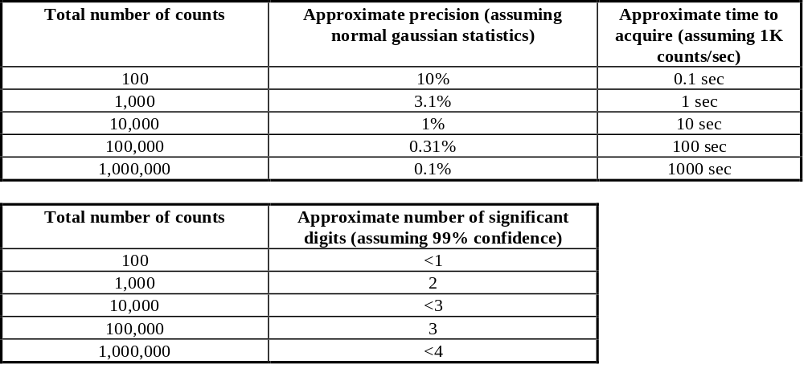
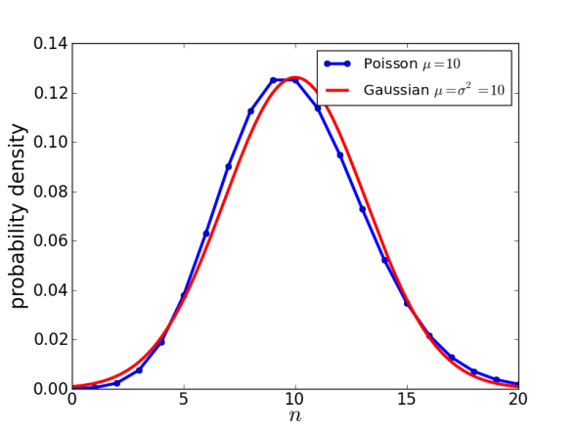
Counting Statistics, cont’d
Loonylabs.org

Slide 35
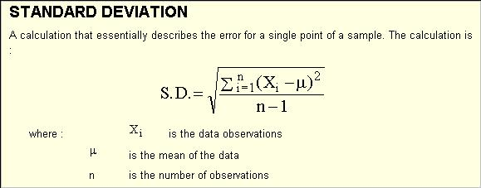
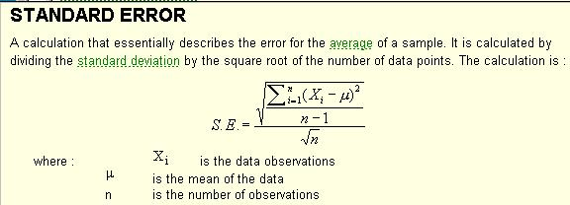
Counting Statistics, cont’d
NB: These measurements only speak to precision, both in counting variation and sample variation. Therefore the only way to get a true measure of one’s counting statistics, is to perform “replicate” measurements on the same point (assuming a stable sample!).

Slide 36
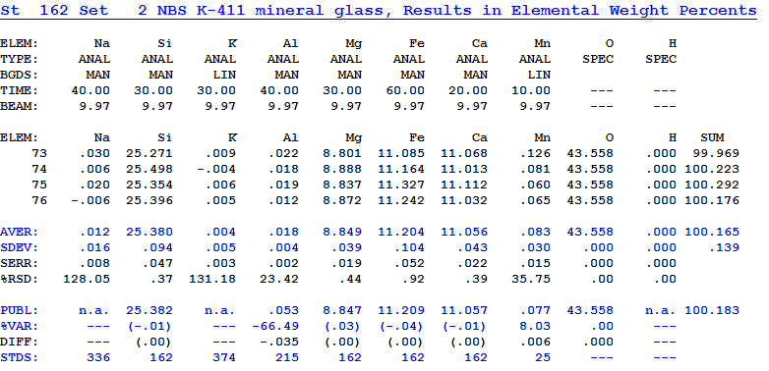
Probe for EPMA Statistics – Average, standard deviation, etc.
NB: The number of digits after a decimal point in a printout composition needs to be used with common sense!
ELEM: Element symbol (if followed by a "-D" the quantitation is disabled)
AVER: Average
SDEV: Standard deviation
SERR: Standard error
%RSD: Relative percent standard deviation (SDEV/AVER * 100)
PUBL: Published concentration from STANDARD.MDB database. (n.a.=not analyzed)
%VAR: Percent variance from the "published" value
DIFF: Algebraic difference from the "published" value
STDS: Standard number assignment (primary standard for this element)

Slide 37
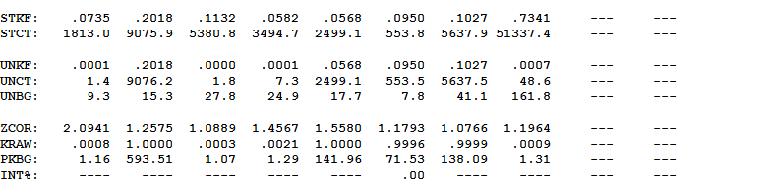
Probe for EPMA Data Statistics
STKF: Standard K-factor
STCT: Standard count net intensity count rate (Peak–Bkg)
UNKF: Unknown K-factor
UNCT: Unknown count net intensity rate (Peak-Bkg)
UNBG: Unknown background count rate
ZCOR: ZAF correction factor (matrix correction)
KRAW: Raw k-ratio (unknown counts/standard counts) corrected for background, interferences, etc.
PKBG: Peak to background ratio
INT%: Percent interference correction

Slide 38
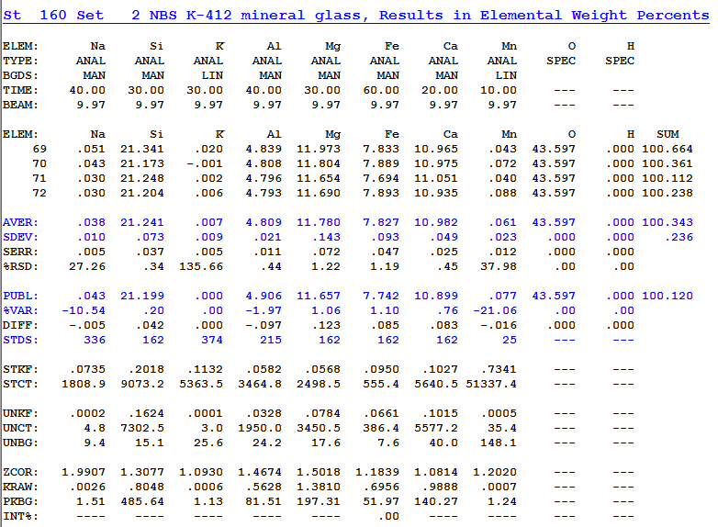
Errors in Secondary Standards – Accuracy Check!
Major/Minor Element Accuracy

Slide 39
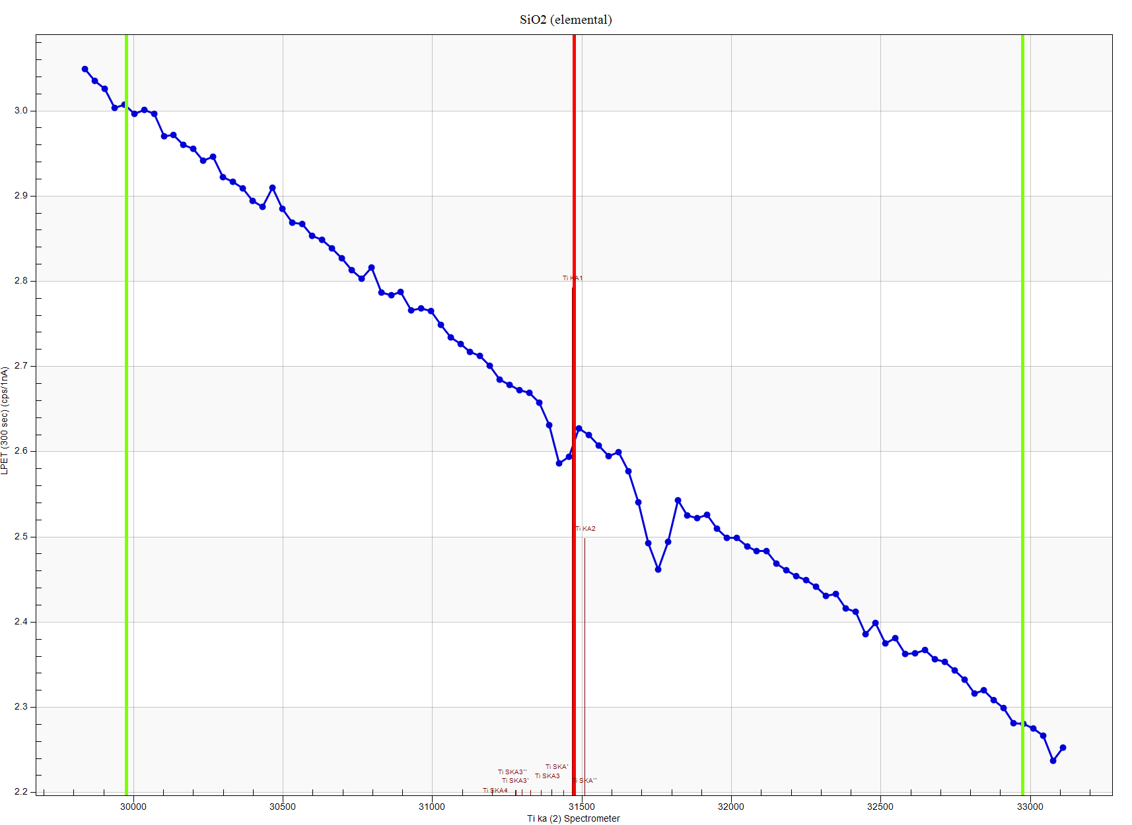
Errors in Secondary Standards – Accuracy Check!
Trace Accuracy: How well can you measure zero?
Ti ka in Quartz
“Holes” in the
continuum!
Requires a “blank” correction for high accuracy traces!

Slide 40
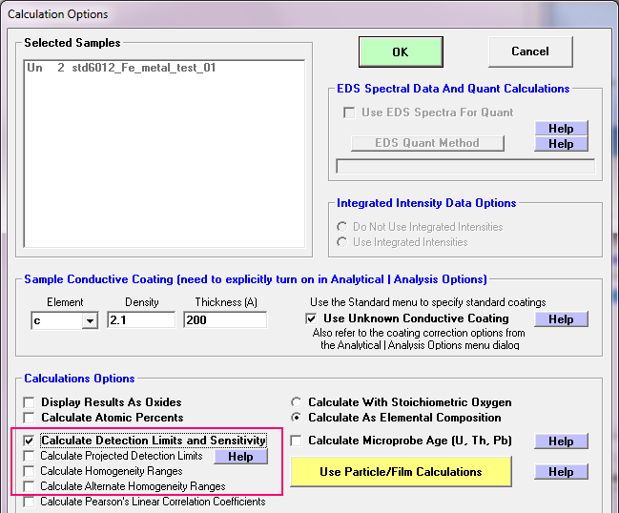
Probe for EPMA Statistics – Detection limits, sensitivity
Probe for EPMA software provides for additional optional statistics. One set relates to detection limits, i.e. what is the lowest level you can be confident in reporting.
The other set of statistics relates to analytical sensitivity or analytical error, i.e., how confident are you that two numbers are statistically significantly different.

Slide 41
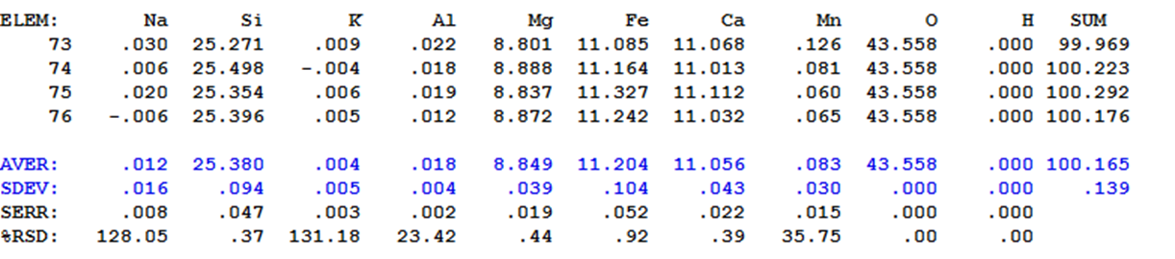
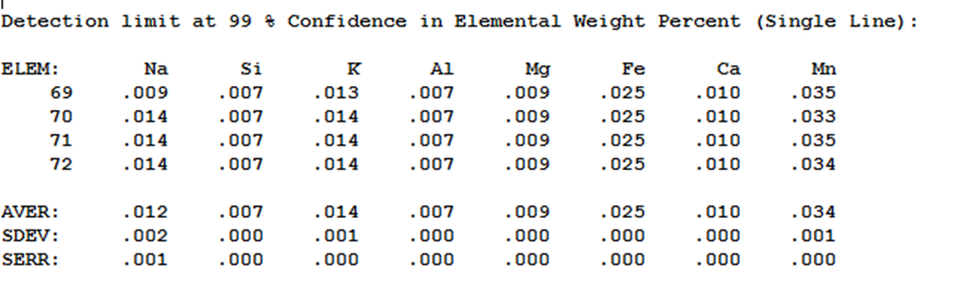
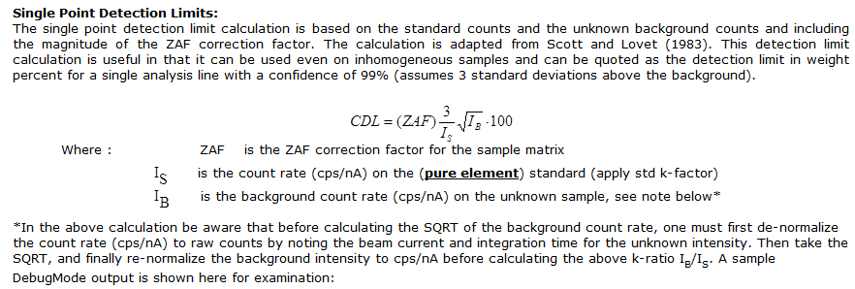
Probe for EPMA Statistics – Detection limits, cont’d

Slide 42
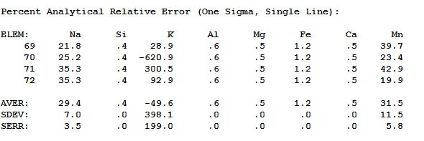
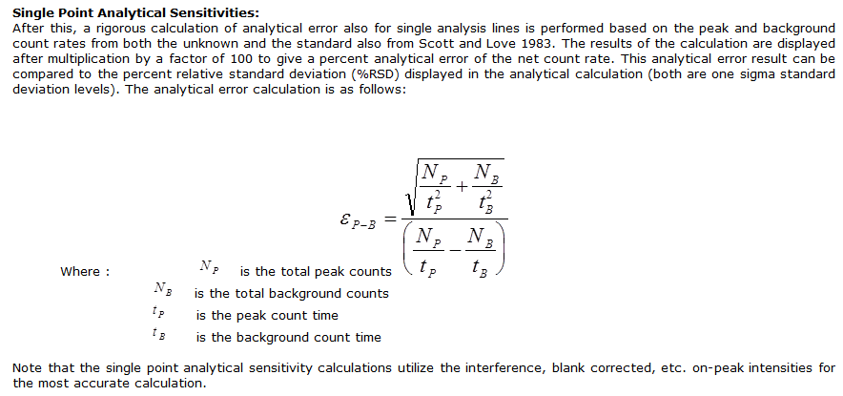
Probe for EPMA Statistics – Analytical sensitivity

Slide 43
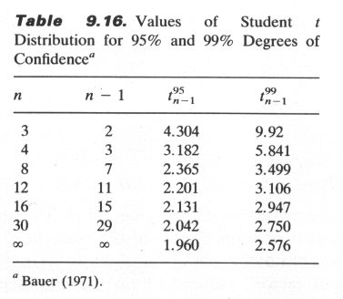
Student’s t distribution
The general problem, where the sample size is small and the population variance is unknown, was first treated in 1905 by W.S. Gossett, who published his analysis under the pseudonym “Student”.
His employer, the Guinness Breweries of Ireland, had a policy of keeping all their research as proprietary secrets.
The importance of his work argued for its being published, but it was felt that anonymity would protect the company. (S.L. Meyer, Data Analysis for Scientists and Engineers, 1975, p. 274.)
Goldstein et al, p. 497

Slide 44
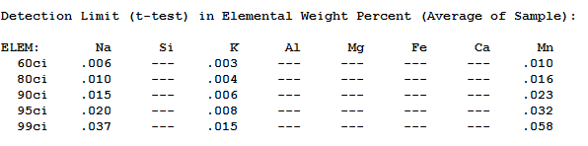
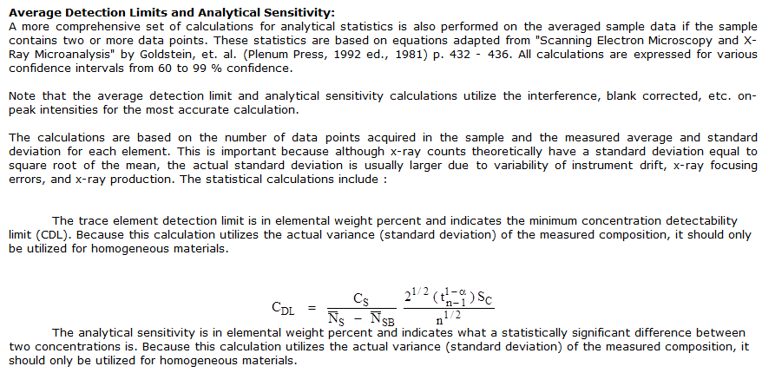
Probe for EPMA Statistics – Average statistics, t-tests

Slide 45
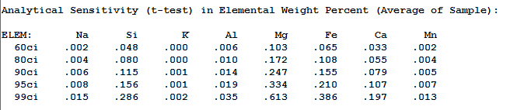
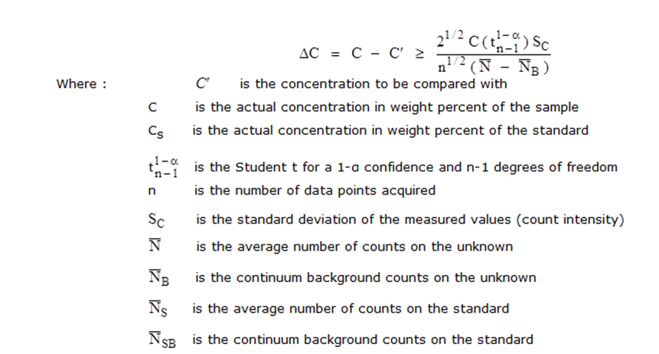
Probe for EPMA Statistics – Average statistics, t-tests, cont’d

Slide 46

Numbers of significant figures
There have been cases where people have taken reported compositions (i.e. wt. % elements or oxides) from probe printouts and then faithfully reproduced them exactly as they got them. Once someone took figures that were reported to 3 decimal points and argued that a difference in the 3rd decimal place had some geochemical significance.
The number of significant figures reported in a printout is a “mere” programming format issue, and has nothing to do with scientific precision!
However, a feature to Probe for EPMA is an option to output only the actual significant number of digits (note this is not normally enabled).
Having said that, it is “tradition” to report to 2 decimal places. However, that should not be taken to represent precision, without a statistical test, such as given before.

Slide 47
Numbers of significant figures, cont’d
A plagioclase analysis, using 3 digits after the decimal:
ELEM: Na2O SiO2 K2O Al2O3 MgO CaO TiO2 MnO FeO P2O5 Cr2O3 NiO SUM
593 1.344 64.213 15.276 19.110 -.008 -.007 .001 .007 .272 .105 -.030 .040 100.324
594 1.329 64.538 13.973 19.152 .001 .001 .019 .008 .226 .055 -.001 -.016 99.287
595 1.182 64.653 14.074 19.040 -.002 .055 .000 .024 .351 .123 .034 .024 99.556
596 1.307 64.147 15.242 19.173 .021 -.006 -.001 .031 .434 .101 -.024 .009 100.435
597 1.399 64.333 15.295 18.996 -.005 .051 -.003 .028 .472 .106 -.008 -.034 100.631
AVER: 1.312 64.377 14.772 19.094 .002 .019 .003 .020 .351 .098 -.006 .005 100.047
SDEV: .080 .214 .685 .075 .011 .031 .009 .011 .104 .025 .025 .030 .589
SERR: .036 .096 .306 .033 .005 .014 .004 .005 .047 .011 .011 .013
%RSD: 6.1 .3 4.6 .4 693.7 165.8 301.0 56.2 29.6 25.9 -444.1 655.4
After we enable the Probe for EPMA Analytical Option “Display only statistically significant number of numerical digits”:
ELEM: Na2O SiO2 K2O Al2O3 MgO CaO TiO2 MnO FeO P2O5 Cr2O3 NiO SUM
593 1.3 64.2 15.3 19.1 n.d. n.d. n.d. n.d. .3 .1 n.d. n.d. 100.3
594 1.3 64.5 14.0 19.2 n.d. n.d. n.d. n.d. .2 .05 n.d. n.d. 99.3
595 1.2 64.7 14.1 19.0 n.d. .05 n.d. n.d. .35 .12 n.d. n.d. 99.6
596 1.3 64.1 15.2 19.2 .02 n.d. n.d. .03 .43 .1 n.d. n.d. 100.4
597 1.4 64.3 15.3 19.0 n.d. .05 n.d. n.d. .47 .1 n.d. n.d. 100.6
AVER: 1.3 64.4 14.8 19.1 n.d. n.d. n.d. n.d. .35 .098 n.d. n.d. 100.05
SDEV: .080 .214 .685 .075 .011 .031 .009 .011 .104 .025 .025 .030 .589
SERR: .036 .096 .306 .033 .005 .014 .004 .005 .047 .011 .011 .013
%RSD: 6.1 .3 4.6 .4 693.7 165.8 301.0 56.2 29.6 25.9 -444.1 655.4

Slide 48
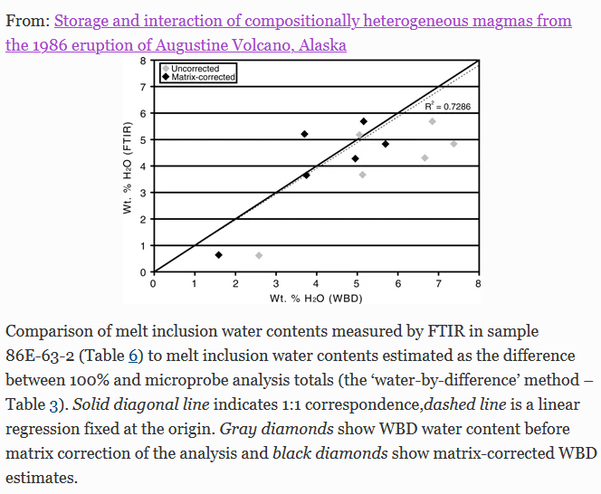
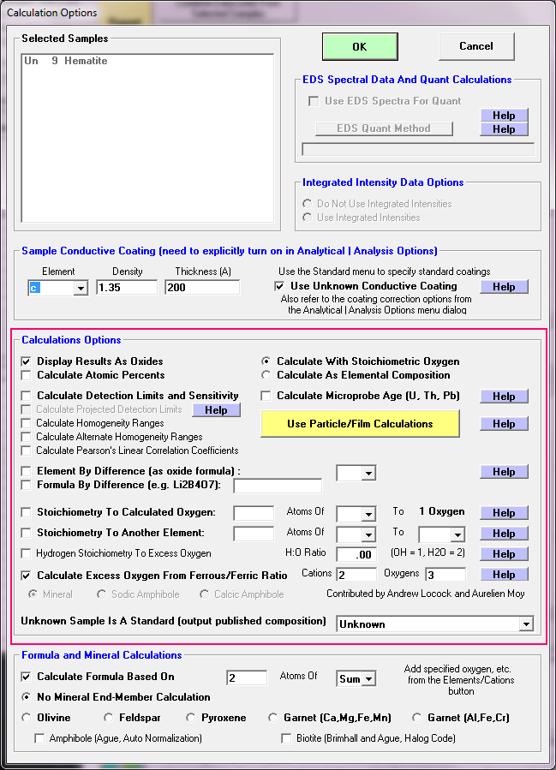
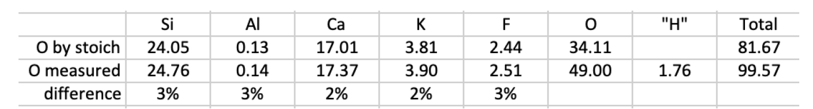
Errors due to “unanalyzed” elements!
Examples:
Excess oxygen when ferric iron is present
When water or hydroxyl are present in minerals and glasses
Carbon in carbonates
Boron, lithium, etc.
Roman et al., 2006
Fournelle et al., 2020

Slide 49
Summary: How to know if the EPMA results are “good”?
There are only 2 tests to prove your results are “good” – actually, it is more correct to say that if your results can pass the test(s), then you know they are not necessarily bad analyses:
100 wt.% totals (note: NOT 100 atomic % totals). Typically, a range from 98.5 - 100.5 wt.% for silicates, glasses and other compounds is considered “good”. It extends on the low side a little to accommodate a small amount of minor/trace elements that are realistically present in most natural (earth) materials. These analyses typically “do oxygen by stoichiometry” which can introduce some undercounting where the Fe:O ratio has been set to a default of 1:1, and some the iron is ferric (Fe:O 2:3). So for spinels (e.g. Fe₃O₄), a perfectly good total could be 93wt%.
Stoichiometry, if such a test is valid (e.g. the material is a line compound, or a mineral of a set stoichiometry.

Slide 50
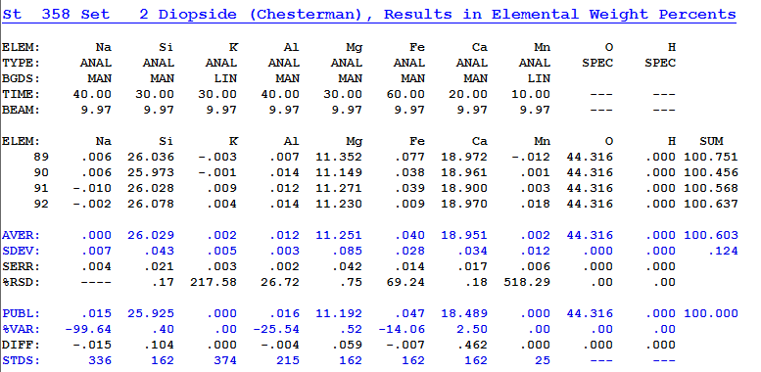
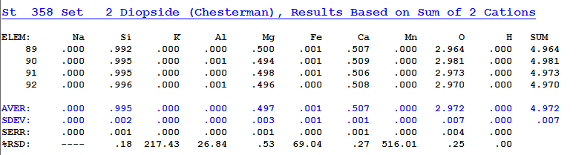
Example: how to know if the EPMA results are “good”?
The total is good, 100.6 wt.%
The stoichiometry is OK: with 3 oxygens specified, there should be 1.00 Si atoms and we have .995. The other cations Mg+Ca+Fe should be 1.00, and we have 1.005.
The analysis is OK and could be published. If problems were seen at the time of analysis, it might be useful to recheck the Si and Mg peak positions, and re-acquire standard counts for Si and Mg.
If this were only seen after the fact, you could re-examine the standard counts and see if there are any obvious outliers (e.g., low totals) that could be *legitimately* discarded.
You cannot arbitrarily delete points with “high” totals!
High totals means you have something wrong that needs to be fixed!

Slide 51
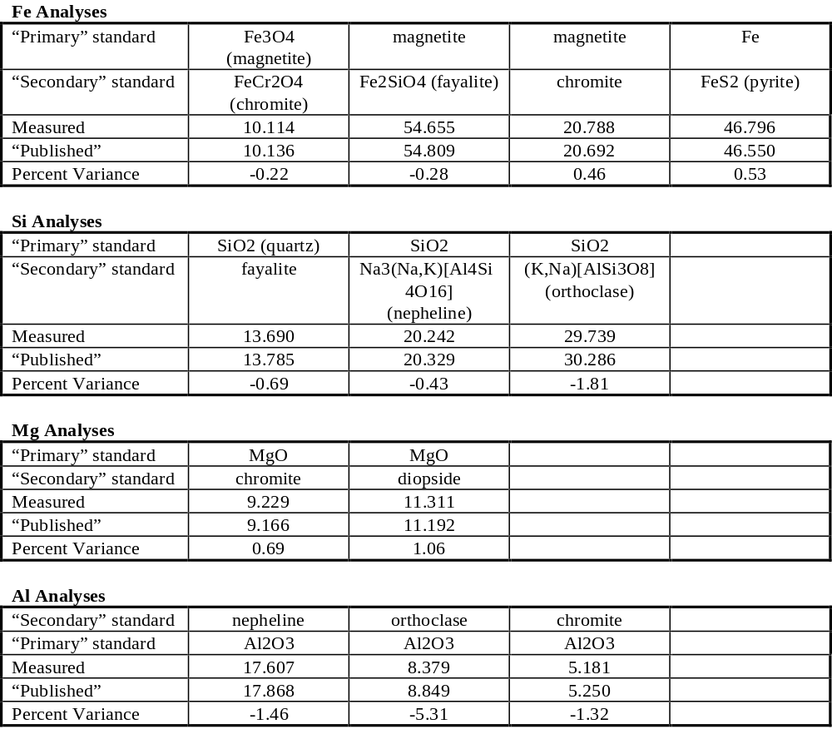
“Typical” Accuracy
(if you do everything right)

Slide 52
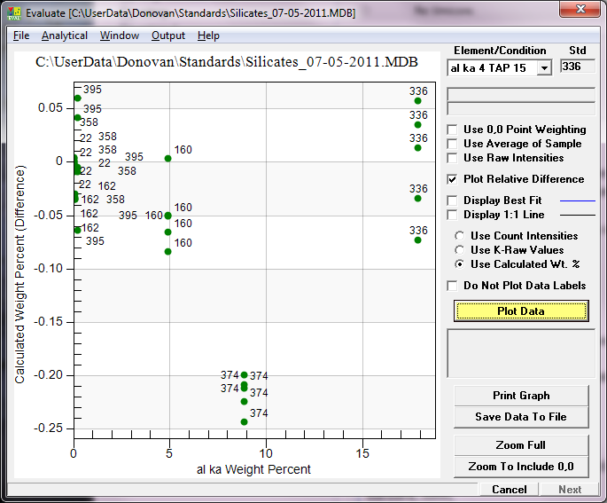
Evaluate Secondary Standards!
0.2 wt.%
is a 2.5%
relative error

Slide 53
Conclusion: high accuracy/high precision is possible in EPMA!
Perform dead time calibrations every few years or so (Si Ka on Si metal for TAP and PET, Ti Ka on Ti metal for PET/LiF.
Obtain accurate primary/secondary standards, high purity synthetic materials (on going FIGMAS global effort)
Check backgrounds for interferences (on and off-peak), consider MAN background corrections
Include all unanalyzed elements in the matrix correction
Perform replicate analyses for precision statistics
Perform blank correction for trace elements (Donovan et al., 2011)
Check for secondary boundary fluorescence (CalcZAF/Standard)

