Slide 1
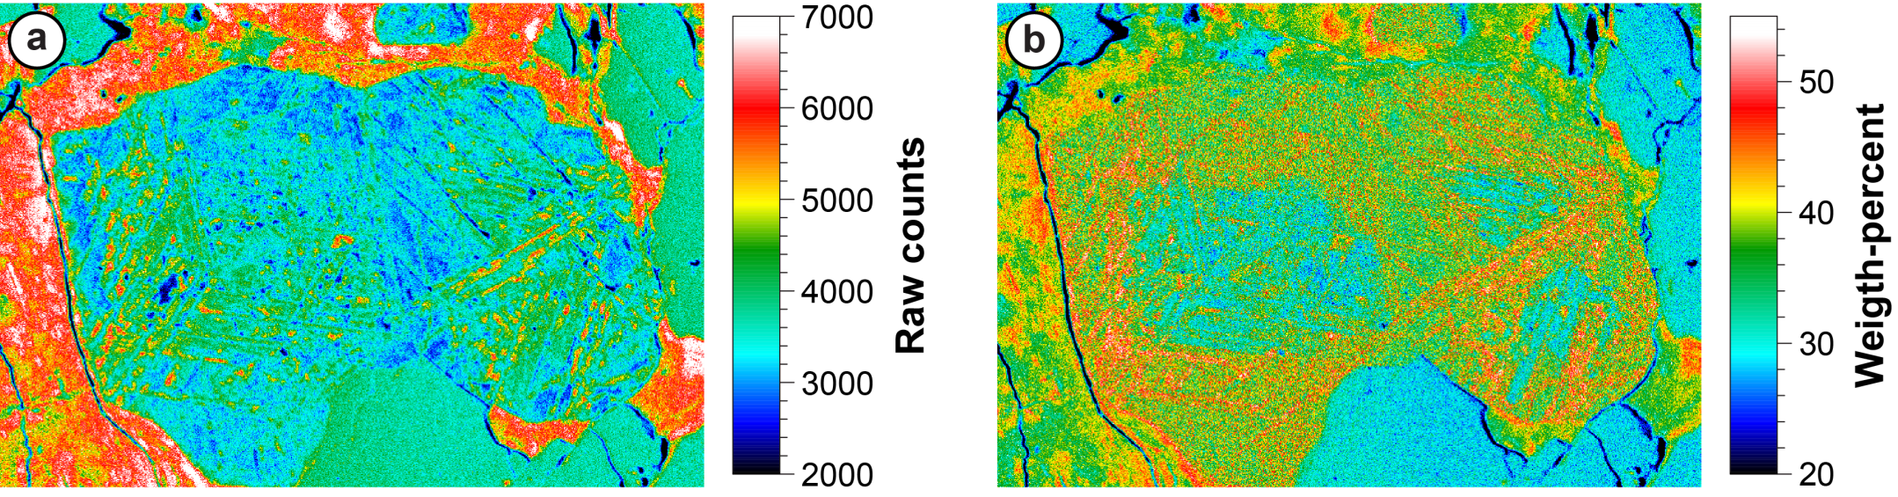
Athens EPMA Workshop, 2022
Quantitative Analysis of Light (low emission energy) Elements
Oxygen in FeTi oxides
Donovan et al., 2021
EPMA User Form:
https://probesoftware.com/smf/index.php
John Donovan
University Of Oregon
CAMCOR
Modified from Fournelle, 2006

Slide 2
Which Elements are we talking about?
Kα X-ray Data
Element
Z
Wavelength Å
Energy (eV)
Edge (eV)
Be
4
114
109
112
B
5
67.6
183
192
C
6
44.7
277
284
N
7
31.6
292
400
O
8
23.6
525
532
F
9
18.3
677
687
We are concerned here primarily about the K lines of elements Be-F, although many of the concerns affecting their analysis is also true for L and M lines of heavier elements that fall in this low wavelength (low energy) realm.
(Now, >2012, Li is doable…sort of!)

Slide 3
So what’s the problem with light elements?
You name it!
Surface sensitivity…shallow emission, oxide layer, surface roughness!
Low fluorescent yield (high Auger production)…poor sensitivity!
High x-ray absorption… large matrix corrections!
Poor spectral resolution…background placement is problematic!
Large and numerous spectral interferences…must be corrected for!
X-ray transition includes valence shell… chemical bond sensitivity!
Sometimes crystallographic orientation issues… polarization!
Beam interactions with sample…oxidation, carbon contamination!

Slide 4
Light Element Quantitative Analysis Strategies
Avoid if possible (use elements by stoichiometry… or by difference, ugh!)
Use standards matrix matched to unknowns (if available!)
Use integrated intensity (scan) acquisition for standards and unknowns (time consuming acquisition)
If no peak shape changes, only position shift (e.g., S Kα), simply use different peak positions for standards and unknowns
Use peak intensity (normal) acquisitions, but utilize Area Peak Factors (APFs) (see Bastin) to correct for peak shape effects
Consider *empirically* measured mass absorption coefficients (MACs) from the literature for best accuracy in the matrix correction

Slide 5
Long Wavelength Spectrometry
TAP and stearate crystals, or the newer layered synthetic (“pseudo crystals”) have been the two options until recently. Each category has positive and negative features:
TAP and stearate: better spectral resolution (avoid interferences), but peak shape differences accentuated and there are lower count rates; stearates somewhat less stable.
LSMs: poorer spectral resolution (interferences unavoidable), but higher orders suppressed, and there are much higher count rates.
Diffraction Gratings: JEOL (and Cameca?) have looked at diffraction gratings, though only JEOL is commercially selling a spectrometer. See JEOL SXES:
  https://www.jeol.co.jp/en/products/detail/SXES.html

Slide 6
Crystals and LDEs/PCs
Consider the order of 2d in Braggs Law: sin θ varies from .2-.8, and λ varies over a wide range from hundreds to fractions of an A. Thus, we need diffractors that cover a similar range of 2d, from around 1 Å to hundreds of Å. Normally we utilize TAP, PET and LIF crystals for the shorter wavelengths. For longer wavelengths we utilize layered synthetic microstructures (LDEs for layered dispersive elements or PC for pseudo crystals), produced by sputtering of alternating light and heavy elements, such as W and Si, or Ni and C in order to create a periodic structure of different electron densities.
In reality, people interchange the words LDE and PC. Cameca uses PC and JEOL uses LDE, for same thing.
(simple) Bragg’s Law:
nλ = 2d sinθ
n is order of diffraction. λ = wavelength (angstroms)

Slide 7
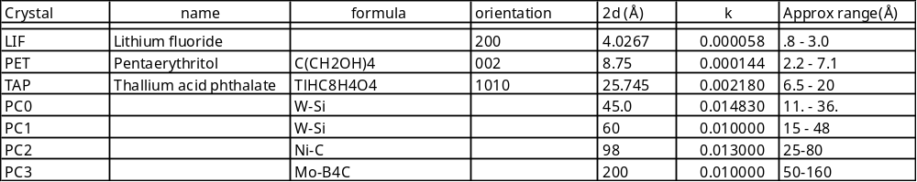
Typical crystals and LDEs/PCs
nλ = 2d sinθ, where n is order of diffraction
There is a more accurate form of Braggs Law, that takes into account refraction effects, which are more pronounced in the layered synthetic diffractors, e.g.,
nλ = 2d sinθ(1-k/n²),
where k is refractive index

Slide 8
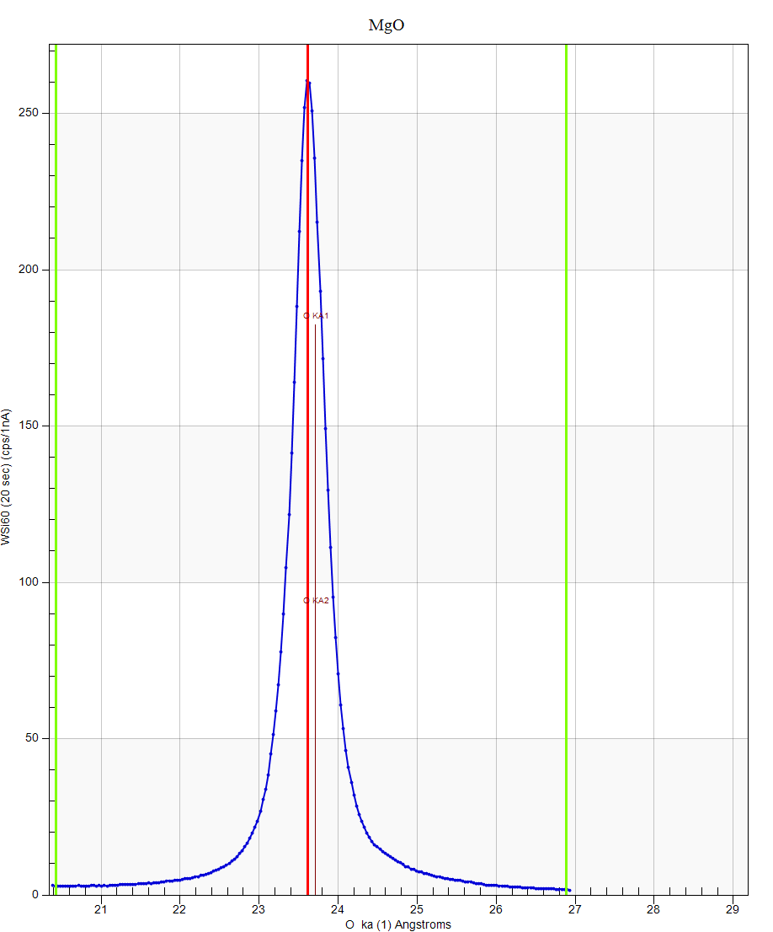
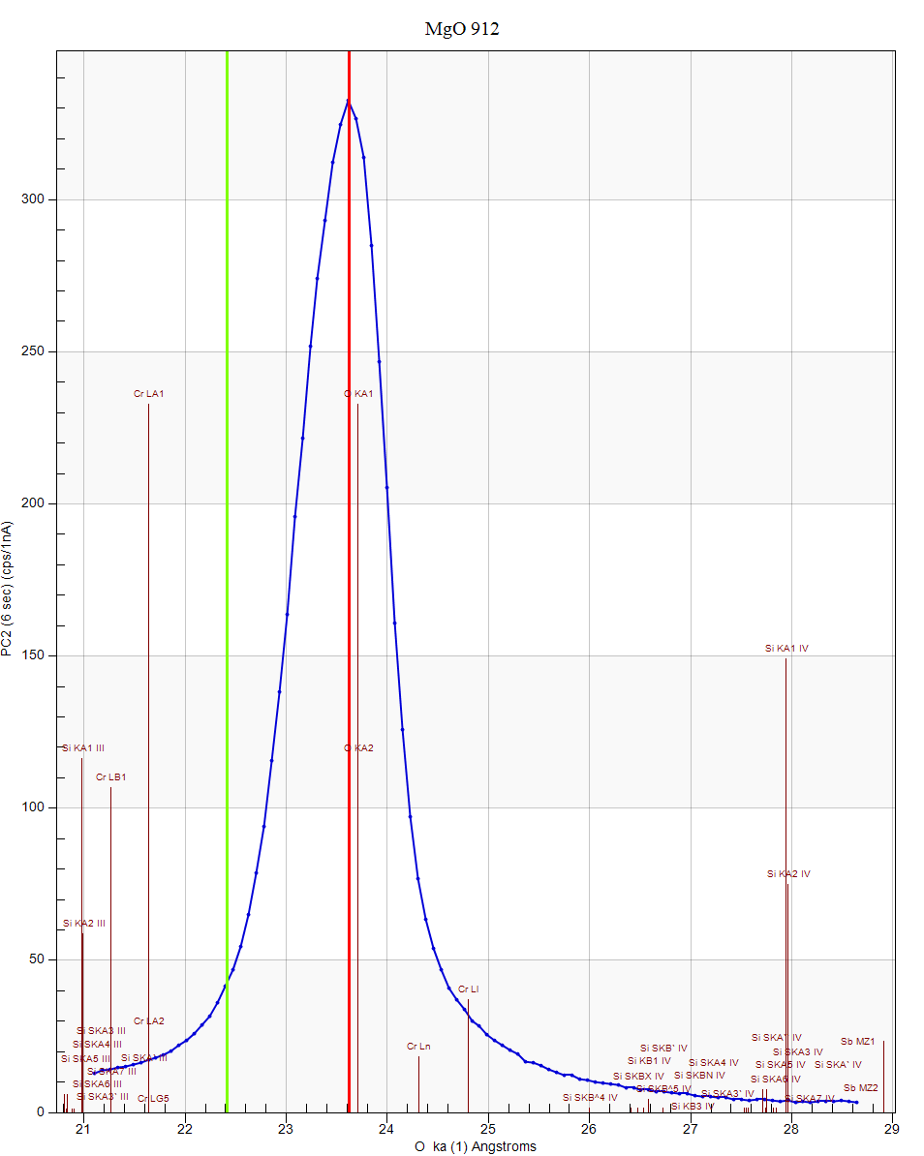
Crystal resolution/bgd comparison
Å
Å
O Kα on PC1
O Ka on PC2
PC1 gives a better P/B and better spectral resolution

Slide 9
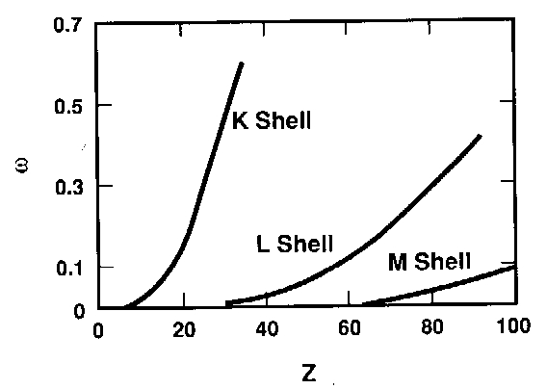
Fluorescence Yields
The yields of K lines of B-F are <0.05, as well as the L and M lines of the higher Z elements that fall below 1 keV (longer than 12 Å).
We are discussing this in one context--light elements -- but need to view the wider issue too.
While the above may be strictly correct, it is also somewhat disingenuous. Recall the F.Y. means only the fraction of x-rays vs fraction of Auger electrons being produced by inner shell ionizations…it says nothing about the actual number of x-rays you can count on your spectrometers! At 7 keV and 20 nA we can easily generate 50,000 counts a second of B Ka -- in pure B.

Slide 10
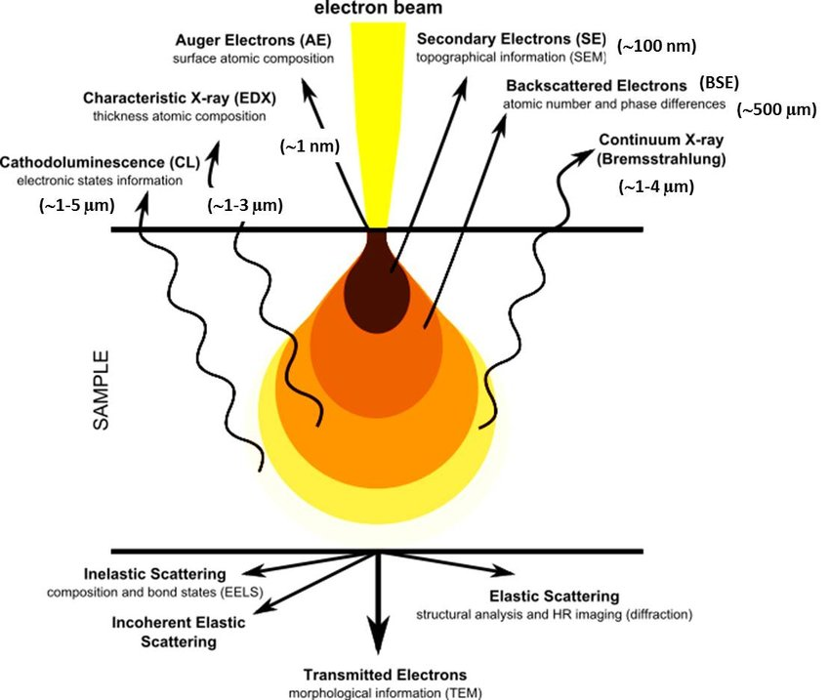
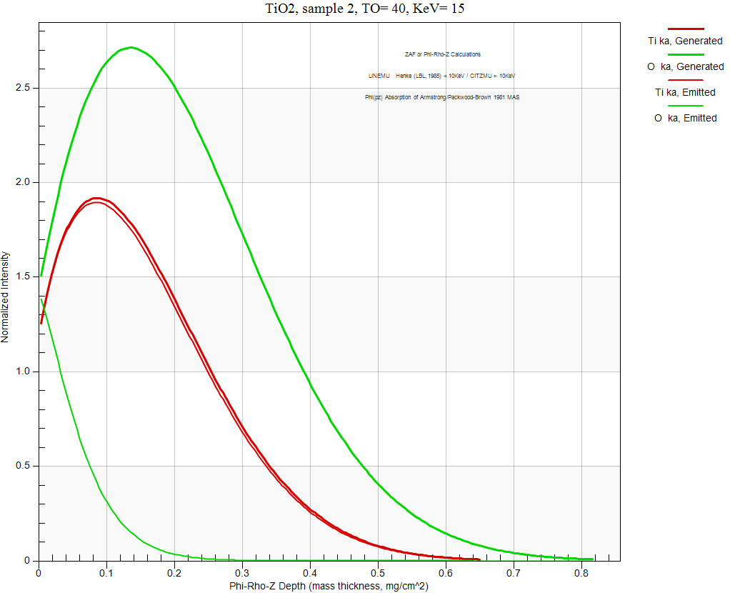

Light element generation volumes are large, but emission volumes are close to surface
More like < 200 nm
for low energy X-rays
with high absorption!

Slide 11
Major Elements vs. Trace Elements
When measuring major light elements consider:
Standards (matrix match?)
Mass absorption coefficients (MACs)
Area Peak Factors (APFs)
Matrix corrections (and spectral interferences)
When measuring trace light elements consider:
Spectral interferences (on-peak and off-peak)
Background curvature and modeling
Surface contamination, e.g., oxidation, carbon contamination, etc.

Slide 12
Major Light Elements
When measuring major light elements consider:
Peak shape/shift effects relative to ones standard. Ideally one can find a matrix matched standard highly similar to the unknown.
If not, use “compound” APFs appropriately normalized to the light element standards, if they are available in the literature
If compound APFs are not available, use “specified” APFs, where one measures peak/integrated intensities on both the standard and unknown from acquired wavescans, for peak shape changes and enter those values into the software

Slide 13
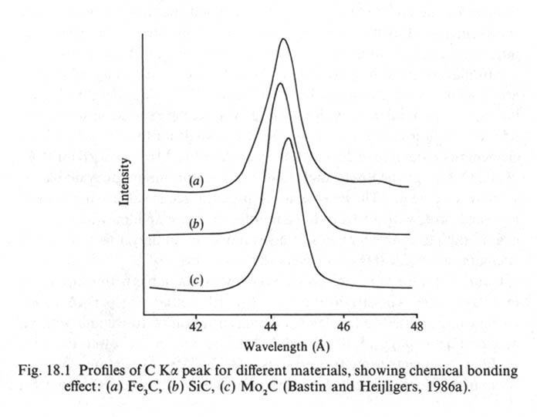
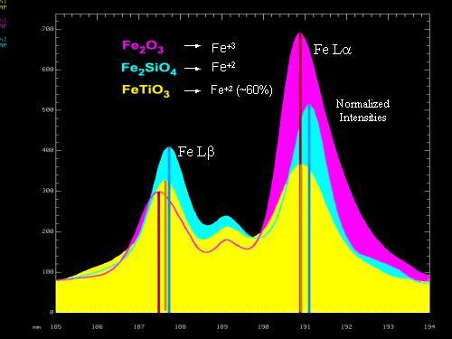
Peak Shift and Shape Changes
C Ka
The electrons involved with the transitions yielding the C kα X-ray are valence electrons. Differences in bonding are reflected in differences in the shapes of the peaks (including shifts of the maxima).
Here the Fe Lα and Lβ peak shapes and intensities are functions of the bonding (valence states). Attempts have been made to utilize this for determining valences of Fe and Mn compounds; results are complicated.
Fig 18.1, from Reed 1993, p. 275
(From Meeker and Lowers, Standards for the analysis of geological and ceramic materials, Slide 813, NIST-MAS Workshop, April 2002.)

Slide 14
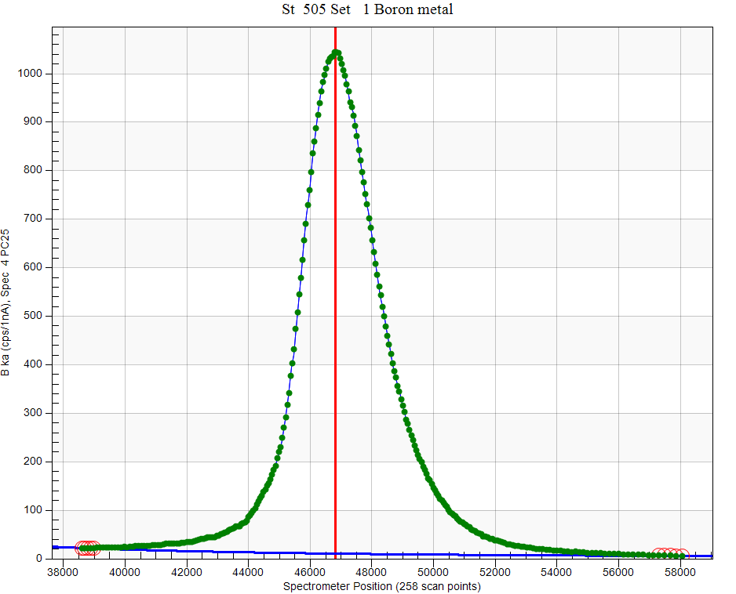
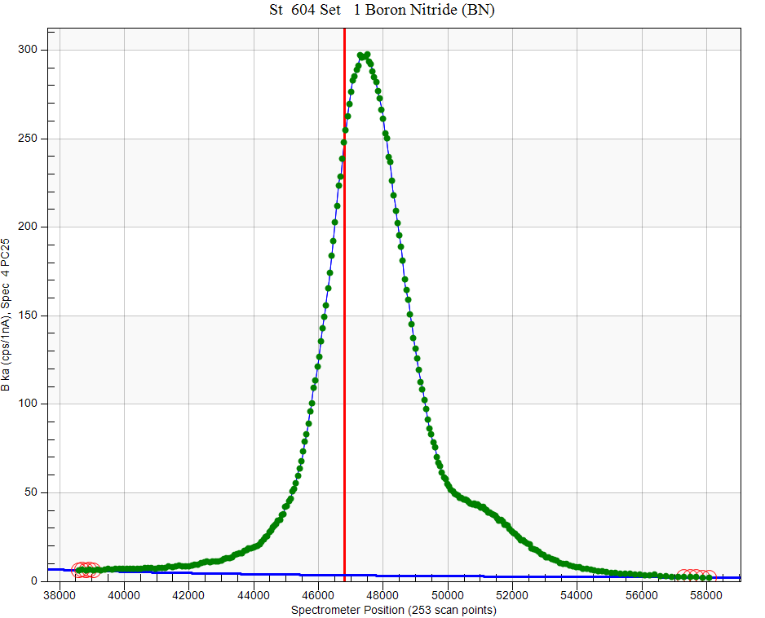
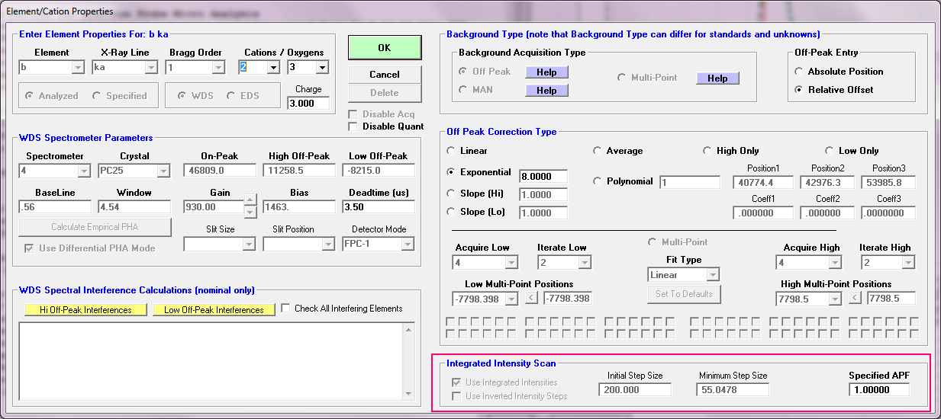
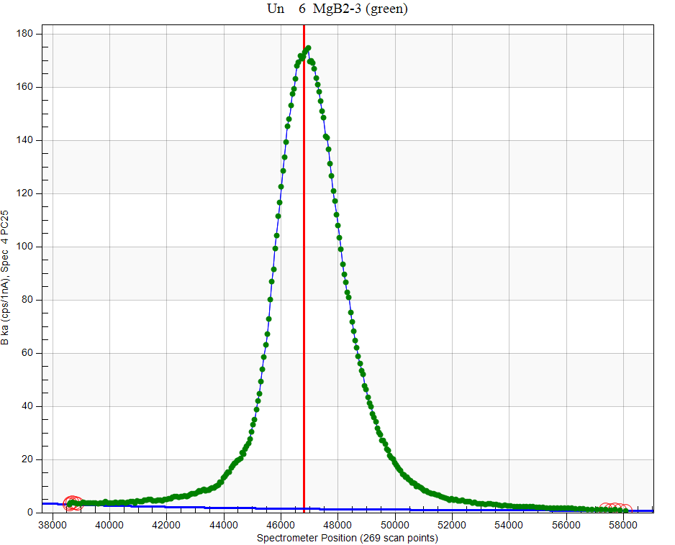
Major Element Strategies: Integrated
Intensity Acquisitions

Slide 15
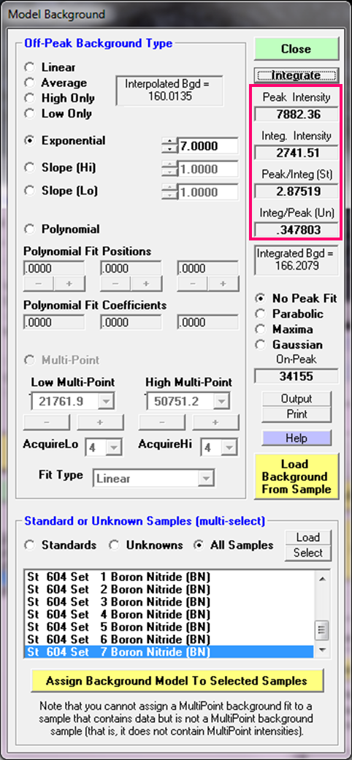
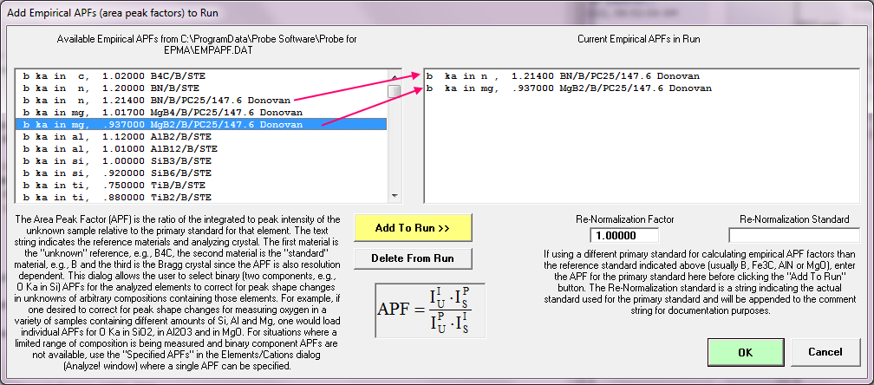
Major Element Strategies: Empirical APFs
There are two types of APFs (area peak factors):
Compound APFs from measurements on binary oxides, carbides, borides, etc. which are “compounded” for complex matrices based on current composition iteratively within the matrix correction.
Specified APFs measured on a specific standard relative to a specific unknown and applied before the matrix iteration.

Slide 16
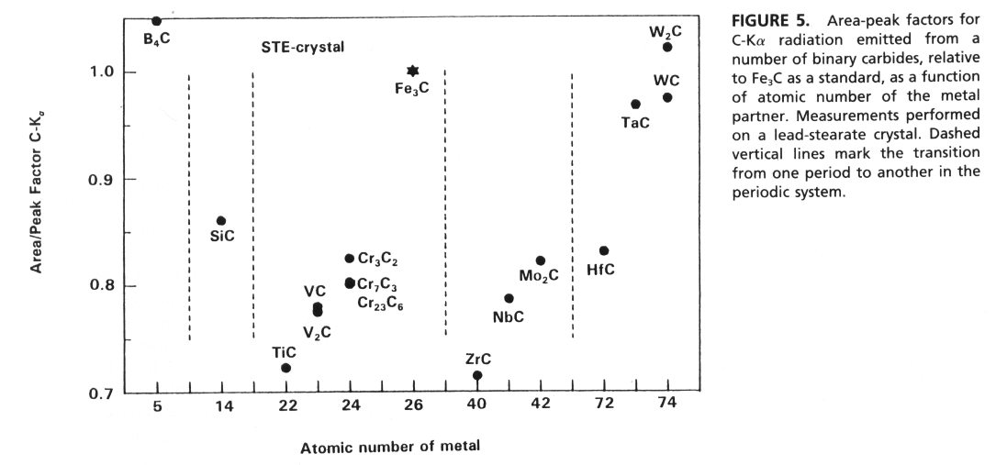
APF compilations
C Ka
Bastin and Heijligers, 1992, Present and future of light element analysis with electron beam instruments. Microbeam Analysis, 1, 61-73.

Slide 17
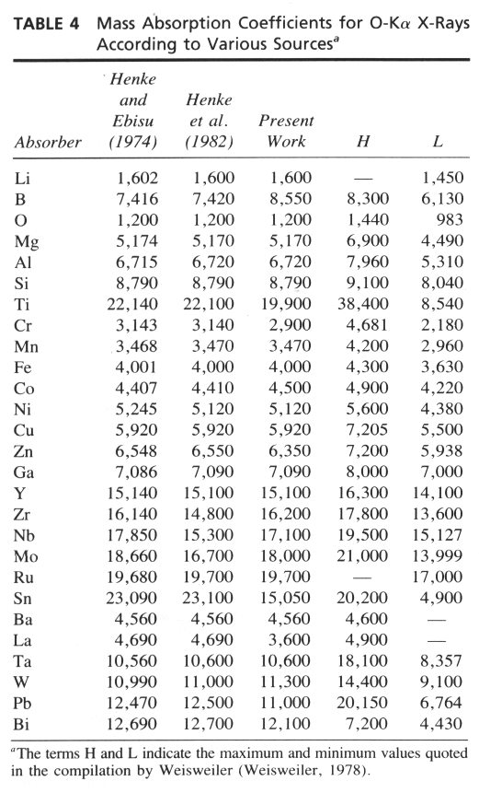
Tabulated MACs
An additional complication is that many mass absorption coefficients for use with light elements are not known with great accuracy, as shown in the adjacent table of MACs for O Ka X-rays, which show the ‘best’ determinations by Bastin and Heijligers (1992), two pre-eminent researchers in this field.
Bastin and Heijligers, 1992, Present and future of light element analysis with electron beam instruments. Microbeam Analysis, 1, 61-73.

Slide 18
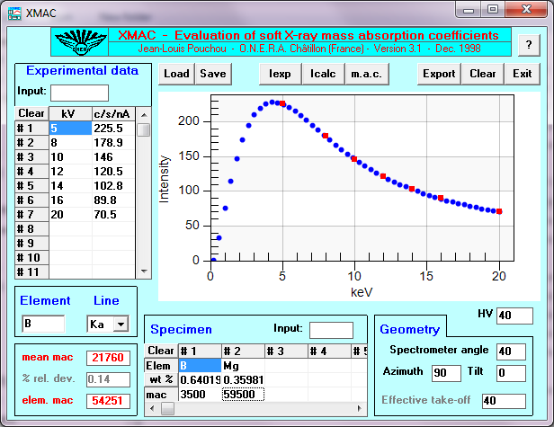
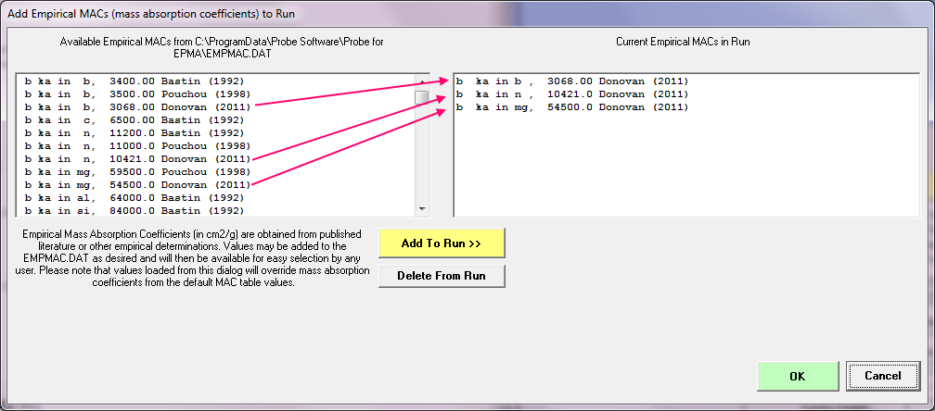
Major Element Strategies: Empirical MACs
For MACs on the order of 10⁴, a 1% change in the MAC corresponds to an approximately 1% change in the concentration.

Slide 19
Trace Light Elements
When measuring trace light elements consider:
Background placement: including interferences on both the on-peak positions, and also off-peak positions (unless using MAN methods). Consider use of multi-point backgrounds (MPB).
Background shape and fit models. Curvature of the background is usually significant for light elements backgrounds, especially at low sin thetas.
Surface contamination, especially (native) oxide layers, beam induced oxidation, native hydrocarbon, hydrocarbon contamination.

Slide 20
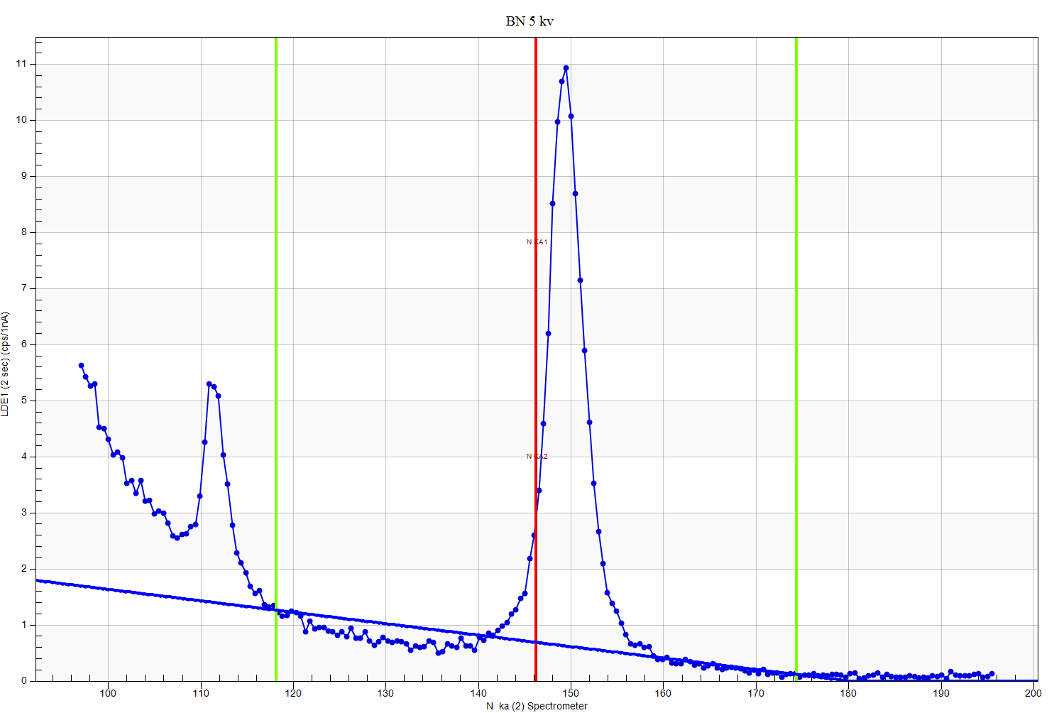
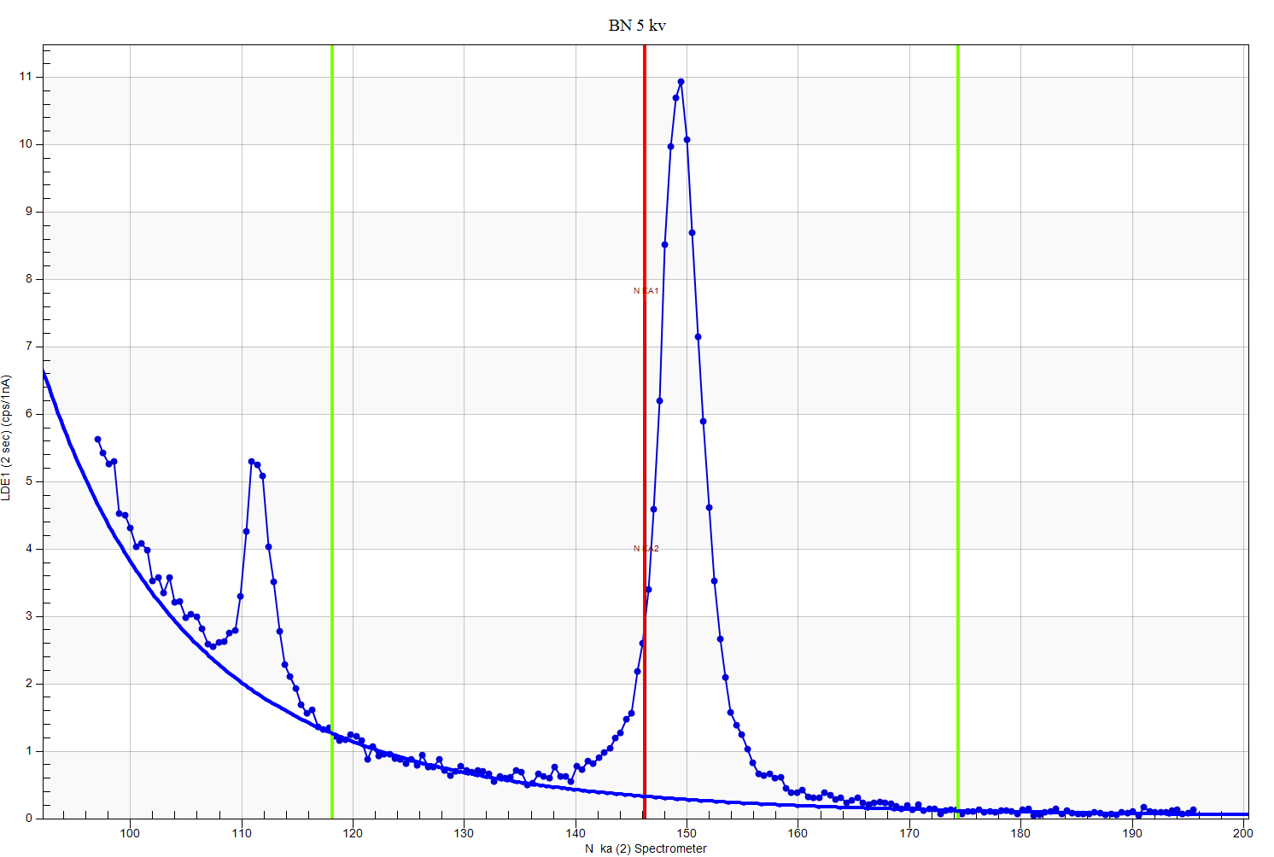
Trace Strategies: Curved backgrounds
There are some cases where the background has a curvature, particularly at low sin theta A linear model (below) results in too high calculated background.

Slide 21
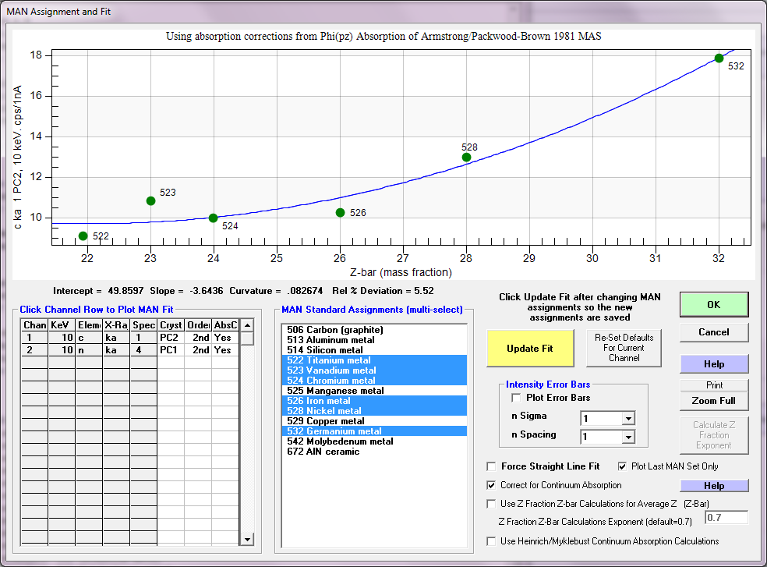
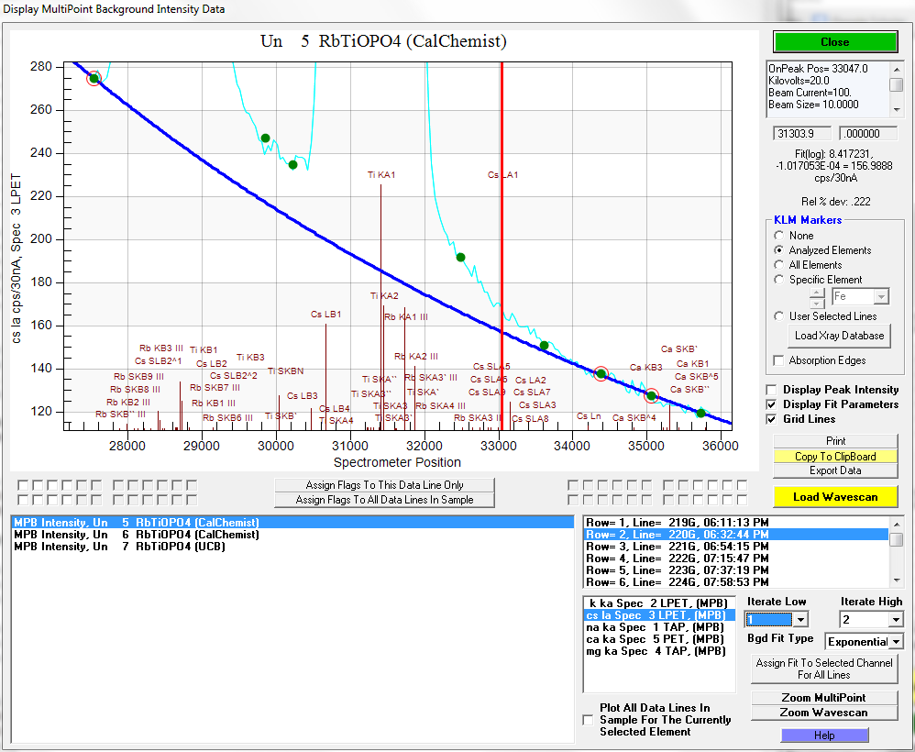
Consider mean atomic number (MAN)
or multi-point backgrounds (MPB)
MPB (iterated outside the matrix correction)
MAN (Z-bar vs. “on-peak” intensity iterated in the matrix correction)

Slide 22
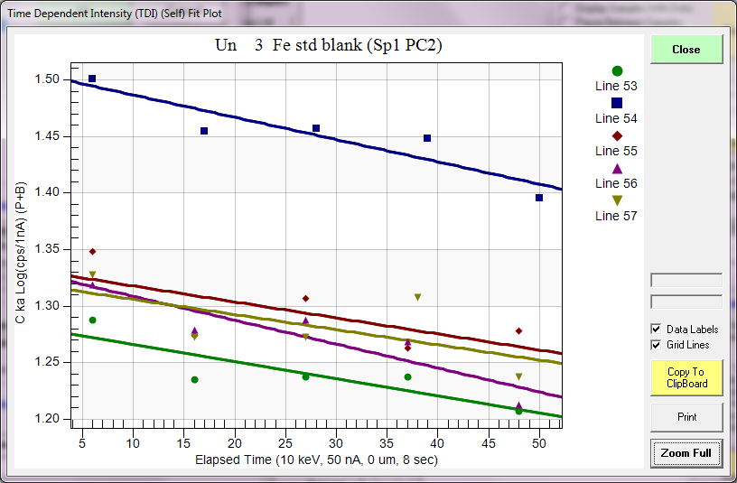
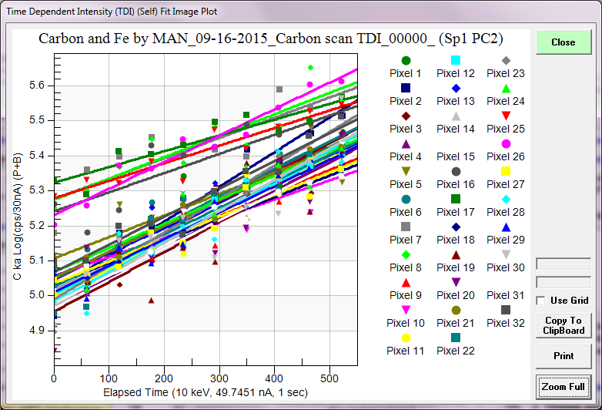
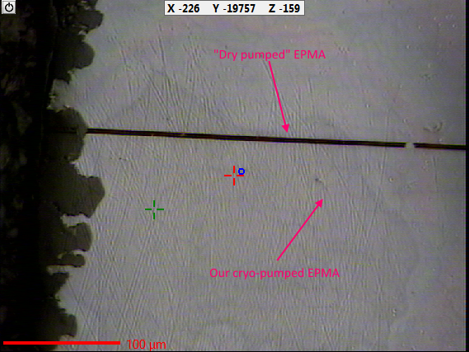
Carbon contamination often requires TDI correction for trace carbon
Cryo-pumped clean system
Contaminated system
Optical image

Slide 23
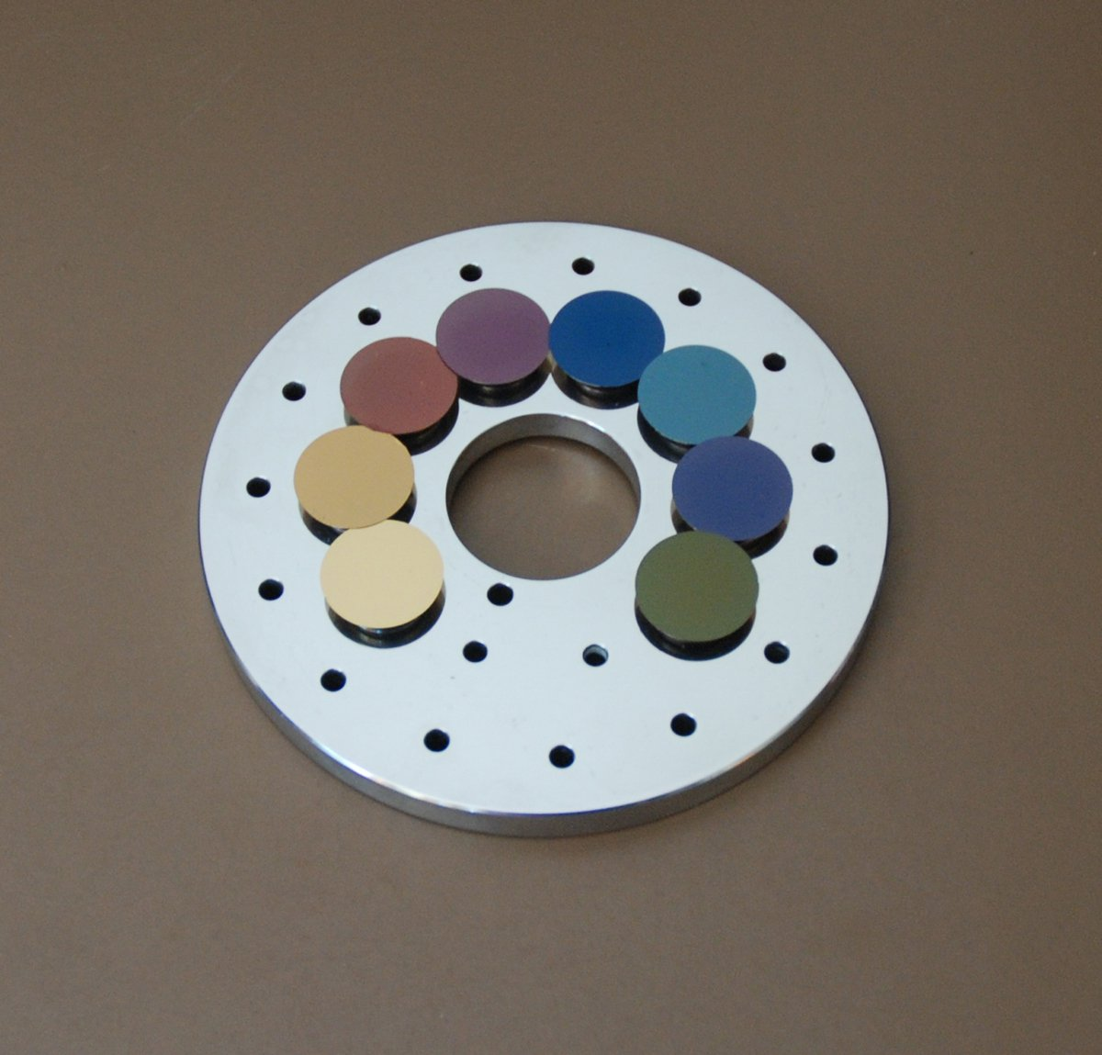
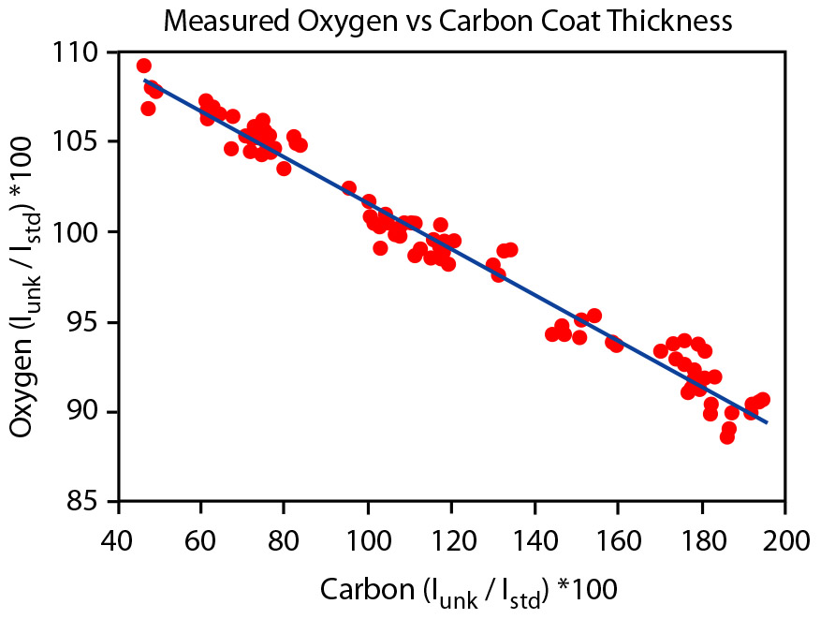
Sample/standard Error: Physical issues – carbon coat
20 nm (200 A)
Carbon coat: the conductive coating on the samples should be of the same thickness as on the standards being used. This can be evaluated experimentally or with the GMRFilm modeling program.
Kerrick et al. (1973) measured the effect and showed it affected the light elements most strongly, and was worst at lower E₀: a difference of 200 Å between sample and standard translated to a 4% difference in F Ka intensity.
There is some antidotal evidence that old (many years-decade?) carbon coats may “go bad” (oxidize? delaminate?) and lose conductivity.
McSwiggen compared oxygen and carbon intensities between a carbon coated standard with various carbon coated SiO2 glass materials.
McSwiggen and Associates

Slide 24
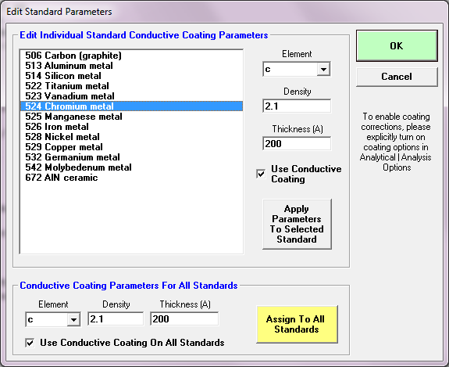
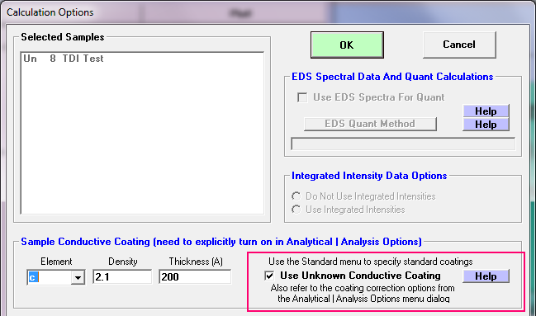
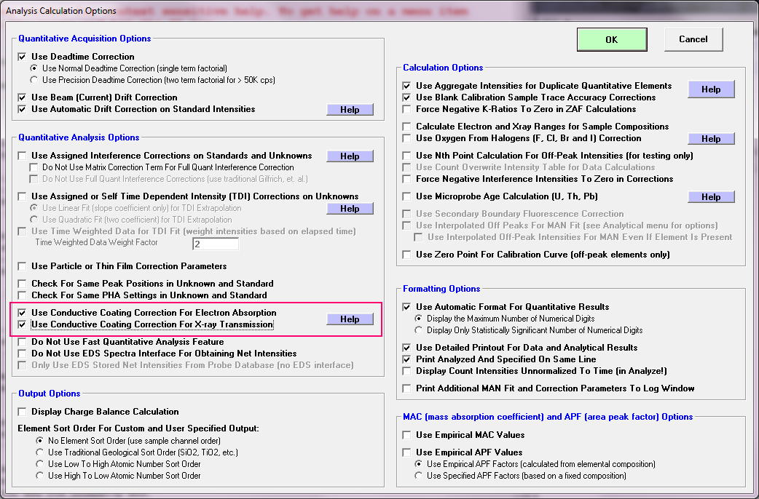
Sample/standard Error: Physical issues – carbon coat
For high accuracy light element work (major/minor elements), you must coat your standards and unknowns together!
Or
correct the for the difference in standard/unknown coating differences in material and/or thickness in software!

Slide 25
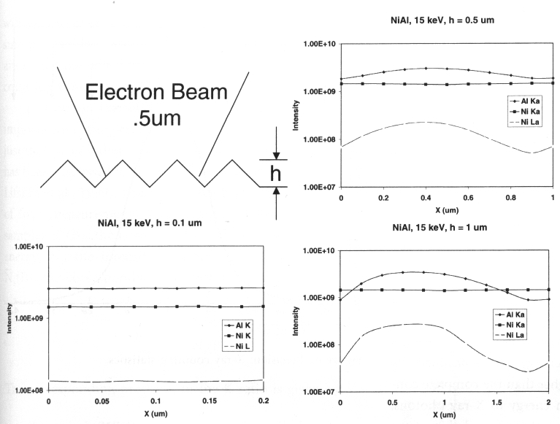
Light Elements are affected by Surface Irregularities
These Monte Carlo simulations show the effect on K and L line X-rays of Ni and Al, of one-directional V-grooves of height (h) varying from .1 to 1 μm. The smallest (.1 μm) grooves have no noticeable effect, but the deeper grooves clearly have major impacts on Al Ka and Ni La (due to more or less absorption), with the greatest impact on the lowest energy line.
Lifshin and Gauvin, 2001, Fig. 4, p. 171.

Slide 26
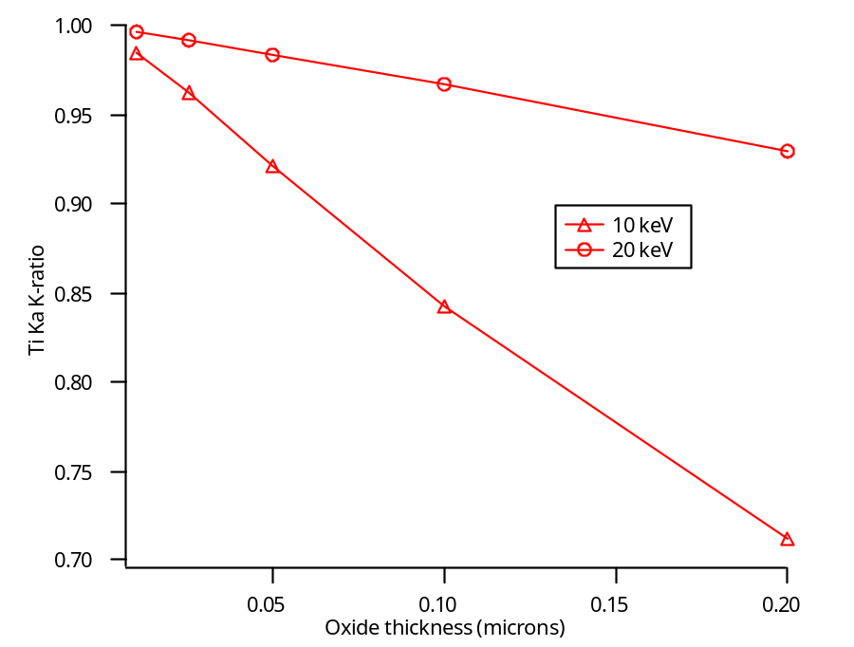
Light elements are sensitive to surface layers!
Oxide coating/film: this can be a significant problem for metals that oxidize (e.g., Al, Mn, Mg, Ti, etc.), particularly for standards. These can reach fractions of a μm in depth, and significantly alter the X-ray intensity of the line being acquired for the standard, resulting in an overestimate of the element in the unknown.
Re-polish Your Metal Standard Mounts Every Year!
Or even more often in the case of some metals!
Fournelle, 2006
This plot shows the effect of a thin oxide skin (TiO₂) on reducing the characteristic X-rays from a pure metal standard (Ti), and is most severe for lower E₀. (Modeled with GMRFilm software).

Slide 27
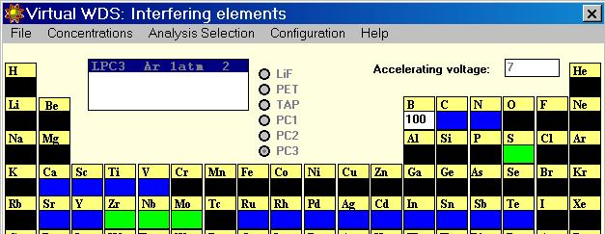
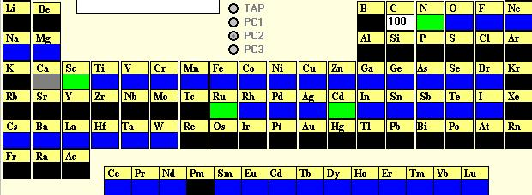
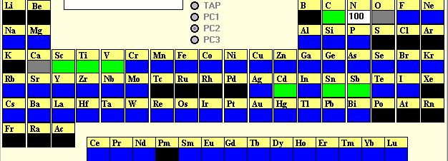
Spectral Interferences (as shown by Virtual WDS)
Potential interferences…
Green indicates first order interferences, and blue higher order ones.
B
C
N

Slide 28
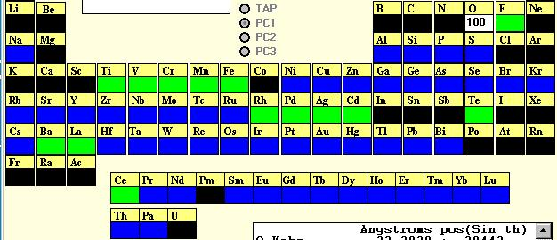
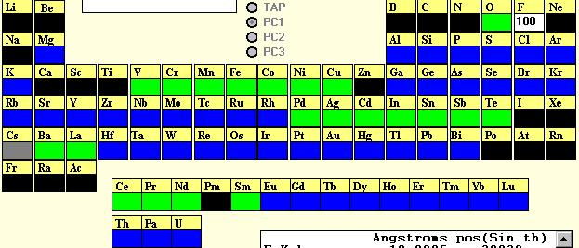
More Interferences (as shown by Virtual WDS)
O
Note the large number of interferences for O and F ka. This increases the difficulty of analysis of those elements.
F

Slide 29
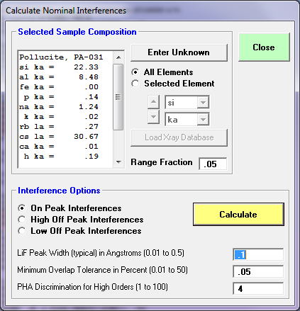
Lots of interferences for low energy lines!
On Peak Interferences for : St 1125 Pollucite, PA-031
For Si ka TAP at 7.14182 angstroms, at an assumed concentration of 22.32913 wt.%
Interference by Cs LG1 III at 7.04600 ( 27368.4) ( -372.20) = 1.5%
Interference by Cs SLG1` III at 7.06470 ( 27441.1) ( -299.56) = .2%
Interference by Rb LB1 at 7.07670 ( 27487.7) ( -252.95) = .3%
On Peak Position ------------- at 7.14182 ( 27740.6)
Interference by Rb LA1 at 7.31900 ( 28428.8) ( 688.201) = .5%
Interference by Rb LA2 at 7.32770 ( 28462.6) ( 721.996) = .1%
Interference by Cs SLB2^1 III at 7.45760 ( 28967.2) ( 1226.56) = .1%
Interference by Cs SLB2^2 III at 7.46430 ( 28993.2) ( 1252.58) = .1%
For Al ka TAP at 8.35836 angstroms, at an assumed concentration of 8.478515 wt.%
Interference by Cs LB4 III at 8.00060 ( 31076.3) ( -1389.6) = .5%
Interference by Cs LB1 III at 8.05290 ( 31279.5) ( -1186.5) = 4.8%
On Peak Position ------------- at 8.35836 ( 32466.0)
Interference by Rb Ll at 8.36600 ( 32495.6) ( 29.6582) = .1%
Interference by Cs SLA9 III at 8.53770 ( 33162.6) ( 696.584) = .3%
Interference by Cs SLA8 III at 8.57350 ( 33301.6) ( 835.639) = .3%
Interference by Cs SLA7 III at 8.59970 ( 33403.4) ( 937.408) = .2%
Interference by Cs SLA6 III at 8.62800 ( 33513.3) ( 1047.33) = .2%
Interference by Cs SLA5 III at 8.63740 ( 33549.8) ( 1083.84) = .1%
Interference by Cs SLA3 III at 8.66400 ( 33653.1) ( 1187.16) = .1%
Interference by Cs LA1 III at 8.67840 ( 33709.1) ( 1243.10) = 9.5%
Interference by Cs LA2 III at 8.70680 ( 33819.4) ( 1353.41) = .8%
For Fe ka LiF at 1.93746 angstroms, at an assumed concentration of 0 wt.%
On Peak Position ------------- at 1.93746 ( 48115.4)
For P ka PET at 6.15890 angstroms, at an assumed concentration of 0.1440164 wt.%
On Peak Position ------------- at 6.15890 ( 70387.4)
Interference by Ca KB1 II at 6.18080 ( 70637.7) ( 250.305) = .1%
Interference by Ca KB3 II at 6.18080 ( 70637.7) ( 250.305) = .1%
For Na ka TAP at 11.9361 angstroms, at an assumed concentration of 1.238893 wt.%
Interference by Cs LA1 IV at 11.5710 ( 44944.7) ( -1418.2) = 5.8%
Interference by Cs LA2 IV at 11.6090 ( 45092.3) ( -1270.6) = 1.7%
Interference by Cs LG1 V at 11.7430 ( 45612.7) ( -750.16) = 7.5%
On Peak Position ------------- at 11.9361 ( 46362.9)
Interference by Cs Ln IV at 11.9760 ( 46517.8) ( 154.875) = 11.4%
For K ka PET at 3.74296 angstroms, at an assumed concentration of 1.660312E-02 wt.%
Interference by Rb SKA4 IV at 3.68730 ( 42140.6) ( -636.15) = 1.8%
Interference by Rb SKA3 IV at 3.68860 ( 42155.4) ( -621.30) = 1.9%
Interference by Rb SKA3` IV at 3.69080 ( 42180.6) ( -596.15) = 2.0%
Interference by Rb KA1 IV at 3.70290 ( 42318.9) ( -457.87) = 297.6%
Interference by Rb KA2 IV at 3.71960 ( 42509.7) ( -267.01) = 220.7%
On Peak Position ------------- at 3.74296 ( 42776.7)
For Rb la PET at 7.31937 angstroms, at an assumed concentration of 0.2651792 wt.%
On Peak Position ------------- at 7.31937 ( 83649.9)
For Cs la LiF at 2.89257 angstroms, at an assumed concentration of 30.67372 wt.%
On Peak Position ------------- at 2.89257 ( 71834.7)
For Ca ka PET at 3.35997 angstroms, at an assumed concentration of 1.429387E-02 wt.%
Interference by Cs Ll at 3.26790 ( 37347.4) ( -1052.2) = 611.3%
Interference by Rb KB1 IV at 3.31530 ( 37889.1) ( -510.47) = 53.8%
Interference by Rb KB3 IV at 3.31770 ( 37916.6) ( -483.04) = 29.2%
Interference by Rb SKBN IV at 3.32490 ( 37998.9) ( -400.76) = 4.3%
On Peak Position ------------- at 3.35997 ( 38399.6)
Interference by K SKB^4 at 3.40390 ( 38901.7) ( 502.098) = .5%
Interference by K SKB`` at 3.44120 ( 39328.0) ( 928.387) = .1%
Interference by K SKB^5 at 3.44930 ( 39420.6) ( 1020.96) = .1%
Interference by K KB1 at 3.45460 ( 39481.1) ( 1081.53) = .7%
Interference by K KB3 at 3.45460 ( 39481.1) ( 1081.53) = .4%
For O ka WSi60 at 23.9756 angstroms, at an assumed concentration of 36.989 wt.%
Interference by Na SKA3 II at 23.6110 ( 38706.6) ( -597.63) = .1%
Interference by Na KA1 II at 23.8180 ( 39045.9) ( -258.29) = .4%
Interference by Na KA2 II at 23.8180 ( 39045.9) ( -258.29) = .2%
Interference by Al KB1 III at 23.9500 ( 39262.3) ( -41.895) = .1%
On Peak Position ------------- at 23.9756 ( 39304.2)
Interference by P KA1 IV at 24.6360 ( 40386.9) ( 1082.70) = .1%
Interference by P KA2 IV at 24.6490 ( 40408.2) ( 1104.01) = .1%
Interference by Al SKA4 III at 24.8130 ( 40677.1) ( 1372.86) = .2%
Interference by Al SKA3 III at 24.8610 ( 40755.7) ( 1451.55) = .2%
Interference by Al SKA` III at 24.9150 ( 40844.3) ( 1540.07) = .1%
Interference by Al KA1 III at 25.0150 ( 41008.2) ( 1704.00) = 2.4%
Interference by Al KA2 III at 25.0220 ( 41019.7) ( 1715.48) = 1.2%
CalcZAF/Standard (free software)

Slide 30
Boron
Example of pathological interferences on B ka: Mo Mz falls very close to the peak, and the strong spectral reflectance of the Si La line greatly complicates determining the background.
B-free Mo₅Si₃ appears to have 3.82 wt.% B, or 19.7 atomic% B – a major error
With Probe for EPMA, we can define curved backgrounds, and subtract the interferences within the matrix correction, yielding excellent results.
3000
B Ka/10
Si L sp.ref.
2500
Mo Mz
2000
Counts
1500
1000
500
0
50
60
70
80
Wavelength (A)
Fournelle, 2006

Slide 31
Some (random) particular issues
Be: rarely analyzed (heavily absorbed); polarization
B: Interference by Cl L, Mo, Nb, Zr M lines; specular reflectance of Si L with PC3 (but not PC2)
C: diamond not usually a good standard; try graphite
N: interference by Ti L
O: Interference by ²Na K; just above C edge, heavily affected by carbon contamination or coat thickness
F: Interference by ³P Ka, Fe L, Ce Mz; mobility in apatite (orientation)

Slide 32
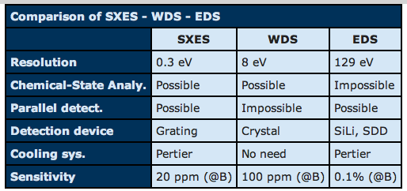
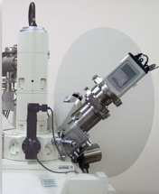
“Soft X-ray Emission Spectrometer”
JEOL offers the SXES (soft x-ray extended range spectrometer) which permits EPMA of a hitherto inaccessible element, Li.

Slide 33
Conclusion: Yes, high accuracy, high sensitivity, light element quant is possible!
Use PC/LDE Bragg “pseudo-crystals” (lower resolution, but better reflectivity and suppression of higher order reflections)
Use matrix matched standard, or integrated intensity scanning (very time consuming) or empirical MACs with APFs (compound or specified)
Perform careful background modeling and use curved background fits or mean atomic number (MAN) or multi-point background acquisition (MPB).
Investigate and correct for spectral interferences
Investigate different matrix corrections (PAP, XPP, etc.)

