Slide 1
Is automatic Peak ID infallible:
Major constituents (C > 0.1 mass fraction or 10%)?
Minor (0.01 < C < 0.1 mass fraction, 1-10%)?
Trace (C < 0.01 mass fraction or 1%)?

Slide 2
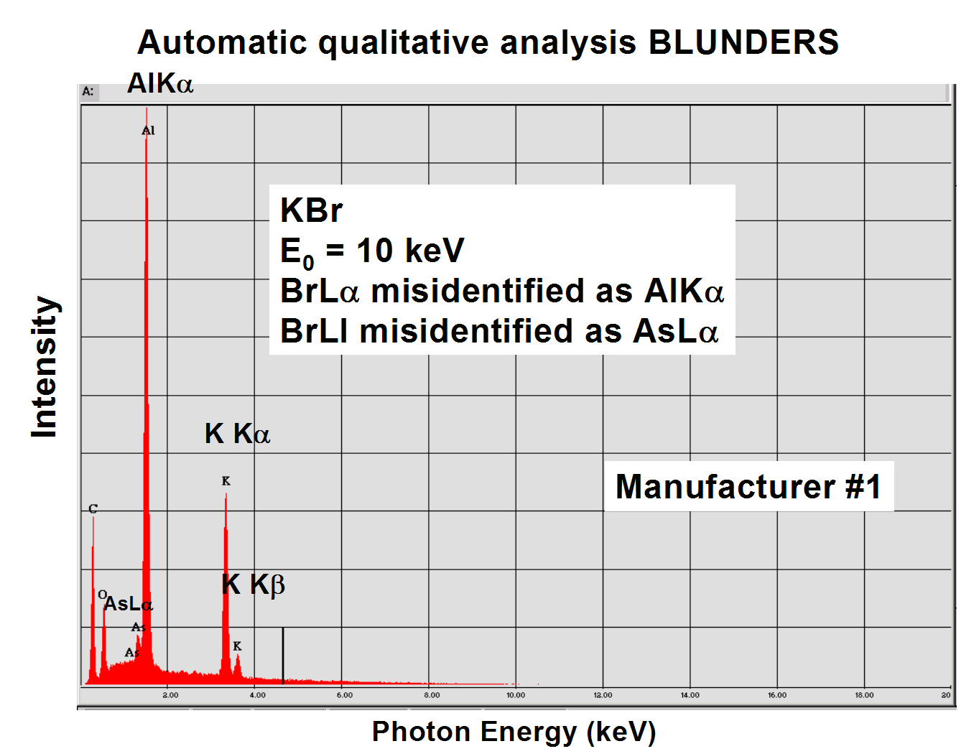

Slide 3
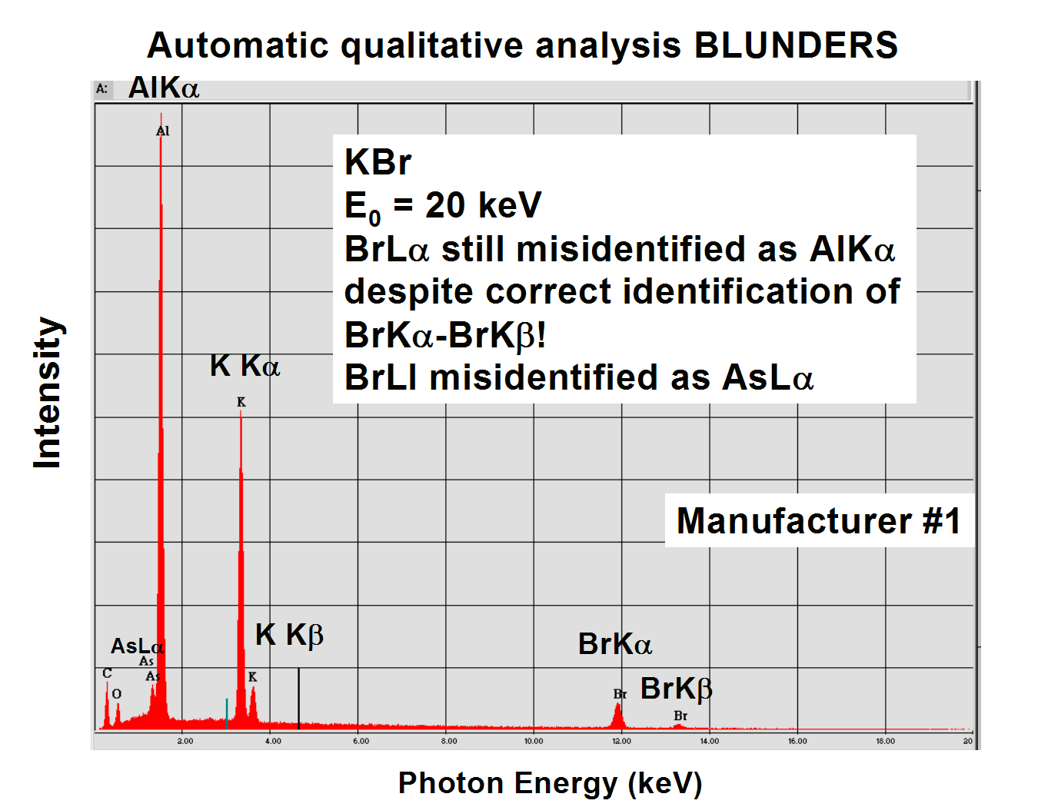

Slide 4
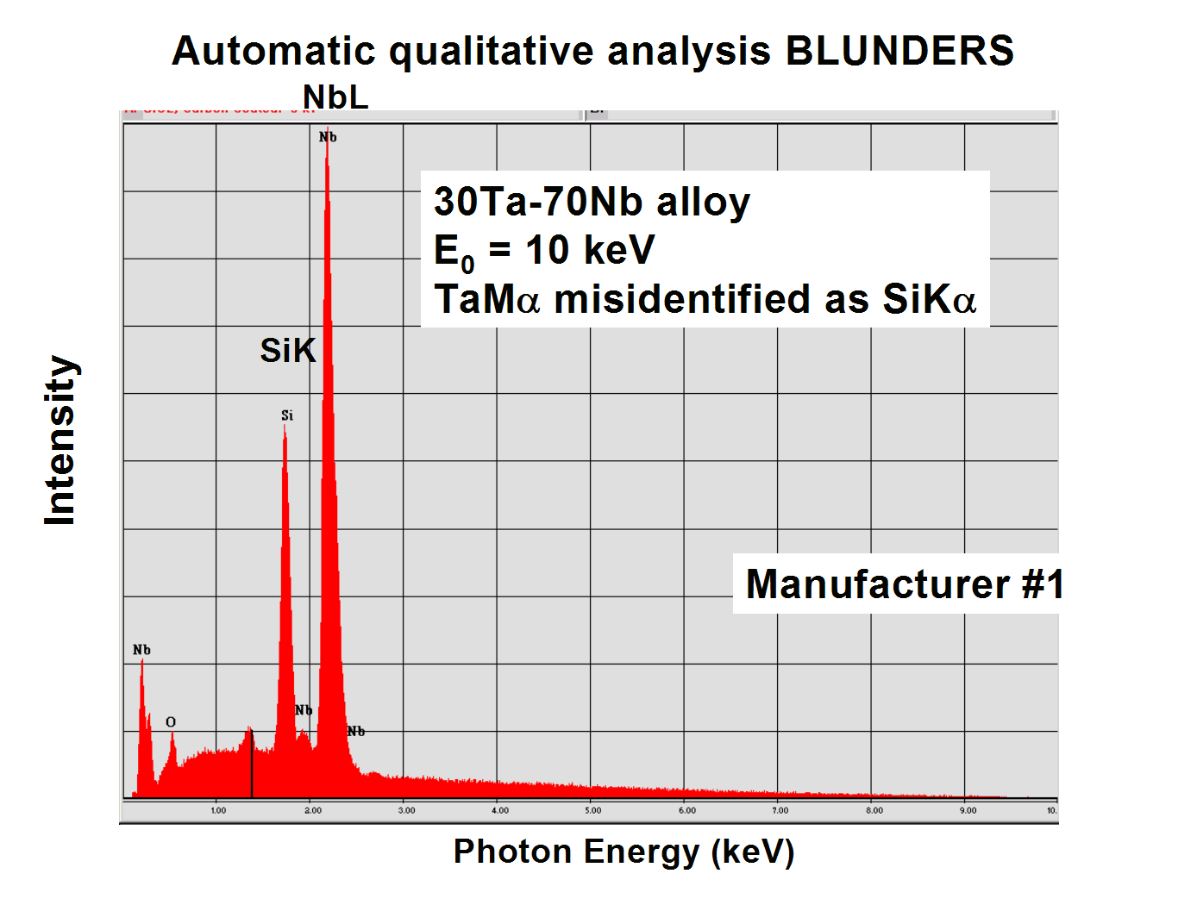

Slide 5
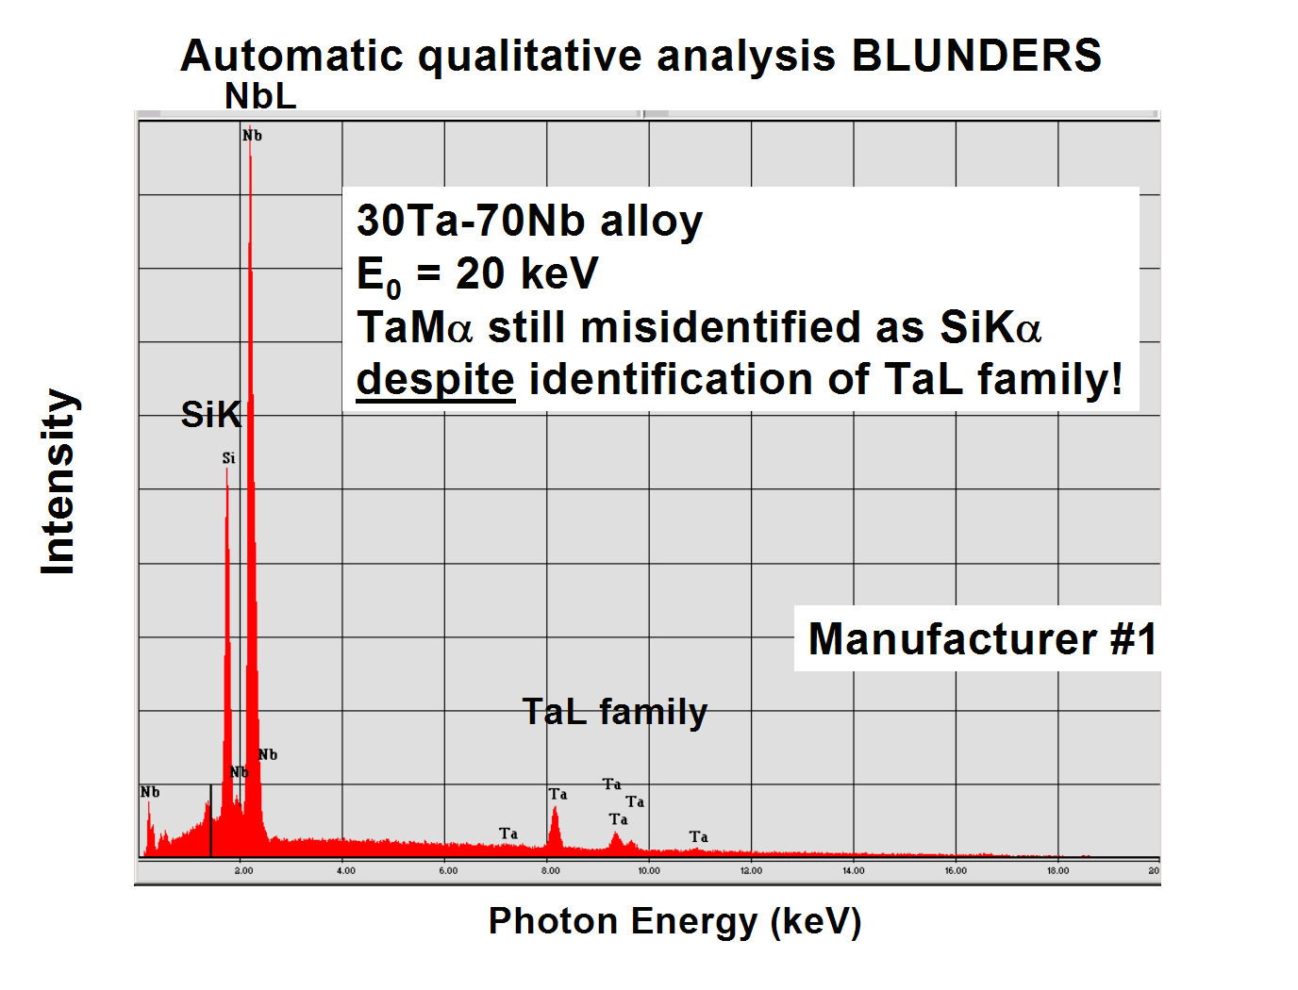

Slide 6
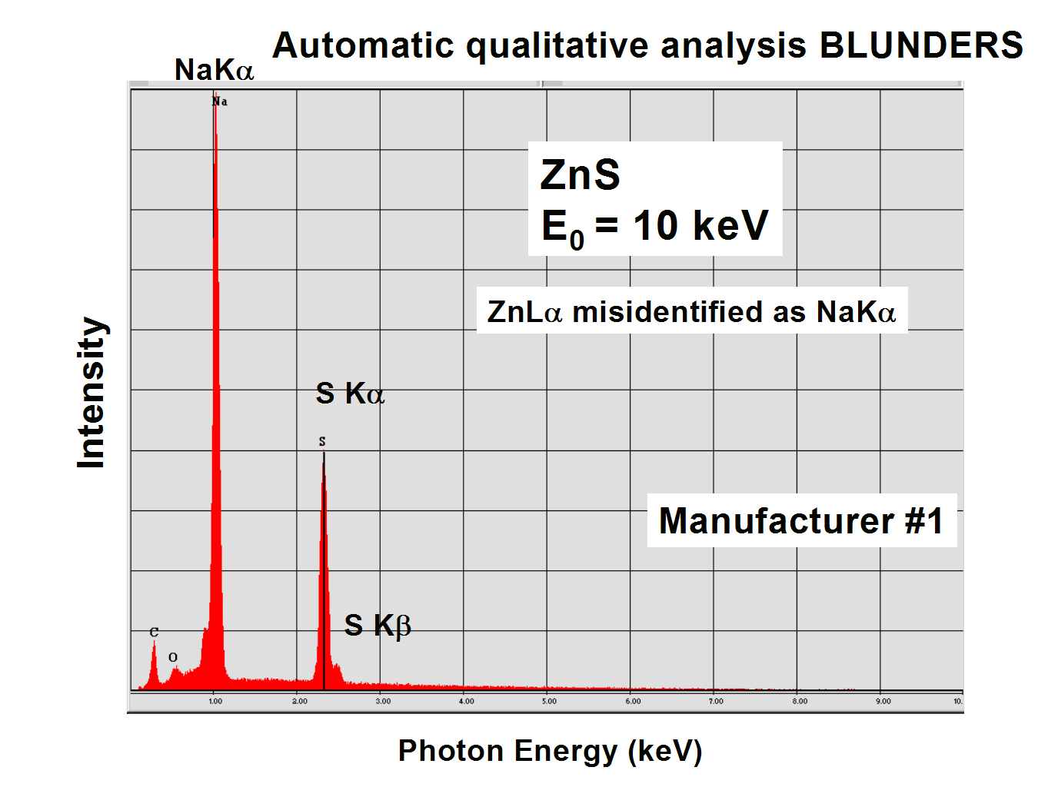

Slide 7
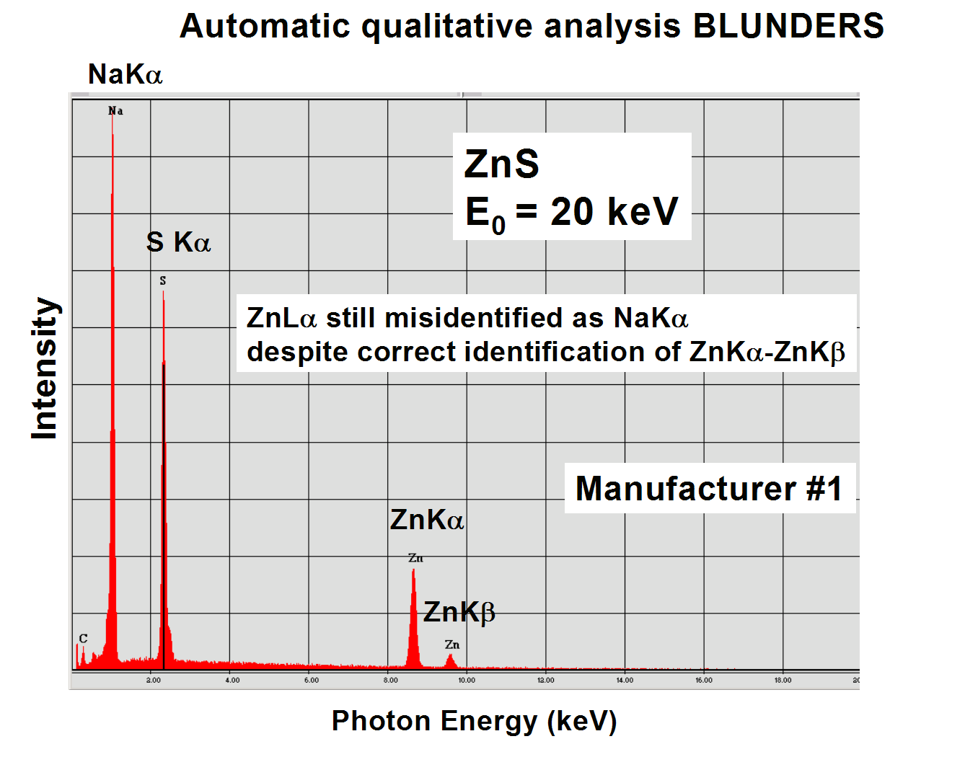

Slide 8
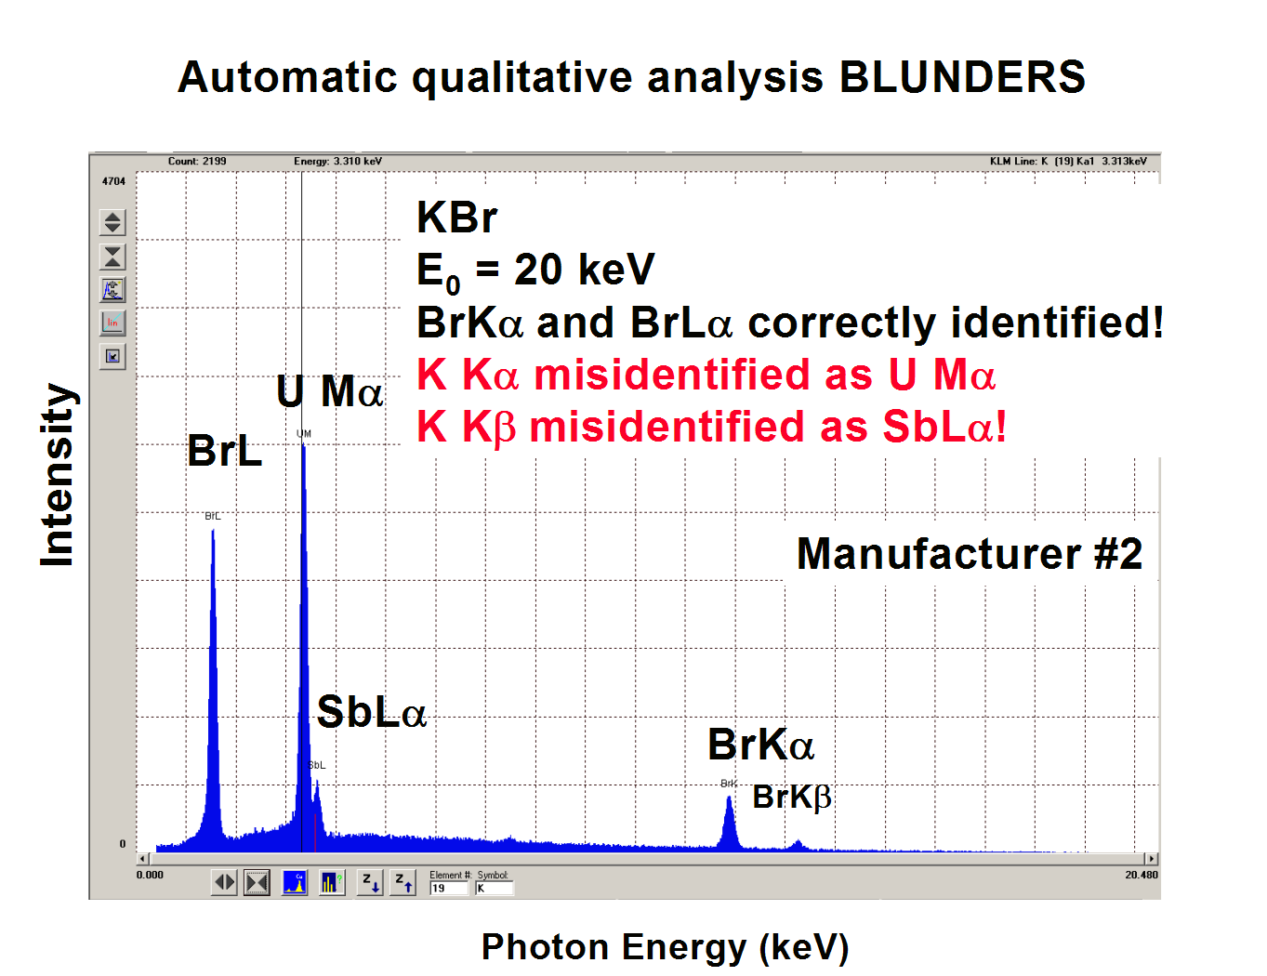

Slide 9
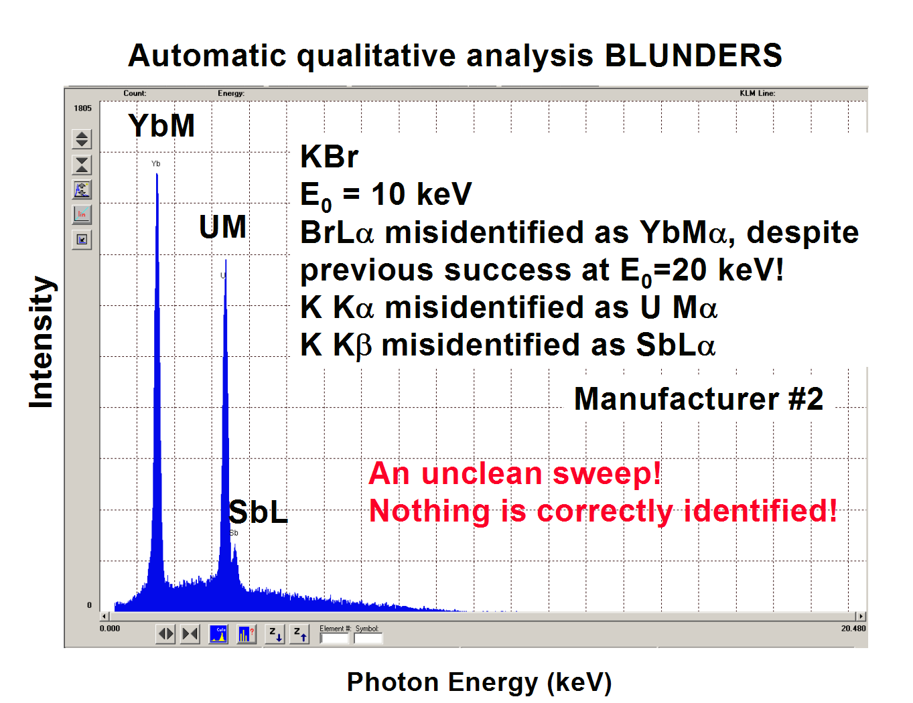

Slide 10
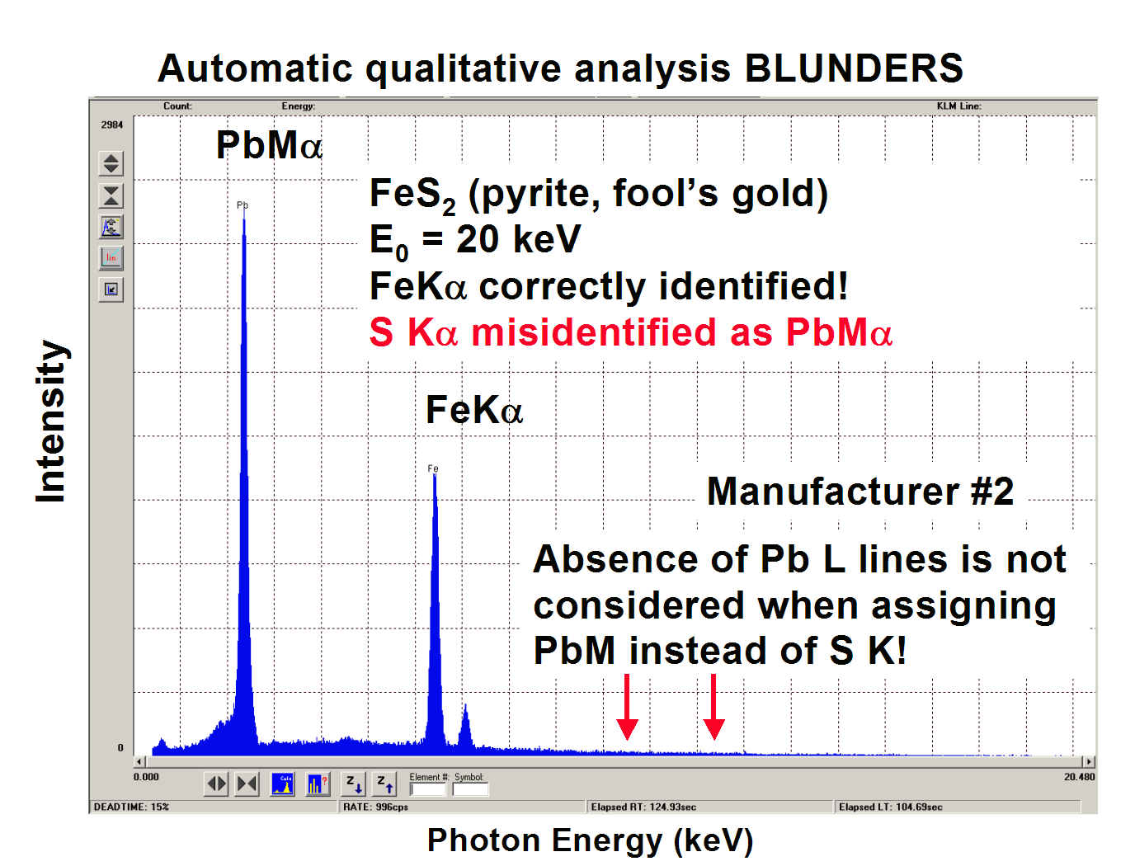

Slide 11
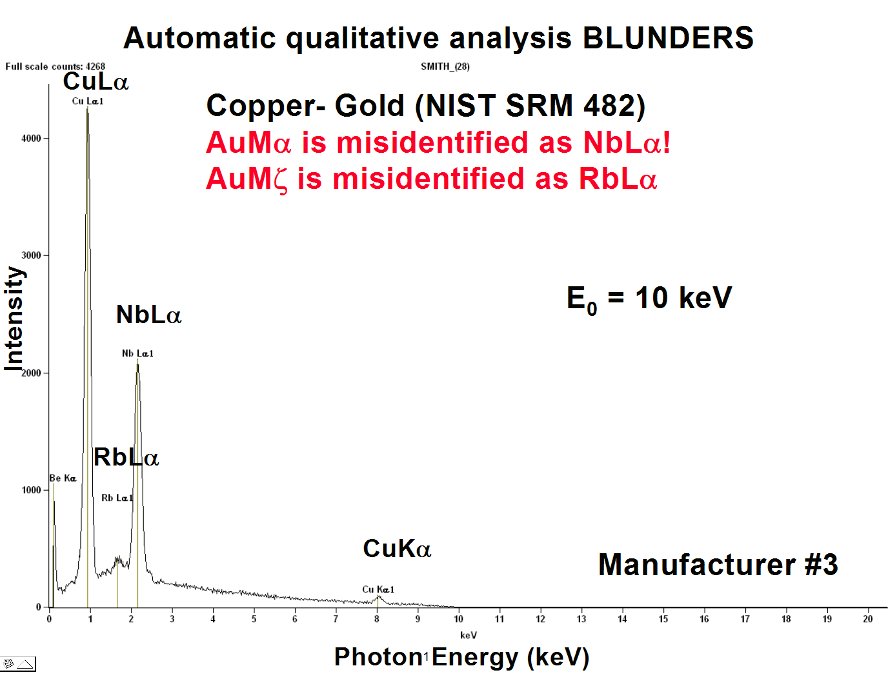

Slide 12
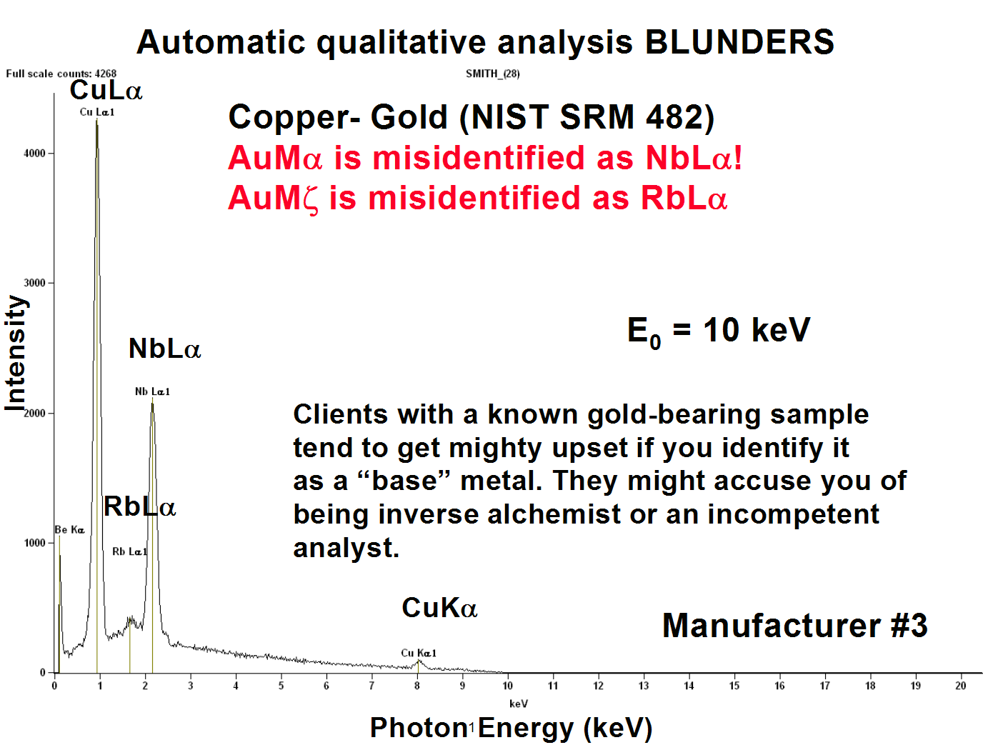

Slide 13
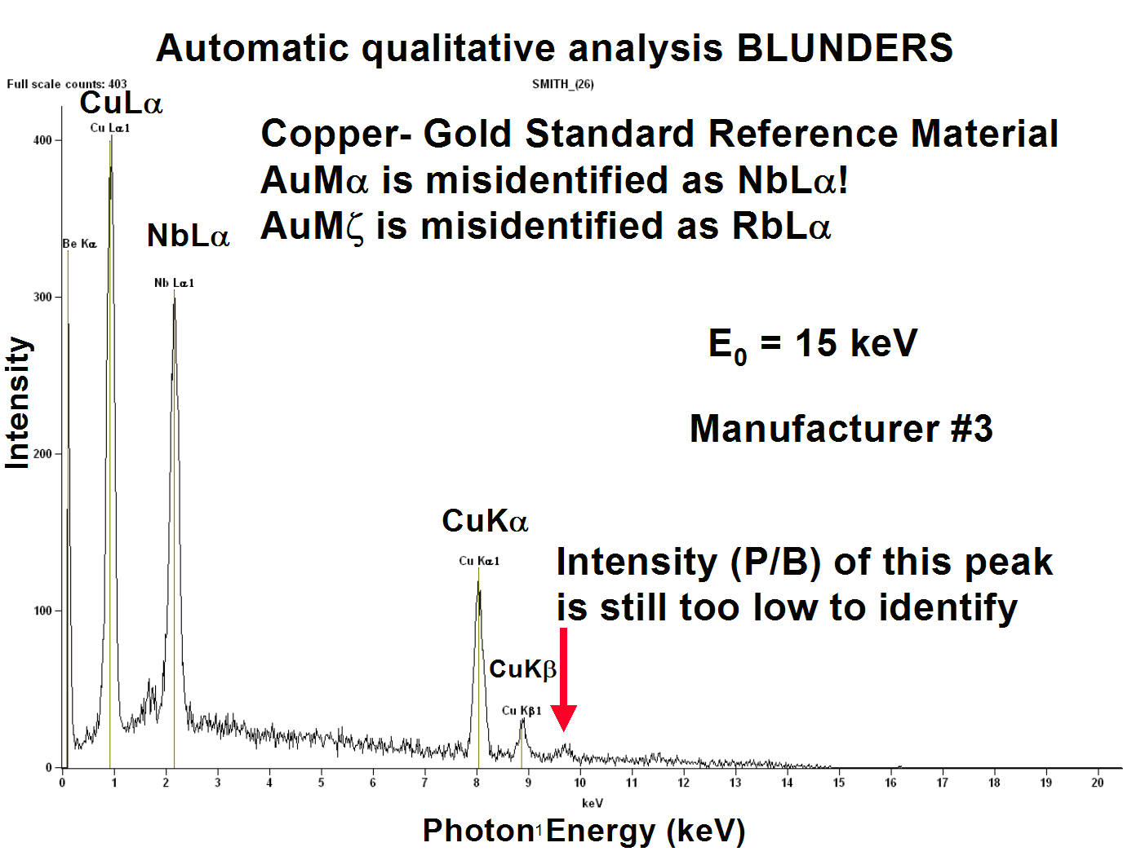

Slide 14
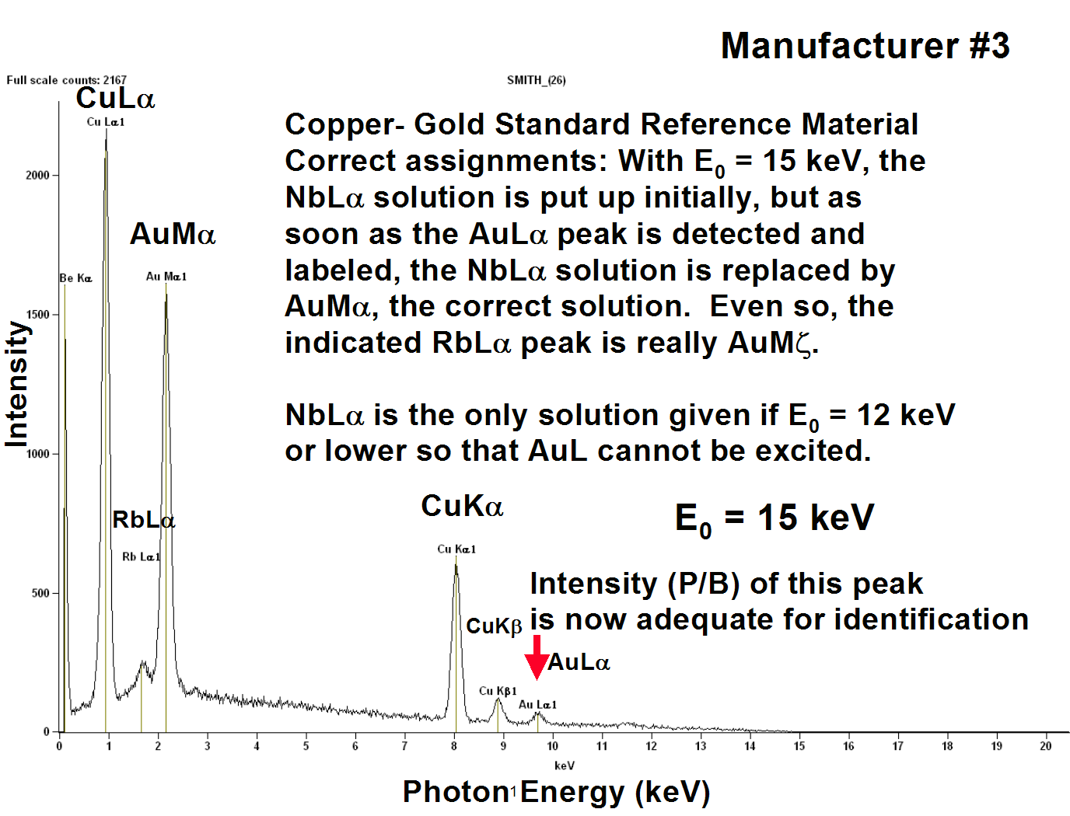

Slide 15
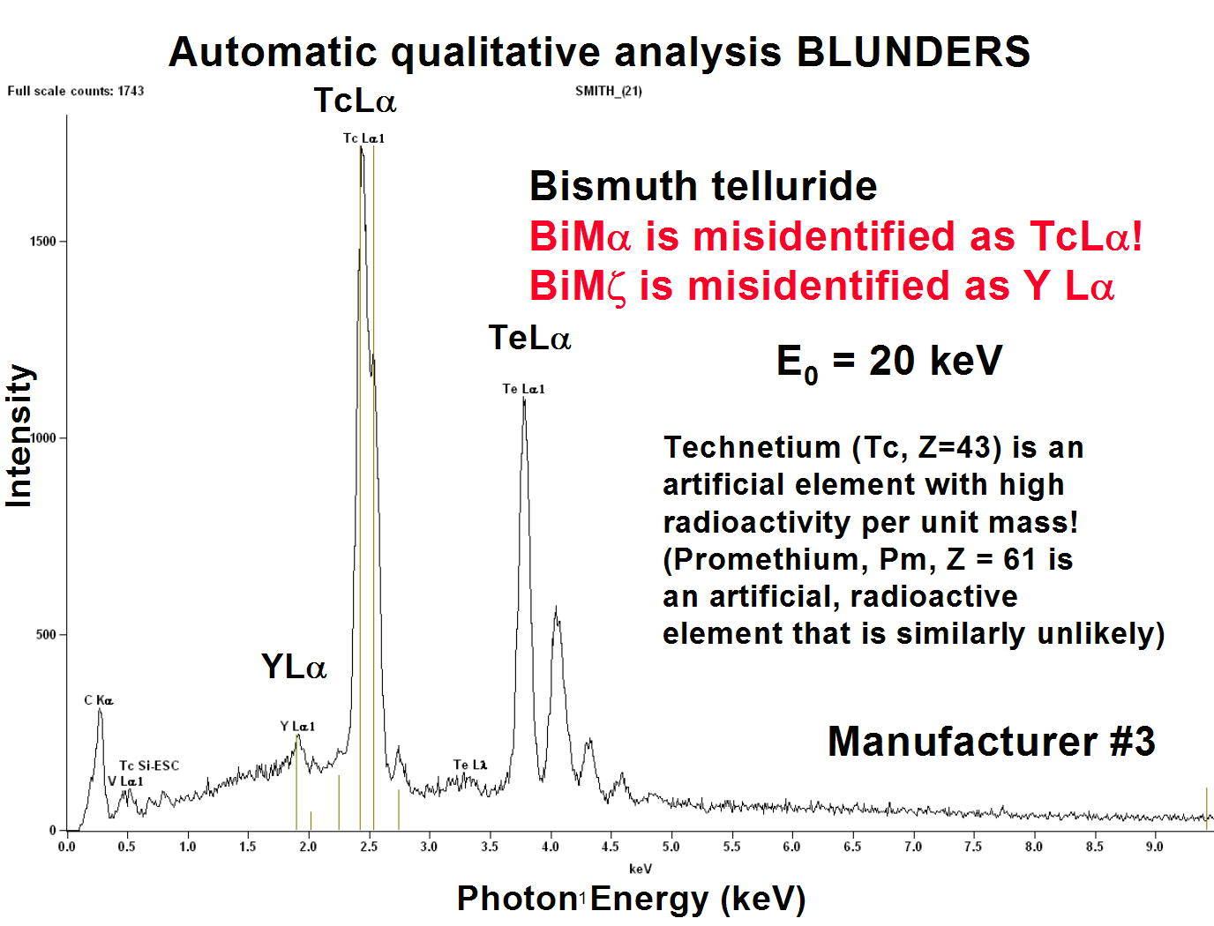

Slide 16
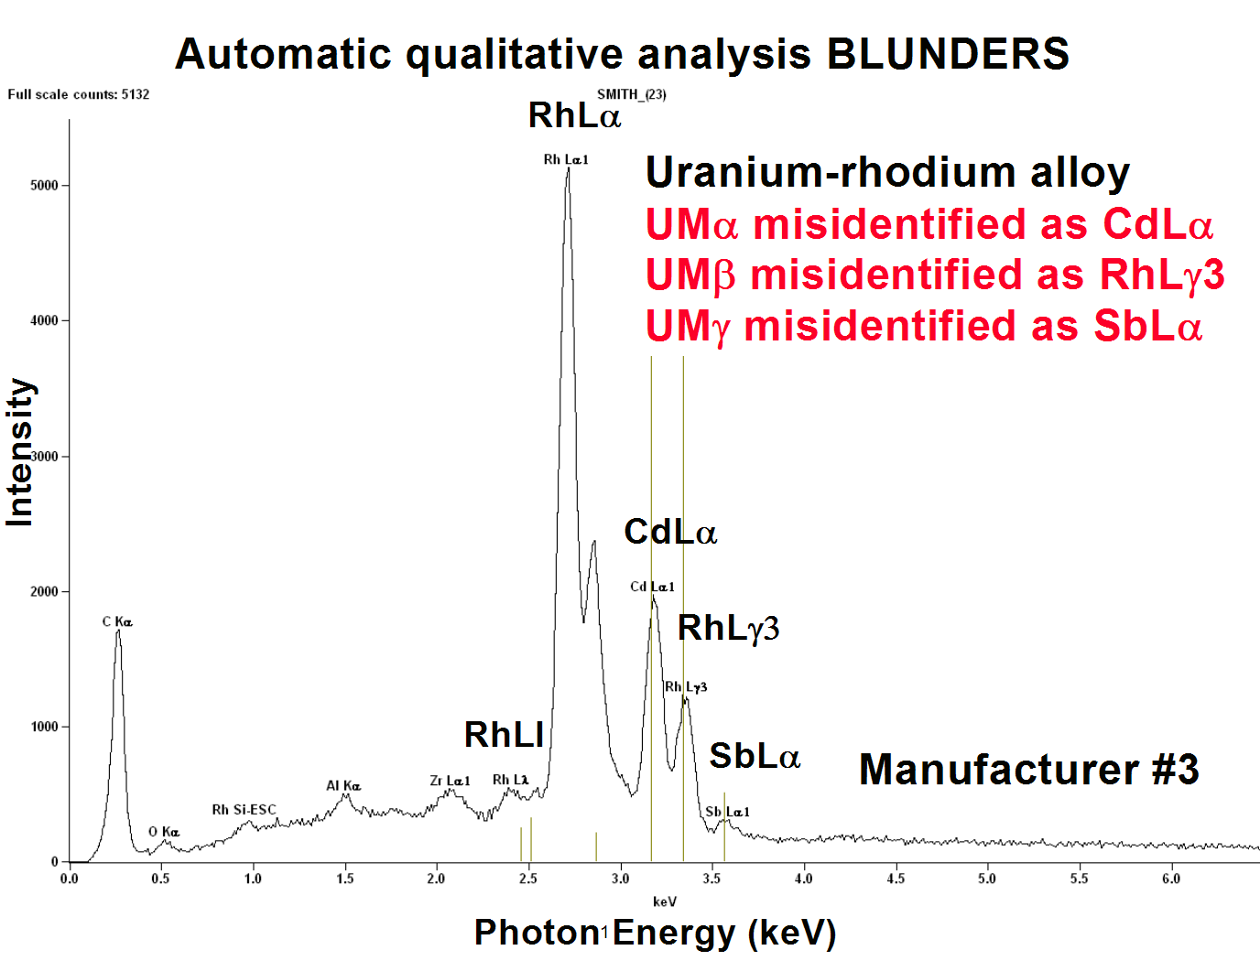

Slide 17
What is actually being done in automatic qualitative analysis?
First level approach
  Peak finding algorithm locates peak channels for peaks above a minimum peak/noise threshold (usually user-selected, e.g., peak counts > 3 B^{1/2})
  Peak channels are compared to a database, and closest match within + ΔE (usually a user-selected parameter, e.g., 30 eV)
Study has shown that this method fails to identify major peaks about 5% of the time! BLUNDERS!
  Learn how to do peak ID manually to groundtruth the automatic peak ID!

Slide 18
Avoiding Automatic Peak ID Blunders
What is the analyst supposed to do?
  Groundtruth every automatic peak ID solution
    Use all available software aids, e.g., KLM markers, “interference tables”, to inspect peak IDs
    Pay attention to the physics:
      Label all family members (Ka-Kb, Ll, La, Lb Lg, Lh; Ma-Mb-Mg-Mz-M₂N₄, etc.)
      Label K-L and L-M pairs
      Label escape peaks and sum peaks
    Practice manual Peak ID solution; e.g., SEMXM, 3rd ed., Goldstein et al., pp 357-382

Slide 19
Personal Quality Assurance Plan for EDS X-ray Microanalysis
Operational: Qualitative analysis
  1. EDS system calibration:
    (1) ALWAYS check calibration at the beginning of a measurement campaign; e.g., record a Cu spectrum at E₀ = 20 keV and save with session spectra.
    (2) Learn how to perform calibration
  2. Learn how to choose automatic qualitative analysis parameters
    (1) Peak level discriminator, P/B: how small a peak will be examined?
    (2) Energy search range, ΔE, around peak
  3. Testing automatic qualitative analysis
    (1) Challenge autoqual software with a range of pure elements, simple compounds, and multiple element mixtures.
    (2) Examine identification of sum and escape peaks of major elements
    (3) Test qualitative analysis as a function of beam energy, especially in the low voltage range (E₀ < 5 keV) if important.
    (4) Examine reliability as a function of major (>0.1), minor (0.01 to 0.1), and trace (< 0.01) levels
    (5) Look for false positives (incorrect identifications) and false negatives (e.g., missed peaks).

